Slide 1
CS 152 Computer Architecture and Engineering Lecture 16: Vector Computers
Krste Asanovic
Electrical Engineering and Computer Sciences
University of California, Berkeley
http://www.eecs.berkeley.edu/~krste
http://inst.cs.berkeley.edu/~cs152

Slide 2
Last Time Lecture 15: VLIW
In a classic VLIW, compiler is responsible for avoiding all hazards -> simple hardware, complex compiler. Later VLIWs added more dynamic hardware interlocks
Use loop unrolling and software pipelining for loops, trace scheduling for more irregular code
Static scheduling difficult in presence of unpredictable branches and variable latency memory

Slide 3
Intel EPIC IA-64
EPIC is the style of architecture (cf. CISC, RISC)
Explicitly Parallel Instruction Computing
IA-64 is Intel’s chosen ISA (cf. x86, MIPS)
IA-64 = Intel Architecture 64-bit
An object-code compatible VLIW
Itanium (aka Merced) is first implementation (cf. 8086)
First customer shipment expected 1997 (actually 2001)
McKinley, second implementation shipped in 2002
Recent version, Tukwila 2008, quad-cores, 65nm (not shipping until 2010?)

Slide 4
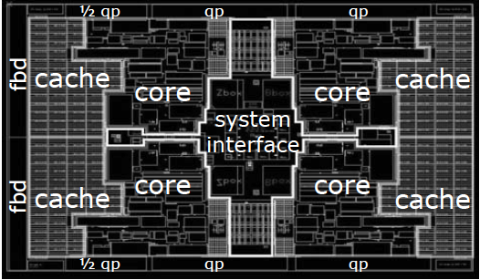
Quad Core Itanium “Tukwila” [Intel 2008]
4 cores
6MB $/core, 24MB $ total
~2.0 GHz
698mm² in 65nm CMOS!!!!!
170W
Over 2 billion transistor

Slide 5
IA-64 Instruction Format
Instruction 2
Instruction 1
Instruction 0
Template
128-bit instruction bundle
Template bits describe grouping of these instructions with others in adjacent bundles
Each group contains instructions that can execute in parallel
bundle j-1
bundle j
bundle j+1
bundle j+2
group i-1
group i
group i+1
group i+2

Slide 6
IA-64 Registers
128 General Purpose 64-bit Integer Registers
128 General Purpose 64/80-bit Floating Point Registers
64 1-bit Predicate Registers
GPRs rotate to reduce code size for software pipelined loops

Slide 7
IA-64 Predicated Execution
Problem: Mispredicted branches limit ILP
Solution: Eliminate hard to predict branches with predicated execution
Almost all IA-64 instructions can be executed conditionally under predicate
Instruction becomes NOP if predicate register false
b0:
Inst 1
Inst 2
br a==b, b2
if
Inst 1
Inst 2
p1,p2 <- cmp(a==b)
(p1) Inst 3 || (p2) Inst 5
(p1) Inst 4 || (p2) Inst 6
Inst 7
Inst 8
b1:
Inst 3
Inst 4
br b3
else
Predication
b2:
Inst 5
Inst 6
then
One basic block
b3:
Inst 7
Inst 8
Mahlke et al, ISCA95: On average >50% branches removed
Four basic blocks

Slide 8
Fully Bypassed Datapath
stall
PC for JAL, ...
E
M
W
0x4
nop
IR
IR
IR
Add
ASrc
31
we
rs1
addr
D
rs2
A
PC
ws
rd1
we
inst
IR
wd
rd2
ALU
Y
addr
Inst
Memory
GPRs
B
rdata
Data
Memory
R
Imm
Ext
wdata
BSrc
wdata
MD1
MD2
Where does predication fit in?
Notes:
This slide should be redone with predicates…

Slide 9
IA-64 Speculative Execution
Problem: Branches restrict compiler code motion
Solution: Speculative operations that don’t cause exceptions
Load.s r1
Inst 1
Inst 2
br a==b, b2
Speculative load never causes exception, but sets “poison” bit on destination register
Inst 1
Inst 2
br a==b, b2
Load r1
Use r1
Inst 3
Check for exception in original home block jumps to fixup code if exception detected
Chk.s r1
Use r1
Inst 3
Can’t move load above branch because might cause spurious exception
Particularly useful for scheduling long latency loads early

Slide 10
IA-64 Data Speculation
Problem: Possible memory hazards limit code scheduling
Solution: Hardware to check pointer hazards
Data speculative load adds address to address check table
Inst 1
Inst 2
Store
Load.a r1
Inst 1
Inst 2
Store
Store invalidates any matching loads in address check table
Load r1
Use r1
Inst 3
Load.c
Use r1
Inst 3
Can’t move load above store because store might be to same address
Check if load invalid (or missing), jump to fixup code if so
Requires associative hardware in address check table

Slide 11
Limits of Static Scheduling
Unpredictable branches
Variable memory latency (unpredictable cache misses)
Code size explosion
Compiler complexity
Despite several attempts, VLIW has failed in general-purpose computing arena.
Successful in embedded DSP market.

Slide 12
Supercomputers
Definition of a supercomputer:
Fastest machine in world at given task
A device to turn a compute-bound problem into an I/O bound problem
Any machine costing $30M+
Any machine designed by Seymour Cray
CDC6600 (Cray, 1964) regarded as first supercomputer

Slide 13
Supercomputer Applications
Typical application areas
Military research (nuclear weapons, cryptography)
Scientific research
Weather forecasting
Oil exploration
Industrial design (car crash simulation)
Bioinformatics
Cryptography
All involve huge computations on large data sets
In 70s-80s, Supercomputer ≡ Vector Machine

Slide 14
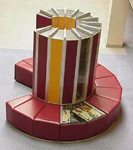
Vector Supercomputers
Epitomized by Cray-1, 1976:
Scalar Unit
Load/Store Architecture
Vector Extension
Vector Registers
Vector Instructions
Implementation
Hardwired Control
Highly Pipelined Functional Units
Interleaved Memory System
No Data Caches
No Virtual Memory

Slide 15
Cray-1 (1976)
V0
V_{i}
V. Mask
V1
V_{j}
64 Element Vector Registers
V2
V. Length
V3
V_{k}
Single Port
Memory
16 banks of 64-bit words
+
8-bit SECDED
80MW/sec data load/store
320MW/sec instruction
buffer refill
V4
V5
V6
V7
FP Add
S0
S_{j}
FP Mul
( (A_{h}) + j k m )
S1
S2
S_{k}
FP Recip
64
T Regs
S_{i}
S3
(A₀)
S4
S_{i}
Int Add
T_{jk}
S5
S6
Int Logic
S7
Int Shift
( (A_{h}) + j k m )
A0
Pop Cnt
A1
A_{i}
A2
A_{j}
(A₀)
64
B Regs
A3
A_{k}
Addr Add
B_{jk}
A4
A5
A_{i}
Addr Mul
A6
A7
64-bitx16
NIP
CIP
4 Instruction Buffers
LIP
memory bank cycle 50 ns processor cycle 12.5 ns (80MHz)

Slide 16
Vector Programming Model
Scalar Registers
Vector Registers
r15
v15
r0
v0
[0]
[1]
[2]
[VLRMAX-1]
Vector Length Register
VLR
v1
Vector Arithmetic Instructions
ADDV v3, v1, v2
v2
+
+
+
+
+
+
v3
[0]
[1]
[VLR-1]
Vector Load and Store Instructions
LV v1, r1, r2
Vector Register
v1
Memory
Base, r1
Stride, r2

Slide 17
Vector Code Example
# C code
for (i=0; i<64; i++)
C[i] = A[i] + B[i];
# Scalar Code
LI R4, 64
loop:
L.D F0, 0(R1)
L.D F2, 0(R2)
ADD.D F4, F2, F0
S.D F4, 0(R3)
DADDIU R1, 8
DADDIU R2, 8
DADDIU R3, 8
DSUBIU R4, 1
BNEZ R4, loop
# Vector Code
LI VLR, 64
LV V1, R1
LV V2, R2
ADDV.D V3, V1, V2
SV V3, R3

Slide 18
Vector Instruction Set Advantages
Compact
one short instruction encodes N operations
Expressive, tells hardware that these N operations:
are independent
use the same functional unit
access disjoint registers
access registers in same pattern as previous instructions
access a contiguous block of memory (unit-stride load/store)
access memory in a known pattern (strided load/store)
Scalable
can run same code on more parallel pipelines (lanes)

Slide 19
Vector Arithmetic Execution
Use deep pipeline (=> fast clock) to execute element operations
Simplifies control of deep pipeline because elements in vector are independent (=> no hazards!)
V1
V2
V3
Six stage multiply pipeline
V3 <- v1 * v2

Slide 20
Vector Instruction Execution
ADDV C,A,B
Execution using one pipelined functional unit
Execution using four pipelined functional units
A[6]
B[6]
A[24]
B[24]
A[25]
B[25]
A[26]
B[26]
A[27]
B[27]
A[5]
B[5]
A[20]
B[20]
A[21]
B[21]
A[22]
B[22]
A[23]
B[23]
A[4]
B[4]
A[16]
B[16]
A[17]
B[17]
A[18]
B[18]
A[19]
B[19]
A[3]
B[3]
A[12]
B[12]
A[13]
B[13]
A[14]
B[14]
A[15]
B[15]
C[2]
C[8]
C[9]
C[10]
C[11]
C[1]
C[4]
C[5]
C[6]
C[7]
C[0]
C[0]
C[1]
C[2]
C[3]

Slide 21
Vector Memory System
Cray-1, 16 banks, 4 cycle bank busy time, 12 cycle latency
Bank busy time: Time before bank ready to accept next request
Base
Stride
Vector Registers
Address Generator
+
0
1
2
3
4
5
6
7
8
9
A
B
C
D
E
F
Memory Banks

Slide 22
Vector Unit Structure
Functional Unit
Vector
Registers
Elements 0, 4, 8, …
Elements 1, 5, 9, …
Elements 2, 6, 10, …
Elements 3, 7, 11, …
Lane
Memory Subsystem

Slide 23
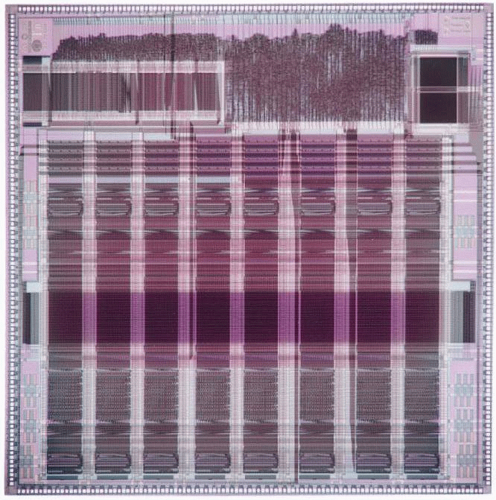
T0 Vector Microprocessor (UCB/ICSI, 1995)
Vector register elements striped over lanes
Lane
[24]
[25]
[26]
[27]
[28]
[29]
[30]
[31]
[16]
[17]
[18]
[19]
[20]
[21]
[22]
[23]
[8]
[9]
[10]
[11]
[12]
[13]
[14]
[15]
[0]
[1]
[2]
[3]
[4]
[5]
[6]
[7]

Slide 24
Vector Instruction Parallelism
Can overlap execution of multiple vector instructions
example machine has 32 elements per vector register and 8 lanes
Load Unit
Multiply Unit
Add Unit
load
mul
add
time
load
mul
add
Instruction issue
Complete 24 operations/cycle while issuing 1 short instruction/cycle

Slide 25
CS152 Administrivia
Quiz 5, Thursday April 23

Slide 26
Vector Chaining
Vector version of register bypassing
introduced with Cray-1
V1
V2
V3
V4
V5
LV v1
MULV v3,v1,v2
ADDV v5, v3, v4
Chain
Chain
Load Unit
Mult.
Add
Memory

Slide 27
Vector Chaining Advantage
Without chaining, must wait for last element of result to be written before starting dependent instruction
Load
Mul
Time
Add
With chaining, can start dependent instruction as soon as first result appears
Load
Mul
Add

Slide 28
Vector Startup
Two components of vector startup penalty
functional unit latency (time through pipeline)
dead time or recovery time (time before another vector instruction can start down pipeline)
Functional Unit Latency
R
X
X
X
W
R
X
X
X
W
First Vector Instruction
R
X
X
X
W
R
X
X
X
W
R
X
X
X
W
Dead Time
R
X
X
X
W
R
X
X
X
W
R
X
X
X
W
Dead Time
R
X
X
X
W
Second Vector Instruction
R
X
X
X
W

Slide 29
Dead Time and Short Vectors
No dead time
4 cycles dead time
T0, Eight lanes
No dead time
100% efficiency with 8 element vectors
64 cycles active
Cray C90, Two lanes
4 cycle dead time
Maximum efficiency 94% with 128 element vectors

Slide 30
Vector Memory-Memory versus Vector Register Machines
Vector memory-memory instructions hold all vector operands in main memory
The first vector machines, CDC Star-100 (‘73) and TI ASC (‘71), were memory-memory machines
Cray-1 (’76) was first vector register machine
Vector Memory-Memory Code
Example Source Code
ADDV C, A, B
SUBV D, A, B
for (i=0; i<N; i++)
{
C[i] = A[i] + B[i];
D[i] = A[i] - B[i];
}
Vector Register Code
LV V1, A
LV V2, B
ADDV V3, V1, V2
SV V3, C
SUBV V4, V1, V2
SV V4, D

Slide 31
Vector Memory-Memory vs. Vector Register Machines
Vector memory-memory architectures (VMMA) require greater main memory bandwidth, why?
All operands must be read in and out of memory
VMMAs make if difficult to overlap execution of multiple vector operations, why?
Must check dependencies on memory addresses
VMMAs incur greater startup latency
Scalar code was faster on CDC Star-100 for vectors < 100 elements
For Cray-1, vector/scalar breakeven point was around 2 elements
Apart from CDC follow-ons (Cyber-205, ETA-10) all major vector machines since Cray-1 have had vector register architectures
(we ignore vector memory-memory from now on)

Slide 32
Acknowledgements
These slides contain material developed and copyright by:
Arvind (MIT)
Krste Asanovic (MIT/UCB)
Joel Emer (Intel/MIT)
James Hoe (CMU)
John Kubiatowicz (UCB)
David Patterson (UCB)
MIT material derived from course 6.823
UCB material derived from course CS252

