Slide 1
CS 152 Computer Architecture and Engineering Lecture 15: Vector Computers
Krste Asanovic
Electrical Engineering and Computer Sciences
University of California, Berkeley
http://www.eecs.berkeley.edu/~krste
http://inst.cs.berkeley.edu/~cs152

Slide 2
Last Time Lecture 14: Multithreading
Simultaneous
Multithreading
Time (processor cycle)
Superscalar
Fine-Grained
Coarse-Grained
Multiprocessing
Thread 1
Thread 3
Thread 5
Thread 2
Thread 4
Idle slot

Slide 3
Supercomputers
Definition of a supercomputer:
Fastest machine in world at given task
A device to turn a compute-bound problem into an I/O bound problem
Any machine costing $30M+
Any machine designed by Seymour Cray
CDC6600 (Cray, 1964) regarded as first supercomputer

Slide 4
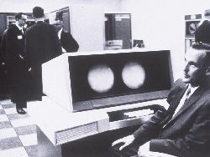
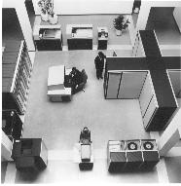
CDC 6600 Seymour Cray, 1963
A fast pipelined machine with 60-bit words
128 Kword main memory capacity, 32 banks
Ten functional units (parallel, unpipelined)
Floating Point: adder, 2 multipliers, divider
Integer: adder, 2 incrementers, ...
Hardwired control (no microcoding)
Scoreboard for dynamic scheduling of instructions
Ten Peripheral Processors for Input/Output
a fast multi-threaded 12-bit integer ALU
Very fast clock, 10 MHz (FP add in 4 clocks)
>400,000 transistors, 750 sq. ft., 5 tons, 150 kW, novel freon-based technology for cooling
Fastest machine in world for 5 years (until 7600)
over 100 sold ($7-10M each)

Slide 5
IBM Memo on CDC6600
Thomas Watson Jr., IBM CEO, August 1963:
“Last week, Control Data ... announced the 6600 system. I understand that in the laboratory developing the system there are only 34 people including the janitor. Of these, 14 are engineers and 4 are programmers... Contrasting this modest effort with our vast development activities, I fail to understand why we have lost our industry leadership position by letting someone else offer the world's most powerful computer.”
To which Cray replied: “It seems like Mr. Watson has answered his own question.”

Slide 6
CDC 6600: A Load/Store Architecture
Separate instructions to manipulate three types of reg.
8 60-bit data registers (X)
8 18-bit address registers (A)
8 18-bit index registers (B)
All arithmetic and logic instructions are reg-to-reg
Only Load and Store instructions refer to memory!
Touching address registers 1 to 5 initiates a load
6 to 7 initiates a store
- very useful for vector operations
6
3
3
3
opcode i j k Ri  ← (Rj) op (Rk)
opcode i j disp Ri ← M[(Rj) + disp]
6
3
3
18

Slide 7
CDC 6600: Datapath
Operand Regs
8 x 60-bit
operand
10 Functional
Units
result
Central
Memory
128K words,
32 banks,
1μs cycle
IR
Address Regs Index Regs
8 x 18-bit 8 x 18-bit
Inst. Stack
8 x 60-bit
operand
addr
result
addr

Slide 8
CDC6600 ISA designed to simplify high-performance implementation
Use of three-address, register-register ALU instructions simplifies pipelined implementation
No implicit dependencies between inputs and outputs
Decoupling setting of address register (Ar) from retrieving value from data register (Xr) simplifies providing multiple outstanding memory accesses
Software can schedule load of address register before use of value
Can interleave independent instructions inbetween
CDC6600 has multiple parallel but unpipelined functional units
E.g., 2 separate multipliers
Follow-on machine CDC7600 used pipelined functional units
Foreshadows later RISC designs

Slide 9
CDC6600: Vector Addition
B0 ← - n
loop: JZE B0, exit
A0 ← B0 + a0 load X0
A1 ← B0 + b0 load X1
X6 ← X0 + X1
A6 ← B0 + c0 store X6
B0 ← B0 + 1
jump loop
Ai = address register
Bi = index register
Xi = data register

Slide 10
Supercomputer Applications
Typical application areas
Military research (nuclear weapons, cryptography)
Scientific research
Weather forecasting
Oil exploration
Industrial design (car crash simulation)
Bioinformatics
Cryptography
All involve huge computations on large data sets
In 70s-80s, Supercomputer ≡ Vector Machine

Slide 11
Vector Programming Model
Scalar Registers
Vector Registers
r15
v15
r0
v0
[0]
[1]
[2]
[VLRMAX-1]
Vector Length Register
VLR
v1
Vector Arithmetic Instructions
ADDV v3, v1, v2
v2
+
+
+
+
+
+
v3
[0]
[1]
[VLR-1]
Vector Load and Store Instructions
LV v1, r1, r2
Vector Register
v1
Memory
Base, r1
Stride, r2

Slide 12
Vector Code Example
# C code
for (i=0; i<64; i++)
C[i] = A[i] + B[i];
# Scalar Code
LI R4, 64
loop:
L.D F0, 0(R1)
L.D F2, 0(R2)
ADD.D F4, F2, F0
S.D F4, 0(R3)
DADDIU R1, 8
DADDIU R2, 8
DADDIU R3, 8
DSUBIU R4, 1
BNEZ R4, loop
# Vector Code
LI VLR, 64
LV V1, R1
LV V2, R2
ADDV.D V3, V1, V2
SV V3, R3

Slide 13
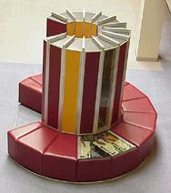
Vector Supercomputers
Epitomized by Cray-1, 1976:
Scalar Unit
Load/Store Architecture
Vector Extension
Vector Registers
Vector Instructions
Implementation
Hardwired Control
Highly Pipelined Functional Units
Interleaved Memory System
No Data Caches
No Virtual Memory

Slide 14
Cray-1 (1976)
V0
V_{i}
V. Mask
V1
V_{j}
64 Element Vector Registers
V2
V. Length
V3
V_{k}
Single Port
Memory
16 banks of 64-bit words
+
8-bit SECDED
80MW/sec data load/store
320MW/sec instruction
buffer refill
V4
V5
V6
V7
FP Add
S0
S_{j}
FP Mul
( (A_{h}) + j k m )
S1
S2
S_{k}
FP Recip
64
T Regs
S_{i}
S3
(A₀)
S4
S_{i}
Int Add
T_{jk}
S5
S6
Int Logic
S7
Int Shift
( (A_{h}) + j k m )
A0
Pop Cnt
A1
A_{i}
A2
A_{j}
(A₀)
64
B Regs
A3
A_{k}
Addr Add
B_{jk}
A4
A5
A_{i}
Addr Mul
A6
A7
64-bitx16
NIP
CIP
4 Instruction Buffers
LIP
memory bank cycle 50 ns processor cycle 12.5 ns (80MHz)

Slide 15
Vector Instruction Set Advantages
Compact
one short instruction encodes N operations
Expressive, tells hardware that these N operations:
are independent
use the same functional unit
access disjoint registers
access registers in same pattern as previous instructions
access a contiguous block of memory (unit-stride load/store)
access memory in a known pattern (strided load/store)
Scalable
can run same code on more parallel pipelines (lanes)

Slide 16
Vector Arithmetic Execution
Use deep pipeline (=> fast clock) to execute element operations
Simplifies control of deep pipeline because elements in vector are independent (=> no hazards!)
V1
V2
V3
Six stage multiply pipeline
V3 <- v1 * v2

Slide 17
Vector Instruction Execution
ADDV C,A,B
Execution using one pipelined functional unit
Execution using four pipelined functional units
A[6]
B[6]
A[24]
B[24]
A[25]
B[25]
A[26]
B[26]
A[27]
B[27]
A[5]
B[5]
A[20]
B[20]
A[21]
B[21]
A[22]
B[22]
A[23]
B[23]
A[4]
B[4]
A[16]
B[16]
A[17]
B[17]
A[18]
B[18]
A[19]
B[19]
A[3]
B[3]
A[12]
B[12]
A[13]
B[13]
A[14]
B[14]
A[15]
B[15]
C[2]
C[8]
C[9]
C[10]
C[11]
C[1]
C[4]
C[5]
C[6]
C[7]
C[0]
C[0]
C[1]
C[2]
C[3]

Slide 18
Interleaved Vector Memory System
Cray-1, 16 banks, 4 cycle bank busy time, 12 cycle latency
Bank busy time: Time before bank ready to accept next request
Base
Stride
Vector Registers
Address Generator
+
0
1
2
3
4
5
6
7
8
9
A
B
C
D
E
F
Memory Banks

Slide 19
Vector Unit Structure
Functional Unit
Vector
Registers
Elements 0, 4, 8, …
Elements 1, 5, 9, …
Elements 2, 6, 10, …
Elements 3, 7, 11, …
Lane
Memory Subsystem

Slide 20
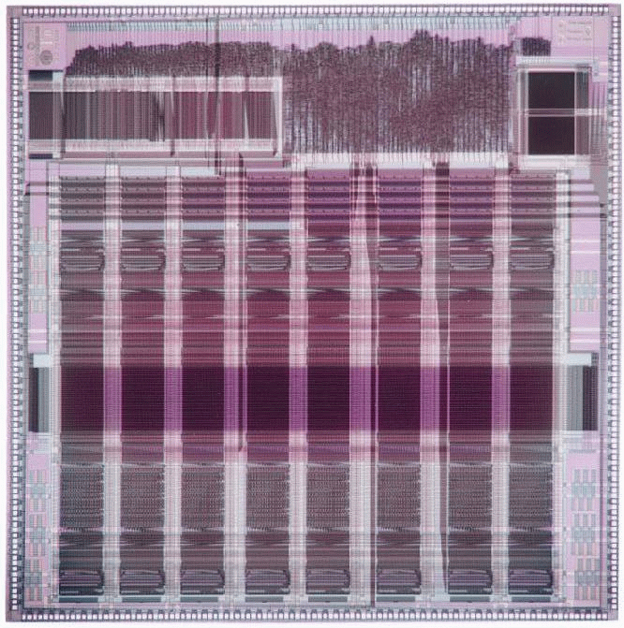
T0 Vector Microprocessor (UCB/ICSI, 1995)
Vector register elements striped over lanes
Lane
[24]
[25]
[26]
[27]
[28]
[29]
[30]
[31]
[16]
[17]
[18]
[19]
[20]
[21]
[22]
[23]
[8]
[9]
[10]
[11]
[12]
[13]
[14]
[15]
[0]
[1]
[2]
[3]
[4]
[5]
[6]
[7]

Slide 21
Vector Instruction Parallelism
Can overlap execution of multiple vector instructions
example machine has 32 elements per vector register and 8 lanes
Load Unit
Multiply Unit
Add Unit
load
mul
add
time
load
mul
add
Instruction issue
Complete 24 operations/cycle while issuing 1 short instruction/cycle

Slide 22
CS152 Administrivia
Undergraduate Research Poster Session, Tuesday April 19th, 11:30am-1:30pm, Hearst Mining Building
Check CoE website
Also, contact me if interested in architecture research or industry internships over summer.

Slide 23
Vector Chaining
Vector version of register bypassing
introduced with Cray-1
V1
V2
V3
V4
V5
LV v1
MULV v3,v1,v2
ADDV v5, v3, v4
Chain
Chain
Load Unit
Mult.
Add
Memory

Slide 24
Vector Chaining Advantage
Without chaining, must wait for last element of result to be written before starting dependent instruction
Load
Mul
Time
Add
With chaining, can start dependent instruction as soon as first result appears
Load
Mul
Add

Slide 25
Vector Startup
Two components of vector startup penalty
functional unit latency (time through pipeline)
dead time or recovery time (time before another vector instruction can start down pipeline)
Functional Unit Latency
R
X
X
X
W
R
X
X
X
W
First Vector Instruction
R
X
X
X
W
R
X
X
X
W
R
X
X
X
W
Dead Time
R
X
X
X
W
R
X
X
X
W
R
X
X
X
W
Dead Time
R
X
X
X
W
Second Vector Instruction
R
X
X
X
W

Slide 26
Dead Time and Short Vectors
No dead time
4 cycles dead time
T0, Eight lanes
No dead time
100% efficiency with 8 element vectors
64 cycles active
Cray C90, Two lanes
4 cycle dead time
Maximum efficiency 94% with 128 element vectors

Slide 27
Vector Memory-Memory versus Vector Register Machines
Vector memory-memory instructions hold all vector operands in main memory
The first vector machines, CDC Star-100 (‘73) and TI ASC (‘71), were memory-memory machines
Cray-1 (’76) was first vector register machine
Vector Memory-Memory Code
Example Source Code
ADDV C, A, B
SUBV D, A, B
for (i=0; i<N; i++)
{
C[i] = A[i] + B[i];
D[i] = A[i] - B[i];
}
Vector Register Code
LV V1, A
LV V2, B
ADDV V3, V1, V2
SV V3, C
SUBV V4, V1, V2
SV V4, D

Slide 28
Vector Memory-Memory vs. Vector Register Machines
Vector memory-memory architectures (VMMA) require greater main memory bandwidth, why?
All operands must be read in and out of memory
VMMAs make if difficult to overlap execution of multiple vector operations, why?
Must check dependencies on memory addresses
VMMAs incur greater startup latency
Scalar code was faster on CDC Star-100 for vectors < 100 elements
For Cray-1, vector/scalar breakeven point was around 2 elements
Apart from CDC follow-ons (Cyber-205, ETA-10) all major vector machines since Cray-1 have had vector register architectures
(we ignore vector memory-memory from now on)

Slide 29
Automatic Code Vectorization
for (i=0; i < N; i++)
C[i] = A[i] + B[i];
Scalar Sequential Code
Vectorized Code
load
load
load
Iter. 1
load
load
load
Time
add
add
add
store
store
store
load
Iter. 1
Iter. 2
Iter. 2
load
Vector Instruction
add
Vectorization is a massive compile-time reordering of operation sequencing
⇒ requires extensive loop dependence analysis
store

Slide 30
Vector Stripmining
Problem: Vector registers have finite length
Solution: Break loops into pieces that fit in registers, “Stripmining”
ANDI R1, N, 63 # N mod 64
MTC1 VLR, R1 # Do remainder
loop:
LV V1, RA
DSLL R2, R1, 3 # Multiply by 8
DADDU RA, RA, R2 # Bump pointer
LV V2, RB
DADDU RB, RB, R2
ADDV.D V3, V1, V2
SV V3, RC
DADDU RC, RC, R2
DSUBU N, N, R1 # Subtract elements
LI R1, 64
MTC1 VLR, R1 # Reset full length
BGTZ N, loop # Any more to do?
for (i=0; i<N; i++)
C[i] = A[i]+B[i];
A
B
C
+
Remainder
+
64 elements
+

Slide 31
Vector Conditional Execution
Problem: Want to vectorize loops with conditional code:
for (i=0; i<N; i++)
if (A[i]>0) then
A[i] = B[i];
Solution: Add vector mask (or flag) registers
vector version of predicate registers, 1 bit per element
…and maskable vector instructions
vector operation becomes NOP at elements where mask bit is clear
Code example:
CVM # Turn on all elements
LV vA, rA # Load entire A vector
SGTVS.D vA, F0 # Set bits in mask register where A>0
LV vA, rB # Load B vector into A under mask
SV vA, rA # Store A back to memory under mask

Slide 32
Masked Vector Instructions
Simple Implementation
execute all N operations, turn off result writeback according to mask
Density-Time Implementation
scan mask vector and only execute elements with non-zero masks
M[7]=1
A[7]
B[7]
M[7]=1
M[6]=0
A[6]
B[6]
M[6]=0
A[7]
B[7]
M[5]=1
A[5]
B[5]
M[5]=1
M[4]=1
A[4]
B[4]
M[4]=1
M[3]=0
A[3]
B[3]
M[3]=0
C[5]
M[2]=0
C[4]
M[1]=1
M[2]=0
C[2]
M[0]=0
M[1]=1
C[1]
C[1]
Write data port
M[0]=0
C[0]
Write Enable
Write data port

Slide 33
Vector Reductions
Problem: Loop-carried dependence on reduction variables
sum = 0;
for (i=0; i<N; i++)
sum += A[i]; # Loop-carried dependence on sum
Solution: Re-associate operations if possible, use binary tree to perform reduction
# Rearrange as:
sum[0:VL-1] = 0 # Vector of VL partial sums
for(i=0; i<N; i+=VL) # Stripmine VL-sized chunks
sum[0:VL-1] += A[i:i+VL-1]; # Vector sum
# Now have VL partial sums in one vector register
do {
VL = VL/2; # Halve vector length
sum[0:VL-1] += sum[VL:2*VL-1] # Halve no. of partials
} while (VL>1)

Slide 34
Vector Scatter/Gather
Want to vectorize loops with indirect accesses:
for (i=0; i<N; i++)
A[i] = B[i] + C[D[i]]
Indexed load instruction (Gather)
LV vD, rD # Load indices in D vector
LVI vC, rC, vD # Load indirect from rC base
LV vB, rB # Load B vector
ADDV.D vA,vB,vC # Do add
SV vA, rA # Store result

Slide 35
Vector Scatter/Gather
Scatter example:
for (i=0; i<N; i++)
A[B[i]]++;
Is following a correct translation?
LV vB, rB # Load indices in B vector
LVI vA, rA, vB # Gather initial A values
ADDV vA, vA, 1 # Increment
SVI vA, rA, vB # Scatter incremented values

Slide 36
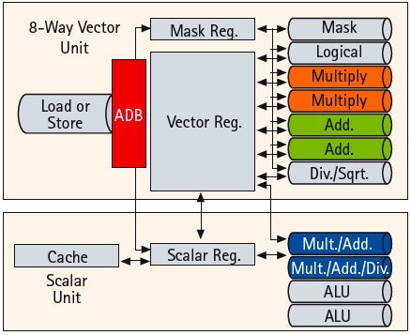
A Modern Vector Super: NEC SX-9 (2008)
65nm CMOS technology
Vector unit (3.2 GHz)
8 foreground VRegs + 64 background VRegs (256x64-bit elements/VReg)
64-bit functional units: 2 multiply, 2 add, 1 divide/sqrt, 1 logical, 1 mask unit
8 lanes (32+ FLOPS/cycle, 100+ GFLOPS peak per CPU)
1 load or store unit (8 x 8-byte accesses/cycle)
Scalar unit (1.6 GHz)
4-way superscalar with out-of-order and speculative execution
64KB I-cache and 64KB data cache
Memory system provides 256GB/s DRAM bandwidth per CPU
Up to 16 CPUs and up to 1TB DRAM form shared-memory node
total of 4TB/s bandwidth to shared DRAM memory
Up to 512 nodes connected via 128GB/s network links (message passing between nodes)
Notes:
Picture from NEC article “A hardware overview of SX-6 and SX-7 supercomputer”

Slide 37
Multimedia Extensions (aka SIMD extensions)
64b
32b
32b
16b
16b
16b
16b
8b
8b
8b
8b
8b
8b
8b
8b
Very short vectors added to existing ISAs for microprocessors
Use existing 64-bit registers split into 2x32b or 4x16b or 8x8b
This concept first used on Lincoln Labs TX-2 computer in 1957, with 36b datapath split into 2x18b or 4x9b
Newer designs have 128-bit registers (PowerPC Altivec, Intel SSE2/3/4)
Single instruction operates on all elements within register
16b
16b
16b
16b
16b
16b
16b
16b
4x16b adds
+
+
+
+
16b
16b
16b
16b

Slide 38
Multimedia Extensions versus Vectors
Limited instruction set:
no vector length control
no strided load/store or scatter/gather
unit-stride loads must be aligned to 64/128-bit boundary
Limited vector register length:
requires superscalar dispatch to keep multiply/add/load units busy
loop unrolling to hide latencies increases register pressure
Trend towards fuller vector support in microprocessors
Better support for misaligned memory accesses
Support of double-precision (64-bit floating-point)
New Intel AVX spec (announced April 2008), 256b vector registers (expandable up to 1024b)

Slide 39
Acknowledgements
These slides contain material developed and copyright by:
Arvind (MIT)
Krste Asanovic (MIT/UCB)
Joel Emer (Intel/MIT)
James Hoe (CMU)
John Kubiatowicz (UCB)
David Patterson (UCB)
MIT material derived from course 6.823
UCB material derived from course CS252

