Slide 1
CS 152 Computer Architecture and Engineering CS252 Graduate Computer Architecture Lecture 7 – Memory III
Krste Asanovic
Electrical Engineering and Computer Sciences
University of California at Berkeley
http://www.eecs.berkeley.edu/~krste
http://inst.eecs.berkeley.edu/~cs152

Slide 2
Last time in Lecture 6
3 C’s of cache misses
Compulsory, Capacity, Conflict
Write policies
Write back, write-through, write-allocate, no write allocate
Pipelining write hits
Multi-level cache hierarchies reduce miss penalty
3 levels common in modern systems (some have 4!)
Can change design tradeoffs of L1 cache if known to have L2
Inclusive versus exclusive cache hierarchies

Slide 3
Recap: Multilevel Caches
Problem: A memory cannot be large and fast
Solution: Increasing sizes of cache at each level
DRAM
CPU
L2$
L1$
Local miss rate = misses in cache / accesses to cache
Global miss rate = misses in cache / CPU memory accesses
Misses per instruction = misses in cache / number of instructions
Notes:
MPI makes it easier to compute overall performance (jse)

Slide 4
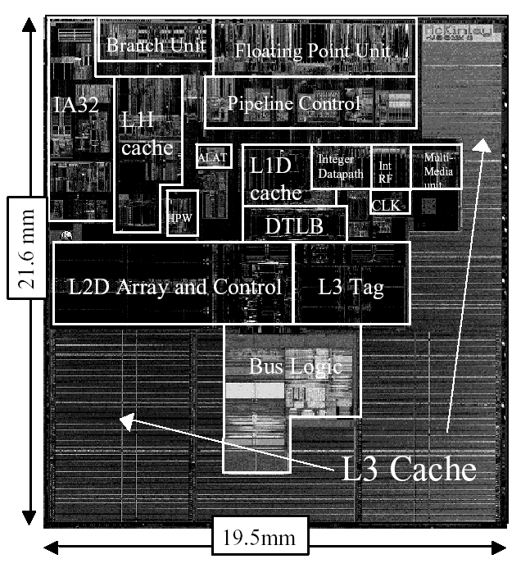
Itanium-2 On-Chip Caches (Intel/HP, 2002)
Level 1: 16KB, 4-way s.a., 64B line, quad-port (2 load+2 store), single cycle latency
Level 2: 256KB, 4-way s.a, 128B line, quad-port (4 load or 4 store), five cycle latency
Level 3: 3MB, 12-way s.a., 128B line, single 32B port, twelve cycle latency
Notes:
If two is good, then three must be better (jse)

Slide 5
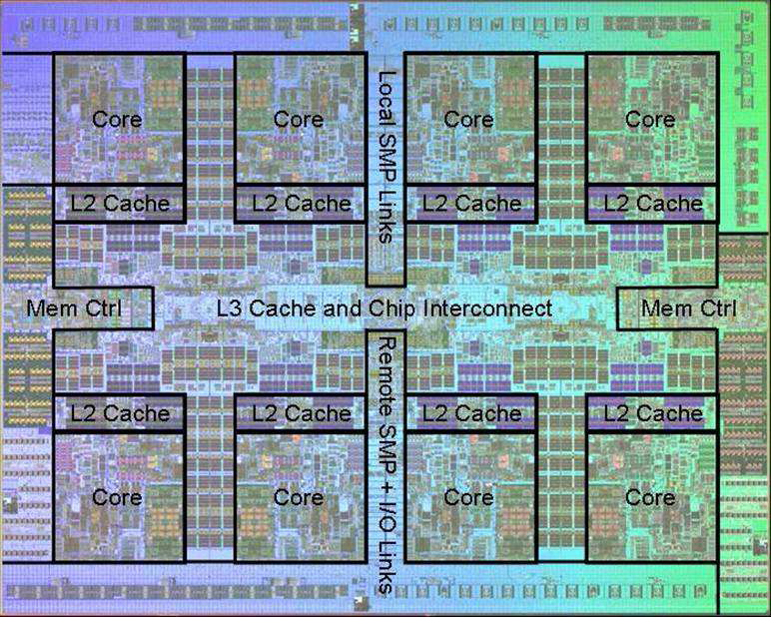
Power 7 On-Chip Caches [IBM 2009]
32KB L1 I$/core
32KB L1 D$/core
3-cycle latency
256KB Unified L2$/core
8-cycle latency
32MB Unified Shared L3$
Embedded DRAM (eDRAM)
25-cycle latency to local slice

Slide 6
IBM z196 Mainframe Caches 2010
96 cores (4 cores/chip, 24 chips/system)
Out-of-order, 3-way superscalar @ 5.2GHz
L1: 64KB I-$/core + 128KB D-$/core
L2: 1.5MB private/core (144MB total)
L3: 24MB shared/chip (eDRAM) (576MB total)
L4: 768MB shared/system (eDRAM)

Slide 7
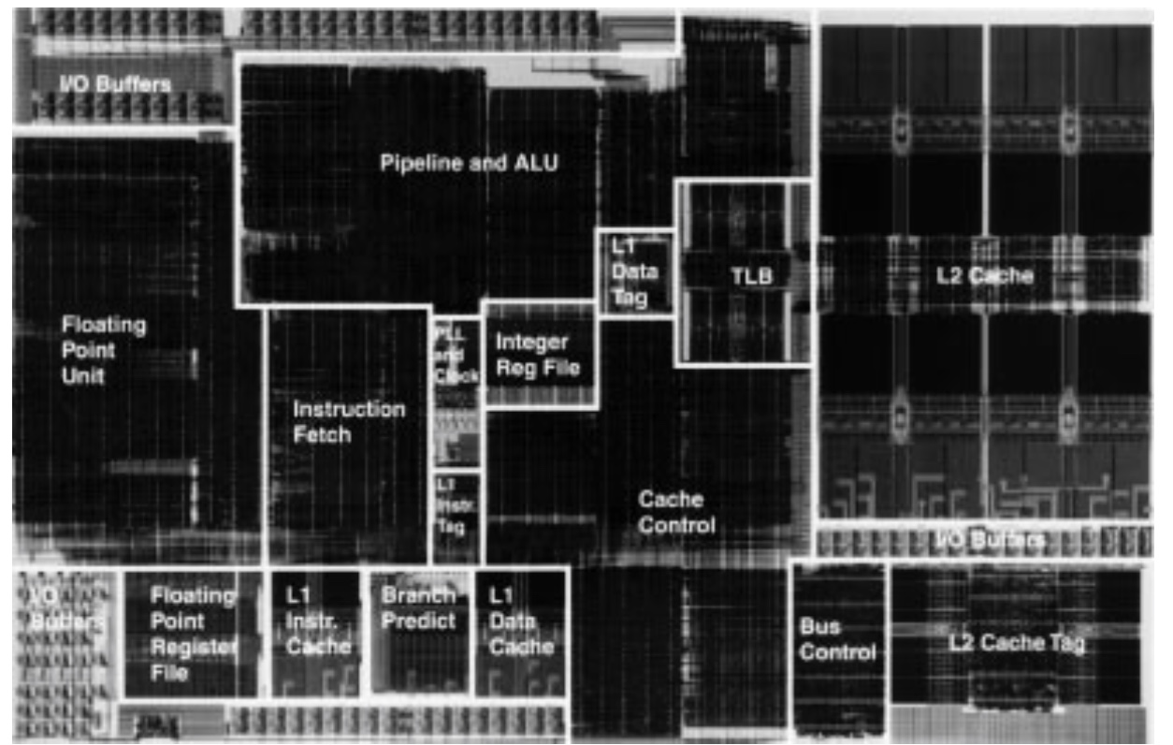
Exponential X704 PowerPC Processor (1997)
32KB L2 8-way Set-Associative Write-Back Unified Cache
2KB L1 Direct-Mapped Instruction Cache
2KB L1 Direct-Mapped Write-Through Data Cache

Slide 8
Victim Caches (HP 7200)
CPU
Unified L2 Cache
L1 Data Cache
RF
Evicted data
from L1
Victim
FA Cache
4 blocks
to where?
Hit data from VC (miss in L1)
Evicted data
from VC
Victim cache is a small associative backup cache, added to a direct-mapped cache, which holds recently evicted lines
First look up in direct-mapped cache
If miss, look in victim cache
If hit in victim cache, swap hit line with line now evicted from L1
If miss in victim cache, L1 victim -> VC, VC victim->?
Fast hit time of direct mapped but with reduced conflict misses

Slide 9
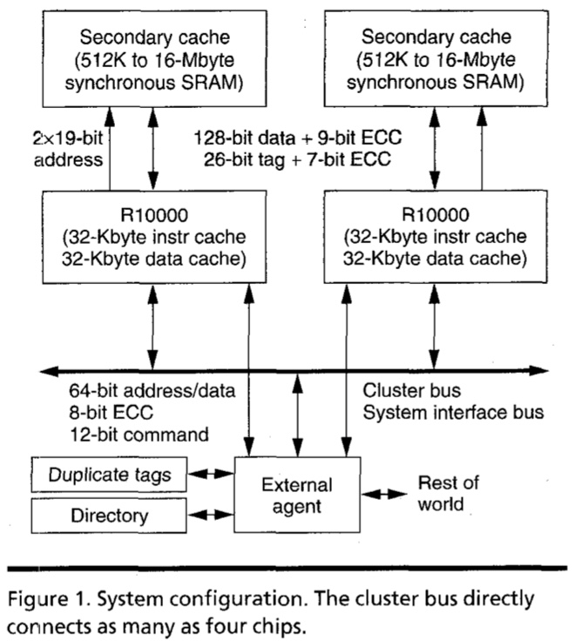
MIPS R10000 Off-Chip L2 Cache (Yeager, IEEE Micro 1996)

Slide 10
Way-Predicting Caches (MIPS R10000 L2 cache)
Use processor address to index into way-prediction table
Look in predicted way at given index, then:
HIT
MISS
Return copy
of data from
cache
Look in other way
Read block of data from
next level of cache
MISS
SLOW HIT
(change entry in prediction table)

Slide 11
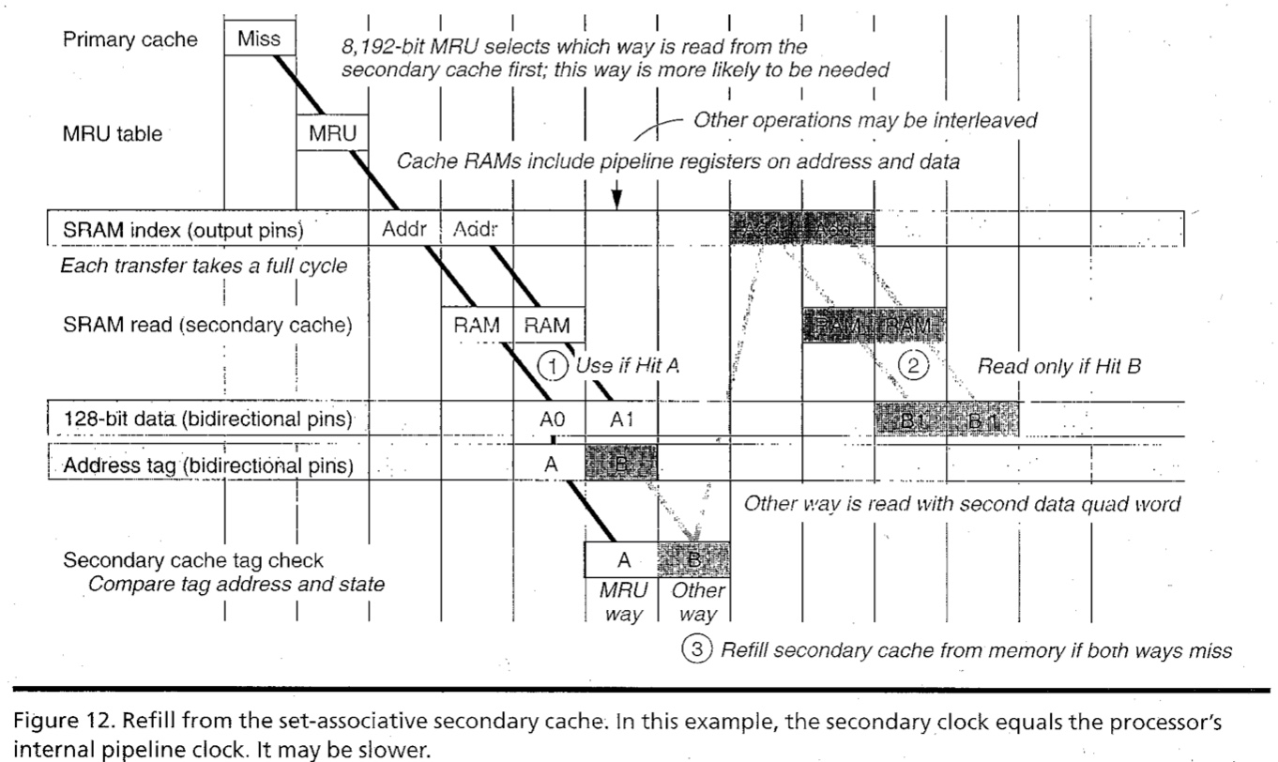
R10000 L2 Cache Timing Diagram

Slide 12
Way-Predicting Instruction Cache (Alpha 21264-like)
Jump target
Store last-used way for sequential path and predicted branch taken path. Can be fetching multiple instructions per cycle.
0x4
Jump control
Add
PC
addr
inst
Primary
Instruction
Cache
way
Sequential Way
Branch Target Way

Slide 13
Prefetching
Speculate on future instruction and data accesses and fetch them into cache(s)
Instruction accesses easier to predict than data accesses
Varieties of prefetching
Hardware prefetching
Software prefetching
Mixed schemes
What types of misses does prefetching affect?
Notes:
Reduces compulsory misses, can increase conflict and
capacity misses.

Slide 14
Issues in Prefetching
Usefulness – should produce hits
Timeliness – not late and not too early
Cache and bandwidth pollution
L1 Instruction
Unified L2 Cache
CPU
L1 Data
RF
Prefetched data

Slide 15
Hardware Instruction Prefetching
Instruction prefetch in Alpha AXP 21064
Fetch two lines on a miss; the requested line (i) and the next consecutive line (i+1)
Requested line placed in cache, and next line in instruction stream buffer
If miss in cache but hit in stream buffer, move stream buffer line into cache and prefetch next line (i+2)
Prefetched
instruction line
Req
line
Stream
Buffer
CPU
Unified L2 Cache
L1 Instruction
RF
Req
line
Notes:
Need to check the stream buffer if the requested line is in there.
Never more than one 32-byte line in the stream buffer.

Slide 16
Hardware Data Prefetching
Prefetch-on-miss:
Prefetch b + 1 upon miss on b
One-Block Lookahead (OBL) scheme
Initiate prefetch for block b + 1 when block b is accessed
Why is this different from doubling block size?
Can extend to N-block lookahead
Strided prefetch
If observe sequence of accesses to line b, b+N, b+2N, then prefetch b+3N etc.
Example: IBM Power 5 [2003] supports eight independent streams of strided prefetch per processor, prefetching 12 lines ahead of current access
Notes:
HP PA 7200 uses OBL prefetching
Tag prefetching is twice as effective as prefetch-on-miss in
reducing miss rates.

Slide 17
CS152 Administrivia
Lab 1 due at start of class on Monday Feb 12
PS 2 out on Wednesday, Thursday, due Wednesday Feb 21
Friday’s sections will review PS 1 and solutions

Slide 18
CS252 Administrivia
Start thinking of class projects and forming teams of two
Proposal due Monday March 5th

Slide 19
Software Prefetching
for(i=0; i < N; i++) { prefetch( &a[i + 1] ); prefetch( &b[i + 1] ); SUM = SUM + a[i] * b[i]; }
Notes:
Cache should be non-blocking or lockup-free.
By that we mean that the processor can proceed while the prefetched
Data is being fetched; and the caches continue to supply instructions
And data while waiting for the prefetched data to return.

Slide 20
Software Prefetching Issues
Timing is the biggest issue, not predictability
If you prefetch very close to when the data is required, you might be too late
Prefetch too early, cause pollution
Estimate how long it will take for the data to come into L1, so we can set P appropriately
Why is this hard to do?
for(i=0; i < N; i++) { prefetch( &a[i + P] ); prefetch( &b[i + P] ); SUM = SUM + a[i] * b[i]; }
Must consider cost of prefetch instructions

Slide 21
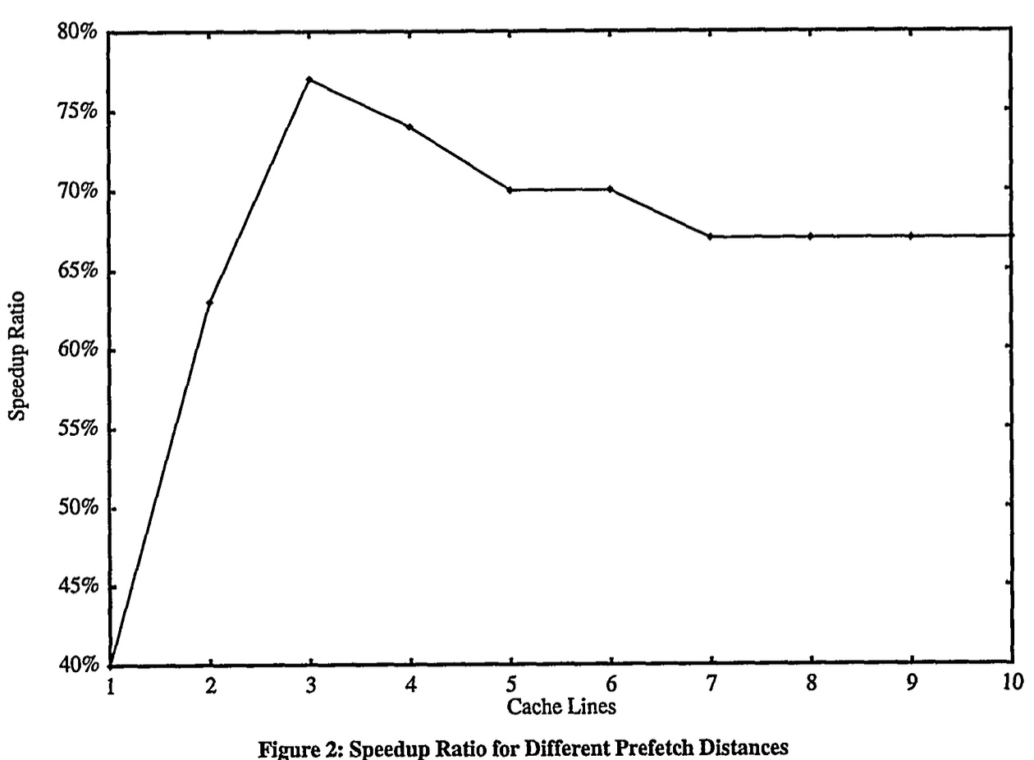
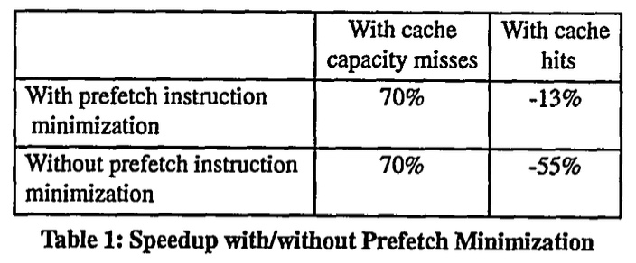
Software Prefetching Example
[“Data prefetching on the HP PA8000”, Santhanam et al., 1997]

Slide 22
Compiler Optimizations
Restructuring code affects the data access sequence
Group data accesses together to improve spatial locality
Re-order data accesses to improve temporal locality
Prevent data from entering the cache
Useful for variables that will only be accessed once before being replaced
Needs mechanism for software to tell hardware not to cache data (“no-allocate” instruction hints or page table bits)
Kill data that will never be used again
Streaming data exploits spatial locality but not temporal locality
Replace into dead cache locations
Notes:
Miss-rate reduction without any hardware changes.
Hardware designer’s favorite solution.

Slide 23
Loop Interchange
for(j=0; j < N; j++) { for(i=0; i < M; i++) { x[i][j] = 2 * x[i][j]; } }
for(i=0; i < M; i++) { for(j=0; j < N; j++) { x[i][j] = 2 * x[i][j]; } }
What type of locality does this improve?

Slide 24
Loop Fusion
for(i=0; i < N; i++) a[i] = b[i] * c[i];
for(i=0; i < N; i++)
d[i] = a[i] * c[i];
for(i=0; i < N; i++) { a[i] = b[i] * c[i]; d[i] = a[i] * c[i];
}
What type of locality does this improve?

Slide 25
Matrix Multiply, Naïve Code
z
j
for(i=0; i < N; i++) for(j=0; j < N; j++) { r = 0; for(k=0; k < N; k++) r = r + y[i][k] * z[k][j]; x[i][j] = r; }
k
y
k
x
j
i
i
Not touched
Old access
New access

Slide 26
Matrix Multiply with Cache Tiling
for(jj=0; jj < N; jj=jj+B) for(kk=0; kk < N; kk=kk+B) for(i=0; i < N; i++) for(j=jj; j < min(jj+B,N); j++) { r = 0; for(k=kk; k < min(kk+B,N); k++) r = r + y[i][k] * z[k][j]; x[i][j] = x[i][j] + r; }
z
j
k
y
k
x
j
i
i
What type of locality does this improve?
Notes:
Y benefits from spatial locality
z benefits from temporal locality

Slide 27
Acknowledgements
This course is partly inspired by previous MIT 6.823 and Berkeley CS252 computer architecture courses created by my collaborators and colleagues:
Arvind (MIT)
Joel Emer (Intel/MIT)
James Hoe (CMU)
John Kubiatowicz (UCB)
David Patterson (UCB)

