Slide 1
CS 152 Computer Architecture and Engineering
CS252 Graduate Computer Architecture
Lecture 23 Domain-Specific Architectures
Krste Asanovic
Electrical Engineering and Computer Sciences
University of California at Berkeley
http://www.eecs.berkeley.edu/~krste
http://inst.eecs.berkeley.edu/~cs152

Slide 2
Last Time in Lecture 22
Multiple types of virtual machine
  user level
  system level
User virtual machine is ISA plus environment
System virtual machine provides environment for an OS
ISA translation
  running one ISA on another
  implementing portions of an ISA in software
System virtual machine monitors or hypervisors
  manage multiple OS on same machine

Slide 3
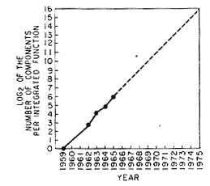
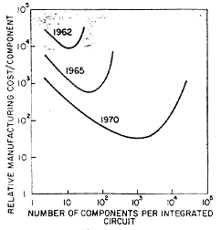


Moore’s Law
More Transistors/Chip
Cheaper!
“Cramming more components onto integrated circuits”, Gordon E. Moore, Electronics, 1965

Slide 4
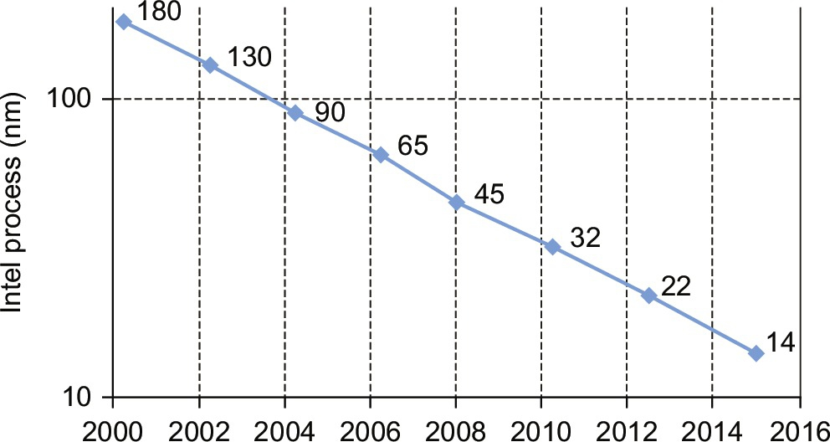
Moore’s Law Scaling Slowing
10?
2018
Figure 7.1 Time before new Intel semiconductor process technology measured in nm. The y-axis is log scale. Note that the time stretched previously from about 24 months per new process step to about 30 months since 2010.

Slide 5
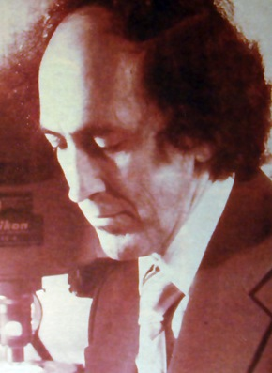
End of Dennard (Voltage) Scaling
Moore, ISSCC Keynote, 2003
Dennard Scaling
Post-Dennard Scaling

Slide 6
Single-Thread Processor Performance
[ Hennessy & Patterson, 2017 ]

Slide 7
Domain-Specific Architectures
In early 2000s, microprocessors moved to manycore architecture (multiple general-purpose cores per die) to improve energy efficiency for parallel workloads.
Now, great interest in more specialized architectures to further improve energy efficiency on certain workloads
Four examples:
Google TPU
Microsoft Catapult
Intel Crest (now Nervana)
Google Pixel Visual Core

Slide 8
Guidelines for DSAs
Use dedicated memories to minimize data movement
Invest resources into more arithmetic units or bigger memories
Use the easiest form of parallelism that matches the domain
Reduce data size and type to the simplest needed for the domain
Use a domain-specific programming language
Guidelines for DSAs

Slide 9
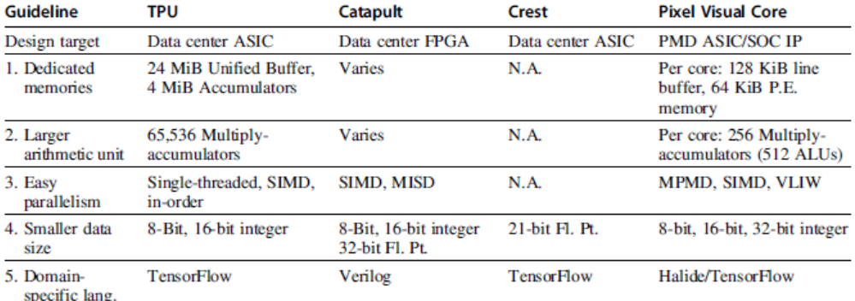
Guidelines for DSAs
Guidelines for DSAs

Slide 10
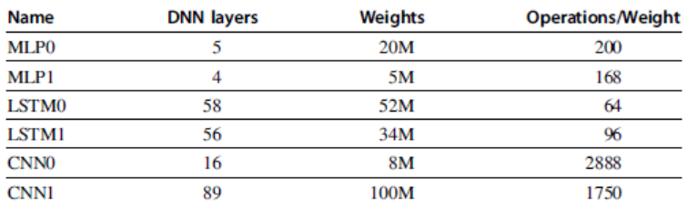
Example: Deep Neural Networks
Inpired by neuron of the brain
Computes non-linear “activiation” function of the weighted sum of input values
Neurons arranged in layers
Example: Deep Neural Networks

Slide 11
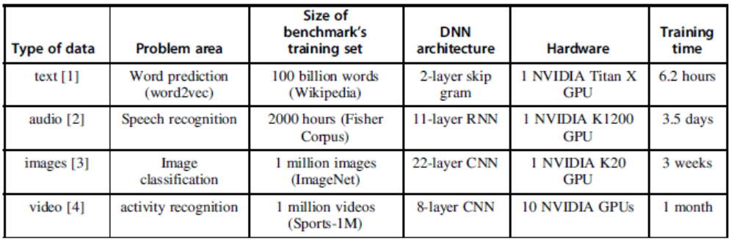
Example: Deep Neural Networks
Most practitioners will use existing design
  Topology
  Data type
Training (learning):
  Calculate weights using backpropagation algorithm
  Supervised learning: stochastic gradient descent
Inference: use neural network for classification
Example: Deep Neural Networks

Slide 12
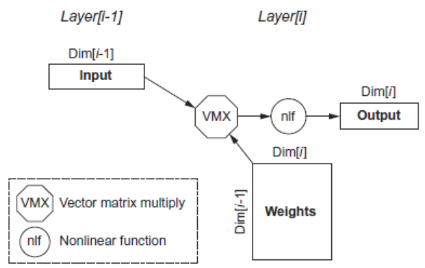
Multi-Layer Perceptrons
Example: Deep Neural Networks
Parameters:
  Dim[i]: number of neurons
  Dim[i-1]: dimension of input vector
  Number of weights: Dim[i-1] x Dim[i]
  Operations: 2 x Dim[i-1] x Dim[i]
  Operations/weight: 2

Slide 13
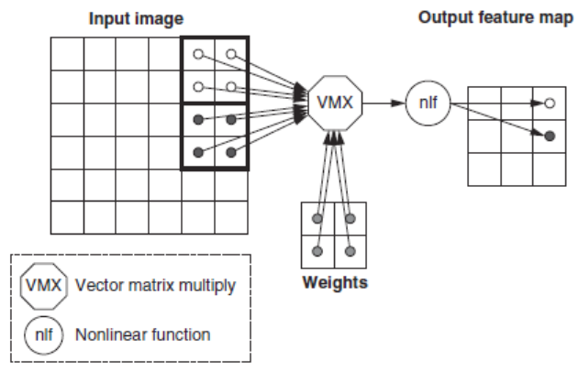
Convolutional Neural Network
Computer vision
Each layer raises the level of abstraction
  First layer recognizes horizontal and vertical lines
  Second layer recognizes corners
  Third layer recognizes shapes
  Fourth layer recognizes features, such as ears of a dog
  Higher layers recognizes different breeds of dogs
Example: Deep Neural Networks

Slide 14
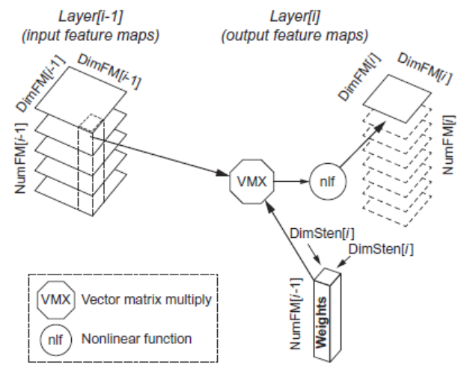
Convolutional Neural Network
Parameters:
  DimFM[i-1]: Dimension of the (square) input Feature Map
  DimFM[i]: Dimension of the (square) output Feature Map
  DimSten[i]: Dimension of the (square) stencil
  NumFM[i-1]: Number of input Feature Maps
  NumFM[i]: Number of output Feature Maps
  Number of neurons: NumFM[i] x DimFM[i]²
  Number of weights per output Feature Map: NumFM[i-1] x DimSten[i]²
  Total number of weights per layer: NumFM[i] x Number of weights per output Feature Map
  Number of operations per output Feature Map: 2 x DimFM[i]² x Number of weights per output Feature Map
  Total number of operations per layer: NumFM[i] x Number of operations per output Feature Map = 2 x DimFM[i]² x NumFM[i] x Number of weights per output Feature Map = 2 x DimFM[i]² x Total number of weights per layer
  Operations/Weight: 2 x DimFM[i]²
Example: Deep Neural Networks

Slide 15
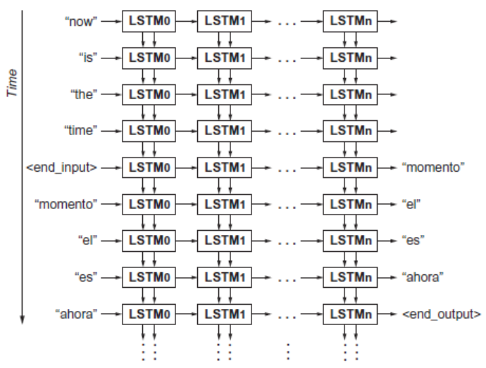
Recurrent Neural Network
Speech recognition and language translation
Long short-term memory (LSTM) network
Example: Deep Neural Networks

Slide 16
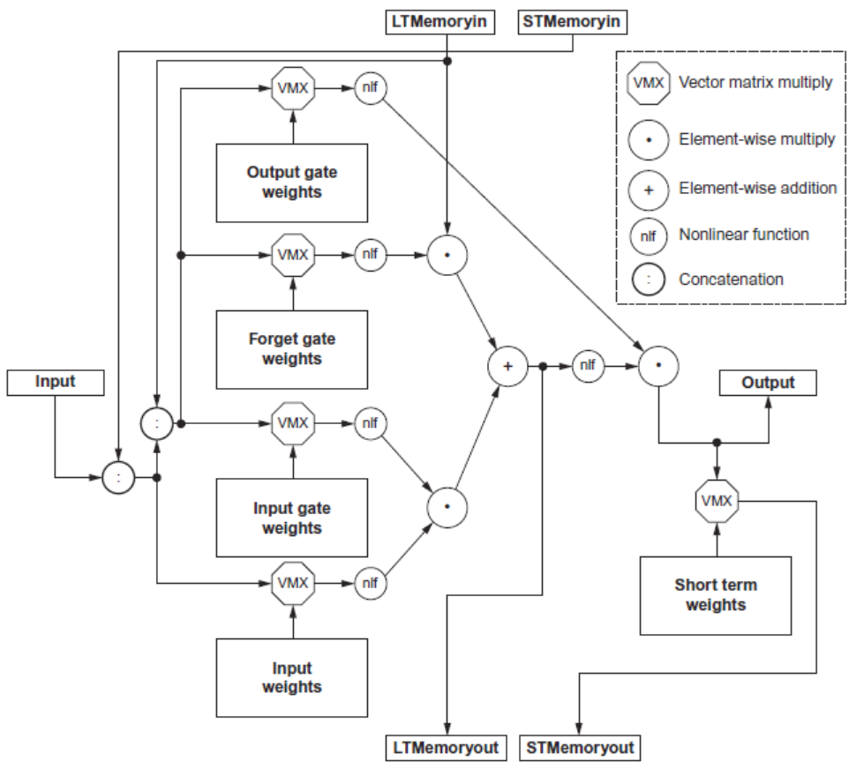
Recurrent Neural Network
Parameters:
  Number of weights per cell: 3 x (3 x Dim x Dim)+(2 x Dim x Dim) + (1 x Dim x Dim) = 12 x Dim²
  Number of operations for the 5 vector-matrix multiplies per cell: 2 x Number of weights per cell = 24 x Dim²
  Number of operations for the 3 element-wise multiplies and 1 addition (vectors are all the size of the output): 4 x Dim
  Total number of operations per cell (5 vector-matrix multiplies and the 4 element-wise operations): 24 x Dim² + 4 x Dim
  Operations/Weight: ~2
Example: Deep Neural Networks

Slide 17
Convolutional Neural Network
Batches:
  Reuse weights once fetched from memory across multiple inputs
  Increases operational intensity
Quantization
  Use 8- or 16-bit fixed point
Summary:
  Need the following kernels:
    Matrix-vector multiply
    Matrix-matrix multiply
    Stencil
    ReLU (Rectified Linear Unit = max(0,x) )
    Sigmoid
    Hyperbolic tangent
Example: Deep Neural Networks

Slide 18
Tensor Processing Unit
Google’s DNN ASIC
256 x 256 8-bit matrix-multiply unit
Large software-managed scratchpad
Coprocessor on the PCIe bus
Tensor Processing Unit

Slide 19
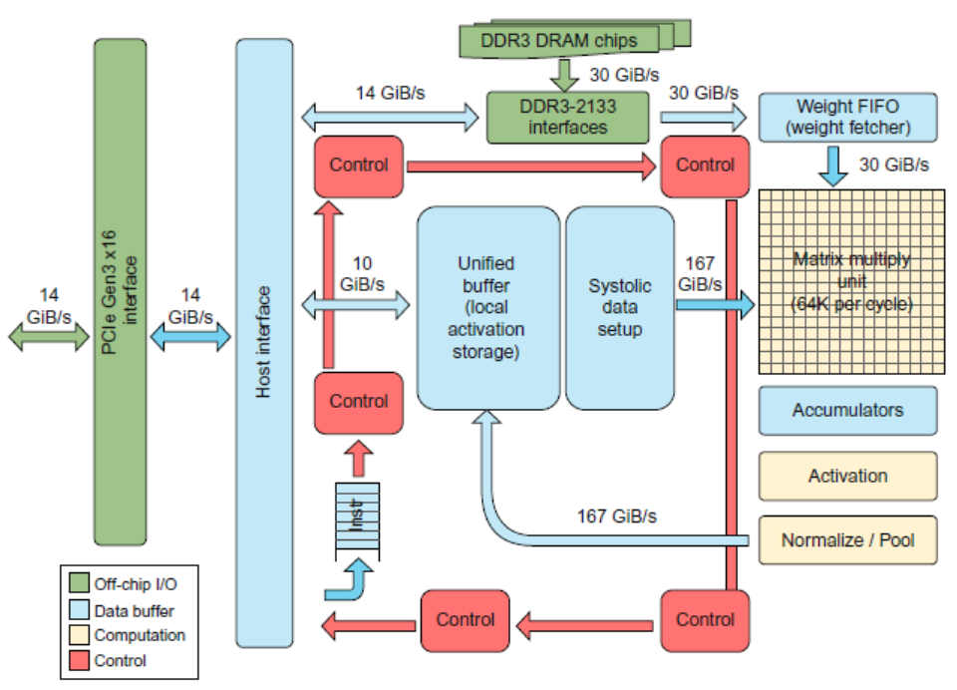
Tensor Processing Unit
Tensor Processing Unit

Slide 20
TPU ISA
Read_Host_Memory
  Reads memory from the CPU memory into the unified buffer
Read_Weights
  Reads weights from the Weight Memory into the Weight FIFO as input to the Matrix Unit
MatrixMatrixMultiply/Convolve
  Perform a matrix-matrix multiply, a vector-matrix multiply, an element-wise matrix multiply, an element-wise vector multiply, or a convolution from the Unified Buffer into the accumulators
  takes a variable-sized B*256 input, multiplies it by a 256x256 constant input, and produces a B*256 output, taking B pipelined cycles to complete
Activate
  Computes activation function
Write_Host_Memory
  Writes data from unified buffer into host memory
Tensor Processing Unit

Slide 21
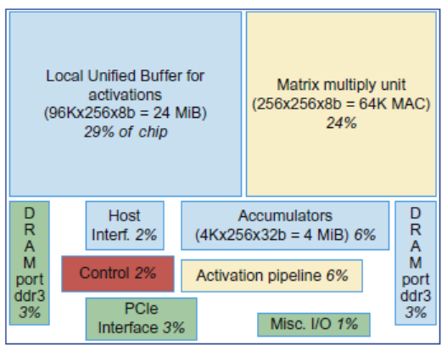
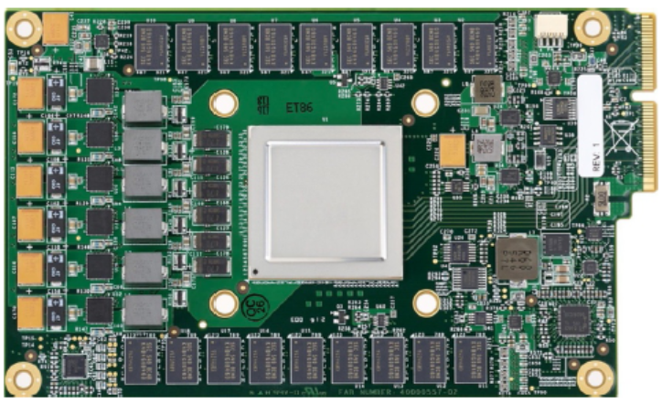
TPU Implementation
Tensor Processing Unit

Slide 22
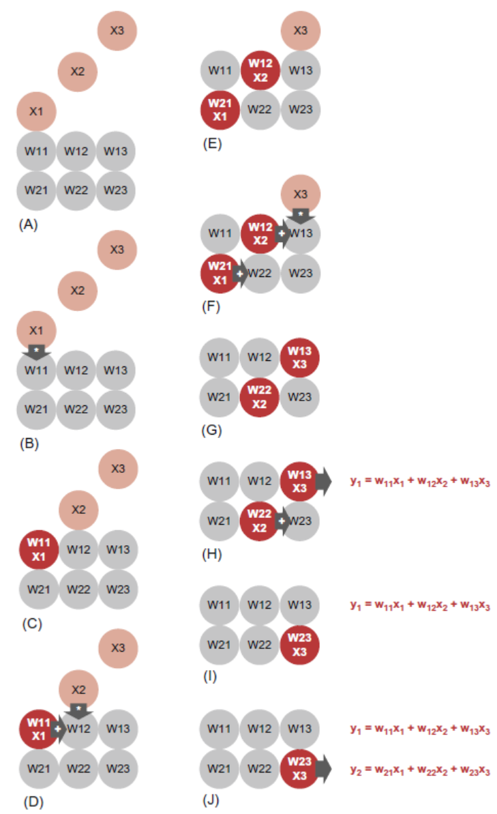
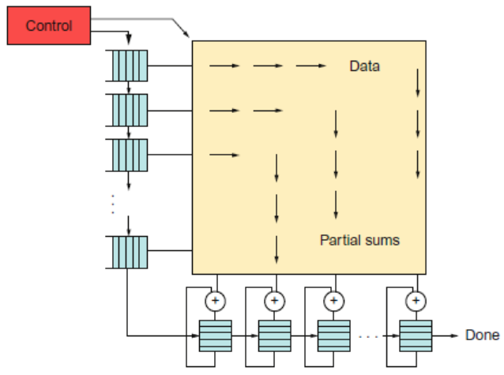
TPU Operation
Tensor Processing Unit

Slide 23
The TPU and the Guidelines
Use dedicated memories
  24 MiB dedicated buffer, 4 MiB accumulator buffers
Invest resources in arithmetic units and dedicated memories
  60% of the memory and 250X the arithmetic units of a server-class CPU
Use the easiest form of parallelism that matches the domain
  Exploits 2D SIMD parallelism
Reduce the data size and type needed for the domain
  Primarily uses 8-bit integers
Use a domain-specific programming language
  Uses TensorFlow
Tensor Processing Unit

Slide 24
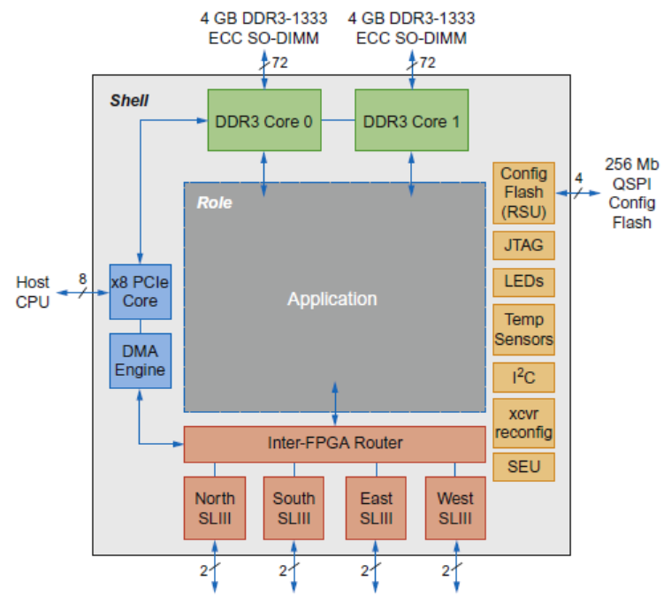
Microsoft Catapult
Needed to be general-purpose and power-efficient
  Uses FPGA PCIe board with dedicated 20 Gbps network in 6 x 8 torus
  Each of the 48 servers in half the rack has a Catapult board
  Limited to 25 watts
  32 MiB Flash memory
  Two banks of DDR3-1600 (11 GB/s) and 8 GiB DRAM
  FPGA (unconfigured) has 3962 18-bit ALUs and 5 MiB of on-chip memory
  Programmed in Verilog RTL
  Shell is 23% of the FPGA
Microsoft Capapult

Slide 25
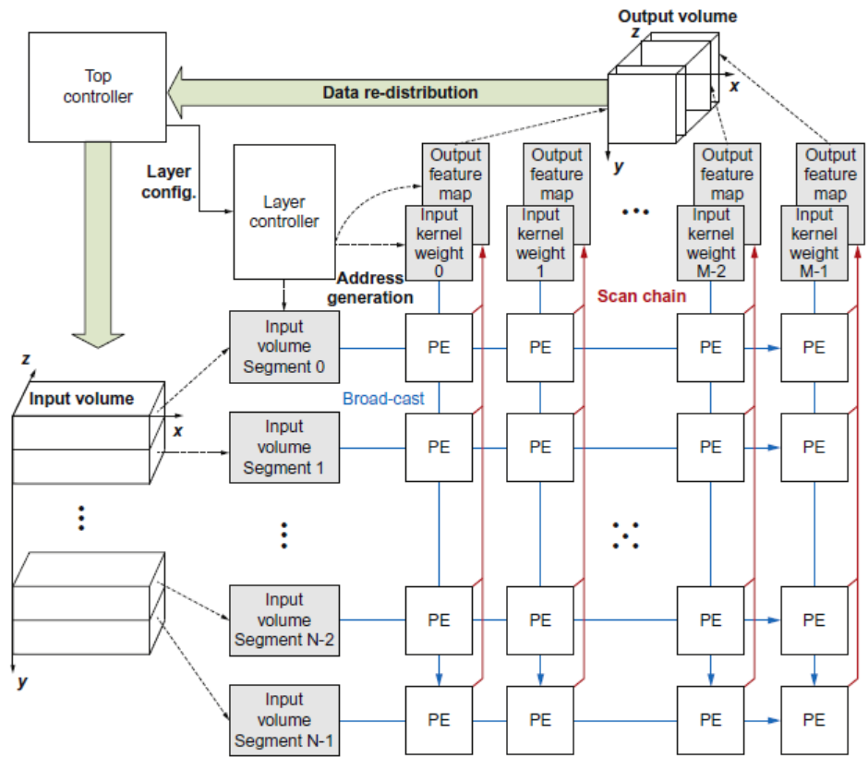
Microsoft Catapult: CNN
CNN accelerator, mapped across multiple FPGAs
Microsoft Capapult

Slide 26
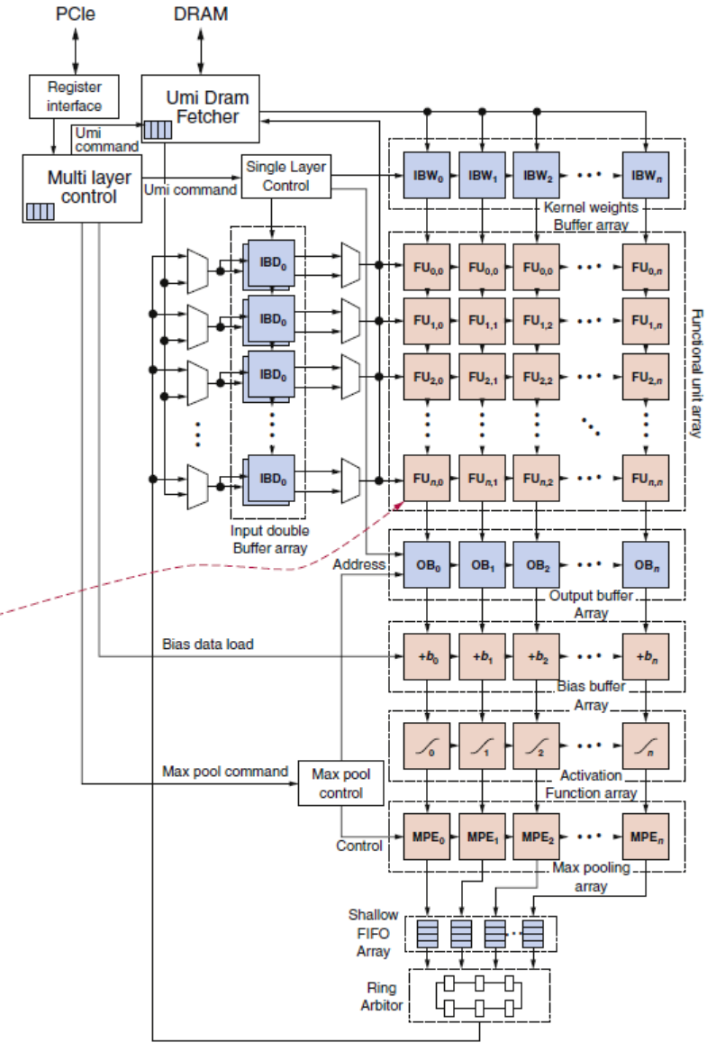
Microsoft Catapult: CNN
Microsoft Capapult

Slide 27
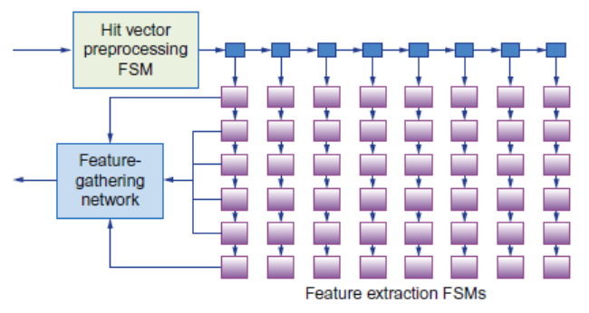
Microsoft Catapult: Search Ranking
Feature extraction (1 FPGA)
  Extracts 4500 features for every document-query pair, e.g. frequency in which the query appears in the page
  Systolic array of FSMs
Free-form expressions (2 FPGAs)
  Calculates feature combinations
Machine-learned Scoring (1 FPGA for compression, 3 FPGAs calculate score)
  Uses results of previous two stages to calculate floating-point score
One FPGA allocated as a hot-spare
Microsoft Capapult

Slide 28
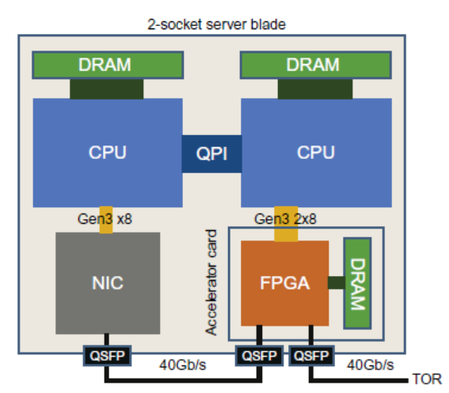
Microsoft Catapult: Search Ranking
Microsoft Capapult
Version 2 of Catapult
  Placed the FPGA between the CPU and NIC
  Increased network from 10 Gb/s to 40 Gb/s
  Also performs network acceleration
  Shell now consumes 44% of the FPGA
  Now FPGA performs only feature extraction

Slide 29
Catapult and the Guidelines
Use dedicated memories
  5 MiB dedicated memory
Invest resources in arithmetic units and dedicated memories
  3926 ALUs
Use the easiest form of parallelism that matches the domain
  2D SIMD for CNN, MISD parallelism for search scoring
Reduce the data size and type needed for the domain
  Uses mixture of 8-bit integers and 64-bit floating-point
Use a domain-specific programming language
  Uses Verilog RTL; Microsoft did not follow this guideline
Microsoft Capapult

Slide 30
CS152 Administrivia
Wednesday April 25, lecture time will be review session
Friday April 27, discussion will cover caches and review
Final exam, Tuesday May 8, 306 Soda, 11:30am-2:30pm

Slide 31
CS252 Administrivia
Monday April 23rd, last Project Checkpoint, 4-5pm, 405 Soda
  Prepare 10-minute presentation on current status
Project presentations, May 2nd, 2:30pm-5pm, 511 Soda

Slide 32
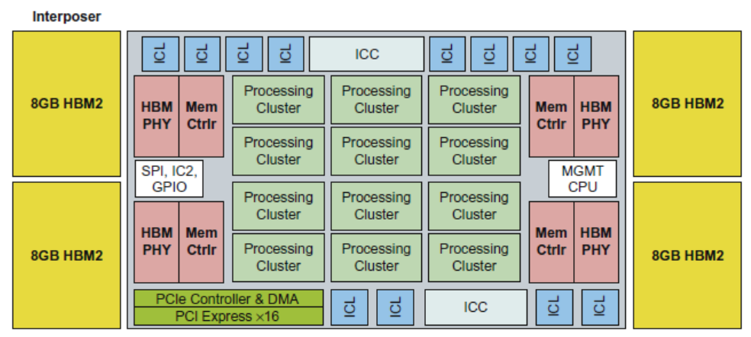
Intel Crest (now “Nervana”)
Intel Crest
DNN training
16-bit fixed point
Operates on blocks of 32x32 matrices
SRAM + HBM2

Slide 33
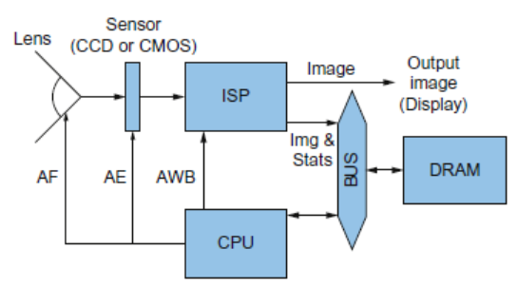
Google Pixel Visual Core
Pixel Visual Core
  Image Processing Unit
  Performs stencil operations
  Descended from Image Signal processor
Pixel Visual Core

Slide 34
Pixel Visual Core
Software written in Halide, a DSL
  Compiled to virtual ISA
  vISA is lowered to physical ISA using application-specific parameters
  pISA is VLSI
Optimized for energy
  Power Budget is 6 to 8 W for bursts of 10-20 seconds, dropping to tens of milliwatts when not in use
  8-bit DRAM access equivalent energy as 12,500 8-bit integer operations or 7 to 100 8-bit SRAM accesses
  IEEE-754 floating-point operations require 22X to 150X of the cost of 8-bit integer operations
Optimized for 2D access
  2D SIMD unit
  On-chip SRAM structured using a square geometry
Pixel Visual Core

Slide 35
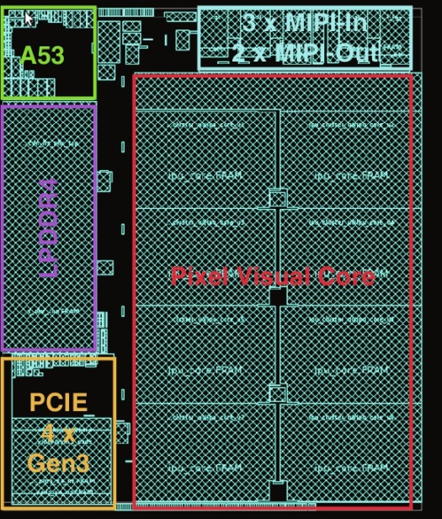
Pixel Core Layout
Figure 7.38 Floor plan of the 8-core Pixel Visual Core chip. A53 is an ARMv7 core. LPDDR4 is a DRAM controller. PCIE and MIPI are I/O buses.

Slide 36
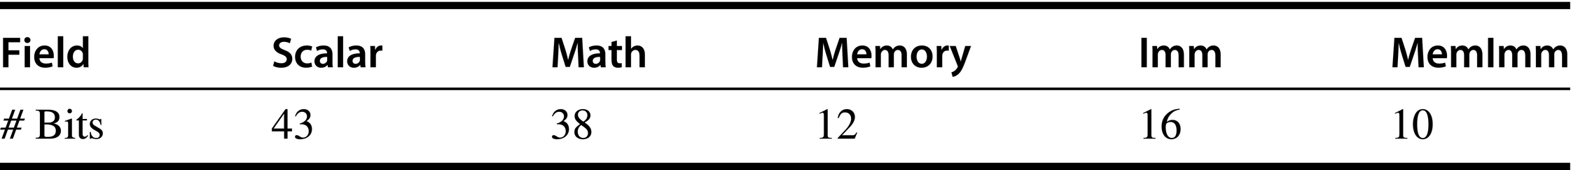
Pixel Core VLIW Format
Figure 7.35 VLIW format of the 119-bit pISA instruction.

Slide 37
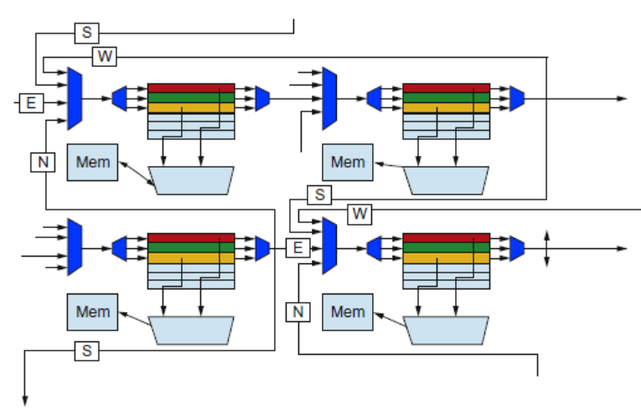
Pixel Visual Core
Pixel Visual Core

Slide 38
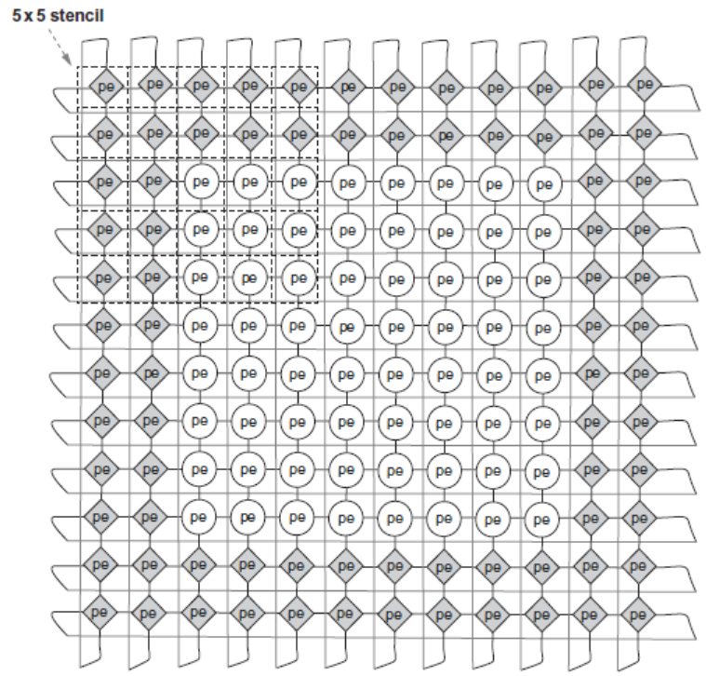
Pixel Visual Core
Pixel Visual Core

Slide 39
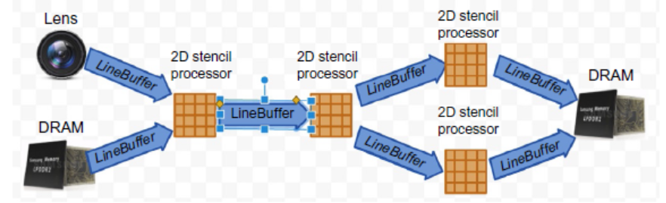
Pixel Visual Core
Pixel Visual Core

Slide 40
Visual Core and the Guidelines
Use dedicated memories
  128 + 64 MiB dedicated memory per core
Invest resources in arithmetic units and dedicated memories
  16x16 2D array of processing elements per core and 2D shifting network per core
Use the easiest form of parallelism that matches the domain
  2D SIMD and VLIW
Reduce the data size and type needed for the domain
  Uses mixture of 8-bit and 16-bit integers
Use a domain-specific programming language
  Halide for image processing and TensorFlow for CNNs
Microsoft Capapult

Slide 41
Computer Architecture in 2018
Explosion of interest in custom architectures due to end of transistor scaling
  Full employment for computer architects!
But need to learn about application domains
  Cannot just work with precompiled binaries anymore!
Get involved in research projects,
  ADEPT – microprocessor architecture and chip design
  RISE – machine learning, datacenter software, and security
Undergrad research experience is the most important part of application to top grad schools!

Slide 42
End of CS152/CS252
Thanks for taking part in first offering of redesigned course structure!
Welcome feedback on course eval, or via email

