Slide 1
C Review Session
Hosted by: Collin Johnston and Maajid Nazrulla
http://bit.ly/MKzj0f

Slide 2
Introduction: Welcome!
According to Wikipedia, C is a general purpose, statically typed, imperative (procedural), multiplatform
language initially developed by Dennis Ritchie during the late 1960s and early 1970s at AT&T Bell
Labs.
This review session will cover basics of ANSI C, a family of standards published by the American
National Standards Institute.
For the purposes of this session it is expected that you have basic knowledge from 61B and 61C of a statically typed language such as Java, and that you have basic programming experience already.

Slide 3
Data Types and Sizes
Table taken from Wikipedia.

Slide 4
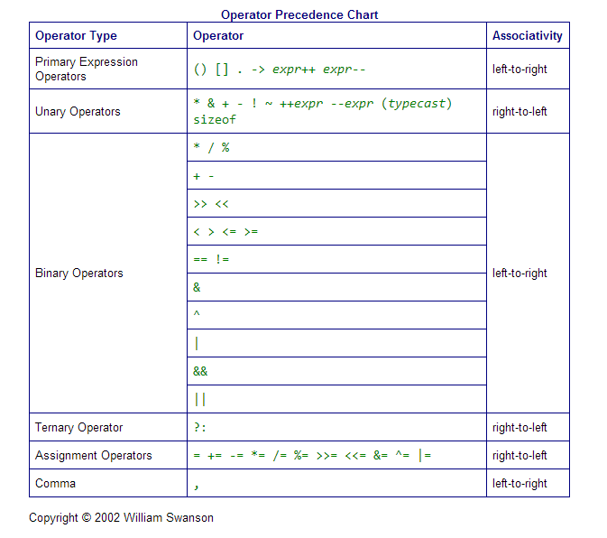
Operator Precedence in C
Note that operator overloading is not supported in C, beyond what is natively implemented.
Suppose we have two unsigned ints, lo and hi, between 0 and 255 and we want to set a third unsigned integer to a 16 bit value whose lower order bits are lo and whose higher order bits are those of hi.
We choose to do:
unsigned int16_t i = hi << 8 + lo;
What is wrong with this?
Table taken from http://www.swansontec.com/sopc.html .

Slide 5
Operator Precedence in C
Note that operator overloading is not supported in C, beyond what is natively implemented.
Suppose we have two unsigned ints, lo and hi, between 0 and 255 and we want to set a third unsigned integer to a 16 bit value whose lower order bits are lo and whose higher order bits are those of hi.
We choose to do:
unsigned int16_t i = hi << 8 + lo;
Instead, we choose to do the following:
unsigned int16_t i = hi << 8 | lo;
Is there anything wrong now?
Table taken from http://www.swansontec.com/sopc.html .

Slide 6
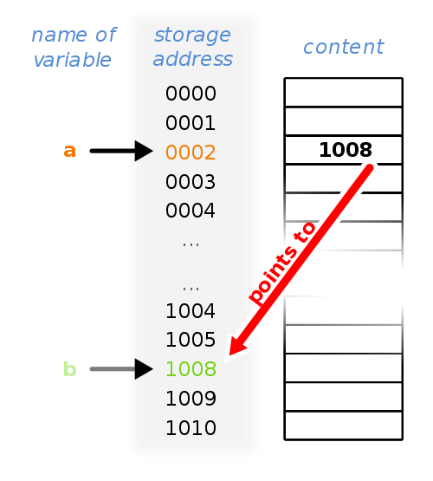
Pointers
•Consider memory to be a single huge array
- Each cell/entry of the array has an address
- Each cell also stores some value
•Don’t confuse the address referring to a
memory location with the value stored there
243

Slide 7
Pointers
Syntax:
a = 1008
*a = 243
&b = 1008
&a = ?
a[4] = *(a+4)
243

Slide 8
#include <stdio.h>
int main(int argc, char* argv[]) {
int* p; // Declares a pointer to an int
int a = 7; // Declares an int with value 7
p = &a; // sets the value of p to the address of a
int i = *p; // Declares an int i whose value is the value at address p
printf("%u\n", &i); // Prints the address of i
printf("%d\n", i); // Prints the value of i (7)
return 0;
}
What does this code do?

Slide 9
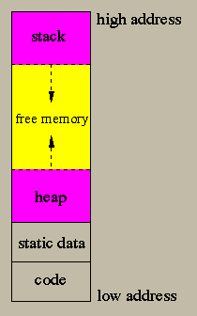
Memory Basics
Image taken from:
http://lambda.uta.edu/cse5317/notes/node33.html
We have four regions in the address space of a program. They are, from highest address to lowest:
Stack (grows downward, toward lower addresses)
Heap (grows upward, resizes dynamically)
Static (doesn’t change in size)
Code (doesn’t change)
Let’s cover each briefly, starting with the code section.

Slide 10
Memory Basics: Code Section
The code section is where the C source code from your program resides in memory.
It is also alternatively known as the code segment, text segment, or just text.
This section is allocated at run time and is a fixed size.
Generally the code segment is read-only. Architectures in which the code segment is not read-only support self-modifying code.
The code section is often placed below the heap and stack locations to protect it from being overwritten due to heap or stack overflows.

Slide 11
Memory Basics: Static Data Section
The static data section is where persistent variables such as global variables (or any variables declared outside a function) and string literals are stored.
The data in the static data section can change, but the size is determined at compile time and cannot change.
Like the code section, static data is often placed below the heap and stack locations to protect it from being overwritten due to heap or stack overflows.

Slide 12
Memory Basics: Heap
Image taken from:
http://lambda.uta.edu/cse5317/notes/node33.html
The heap segment is where dynamically allocated data resides.
Addressing for the heap segment generally starts above the static data section and grows upward. This is done to maximize the amount of memory available for dynamic allocation while minimizing interference with the stack.
The programmer must manage the heap in C-this is done through several functions which we will soon cover.
The data in the heap can be accessed across functions. This is useful for data structures that require the flexibility of dynamic memory allocation as well as access by multiple functions.

Slide 13
Memory Basics: Stack
Image taken from:
http://lambda.uta.edu/cse5317/notes/node33.html
The stack segment is where local variables reside for function calls. It’s a LIFO (Last In, First Out) data structure.
The stack is incremented by adding stack frames, which are contiguous blocks of memory that contain local variables for a single procedure call.
Each stack frame contains space for the location of the calling function, its arguments, and space for local variables.
A stack frame contains a return address. When the function returns, the stack pointer jumps to the return address and the memory occupied by the stack frame is automatically freed.
The current position of the stack (lowest stack frame) is pointed to by the stack pointer.

Slide 14
Memory Basics: Stack Tips
Note that stack frames are freed as soon as the function they belong to returns. If you want to use things across functions, then you should allocate to the heap instead.
For this reason you should take care never to return a pointer to a local variable. After the function returns, the pointer will be pointing to garbage.
A stack overflow occurs when the stack pointer collides with the heap. If too much data is allocated locally by functions, either due to excessive recursion or very large local variables, stack overflow (and a resulting segmentation fault) can occur. You can avoid this by dynamically allocating large variables and converting recursive code into iterative code (loops).

Slide 15
Memory Allocation
void *malloc(size_t size)
Attempts to allocate ‘size’ bytes of memory on the heap and returns a pointer to the beginning of the block if successful.
void *calloc(size_t nitems, size_t size)
Attempts to allocate ‘nitems’ * ‘size’ bytes (nitems, size bytes each), and initializes them all to 0.
void *realloc(void *ptr, size_t size)
Attempts to change the block of memory pointed to by ‘ptr’ to be ‘size’ bytes.

Slide 16
Declaring Arrays
Arrays in C are contiguous blocks of memory.
They do not know their own length, unlike Java arrays.
#include <stdio.h>
#include <stdlib.h>
#define SIZE 4
int main(int argc, char* argv[]) {
int A[SIZE]; // Declare an array of ints of size SIZE
int B[] = {1,2,3,4}; //Declare an array of ints with initial values
int* C = malloc(4*sizeof(int)); // Allocate enough memory for 4 ints on heap
if(!C){ // Check if malloc succeeds
printf("malloc failed");
exit(1);
}
free(C); // Free allocated memory
return 0;
}

Slide 17
Structs and Typedefs
Why use structs and typedefs?
Easy way to define new data structures; structs are data structures that are composed of simpler data types.
Similar to classes in Java/C++, but without inheritance or methods.
Typedefs are often useful to differentiate between incompatible or different things that can have the same basic type. An example is differentiating between a player’s score and his ID, which may both be integers. A function that takes one should not take the other.

Slide 18
#include <stdlib.h>
#include <stdio.h>
#include <string.h>
struct idCard {
unsigned int id;
char[32] name;
};

Slide 19
#include <stdlib.h>
#include <stdio.h>
#include <string.h>
struct idCard {
unsigned int id;
char* name;
};

Slide 20
#include <stdlib.h>
#include <stdio.h>
#include <string.h>
struct idCard {
unsigned int id;
char* name;
};
typedef struct idCard idCard_t;

Slide 21
#include <stdlib.h>
#include <stdio.h>
#include <string.h>
typedef struct idCard {
unsigned int id;
char* name;
} idCard_t; // Combines struct definition with typedef

Slide 22
#include <stdlib.h>
#include <stdio.h>
#include <string.h>
typedef struct idCard {
unsigned int id;
char* name;
} idCard_t; // Combines struct definition with typedef
void setName(idCard_t *id, char* name) {
char* tmp = (char*) realloc(id->name,
sizeof(char) *(strlen(name) + 1));
if (!tmp) { //check if realloc succeeds
printf(“Realloc failed!\n”);
exit(1);
}
id->name = tmp;
strcpy(id->name, name); //copy contents of name
//to id->name
}
int main() {
idCard_t myCard;
myCard.id = 1001;
setName(&myCard, “Alice”);
printf(“myCard is (%u, %s)\n”,
myCard.id,myCard.name);
return 0;
}
Running produces:
myCard is (1001, Alice)

Slide 23
enum direction { NORTH, WEST, SOUTH, EAST } ;
typedef enum direction direction_t;
direction_t getOppositeDirection(direction_t direction) {
switch(direction) {
case NORTH: return SOUTH;
case SOUTH: return NORTH;
case EAST: return WEST;
case WEST: return EAST;
}
}
int main() {
printf("Opposite of NORTH: %d", getOppositeDirection(NORTH));
return 0;
}
Prints: Opposite of NORTH: 2
Enums

Slide 24
Function Pointers
A function pointer, instead of pointing to data values, points to code that is executable in memory. When a function pointer is dereferenced, it can be used to call the function that it points to, just like any other function call. This is known as an indirect call.
Let’s write the map function.
In Python,
map([1, 2, 3, 4], lambda x: x*x) returns [1, 4, 9, 16]
How might we write this in C?
How would we pass a function to another function?

Slide 25
#include <stdlib.h>
#include <stdio.h>
int* map(int* input, size_t length, int(*func)(int)) {
int* newArray;
int i;
if (!(newArray = malloc(length*sizeof(int)))){
printf("Malloc Failed\n");
exit(1);
}
for(i = 0; i < length; i++)
newArray[i] = func(input[i]);
return newArray;
}
int squared(int x) {
return x * x;
}
Function Pointers

Slide 26
#include <stdlib.h>
#include <stdio.h>
int* map(int* input, size_t length, int(*func)(int)) {
int* newArray;
int i;
if (!(newArray = malloc(length*sizeof(int)))){
printf("Malloc Failed\n");
exit(1);
}
for(i = 0; i < length; i++)
newArray[i] = func(input[i]);
return newArray;
}
int squared(int x) {
return x * x;
}
Function Pointers
int main(){
int array[] = {1, 2, 3, 4};
int i;
int* array_squared = map(array, 4,
&squared);
for(i = 0; i < 4; i++)
printf("array_squared[%d]: %d\n", i,
array_squared[i]);
return 0;
}

Slide 27
Keywords in C
Examples of keywords: extern, const, static, if, continue, break.
extern: declares the variable as global so that it can be used by other programs. This is the default for variables and functions at the global level. You still need the variable initialization in the source file or the linked source file.
const: declares a variable as constant or ‘read-only’. A constant variable cannot be assigned to after initialization.
static: declares a variable as only visible to the file it is in (opposite of extern). You can also declare static variables inside a function to make that variable keep state between invocations. However, this is discouraged since it is confusing and not thread-safe.
Full list of keywords in ANSI C available here: http://tigcc.ticalc.org/doc/keywords.html
extern int var;
int var = 10;
const int var = 5;
var = 10; // error

Slide 28
Header Files
#include <file.h>: Takes the contents of file.h and inserts it at the location of #include before compilation.
The header files should include the variable declarations required for file.c.
If you create your own c header files you need to “link” them when compiling.
./c_lib/functions.h
./functions.c
./main.c
int rand_int();
#include “functions.h”
int rand_int() {
return 4;
}
#include “functions.h”
#include <stdio.h>
int main() {
printf(“%d\n”, rand_int());
printf(“%d\n”, rand_int());
return 0;
}
To compile these files we need to tell gcc where to find the .c and .h files.
gcc -Wall -g -I ./c_lib functions.c main.c -o main
Show all warnings

Slide 29
Header Files
#include <file.h>: Takes the contents of file.h and inserts it at the location of #include before compilation.
The header files should include the variable declarations required for file.c.
If you create your own c header files you need to “link” them when compiling.
./c_lib/functions.h
./functions.c
./main.c
int rand_int();
#include “functions.h”
int rand_int() {
return 4;
}
#include “functions.h”
#include <stdio.h>
int main() {
printf(“%d\n”, rand_int());
printf(“%d\n”, rand_int());
return 0;
}
To compile these files we need to tell gcc where to find the .c and .h files.
gcc -Wall -g -I ./c_lib functions.c main.c -o main
Create gdb symbols

Slide 30
Header Files
#include <file.h>: Takes the contents of file.h and inserts it at the location of #include before compilation.
The header files should include the variable declarations required for file.c.
If you create your own c header files you need to “link” them when compiling.
./c_lib/functions.h
./functions.c
./main.c
int rand_int();
#include “functions.h”
int rand_int() {
return 4;
}
#include “functions.h”
#include <stdio.h>
int main() {
printf(“%d\n”, rand_int());
printf(“%d\n”, rand_int());
return 0;
}
To compile these files we need to tell gcc where to find the .c and .h files.
gcc -Wall -g -I ./c_lib functions.c main.c -o main
Where to find header files

Slide 31
Header Files
#include <file.h>: Takes the contents of file.h and inserts it at the location of #include before compilation.
The header files should include the variable declarations required for file.c.
If you create your own c header files you need to “link” them when compiling.
./c_lib/functions.h
./functions.c
./main.c
int rand_int();
#include “functions.h”
int rand_int() {
return 4;
}
#include “functions.h”
#include <stdio.h>
int main() {
printf(“%d\n”, rand_int());
printf(“%d\n”, rand_int());
return 0;
}
To compile these files we need to tell gcc where to find the .c and .h files.
gcc -Wall -g -I ./c_lib functions.c main.c -o main
Where to find source files

Slide 32
Header Files
#include <file.h>: Takes the contents of file.h and inserts it at the location of #include before compilation.
The header files should include the variable declarations required for file.c.
If you create your own c header files you need to “link” them when compiling.
./c_lib/functions.h
./functions.c
./main.c
int rand_int();
#include “functions.h”
int rand_int() {
return 4;
}
#include “functions.h”
#include <stdio.h>
int main() {
printf(“%d\n”, rand_int());
printf(“%d\n”, rand_int());
return 0;
}
To compile these files we need to tell gcc where to find the .c and .h files.
gcc -Wall -g -I ./c_lib functions.c main.c -o main
The output file

Slide 33
Makefiles
Nice tutorial here: http://mrbook.org/tutorials/make/
Running make from the command line will look for a file named Makefile in the working directory and execute it.
At its most basic level, a makefile is simply composed of:
target: dependencies [tab] system command
As an example of the above, suppose we wanted to run:
gcc -g -Wall main.c hello_world.c yay.c -o hello_world
We could then write this in the makefile:
The target for the above makefile is all. This is the default target for a makefile, if no other is provided. Other targets can also often be useful, since if we modify particular files in our program, we can recompile only those files instead of recompiling the entire program.
all:
gcc -g -Wall main.c hello_world.c yay.c -o hello_world

Slide 34
Makefiles
You can put variables and comments in makefiles. Anything on a line following the # character is a comment. Variables are assigned with a single =, and you can use a variable VARNAME by calling $(VARNAME) like the following:
CC = gcc
all:
$(CC) -g -Wall main.c hello_world.c yay.c -o hello_world
A common target is clean , which usually is written as a system command that will clean the output files and executables created by compilation so that a “clean” compilation can be made afterward. For example:
all:
$(CC) -g -Wall main.c hello_world.c yay.c -o hello_world
#this command can be invoked by typing ‘make clean’
clean:
rm -rf *.o hello_world

Slide 35
Makefile Example
CC = gcc
ifeq ($(shell sw_vers 2>/dev/null | grep Mac | awk '{ print $$2}'),Mac)
CFLAGS = -std=c99 -g -DGL_GLEXT_PROTOTYPES -I./include/ -I/usr/X11/include \
-DOSX
LDFLAGS = -framework GLUT -framework OpenGL \
-L"/System/Library/Frameworks/OpenGL.framework/Libraries" \
-lGL -lGLU -lm -lstdc
else
CFLAGS = -std=c99 -g -DGL_GLEXT_PROTOTYPES -Iglut-3.7.6-bin
LDFLAGS = -lglut -lGLU
endif
RM = /bin/rm -f
all: main
main: raytracer.o
$(CC) $(CFLAGS) -o myprog raytracer.o $(LDFLAGS)
raytracer.o: raytracer.c
$(CC) $(CFLAGS) -c raytracer.c -o raytracer.o
clean:
$(RM) *.o myprog

Slide 36
GDB - GNU Debugger
gdb is used to debug c files
To use gdb you must compile with -g with gcc
gdb supports:
- breakpoints
- error traceback inspection
- stepping through the program

Slide 37
GDB - GNU Debugger
int main() {
long i = 0;
int zero_value = *(int*)i;
return zero_value;
}
collin@cirrus:~/c_test$ gdb a.out
GNU gdb (Ubuntu/Linaro 7.4-2012.04-0ubuntu2.1) 7.4-2012.04
Reading symbols from /home/collin/c_test/a.out...done.
(gdb) run
Starting program: /home/collin/c_test/a.out
Program received signal SIGSEGV, Segmentation fault.
0x00000000004004c4 in main () at error.c:3
3 int zero_value = *(int*)i;
(gdb) print i
$1 = 0
(gdb)
Shows the function, file, and line number of the error
Shows the code that produced the error

Slide 38
GDB - GNU Debugger
int main() {
long i = 0;
int zero_value = *(int*)i;
return zero_value;
}
collin@cirrus:~/c_test$ gdb a.out
GNU gdb (Ubuntu/Linaro 7.4-2012.04-0ubuntu2.1) 7.4-2012.04
Reading symbols from /home/collin/c_test/a.out...done.
(gdb) run
Starting program: /home/collin/c_test/a.out
Program received signal SIGSEGV, Segmentation fault.
0x00000000004004c4 in main () at error.c:3
3 int zero_value = *(int*)i;
(gdb) print i
$1 = 0
(gdb) quit
Shows the function, file, and line number of the error
Shows the code that produced the error

Slide 39
GDB - GNU Debugger
int main() {
long i = 0;
int zero_value = *(int*)i;
return zero_value;
}
Reading symbols from /home/collin/c_test/a.out...done.
(gdb) break 3
Breakpoint 1 at 0x4004c0: file error.c, line 3.
(gdb)

Slide 40
GDB - GNU Debugger
int main() {
long i = 0;
int zero_value = *(int*)i;
return zero_value;
}
Reading symbols from /home/collin/c_test/a.out...done.
(gdb) break 3
Breakpoint 1 at 0x4004c0: file error.c, line 3.
(gdb) run
Starting program: /home/collin/c_test/a.out
Breakpoint 1, main () at error.c:3
3 int zero_value = *(int*)i;
(gdb)

Slide 41
GDB - GNU Debugger
int main() {
long i = 0;
int zero_value = *(int*)i;
return zero_value;
}
Reading symbols from /home/collin/c_test/a.out...done.
(gdb) break 3
Breakpoint 1 at 0x4004c0: file error.c, line 3.
(gdb) run
Starting program: /home/collin/c_test/a.out
Breakpoint 1, main () at error.c:3
3 int zero_value = *(int*)i;
(gdb) call i = &i
$1 = 140737488348512
(gdb)

Slide 42
GDB - GNU Debugger
int main() {
long i = 0;
int zero_value = *(int*)i;
return zero_value;
}
Reading symbols from /home/collin/c_test/a.out...done.
(gdb) break 3
Breakpoint 1 at 0x4004c0: file error.c, line 3.
(gdb) run
Starting program: /home/collin/c_test/a.out
Breakpoint 1, main () at error.c:3
3 int zero_value = *(int*)i;
(gdb) call i = &i
$1 = 140737488348512
(gdb) continue
Continuing.
[Inferior 1 (process 22438) exited with code 0140]

Slide 43
References and Credits
This presentation was possible thanks to the following references and people:
CS61C Spring and Summer 2013 Slides and References from Dan Garcia and Justin Hsia. Links to the course webpages here: Summer 2013 and Spring 2013.
The GNU C reference manual, website here.
The C Programming Language, written by Brian Kernighan and Dennis Ritchie.
C Traps and Pitfalls, written by Andrew Koenig.
Various man pages and other Unix documentation.

Slide 44
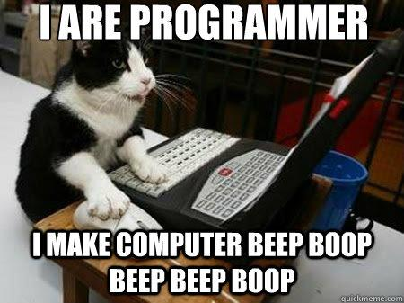
That’s it! Any Questions?

