Slide 1
Good/Bad Crypto (cont.) & Bitcoin

Slide 2
Announcements!
Midterm 1 Monday, 5-7 pm
Bring your student ID
Project 1 due tonight
Make only 1 submission per group!

Slide 3
Exercise: Send me an encrypted message
Make sure no one else can read the message
Use any communication method you want
How can you find my public key?
How can you be sure it’s me?
How can I be sure it’s you?
How can I respond in encrypted form?
Does the communication have forward secrecy?
Does it have integrity? Authentication?
Is it deniable? Or non-repudiable?

Slide 4
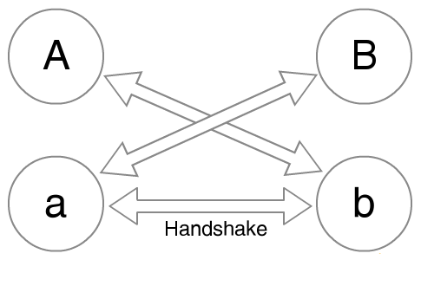
Signal
Authenticated Diffie-Hellman with Deniability
Alice has long term secret key A, generates ephemeral secret key a.
Bob has long term secret key B, generates ephemeral secret key b.

Slide 5
Signal
Authenticated Diffie-Hellman with Deniability
Alice sends g^{A} and gª
Bob sends g^{B} and g^{b}

Slide 6
Signal
Authenticated Diffie-Hellman with Deniability
Both compute KDF(g^{Ab}, g^{aB}, g^{ab})

Slide 7
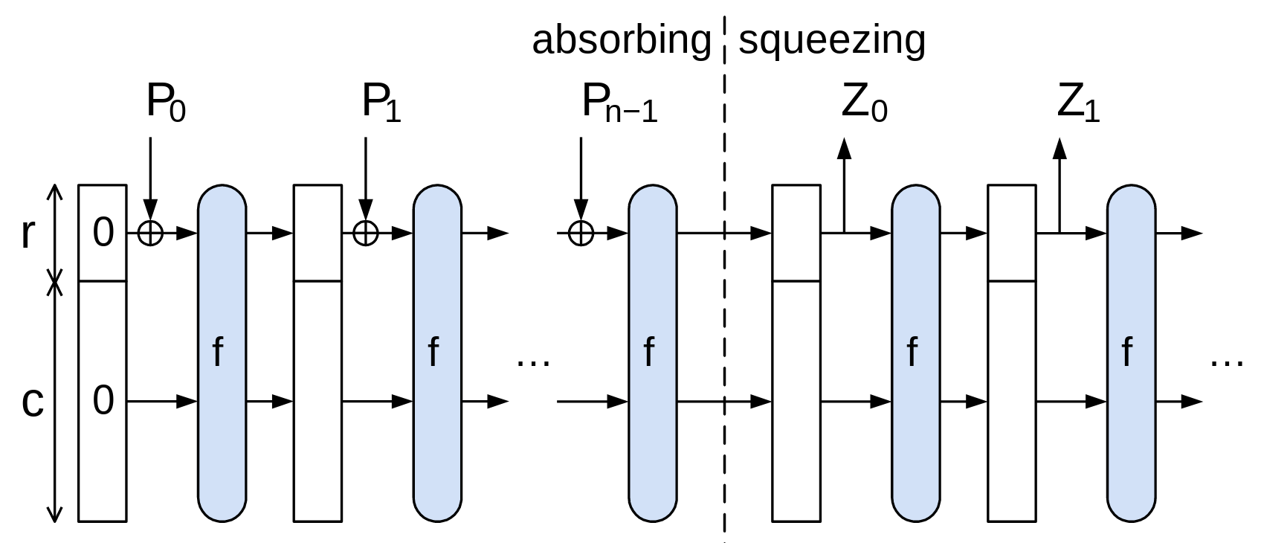
SHA3 (Keccak)
Cryptographic Sponge Construction

Slide 8
Unusability: PGP
I hate Pretty Good Privacy
But not because of the cryptography...
The PGP cryptography is decent...
Except it lacks "Forward Secrecy": If I can get someone's private key I can decrypt all their old messages
The metadata is awful...
By default, PGP says who every message is from and to
It makes it much faster to decrypt
It is hard to hide metadata well, but its easy to do things better than what PGP does
It is never transparent
Even with a "good" client like GPG-tools on the Mac
And I don't have a client on my cellphone

Slide 9
Unusability: How do you find someone's PGP key?
Go to their personal website?
Check their personal email?
Ask them to mail it to you
In an unencrypted channel?
Check on the MIT keyserver?
And get the old key that was mistakenly uploaded and can never be removed?

Slide 10
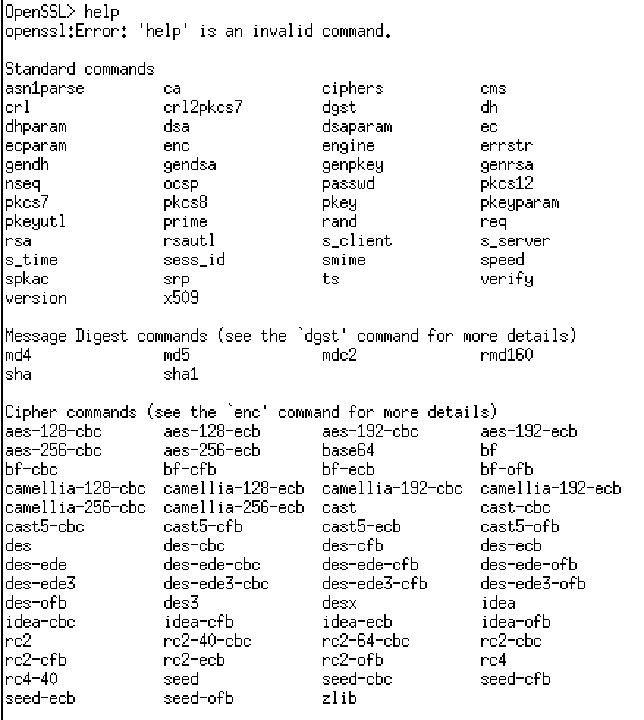
Unusability: openssl libcrypto and libssl
OpenSSL is a nightmare...
A gazillion different little functions needed to do anything
So much of a nightmare that I'm not going to bother learning it to teach you how bad it is
This is why the old python-based project didn't give this raw even though it used OpenSSL under the hood
But just to give you an idea: The command line OpenSSL utility options:

Slide 11
An Old Cryptofail: Too Short Keys
During WWII, the Germans used enigma:
System was a "rotor machine": A series of rotors, with each rotor permuting the alphabet and every keypress incrementing the settings
Key was the selection of rotors, initial settings, and a permutation plugboard
Which is not all that much entropy!
The British built a system (the "Bombe") to brute-force Enigma
Required a known-plaintext (a "crib") to verify decryption: e.g. the weather report
Sometimes the brits would deliberately "seed" a naval minefield for a chosen-plaintext attack

Slide 12
Another Cryptofail: Two-Time Pad
What if we reuse a key K jeeeest once in a One Time Pad?
Alice sends C = E(M, K) and C' = E(M', K)
Eve observes M ⊕ K and M' ⊕ K
Can she learn anything about M and/or M' ?
Eve computes C ⊕ C' = (M ⊕ K) ⊕ (M' ⊕ K) = (M ⊕ M') ⊕ (K ⊕ K) = (M ⊕ M') ⊕ 0 = M ⊕ M'
Now she knows which bits in M match bits in M'
And if Eve already knew M, now she knows M'!
Even if not, Eve can guess M and ensure that M' is consistent

Slide 13
VENONA: Pad Reuse in the Real World
The Soviets used one-time pads for communication from their spies in the US
After all, it is provably secure!
During WWII, the Soviets started reusing key material
Uncertain whether it was just the cost of generating pads or what...
VENONA was a US cryptanalysis project designed to break these messages
Included confirming/identifying the spies targeting the US Manhattan project
Project continued until 1980!
Not declassified until 1995!
So secret even President Truman wasn't informed about it.
But the Soviets found out about it in 1949, but their one-time pad reuse was fixed after 1948 anyway

Slide 14
2-Time Pad Cryptofail Remarkably Common
Actually happens more often than you'd like...
Because if you use CTR mode and repeat the IV, you are doing the same thing!
Recently discovered in WiFi implementations!
WiFi breaks up the message into a series of packets, each packet is encrypted separately

Slide 15
Cryptofail Hotness: KRACK attack...
To actually encrypt the individual packets: IV of a packet is {Agreed IV || packet counter}
Thus for each packet you only need to send the packet counter (48 bits) rather than the full IV (128b)
Multiple different modes
One common one is CCM (Counter with CBC-MAC)
MAC the data with CBC-MAC Then encrypt with CTR mode
The highest performance is GCM (Galois/Counter Mode)
KRACK:
"Hey WiFi Device, reset your packet counter" "Okeydoke"
But if you thought CTR mode was bad on IV reuse...
GCM is worse: A couple of reused IVs can reveal enough information to forge the authentication!
Discovered a year and a half ago, fairly quickly patch, but still!

Slide 16
GCM...
GCM is like CTR mode with a twist...
The confidentiality is pure CTR mode
The "Galois" part is a hash of the cipher text
The only secret part being the "Auth Data"
Reuse the IV, what happens?
Not only do you have CTR mode loss of confidentiality...
But if you do it enough, you lose confidentiality on the Auth Data...
So you lose the integrity that GCM supposedly provided!

Slide 17
DSA Signatures...
Based on Diffie-Hellman
Two initial parameters, L and N, and a hash function H
L == key length, eg 2048 N <= len(H), e.g. 256
An N-bit prime q, an L-bit prime p such that p - 1 is a multiple of q, and g = h^{(p-1)/q} mod p for some arbitrary h (1 < h < p − 1)
{p, q, g} are public parameters
Alice creates her own random private key x < q
Public key y = g^{x} mod p

Slide 18
Alice's Signature...
Create a random value k < q
Calculate r = (g^{k} mod p) mod q
If r = 0, start again
Calculate s = k⁻¹ (H(m) + xr) mod q
If s = 0, start again
Signature is {r, s} (Advantage over an El-Gamal signature variation: Smaller signatures)
Verification
w = s⁻¹ mod q
u1 = H(m) * w mod q
u2 = r * w mod q
v = (g^{u1}y^{u2} mod p) mod q
Validate that v = r

Slide 19
But Easy To Screw Up...
k is not just a nonce... It must be random and secret
If you know k, you can calculate x
And even if you just reuse a random k... for two signatures sa and sb
A bit of algebra proves that k = (HA – HB) / (sa – sb)
A good reference:
How knowing k tells you x: https://rdist.root.org/2009/05/17/the-debian-pgp-disaster-that-almost-was/
How two signatures tells you k: https://rdist.root.org/2010/11/19/dsa-requirements-for-random-k-value/

Slide 20
And NOT theoretical: Sony Playstation 3 DRM
The PS3 was designed to only run signed code
They used ECDSA as the signature algorithm
This prevents unauthorized code from running
They had an option to run alternate operating systems (Linux) that they then removed
Of course this was catnip to reverse engineers
Best way to get people interested: remove Linux from a device...
It turns for out one of the key authentication keys used to sign the firmware...
Ended up reusing the same k for multiple signatures!

Slide 21
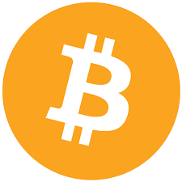
And NOT Theoretical: Android RNG Bug + Bitcoin
OS Vulnerability in 2013 Android "SecureRandom" wasn't actually secure!
Not only was it low entropy, it would occasionally return the same value multiple times
Multiple Bitcoin wallet apps on Android were affected
"Pay B Bitcoin to Bob" is signed by Alice's public key using ECDSA
Message is broadcast publicly for all to see
So you'd have cases where "Pay B to Bob" and "Pay C to Carol" were signed with the same k
So of course someone scanned for all such Bitcoin transactions

