Slide 1
Cloud Computing
Ali Ghodsi
UC Berkeley, AMPLab
alig@cs.berkeley.edu

Slide 2
Background of Cloud Computing
1990: Heyday or parallel computing, multi-processors
Cannot make computers faster, they’ll overheat, cannot make transistors smaller, etc.
Multiprocessors the only way to go
But computers continued doubling in speed
Smaller transistors, better cooling, …

Slide 3
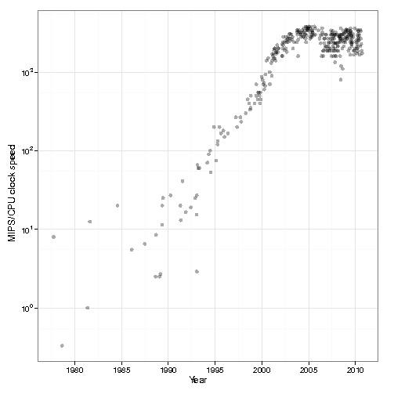
Multi-core Revolution
15-20 years later than predicted, we have hit the performance wall

Slide 4
At the same time…
Amount of stored data is exploding…

Slide 5
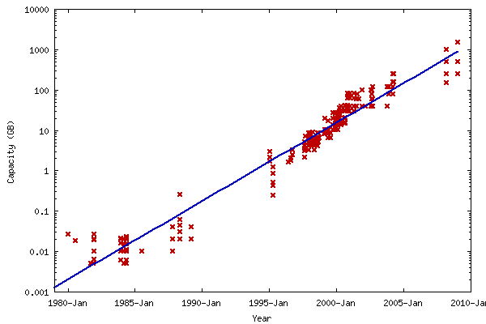
Data Deluge
Billions of users connected through the net
WWW, FB, twitter, cell phones, …
80% of the data on FB was produced last year
Storage getting cheaper
Store evermore data

Slide 6
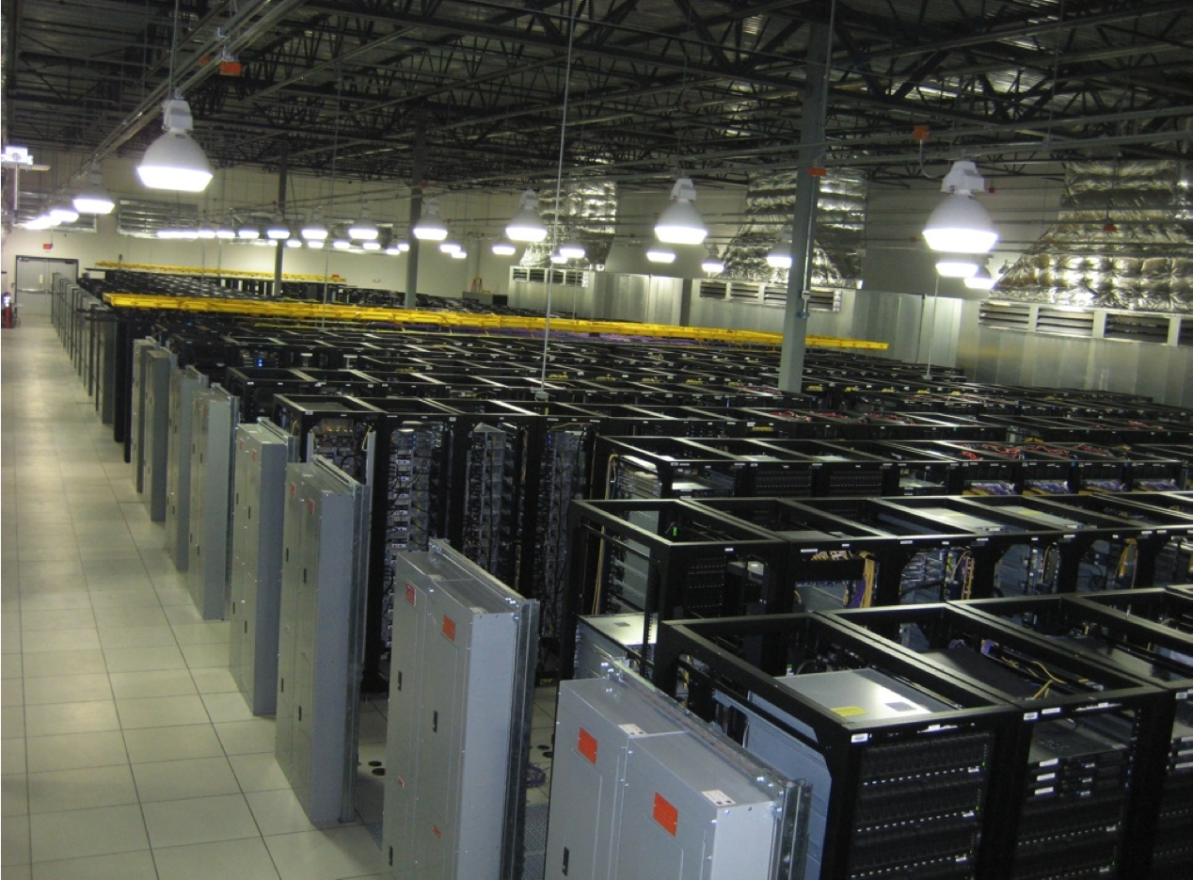
Solving the Impedance Mismatch
Computers not getting faster, drowning in data
How to resolve the dilemma?
Solution adopted by web-scale companies
Go massively distributed and parallel

Slide 7
Enter the World of Distributed Systems
Distributed Systems/Computing
Loosely coupled set of computers, communicating through message passing, solving a common goal
Distributed computing is challenging
Dealing with partial failures (examples?)
Dealing with asynchrony (examples?)
Disitributed Computing vs Parallel Computing?
distributed computing=parallel computing+partial failures
Notes:
Partial failures, network and computers
Asynchrony, network, computers,

Slide 8
Dealing with Distribution
Some tools to help distributed programming
Message Passing Interface (MPI)
Distributed Shared Memory (DSM)
Remote Procedure Calls (RPC)
RMI, WS, SOA
Distributed programming still very hard

Slide 9
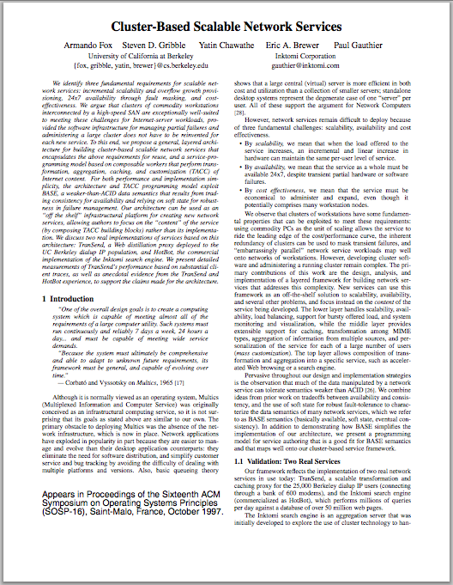
Nascent Cloud Computing
Inktomi, founded by Eric Brewer/UCB
Pioneered most of the concepts of cloud computing
First step toward an operating system for the datacenter

Slide 10
The Datacenter is the new Computer

Slide 11
Datacenter OS
If the datacenter is the new computer
what is it’s operating system?
NB: not talking of a host OS

Slide 12
Classical Operating Systems
Data sharing
IPC, files, pipes, …
Programming Abstractions
Libraries (libc), system calls, …
Multiplexing of resources
Time sharing, virtual memory, …

Slide 13
Datacenter Operating System
Data sharing
Google File System, key/value stores
Programming Abstractions
Google MapReduce, PIG, Hive, Spark
Multiplexing of resources
Mesos, YARN, ZooKeeper, BookKeeper…

Slide 14
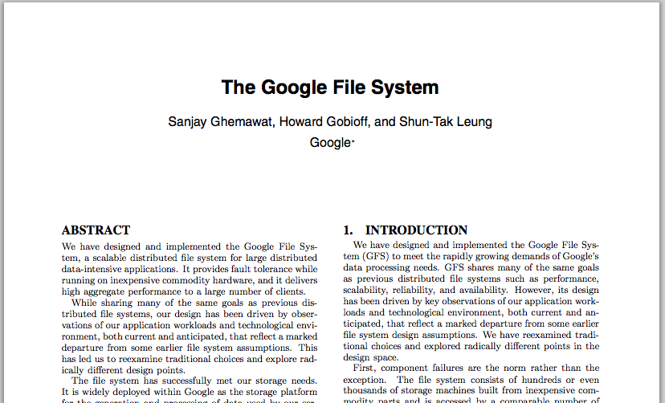
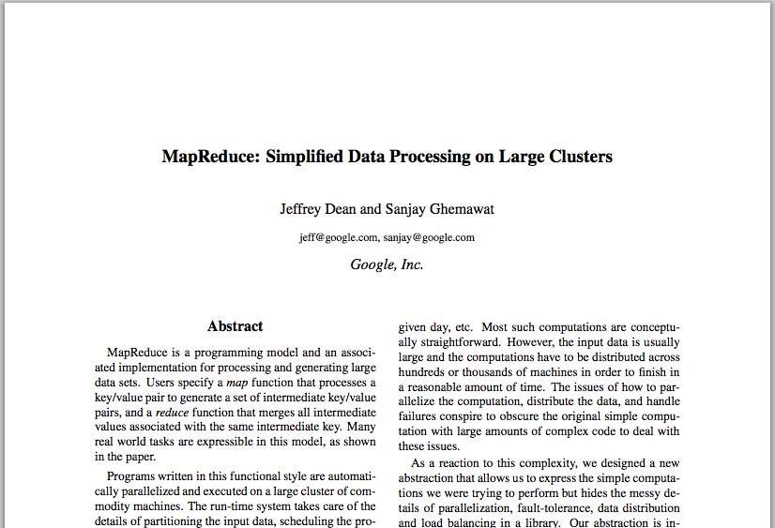
Google Cloud Infrastructure
Google File System (GFS), 2003
Distributed File System for entire cluster
Single namespace
Google MapReduce (MR), 2004
Runs queries/jobs on data
Manages work distribution & fault- tolerance
Colocated with file system
Open source versions Hadoop DFS and Hadoop MR

Slide 15
Google File System (GFS) Hadoop Distributed File System (HDFS)

Slide 16
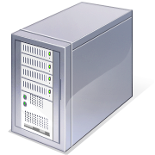
GFS/HDFS Architecture
Files split into blocks
Blocks replicated across several datanodes
Namenode stores metadata (file names, locations, etc)
Namenode
File1
1
2
3
4
Datanodes
1
2
1
3
2
1
4
2
4
3
3
4

Slide 17
GFS/HDFS Insights
Petabyte storage
Large block sizes (128 MB)
Less metadata about blocks enables centralized architecture
Big blocks allow high throughput sequential reads/writes
Data striped on hundreds/thousands of servers
Scan 100 TB on 1 node @ 50 MB/s = 24 days
Scan on 1000-node cluster = 35 minutes
Notes:
Large block: throughput, smaller metadata to central
Stripe: would take forever to read

Slide 18
GFS/HDFS Insights (2)
Failures will be the norm
Mean time between failures for 1 node = 3 years
Mean time between failures for 1000 nodes = 1 day
Use commodity hardware
Failures are the norm anyway, buy cheaper hardware
No complicated consistency models
Single writer, append-only data
Notes:
Large block: throughput, smaller metadata to central
Stripe: would take forever to read

Slide 19
MapReduce

Slide 20
MapReduce Model
Data type: key-value records
Map function:
(K_{in}, V_{in}) ➔ list(K_{inter}, V_{inter})
Group all identical K_{inter} values and pass to reducer
Reduce function:
(K_{inter}, list(V_{inter})) ➔ list(K_{out}, V_{out})

Slide 21
Example: Word Count
Input: key is filename, value is a line in input file
def mapper(file, line):
foreach word in line.split():
output(word, 1)
Intermediate: key is a word, value is 1
def reducer(key, values):
output(key, sum(values))

Slide 22
Word Count Execution
Input
Map
Shuffle & Sort
Reduce
Output
k: brown, v: [1,1]
k: fox, v: [1,1]
k: how, v: [1]
k: now, v: [1]
k: the v: [1,1,1]
the, 1
brown, 1
fox, 1
the quick
brown fox
brown, 2
fox, 2
how, 1
now, 1
the, 3
Map
quick, 1
Reduce
the, 1
fox, 1
the, 1
the fox ate the mouse
Map
ate, 1
mouse, 1
k: ate v: [1]
k: cow, v: [1]
k: mouse, v: [1]
k: quick, v: [1]
how, 1
now, 1
brown, 1
ate, 1
cow, 1
mouse, 1
quick, 1
how now
brown cow
cow, 1
Reduce
Map

Slide 23
What is MapReduce Used For?
At Google:
Index building for Google Search
Article clustering for Google News
Statistical machine translation
At Yahoo!:
Index building for Yahoo! Search
Spam detection for Yahoo! Mail
At Facebook:
Data mining
Ad optimization
Spam detection

Slide 24
MapReduce Model Insights
Restricted model
Same fine-grained operation (m & r) repeated on big data
Operations must be deterministic
Operations must have no side effects
Only communication is through the shuffle
Operation (m & r) output saved (on disk)

Slide 25
MapReduce pros
Distribution is completely transparent
Not a single line of distributed programming
Automatic fault-tolerance
Determinism enables running failed tasks somewhere else again
Saved intermediate data enables just re-running failed reducers
Notes:
Transparent: not a single line of code

Slide 26
MapReduce pros
Automatic scaling
As operations as side-effect free, they can be distributed to any number of machines dynamically
Automatic load-balancing
Move tasks and speculatively execute duplicate copies of slow tasks (stragglers)
Notes:
Transparent: not a single line of code
Scaling: can run on 1 KB file, can run on 1 PB file, can run on 1 machine, can run on 1000
Restriction: Monte-carlo simulation

Slide 27
MapReduce cons
Restricted programming model
Not always natural to express problems in
Low-level coding necessary
Little support for iterative jobs
High-latency (batch processing)
Addressed by follow-up research
Pig and Hive for high-level coding
Spark for iterative and low-latency jobs
Notes:
Expressitivity; can however do graph algos, even simulate other parallel models (PRAM and BSP

Slide 28
PIG & Hive

Slide 29
Pig
High-level language:
Expresses sequences of MapReduce jobs
Provides relational (SQL) operators (JOIN, GROUP BY, etc)
Easy to plug in Java functions
Started at Yahoo! Research
Runs about 50% of Yahoo!’s jobs

Slide 30
An Example Problem
Suppose you have user data in one file, website data in another, and you need to find the top 5 most visited pages by users aged 18-25.
Load Users
Load Pages
Filter by age
Join on name
Group on url
Count clicks
Order by clicks
Take top 5
Example from http://wiki.apache.org/pig-data/attachments/PigTalksPapers/attachments/ApacheConEurope09.ppt

Slide 31
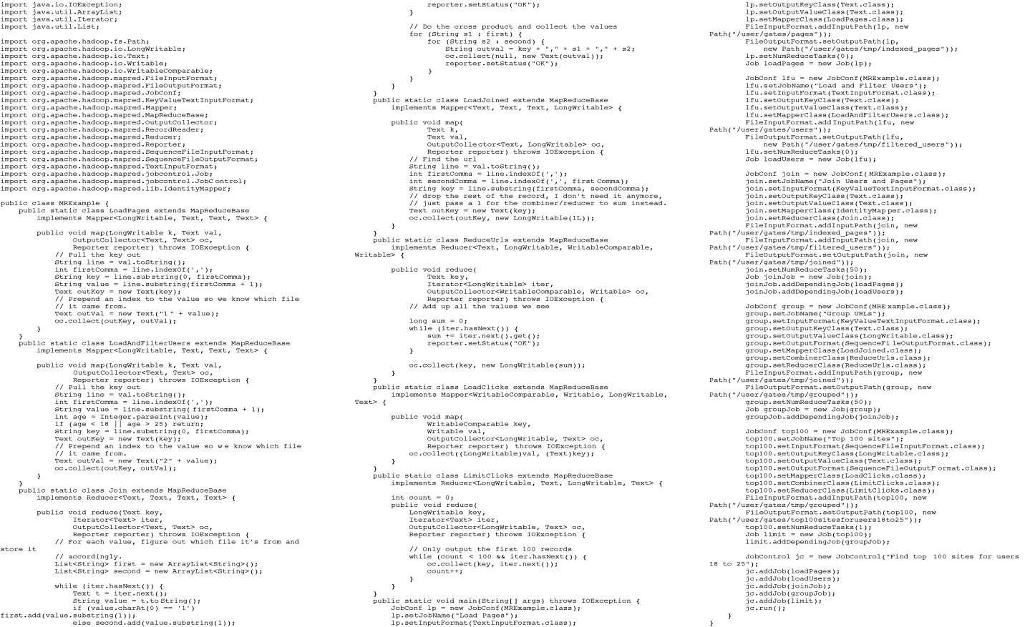
In MapReduce
Example from http://wiki.apache.org/pig-data/attachments/PigTalksPapers/attachments/ApacheConEurope09.ppt
Notes:
My point in putting in the java code isn’t too actually walk through it. It’s just to show that you have to hand code a fair amount of java. That way I can just point and say “look how much java you’d have to write to accomplish this”

Slide 32
In Pig Latin
Users = load ‘users’ as (name, age); Filtered = filter Users by age >= 18 and age <= 25; Pages = load ‘pages’ as (user, url); Joined = join Filtered by name, Pages by user; Grouped = group Joined by url; Summed = foreach Grouped generate group, count(Joined) as clicks; Sorted = order Summed by clicks desc; Top5 = limit Sorted 5;
store Top5 into ‘top5sites’;
Example from http://wiki.apache.org/pig-data/attachments/PigTalksPapers/attachments/ApacheConEurope09.ppt
Notes:
Rather than using capital letters, which makes Pig Latin look like SQL, I added Eclipse style highlighting instead. Hopefully this makes clear what are the key words without making it look like a Matisse painting.

Slide 33
Translation to MapReduce
Notice how naturally the components of the job translate into Pig Latin.
Load Users
Load Pages
Users = load … Filtered = filter … Pages = load … Joined = join … Grouped = group … Summed = … count()… Sorted = order … Top5 = limit …
Filter by age
Join on name
Group on url
Count clicks
Order by clicks
Take top 5
Example from http://wiki.apache.org/pig-data/attachments/PigTalksPapers/attachments/ApacheConEurope09.ppt
Notes:
No need to think about how many map reduce jobs this decomposes into, or connecting data flows between map reduces jobs, or even that this is taking place on top of map reduce at all.

Slide 34
Translation to MapReduce
Notice how naturally the components of the job translate into Pig Latin.
Load Users
Load Pages
Users = load … Filtered = filter … Pages = load … Joined = join … Grouped = group … Summed = … count()… Sorted = order … Top5 = limit …
Filter by age
Join on name
Job 1
Group on url
Job 2
Count clicks
Order by clicks
Job 3
Take top 5
Example from http://wiki.apache.org/pig-data/attachments/PigTalksPapers/attachments/ApacheConEurope09.ppt
Notes:
No need to think about how many map reduce jobs this decomposes into, or connecting data flows between map reduces jobs, or even that this is taking place on top of map reduce at all.

Slide 35
Hive
Relational database built on Hadoop
Maintains table schemas
SQL-like query language (which can also call Hadoop Streaming scripts)
Supports table partitioning, complex data types, sampling, some query optimization
Developed at Facebook
Used for most Facebook jobs

Slide 36
Spark

Slide 37
Spark Motivation
Complex jobs, interactive queries and online processing all need one thing that MR lacks:
Efficient primitives for data sharing
Stage 1
Stage 2
Stage 3
Query 1
Job 1
Job 2
Query 2
…
Query 3
Iterative job
Interactive mining
Stream processing

Slide 38
Spark Motivation
Complex jobs, interactive queries and online processing all need one thing that MR lacks:
Efficient primitives for data sharing
Stage 1
Stage 2
Stage 3
Query 1
Problem: in MR, only way to share data across jobs is stable storage (e.g. file system) -> slow!
Job 1
Job 2
Query 2
…
Query 3
Iterative job
Interactive mining
Stream processing

Slide 39
Examples
HDFS read
HDFS write
HDFS read
HDFS write
iter. 1
iter. 2
. . .
Input
HDFS read
query 1
result 1
query 2
result 2
query 3
result 3
Input
. . .
Notes:
Each iteration is, for example, a MapReduce job

Slide 40
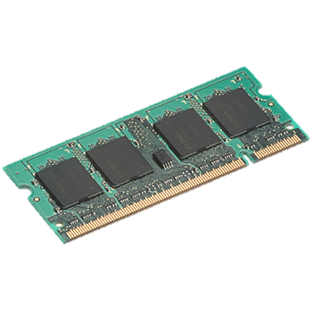
Goal: In-Memory Data Sharing
iter. 1
iter. 2
. . .
Input
query 1
one-time processing
query 2
query 3
Input
Distributed memory
. . .
10-100× faster than network and disk

Slide 41
Solution: Resilient Distributed Datasets (RDDs)
Partitioned collections of records that can be stored in memory across the cluster
Manipulated through a diverse set of transformations (map, filter, join, etc)
Fault recovery without costly replication
Remember the series of transformations that built an RDD (its lineage) to recompute lost data
www.spark-project.org

Slide 42
Mesos

Slide 43
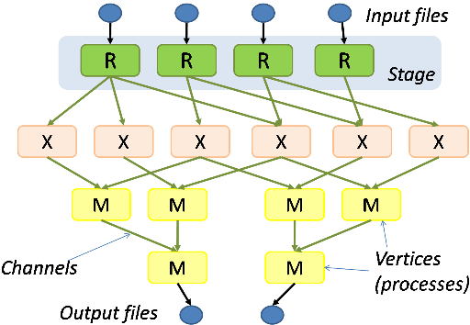
Background
Rapid innovation in cluster computing frameworks
Pregel
Pig
Ciel
Dryad
Percolator
Notes:
Just mention briefly that there are things MR and Dryad can’t do, and that there are competing implementations; perhaps also note the need to share resources with other data center services here?
The excitement surrounding cluster computing frameworks like Hadoop continues to accelerate. (e.g. EC2 Hadoop and Dryad in Azure)
Startups, enterprises, and us researchers are bursting with ideas to improve these already existing frameworks. But more importantly as we encounter the limitations of MR, we’re making a shopping list of what we want in next generation frameworks, new abstractions, programming models, even new implementations of existing models (e.g. Erlang MR called Disco).
We believe that no single framework can best facilitate this innovation, but instead that people will want to run existing and new frameworks on the same physical clusters at the same time.

Slide 44
Problem
Rapid innovation in cluster computing frameworks
No single framework optimal for all applications
Want to run multiple frameworks in a single cluster
…to maximize utilization
…to share data between frameworks
Notes:
Just mention briefly that there are things MR and Dryad can’t do, and that there are competing implementations; perhaps also note the need to share resources with other data center services here?
The excitement surrounding cluster computing frameworks like Hadoop continues to accelerate. (e.g. EC2 Hadoop and Dryad in Azure)
Startups, enterprises, and us researchers are bursting with ideas to improve these already existing frameworks. But more importantly as we encounter the limitations of MR, we’re making a shopping list of what we want in next generation frameworks, new abstractions, programming models, even new implementations of existing models (e.g. Erlang MR called Disco).
We believe that no single framework can best facilitate this innovation, but instead that people will want to run existing and new frameworks on the same physical clusters at the same time.

Slide 45
Where We Want to Go
Today: static partitioning
Mesos: dynamic sharing
Hadoop
Pregel
Shared cluster
MPI
Notes:
Say that frameworks are developed independently
Say multiple jobs -> demand varies over time
Mention this is what current schedulers do
Number of nodes can be decreased with better utilization

Slide 46
Solution
Mesos is a common resource sharing layer over which diverse frameworks can run
Hadoop
Pregel
Hadoop
Pregel
…
…
Mesos
Node
Node
Node
Node
Node
Node
Node
Node
Notes:
Before and after pics

Slide 47
Other Benefits of Mesos
Run multiple instances of the same framework
Isolate production and experimental jobs
Run multiple versions of the framework concurrently
Build specialized frameworks targeting particular problem domains
Better performance than general-purpose abstractions
Notes:
Simplify cluster management?

Slide 48
Mesos Goals
High utilization of resources
Support diverse frameworks (current & future)
Scalability to 10,000’s of nodes
Reliability in face of failures
Resulting design: Small microkernel-like core that pushes scheduling logic to frameworks
Notes:
Assumptions
Shared storage
Not all tasks require full node
Not all nodes identical
We have achieved these goals and it’s been deployed

Slide 49
Design Elements
Fine-grained sharing:
Allocation at the level of tasks within a job
Improves utilization, latency, and data locality
Resource offers:
Simple, scalable application-controlled scheduling mechanism

Slide 50
Element 1: Fine-Grained Sharing
Coarse-Grained Sharing (HPC):
Fine-Grained Sharing (Mesos):
Fw. 3
Fw. 3
Fw. 2
Fw. 1
Framework 1
Fw. 1
Fw. 2
Fw. 2
Fw. 1
Fw. 2
Fw. 1
Fw. 3
Framework 2
Fw. 3
Fw. 3
Fw. 2
Fw. 2
Fw. 3
Fw. 2
Framework 3
Fw. 1
Fw. 1
Fw. 3
Fw. 2
Storage System (e.g. HDFS)
Storage System (e.g. HDFS)
+ Improved utilization, responsiveness, data locality
Notes:
Mention short tasks

Slide 51
Element 2: Resource Offers
Option: Global scheduler
Frameworks express needs in a specification language, global scheduler matches them to resources
+ Can make optimal decisions
– Complex: language must support all framework needs
– Difficult to scale and to make robust
– Future frameworks may have unanticipated needs

Slide 52
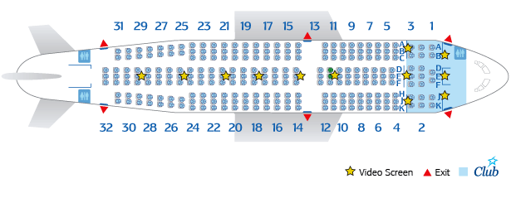
Element 2: Resource Offers
Mesos: Resource offers
Offer available resources to frameworks, let them pick which resources to use and which tasks to launch
Keeps Mesos simple, lets it support future frameworks
Decentralized decisions might not be optimal
Notes:
Still need a language for describing resources, but that’s fundamentally easier
No southwest

Slide 53
Mesos Architecture
MPI job
Hadoop job
MPI scheduler
Hadoop scheduler
Pick framework to offer resources to
Mesos
master
Allocation module
Resource offer
Mesos slave
Mesos slave
MPI executor
MPI executor
task
task

Slide 54
Mesos Architecture
MPI job
Hadoop job
MPI scheduler
Hadoop scheduler
Resource offer = list of (node, availableResources)
E.g. { (node1, <2 CPUs, 4 GB>),
(node2, <3 CPUs, 2 GB>) }
Pick framework to offer resources to
Mesos
master
Allocation module
Resource offer
Mesos slave
Mesos slave
MPI executor
MPI executor
task
task

Slide 55
Mesos Architecture
MPI job
Hadoop job
MPI scheduler
Hadoop scheduler
Framework-specific scheduling
task
Pick framework to offer resources to
Mesos
master
Allocation module
Resource offer
Mesos slave
Mesos slave
Launches and isolates executors
MPI executor
MPI executor
Hadoop executor
task
task
Notes:
Note about separation of inter-framework and intra-framework

Slide 56
Summary
Cloud computing/datacenters are the new computer
Emerging “operating system” appearing
Pieces of the OS
High-throughput filesystems (GFS/HDFS)
Job frameworks (MapReduce, Pregel)
High-level query languages (Pig, Hive)

