Slide 1
Intro to Threads
- after tying up loose ends -
David E. Culler
CS162 – Operating Systems and Systems Programming
Lecture 6
Sept 12, 2014
Reading: A&D Ch4.1-5
HW 1 due Mon 9/15
Proj 1 out next week

Slide 2
Threads Motivation
Operating systems need to be able to handle multiple things at once (MTAO)
  processes, interrupts, background system maintenance
Servers need to handle MTAO
  Multiple connections handled simultaneously
Parallel programs need to handle MTAO
  To achieve better performance
Programs with user interfaces often need to handle MTAO
  To achieve user responsiveness while doing computation
Network and disk bound programs need to handle MTAO
  To hide network/disk latency

Slide 3
Definitions
A thread is a single execution sequence that represents a separately schedulable task
Protection is an orthogonal concept
  Can have one or many threads per protection domain
  Single threaded user program: one thread, one protection domain
  Multi-threaded user program: multiple threads, sharing same data structures, isolated from other user programs
  Multi-threaded kernel: multiple threads, sharing kernel data structures, capable of using privileged instructions

Slide 4
First some Loose ends

Slide 5
Namespaces for communication
Hostname
  www.eecs.berkeley.edu
IP address
  128.32.244.172 (ipv6?)
Port Number
  0-1023 are “well known” or “system” ports
    Superuser privileges to bind to one
  1024 – 49151 are “registered” ports (registry)
    Assigned by IANA for specific services
  49152–65535 (2¹⁵+2¹⁴ to 2¹⁶−1) are “dynamic” or “private”
    Automatically allocated as “ephemeral Ports”

Slide 6
Recall: UNIX Process Management
UNIX fork – system call to create a copy of the current process, and start it running
  No arguments!
UNIX exec – system call to change the program being run by the current process
UNIX wait – system call to wait for a process to finish
UNIX signal – system call to send a notification to another process
Notes:
UNIX splits creating a process into two steps, each of them a lot simpler.

Slide 7
Signals – infloop.c
#include <stdlib.h>
#include <stdio.h>
#include <sys/types.h>
#include <unistd.h>
#include <signal.h>
void signal_callback_handler(int signum)
{
printf("Caught signal %d - phew!\n",signum);
exit(1);
}
int main() {
signal(SIGINT, signal_callback_handler);
while (1) {}
}
Got top?

Slide 8
Process races: fork.c
if (cpid > 0) {
mypid = getpid();
printf("[%d] parent of [%d]\n", mypid, cpid);
for (i=0; i<100; i++) {
printf("[%d] parent: %d\n", mypid, i);
// sleep(1);
}
} else if (cpid == 0) {
mypid = getpid();
printf("[%d] child\n", mypid);
for (i=0; i>-100; i--) {
printf("[%d] child: %d\n", mypid, i);
// sleep(1);
}
}

Slide 9
UNIX Process Management
UNIX fork – system call to create a copy of the current process, and start it running
  No arguments!
UNIX exec – system call to change the program being run by the current process
UNIX wait – system call to wait for a process to finish
UNIX signal – system call to send a notification to another process
Notes:
UNIX splits creating a process into two steps, each of them a lot simpler.

Slide 10
Signals – infloop.c
#include <stdlib.h>
#include <stdio.h>
#include <sys/types.h>
#include <unistd.h>
#include <signal.h>
void signal_callback_handler(int signum)
{
printf("Caught signal %d - phew!\n",signum);
exit(1);
}
int main() {
signal(SIGINT, signal_callback_handler);
while (1) {}
}
Got top?

Slide 11
Process races: fork.c
if (cpid > 0) {
mypid = getpid();
printf("[%d] parent of [%d]\n", mypid, cpid);
for (i=0; i<100; i++) {
printf("[%d] parent: %d\n", mypid, i);
// sleep(1);
}
} else if (cpid == 0) {
mypid = getpid();
printf("[%d] child\n", mypid);
for (i=0; i>-100; i--) {
printf("[%d] child: %d\n", mypid, i);
// sleep(1);
}
}

Slide 12
BIG OS Concepts so far
Processes
Address Space
Protection
Dual Mode
Interrupt handlers (including syscall and trap)
File System
  Integrates processes, users, cwd, protection
Key Layers: OS Lib, Syscall, Subsystem, Driver
  User handler on OS descriptors
Process control
  fork, wait, signal, exec
Communication through sockets
Client-Server Protocol

Slide 13
Course Structure: Spiral
File Systems (8)
Address Space (4)
Concurrency (6)
Reliability, Security, Cloud (8)
Distributed Systems (8)
OS Concepts (3)
intro

Slide 14
Traditional UNIX Process
Process: Operating system abstraction to represent what is needed to run a single program
  Often called a “HeavyWeight Process”
Two parts:
  Sequential program execution stream
    Code executed as a sequential stream of execution (i.e., thread)
    Includes State of CPU registers
  Protected resources:
    Main memory state (contents of Address Space)
    I/O state (i.e. file descriptors)

Slide 15
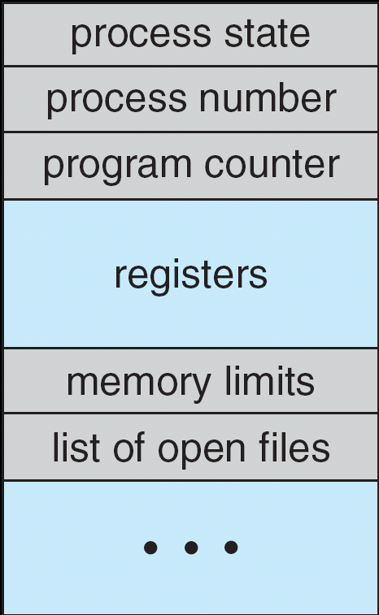
How do we Multiplex Processes?
The current state of process held in a process control block (PCB):
  This is a “snapshot” of the execution and protection environment
  Only one PCB active at a time
Give out CPU time to different processes (Scheduling):
  Only one process “running” at a time
  Give more time to important processes
Give pieces of resources to different processes (Protection):
  Controlled access to non-CPU resources
  Example mechanisms:
    Memory Mapping: Give each process their own address space
    Kernel/User duality: Arbitrary multiplexing of I/O through system calls
Process
Control
Block

Slide 16
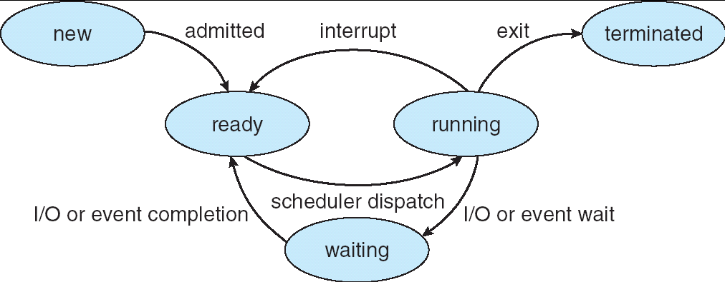
Lifecycle of a Process
As a process executes, it changes state:
  new: The process is being created
  ready: The process is waiting to run
  running: Instructions are being executed
  waiting: Process waiting for some event to occur
  terminated: The process has finished execution

Slide 17
Process Control Block
The current state of process held in a process control block (PCB): (for a single-threaded process)
Process Control Block

Slide 18
Modern Process with Threads
Thread: a sequential execution stream within process (Sometimes called a “Lightweight process”)
  Process still contains a single Address Space
  No protection between threads
Multithreading: a single program made up of a number of different concurrent activities
  Sometimes called multitasking, as in Ada …
Why separate the concept of a thread from that of a process?
  Discuss the “thread” part of a process (concurrency)
  Separate from the “address space” (protection)
  Heavyweight Process ≡ Process with one thread

Slide 19

Single and Multithreaded Processes
Threads encapsulate concurrency: “Active” component
Address spaces encapsulate protection: “Passive” part
  Keeps buggy program from trashing the system
Why have multiple threads per address space?
Notes:
Sometimes need parallelism for a single job, and processes are very expensive – to start, switch between, and to communicate between

Slide 20
Examples multithreaded programs
Embedded systems
  Elevators, Planes, Medical systems, Wristwatches
  Single Program, concurrent operations
Most modern OS kernels
  Internally concurrent because have to deal with concurrent requests by multiple users
  But no protection needed within kernel
Database Servers
  Access to shared data by many concurrent users
  Also background utility processing must be done
Notes:
DB servers very important – provide “shared data” view to users.
Many users can read/write at once – how is consistency managed?

Slide 21
Example multithreaded programs (con’t)
Network Servers
  Concurrent requests from network
  Again, single program, multiple concurrent operations
  File server, Web server, and airline reservation systems
Parallel Programming (More than one physical CPU)
  Split program into multiple threads for parallelism
  This is called Multiprocessing
Some multiprocessors are actually uniprogrammed:
  Multiple threads in one address space but one program at a time

Slide 22
Putting it together: Process
(Unix) Process
A(int tmp) {
if (tmp<2)
B();
printf(tmp);
}
B() {
C();
}
C() {
A(2);
}
A(1);
…
Memory
Stack
Resources
I/O State
(e.g., file, socket contexts)
Sequential stream of instructions
CPU state (PC, SP, registers..)
Stored in OS

Slide 23
Putting it together: Processes
Process 1
Process 2
Process N
Switch overhead: high
  CPU state: low
  Memory/IO state: high
Process creation: high
Protection
  CPU: yes
  Memory/IO: yes
Sharing overhead: high (involves at least a context switch)
Mem.
Mem.
Mem.
IO
state
IO
state
…
IO
state
CPU
state
CPU
state
CPU
state
CPU sched.
OS
1 process at a time
CPU
(1 core)

Slide 24
Putting it together: Threads
Process 1
Process N
threads
threads
Switch overhead: low (only CPU state)
Thread creation: low
Protection
  CPU: yes
  Memory/IO: No
Sharing overhead: low (thread switch overhead low)
Mem.
Mem.
…
IO
state
…
…
IO
state
CPU
state
CPU
state
CPU
state
CPU
state
CPU sched.
OS
1 thread at a time
CPU
(1 core)

Slide 25
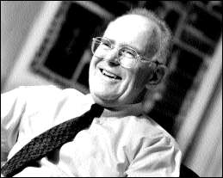
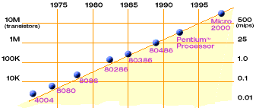
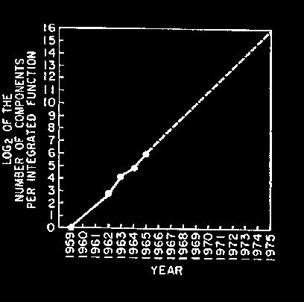
Technology Trends: Moore’s Law
Moore’s Law
2X transistors/Chip Every 1.5 years
Called “Moore’s Law”
Gordon Moore (co-founder of Intel) predicted in 1965 that the transistor density of semiconductor chips would double roughly every 18 months.
Microprocessors have become smaller, denser, and more powerful.

Slide 26
New Challenge: Slowdown in Joy’s law of Performance
3X
From Hennessy and Patterson, Computer Architecture: A Quantitative Approach, 4th edition, Sept. 15, 2006
Joy’s Law: Perf ≈ 2^{(Year-1984)} MIPS
⇒ Sea change in chip design: multiple “cores” or processors per chip
VAX : 25%/year 1978 to 1986
RISC + x86: 52%/year 1986 to 2002
RISC + x86: ??%/year 2002 to present

Slide 27
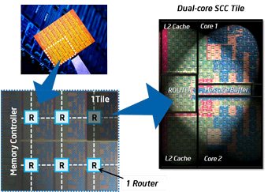
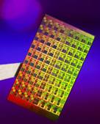
ManyCore Chips: The future is here
Intel 80-core multicore chip (Feb 2007)
  80 simple cores
  Two FP-engines / core
  Mesh-like network
  100 million transistors
Intel Single-Chip Cloud
Computer (August 2010)
  24 “tiles” with two cores/tile
  24-router mesh network
  4 DDR3 memory controllers
  Hardware support for message-passing
“ManyCore” refers to many processors/chip
  64? 128? Hard to say exact boundary
How to program these?
  Use 2 CPUs for video/audio
  Use 1 for word processor, 1 for browser
  76 for virus checking???
Parallelism must be exploited at all levels

Slide 28
Putting it together: Multi-Cores
Process 1
Process N
threads
threads
Switch overhead: low (only CPU state)
Thread creation: low
Protection
  CPU: yes
  Memory/IO: No
Sharing overhead: low (thread switch overhead low)
Mem.
Mem.
…
IO
state
…
…
IO
state
CPU
state
CPU
state
CPU
state
CPU
state
CPU sched.
OS
4 threads at a time
core 1
Core 2
Core 3
Core 4
CPU

Slide 29
Putting it together: Hyper-Threading
Process 1
Process N
threads
threads
Switch overhead between hardware-threads: very-low (done in hardware)
Contention for ALUs/FPUs may hurt performance
Mem.
Mem.
…
IO
state
…
…
IO
state
CPU
state
CPU
state
CPU
state
CPU
state
CPU sched.
OS
hardware-threads
(hyperthreading)
8 threads at a time
core 1
core 2
core 3
core 4
CPU

Slide 30
Memory Footprint: Two-Threads
If we stopped this program and examined it with a debugger, we would see
  Two sets of CPU registers
  Two sets of Stacks
Questions:
  How do we position stacks relative to
  each other?
  What maximum size should we choose
  for the stacks?
  What happens if threads violate this?
  How might you catch violations?
Stack 1
Stack 2
Address Space
Heap
Global Data
Code

Slide 31
Thread Operations
thread_fork(func, args)
  Create a new thread to run func(args)
  Pintos: thread_create
thread_yield()
  Relinquish processor voluntarily
  Pintos: thread_yield
thread_join(thread)
  In parent, wait for forked thread to exit, then return
thread_exit
  Quit thread and clean up, wake up joiner if any
  Pintos: thread_exit
http://cs162.eecs.berkeley.edu/static/lectures/code06/pthread.c

Slide 32
Thread Abstraction
Infinite number of processors
Threads execute with variable speed
  Programs must be designed to work with any schedule
Notes:
Execution model: each thread runs on a dedicated virtual processor with unpredictable and variable speed.

Slide 33
Programmer vs. Processor View

Slide 34
Possible Executions

Slide 35
Thread State
State shared by all threads in process/addr space
  Content of memory (global variables, heap)
  I/O state (file system, network connections, etc)
State “private” to each thread
  Kept in TCB ≡ Thread Control Block
  CPU registers (including, program counter)
  Execution stack – what is this?
Execution Stack
  Parameters, temporary variables
  Return PCs are kept while called procedures are executing

Slide 36
Thread Lifecycle

Slide 37
Shared vs. Per-Thread State

Slide 38
Per Thread State
Each Thread has a Thread Control Block (TCB)
  Execution State: CPU registers, program counter (PC), pointer to stack (SP)
  Scheduling info: state, priority, CPU time
  Various Pointers (for implementing scheduling queues)
  Pointer to enclosing process (PCB)
  Etc (add stuff as you find a need)
OS Keeps track of TCBs in protected memory
  In Array, or Linked List, or …

Slide 39
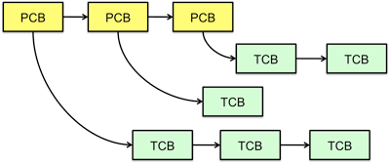
Multithreaded Processes
PCB points to multiple TCBs:
Switching threads within a block is a simple thread switch
Switching threads across blocks requires changes to memory and I/O address tables.

Slide 40
The Numbers
Context switch in Linux: 3-4 μsecs (Current Intel i7 & E5).
Thread switching faster than process switching (100 ns).
But switching across cores about 2x more expensive than within-core switching.
Context switch time increases sharply with the size of the working set*, and can increase 100x or more.
* The working set is the subset of memory used by the process in a time window.
Moral: Context switching depends mostly on cache limits and the process or thread’s hunger for memory.

Slide 41
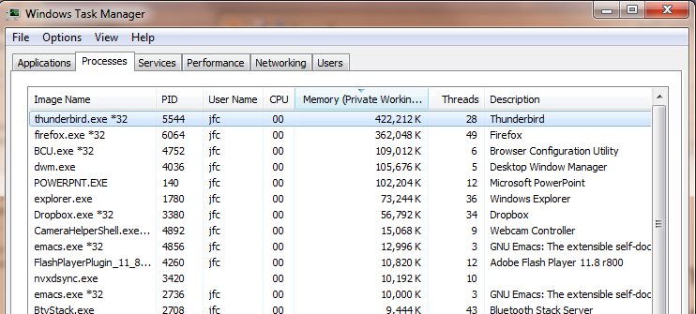
The Numbers
Many process are multi-threaded, so thread context switches may be either within-process or across-processes.

Slide 42
Threads in a Process
Threads are useful at user-level
  Parallelism, hide I/O latency, interactivity
Option A (early Java): user-level library, within a single-threaded process
  Library does thread context switch
  Kernel time slices between processes, e.g., on system call I/O
Option B (Linux, MacOS, Windows): use kernel threads
  System calls for thread fork, join, exit (and lock, unlock,…)
  Kernel does context switching
  Simple, but a lot of transitions between user and kernel mode
Option C (Windows): scheduler activations
  Kernel allocates processors to user-level library
  Thread library implements context switch
  System call I/O that blocks triggers upcall
Option D: Asynchronous I/O

Slide 43
Classification
One
Many
# of addr spaces:
# threads
Per AS:
One
MS/DOS, early Macintosh
Traditional UNIX
Many
Embedded systems (Geoworks, VxWorks, JavaOS,etc)
JavaOS, Pilot(PC)
Mach, OS/2, HP-UX, Win NT to 8, Solaris, OS X, Android, iOS
Real operating systems have either
  One or many address spaces
  One or many threads per address space

Slide 44
OS Archaeology
Because of the cost of developing an OS from scratch, most modern OSes have a long lineage:
Multics → AT&T Unix → BSD Unix → Ultrix, SunOS, NetBSD,…
Mach (micro-kernel) + BSD → NextStep → XNU →
Apple OSX, iphone iOS
Linux → Android OS
CP/M → QDOS → MS-DOS → Windows 3.1 → NT → 95 → 98 → 2000 → XP → Vista → 7 → 8 → phone → …
Linux → RedHat, Ubuntu, Fedora, Debian, Suse,…
Notes:
Multics: MIT, GE, Bell Labs, 1969
Revolutionary but “bloated” at 135kB
Famous “failures”: Multics, Mach, NextStep: innovative but too flawed to succeed.
Microsoft established itself by writing an OS to compete with CP/M which IBM couldn’t negotiate with its author. They instead bought QDOS from a small code author who had written it from the CP/M manual.
Interestingly, there were some other OSes that didn’t have such a long lineage (e.g. IBM OS/2)

Slide 45
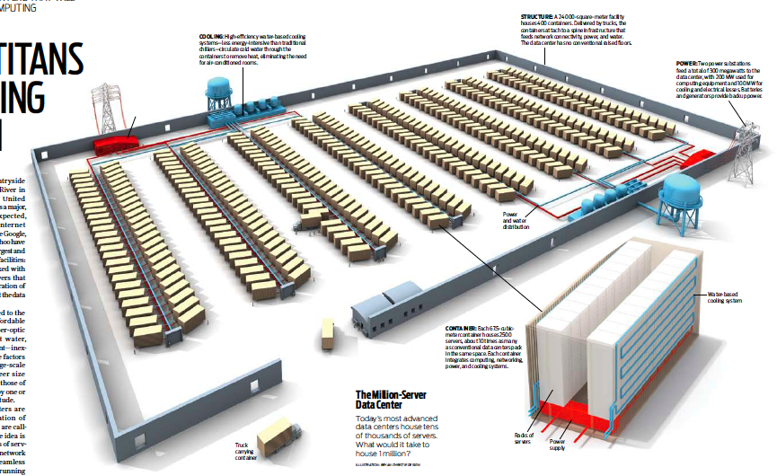
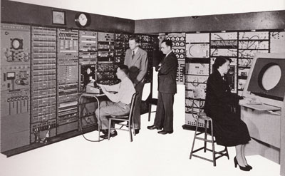

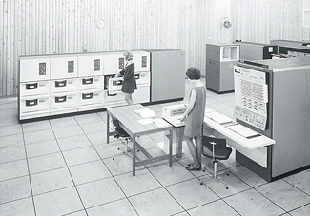
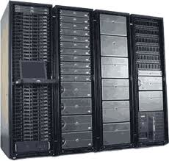
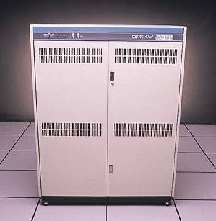
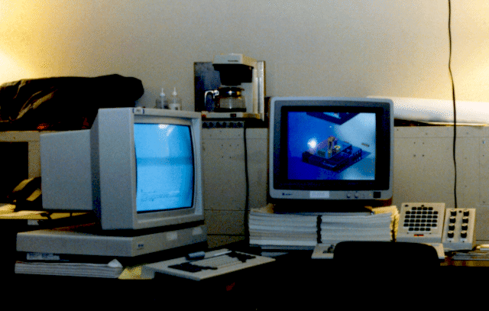

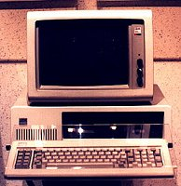





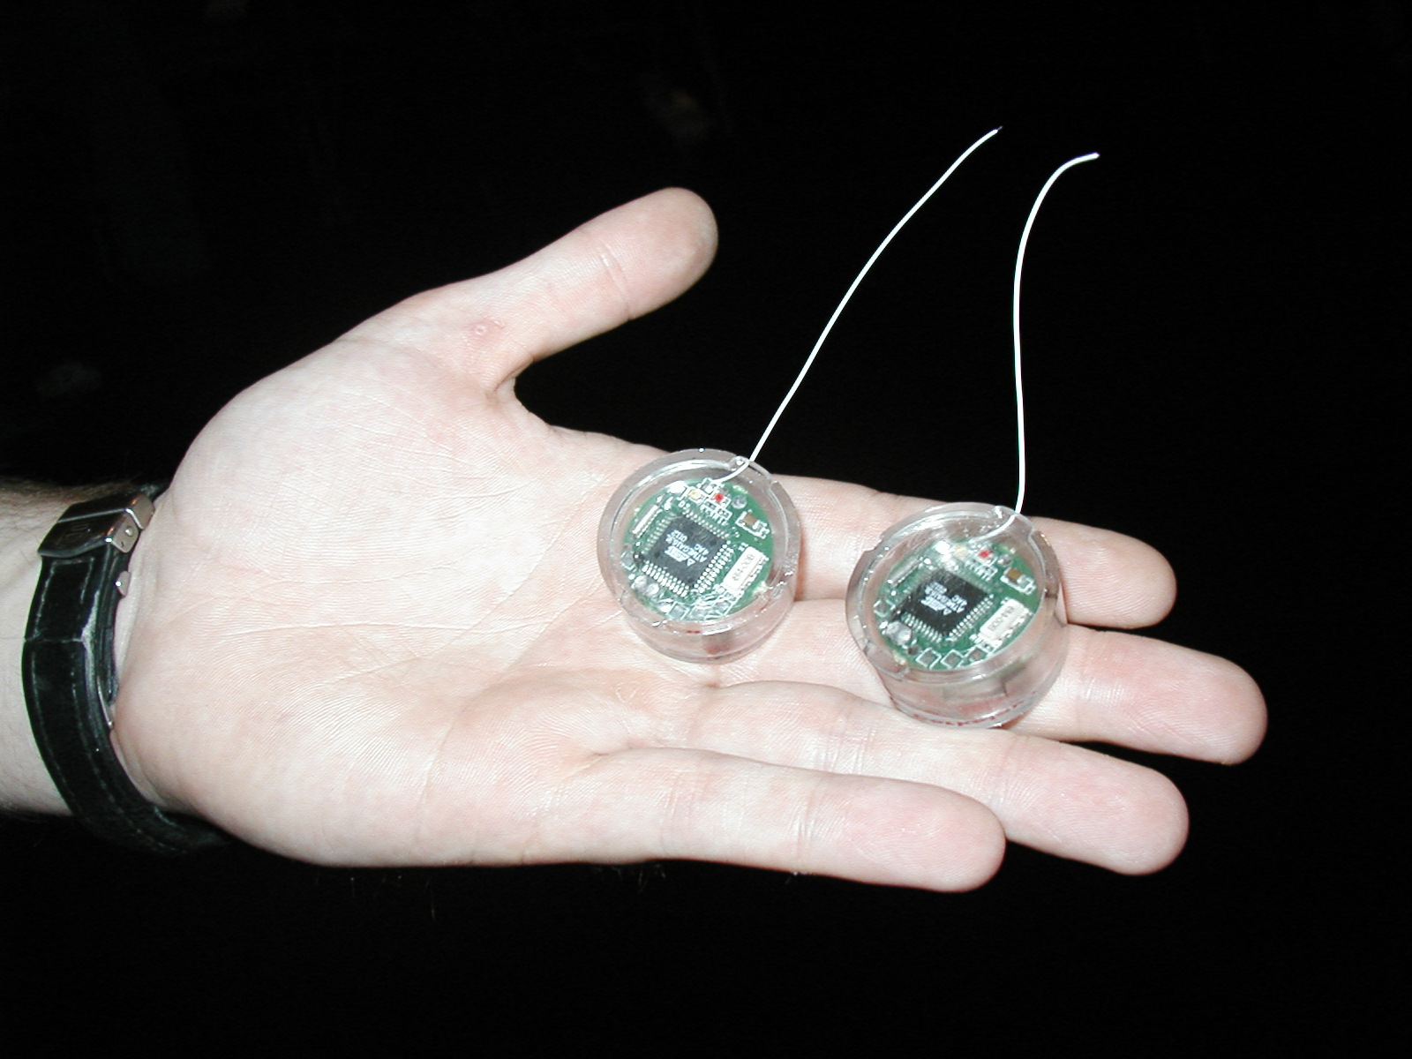
Dramatic change
Computers
Per Person
Number crunching, Data Storage, Massive Services,
Mining
1:10⁶
Mainframe
Mini
1:10³
Workstation
Productivity,
Interactive
PC
Laptop
1:1
PDA
Cell
Streaming from/to the physical world
10³:1
years
Mote!
The Internet of Things!
Bell’s Law: new computer class per 10 years

Slide 46
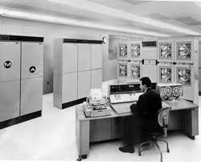
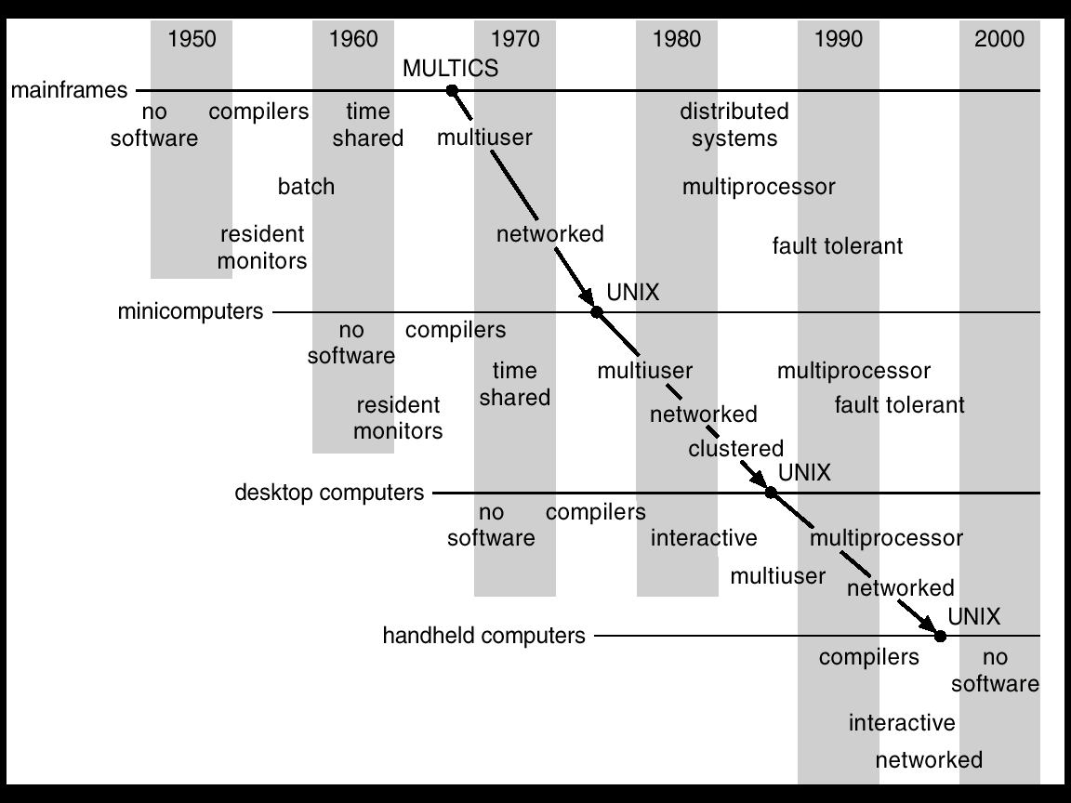
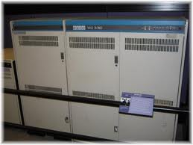
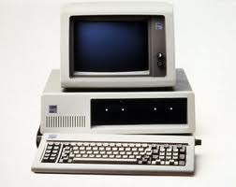
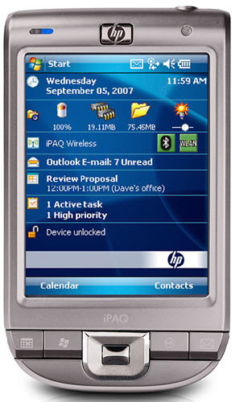
Migration of OS Concepts and Features

