Slide 1
CS162
Operating Systems and
Systems Programming
Lecture 17
Performance
Storage Devices, Queueing Theory
October 25, 2017
Prof. Ion Stoica
http://cs162.eecs.Berkeley.edu

Slide 2
Review: Basic Performance Concepts
Response Time or Latency: Time to perform an operation
Bandwidth or Throughput: Rate at which operations are performed (op/s)
  Files: NB/s, Networks: Mb/s, Arithmetic: GFLOP/s
Start up or “Overhead”: time to initiate an operation
Most I/O operations are roughly linear in n bytes
  Latency(n) = Overhead + n/Bandwidth

Slide 3
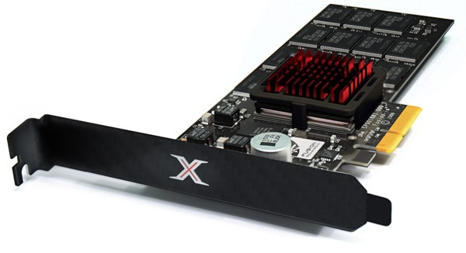
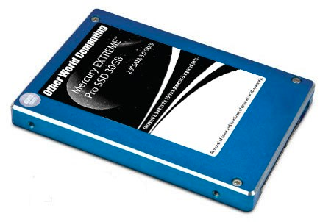
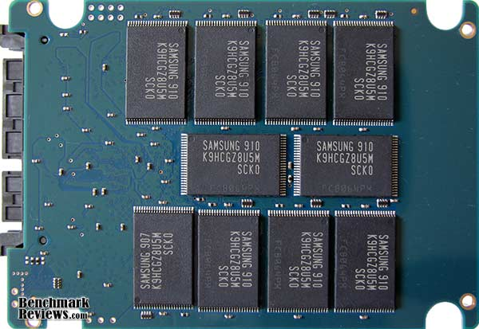
Solid State Disks (SSDs)
1995 – Replace rotating magnetic media with non-volatile memory (battery backed DRAM)
2009 – Use NAND Multi-Level Cell (2 or 3-bit/cell) flash memory
  Sector (4 KB page) addressable, but stores 4-64 “pages” per memory block
  Trapped electrons distinguish between 1 and 0
No moving parts (no rotate/seek motors)
  Eliminates seek and rotational delay (0.1-0.2ms access time)
  Very low power and lightweight
  Limited “write cycles”
Rapid advances in capacity and cost ever since!

Slide 4
SSD Architecture – Reads
NAND
NAND
NAND
NAND
NAND
NAND
NAND
NAND
Host
Buffer
Manager
(software
Queue)
Flash
Memory
Controller
NAND
NAND
NAND
NAND
SATA
NAND
NAND
NAND
NAND
NAND
NAND
NAND
NAND
DRAM
NAND
NAND
NAND
NAND
NAND
NAND
  Read 4 KB Page: ~25 usec
  No seek or rotational latency
  Transfer time: transfer a 4KB page
    SATA: 300-600MB/s => ~4 x10³ b / 400 x 10⁶ bps => 10 us
  Latency = Queuing Time + Controller time + Xfer Time
  Highest Bandwidth: Sequential OR Random reads
NAND
NAND
NAND
NAND
NAND
NAND

Slide 5
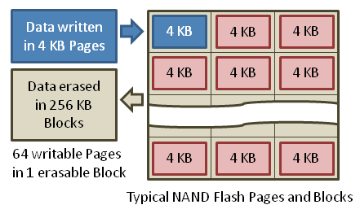
SSD Architecture – Writes
  Writing data is complex! (~200μs – 1.7ms )
  Can only write empty pages in a block
  Erasing a block takes ~1.5ms
  Controller maintains pool of empty blocks by coalescing used pages (read, erase, write), also reserves some % of capacity
Rule of thumb: writes 10x reads, erasure 10x writes
https://en.wikipedia.org/wiki/Solid-state_drive

Slide 6
Amusing calculation: is a full Kindle heavier than an empty one?
Actually, “Yes”, but not by much
Flash works by trapping electrons:
  So, erased state lower energy than written state
Assuming that:
  Kindle has 4GB flash
  ½ of all bits in full Kindle are in high-energy state
  High-energy state about 10⁻¹⁵ joules higher
  Then: Full Kindle is 1 attogram (10⁻¹⁸gram) heavier
  (Using E = mc²)
Of course, this is less than most sensitive scale can measure
(it can measure 10⁻⁹ grams)
Of course, this weight difference overwhelmed by battery discharge, weight from getting warm, ….
According to John Kubiatowicz (New York Times, Oct 24, 2011)

Slide 7
SSD Summary
Pros (vs. hard disk drives):
  Low latency, high throughput (eliminate seek/rotational delay)
  No moving parts:
    Very light weight, low power, silent, very shock insensitive
  Read at memory speeds (limited by controller and I/O bus)
Cons
  Small storage (0.1-0.5x disk), expensive (3-20x disk)
    Hybrid alternative: combine small SSD with large HDD
  Asymmetric block write performance: read pg/erase/write pg
    Controller garbage collection (GC) algorithms have major effect on performance
  Limited drive lifetime
    1-10K writes/page for MLC NAND
    Avg failure rate is 6 years, life expectancy is 9–11 years
These are changing rapidly!
No longer true!

Slide 8
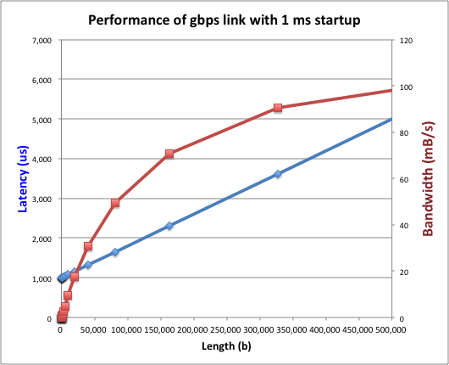
What Goes into Startup Cost for I/O?
Syscall overhead
Operating system processing
Controller Overhead
Device Startup
  Mechanical latency for a disk
  Media Access + Speed of light + Routing for network
Queuing (next topic)
Startup cost (fixed overhead)

Slide 9
I/O Performance
300
Response
Time (ms)
Controller
User
Thread
I/O
device
200
Queue
[OS Paths]
100
Response Time = Queue + I/O device service time
0
Performance of I/O subsystem
  Metrics: Response Time, Throughput
  Effective BW per op = transfer size / response time
    EffBW(n) = n / (S + n/B) = B / (1 + SB/n )
0%
100%
Throughput (Utilization)
(% total BW)
# of ops
time per op
Fixed overhead

Slide 10
I/O Performance
300
Response
Time (ms)
Controller
User
Thread
I/O
device
200
Queue
[OS Paths]
100
Response Time = Queue + I/O device service time
0
Performance of I/O subsystem
  Metrics: Response Time, Throughput
  Effective BW per op = transfer size / response time
    EffBW(n) = n / (S + n/B) = B / (1 + SB/n )
  Contributing factors to latency:
    Software paths (can be loosely modeled by a queue)
    Hardware controller
    I/O device service time
Queuing behavior:
  Can lead to big increases of latency as utilization increases
  Solutions?
0%
100%
Throughput (Utilization)
(% total BW)

Slide 11
A Simple Deterministic World
arrivals
Queue
Server
departures
T_{Q}
T_{S}
T_{A}
T_{A}
T_{A}
T_{q}
T_{S}
Assume requests arrive at regular intervals, take a fixed time to process, with plenty of time between …
Service rate (μ = 1/T_{S}) - operations per sec
Arrival rate: (λ = 1/T_{A}) - requests per second
Utilization: U = λ/μ , where λ < μ
Average rate is the complete story

Slide 12
A Ideal Linear World
Saturation
1
1
Delivered Throughput
Delivered Throughput
Empty Queue
Unbounded
0
1
0
1
Offered Load (T_{S}/T_{A})
Offered Load (T_{S}/T_{A})
Queue delay
Queue delay
time
time
What does the queue wait time look like?
  Grows unbounded at a rate ~ (T_{s}/T_{A}) till request rate subsides

Slide 13
A Bursty World
arrivals
Queue
Server
departures
T_{Q}
T_{S}
Arrivals
Q depth
Server
Requests arrive in a burst, must queue up till served
Same average arrival time, but almost all of the requests experience large queue delays
Even though average utilization is low

Slide 14
So how do we model the burstiness of arrival?
Elegant mathematical framework if you start with exponential distribution
  Probability density function of a continuous random variable with a mean of 1/λ
  f(x) = λe^{-λx}
  “Memoryless”
Likelihood of an event occurring is independent of how long we’ve been waiting
mean arrival interval (1/λ)
Lots of short arrival intervals (i.e., high instantaneous rate)
Few long gaps (i.e., low instantaneous rate)
x (λ)

Slide 15
Background: General Use of Random Distributions
Server spends variable time (T) with customers
  Mean (Average) m = Σp(T)×T
  Variance (stddev²) σ² = Σp(T)×(T-m)² = Σp(T)×T²-m²
  Squared coefficient of variance: C = σ²/m²
  Aggregate description of the distribution
Important values of C:
  No variance or deterministic ⇒ C=0
  “Memoryless” or exponential ⇒ C=1
    Past tells nothing about future
    Poisson process – purely or completely random process
    Many complex systems (or aggregates)
    are well described as memoryless
  Disk response times C ≈ 1.5 (majority seeks < average)
Mean
(m)
σ
Distribution
of service times
mean
Memoryless

Slide 16
Introduction to Queuing Theory
Controller
Arrivals
Disk
Departures
Queue
Queuing System
What about queuing time??
  Let’s apply some queuing theory
  Queuing Theory applies to long term, steady state behavior ⇒ Arrival rate = Departure rate
Arrivals characterized by some probabilistic distribution
Departures characterized by some probabilistic distribution
Notes:
Old and New Testament by Kleirock
Regret skipping as grad student

Slide 17
Little’s Law
N
arrivals
departures
λ
L
In any stable system
  Average arrival rate = Average departure rate
The average number of jobs/tasks in the system (N) is equal to arrival time / throughput (λ) times the response time (L)
  N (jobs) = λ (jobs/s) x L (s)
Regardless of structure, bursts of requests, variation in service
  Instantaneous variations, but it washes out in the average
  Overall, requests match departures

Slide 18
Example
L = 5
λ = 1
L = 5
N = 5 jobs
Jobs
0
1
2
3
4
5
6
7
8
9
10
11
12
13
14
15
16
time
A: N = λ x L
E.g., N = λ x L = 5

Slide 19
Little’s Theorem: Proof Sketch
N
arrivals
departures
λ
Job i
L(i) = response time of job i
N(t) = number of jobs in system
at time t
L
N(t)
time
L(1)
T

Slide 20
Little’s Theorem: Proof Sketch
N
arrivals
departures
λ
Job i
L(i) = response time of job i
N(t) = number of jobs in system
at time t
L
N(t)
time
T
What is the system occupancy, i.e., average
number of jobs in the system?

Slide 21
Little’s Theorem: Proof Sketch
N
arrivals
departures
λ
Job i
L(i) = response time of job i
N(t) = number of jobs in system
at time t
S(i) = L(i) * 1 = L(i)
L
S(k)
N(t)
S(2)
S(1)
time
T
S = S(1) + S(2) + … + S(k) = L(1) + L(2) + … + L(k)

Slide 22
Little’s Theorem: Proof Sketch
N
arrivals
departures
λ
Job i
L(i) = response time of job i
N(t) = number of jobs in system
at time t
S(i) = L(i) * 1 = L(i)
L
N(t)
S= area
time
T
Average occupancy (N_{avg}) = S/T

Slide 23
Little’s Theorem: Proof Sketch
N
arrivals
departures
λ
Job i
L(i) = response time of job i
N(t) = number of jobs in system
at time t
S(i) = L(i) * 1 = L(i)
L
S(k)
N(t)
S(2)
S(1)
time
T
Navg = S/T = (L(1) + … + L(k))/T

Slide 24
Little’s Theorem: Proof Sketch
N
arrivals
departures
λ
Job i
L(i) = response time of job i
N(t) = number of jobs in system
at time t
S(i) = L(i) * 1 = L(i)
L
S(k)
N(t)
S(2)
S(1)
time
T
N_{avg} = (L(1) + … + L(k))/T = (N_{total}/T)*(L(1) + … + L(k))/N_{total}

Slide 25
Little’s Theorem: Proof Sketch
N
arrivals
departures
λ
Job i
L(i) = response time of job i
N(t) = number of jobs in system
at time t
S(i) = L(i) * 1 = L(i)
L
S(k)
N(t)
S(2)
S(1)
time
T
N_{avg} = (N_{total}/T)*(L(1) + … + L(k))/N_{total} = λ_{avg} × L_{avg}

Slide 26
Little’s Theorem: Proof Sketch
N
arrivals
departures
λ
Job i
L(i) = response time of job i
N(t) = number of jobs in system
at time t
S(i) = L(i) * 1 = L(i)
L
S(k)
N(t)
S(2)
S(1)
time
T
N_{avg} = λ_{avg} × L_{avg}

Slide 27
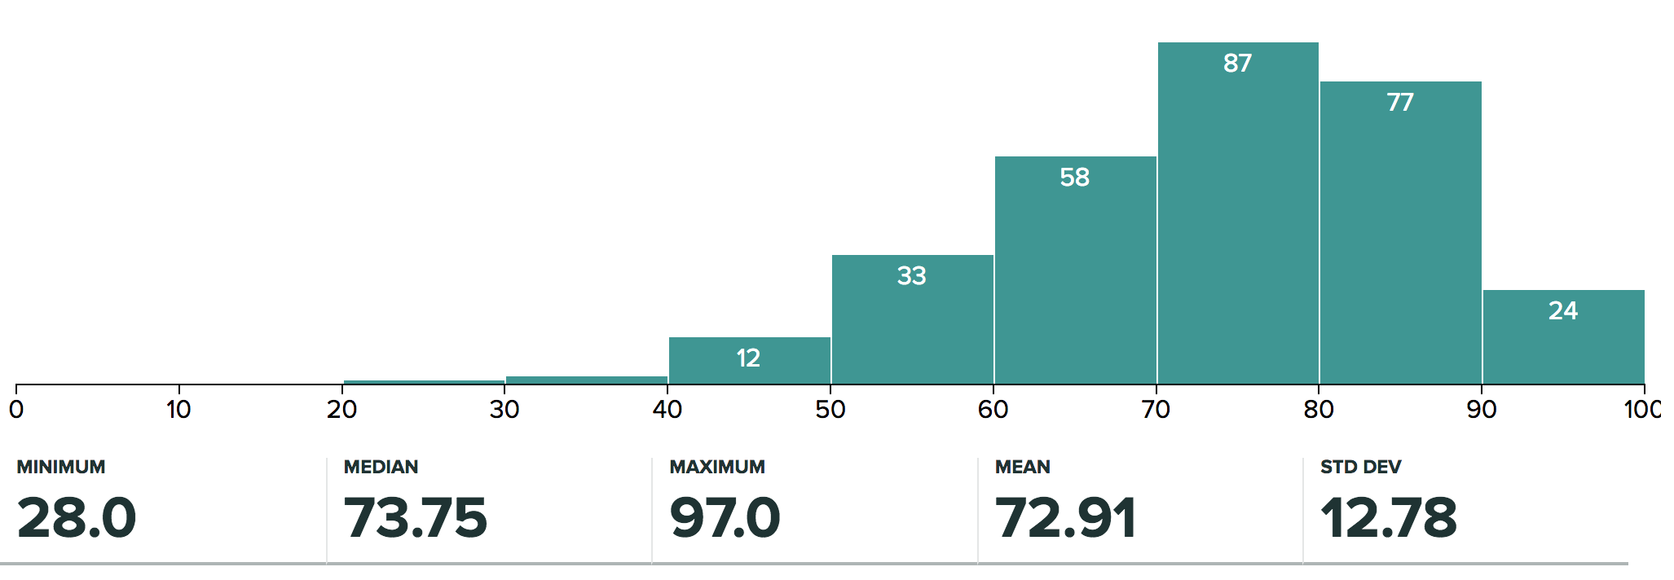
Administrivia
Regrade request deadline Tue 10/31 at midnight
  Please only submit regrade requests for grading errors!
Ion out again on Monday (attending SOSP), 10/29
  Lecture will be given by Anthony Joseph

Slide 28
break

Slide 29
A Little Queuing Theory: Some Results (1/2)
Assumptions:
  System in equilibrium; No limit to the queue
  Time between successive arrivals is random and memoryless
Parameters that describe our system:
  λ: mean number of arriving customers/second
  T_{ser}: mean time to service a customer (“m”)
  C: squared coefficient of variance = σ²/m²
  μ: service rate = 1/T_{ser}
  u: server utilization (0≤u≤1): u = λ/μ = λ × T_{ser}
Parameters we wish to compute:
  T_{q}: Time spent in queue
  L_{q}: Length of queue = λ × T_{q} (by Little’s law)
Queue
Server
Arrival Rate
λ
Service Rate
μ=1/T_{ser}

Slide 30
A Little Queuing Theory: Some Results (2/2)
Queue
Server
Arrival Rate
λ
Service Rate
μ=1/T_{ser}
Parameters that describe our system:
  λ: mean number of arriving customers/second λ= 1/T_{A}
  T_{ser}: mean time to service a customer (“m”)
  C: squared coefficient of variance = σ²/m²
  μ: service rate = 1/T_{ser}
  u: server utilization (0≤u≤1): u = λ/μ = λ × T_{ser}
Parameters we wish to compute:
  T_{q}: Time spent in queue
  L_{q}: Length of queue = λ × T_{q} (by Little’s law)
Results (M: Poisson arrival process, 1 server):
  Memoryless service time distribution (C = 1): Called an M/M/1 queue
    T_{q} = T_{ser} x u/(1 – u)
  General service time distribution (no restrictions): Called an M/G/1 queue
    T_{q} = T_{ser} x ½(1+C) x u/(1 – u))

Slide 31
A Little Queuing Theory: An Example (1/2)
Example Usage Statistics:
  User requests 10 x 8KB disk I/Os per second
  Requests & service exponentially distributed (C=1.0)
  Avg. service = 20 ms (From controller + seek + rotation + transfer)
Questions:
  How utilized is the disk (server utilization)? Ans:, u = λT_{ser}
  What is the average time spent in the queue? Ans: T_{q}
  What is the number of requests in the queue? Ans: L_{q}
  What is the avg response time for disk request? Ans: T_{sys} = T_{q} + T_{ser}

Slide 32
A Little Queuing Theory: An Example (2/2)
Questions:
  How utilized is the disk (server utilization)? Ans:, u = λT_{ser}
  What is the average time spent in the queue? Ans: T_{q}
  What is the number of requests in the queue? Ans: L_{q}
  What is the avg response time for disk request? Ans: T_{sys} = T_{q} + T_{ser}
Computation:
λ (avg # arriving customers/s) = 10/s
T_{ser} (avg time to service customer) = 20 ms (0.02s)
u (server utilization) = λ x T_{ser}= 10/s x .02s = 0.2
T_{q} (avg time/customer in queue) = T_{ser} x u/(1 – u)
= 20 x 0.2/(1-0.2) = 20 x 0.25 = 5 ms (0 .005s)
L_{q} (avg length of queue) = λ x T_{q}=10/s x .005s = 0.05s
T_{sys} (avg time/customer in system) =T_{q} + T_{ser}= 25 ms

Slide 33
Queuing Theory Resources
Resources page contains Queueing Theory Resources (under Readings):
  Scanned pages from Patterson and Hennessy book that gives further discussion and simple proof for general equation: https://cs162.eecs.berkeley.edu/static/readings/patterson_queue.pdf
  A complete website full of resources: http://web2.uwindsor.ca/math/hlynka/qonline.html
Some previous midterms with queueing theory questions
Assume that Queueing Theory is fair game for Midterm III

Slide 34
Optimize I/O Performance
300
Response
Time (ms)
Controller
User
Thread
I/O
device
200
Queue
[OS Paths]
100
Response Time = Queue + I/O device service time
How to improve performance?
  Make everything faster ☺
  More decoupled (Parallelism) systems
  Do other useful work while waiting
    Multiple independent buses or controllers
  Optimize the bottleneck to increase service rate
    Use the queue to optimize the service
Queues absorb bursts and smooth the flow
Add admission control (finite queues)
  Limits delays, but may introduce unfairness and livelock
0
0%
100%
Throughput (Utilization)
(% total BW)

Slide 35
When is Disk Performance Highest?
When there are big sequential reads, or
When there is so much work to do that they can be piggy backed (reordering queues—one moment)
OK to be inefficient when things are mostly idle
Bursts are both a threat and an opportunity
<your idea for optimization goes here>
  Waste space for speed?
Other techniques:
  Reduce overhead through user level drivers
  Reduce the impact of I/O delays by doing other useful work in the meantime

Slide 36
Disk Scheduling (1/2)
Disk can do only one request at a time; What order do you choose to do queued requests?
FIFO Order
  Fair among requesters, but order of arrival may be
  to random spots on the disk ⇒ Very long seeks
SSTF: Shortest seek time first
  Pick the request that’s closest on the disk
  Although called SSTF, today must include
  rotational delay in calculation, since
  rotation can be as long as seek
  Con: SSTF good at reducing seeks, but
  may lead to starvation
User
Requests
2,2
5,2
7,2
3,10
2,1
2,3
Head
3
Disk Head
2
1
4

Slide 37
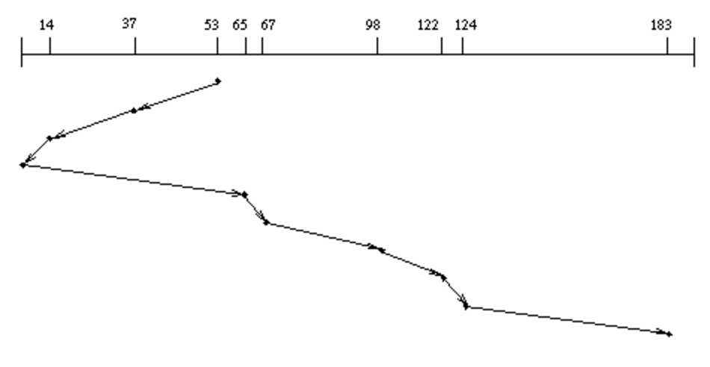
Disk Scheduling (2/2)
Disk can do only one request at a time; What order do you choose to do queued requests?
SCAN: Implements an Elevator Algorithm: take the closest request in the direction of travel
  No starvation, but retains flavor of SSTF
User
Requests
2,2
5,2
7,2
3,10
2,1
2,3
Head

Slide 38
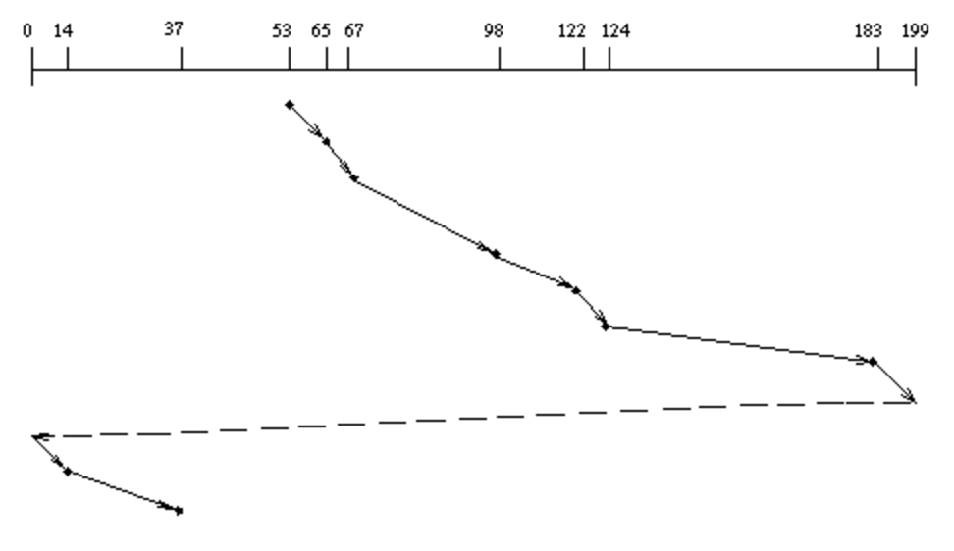
Disk Scheduling (2/2)
Disk can do only one request at a time; What order do you choose to do queued requests?
C-SCAN: Circular-Scan: only goes in one direction
  Skips any requests on the way back
  Fairer than SCAN, not biased towards pages in middle
User
Requests
2,2
5,2
7,2
3,10
2,1
2,3
Head

Slide 39
Summary
Disk Performance:
  Queuing time + Controller + Seek + Rotational + Transfer
  Rotational latency: on average ½ rotation
  Transfer time: spec of disk depends on rotation speed and bit storage density
Devices have complex interaction and performance characteristics
  Response time (Latency) = Queue + Overhead + Transfer
    Effective BW = BW * T/(S+T)
  HDD: Queuing time + controller + seek + rotation + transfer
  SDD: Queuing time + controller + transfer (erasure & wear)
Systems (e.g., file system) designed to optimize performance and reliability
  Relative to performance characteristics of underlying device
Bursts & High Utilization introduce queuing delays
Queuing Latency:
  M/M/1 and M/G/1 queues: simplest to analyze
  As utilization approaches 100%, latency → ∞
  T_{q} = T_{ser} x ½(1+C) x u/(1 – u))

