Slide 1
CS162
Operating Systems and
Systems Programming
Lecture 19
File Systems (Con’t),
MMAP
October 1st, 2017
Prof. Ion Stoica
http://cs162.eecs.Berkeley.edu

Slide 2
So What About a “Real” File System?
Meet the inode:
file_number

Slide 3
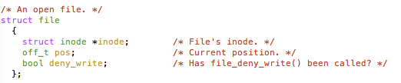
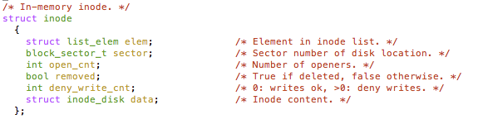
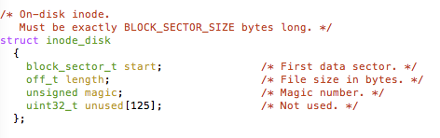
An “Almost Real” File System
Pintos: src/filesys/file.c, inode.c
file_number

Slide 4
Unix File System (1/2)
Original inode format appeared in BSD 4.1
  Berkeley Standard Distribution Unix
  Part of your heritage!
  Similar structure for Linux Ext2/3
File Number is index into inode arrays
Multi-level index structure
  Great for little and large files
  Asymmetric tree with fixed sized blocks

Slide 5
Unix File System (2/2)
Metadata associated with the file
  Rather than in the directory that points to it
UNIX Fast File System (FFS) BSD 4.2 Locality Heuristics:
  Block group placement
  Reserve space
Scalable directory structure

Slide 6
File Attributes
inode metadata
User
Group
9 basic access control bits
- UGO x RWX
Setuid bit
- execute at owner permissions
rather than user
Setgid bit
- execute at group’s permissions

Slide 7
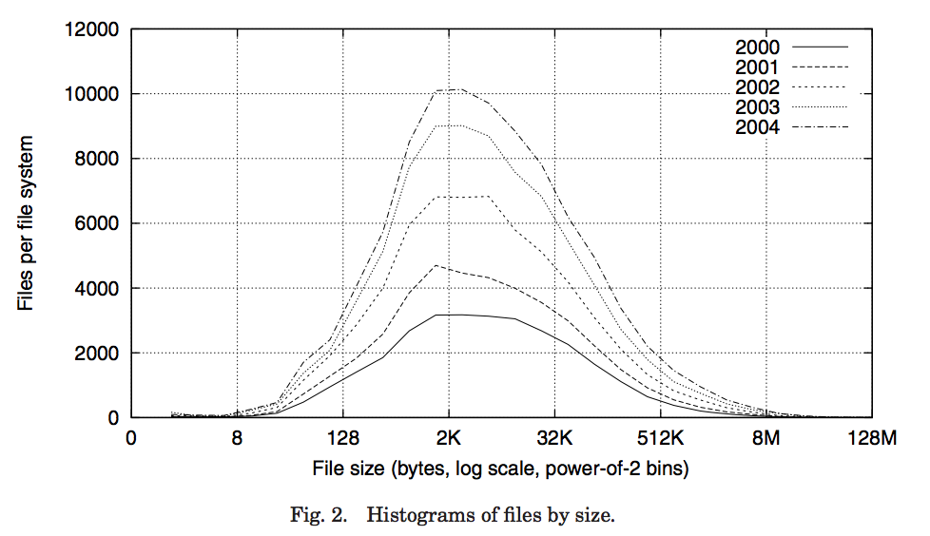
Data Storage
Small files: 12 pointers direct to data blocks
Direct pointers
4kB blocks ⇒ sufficient for files up to 48KB

Slide 8
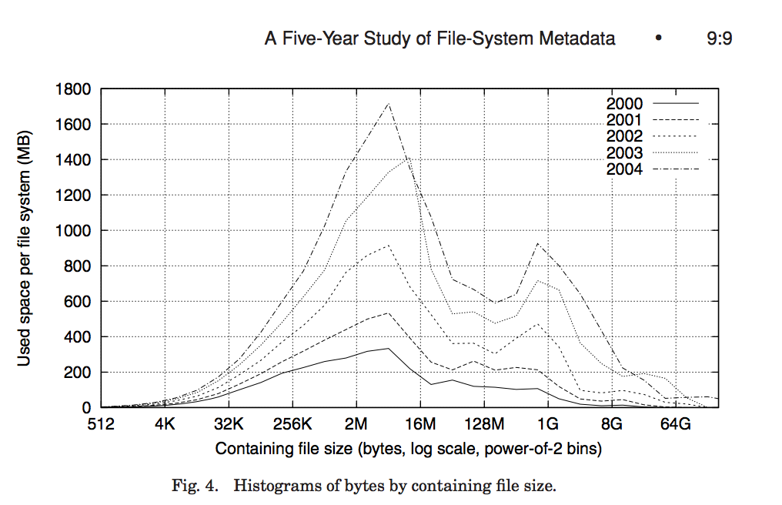
Data Storage
Large files: 1,2,3 level indirect pointers
Indirect pointers
- point to a disk block
containing only pointers
- 4 kB blocks => 1024 ptrs
=> 4 MB @ level 2
=> 4 GB @ level 3
=> 4 TB @ level 4
48 KB
+4 MB
+4 GB
+4 TB

Slide 9
UNIX BSD 4.2 (1984) (1/2)
Same as BSD 4.1 (same file header and triply indirect blocks), except incorporated ideas from Cray Operating System:
  Uses bitmap allocation in place of freelist
  Attempt to allocate files contiguously
  10% reserved disk space
  Skip-sector positioning (mentioned later)

Slide 10
UNIX BSD 4.2 (1984) (2/2)
Problem: When create a file, don’t know how big it will become (in UNIX, most writes are by appending)
  How much contiguous space do you allocate for a file?
  In BSD 4.2, just find some range of free blocks
    Put each new file at the front of different range
    To expand a file, you first try successive blocks in bitmap, then choose new range of blocks
  Also in BSD 4.2: store files from same directory near each other
Fast File System (FFS)
  Allocation and placement policies for BSD 4.2

Slide 11
Attack of the Rotational Delay
Problem 2: Missing blocks due to rotational delay
  Issue: Read one block, do processing, and read next block. In meantime, disk has continued turning: missed next block! Need 1 revolution/block!
  Solution1: Skip sector positioning (“interleaving”)
    Place the blocks from one file on every other block of a track: give time for processing to overlap rotation
    Can be done by OS or in modern drives by the disk controller
Skip Sector
Track Buffer
(Holds complete track)

Slide 12
Attack of the Rotational Delay
Problem 2: Missing blocks due to rotational delay
  Issue: Read one block, do processing, and read next block. In meantime, disk has continued turning: missed next block! Need 1 revolution/block!
  Solution 2: Read ahead: read next block right after first, even if application hasn’t asked for it yet
    This can be done either by OS (read ahead)
    By disk itself (track buffers) - many disk controllers have internal RAM that allows them to read a complete track
Note: Modern disks + controllers do many things “under the covers”
  Track buffers, elevator algorithms, bad block filtering
Skip Sector
Track Buffer
(Holds complete track)

Slide 13
Where are inodes Stored?
In early UNIX and DOS/Windows’ FAT file system, headers stored in special array in outermost cylinders
Header not stored anywhere near the data blocks
  To read a small file, seek to get header, seek back to data
Fixed size, set when disk is formatted
  At formatting time, a fixed number of inodes are created
  Each is given a unique number, called an “inumber”

Slide 14
Where are inodes Stored?
Later versions of UNIX moved the header information to be
closer to the data blocks
  Often, inode for file stored in same “cylinder group” as parent directory of the file (makes an ls of that directory run fast)
Pros:
  UNIX BSD 4.2 puts bit of file header array on many cylinders
  For small directories, can fit all data, file headers, etc. in same cylinder ⇒ no seeks!
  File headers much smaller than whole block (a few hundred bytes), so multiple headers fetched from disk at same time
  Reliability: whatever happens to the disk, you can find many of the files (even if directories disconnected)
Part of the Fast File System (FFS)
  General optimization to avoid seeks

Slide 15
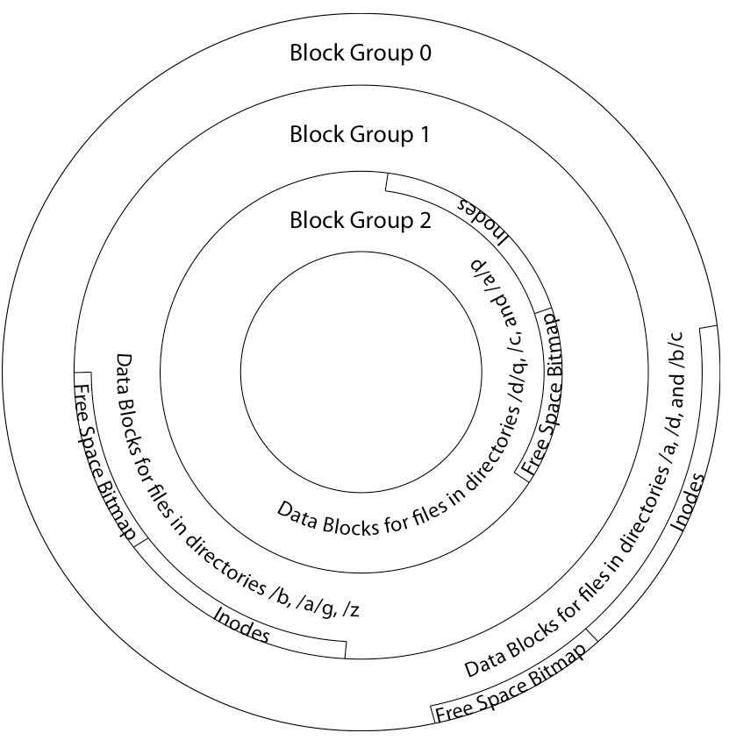
4.2 BSD Locality: Block Groups
File system volume is divided into a set of block groups
  Close set of tracks
Data blocks, metadata, and free space
interleaved within block group
  Avoid huge seeks between
  user data and system structure
Put directory and its files in
common block group

Slide 16
4.2 BSD Locality: Block Groups
First-Free allocation of new
file blocks
  To expand file, first try
  successive blocks in bitmap, then
  choose new range of blocks
  Few little holes at start, big
  sequential runs at end of group
  Avoids fragmentation
  Sequential layout for big files
Important: keep 10% or more free!
  Reserve space in the Block Group

Slide 17
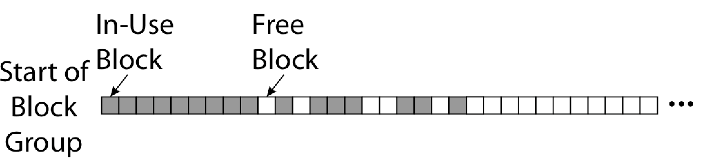
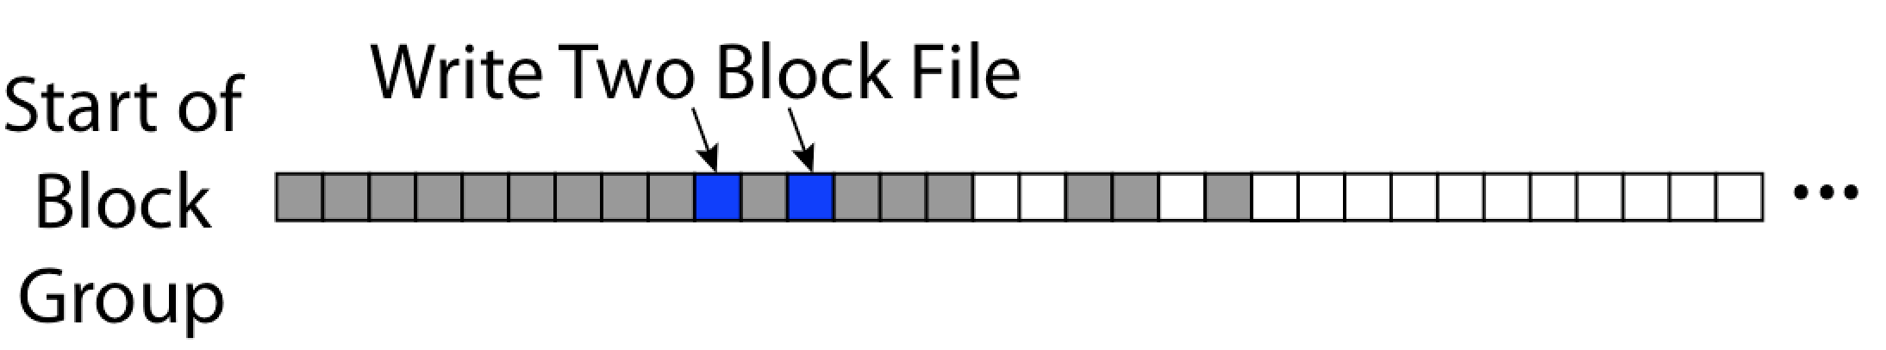
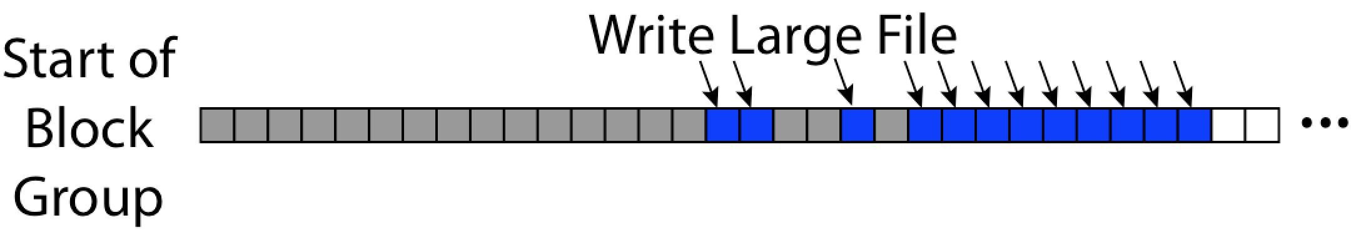
UNIX 4.2 BSD FFS First Fit Block Allocation
Fills in the small holes at the start of block group
Avoids fragmentation, leaves contiguous free space at end

Slide 18
UNIX 4.2 BSD FFS
Pros
  Efficient storage for both small and large files
  Locality for both small and large files
  Locality for metadata and data
  No defragmentation necessary!
Cons
  Inefficient for tiny files (a 1 byte file requires both an inode and a data block)
  Inefficient encoding when file is mostly contiguous on disk
  Need to reserve 10-20% of free space to prevent fragmentation

Slide 19
break

Slide 20
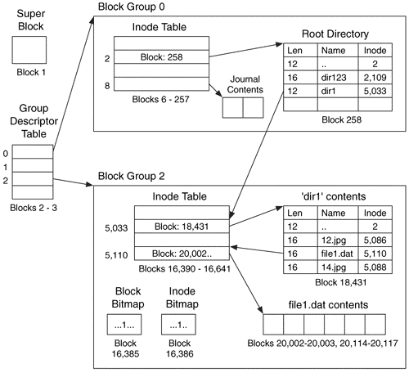
Linux Example: Ext2/3 Disk Layout
Disk divided into block groups
  Provides locality
  Each group has two block-sized bitmaps (free blocks/inodes)
  Block sizes settable
  at format time:
  1K, 2K, 4K, 8K…
Actual inode structure similar to 4.2 BSD
  with 12 direct pointers
Ext3: Ext2 with Journaling
  Several degrees of protection with comparable overhead
Example: create a file1.dat
under /dir1/ in Ext3

Slide 21
A bit more on directories
Stored in files, can be read, but typically don’t
  System calls to access directories
  open / creat traverse the structure
  mkdir /rmdir add/remove entries
  link / unlink (rm)
    Link existing file to a directory
      Not in FAT !
    Forms a DAG
When can file be deleted?
  Maintain ref-count of links to the file
  Delete after the last reference is gone
libc support
  DIR * opendir (const char *dirname)
  struct dirent * readdir (DIR *dirstream)
  int readdir_r (DIR *dirstream, struct dirent *entry,
  struct dirent **result)
/usr
/usr/lib
/usr/lib4.3
/usr/lib/foo
/usr/lib4.3/foo

Slide 22
Links
Hard link
  Sets another directory entry to contain the file number for the file
  Creates another name (path) for the file
  Each is “first class”
Soft link or Symbolic Link or Shortcut
  Directory entry contains the path and name of the file
  Map one name to another name

Slide 23
Large Directories: B-Trees (dirhash)
in FreeBSD, NetBSD, OpenBSD

Slide 24
NTFS
New Technology File System (NTFS)
  Default on Microsoft Windows systems
Variable length extents
  Rather than fixed blocks
Everything (almost) is a sequence of <attribute:value> pairs
  Meta-data and data
Mix direct and indirect freely
Directories organized in B-tree structure by default

Slide 25
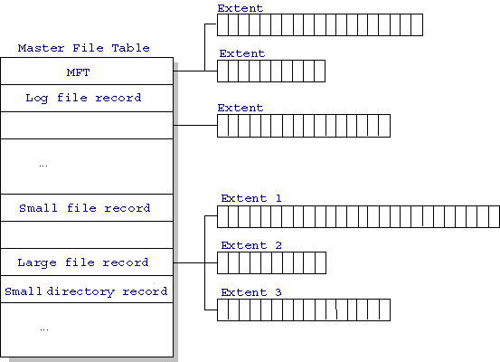
NTFS
Master File Table
  Database with Flexible 1KB entries for metadata/data
  Variable-sized attribute records (data or metadata)
  Extend with variable depth tree (non-resident)
Extents – variable length
contiguous regions
  Block pointers cover
  runs of blocks
  Similar approach in
  Linux (ext4)
  File create can provide
  hint as to size of file
Journaling for reliability
  Discussed later
http://ntfs.com/ntfs-mft.htm

Slide 26
NTFS Small File
Create time, modify time, access time,
Owner id, security specifier, flags (RO, hidden, sys)
data attribute
Attribute list

Slide 27
NTFS Medium File

Slide 28
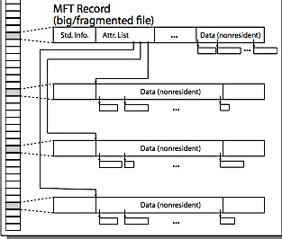
NTFS Multiple Indirect Blocks

Slide 30
Memory Mapped Files
Traditional I/O involves explicit transfers between buffers in process address space to/from regions of a file
  This involves multiple copies into caches in memory, plus system calls
What if we could “map” the file directly into an empty region of our address space
  Implicitly “page it in” when we read it
  Write it and “eventually” page it out
Executable files are treated this way when we exec the process!!

Slide 31
Recall: Who Does What, When?
Process
virtual address
physical address
MMU
page#
PT
instruction
frame#
retry
page fault
offset
exception
frame#
Operating System
offset
update PT entry
Page Fault Handler
load page from disk
scheduler

Slide 32
Using Paging to mmap() Files
Process
virtual address
physical address
MMU
page#
PT
instruction
frame#
offset
retry
page fault
exception
Read File contents
from memory!
Operating System
Create PT entries
for mapped region
as “backed” by file
Page Fault Handler
File
scheduler
mmap() file to region of VAS

Slide 33
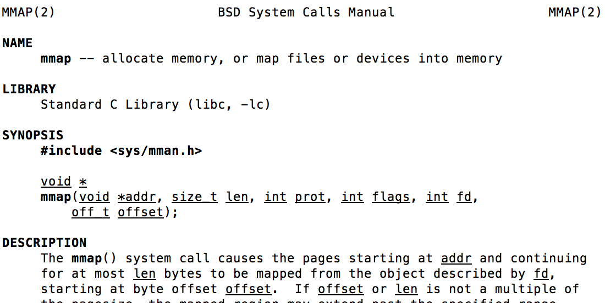
mmap() system call
May map a specific region or let the system find one for you
  Tricky to know where the holes are
Used both for manipulating files and for sharing between processes

Slide 34
An mmap() Example
#include <sys/mman.h> /* also stdio.h, stdlib.h, string.h, fcntl.h, unistd.h */
int something = 162;
int main (int argc, char *argv[]) {
int myfd;
char *mfile;
printf("Data at: %16lx\n", (long unsigned int) &something);
printf("Heap at : %16lx\n", (long unsigned int) malloc(1));
printf("Stack at: %16lx\n", (long unsigned int) &mfile);
/* Open the file */
myfd = open(argv[1], O_RDWR | O_CREAT);
if (myfd < 0) { perror("open failed!");exit(1); }
/* map the file */
mfile = mmap(0, 10000, PROT_READ|PROT_WRITE, MAP_FILE|MAP_SHARED, myfd, 0);
if (mfile == MAP_FAILED) {perror("mmap failed"); exit(1);}
printf("mmap at : %16lx\n", (long unsigned int) mfile);
puts(mfile);
strcpy(mfile+20,"Let's write over it");
close(myfd);
return 0;
}
$ ./mmap test
Data at: 105d63058
Heap at : 7f8a33c04b70
Stack at: 7fff59e9db10
mmap at : 105d97000
This is line one
This is line two
This is line three
This is line four
$ cat test
This is line one
ThiLet's write over its line three
This is line four

Slide 35
File System Summary (1/2)
File System:
  Transforms blocks into Files and Directories
  Optimize for size, access and usage patterns
  Maximize sequential access, allow efficient random access
  Projects the OS protection and security regime (UGO vs ACL)
File defined by header, called “inode”
Naming: translating from user-visible names to actual sys resources
  Directories used for naming for local file systems
  Linked or tree structure stored in files
Multilevel Indexed Scheme
  inode contains file info, direct pointers to blocks, indirect blocks, doubly indirect, etc..
  NTFS: variable extents not fixed blocks, tiny files data is in header

Slide 36
File System Summary (2/2)
4.2 BSD Multilevel index files
  Inode contains ptrs to actual blocks, indirect blocks, double indirect blocks, etc.
  Optimizations for sequential access: start new files in open ranges of free blocks, rotational optimization
File layout driven by freespace management
  Integrate freespace, inode table, file blocks and dirs into block group
Deep interactions between mem management, file system, sharing
  mmap(): map file or anonymous segment to memory

