Slide 1
Welcome to CS162
David E. Culler
CS162 – Operating Systems and Systems Programming
http://cs162.eecs.berkeley.edu/
Lecture 1
August 29, 2019
Overflow Lecture 8/30 @ 2:00 in 306 Soda
Read A&D Ch1
HW0 out, due 9/6

Slide 2

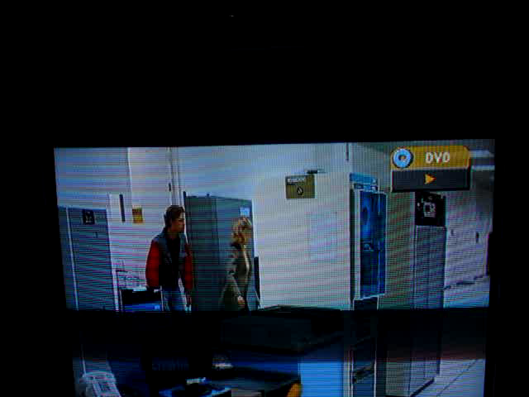
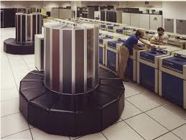

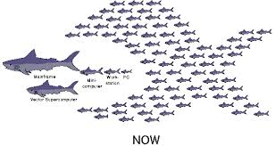
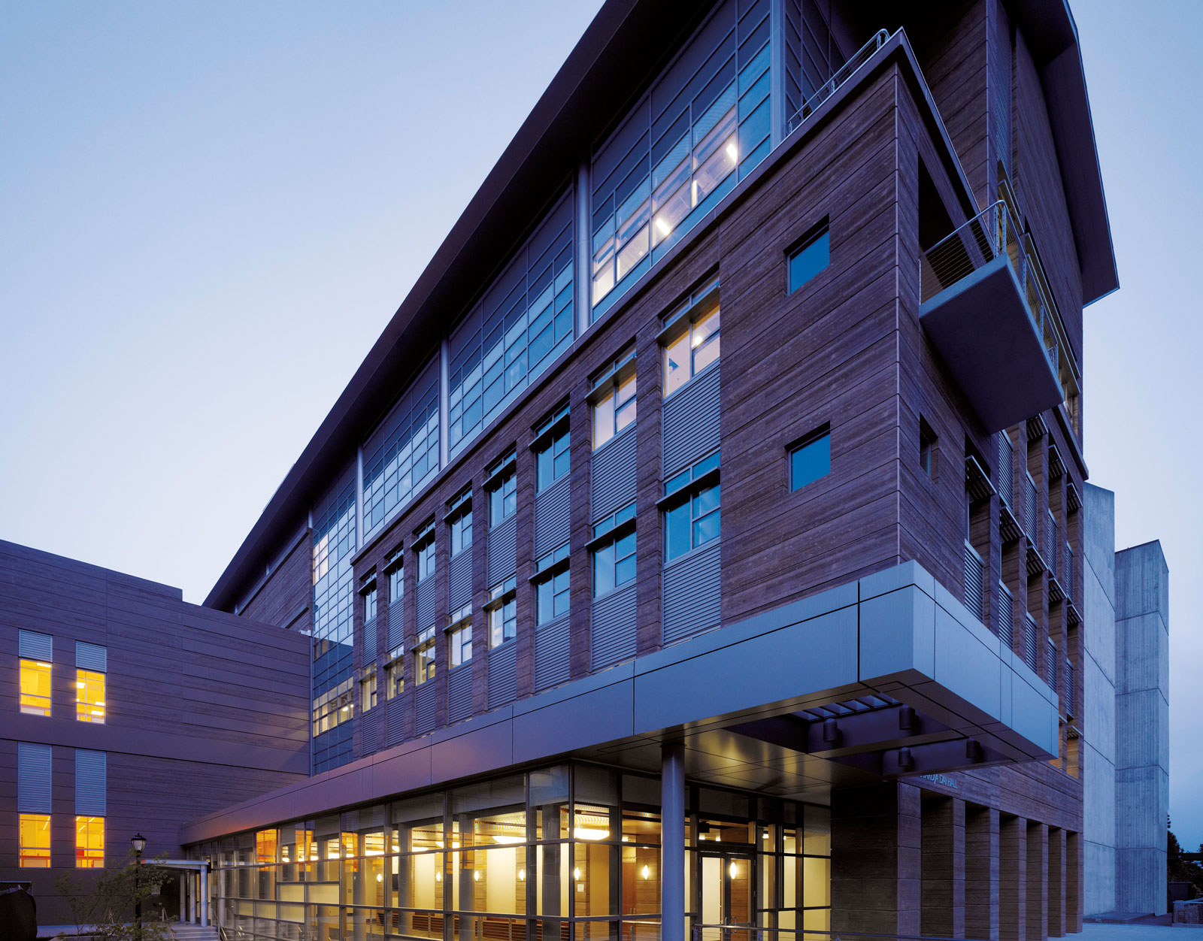
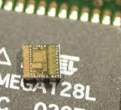
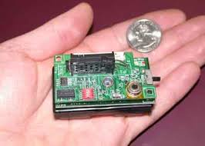
Introducing the CS162 Team - me
David Culler (culler@berkeley.edu)
  783 Soda Hall
  http://www.cs.berkeley.edu/~culler
  Office hours: M 2-3, Tu 3:30-5, W 1-2
  Before/after class
Extreme Systems
  Cray Time Sharing System
  OS386, OS286
  Active Messages
  Massive Clusters for Internet Services
  TinyOS / Berkeley Motes (IoT)
  BOSS – OS for the Built Environment

Slide 3
Your TAs / Mentors
Jack Kolb
jkolb@cs.berkeley.edu
Sam Kumar
samkumar@cs.berkeley.edu
Varsha Ramakrishnan
vio@berkeley.edu
Nicholas Riasanovsky
njriasanovsky@berkeley.edu
Annie Ro
anniero@berkeley.edu
Alan Ton
alanton@berkeley.edu
William Walker
wewalker@berkeley.edu
Sharie Wang
sharie@berkeley.edu
William Wang
hwang97@berkeley.edu
Alexander Wu
alexanderwu@berkeley.edu
Yi Zhao
yi@berkeley.edu

Slide 4
Today’s Objectives
Introduce you to Operating Systems & Their Design
Introduce the CS162 instructional team & Plan
Establish expectations and logistics
Maybe get a little excited about how OS is so essential in creating and advancing this “connected world” …

Slide 5
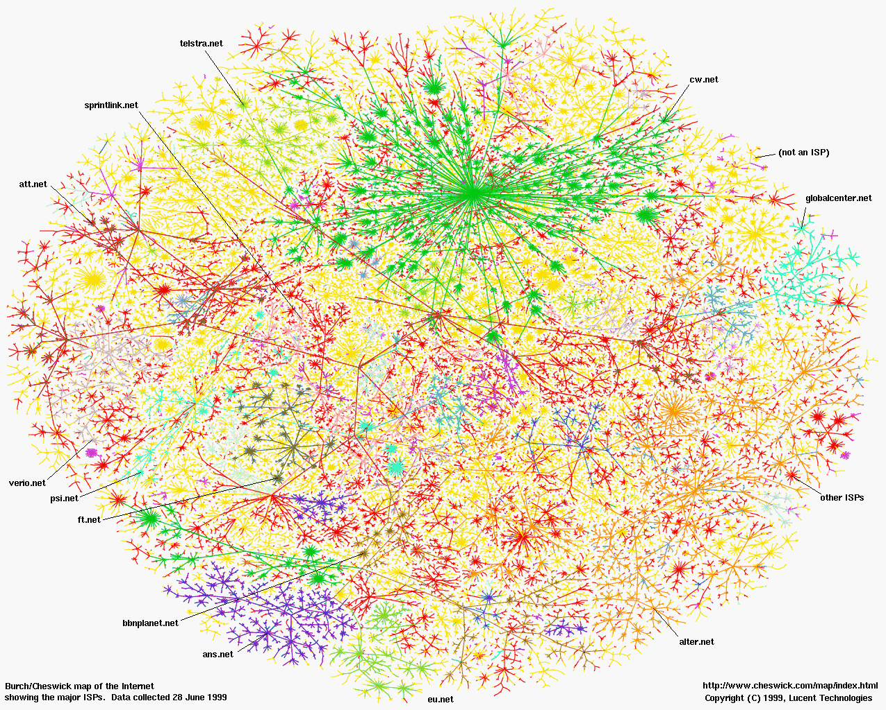
Most Transformative Artifact of Human Civilization …

Slide 6

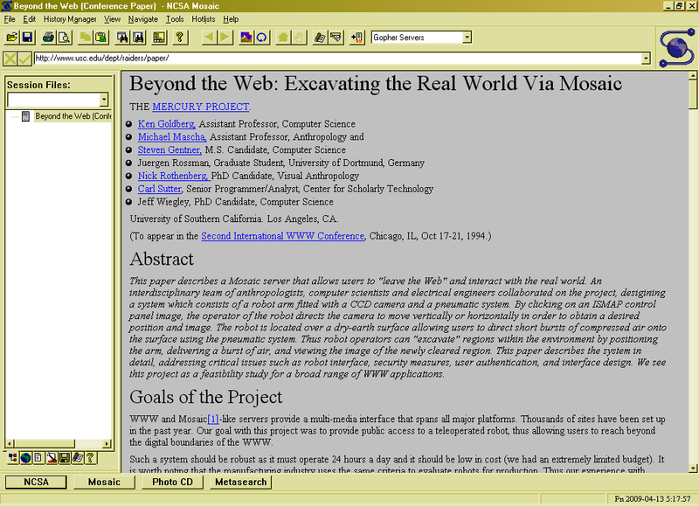
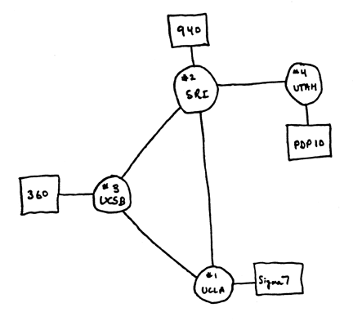
ARPANet
Internet
WWW
RFC 675 TCP/IP
HTTP 0.9
2.0 B 1/26/11
1969
1974
1990

Slide 7
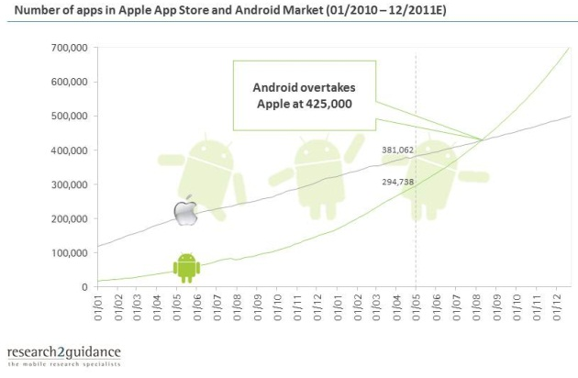
Operating Systems at the heart of it all …
Make the incredible advance in the underlying technology available to a rapid evolving body of applications.
  Processing, Communications, Storage, Interaction, Protected Sharing
The key building blocks
  Processes, Scheduling
  Concurrency, Coordination
  Address spaces, Translation
  Protection, Isolation, Sharing, Security
  Communication, Protocols
  Persistent storage, transactions, consistency, resilience
  Interfaces to all devices

Slide 8
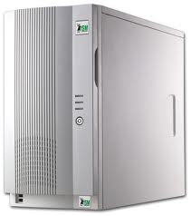
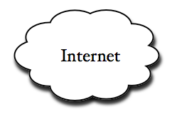
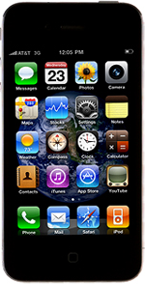
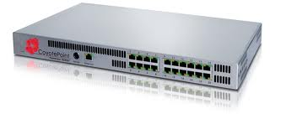
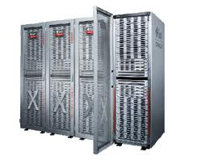
Example: What’s in a Search Query?
DNS
Servers
Datacenter
DNS
request
create
result
page
Search
Index
Page store
Load
balancer
Ad Server
Complex interaction of multiple components in multiple administrative domains
  Systems, services, protocols, …
Notes:
In this course we are not focusing on a single node system but on the end-to-end system. The reason is very simple: today the majority of applications we use does not run on our system. Social networks, e-mail, google docs, online gamming, etc.

Slide 9
Why take CS162?
Some of you will may design and build operating systems or components of them.
  Perhaps more now than ever
Many of you will create systems that utilize the core concepts in operating systems.
  Whether you build software or hardware
  The concepts and design patterns appear at many levels
All of you will build applications, etc. that utilize operating systems
  The better you understand their design and implementation, the better use you’ll make of them.

Slide 10
What is an operating system?
Special layer of software that provides application software access to hardware resources
  Convenient abstraction of complex hardware devices
  Protected access to Shared resources
  Security and Authentication
  Communication amongst logical entities
appln
appln
appln
OS
Hardware

Slide 11
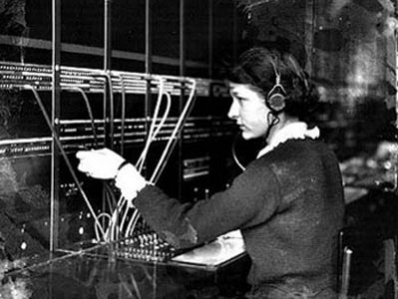
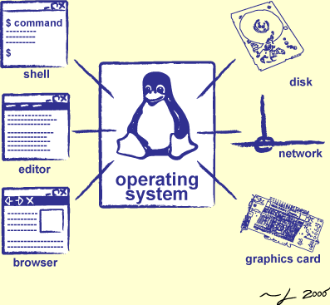
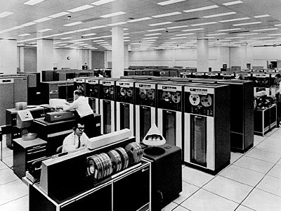
Operator …
Switchboard Operator
Computer Operators

Slide 12
What make something a system?
Multiple interrelated parts
  Each potentially interacts with the others, …
Frame of mind:
  meticulous error handling, anticipating all possible failure cases, defending against malicious/careless users, …
An important part of this class

Slide 13


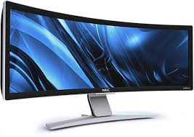

CS61C – Machine Structures (and C)
ISA
Hardware
Memory
Page Table
(TLB)
Processor
Cache
OS
Ctrlr
storage
Networks
Displays
Inputs

Slide 14
OS Basics: “Virtualizing the Machine”
Threads
Sockets
Address Spaces
Keys&Pointers
Processes
Files
Windows
Software
OS Hardware “Virtualization”
Hardware
ISA
Memory
Processor
storage
Networks
Displays
Inputs

Slide 15

What is an Operating System?
Illusionist
  Provide clean, easy to use abstractions of physical resources
    Infinite memory, dedicated machine
    Higher level objects: files, users, messages
    Masking limitations, virtualization

Slide 16
OS Basics: Program => Process
Threads
Sockets
Address Spaces
Keys&Pointers
Processes
Files
Windows
Software
OS Hardware “Virtualization”
Hardware
ISA
Memory
Processor
OS
storage
Networks
Displays
Inputs

Slide 17
Defn: Process
Address Space
One or more threads of control
Additional system state associated with it
Thread:
  locus of control (PC)
  Its registers (processor state when running)
  And its “stack” (SP)
    As required by programming language runtime

Slide 18
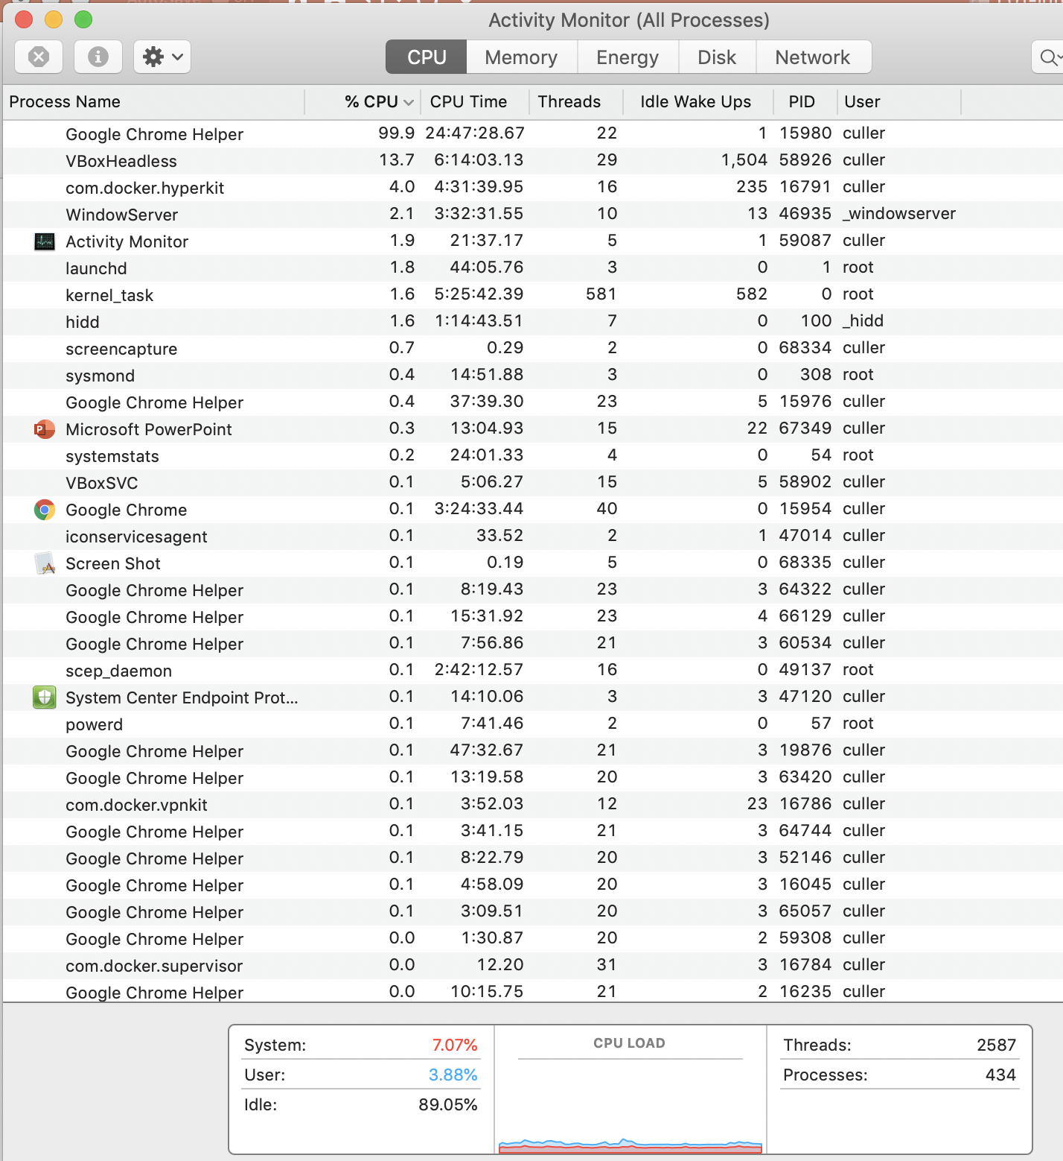
For Example …

Slide 19
OS Basics: Program => Process
Threads
Sockets
Address Spaces
Keys&Pointers
Processes
Files
Windows
Software
OS Hardware “Virtualization”
Hardware
ISA
Memory
Processor
OS
storage
Networks
Displays
Inputs

Slide 20
OS Basics: Context Switch
Threads
Address Spaces
Windows
Processes
Files
Sockets
Software
OS Hardware Virtualization
Hardware
ISA
Memory
Processor
OS
storage
Networks
Displays
Inputs

Slide 21
OS Basics: Scheduling, Protection
Threads
Address Spaces
Windows
Processes
Files
Sockets
Software
OS Hardware Virtualization
Hardware
ISA
Memory
Processor
Protection Boundary
OS
storage
Networks
Displays
Inputs

Slide 22

What is an Operating System?
Referee
  Manage sharing of resources, Protection, Isolation
    Resource allocation, isolation, communication
Illusionist
  Provide clean, easy to use abstractions of physical resources
    Infinite memory, dedicated machine
    Higher level objects: files, users, messages
    Masking limitations, virtualization

Slide 23
OS Basics: I/O
Threads
Address Spaces
Windows
Processes
Files
Sockets
Software
OS Hardware Virtualization
Hardware
ISA
Memory
Processor
Protection Boundary
OS
storage
Networks
Displays
Inputs

Slide 24

What is an Operating System?
Referee
  Manage sharing of resources, Protection, Isolation
    Resource allocation, isolation, communication
Illusionist
  Provide clean, easy to use abstractions of physical resources
    Infinite memory, dedicated machine
    Higher level objects: files, users, messages
    Masking limitations, virtualization
Glue
  Common services
    Storage, Window system, Networking
    Sharing, Authorization
    Look and feel

Slide 25
Creating Process & Loading a Program
Threads
Address Spaces
Windows
Processes
Files
Sockets
Software
OS Hardware Virtualization
Hardware
ISA
Memory
Processor
Protection Boundary
OS
Project 1: PINTOS UserProg
storage
Networks
Displays
Inputs

Slide 26
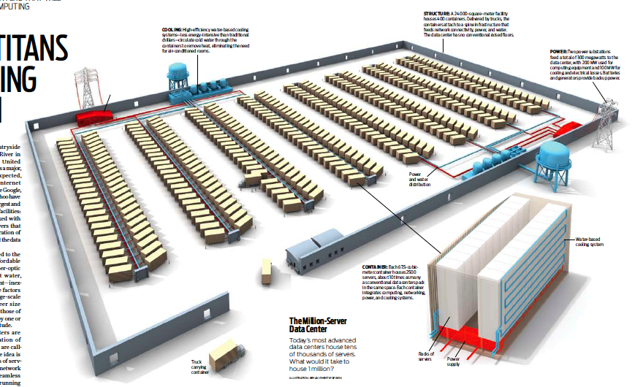
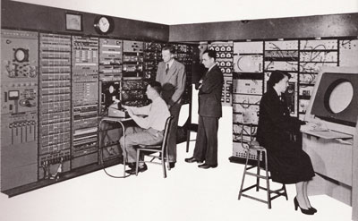
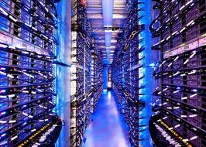
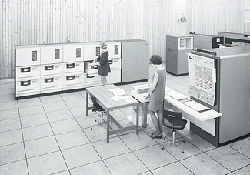
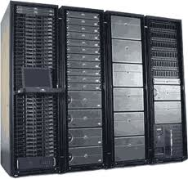
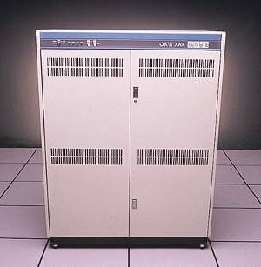
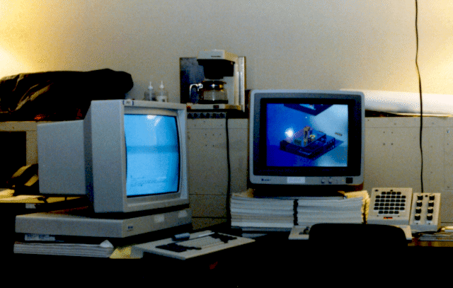
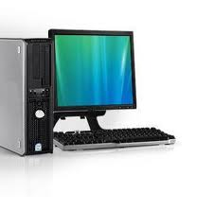
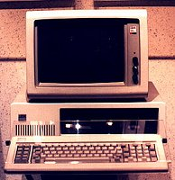
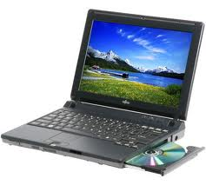

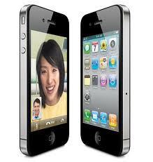


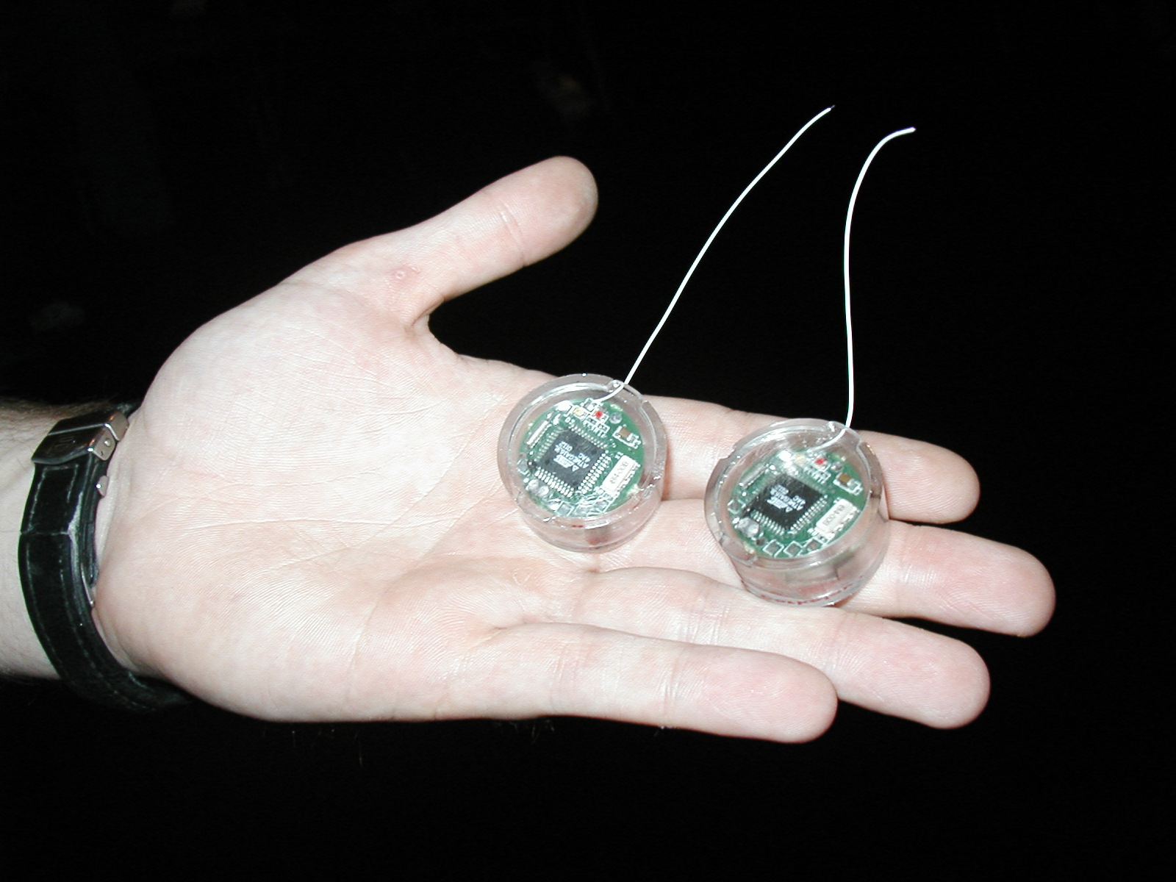
Across incredibly diversity
Computers
Per Person
Number crunching, Data Storage, Massive Inet Services,
ML, …
1:10⁶
Mainframe
Mini
1:10³
Workstation
Productivity,
Interactive
PC
Laptop
1:1
PDA
Cell
Streaming from/to the physical world
10³:1
years
Mote!
The Internet of Things!
Bell’s Law: new computer class per 10 years

Slide 27
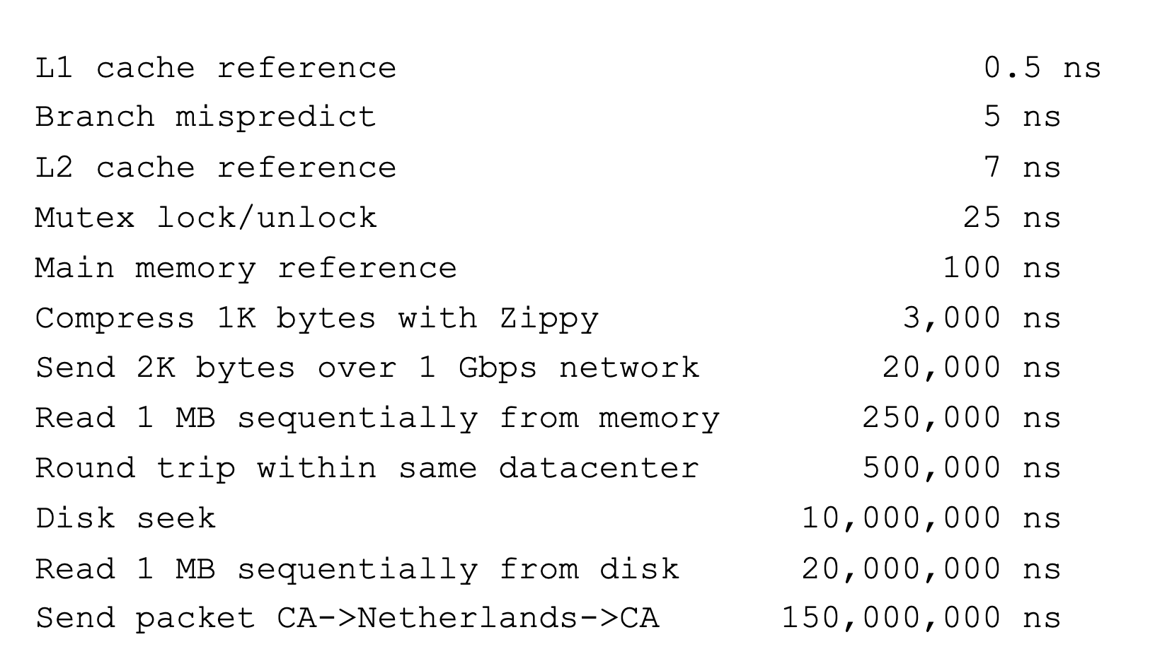
And Range of Timescales
Jeff Dean: "Numbers Everyone Should Know"
Key Stroke / Click
100 ms

Slide 28
Operating systems
Provide consistent abstractions to apps, even on diverse hardware
  File systems, Window Systems, Communications, …
  Processes, threads
  VMs, containers
  Naming systems
Manage resources shared among multiple applications:
  Memory, CPU, storage, …
Achieved by specific algorithms and techniques:
  Scheduling
  Concurrency
  Transactions
  Security
Across immense scale – from 1’s to Billions

Slide 29
Course Structure: Spiral
File Systems (8)
Address Space (4)
Concurrency (6)
Reliability, Security, Cloud (8)
Distributed Systems (8)
OS Concepts (3)
intro

Slide 30
Syllabus – in nutshell
OS Concepts
  Process, I/O, Networks and VM
Concurrency
  Threads, scheduling, locks, deadlock, scalability, fairness
Address Space
  Virtual memory, address translation, protection, sharing
File Systems
  i/o devices, file objects, storage, naming, caching, performance, paging, transactions, databases
Distributed Systems
  Protocols, Tiers, RPC, NFS, DHTs, Consistency, Scalability, multicast
Reliability & Security
  Fault tolerance, protection, security
Cloud Infrastructure

Slide 31
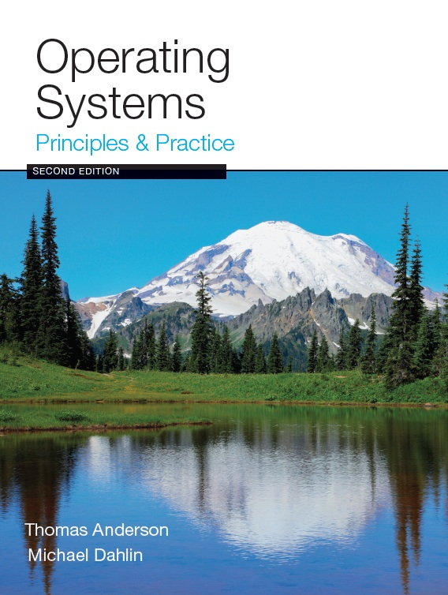
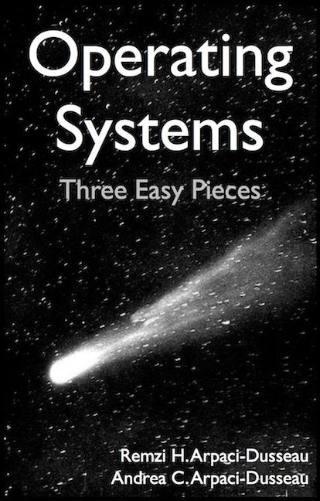
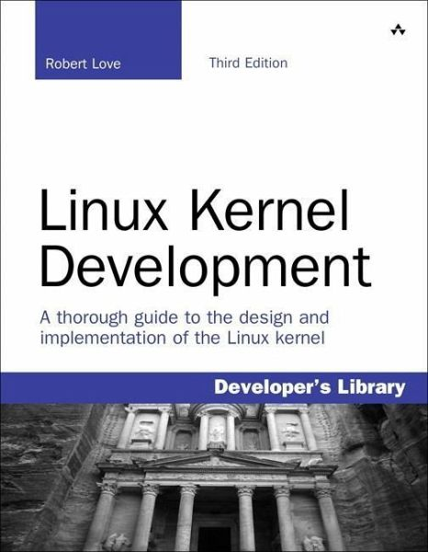
Textbook & Resources
Course text: Operating Systems, Principles and Practice, 2nd ed., by Anderson and Dahlin
Recommended Supplementary Material:
  Operating Systems: Three Easy Pieces, by Remzi and Andrea Arpaci-Dusseau, available for free online at: http://pages.cs.wisc.edu/~remzi/OSTEP
  Linux Kernel Development, 3rd ed., by Robert Love
Additional materials on course website "Readings" page

Slide 32
Infrastructure
Course Website:
https://cs162.eecs.berkeley.edu
Piazza for Q&A:
https://piazza.com/berkeley/spring2019/cs162
Anonymous Feedback Form:
  http://bit.ly/cs162fa19anon

Slide 33
Learning by Doing
Three Group Projects (4 weeks, Pintos in C)
  1. User-programs (exec & syscall)
  1. Threads & Scheduling
  3. File Systems
Individual Homeworks (2 weeks) - preliminary
  0. Tools & Environment, Autograding, recall C, executable
  1. Getting to Pintos-scale C, Basic Threads
  2. BYOS – build your own shell
  3. Threads and Synchronization
  4. Sockets & Threads in HTTP server
  5. Memory mapping and management
  6. Distributed Computing – KV store in Kubernetes
  7. Cloud APIs, GRPC
Weekly quick surveys
  Ungraded, reinforce material, instructional diagnostic
streamlined

Slide 34
Steeping in GO …
Last one or two homeworks in Go
Nudges to learn Go at your own pace along the way

Slide 35
Group Projects
Project teams have 4 members
  never 5, 3 req’s serious justification)
  Must work in groups in “the real world”
  Same section (at least same TA)
Communication and cooperation will be essential
  Design Documents
  Slack/Messenger/whatever doesn’t replace face-to-face
Everyone should do work and have clear responsibilities
  You will evaluate your teammates at the end of each project
  Dividing up by Task is the worst approach. Work as a team.
Communicate with supervisor (TAs)
  What is the team’s plan?
  What is each member’s responsibility?
  Short progress reports are required

Slide 36
Grading
36% exams
36% projects
22% homework
6% participation
Project grading
  Initial design document, Design review, Code, Final design
Submission via git push to release branch
  Triggers autograder
Regular git push so TA sees your progress

Slide 37
Getting started
Start homework 0 immediately
  Get cs162-xx account via https://inst.eecs.berkeley.edu/webacct
  Github account
  Registration survey
  Vagrant virtualbox – VM environment for the course
    Consistent, managed environment on your machine
  Get familiar with all the cs162 tools
  Submit to autograder via git
Go to any section this week
Waitlist
  Pull hw0, get inst acct, go to a section
  Only enrolled students will form project groups
  If cs162 is not for you now, please allow others to take it
  We are going to try to grow more to enroll majors from current waitlist

Slide 38
Preparing Yourself for this Class
The projects will require you to be very comfortable with programming and debugging C
  Pointers (including function pointers, void*)
  Memory Management (malloc, free, stack vs heap)
  Debugging with GDB
You will be working on a larger, more sophisticated code base than anything you've likely seen in 61C
C / 61C review session Tuesday 9/3 7-8pm @ 310 Jacobs

Slide 39
Preparing Yourself for this Class
"Resources" page on course website
C programming reference (still in beta):
  https://cs162.eecs.berkeley.edu/ladder/
This week’s section dedicated to programming and debugging review
  Attend ANY section this week
Review session Tuesday evening
  306 Soda

Slide 40
Personal Growth …
Homeworks will try to offer optional “warm up” and “stretch” problems so you can tailor your learning to your situation

Slide 41
Personal Integrity
UCB Academic Honor Code: "As a member of the UC Berkeley community, I act with honesty, integrity, and respect for others."
http://asuc.org/honorcode/resources/HC%20Guide%20for%20Syllabi.pdf

Slide 42
Collaboration Policy
OK:
Explaining a concept to someone in another group
Discussing algorithms/testing strategies with other groups
Helping debug someone else’s code (in another group)
Searching online for generic algorithms (e.g., hash table)
Not OK:
Sharing code or test cases with another group
Copying OR reading another group’s code or test cases
Copying OR reading online code or test cases from prior years

Slide 43
Late Policy
Deadlines are at 9:00 PM Pacific Time
4 slip days to use for homeworks, no more than 1 per assignment
4 slip days to use (as a group) for projects code, no more than 2 per project (no slip on report)
No credit for late work beyond these

Slide 44
Questions

Slide 45
What make Operating Systems So Exciting and Challenging ?
Managing complexity

Slide 46
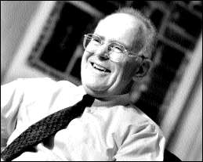
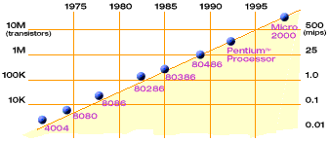
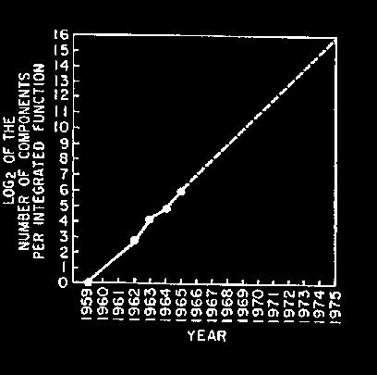
Technology Trends: Moore’s Law
Moore’s Law
2X transistors/Chip Every 1.5 years
Called “Moore’s Law”
Gordon Moore (co-founder of Intel) predicted in 1965 that the transistor density of semiconductor chips would double roughly every 18 months.
Microprocessors have become smaller, denser, and more powerful.

Slide 47
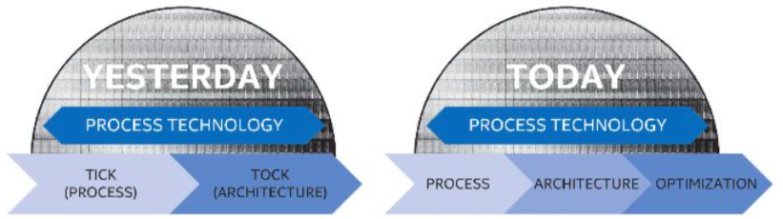
But then Moore’s Law Ended…
Moore’s Law has (officially) ended -- Feb 2016
  No longer getting 2 x transistors/chip every 18 months…
  or even every 24 months
May have only 2-3 smallest geometry fabrication plants left:
  Intel and Samsung and/or TSMC
Vendors moving to 3D stacked chips
  More layers in old geometries

Slide 48
Society connected

Slide 49
New Challenge: Slowdown in Joy’s law of Performance
3X
From Hennessy and Patterson, Computer Architecture: A Quantitative Approach, 4th edition, Sept. 15, 2006
Joy’s Law: Perf ≈ 2^{(Year-1984)} MIPS
⇒ Sea change in chip design: multiple “cores” or processors per chip
VAX : 25%/year 1978 to 1986
RISC + x86: 52%/year 1986 to 2002
RISC + x86: ??%/year 2002 to present

Slide 50
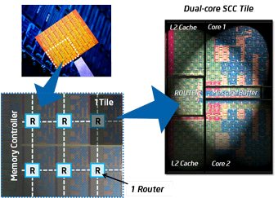
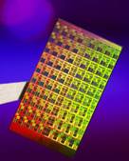
ManyCore Chips: The future is here
Intel 80-core multicore chip (Feb 2007)
  80 simple cores
  Two FP-engines / core
  Mesh-like network
  100 million transistors
Intel Single-Chip Cloud
Computer (August 2010)
  24 “tiles” with two cores/tile
  24-router mesh network
  4 DDR3 memory controllers
  Hardware support for message-passing
“ManyCore” refers to many processors/chip
  64? 128? Hard to say exact boundary
How to program these?
  Use 2 CPUs for video/audio
  Use 1 for word processor, 1 for browser
  76 for virus checking???
Parallelism must be exploited at all levels

Slide 51
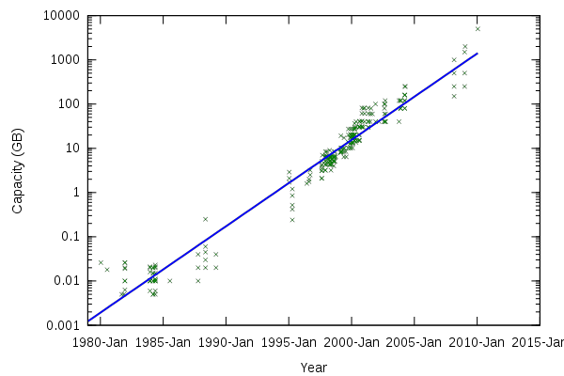
Storage Capacity

Slide 52
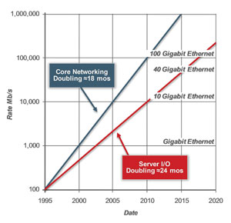
Network Capacity
(source: http://www.ospmag.com/issue/article/Time-Is-Not-Always-On-Our-Side )

Slide 53
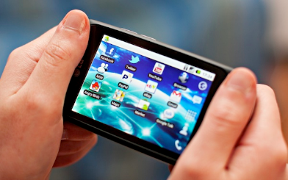
Not Only PCs connected to the Internet
In 2011, smartphone shipments exceeded PC shipments!
2011 shipments:
  487M smartphones
  414M PC clients
    210M notebooks
    112M desktops
    63M tablets
  25M smart TVs
4 billion phones in the world → smartphones over next few years
Then…
1.53B in 2017
262.5M in 2017
164M in 2017
39.5M in 2017

Slide 54
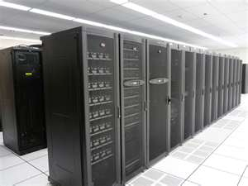
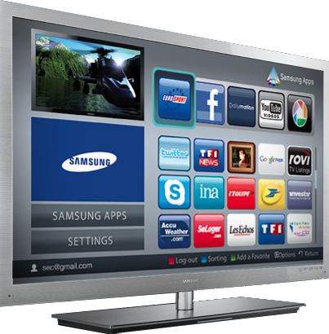
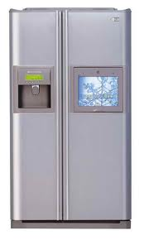
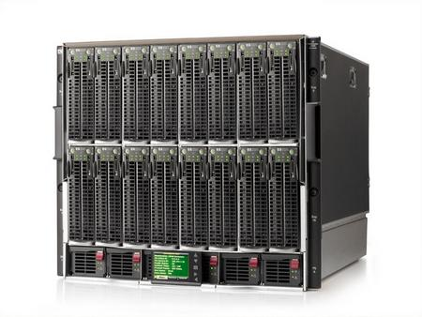
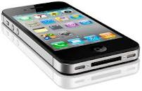







Societal Scale Information Systems
Massive Cluster
The world is a large distributed system
  Microprocessors in everything
  Vast infrastructure behind them
Gigabit Ethernet
Clusters
Massive Cluster
Clusters
Gigabit Ethernet
Internet
Connectivity
Scalable, Reliable,
Secure Services
Databases
Information Collection
Remote Storage
Online Games
Commerce
…
MEMS for
Sensor Nets

Slide 55
Challenge: Complexity
Applications consisting of…
  … a variety of software modules that …
  … run on a variety of devices (machines) that
    … implement different hardware architectures
    … run competing applications
    … fail in unexpected ways
    … can be under a variety of attacks
Not feasible to test software for all possible environments and combinations of components and devices
  The question is not whether there are bugs but how well are they managed.

Slide 56

Increasing Software Complexity
From MIT’s 6.033 course

Slide 57
How do We Tame Complexity?
Every piece of computer hardware different
  Different CPU
    Pentium, ARM, PowerPC, ColdFire
  Different amounts of memory, disk, …
  Different types of devices
    Mice, keyboards, sensors, cameras, fingerprint readers, touch screen
  Different networking environment
    Cable, DSL, Wireless, …
Questions:
  Does the programmer need to write a single program that performs many independent activities?
  Does every program have to be altered for every piece of hardware?
  Does a faulty program crash everything?

Slide 58
Virtualization ??

Slide 59
OS Abstracts underlying hardware
Processor => Thread
Memory => Address Space
Disks, SSDs, … => Files
Networks => Sockets
Machines => Processes
Application
Operating System
Hardware
Abstract Machine Interface
Physical Machine Interface
OS Goals:
  Remove software/hardware quirks (fight complexity)
  Optimize for convenience, utilization, reliability, … (help the programmer)
For any OS area (e.g. file systems, virtual memory, networking, scheduling):
  What hardware interface to handle? (physical reality)
  What’s software interface to provide? (nicer abstraction)

Slide 60

OS Goal: Protecting Processes & The Kernel
Run multiple applications and:
  Keep them from interfering with or crashing the operating system
  Keep them from interfering with or crashing each other

Slide 61
Virtual Machines
Virtualize every detail of a hardware configuration so perfectly that you can run an operating system (and many applications) on top of it.
  VMWare Fusion, Virtual box, Parallels Desktop, Xen, Vagrant
Provides isolation
Complete insulation from change
The norm in the Cloud (server consolidation)
Long history (60’s in IBM OS development)
All our work will take place INSIDE a VM
  Vagrant (new image just for you)

Slide 62

System Virtual Machines: Layers of OSs
Useful for OS development
  When OS crashes, restricted to one VM
  Can aid testing programs on other OSs

Slide 63
Containers virtualize the OS
Roots in OS developments to provide protected systems abstraction, not just application abstraction
  User-level file system (route syscalls to user process)
  Cgroups – predictable, bounded resources (CPU, Mem, BW)

Slide 64

Basic tool: Dual Mode Operation
Hardware provides at least two modes:
  Kernel Mode (or "supervisor" / "protected" mode)
  User Mode
Certain operations are prohibited when running in user mode
  Changing the page table pointer
Carefully controlled transitions between user mode and kernel mode
  System calls, interrupts, exceptions

Slide 65

UNIX OS Structure

Slide 66
Summary: Operating Systems…
Provide a machine abstraction to handle diverse hardware
  Convenience, protection, reliability obtain in creating the illusion
Coordinate resources and protect users from each other
  Utilizing a few critical hardware mechanisms
Simplify application development by providing standard services
Provide fault containment, fault tolerance, and fault recovery
Key concepts: concurrency, isolation, protected sharing, virtualization

