Slide 1
CS 162: Operating Systems and System Programming
Lecture 11: Deadlock, Scheduling, & Synchronization
October 3, 2019
Instructor: David E. Culler & Sam Kumar
https://cs162.eecs.berkeley.edu
Read: A&D 6.5
Project 1 Code due TOMORROW!
Midterm Exam next week Thursday

Slide 2
Outline for Today
(Quickly) Recap and Finish Scheduling
Deadlock
Language Support for Concurrency

Slide 3
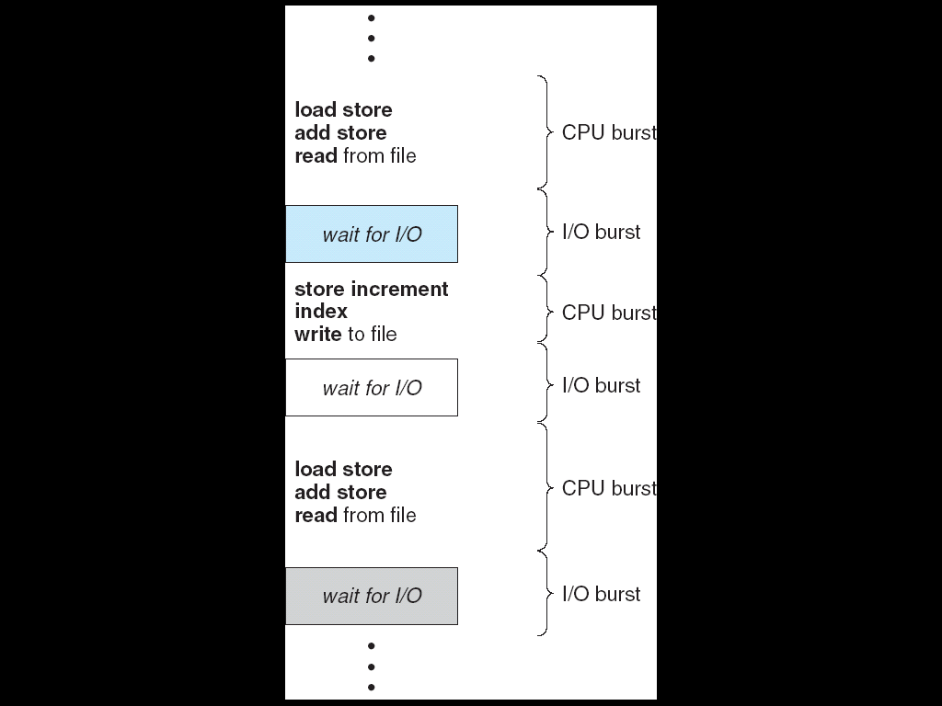
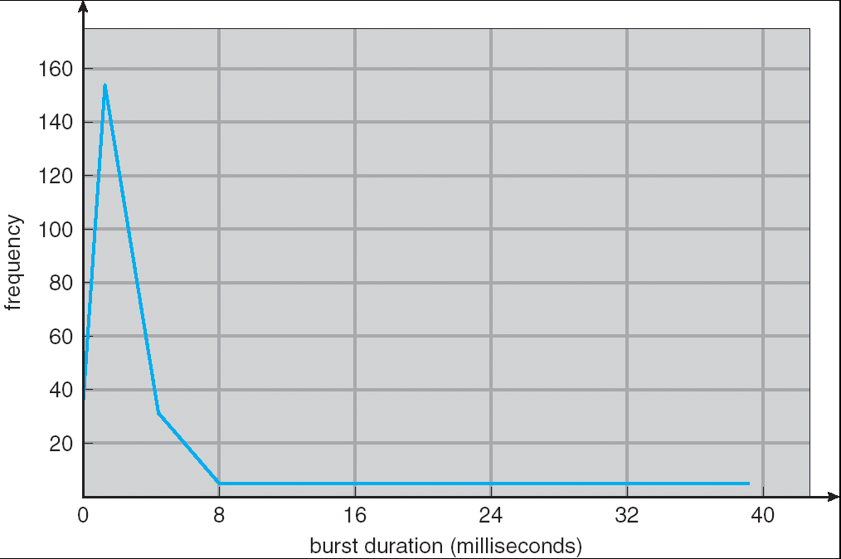
Recall: CPU & I/O Bursts
Programs alternate between bursts of CPU, I/O activity
Scheduler: Which thread (CPU burst) to run next?
Interactive programs vs Compute Bound vs Streaming

Slide 4
Recall: Evaluating Schedulers
Response Time (ideally low)
  What user sees: from keypress to character on screen
  Or completion time for non-interactive
Throughput (ideally high)
  Total operations (jobs) per second
  Overhead (e.g. context switching), artificial blocks
Fairness
  Fraction of resources provided to each
  May conflict with best avg. throughput, resp. time

Slide 5
Recall: What if we knew the future?
Key Idea: remove convoy effect
  Short jobs always stay ahead of long ones
Non-preemptive: Shortest Job First
  Like FCFS where we always chose the best possible ordering
Preemptive Version: Shortest Remaining Time First
  A newly ready process (e.g., just finished an I/O operation) with shorter time replaces the current one

Slide 6
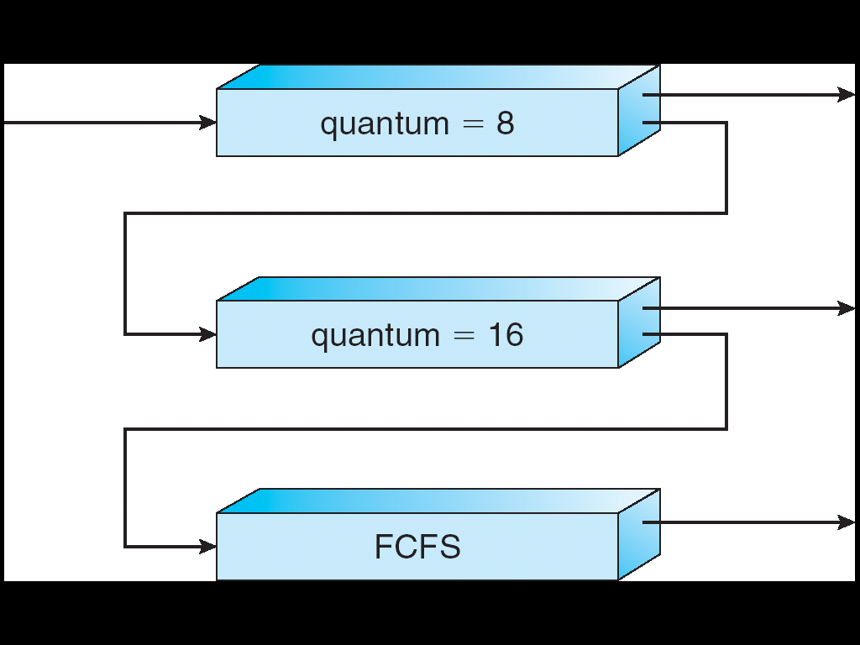
Recall: Multi-Level Feedback Scheduling
Intuition: Priority Level proportional to burst length
Job Exceeds Quantum: Drop to lower queue
Job Doesn't Exceed Quantum: Raise to higher queue
Long-Running Compute
Tasks Demoted to
Low Priority

Slide 7
Recall: Linux O(1) Scheduler
Kernel/Realtime Tasks
User Tasks
0
100
139
MLFQ-Like Scheduler with 140 Priority Levels
  40 for user tasks, 100 "realtime" tasks
  All algorithms O(1) complexity – low overhead
Active and expired queues at each priority
  Once active is empty, swap them (pointers)
  Round Robin within each queue (varying quanta)

Slide 8
Recall: Changing landscape of scheduling
Priority-based scheduling rooted in “time-sharing”
  Allocating precious, limited resources across a diverse workload
    CPU bound, vs interactive, vs I/O bound
80’s brought about personal computers, workstations, and servers on networks
  Different machines of different types for different purposes
  Shift to fairness and avoiding extremes (starvation)
90’s emergence of the web, rise of internet-based services, the data-center-is-the-computer
  Server consolidation, massive clustered services, huge flashcrowds
  It’s about predictability, 95th percentile performance guarantees

Slide 9
Recall: Lottery Scheduling
Q _{i}
Q _{i+1}
time
Given a set of jobs (the mix), provide each with a proportional share of a resource
  e.g., 50% of the CPU for Job A, 30% for Job B, and 20% for Job C
Idea: Give out tickets according to the portion each should receive,
Every quanta (tick) draw one at random, schedule that job (thread) to run

Slide 10
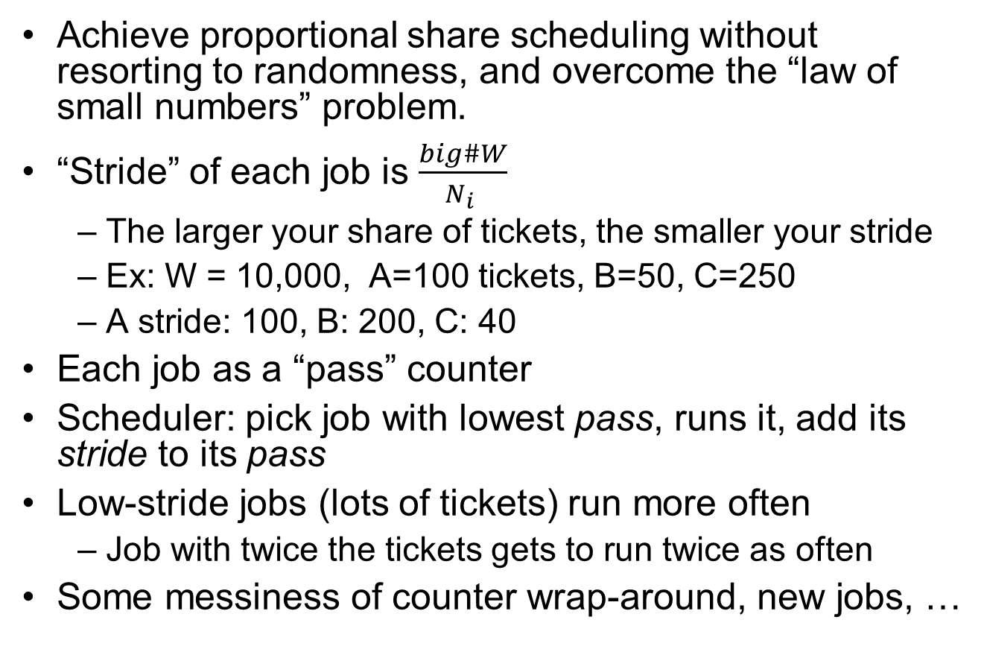
Recall: Stride Scheduling
Achieve proportional share scheduling without resorting to randomness, and overcome the “law of small numbers” problem.
“Stride” of each job is $\frac{big\#W}{N_{i} }$
  The larger your share of tickets, the smaller your stride
  Ex: W = 10,000, A=100 tickets, B=50, C=250
  A stride: 100, B: 200, C: 40
Each job as a “pass” counter
Scheduler: pick job with lowest pass, runs it, add its stride to its pass
Low-stride jobs (lots of tickets) run more often
  Job with twice the tickets gets to run twice as often
Some messiness of counter wrap-around, new jobs, …

Slide 11
Recall: Linux Completely Fair Scheduler
Can't do this with real hardware
  Still need to give out full CPU in time slices
Instead: track CPU time given to a thread so far
Scheduling Decision:
"Repair" illusion of complete fairness
Choose thread with minimum CPU time
T₁
CPU
Time
t/N
T₃
T₂

Slide 12
Recall: Real-Time Scheduling
Goal: Guaranteed Performance
  Meet deadlines even if it means being unfair or slow
  Limit how bad the worst case is
Hard real-time:
  Meet all deadlines (if possible)
  Ideally: determine in advance if this is possible

Slide 13
Recall: Earliest Deadline First (EDF)
Priority scheduling with preemption
Priority proportional to time until deadline
Example with periodic tasks:
0
5
10
15

Slide 14
Recall: Choosing the Right Scheduler
I Care About: | Then Choose:
CPU Throughput | FCFS
Avg. Response Time | SRTF Approximation
I/O Throughput | SRTF Approximation
Fairness (CPU Time) | Linux CFS
Fairness – Wait Time to Get CPU | Round Robin
Meeting Deadlines | EDF
Favoring Important Tasks | Priority

Slide 15
Ensuring Progress
Schedulers try to schedule jobs efficiently
Assume that the threads make progress.
If they are all just waiting for each other or spinning in loops, the scheduler cannot help much.
Let’s see what sorts of problems we might fall into and how to avoid them

Slide 16
Types of Scheduling Problems
Starvation – thread fails to make progress for an indefinite period of time
Deadlock – starvation due to a cycle of waiting among a set of threads
  each thread waits for some other thread in the cycle to take some action
Thread
A
Wait
For
Owned
By
Res 1
Res 2
Owned
By
Wait
For
Thread
B

Slide 17
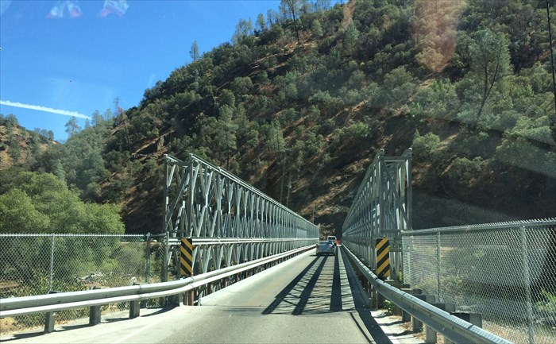
Example: Single-Lane Bridge Crossing
CA 140 to Yosemite National Park

Slide 18
Bridge Crossing Example
Honk!
Each segment of road can be viewed as a resource
  Car must own the segment under them
  Must acquire segment that they are moving into
Deadlock: Two cars in opposite directions meet in middle
Resolving deadlock: “Preempt” road segment, force one car (or several cars) to back up
Prevent deadlock: make sure cars facing opposite directions don’t enter the bridge simultaneously
Starvation (not deadlock): Eastbound traffic doesn’t stop for westbound traffic

Slide 19
Deadlock with Locks
Thread A
x.Acquire();
y.Acquire();
…
y.Release();
x.Release();
Thread B
y.Acquire();
x.Acquire();
…
x.Release();
y.Release();
Nondeterministic Deadlock
Thread
A
Owned
By
Wait
For
Lock x
Lock y
Wait
For
Thread
B
Owned
By

Slide 20
Deadlock with Locks
Thread A Thread B
Mutex1.lock(); Mutex2.lock();
Mutex2.lock(); Mutex1.lock();
. . . . . .
Mutex2.unlock(); Mutex1.unlock();
Mutex1.unlock(); Mutex2.unlock();
Thread 1 and Thread 2 both need two locks, but grab them in different orders
Under what conditions does deadlock occur?
Why might this code run many times with no problem?
How do you fix it?

Slide 21
Deadlock with Locks: Unlucky Case
Thread A
x.Acquire();
y.Acquire(); <stalled>
<unreachable>
…
y.Release();
x.Release();
Thread B
y.Acquire();
x.Acquire(); <stalled>
<unreachable>
…
x.Release();
y.Release();
Thread
A
Owned
By
Wait
For
Lock x
Lock y
Wait
For
Thread
B
Owned
By

Slide 22
Deadlock with Locks: “Lucky” Case
Thread A
x.Acquire();
y.Acquire();
…
y.Release();
x.Release();
Thread B
y.Acquire();
x.Acquire();
…
x.Release();
y.Release();
Sometimes schedule won’t trigger deadlock

Slide 23
Other Types of Deadlock
Threads often block waiting for resources
  Locks
  Terminals
  Printers
  CD drives
  Memory
Threads often block waiting for other threads
  Pipes
  Sockets
You can deadlock on any of these!

Slide 24
Deadlock with Space
Thread A
AllocateOrWait(1 MB)
AllocateOrWait(1 MB)
Free(1 MB)
Free(1 MB)
Thread B
AllocateOrWait(1 MB)
AllocateOrWait(1 MB)
Free(1 MB)
Free(1 MB)
If only 2 MB of space, we get same deadlock situation

Slide 25
How to detect deadlock?

Slide 26
Resource-Allocation Graph
Symbols
System Model
  A set of Threads T₁, T₂, . . ., T_{n}
  Resource types R₁, R₂, . . ., R_{m}
    CPU cycles, memory space, I/O devices
  Each resource type R_{i} has W_{i} instances
  Each thread utilizes a resource as follows:
    Request() / Use() / Release()
Resource-Allocation Graph:
  V is partitioned into two types:
    T = {T₁, T₂, …, T_{n}}, the set threads in the system.
    R = {R₁, R₂, …, R_{m}}, the set of resource types in system
  request edge – directed edge T₁ → R_{j}
  assignment edge – directed edge R_{j} → T_{i}
T₁
T₂
R₁
R₂

Slide 27
Resource-Allocation Graph Examples
Model:
  request edge – directed edge T₁ → R_{j}
  assignment edge – directed edge R_{j} → T_{i}
R₁
R₂
R₁
R₂
R₁
T₂
T₁
T₂
T₃
T₁
T₂
T₃
T₁
T₃
R₃
T₄
R₄
R₃
R₂
R₄
Simple Resource
Allocation Graph
Allocation Graph
With Deadlock
Allocation Graph
With Cycle, but
No Deadlock

Slide 28
Deadlock Detection Algorithm
Only one of each type of resource ⇒ look for loops
More General Deadlock Detection Algorithm
  Let [X] represent an m-ary vector of non-negative
  integers (quantities of resources of each type):
  [FreeResources]: Current free resources each type
  [Request_{X}]: Current requests from thread X
  [Alloc_{X}]: Current resources held by thread X
  See if tasks can eventually terminate on their own
[Avail] = [FreeResources]
Add all nodes to UNFINISHED
do {
done = true
Foreach node in UNFINISHED {
if ([Request_{node}] <= [Avail]) {
remove node from UNFINISHED
[Avail] = [Avail] + [Alloc_{node}]
done = false
}
}
} until(done)
  Nodes left in UNFINISHED ⇒ deadlocked
R₁
T₂
T₁
T₃
T₄
R₂

Slide 29
How should a system deal with deadlock?
Three different approaches:
Deadlock avoidance: dynamically delay resource requests so deadlock doesn’t happen
Deadlock prevention: write your code in a way that it isn’t prone to deadlock
Deadlock recovery: let deadlock happen, and then figure out how to recover from it
Modern operating systems:
  Make sure the system isn’t involved in any deadlock
  Ignore deadlock in applications
    “Ostrich Algorithm”

Slide 30
Deadlock Avoidance
Idea: When a thread requests a resource, OS checks if it would result in deadlock
  If not, it grants the resource right away
  If so, it waits for other threads to release resources
  THIS DOES NOT WORK!!!!
Example:
Thread A
x.Acquire();
y.Acquire();
…
y.Release();
x.Release();
Thread B
y.Acquire();
x.Acquire();
…
x.Release();
y.Release();
Blocks…
Wait…
But it’s too late…

Slide 31
Deadlock Avoidance: Three States
Safe state
  System can delay resource acquisition to prevent deadlock
Unsafe state
  No deadlock yet…
  But threads can request resources in a pattern that unavoidably leads to deadlock
Deadlocked state
  There exists a deadlock in the system
  Also considered “unsafe”
Deadlock avoidance: prevent system from reaching an unsafe state

Slide 32
Deadlock Avoidance
Idea: When a thread requests a resource, OS checks if it would result in deadlock an unsafe state
  If not, it grants the resource right away
  If so, it waits for other threads to release resources
Example:
Thread A
x.Acquire();
y.Acquire();
…
y.Release();
x.Release();
Thread B
y.Acquire();
x.Acquire();
…
x.Release();
y.Release();
Wait until Thread A releases the mutex

Slide 33
Banker’s Algorithm for Preventing Deadlock
Toward right idea:
  State maximum (max) resource needs in advance
  Allow particular thread to proceed if:
    (available resources - #requested) ≥ max
    remaining that might be needed by any thread
Banker’s algorithm (less conservative):
  Allocate resources dynamically
    Evaluate each request and grant if some
    ordering of threads is still deadlock free afterward
    Technique: pretend each request is granted, then run deadlock detection algorithm, substituting
    ([Max_{node}]-[Alloc_{node}] <= [Avail]) for ([Request_{node}] <= [Avail])
    Grant request if result is deadlock free (conservative!)

Slide 34
Banker’s Algorithm for Preventing Deadlock
Toward right idea:
  State maximum resource needs in advance
  Allow particular thread to proceed if:
    (available resources - #requested) ≥ max
    remaining that might be needed by any thread
Banker’s algorithm (less conservative):
  Allocate resources dynamically
    Evaluate each request and grant if some
    ordering of threads is still deadlock free afterward
    Technique: pretend each request is granted, then run deadlock detection algorithm, substituting
    ([Max_{node}]-[Alloc_{node}] <= [Avail]) for ([Request_{node}] <= [Avail])
    Grant request if result is deadlock free (conservative!)
[Avail] = [FreeResources]
Add all nodes to UNFINISHED
do {
done = true
Foreach node in UNFINISHED {
if ([Request_{node}] <= [Avail]) {
remove node from UNFINISHED
[Avail] = [Avail] + [Alloc_{node}]
done = false
}
}
} until(done)

Slide 35
Banker’s Algorithm for Preventing Deadlock
Toward right idea:
  State maximum resource needs in advance
  Allow particular thread to proceed if:
    (available resources - #requested) ≥ max
    remaining that might be needed by any thread
Banker’s algorithm (less conservative):
  Allocate resources dynamically
    Evaluate each request and grant if some
    ordering of threads is still deadlock free afterward
    Technique: pretend each request is granted, then run deadlock detection algorithm, substituting
    ([Max_{node}]-[Alloc_{node}] <= [Avail]) for ([Request_{node}] <= [Avail])
    Grant request if result is deadlock free (conservative!)
[Avail] = [FreeResources]
Add all nodes to UNFINISHED
do {
done = true
Foreach node in UNFINISHED {
if ([Max_{node}]-[Alloc_{node}] <= [Avail]) {
remove node from UNFINISHED
[Avail] = [Avail] + [Alloc_{node}]
done = false
}
}
} until(done)

Slide 36
Banker’s Algorithm for Preventing Deadlock
Toward right idea:
  State maximum resource needs in advance
  Allow particular thread to proceed if:
    (available resources - #requested) ≥ max
    remaining that might be needed by any thread
Banker’s algorithm (less conservative):
  Allocate resources dynamically
    Evaluate each request and grant if some
    ordering of threads is still deadlock free afterward
    Technique: pretend each request is granted, then run deadlock detection algorithm, substituting
    ([Max_{node}]-[Alloc_{node}] <= [Avail]) for ([Request_{node}] <= [Avail])
    Grant request if result is deadlock free (conservative!)
    Keeps system in a “SAFE” state, i.e. there exists a sequence {T₁, T₂, … T_{n}} with T₁ requesting all remaining resources, finishing, then T₂ requesting all remaining resources, etc..
  Algorithm allows the sum of maximum resource needs of all current threads to be greater than total resources

Slide 37
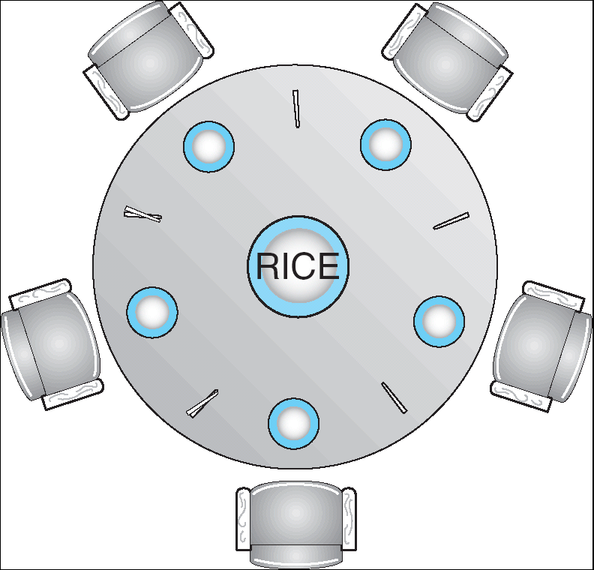
Banker’s Algorithm Example
Banker’s algorithm with dining philosophers
  “Safe” (won’t cause deadlock) if when try to grab chopstick either:
    Not last chopstick
    Is last chopstick but someone will have two afterwards
  What if k-handed lawyers? Don’t allow if:
    It’s the last one, no one would have k
    It’s 2nd to last, and no one would have k-1
    It’s 3rd to last, and no one would have k-2
    …

Slide 38
Deadlock Prevention
Structure code in a way that it isn’t prone to deadlock
First: What must be true about our code for deadlock to happen?

Slide 39
Four requirements for Deadlock
Mutual exclusion
  Only one thread at a time can use a resource.
Hold and wait
  Thread holding at least one resource is waiting to acquire additional resources held by other threads
No preemption
  Resources are released only voluntarily by the thread holding the resource, after thread is finished with it
Circular wait
  There exists a set {T₁, …, T_{n}} of waiting threads
    T₁ is waiting for a resource that is held by T₂
    T₂ is waiting for a resource that is held by T₃
    …
    T_{n} is waiting for a resource that is held by T₁
To prevent deadlock, make sure at least one of these conditions does not hold

Slide 40
Deadlock Prevention (1/2)
Remove “Mutual Exclusion”
  Infinite resources
    Example: Virtual Memory
  Restructure program to avoid sharing

Slide 41
(Virtually) Infinite Resources
Thread A
AllocateOrWait(1 MB)
AllocateOrWait(1 MB)
Free(1 MB)
Free(1 MB)
Thread B
AllocateOrWait(1 MB)
AllocateOrWait(1 MB)
Free(1 MB)
Free(1 MB)
With virtual memory we have “infinite” space so everything will just succeed.

Slide 42
Deadlock Prevention (1/2)
Remove “Mutual Exclusion”
  Infinite resources
    Example: Virtual Memory
  Restructure program to avoid sharing
Remove “Hold-and-Wait”
  Back off and retry
    Removes deadlock but could still lead to starvation
  Request all resources up front
    Reduces concurrency (parallelism?)
    Example: Dining philosophers grab both chopsticks atomically

Slide 43
Request Resources Atomically (1)
Thread A
x.Acquire();
y.Acquire();
…
y.Release();
x.Release();
Thread B
y.Acquire();
x.Acquire();
…
x.Release();
y.Release();
Consider instead:
Thread A
Acquire_both(x, y);
…
y.Release();
x.Release();
Thread B
Acquire_both(y, x);
…
x.Release();
y.Release();

Slide 44
Request Resources Atomically (2)
Or consider this:
Thread A
z.Acquire();
x.Acquire();
y.Acquire();
z.Release();
…
y.Release();
x.Release();
Thread B
z.Acquire();
y.Acquire();
x.Acquire();
z.Release();
…
x.Release();
y.Release();

Slide 45
Deadlock Prevention (2/2)
Remove “No Preemption”
  Allow OS to revoke resources it has granted
    Example: Pre-emptive scheduling
  Doesn’t always work with resource semantics
    Example: Locks

Slide 46
Pre-empting Resources
Thread A
AllocateOrWait(1 MB)
AllocateOrWait(1 MB)
Free(1 MB)
Free(1 MB)
Thread B
AllocateOrWait(1 MB)
AllocateOrWait(1 MB)
Free(1 MB)
Free(1 MB)
With virtual memory we have “infinite” space so everything will just succeed.
Alternative view: we are “pre-empting” memory when paging out to disk, and giving it back when paging back in

Slide 47
Deadlock Prevention (2/2)
Remove “No Preemption”
  Allow OS to revoke resources it has granted
    Example: Pre-emptive scheduling
  Doesn’t always work with resource semantics
    Example: Locks
Remove “Circular Wait”
  Acquire resources in a consistent order

Slide 48
Acquire Resources in Consistent Order
Thread A
x.Acquire();
y.Acquire();
…
y.Release();
x.Release();
Thread B
y.Acquire();
x.Acquire();
…
x.Release();
y.Release();
Consider instead:
Thread A
x.Acquire();
y.Acquire();
…
y.Release();
x.Release();
Thread B
x.Acquire();
y.Acquire();
…
x.Release();
y.Release();
Does it matter in which order the locks are released?

Slide 49
Deadlock Recovery
Let deadlock happen, and then figure out how to deal with it

Slide 50
What to do when detect deadlock?
Terminate thread, force it to give up resources
  In Bridge example, Godzilla picks up a car, hurls it into the river. Deadlock solved!
  Remove a dining lawyer
  But, not always possible – killing a thread holding a mutex leaves world inconsistent
Preempt resources without killing off thread
  Take away resources from thread temporarily
  Doesn’t always fit with semantics of computation
Roll back actions of deadlocked threads
  Hit the rewind button on TiVo, pretend last few minutes never happened
  For bridge example, make one car roll backwards (may require others behind him)
  Common technique in databases (transactions)
  Of course, if you restart in exactly the same way, may reenter deadlock once again
Many operating systems use other options

Slide 51
Recall: Monitors and Condition Variables
Monitor: a lock and zero or more condition variables for managing concurrent access to shared data
  Use of Monitors is a programming paradigm
  Some languages like Java provide monitors in the language
Condition Variable: a queue of threads waiting for something inside a critical section
  Key idea: allow sleeping inside critical section by atomically releasing lock at time we go to sleep
  Contrast to semaphores: Can’t wait inside critical section
Operations:
  Wait(&lock): Atomically release lock and go to sleep. Re-acquire lock later, before returning.
  Signal(): Wake up one waiter, if any
  Broadcast(): Wake up all waiters
Rule: Must hold lock when doing condition variable ops!

Slide 52
Recall: (Mesa) Monitor Pattern
Monitors represent the logic of the program
  Wait if necessary
  Signal when change something so any waiting threads can proceed to recheck their condition
Basic structure of monitor-based program:
  lock
  while (need to wait) {
  condvar.wait();
  }
  unlock
  lock
  condvar.signal();
  unlock
Check and/or update
state variables
Wait if necessary
Check and/or update
state variables

Slide 53
Programming Language Support for Concurrency and Synchronization
Synchronization operations
Exceptional conditions

Slide 54
Concurrency and Synchronization in C
Standard approach: use pthreads, protect access to shared data structures
One pitfall: consistently unlocking a mutex
int Rtn() {
lock.acquire();
…
if (error) {
lock.release();
return errCode;
}
…
lock.release();
return OK;
}

Slide 55
Concurrency and Synchronization in C
Harder with more locks
void Rtn() {
lock1.acquire();
…
if (error) {
lock1.release();
return;
}
…
lock2.acquire();
…
if (error) {
lock2.release()
lock1.release();
return;
}
…
lock2.release();
lock1.release();
return;
}
Is goto a solution???
void Rtn() {
lock1.acquire();
…
if (error) {
goto release_lock1_and_exit;
}
…
lock2.acquire();
…
if (error) {
goto release_both_and_exit;
}
…
release_both_and_exit:
lock2.release();
release_lock1_and_exit:
lock1.release();
return;
}

Slide 56
C++ Lock Guards
#include <mutex>
int global_i = 0;
std::mutex global_mutex;
void safe_increment() {
std::lock_guard<std::mutex> lock(global_mutex);
…
global_i++;
// Mutex released when 'lock' goes out of scope
}

Slide 57
Python with Keyword
More versatile than we'll show here (can be used to close files, database connections, etc.)
lock = threading.Lock()
…
with lock: # Automatically calls acquire()
some_var += 1
…
# release() called however we leave block

Slide 58
Java Language Support for Synchronization
Every Java object has an associated lock:
  Lock is acquired on entry and released on exit from a synchronized method
  Lock is properly released if exception occurs inside a synchronized method
  Mutex execution of synchronized methods (beware deadlock)
class Account {
private int balance;
// object constructor
public Account (int initialBalance) {
balance = initialBalance;
}
public synchronized int getBalance() {
return balance;
}
public synchronized void deposit(int amount) {
balance += amount;
}
}

Slide 59
Java Support for Synchronization
Along with a lock, every object has a single condition variable associated with it
To wait inside a synchronized method:
  void wait();
  void wait(long timeout);
To signal while in a synchronized method:
  void notify();
  void notifyAll();

Slide 60
Go Language Support for Concurrency
Go was designed with concurrent applications in mind
Some language aspects we’ll talk about today
  defer keyword
  Goroutines
  Channels
Some language aspects we won’t talk about
  select keyword
  Contexts

Slide 61
The defer keyword in Go
func Rtn() {
lock.Lock()
…
if error {
lock.Unlock()
return
}
…
lock.Unlock()
return
}
Solution: use defer
func Rtn() {
lock.Lock()
defer lock.Unlock()
…
if error {
return
}
…
return
}

Slide 62
The defer keyword in Go
The queue of “deferred” calls is maintained dynamically
func Rtn() {
lock1.Lock()
defer lock1.Lock()
…
if condition {
lock2.Lock()
defer lock2.Unlock()
}
…
return
}
lock1 is always unlocked here
lock2 is unlocked here only if the condition was true earlier

Slide 63
Goroutines in Go
Goroutines are lightweight, user-level threads
  Scheduling not preemptive (relies on goroutines to yield)
  Yield statements inserted by compiler
Advantages relative to regular threads (e.g., pthreads)
  More lightweight
  Faster context-switch time
Disadvantages
  Less sophisticated scheduling at the user-level
  OS is not aware of user-level threads

Slide 64
Channels in Go
A channel is a bounded buffer
  Writes block if buffer is full
  Reads block if buffer is empty
“Do not communicate by sharing memory; instead, share memory by communicating.”
  From Effective Go
Go prefers using channels to synchronize goroutines
  not mutexes and condition variables, as in pthreads

Slide 65
Channels: Analogy to Homework 1
You used a mutex to synchronize pwords
You used pipes to synchronize fwords
A channel is like a pipe between goroutines
Like pipes:
  Channels are a bounded buffer abstraction
  Writer closes channels so the reader knows to stop trying to read
Unlike pipes:
  Channels exist in userspace, so you don’t have to worry about using file descriptors or different address spaces
  You can send structured data (e.g., objects), not just bytes

Slide 66
Summary
From Priorities to Proportional Share: Linux CFS Scheduler
  Fair fraction of CPU to threads, modulated by priority
Real-time scheduling - meet deadlines, predictability
  Earliest Deadline First (EDF) and Rate Monotonic (RM) scheduling
Starvation vs. Deadlock
  Starvation: thread waits indefinitely
  Deadlock: circular waiting for resources
Four conditions for deadlocks
  Mutual exclusion
  Hold and wait
  No preemption
  Circular wait
Techniques for addressing Deadlock
  Detect deadlock and then recover
  Ensure that system will never enter a deadlock
Threads and Synchronization integral to modern languages

Slide 67
Bonus Slides

Slide 68
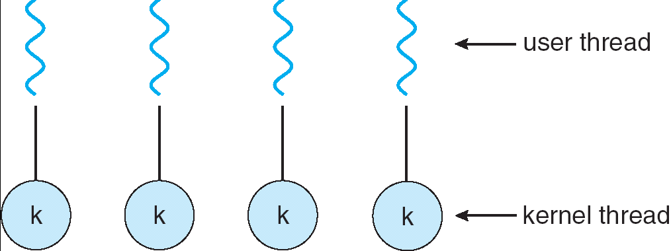
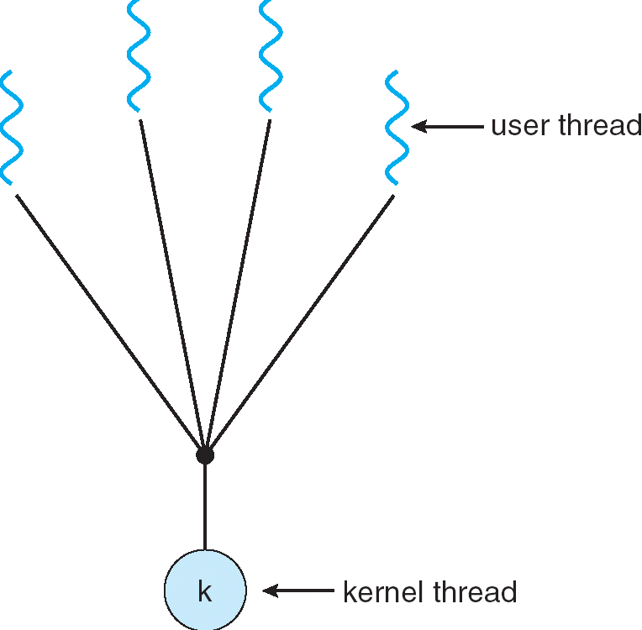
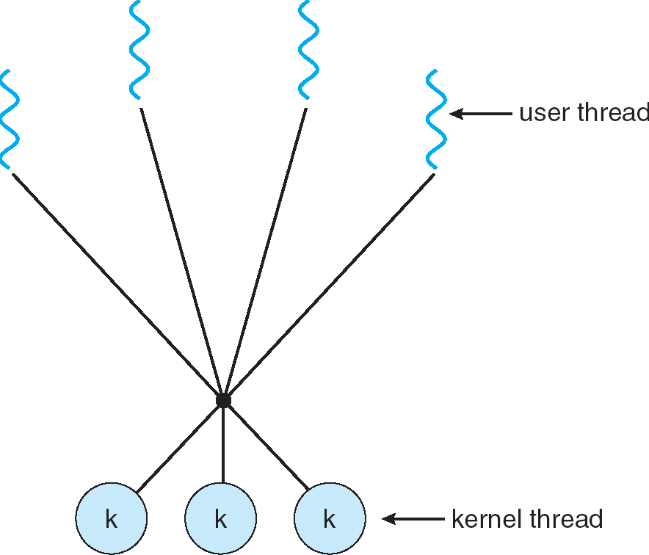
Remember this Slide?
Simple One-to-One
Threading Model
Many-to-One
Many-to-Many

Slide 69
User-Mode Threads: Problems
One user-level thread blocks on syscall: all user-level threads relying on same kernel thread also block
  Kernel cannot intelligently schedule threads it doesn’t know about
Multiple Cores?
No pre-emption: User-level thread must explicitly yield CPU to allow someone else to run

Slide 70
Go User-Level Thread Scheduler
Global Run Queue
Newly created goroutines
Local Run Queue
Local Run Queue
Local Run Queue
OS Thread (M)
OS Thread (M)
OS Thread (M)
…
CPU Core
CPU Core
CPU Core

Slide 71
Go User-Level Thread Scheduler
Why this approach?
1 OS (kernel-supported) thread per CPU core: allows go program to achieve parallelism not just concurrency
  Fewer OS threads? Not utilizing all CPUs
  More OS threads? No additional benefit
    We’ll see one exception to this involving syscalls
Keep goroutine on same OS thread: affinity, nice for caching and performance

Slide 72
Cooperative Scheduling
No pre-emption => goroutines must yield to allow another thread to run
Programmer does not need to do this explicitly
Go runtime injects yields at safe points in execution
  Sending/receiving with a channel
  Acquiring a mutex
  Making a function call
But your code can still tie up the scheduler in "tight loops" (Go's developers are working on this…)

Slide 73
Dealing with Syscalls
Local Run Queue
What if a goroutine wants to make a blocking syscall?
Example: File I/O
Running Grtn.
OS Thread (M1)
CPU Core

Slide 74
Dealing with Syscalls
While syscall is blocking, allocate new OS thread (M2)
M1 is blocked by kernel, M2 lets us continue using CPU
Local Run Queue
OS Thread
(M2)
CPU Core
Blocking Grtn.
OS Thread
(M1)

Slide 75
Dealing with Syscalls
Syscall completes: Put invoking goroutine back on queue
Keep M1 around in a spare pool
Swap it with M2 upon next syscall, no need to pay thread creation cost
Local Run Queue
Running Grtn.
OS Thread
(M2)
Blocking Grtn.
CPU Core
OS Thread
(M1)

