Slide 1
CS162
Operating Systems and
Systems Programming
Lecture 12
Address Translation
October 7th, 2019
Prof. David E. Culler
http://cs162.eecs.Berkeley.edu
Read: A&D Ch 8
MidTerm: Thurs

Slide 2
Recall: Starvation and Deadlock
Starvation: thread waits indefinitely
  Example, low-priority thread waiting for resources constantly in use by high-priority threads
Deadlock: circular waiting for resources
  Thread A owns Res 1 and is waiting for Res 2
  Thread B owns Res 2 and is waiting for Res 1
Deadlock ⇒ Starvation but not vice versa
  Starvation can end (but doesn’t have to)
  Deadlock can’t end without external intervention
Thread
A
Wait
For
Owned
By
Res 1
Res 2
Owned
By
Wait
For
Thread
B
Notes:
Now let's look at some key problems we face when synchronizing or scheduling concurrent tasks.

Slide 3
Recall: Four requirements for Deadlock
Mutual exclusion
  Only one thread at a time can use a resource.
Hold and wait
  Thread holding at least one resource is waiting to acquire additional resources held by other threads
No preemption
  Resources are released only voluntarily by the thread holding the resource, after thread is finished with it
Circular wait
  There exists a set {T₁, …, T_{n}} of waiting threads
    T₁ is waiting for a resource that is held by T₂
    T₂ is waiting for a resource that is held by T₃
    …
    T_{n} is waiting for a resource that is held by T₁
To prevent deadlock, make sure at least one of these conditions does not hold

Slide 4
Recall: How should a system deal with deadlock?
Three different approaches:
Deadlock avoidance: dynamically delay resource requests so deadlock doesn’t happen
Deadlock prevention: write your code in a way that it isn’t prone to deadlock
Deadlock recovery: let deadlock happen, and then figure out how to recover from it
Modern operating systems:
  Make sure the system isn’t involved in any deadlock
  Ignore deadlock in applications
    “Ostrich Algorithm”

Slide 5
Recall: Ways of preventing deadlock
Force all threads to request resources in a particular order preventing any cyclic use of resources
  Example (x.P, y.P, z.P,…)
    Make tasks request disk, then memory, then…
Banker’s algorithm:
  Allocate resources dynamically
    Evaluate each request and grant if some
    ordering of threads is still deadlock free afterward
    Technique: pretend each request is granted, then run deadlock detection algorithm, and grant request if result is deadlock free (conservative!)
  Keeps system in a “SAFE” state, i.e. there exists a sequence {T₁, T₂, … T_{n}} with T₁ requesting all remaining resources, finishing, then T₂ requesting all remaining resources, etc..
  Algorithm allows the sum of maximum resource needs of all current threads to be greater than total resources

Slide 6
Can Priority Inversion cause Deadlock?
Technically not – Consider this example:
  3 threads, T1, T2, T3 in priority order (T3 highest)
  T1 grabs lock, T3 tries to acquire, then sleeps, T2 running
  Will this make progress?
    No, as long as T2 is running
    But T2 could stop at any time and the problem would resolve itself… So, this is not a deadlock (it is a livelock)
  Why is this a priority inversion?
    T3 is prevented from running by T2
How does priority donation help?
  Briefly raising T1 to the same priority as T3⇒T1 can run and release lock, allowing T3 to run
  Does priority donation involve taking lock away from T1?
    NO! That would break semantics of the lock and potentially corrupt any information protected by lock!

Slide 7
Logistics and Such
We have completed the first major segment of the course
The Midterm will cover through last week
  The basics of address translation of Lec. 2, not the new material in this lecture
Homeworks 3 & 4, Project 2 will continue to exercise and cement what we have covered so far.
Building on these foundations, we can now deepen and broaden

Slide 8
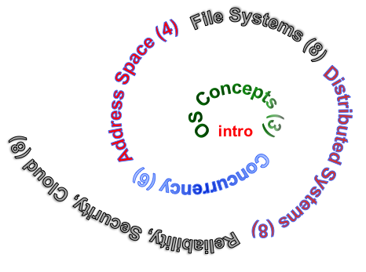
Next Objective
Dive deeper into the concepts and mechanisms of memory sharing and address translation
Enabler of many key aspects of operating systems
  Protection
  Multi-programming
  Isolation
  Memory resource management
  I/O efficiency
  Sharing
  Inter-process communication
  Debugging
  Demand paging
Today: Translation

Slide 9
Recall: Four Fundamental OS Concepts
Thread: Execution Context
  Program Counter, Registers, Execution Flags, Stack
Address space (with translation)
  Program's view of memory is distinct from physical machine
Process: an instance of a running program
  Address Space + One or more Threads + …
Dual mode operation / Protection
  Only the “system” can access certain resources
  Combined with translation, isolates programs from each other

Slide 10
THE BASICS
Address Space:
2^{k} “things”
Address:
k bits
What is 2¹⁰ ?
How many bits to address each byte of 4kb page?
How much memory can be addressed with 20 bits? 32 bits?
48 bits?

Slide 11
Address Space, Process Virtual Address Space
Definition: Set of accessible addresses and the state associated with them
  2³² = ~4 billion on a 32-bit machine
What happens when processor reads or writes to an address?
  Perhaps acts like regular memory
  Perhaps causes I/O operation
    (Memory-mapped I/O)
  Causes program to abort (segfault)?
  Communicate with another program
  …
0x000…
code
Static Data
heap
stack
0xFFF…

Slide 12
Recall: Process Address Space: typical structure
0x000…
Code Segment
PC:
SP:
Static Data
heap
Processor
registers
sbrk syscall
Stack Segment
0xFFF…

Slide 13

Recall: Single and Multithreaded Processes
Threads encapsulate concurrency
  “Active” component of a process
Address spaces encapsulate protection
  Keeps buggy program from trashing the system
  “Passive” component of a process

Slide 14
Virtualizing Resources
Physical Reality:
Different Processes/Threads share the same hardware
  Need to multiplex CPU (Just finished: scheduling)
  Need to multiplex use of Memory (starting today)
  Need to multiplex disk and devices (later in term)
Why worry about memory sharing?
  The complete working state of a process and/or kernel is defined by its data in memory (and registers)
  Consequently, cannot just let different threads of control use the same memory
    Physics: two different pieces of data cannot occupy the same locations in memory
  Probably don’t want different threads to even have access to each other’s memory if in different processes (protection)
Notes:
Now we're going to talk about other ways we can virtualize resources.
Seen: virtualizing CPU by multiplexing many processes and threads onto it (scheduling)
Now: memory

Slide 15
Recall: Key OS Concept: Address Space
Program operates in an address space that is distinct from the physical memory space of the machine
“physical address”
0x000…
“virtual address”
Processor
translator
Memory
Registers
0xFFF…

Slide 16
Important Aspects of Memory Multiplexing
Protection:
  Prevent access to private memory of other processes
    Different pages of memory can be given special behavior (Read Only, Invisible to user programs, etc).
    Kernel data protected from User programs
    Programs protected from themselves
Translation:
  Ability to translate accesses from one address space (virtual) to a different one (physical)
  When translation exists, processor uses virtual addresses, physical memory uses physical addresses
  Can be used to avoid overlap (isolation, protection)
  Can be used to give uniform view of memory to programs
Controlled overlap:
  There are cases where overlap may be desired
    Read-Only data, Execute-Only shared libraries,
    Inter-process communication

Slide 17
Approach
Let’s start simple and physical
Work our way up to typical (page-based) virtual address translation

Slide 18




Recall: Load Pgm in Mem, Create Proc.
Threads
Address Spaces
Windows
Processes
Files
Sockets
Software
OS Hardware Virtualization
Hardware
ISA
Memory
Processor
Protection Boundary
OS
Ctrlr
storage
Networks
Displays
Inputs

Slide 19
Binding of Instructions and Data to Memory
With 4-byte word
0x300 = 4 * 0x0C0
0x0C0 = 0000…0000 1100 0000
0x300 = 0000…0011 0000 0000
Process view of memory
Physical addresses
  data1: dw 32
  …
  start: lw r1,0(data1)
  jal checkit
  loop: addi r1, r1, -1
  bnz r1, loop …
  checkit: …
  0x0300 00000020
  … …
  0x0900 8C2000C0
  0x0904 0C000280
  0x0908 2021FFFF
  0x090C 14200242
  …
  0x0A00

Slide 20
Binding of Instructions and Data to Memory
Physical
Memory
0x0000
0x0300
  00000020
Process view of memory
Physical addresses
  data1: dw 32
  …
  start: lw r1,0(data1)
  jal checkit
  loop: addi r1, r1, -1
  bnz r1, loop …
  checkit: …
  0x0300 00000020
  … …
  0x0900 8C2000C0
  0x0904 0C000280
  0x0908 2021FFFF
  0x090C 14200242
  …
  0x0A00
0x0900
  8C2000C0
  0C000340
  2021FFFF
  14200242
0xFFFF

Slide 21
What about a 2nd instance of this program ?
Physical
Memory
0x0000
Process view of memory
Physical addresses
0x0300
App X
  data1: dw 32
  …
  start: lw r1,0(data1)
  jal checkit
  loop: addi r1, r1, -1
  bnz r1, loop …
  checkit: …
  0x0300 00000020
  … …
  0x0900 8C2000C0
  0x0904 0C000280
  0x0908 2021FFFF
  0x090C 14200242
  …
  0x0A00
0x0900
?
Need address translation!
0xFFFF

Slide 22
What about a 2nd instance of this program ?
Physical
Memory
0x0000
Process view of memory
Physical addresses
0x0300
App X
  data1: dw 32
  …
  start: lw r1,0(data1)
  jal checkit
  loop: addi r1, r1, -1
  bnz r1, loop …
  checkit: …
  0x1300 00000020
  … …
  0x1900 8C2004C0
  0x1904 0C000680
  0x1908 2021FFFF
  0x190C 14200642
  …
  0x1A00
0x0900
0x1000
0x1300
  00000020
0x1900
  8C2004C0
  0C000680
  2021FFFF
  14200642
One of many possible translations!
Where does translation take place?
    Link/Load time, or Execution time?
0xFFFF

Slide 23
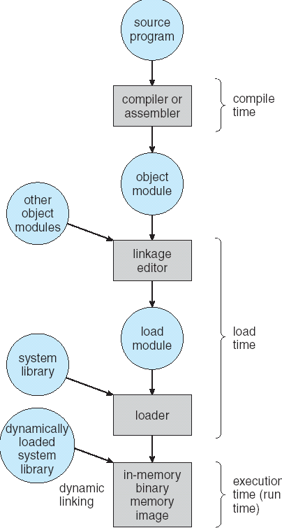
Multi-step Processing of a Program for Execution
Preparation of a program for execution involves components at:
  Compile time (i.e., “gcc”)
  Link/Load time (UNIX “ld” does link)
  Execution time (e.g., dynamic libs)
Addresses can be bound to final values anywhere in this path
  Depends on hardware support
  Also depends on operating system
Dynamic Libraries
  Linking postponed until execution
  Small piece of code (i.e. the stub), locates appropriate memory-resident library routine
  Stub replaces itself with the address of the routine, and executes routine

Slide 24

Uniprogramming – one process at a time
no Translation or Protection
  Application always runs at same place in physical memory since only one application at a time
  Application can access any physical address
  Application given illusion of dedicated machine by giving it reality of a dedicated machine
0xFFFFFFFF
Operating
System
Valid 32-bit
Addresses
Application
0x00000000

Slide 25
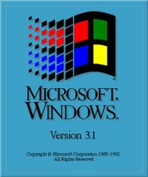
Multiprogramming (primitive stage)
Multiprogramming without Translation or Protection
  Must somehow prevent address overlap between threads
  Use Loader/Linker: Adjust addresses while program loaded into memory (loads, stores, jumps)
    Everything adjusted to memory location where OS put program
    Translation done by a linker-loader (relocation)
    Common in early days (… till Windows 3.x, 95?)
no protection: bugs in any program can cause others to crash or even the OS (and lots of hacks, e.g., TSR)
0xFFFFFFFF
Operating
System
Application2
0x00020000
Application1
0x00000000

Slide 26
Multiprogramming - with Protection
Can we protect programs from each other without translation?
  Yes: use two special registers BaseAddr and LimitAddr to prevent user from straying outside designated area
    Cause error if user tries to access an illegal address
  During switch, kernel loads new base/limit from PCB (Process Control Block)
    User not allowed to change base/limit registers
0xFFFFFFFF
Operating
System
LimitAddr=0x10000
Application2
0x00020000
BaseAddr=0x20000
Application1
0x00000000

Slide 27
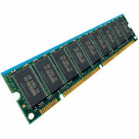
General Address translation
Virtual
Addresses
Physical
Addresses
CPU
MMU
Untranslated read or write
Recall: Address Space:
  All the addresses and state a process can touch
  Each process and kernel has different address space
Consequently, two views of memory:
  View from the CPU (what program sees, virtual memory)
  View from memory (physical memory)
  Translation box (MMU) converts between the two views
Translation ⇒ much easier to implement protection!
  If task A cannot gain access to task B’s data, no way for A to adversely affect B
With translation, every program can be linked/loaded into same region of user address space (no adjustments)
psst. MMU accesses Page Table

Slide 28

Recall: Base and Bounds (e.g., CRAY-1)
Base
Virtual
Address
CPU
+
DRAM
Physical
Address
Bound
(Limit)
<?
No: Error!
Could use base/bounds for dynamic address translation – translation happens at execution:
  Alter address of every load/store by adding “base”
  Generate error if address bigger than limit
Gives program the illusion that it is running on its own dedicated machine, with memory starting at 0
  Program gets continuous region of memory
  Addresses within program do not have to be relocated when program placed in different region of DRAM

Slide 29
Issues with Simple B&B Method
process 6
process 6
process 6
process 6
process 5
process 5
process 5
process 9
process 9
process 11
process 2
process 10
OS
OS
OS
OS
Fragmentation problem over time
  Not every process is same size ⇒ memory becomes fragmented over time
Missing support for sparse address space
  Would like to have multiple chunks/program (Code, Data, Stack, Heap, etc)
Hard to do inter-process sharing
  Want to share code segments when possible
  Want to share memory between processes
  Helped by providing multiple segments per process

Slide 30
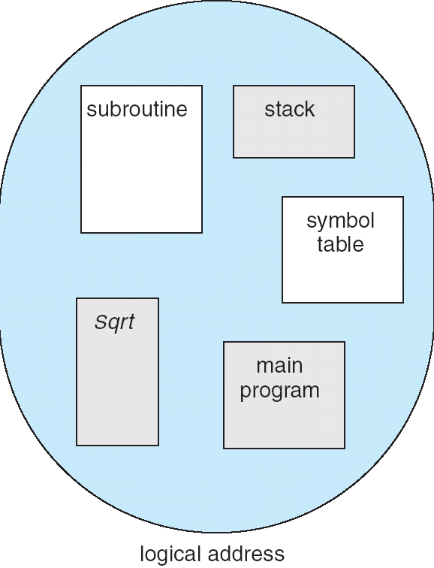
More Flexible Segmentation
1
1
1
4
2
3
2
2
4
3
user view of
memory space
physical
memory space
Logical View: multiple separate segments
  Typical: Code, Data, Stack
  Others: memory sharing, etc
Each segment is given region of contiguous memory
  Has a base and limit
  Can reside anywhere in physical memory

Slide 31
Implementation of Multi-Segment Model
Virtual
Address
offset
>
Error
Seg #
Offset
Base0
Limit0
V
Base1
Limit1
V
Base2
Limit2
V
Base2
Limit2
V
Physical
Address
Base3
Limit3
N
+
Base4
Limit4
V
Base5
Limit5
N
Base6
Limit6
N
Base7
Limit7
V
Check Valid
Segment map resides in processor
  Segment number mapped into base/limit pair
  Base added to offset to generate physical address
  Error check catches offset out of range
As many chunks of physical memory as entries
  Segment addressed by portion of virtual address
  However, could be included in instruction instead:
    x86 Example: mov [es:bx],ax.
What is “V/N” (valid / not valid)?
  Can mark segments as invalid; requires check as well
Access
Error

Slide 32
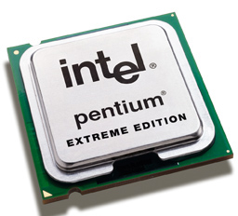
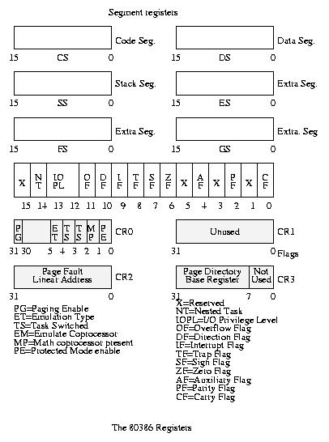
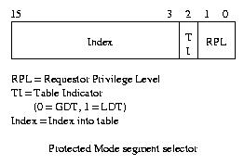
Intel x86 Special Registers
80386 Special Registers
Typical Segment Register
Current Priority is RPL
Of Code Segment (CS)

Slide 33
Example: Four Segments (16 bit addresses)
Seg ID # | Base | Limit
0 (code) | 0x4000 | 0x0800
1 (data) | 0x4800 | 0x1400
2 (shared) | 0xF000 | 0x1000
3 (stack) | 0x0000 | 0x3000
Seg
Offset
15
14
13
0
Virtual Address Format
0x0000
0x0000
0x4000
0x8000
0xC000
Virtual
Address Space
Physical
Address Space

Slide 34
Example: Four Segments (16 bit addresses)
Seg ID # | Base | Limit
0 (code) | 0x4000 | 0x0800
1 (data) | 0x4800 | 0x1400
2 (shared) | 0xF000 | 0x1000
3 (stack) | 0x0000 | 0x3000
Seg
Offset
15
14
13
0
Virtual Address Format
SegID = 0
0x0000
0x0000
0x4000
0x4000
0x4800
0x8000
0xC000
Virtual
Address Space
Physical
Address Space

Slide 35
Example: Four Segments (16 bit addresses)
Seg ID # | Base | Limit
0 (code) | 0x4000 | 0x0800
1 (data) | 0x4800 | 0x1400
2 (shared) | 0xF000 | 0x1000
3 (stack) | 0x0000 | 0x3000
Seg
Offset
15
14
13
0
Virtual Address Format
SegID = 0
0x0000
0x0000
SegID = 1
0x4000
Might
be shared
0x4000
0x4800
0x5C00
0x8000
Space for
Other Apps
0xC000
Shared with
Other Apps
Virtual
Address Space
Physical
Address Space

Slide 36
Example: Four Segments (16 bit addresses)
Seg ID # | Base | Limit
0 (code) | 0x4000 | 0x0800
1 (data) | 0x4800 | 0x1400
2 (shared) | 0xF000 | 0x1000
3 (stack) | 0x0000 | 0x3000
Seg
Offset
15
14
13
0
Virtual Address Format
SegID = 0
0x0000
0x0000
SegID = 1
0x4000
Might
be shared
0x4000
0x4800
0x5C00
0x8000
Space for
Other Apps
0xC000
0xF000
Shared with
Other Apps
Virtual
Address Space
Physical
Address Space

Slide 37
Example of Segment Translation (16bit address)
0x240 main: la $a0, varx
0x244 jal strlen
… …
0x360 strlen: li $v0, 0 ;count
0x364 loop: lb $t0, ($a0)
0x368 beq $r0,$t0, done
… …
0x4050 varx dw 0x314159
Seg ID # | Base | Limit
0 (code) | 0x4000 | 0x0800
1 (data) | 0x4800 | 0x1400
2 (shared) | 0xF000 | 0x1000
3 (stack) | 0x0000 | 0x3000
Let’s simulate a bit of this code to see what happens (PC=0x240):
Fetch 0x0240 (0000 0010 0100 0000). Virtual segment #? 0; Offset? 0x240
Physical address? Base=0x4000, so physical addr=0x4240
Fetch instruction at 0x4240. Get “la $a0, varx”
Move 0x4050 → $a0, Move PC+4→PC

Slide 38
Example of Segment Translation (16bit address)
0x240 main: la $a0, varx
0x244 jal strlen
… …
0x360 strlen: li $v0, 0 ;count
0x364 loop: lb $t0, ($a0)
0x368 beq $r0,$t0, done
… …
0x4050 varx dw 0x314159
Seg ID # | Base | Limit
0 (code) | 0x4000 | 0x0800
1 (data) | 0x4800 | 0x1400
2 (shared) | 0xF000 | 0x1000
3 (stack) | 0x0000 | 0x3000
Let’s simulate a bit of this code to see what happens (PC=0x240):
Fetch 0x0240 (0000 0010 0100 0000). Virtual segment #? 0; Offset? 0x240
Physical address? Base=0x4000, so physical addr=0x4240
Fetch instruction at 0x4240. Get “la $a0, varx”
Move 0x4050 → $a0, Move PC+4→PC
Fetch 0x244. Translated to Physical=0x4244. Get “jal strlen”
Move 0x0248 → $ra (return address!), Move 0x0360 → PC

Slide 39
Example of Segment Translation (16bit address)
0x240 main: la $a0, varx
0x244 jal strlen
… …
0x360 strlen: li $v0, 0 ;count
0x364 loop: lb $t0, ($a0)
0x368 beq $r0,$t0, done
… …
0x4050 varx dw 0x314159
Seg ID # | Base | Limit
0 (code) | 0x4000 | 0x0800
1 (data) | 0x4800 | 0x1400
2 (shared) | 0xF000 | 0x1000
3 (stack) | 0x0000 | 0x3000
Let’s simulate a bit of this code to see what happens (PC=0x240):
Fetch 0x0240 (0000 0010 0100 0000). Virtual segment #? 0; Offset? 0x240
Physical address? Base=0x4000, so physical addr=0x4240
Fetch instruction at 0x4240. Get “la $a0, varx”
Move 0x4050 → $a0, Move PC+4→PC
Fetch 0x244. Translated to Physical=0x4244. Get “jal strlen”
Move 0x0248 → $ra (return address!), Move 0x0360 → PC
Fetch 0x360. Translated to Physical=0x4360. Get “li $v0, 0”
Move 0x0000 → $v0, Move PC+4→PC

Slide 40
Example of Segment Translation (16bit address)
0x0240 main: la $a0, varx
0x0244 jal strlen
… …
0x0360 strlen: li $v0, 0 ;count
0x0364 loop: lb $t0, ($a0)
0x0368 beq $r0,$t0, done
… …
0x4050 varx dw 0x314159
Seg ID # | Base | Limit
0 (code) | 0x4000 | 0x0800
1 (data) | 0x4800 | 0x1400
2 (shared) | 0xF000 | 0x1000
3 (stack) | 0x0000 | 0x3000
Let’s simulate a bit of this code to see what happens (PC=0x0240):
Fetch 0x0240 (0000 0010 0100 0000). Virtual segment #? 0; Offset? 0x240
Physical address? Base=0x4000, so physical addr=0x4240
Fetch instruction at 0x4240. Get “la $a0, varx”
Move 0x4050 → $a0, Move PC+4→PC
Fetch 0x0244. Translated to Physical=0x4244. Get “jal strlen”
Move 0x0248 → $ra (return address!), Move 0x0360 → PC
Fetch 0x0360. Translated to Physical=0x4360. Get “li $v0, 0”
Move 0x0000 → $v0, Move PC+4→PC
Fetch 0x0364. Translated to Physical=0x4364. Get “lb $t0, ($a0)”
Since $a0 is 0x4050, try to load byte from 0x4050
Translate 0x4050 (0100 0000 0101 0000). Virtual segment #? 1; Offset? 0x50
Physical address? Base=0x4800, Physical addr = 0x4850,
Load Byte from 0x4850→$t0, Move PC+4→PC

Slide 41
Observations about Segmentation
Translation on every instruction fetch, load or store
Virtual address space has holes
  Segmentation efficient for sparse address spaces
  A correct program should never access gaps (except as mentioned in moment)
    If it does, trap to kernel and dump core
When it is OK to address outside valid range?
  This is how the stack (and heap ?) allowed to grow
  For instance, stack takes fault, system automatically increases size of stack
Need protection mode in segment table
  For example, code segment would be read-only
  Data and stack would be read-write (stores allowed)
  Shared segment could be read-only or read-write
What must be saved/restored on context switch?
  Segment table stored in CPU, not in memory (small)
  Might store all of processes memory onto disk when switched (called “swapping”)

Slide 42
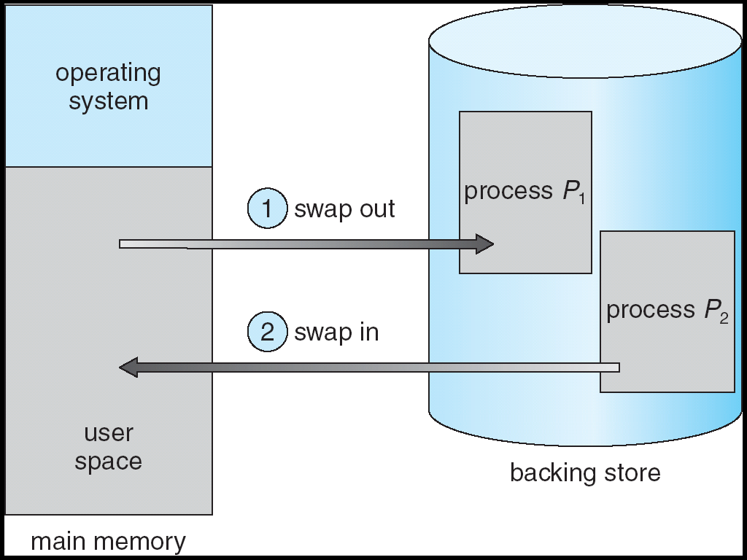
What if not all segments fit into memory?
Extreme form of Context Switch: Swapping
  In order to make room for next process, some or all of the previous process is moved to disk
    Likely need to send out complete segments
  This greatly increases the cost of context-switching
What might be a desirable alternative?
  Some way to keep only active portions of a process in memory at any one time
  Need finer granularity control over physical memory

Slide 43
Problems with Segmentation
Must fit variable-sized chunks into physical memory
May move processes multiple times to fit everything
Limited options for swapping to disk
Fragmentation: wasted space
  External: free gaps between allocated chunks
  Internal: don’t need all memory within allocated chunks

Slide 44
Recall: General Address Translation
Code
Data
Heap
Stack
Data 2
Code
Data
Heap
Stack
Stack 1
Heap 1
Code 1
Stack 2
Prog 1
Virtual
Address
Space 1
Data 1
Prog 2
Virtual
Address
Space 2
Heap 2
Code 2
OS code
Translation Map 1
OS data
Translation Map 2
OS heap &
Stacks
Physical Address Space

Slide 45
Paging: Physical Memory in Fixed Size Chunks
Solution to fragmentation from segments?
  Allocate physical memory in fixed size chunks (“pages”)
  Every chunk of physical memory is equivalent
    Can use simple vector of bits to handle allocation:
    00110001110001101 … 110010
    Each bit represents page of physical memory
    1 ⇒ allocated, 0 ⇒ free
Should pages be as big as our previous segments?
  No: Can lead to lots of internal fragmentation
    Typically have small pages (1K-16K)
  Consequently: need multiple pages/segment

Slide 46
How to Implement Paging?
Virtual Address:
Virtual
Page #
Offset
PageTablePtr
page #0
V,R
Physical
Page #
Offset
page #1
V,R
page #1
V,R
page #2
V,R,W
Physical Address
PageTableSize
>
page #3
V,R,W
Check Perm
Access Error
page #4
N
page #5
V,R,W
Access
Error
Page Table (One per process)
  Resides in physical memory
  Contains physical page and permission for each virtual page
    Permissions include: Valid bits, Read, Write, etc
Virtual address mapping
  Offset from Virtual address copied to Physical Address
    Example: 10 bit offset ⇒ 1024-byte pages
  Virtual page # is all remaining bits
    Example for 32-bits: 32-10 = 22 bits, i.e. 4 million entries
    Physical page # copied from table into physical address
  Check Page Table bounds and permissions

Slide 47
Simple Page Table Example
Example (4 byte pages)
0x00
0000 0000
0x00
a
b
c
d
0001 0000
0x04
0
4
i
j
k
l
0x04
0000 0100
1
0000 1100
0x05!
e
f
g
h
3
2
1
0000 0100
0x08
0x06?
0x08
0000 1000
Page
Table
0x0C
i
j
k
l
e
f
g
h
0x09?
0x0E!
0x10
Virtual
Memory
0000 0110
0000 1110
a
b
c
d
0000 1001
0000 0101
Physical
Memory
Notes:
What is virtual address 0x6? 1|10 = 3|2 = 0xE
What is virtual address 0x9? 10|01 = 1|1 = 0x5

Slide 48
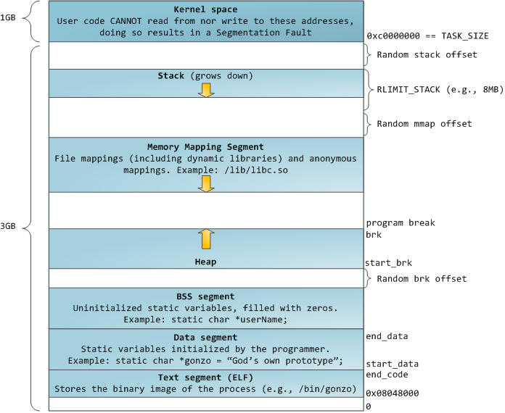
Example: Memory Layout for Linux 32-bit *
* Pre-Meltdown patches, more later
http://static.duartes.org/img/blogPosts/linuxFlexibleAddressSpaceLayout.png

Slide 49
Paged virtual address space
Page Table
Virtual memory view
11111 11101
11110 11100
11101 null
11100 null
11011 null
11010 null
11001 null
11000 null
10111 null
10110 null
10101 null
10100 null
10011 null
10010 10000
10001 01111
10000 01110
01111 null
01110 null
01101 null
01100 null
01011 01101
01010 01100
01001 01011
01000 01010
00111 null
00110 null
00101 null
00100 null
00011 00101
00010 00100
00001 00011
00000 00010
Physical memory view
1111 1111
1110 1111
1111 0000
stack
stack
1110 0000
1100 0000
heap
1000 0000
heap
0111 000
data
data
0101 000
0100 0000
code
code
0001 0000
0000 0000
0000 0000
page #
offset

Slide 50
Summary: Paging
Virtual memory view
Page Table
11111 11101
11110 11100
11101 null
11100 null
11011 null
11010 null
11001 null
11000 null
10111 null
10110 null
10101 null
10100 null
10011 null
10010 10000
10001 01111
10000 01110
01111 null
01110 null
01101 null
01100 null
01011 01101
01010 01100
01001 01011
01000 01010
00111 null
00110 null
00101 null
00100 null
00011 00101
00010 00100
00001 00011
00000 00010
Physical memory view
1111 1111
stack
1110 0000
stack
1110 0000
1100 0000
What happens if stack grows to 1110 0000?
heap
1000 0000
heap
0111 000
data
data
0101 000
0100 0000
code
code
0001 0000
0000 0000
0000 0000
page #
offset

Slide 51
Summary: Paging
Virtual memory view
Page Table
11111 11101
11110 11100
11101 10111
11100 10110
11011 null
11010 null
11001 null
11000 null
10111 null
10110 null
10101 null
10100 null
10011 null
10010 10000
10001 01111
10000 01110
01111 null
01110 null
01101 null
01100 null
01011 01101
01010 01100
01001 01011
01000 01010
00111 null
00110 null
00101 null
00100 null
00011 00101
00010 00100
00001 00011
00000 00010
Physical memory view
1111 1111
stack
1110 0000
stack
1110 0000
1100 0000
stack
Allocate new pages where room!
heap
1000 0000
heap
0111 000
data
Challenge: Table size equal to # of pages in virtual memory!
data
0101 000
0100 0000
code
code
0001 0000
0000 0000
0000 0000
page #
offset

Slide 52
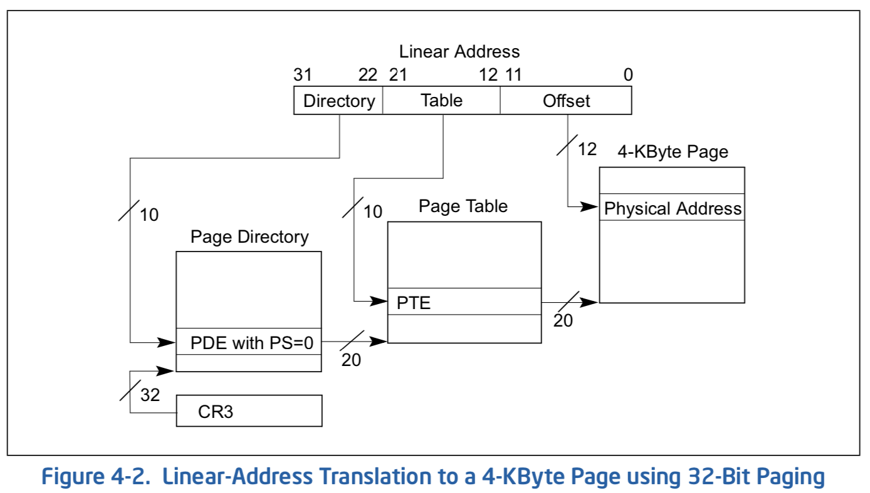
x86 classic 32-bit address translation
CR3 provides physical address of the “Page Directory”, i.e., first level of 2-level translation

Slide 53
Page Table Discussion
What provides protection?
What needs to be switched on a context switch?
  Page table pointer and limit
Analysis
  Pros: Simple memory allocation & management, Simple uniform process address space?
  Con: What if address space is sparse?
    e.g., on UNIX, code starts at 0, stack starts at (2³¹-1)
    With 1K pages, need 2 million page table entries!
  Con: What if table really big?
    Not all pages used all the time ⇒ would be nice to have working set of page table in memory
Could processes constructively share memory?
How big is the page table? Does it all need to be in memory?
  How about multi-level paging
  or combining paging and segmentation?
Notes:
What if page size is very small? VAX had a 512-byte page size = lots of space for page table entries
What if page size is really big? Wastes space inside of page (internal fragmentation)

Slide 54
Simple mechanism – Profound Implications
Address Space Randomization
  Position-Independent Code => can place user code region anywhere in the address space
    Random start address makes much harder for attacker to cause jump to code that it seeks to take over
  Stack & Heap can start anywhere, so randomize placement
Kernel address space isolation
  Don’t map whole kernel space into each process, switch to kernel page table

Slide 55
What about Sharing?
Virtual Address
(Process A):
Virtual
Page #
Offset
PageTablePtrA
page #0
V,R
page #1
V,R
page #2
V,R,W
page #2
V,R,W
page #3
V,R,W
Shared
Page
page #4
N
page #5
V,R,W
PageTablePtrB
page #0
V,R
page #1
N
This physical page
appears in address
space of both processes
page #2
V,R,W
page #3
N
page #4
V,R
page #4
V,R
page #5
V,R,W
Virtual Address
(Process B):
Virtual
Page #
Offset

Slide 56
Where is page sharing used ?
The “kernel region” of every process has the same page table entries
The process cannot access it at user level
But on U->K switch, kernel code can access it AS WELL AS the region for THIS user
  What does the kernel need to do to access other user processes?
User-level system libraries (execute only)

Slide 57
How big do things get?
32-bit address space => 2³² bytes (4 GB)
Typical page size: 4 kb
  how many bits of the address is that ? (hint 2¹⁰ = 1024)
So how many entries in the page table of each process?
  2²⁰ (that’s about a million) x 4 bytes each => 4 MB
  When 32-bit machines got started (vax 11/780, intel 80386) 16 mb was a LOT of memory
It has huge holes in it.

Slide 58
For sparse address space: two-level page table
Physical
Address:
Physical
Page #
Offset
10 bits
10 bits
12 bits
Virtual
Address:
Virtual
P1 index
Virtual
P2 index
Offset
4KB
PageTablePtr
4 bytes
Tree of Page Tables
Tables fixed size (1024 entries)
  On context-switch: save single PageTablePtr register
Valid bits on Page Table Entries
  Don’t need every 2nd-level table
  Even when exist, 2nd-level tables can reside on disk if not in use
4 bytes

Slide 59
Summary: Two-Level Paging
Virtual memory view
Page Table
(level 1)
Page Tables
(level 2)
Physical memory view
1111 1111
stack
11 11101
10 11100
01 10111
00 10110
stack
1110 0000
1111 0000
1100 0000
stack
111
110 null
101 null
100
011 null
010
001 null
000
11 null
10 10000
01 01111
00 01110
heap
1000 0000
heap
0111 000
11 01101
10 01100
01 01011
00 01010
data
data
0101 000
0100 0000
11 00101
10 00100
01 00011
00 00010
code
page2 #
code
0001 0000
0000 0000
0000 0000
page1 #
offset

Slide 60
Summary: Two-Level Paging
Virtual memory view
Page Table
(level 1)
Page Tables
(level 2)
Physical memory view
stack
11 11101
10 11100
01 10111
00 10110
stack
1110 0000
stack
111
110 null
101 null
100
011 null
010
001 null
000
11 null
10 10000
01 01111
00 01110
1001 0000
(0x90)
heap
heap
1000 0000
(0x80)
In best case, total size of page tables ≈ number of pages used by program virtual memory. Requires two additional memory access!
11 01101
10 01100
01 01011
00 01010
data
data
11 00101
10 00100
01 00011
00 00010
code
code
0001 0000
0000 0000

Slide 61
Sharing with multilevel page tables
10 bits
10 bits
12 bits
Physical
Page #
Offset
Virtual
Address:
Virtual
P1 index
Virtual
P2 index
Offset
4KB
PageTablePtr
PageTablePtr’
Entire regions of the address space can be efficiently shared

Slide 62
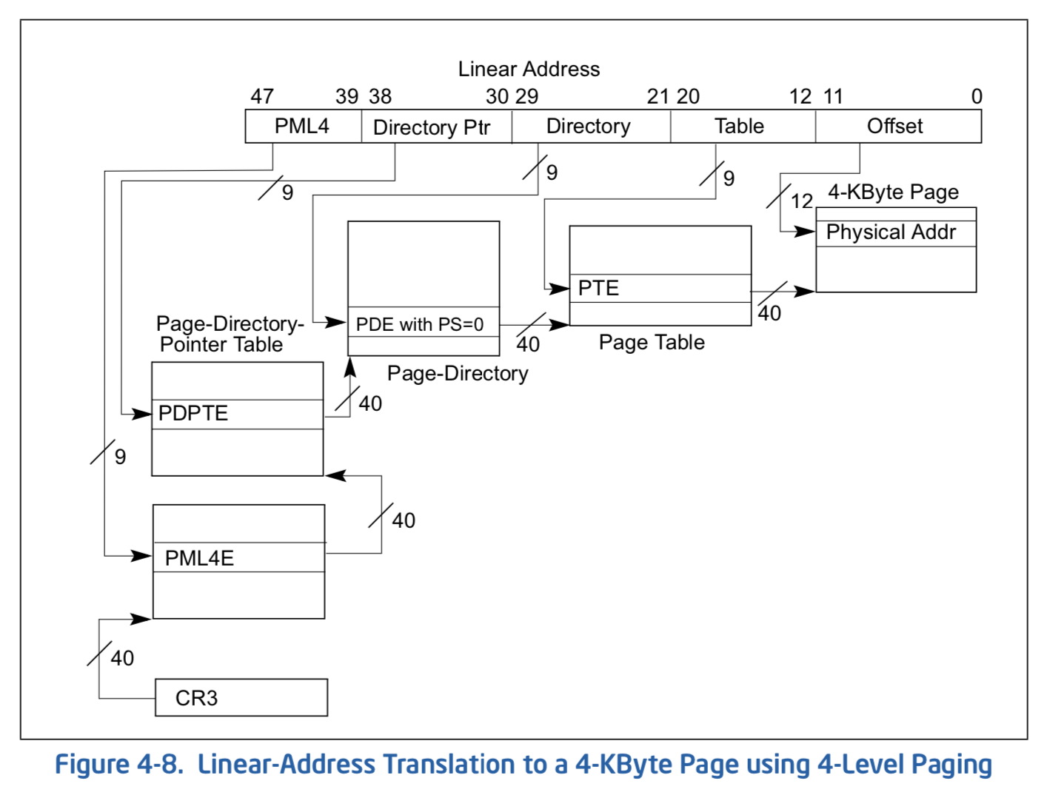
What about a large address space
All current x86 processor support a 64 bit operation
64-bit words (so ints are 8 bytes) but 48-bit addresses

Slide 63
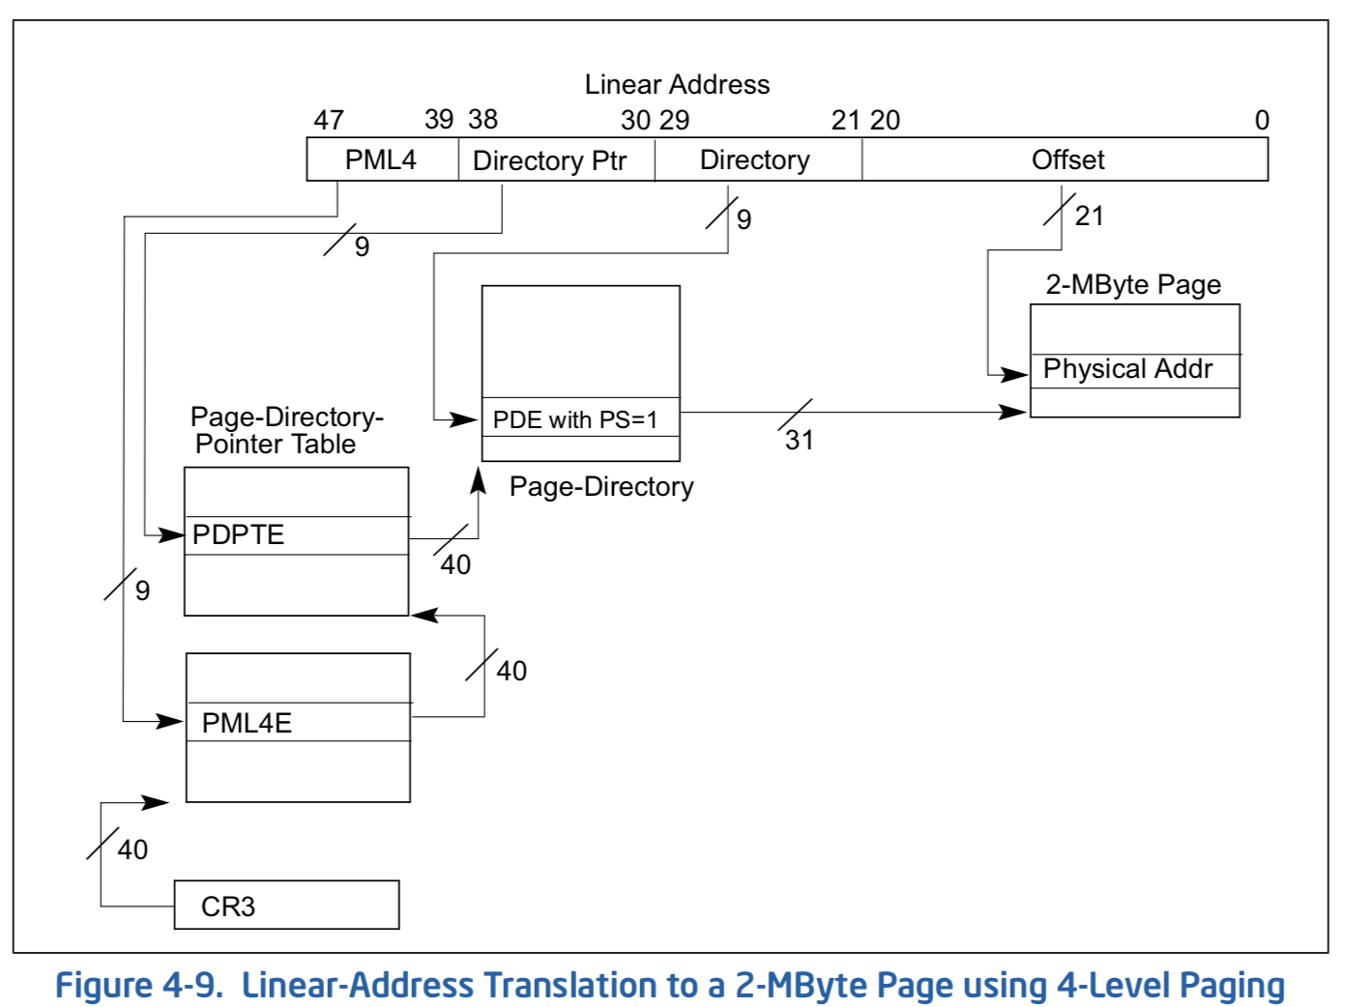
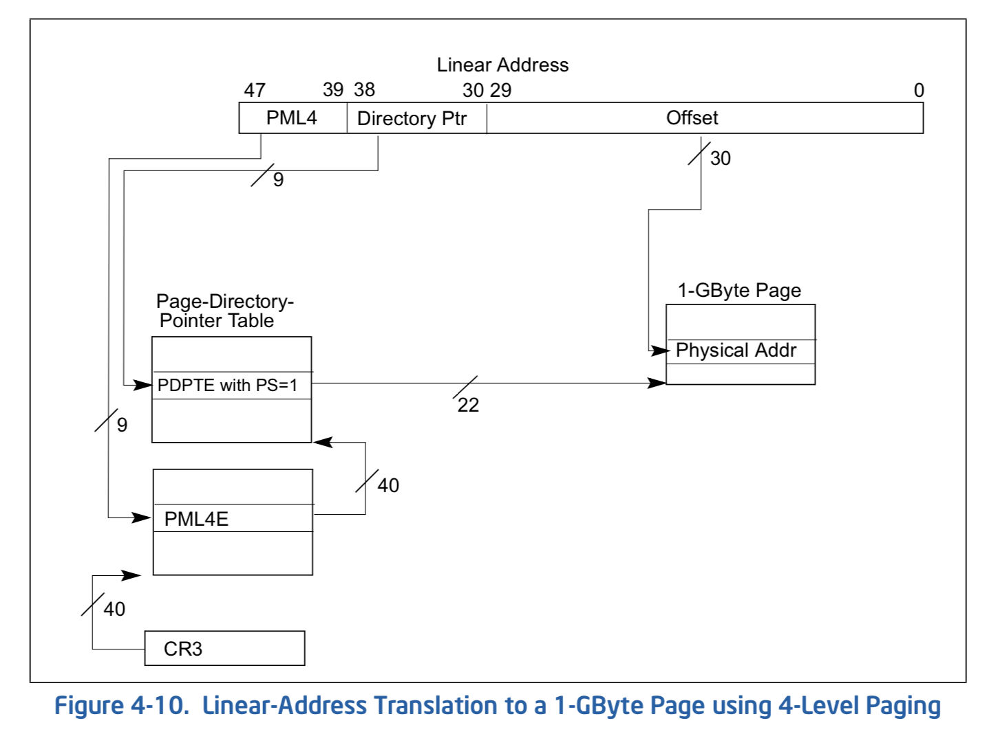
What about a large address space
Or larger page sizes, memory is now cheap

Slide 64
That MMU
For every memory reference – instruction fetch, load or store:
  the virtual address is presented to the MMU
  It indexes through as many levels of page table entries as necessary to translate it to a physical address
  At any stage, it may encounter a “Fault” if the page (or page table page) is not resident or not accessible
Tricky to make this go extremely fast
  But that’s all in hardware

Slide 65
Multi-level Translation Analysis
Pros:
  Allocate (roughly) just page table entries needed for process
    Dense regions (code, static, heap, stack) with holes between
  Easy memory allocation
  Easy Sharing
    Share at segment or page level (need additional reference counting)
Cons:
  Minimum unit of page table allocation is a page
    1024 entries x 4 KB => 4 MB region of address space
  Two (or more) lookups per reference
    Seems very expensive!
    This is where the MMU gets fancy

Slide 66
So what needs to be in that PCB?
Pointer to the page table for the process
Thread Structures (regs, stacks, scheduling)
File descriptors for open files
  Buffers?
Kernel lock objects
Other scheduling data

Slide 67
Summary
Segment Mapping
  Segment registers within processor
  Segment ID associated with each access
    Can come from fields in instruction instead (x86)
  Each segment contains base and limit information
    Offset (rest of address) adjusted by adding base
  Closely approximate by sparse regions of flat virtual address space
Paged Virtual Address Space & Page Tables
  Address space divided into fixed-sized chunks of memory
  Virtual page number from virtual address mapped through page table to physical page number
  Offset of virtual address same as physical address
  Large Address space => Large page tables
Multi-Level Tables
  Virtual address mapped to series of tables
  Permit sparse population of address space

Slide 68
Extras

Slide 69
Multi-level Translation: Segments + Pages
What about a tree of tables?
  Lowest level page table ⇒ memory still allocated with bitmap
  Higher levels often segmented
Could have any number of levels. Example (top segment):
What must be saved/restored on context switch?
  Contents of top-level segment registers (for this example)
  Pointer to top-level table (page table)
Virtual
Address:
Virtual
Seg #
Virtual
Page #
Offset
page #0
V,R
Base0
Limit0
V
page #1
V,R
Physical
Page #
Offset
page #2
V,R,W
Base1
Limit1
V
page #2
V,R,W
Physical Address
Base2
Limit2
V
page #3
V,R,W
Base2
Limit2
V
Base3
Limit3
N
page #4
N
Base4
Limit4
V
page #5
V,R,W
Check Permissions
Base5
Limit5
N
Base6
Limit6
N
Base7
Limit7
V
>
Access
Error
Access
Error

Slide 70
What about Sharing (Complete Segment)?
Process A:
Virtual
Seg #
Virtual
Page #
Offset
page #0
V,R
page #1
V,R
page #2
V,R,W
Base0
Limit0
V
page #3
V,R,W
Base1
Limit1
V
page #4
N
Base2
Limit2
V
Base2
Limit2
V
page #5
V,R,W
Base3
Limit3
N
Base4
Limit4
V
Shared Segment
Base5
Limit5
N
Base6
Limit6
N
Base0
Limit0
V
Base7
Limit7
V
Base1
Limit1
V
Base2
Base2
Limit2
Limit2
V
V
Base3
Limit3
N
Base4
Limit4
V
Base5
Limit5
N
Base6
Limit6
N
Base7
Limit7
V
Process B:
Virtual
Seg #
Virtual
Page #
Offset

