Slide 1
Virtual Machines
David E. Culler
CS162 – Operating Systems and Systems Programming
http://cs162.eecs.berkeley.edu/
Lecture 15
October 22, 2019
Read 3Easy App B
A&D 10.2

Slide 2
Mark your calendar
November 14, Guest Lecture by Dr. Eric Brewer, Google VP of Infrastructure
  Former UCB Faculty
  Founded Inktomi – first fast massive search engine
    inktomi.Berkeley.edu => inktomi.com
  Responsible for re-architecting Google’s internals
  Including Kubernetes.
Let’s fill the room
  Great chance to engage with one of the field’s leading thinkers

Slide 3
Paging Review
Page Table provides a virtual address space for each process
  Serves as the basis of protection
Allows creation of the illusion of a very large memory dedicated to each
  TLB translates every reference form Virtual to Physical
    Fast, High associativity, Small, OS manages consistency
Also basis for sharing (MMAP), fast fork (copy—on-write), fast exec (load by swap)
Key policy issue is page replacement policy
  Approximation to LRU
Clock algorithm (or N-th chance)
  Scan through physical frames, replace first one that has not been accesses in last N passes (clock: N==1)
  Reverse map: frame => PTE, accessed bit in PTE

Slide 4
Management of the Memory Hierarchy
Managed in
Hardware
Managed in Software - OS
?
Processor
Secondary
Storage
(Disk)
TLB
PT
L2 Cache
Registers
L1 Cache
Secondary
Storage
(SSD)
PT
PT
Main
Memory
(DRAM)
PT
TLB
L3 Cache
(shared)
L2 Cache
Registers
L1 Cache
Accessed in Hardware
Speed (ns):
0.3
1
3
10-30
100
100,000
(0.1 ms)
10,000,000
(10 ms)
Size (bytes):
100Bs
10kBs
100kBs
MBs
GBs
100GBs
TBs
Notes:
The design goal is to present the user with as much memory as is available in the cheapest technology (points to the disk).
While by taking advantage of the principle of locality, we like to provide the user an average access speed that is very close to the speed that is offered by the fastest technology.
(We will go over this slide in details in the next lecture on caches).
+1 = 16 min. (X:56)

Slide 5
Demand Paging Mechanisms
PTE makes demand paging implementable
  Valid ⇒ Page in memory, PTE points at physical page
  Not Valid ⇒ Page not in memory; use info in PTE to find it on disk when necessary
Suppose user references page with invalid PTE?
  Memory Management Unit (MMU) traps to OS
    Resulting trap is a “Page Fault”
  What does OS do on a Page Fault?:
    Choose an old page to replace
    If old page modified (“D=1”), write contents back to disk
    Change its PTE and any cached TLB to be invalid
    Load new page into memory from disk
    Update page table entry, invalidate TLB for new entry
    Continue thread from original faulting location
  TLB for new page will be loaded when thread continued!
  While pulling pages off disk for one process, OS runs another process from ready queue
    Suspended process sits on wait queue
Cache

Slide 6
Recall: Clock Algorithm (aka Not Recently Used)
Set of all pages
in Memory
Single Clock Hand:
  Advances through memory frames
  Check for pages not used recently
  Best candidates for eviction
Which bits of a PTE entry are useful to us?
  Use: Set when page is referenced; cleared by clock algorithm
  Modified: set when page is modified, cleared when page written to disk
  Valid: ok for program to reference this page
  Read-only: ok for program to read page, but not modify
    For example for catching modifications to code pages!
Clock Algorithm: pages arranged in a ring
  On page fault (or background reaper):
    Advance clock hand (not real time)
    Check use bit: 1→used recently; clear and leave alone
    0→selected candidate for replacement
  Crude partitioning of pages into two groups: young and old

Slide 7
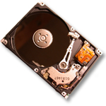
Recall: Clock, Free List, 2nd Chance
Set of all pages
in Memory
Single Clock Hand: Advances as needed to keep freelist full (“background”)
D
D
Free Pages
For Processes
Keep set of free pages ready for use in demand paging
  Freelist filled in background by Clock algorithm or other technique (“Pageout demon”)
  Dirty pages start copying back to disk when enter list
Like VAX second-chance list
  If page needed before reused, just return to active set
Advantage: faster for page fault
  Can always use page (or pages) immediately on fault

Slide 8
Reverse Page Mapping (Sometimes called “Coremap”)
Physical page frames often shared by many different address spaces/page tables
  All children forked from given process
  Shared memory pages between processes
Whatever reverse mapping mechanism that is in place must be fast
  Must hunt down all page tables pointing at given page frame when freeing a page
  Must hunt down all PTEs when seeing if pages “active”
Implementation options:
  For every page descriptor, keep linked list of page table entries that point to it
    Management nightmare – expensive
  Linux: Object-based reverse mapping
    Link together memory region descriptors instead (much coarser granularity)

Slide 9
Allocation of Page Frames (Memory Pages)
How do we allocate memory among different processes?
  Does every process get the same fraction of memory? Different fractions?
  Should we completely swap some processes out of memory?
Each process needs minimum number of pages
  Want to make sure that all processes that are loaded into memory can make forward progress
  Example: IBM 370 – 6 pages to handle SS MOVE instruction:
    instruction is 6 bytes, might span 2 pages
    2 pages to handle from
    2 pages to handle to
Possible Replacement Scopes:
  Global replacement – process selects replacement frame from set of all frames; one process can take a frame from another
  Local replacement – each process selects from only its own set of allocated frames

Slide 10
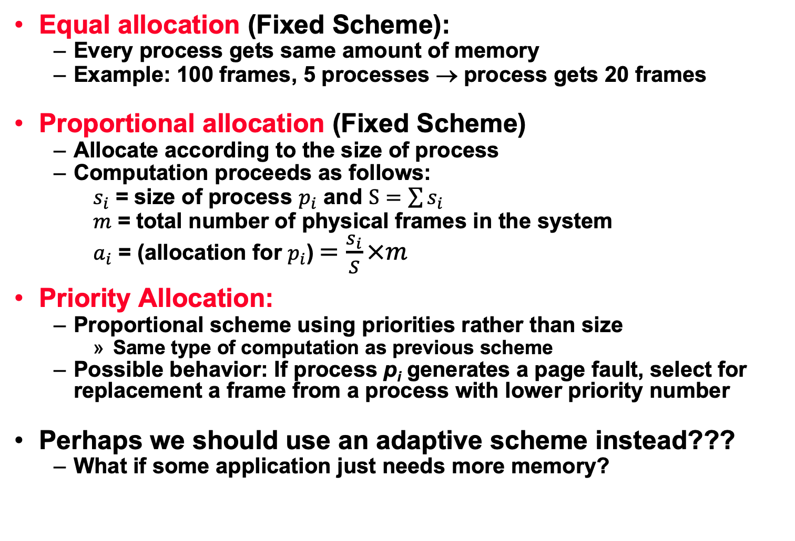
Fixed/Priority Allocation
Equal allocation (Fixed Scheme):
  Every process gets same amount of memory
  Example: 100 frames, 5 processes → process gets 20 frames
Proportional allocation (Fixed Scheme)
  Allocate according to the size of process
  Computation proceeds as follows:
  $s_{i}$ = size of process $p_{i}$ and $S=\sum{s_{i}}$
  $m$ = total number of physical frames in the system
  $a_{i}$ = (allocation for $p_{i}$)$=\frac{s_{i}}{S}×m$
Priority Allocation:
  Proportional scheme using priorities rather than size
    Same type of computation as previous scheme
  Possible behavior: If process p_{i} generates a page fault, select for replacement a frame from a process with lower priority number
Perhaps we should use an adaptive scheme instead???
  What if some application just needs more memory?

Slide 11
What about Compulsory Misses?
Recall that compulsory misses are misses that occur the first time that a page is seen
  Pages that are touched for the first time
  Pages that are touched after process is swapped out/swapped back in
Clustering:
  On a page-fault, bring in multiple pages “around” the faulting page
  Since efficiency of disk reads increases with sequential reads, makes sense to read several sequential pages
Working Set Tracking:
  Use algorithm to try to track working set of application
  When swapping process back in, swap in working set

Slide 12
On to Virtual Machines …

Slide 13

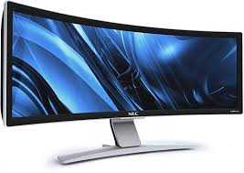

OS software supports user level software
Illusion: virtualizes hardware resources and provides convenient high level user abstractions & services
Referee: provide isolation & protection, allocates resources to user processes
Glue: efficient access, sharing, resource management
User Software
Unprivileged Instructions
syscall handlers
Privileged Instructions
scheduler
syscall tbl
subsystems
System Software
intr tbl
intrpt handlers
Page Tables
Drivers
regs
Hardware
Processor
Memory
I/O Devices

Slide 14

Today: turn system / user inside out

Slide 15
Recall (L1) Virtual Machines
Virtualize every detail of a hardware configuration so perfectly that you can run an operating system (and many applications) on top of it.
  VMWare Fusion, Virtual box, Parallels Desktop, Xen, Vagrant
Provides isolation
Complete insulation from change
The norm in the Cloud (server consolidation)
Long history (60’s in IBM OS development)
All our work will take place INSIDE a VM
  Vagrant (new image just for you)

Slide 16
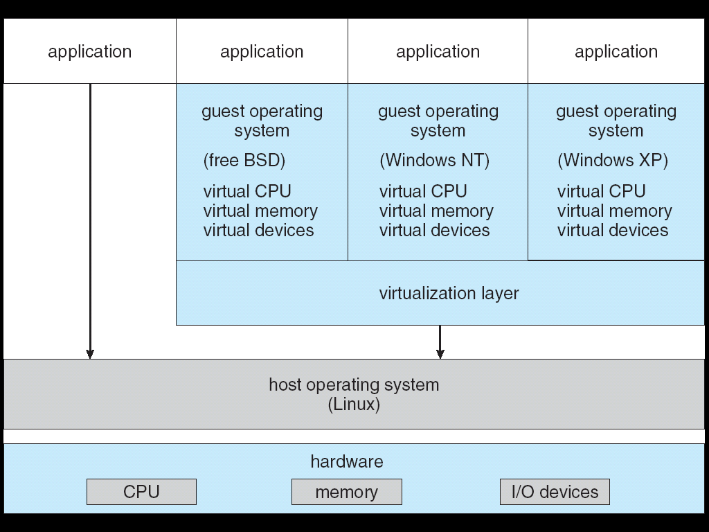
System Virtual Machines: Layers of OSs
Useful for OS development
  When OS crashes, restricted to one VM
  Can aid testing programs on other OSs

Slide 17
Containers virtualize the OS
Roots in OS developments to provide protected systems abstraction, not just application abstraction
  User-level file system (route syscalls to user process)
  Cgroups – predictable, bounded resources (CPU, Mem, BW)

Slide 18
Motivation
An “Application” is no longer a stand-alone executable or composition of vendor-supplied software, it is often a complex platform utilizing several deep software stacks, many processes, shared libraries and services, …
  All of which evolve fairly rapidly
To stand up a viable instance requires “all of it”, so need to wrap up the “entire stack”
  The OS and all its user-level daemons, the software installed in its file system
  The hardware itself
Want to isolate this entire ensemble from other ensembles, which may be on the same physical machine (server consolidation)
Want to be able to allocate resources predictably

Slide 19
Our “Host Operating System”
User Software
syscall handlers
scheduler
syscall tbl
subsystems
System Software
intr tbl
intrpt handlers
Page Tables
Drivers
regs
Hardware
Processor
Memory
I/O Devices

Slide 20
User-level “Guest” Operating System
appln
process
appln
process
User Software
“virtual hardware”
scheduler
syscall handlers
process & thread mgmt
syscall tbl
file systems
System Software
intr tbl
intrpt handlers
VM system
Page Tables
Drivers
regs
Hardware
Processor
Memory
I/O Devices

Slide 21
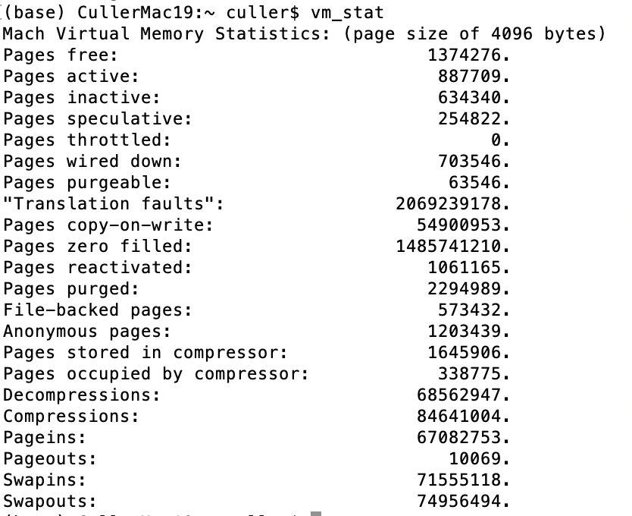
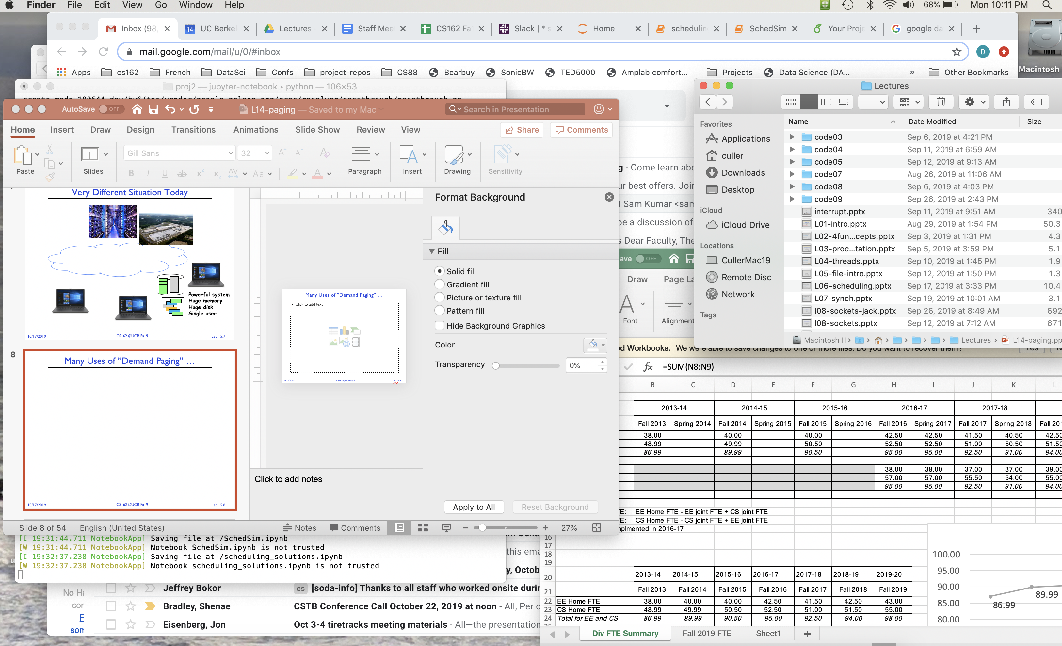
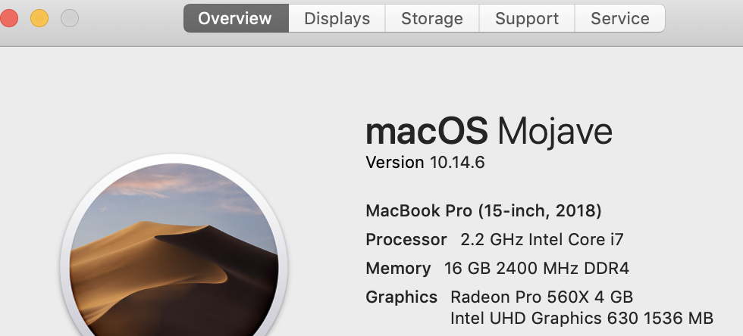
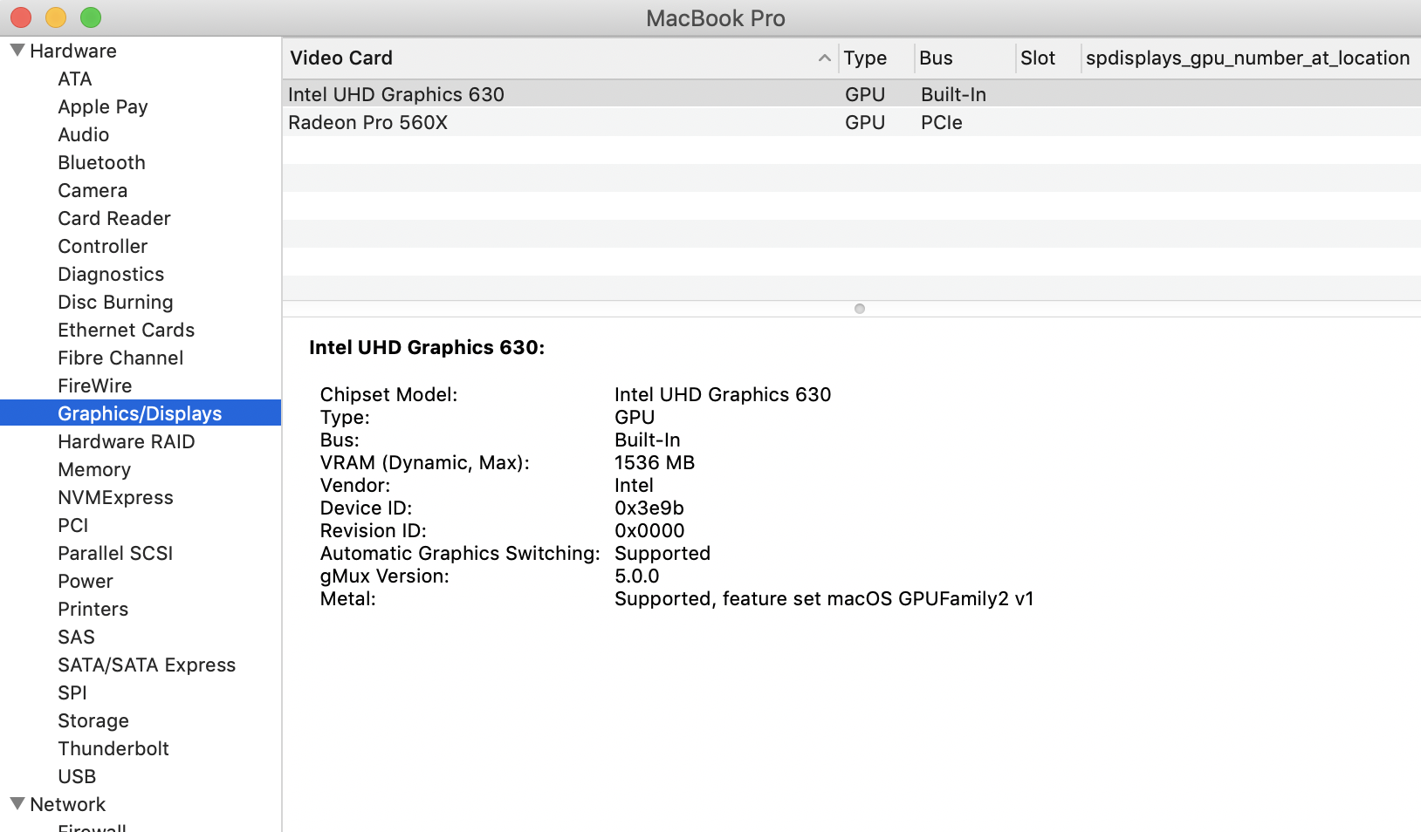
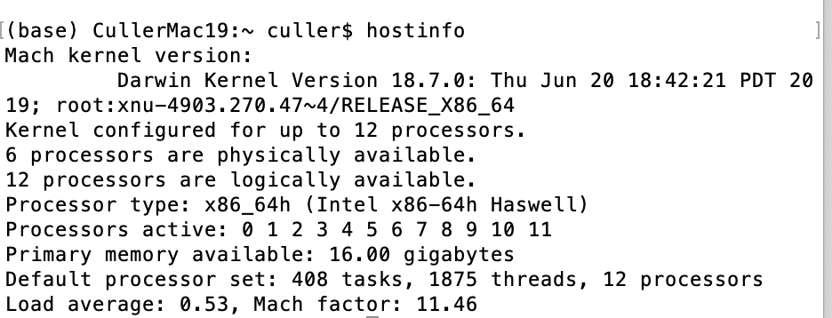
Example: my Macbook Pro / OS-X

Slide 22
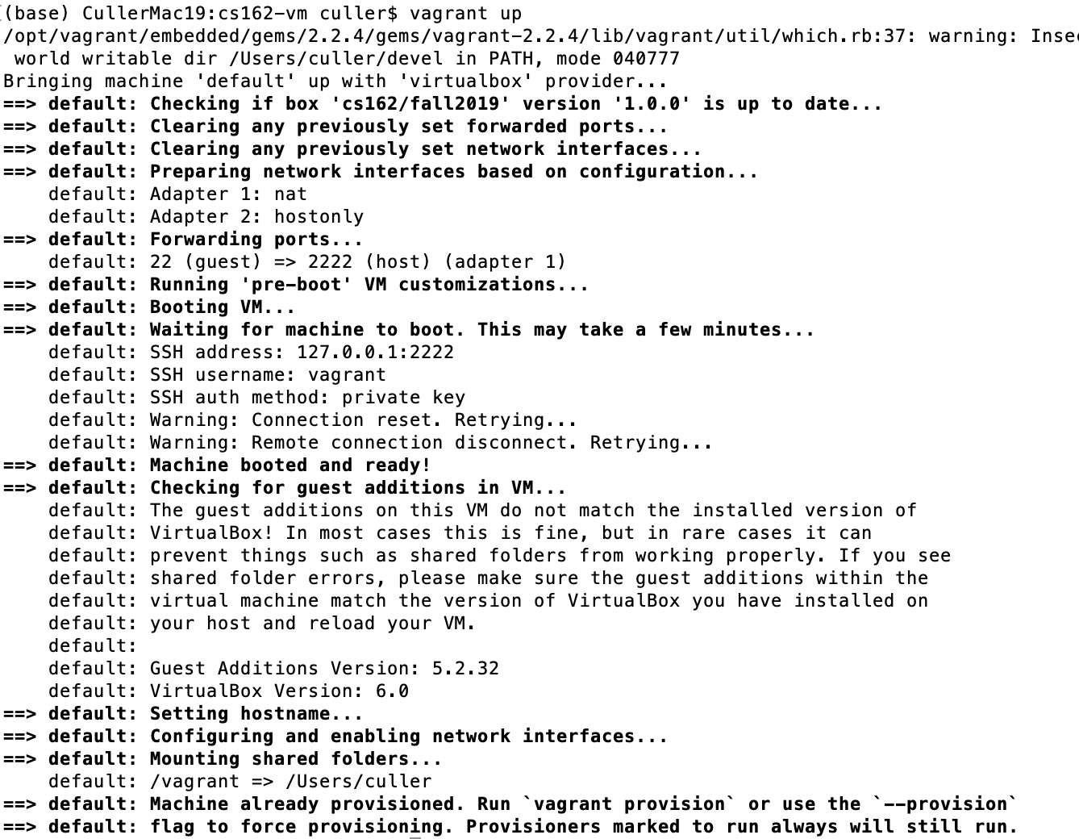
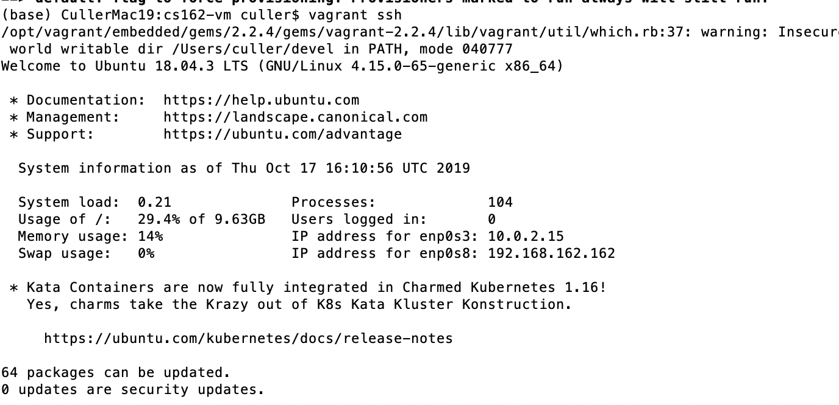
Up that Virtual Machine

Slide 23
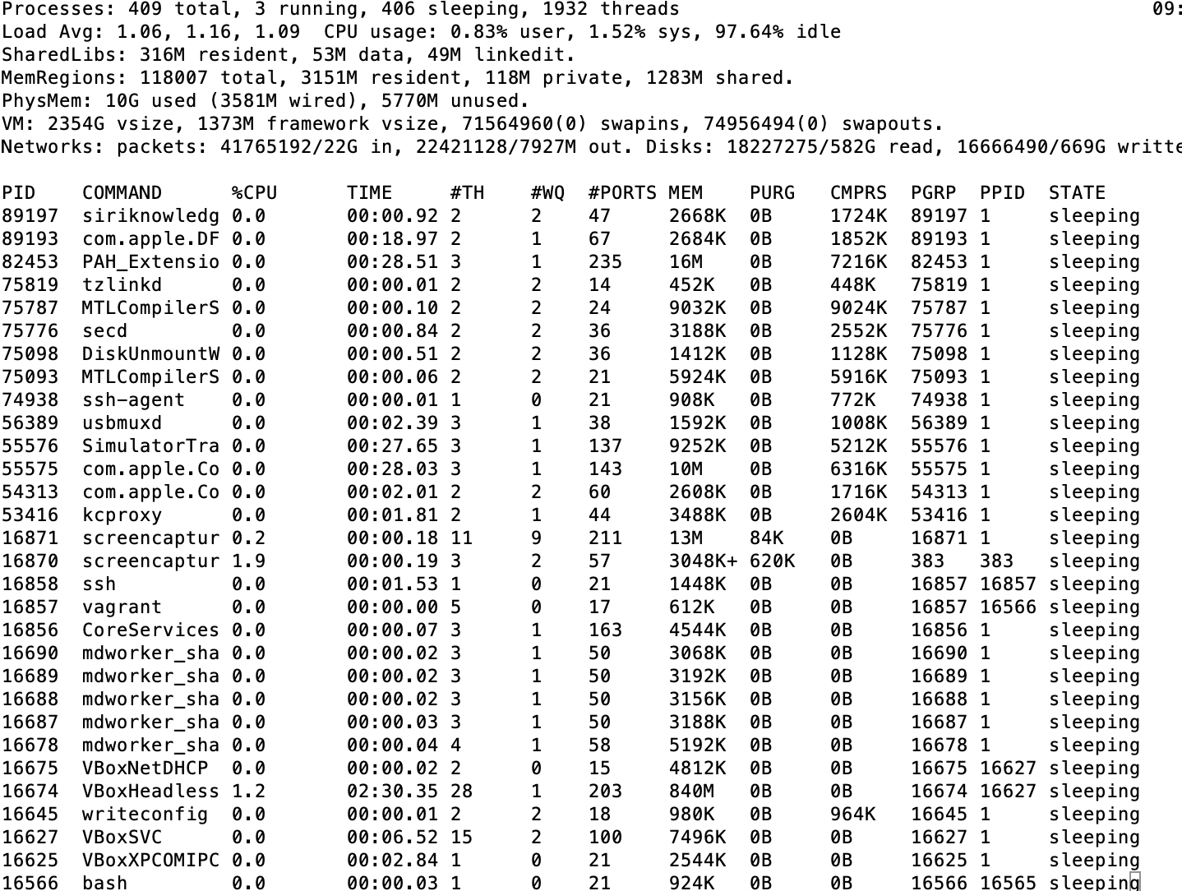
In the Host OS

Slide 24
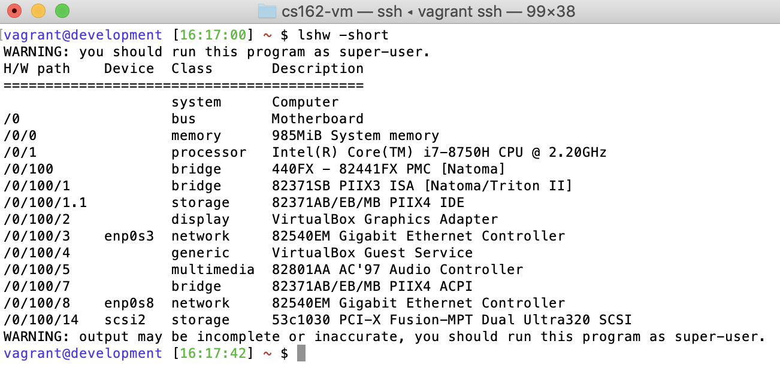
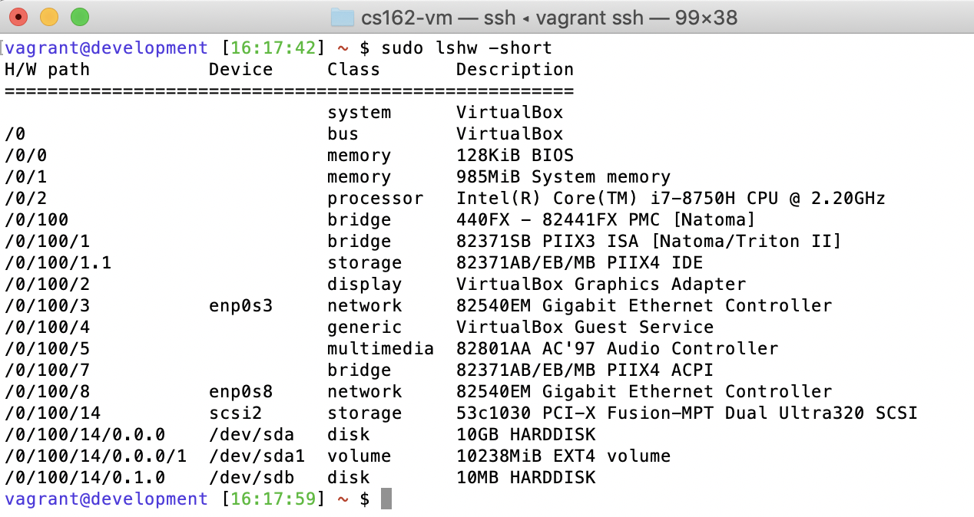
In the vbox / vagrant

Slide 25
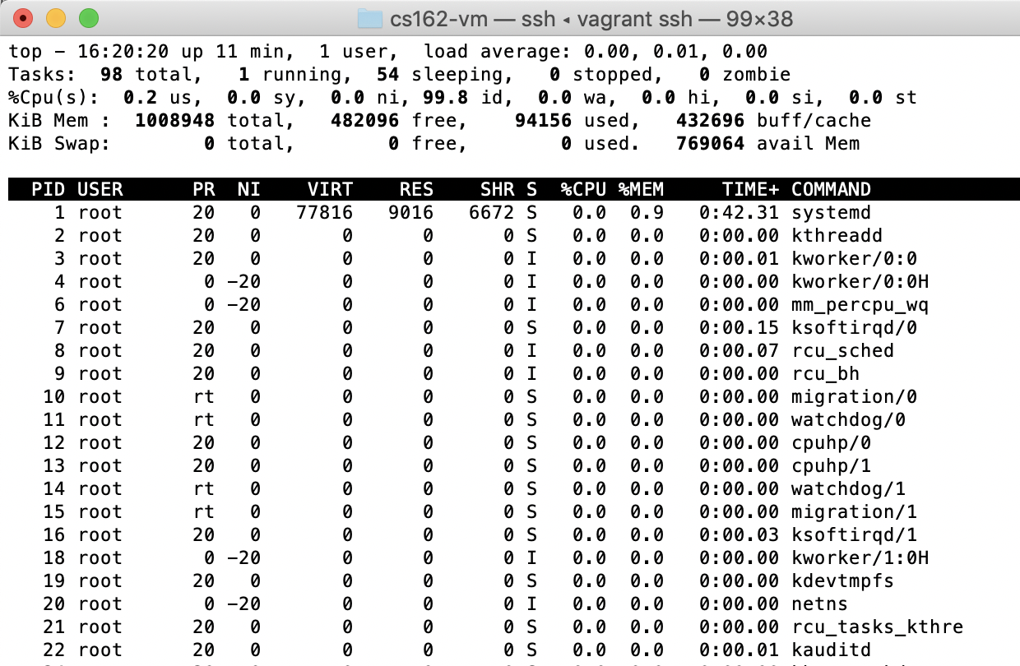
Guest ubuntu Linux

Slide 26
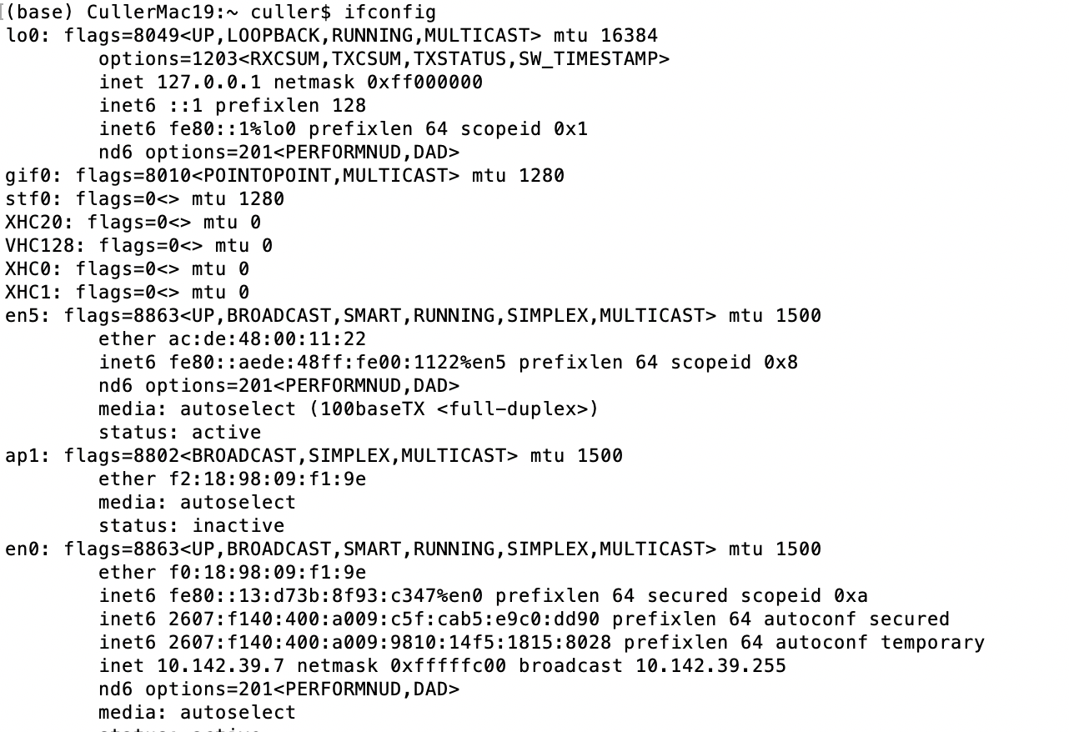
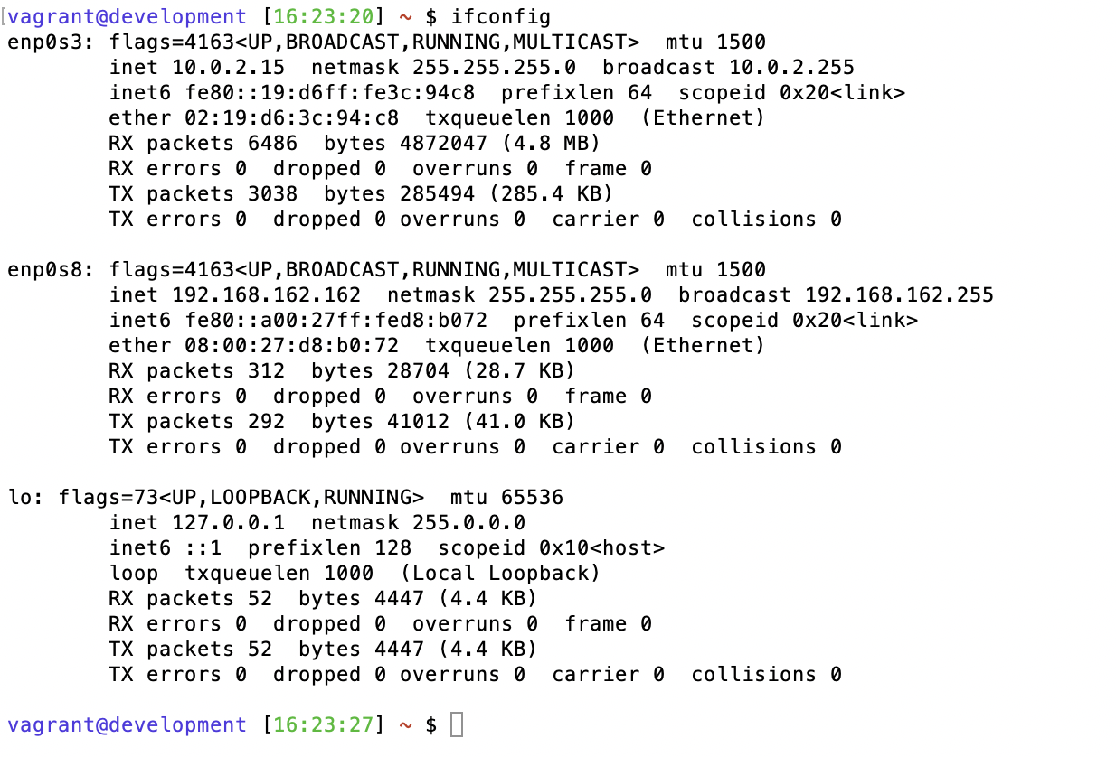
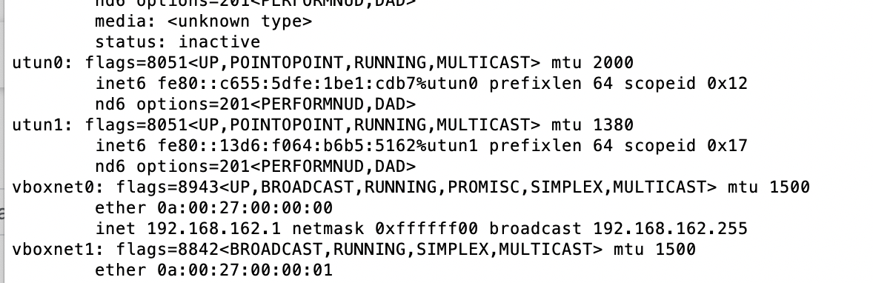
And networking

Slide 27
User-level “Guest” Operating System
appln
process
appln
process
User Software
Guest OS
Unprivileged Instructions
“virtual hardware”
scheduler
syscall handlers
Privileged Instructions
process & thread mgmt
syscall tbl
file systems
System Software
intr tbl
intrpt handlers
VM system
Page Tables
Drivers
regs
Hardware
Processor
I/O Devices
Memory

Slide 28
Software Emulation of Hardware
Example: QEMU for x86
  Used to do MIPS R3000 (subset) emulation as 61C project
User software emulates the behavior of every single instruction
  Data structure for Processor, Memory, I/O, etc
  Code for Instruction Cycle: Fetch Instruction, Decode, Fetch Operands, Perform Operation, Store Results, Update PC
  Emulate privilege levels, interrupts, MMU, . . . too
  Load (i.e., boot) image of the operating system
  Initializes (virtual) HW, loads pgms, schedules threads, etc.
Popular in the 90’s
  run Windows (x86) on your MAC (M68000), …
  Software Fault Isolation
Lots of dynamic translation optimizations to reduce overhead from 1000-fold to 2-10 fold
  Want more like 10-20% overhead

Slide 29
Guest Virtual Hardware: proc regs
VM-X
User Software
Guest OS
appln
process
“virtual hardware”
Unprivileged Instructions
scheduler
Privileged Instructions
syscall handlers
process & thread mgmt
file systems
System Software
syscall tbl
intr tbl
intrpt handlers
VM system
Page Tables
Drivers
regs
Hardware
Processor
I/O Devices
Memory

Slide 30
Virtual Hardware: “physical mem”
VM process VAS
VM-X
mmap <file>
User Software
Guest OS
appln
process
“virtual hardware”
Unprivileged Instructions
mem
scheduler
Privileged Instructions
syscall handlers
process & thread mgmt
file systems
System Software
syscall tbl
intr tbl
intrpt handlers
VM system
Page Tables
Drivers
regs
Hardware
Processor
I/O Devices
Memory

Slide 31
Virtual Hardware: “I/O Device”
VM process VAS
VM-X
mmap <file>
host file
User Software
Guest OS
appln
process
“virtual hardware”
Unprivileged Instructions
mem
scsi disk
scheduler
Privileged Instructions
syscall handlers
process & thread mgmt
file systems
System Software
syscall tbl
intr tbl
intrpt handlers
VM system
Page Tables
Drivers
regs
Hardware
Processor
I/O Devices
Memory

Slide 32
Virtual Hardware: “I/O Devices”
VM process VAS
VM-X
mmap <file>
host file
User Software
Guest OS
appln
process
window
“virtual hardware”
mem
scsi disk
graphics
scheduler
syscall handlers
process & thread mgmt
file systems
System Software
syscall tbl
intr tbl
intrpt handlers
VM system
Page Tables
Drivers
regs
Hardware
Processor
I/O Devices
Memory

Slide 33
Virtual Hardware: “I/O Devices”
VM process VAS
VM-X
mmap <file>
host file
User Software
Guest OS
appln
process
window
“virtual hardware”
nw intf
mem
scsi disk
graphics
nic
scheduler
syscall handlers
process & thread mgmt
file systems
System Software
syscall tbl
intr tbl
intrpt handlers
VM system
Page Tables
Drivers
regs
Hardware
Processor
I/O Devices
Memory

Slide 34
Challenges
How do we provide virtual address spaces for each of the guest processes?
  Host OS has the REAL page tables
When Guest process does syscall (trap), how does it vector through the Guest OS Syscall Table?
  Interrupts go through the physical interrupt vector
How does the guest OS protect itself from its guest application processes & each other?
Guest OS executes as Unprivileged
  How does it set up its page table? Disable interrupts? …
  Driver Read/Write to I/O devices? Handle interrupts?
How do interrupts get delivered to Guest OS?
Deal with the huge diversity of I/O devices that might be on the host machine?

Slide 35
I/O diversity (1st Try)
Guest OS is configured with drivers for a few particular (virtual) I/O devices
  They claim to be these (often old) devices (SCSI disk, …)
Driver accesses its device through:
Programmed I/O to memory-mapped registers
  Read status registers, Write Control Registers
  Page Table translates to specific physical addresses of I/O device registers
Direct Memory Access (DMA)
  Bulk transfer to/from a memory buffer & device
Device raises interrupt line when operations complete
=> Catch these operations and emulate the device on the host object (file, NW, window)

Slide 36
Guest User Level Memory Access
Guest User Process accesses a virtual address space set up by the Guest OS
But hardware translates the Virtual to Physical Address through the REAL Page Table
  Not the Guest OS Page Table
???

Slide 37
The Two Translations
Guest VAS : PT
Host VM-X VAS : PT
Host Physical Mem
Guest “Physical” Mem
Guest process operates on virtual addresses
  It can’t see what physical address these translate into
Guest OS set up mapping to “guest mem”
  It thinks these are physical addresses
  They are actually within a mapped region of the VM process
Host OS maps VM process VAS to physical mem

Slide 38
VMM Shadow Page Tables
Guest OS Page Tables
VMM Page Tables for VM
Guest VAS pages
Shadow VAS pages
Guest Physical Frames
Host VM Process Pages
Host Physical Frames
Host Physical Frames
Host OS Page Table for VM Process

Slide 39
VMM Shadow Page Tables (cont)
Guest OS Page Tables
VMM Page Tables for VM
Guest VAS pages
Shadow VAS pages
Guest Physical Frames
Host VM Process Pages
Host Physical Frames
Host Physical Frames
Host OS Page Table for VM Process

Slide 40
Virtual Machine Monitor
VM-X
appln
process
User Software
Guest OS
Unprivileged Instructions
“virtual hardware”
scheduler
syscall handlers
Privileged Instructions
Virtual Machine Monitor
Kernel module
Driver
process & thread mgmt
syscall tbl
System Software
intr tbl
intrpt handlers
VM system
Page Tables
Drivers
regs
Hardware
Processor
I/O Devices
Memory

Slide 41
Virtual Machine Monitor
Extends the host operating system using established dynamic mechanisms
  Kernel module / Driver
  Requires administrative privileges – but not reboot
  Has visibility into page table management, interrupt control, hardware configuration
Maintains shadow page tables for every page table in the guest OS
  Mapping from Guest OS Process VAS to Host Physical Mem
How do these shadow page tables get used?

Slide 42
Virtual Machine Monitor
VM-X
appln
process
User Software
Guest OS
Unprivileged Instructions
“virtual hardware”
scheduler
syscall handlers
Privileged Instructions
Virtual Machine Monitor
Kernel module
Driver
process & thread mgmt
syscall tbl
System Software
intr tbl
intrpt handlers
VM system
Page Tables
Drivers
ptbr:
regs
int:
Hardware
Processor
I/O Devices
Memory

Slide 43
VMM – VM – VMM extension process
VMM-X
appln
process
host file
appln
process
User Software
Guest OS
window
nw intf
Unprivileged Instructions
“virtual hardware”
scheduler
syscall handlers
VMM
Privileged Instructions
process & thread mgmt
syscall tbl
System Software
intr tbl
intrpt handlers
VM system
Page Tables
Drivers
ptbr:
regs
int:
Hardware
Processor
I/O Devices
Memory

Slide 44
VM Guest OS Processes
Host OS schedules VMM threads
VMM switches to shadow page table for guest OS’s current process
Resumes Guest OS Thread & Process through return-from-interrupt
Guest OS process runs with composite translation: Guest VA => VMMX VA => PA
  Behaves as it Guest OS page table was in use
  Guest OS region inaccessible to its user processes (protected)
What happens is there is an interrupt?
How does it make a SYSCALL
What about the Guest OS?
  It is not trusted by Host OS, Unpriviledged !

Slide 45
Interrupts while in VM ???
VMM-X
appln
process
host file
appln
process
User Software
Guest OS
window
nw intf
Unprivileged Instructions
“virtual hardware”
scheduler
syscall handlers
VMM
Privileged Instructions
process & thread mgmt
syscall tbl
System Software
intr tbl
intrpt handlers
VM system
Page Tables
Drivers
ptbr:
regs
int:
Hardware
Processor
I/O Devices
Memory

Slide 46
Interrupts
Most interrupts have to do with hardware devices and need to be handled by Host OS
  Regardless of whether Host process, Guest OS process or Guest OS is running
But when Guest processes fault/trap it needs to be handled by the Guest OS
  SYSCALL, Divide by zero, …
  Page Fault ???
Virtual Machine Monitor needs to be involved in Interrupt handling when VM is “running”

Slide 47
VMM: Interrupt Handling
VMM-X
appln
process
host file
appln
process
User Software
Guest OS
window
nw intf
Unprivileged Instructions
“virtual hardware”
scheduler
syscall handlers
VMM
Privileged Instructions
process & thread mgmt
syscall tbl
v_PTs
System Software
v_intr tbl
intr tbl
intrpt handlers
VM system
Page Tables
Drivers
ptbr:
regs
int:
Hardware
Processor
I/O Devices
Memory

Slide 48
Guest Process SYSCALL int
VMM-X
appln
process
host file
appln
process
User Software
Guest OS
window
nw intf
Unprivileged Instructions
“virtual hardware”
scheduler
syscall handlers
VMM
Privileged Instructions
process & thread mgmt
syscall tbl
v_PTs
System Software
v_intr tbl
intr tbl
intrpt handlers
VM system
Page Tables
Drivers
ptbr:
regs
int:
Hardware
Processor
I/O Devices
Memory

Slide 49
Guest Process Syscall
Traps to VMM
VMM can dispatch the exception to the Guest OS syscall hander (through its interrupt vector), which will process args, dispatch to particular system call, etc.
The Guest OS return-from-interrupt resumes the VMM
The VMM can then resume the Guest OS process with the syscall result
VMM serves as intermediary between the Guest Processes and the Guest OS

Slide 50
Guest Process SYSCALL int return
VMM-X
appln
process
host file
appln
process
User Software
Guest OS
window
nw intf
Unprivileged Instructions
“virtual hardware”
scheduler
syscall handlers
VMM
Privileged Instructions
process & thread mgmt
syscall tbl
v_PTs
System Software
v_intr tbl
intr tbl
intrpt handlers
VM system
Page Tables
Drivers
ptbr:
regs
int:
Hardware
Processor
I/O Devices
Memory

Slide 51
Host Interrupt during VM
VMM-X
appln
process
host file
appln
process
User Software
Guest OS
window
nw intf
Unprivileged Instructions
“virtual hardware”
scheduler
syscall handlers
VMM
Privileged Instructions
process & thread mgmt
syscall tbl
v_PTs
System Software
v_intr tbl
intr tbl
intrpt handlers
VM system
Page Tables
Drivers
ptbr:
regs
int:
Hardware
Processor
I/O Devices
Memory

Slide 52
VMM Interrupt Processing
During VM
VMM catches interrupts and either redirects them back to the Host OS or up to the Guest OS
Otherwise, the Host OS receives interrupts
Those that involve the VMM will be delivered to it like other drivers
But, Guest OS is not privileged
  It is running at user level (some VMMs run it at PL=1)
What happens when it executes privileged instructions?
  Access to kernel region? Disable/Enable Interrupts? …

Slide 53
Virtualizable Instruction Set Arch.
An instruction set is virtualizable if all “sensitive” instructions cause a trap if executed in unprivileged mode…
x86 ISAs (till last several years) were not virtualizable in a strict sense and hugely complex
  See VMware paper for incredible work arounds to get effective virtualizations
  Recent generations of x86 have improved support for virtualization
We’ll assume all virtualization sensitive actions by the Guest OS cause a trap to the VMM
  Access to kernel region, Update PTBR, CLI/STI, …
  Change its page tables, …

Slide 54
Host Interrupt during VM
VMM-X
appln
process
host file
appln
process
User Software
Guest OS
window
nw intf
Unprivileged Instructions
“virtual hardware”
scheduler
syscall handlers
VMM
Privileged Instructions
Trap & Emulate
process & thread mgmt
syscall tbl
v_PTs
System Software
v_intr tbl
intr tbl
intrpt handlers
VM system
Page Tables
Drivers
ptbr:
regs
int:
Hardware
Processor
I/O Devices
Memory

Slide 55
Trap and Emulate
When Guest OS tries to access it kernel region it traps to VMM
  Updates to page tables, scheduling threads, switching processes, interrupts,
The VMM decodes what Guest OS is doing (basic blocks of multiple instructions) and emulates them, updating the Guest OS data structures as if it had done it itself.
The VMM “sees” everything the Guest OS tries to do and can take action
  If Guest OS updates a PTE, the VMM updates the shadow PTE
  If it switches PTs, the VMM switches shadows
  When it irets to process thread, VMM gives that process the right shadow

Slide 56
Guest OS Drivers
Drivers interact with “their device” through Programmed I/O (PIO), Direct Memory Access (DMA), and Interrupts
Device has a set of “registers” that are configured to appear at specific physical addresses
  e.g, Read Data, Write Data, Operation, Status, Address
  Mapped into kernel region of virtual address space
Driver reads/writes these to access device
  DMA allows blocks of data to be written to / read from the device
All actions Guest OS drivers take on virtual I/O devices cause traps to the VMM
  It then emulates these operations
CPU
$
Mem
IO bus
controller
rdy busy int …
data_x
data_y

Slide 57
Host Interrupt during VM
VMM-X
appln
process
host file
appln
process
User Software
Guest OS
window
nw intf
Unprivileged Instructions
“virtual hardware”
RPC
trap
scheduler
syscall handlers
VMM
Privileged Instructions
Trap & Emulate
process & thread mgmt
syscall tbl
v_PTs
System Software
v_intr tbl
intr tbl
intrpt handlers
VM system
Page Tables
Drivers
ptbr:
regs
int:
Hardware
Processor
I/O Devices
Memory

Slide 58
Other forms of Virtual Machines
We have described Hosted Virtual Machines
  VMware fusion, Virtual Box, KVM, …
Para-virtualization: Guest OS is modified to work collaboratively with the Host VMM
  VMM presents simplified machine to Guest OS
Hypervisor: VMM resides under all the “Guest” OS – peers, none is the special host
  Much cleaner relationship between VMM and OS’s
OS
OS
OS
Hypervisor (VMM)
Hardware

Slide 59
Stepping Back
In creating a virtual machine we configured a set of resources within which all of its activities – its OS and all its processes – would operate
  Total amount of physical memory (the MMAP)
  Total size of all its disk storage (the file backing its disk)
  Total network bandwidth
These constraints are valuable even without a distinct (possibly heterogenous) Guest OS
Modern operating systems provide performance isolation, in addition to traditional protection isolation
  Without the additional machinery and capability of VMs

Slide 60
Performance Isolation: CGroups
Example:
“production”
“testing”
“dev”
User Software
syscall handlers
scheduler
syscall tbl
subsystems
System Software
intr tbl
intrpt handlers
Page Tables
Drivers
Processor
Memory
Net BW
Files
Hardware

Slide 61
CGroups
Identify collections of processes that will be treated as a group for resource allocation
  Groups can have hierarchical structure
  i.e., a Group can be comprised of subgroups
  Process parent-child relationship defines a hierarchy
    Generalize this beyond fork( )
Set of key resource dimensions
  Processor share (CPU), CPU set (bound to particular cores)
  Physical memory share,
  block IO, net priority, net class
  Namespace (ns), i.e., containers
Resource limiting, prioritization, accounting and control
Containers define a collection of libraries and executables that should be a group

Slide 62
How is all the cgroups info recorded?
Unix-based systems use /proc to represent information about processes
  /proc/<pid> describes process <pid>
/proc/cgroups/*
  Describes what controllers are implemented
Each cgroup controller has a directory under /sys/fs/cgroup/<controller>
  /sys/fs/cgroup/cpu/production
  /sys/fs/cgroup/memory/foo/memory.limit_in_bytes
Kernel monitors and controls processes/threads in accordance with cgroup controllers

Slide 63
Summary
For 50+ years operating systems focused on virtualizing resources to provide clean, protected services to user processes
  Illusion of near infinite resources, despite constraints
  Protection and isolation, Glue (accounting was there too)
Past 15+ years, with ever more resources, focus on predictable share (proportions) of resources (as part of virtualization)
  Predictability: Service level agreements focus on 95th or 99th percentile
  Metering and monitoring to ”groups” of processes, as defined by system administrative goals (also CFS, …)
Virtual machines bring the illusion down to the lowest level and provide an extreme form of resource partitioning
  Re-purpose the mechanisms used for protection, isolation and system extension (drivers) to permit near-perfect emulation
  Intricate interplay of (in kernel) Virtual Machine Monitor and (user level) VMM-X process to allow Guest OS as if on Physical Machine and Guest OS User Processes as if on Guest OS
    VMM interposes between hardware/Host OS and Guest OS (Page Table & Interrupt Tbl)
Shadow Page Table (composition of two PTs) to translate Guest OS process VAS => MMAP region => Physical
Trap and Emulate
Control Groups & Containers provide resource limiting w/o VM

Slide 64
If you want to dig further
Bringing Virtualization to the x86 Architecture with the Original VMware Workstation. E. Bugnion, S. Devine, M. Rosenblum, J. Sugerman, E. Y. Wang, ACM Trans. Comput. Syst. 2012.
  Extremely detailed look at what it takes to pull off VM in older x86
  Good set of references
  Newer systems have better hardware support for virtualization (e.g., KVM)
Xen and the Art of Virtualization, 2003 (paravirtualization)
Disco: Running Commodity Operating Systems on Scalable Multiprocessors (1997) – revived concept of VMMs largely lost since the 70s

