Slide 1
CS162
Operating Systems and
Systems Programming
Lecture 17
Data Storage to File Systems
October 29, 2019
Prof. David Culler
http://cs162.eecs.Berkeley.edu
Read: A&D Ch 12,
13.1-3.2

Slide 2
Recall: OS Storage abstractions

Slide 3
Review: Memory-Mapped Display Controller
Memory-Mapped:
  Hardware maps control registers and display memory into physical address space
    Addresses set by HW jumpers or at boot time
  Simply writing to display memory (also called the “frame buffer”) changes image on screen
    Addr: 0x8000F000 — 0x8000FFFF
  Writing graphics description to cmd queue
    Say enter a set of triangles describing some scene
    Addr: 0x80010000 — 0x8001FFFF
  Writing to the command register may cause on-board graphics hardware to do something
    Say render the above scene
    Addr: 0x0007F004
Can protect with address translation
0x80020000
Graphics
Command
Queue
0x80010000
Display
Memory
0x8000F000
0x0007F004
Command
0x0007F000
Status
Physical
Address
Space

Slide 4
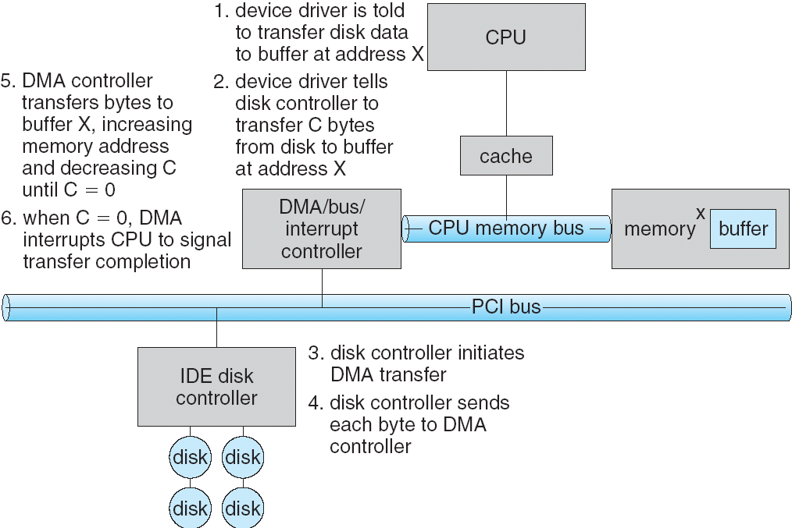
Review: Transferring Data To/From Controller
Programmed I/O:
  Each byte transferred via processor in/out or load/store
  Pro: Simple hardware, easy to program
  Con: Consumes processor cycles proportional to data size
Direct Memory Access:
  Give controller access to memory bus
  Ask it to transfer
  data blocks to/from
  memory directly
Sample interaction
with DMA controller
(from OSC book):
1
2
3

Slide 5
Review: Transferring Data To/From Controller
Programmed I/O:
  Each byte transferred via processor in/out or load/store
  Pro: Simple hardware, easy to program
  Con: Consumes processor cycles proportional to data size
Direct Memory Access:
  Give controller access to memory bus
  Ask it to transfer
  data blocks to/from
  memory directly
Sample interaction
with DMA controller
(from OSC book):
6
5
4

Slide 6
Recall: I/O Device Notifying the OS
The OS needs to know when:
  The I/O device has completed an operation
  The I/O operation has encountered an error
I/O Interrupt:
  Device generates an interrupt whenever it needs service
  Pro: handles unpredictable events well
  Con: interrupts relatively high overhead
Polling:
  OS periodically checks a device-specific status register
    I/O device puts completion information in status register
  Pro: low overhead
  Con: may waste many cycles on polling if infrequent or unpredictable I/O operations
Actual devices combine both polling and interrupts
  For instance – High-bandwidth network adapter:
    Interrupt for first incoming packet
    Poll for following packets until hardware queues are empty
Notes:
After the OS has issued a command to the I/O device either via a special I/O instruction or by writing to a location in the I/O address space, the OS needs to be notified when:
(a) The I/O device has completed the operation.
(b) Or when the I/O device has encountered an error.
This can be accomplished in two different ways: Polling and I/O interrupt.
+1 = 58 min. (Y:38)

Slide 7
Recall: Device Drivers
Device Driver: Device-specific code in the kernel that interacts directly with the device hardware
  Supports a standard, internal interface
  Same kernel I/O system can interact easily with different device drivers
  Special device-specific configuration supported with the ioctl() system call
Device Drivers typically divided into two pieces:
  Top half: accessed in call path from system calls
    implements a set of standard, cross-device calls like open(), close(), read(), write(), ioctl(), strategy()
    This is the kernel’s interface to the device driver
    Top half will start I/O to device, may put thread to sleep until finished
  Bottom half: run as interrupt routine
    Gets input or transfers next block of output
    May wake sleeping threads if I/O now complete

Slide 8

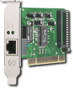
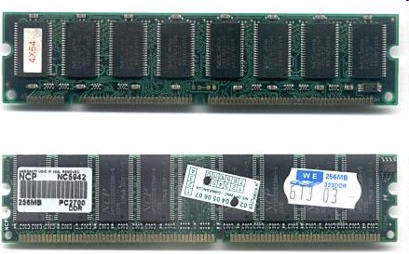
Recall: Kernel Device Structure
The System Call Interface
Process
Management
Memory
Management
Filesystems
Device
Control
Networking
Concurrency,
multitasking
Virtual
memory
Files and dirs:
the VFS
TTYs and
device access
Connectivity
Architecture
Dependent
Code
Memory
Manager
File System Types
Device
Control
Network
Subsystem
Block
Devices
IF drivers

Slide 9
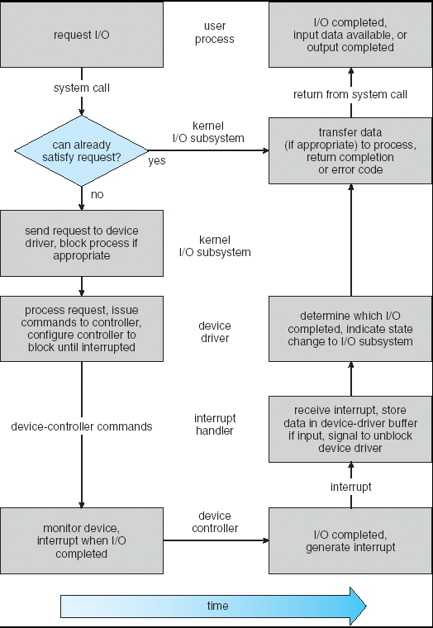
Review: Life Cycle of An I/O Request
User
Program
Kernel I/O
Subsystem
Device Driver
Top Half
Device Driver
Bottom Half
Device
Hardware

Slide 10
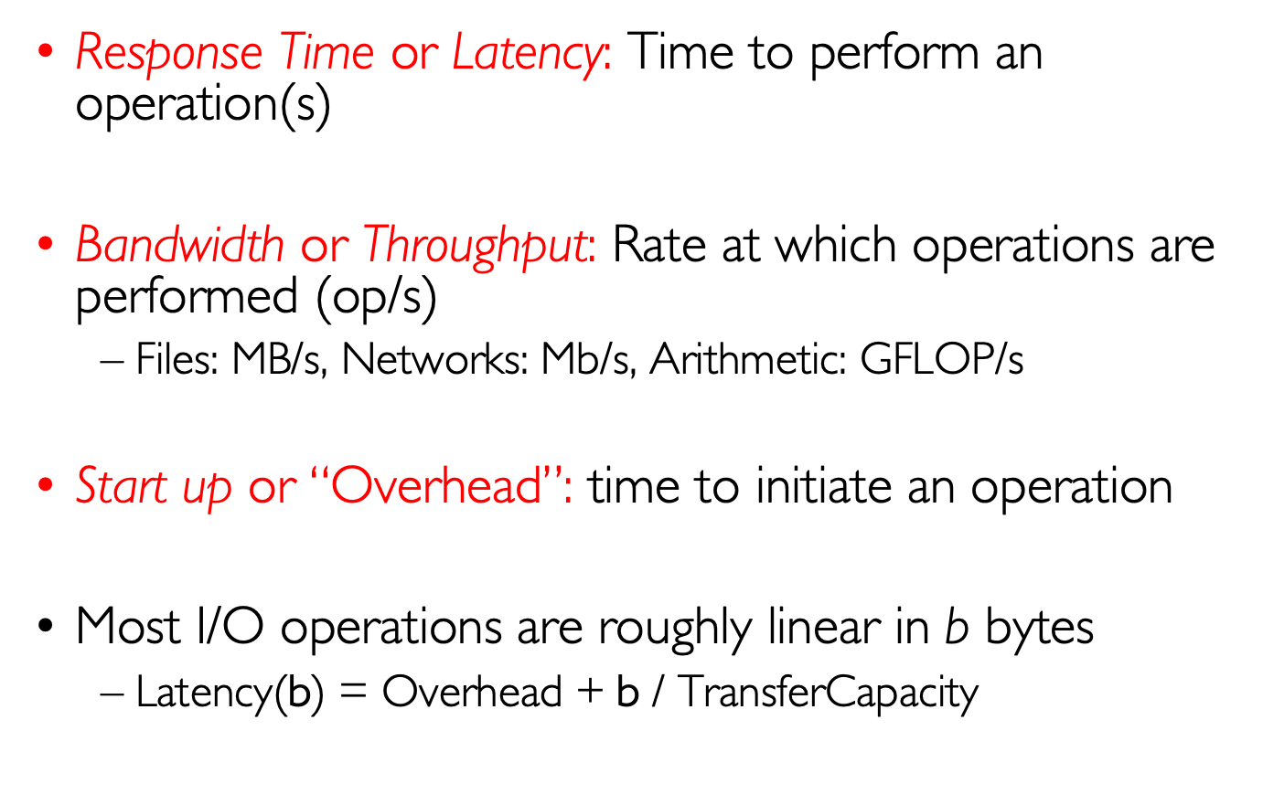
Basic I/O Performance Concepts
Response Time or Latency: Time to perform an operation(s)
Bandwidth or Throughput: Rate at which operations are performed (op/s)
  Files: MB/s, Networks: Mb/s, Arithmetic: GFLOP/s
Start up or “Overhead”: time to initiate an operation
Most I/O operations are roughly linear in b bytes
  Latency(b) = $\text{Overhead}\text{ +} \text{b} \text{/ }\text{TransferCapacity}$

Slide 11
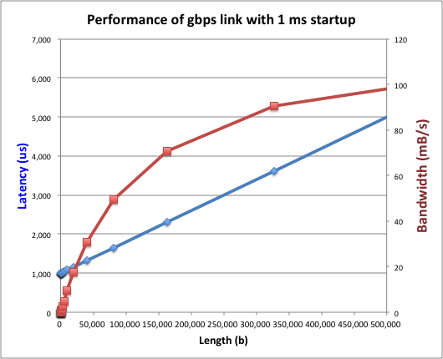
Example (Fast Network or SSD)
Consider: 1 Gb/s link (B = 125 MB/s) w/ startup cost S = 1 ms
  Latency(b) = S + b/B
  Bandwidth = b/(S + b/B) = B*b/(B*S + b) = B/(B*S/b + 1)

Slide 12
Example (Fast Network or SSD)
Consider a 1 Gb/s link (B = 125 MB/s) w/ startup cost S = 1 ms
  Half-power Bandwidth ⇒ B/(B*S/b + 1) = B/2
  Half-power point occurs at b=S*B= 125,000 bytes

Slide 13
Example: at 10 ms startup (like Disk)
  Half-power b = 1,250,000 bytes!

Slide 14
What Determines Peak BW for I/O ?
Bus Speed
  PCI-X: 1064 MB/s = 133 MHz x 64 bit (per lane)
  ULTRA WIDE SCSI: 40 MB/s
  Serial Attached SCSI & Serial ATA & IEEE 1394 (firewire): 1.6 Gb/s full duplex (200 MB/s)
  USB 3.0 – 5 Gb/s
  Thunderbolt 3 – 40 Gb/s
Device Transfer Bandwidth
  Rotational speed of disk
  Write / Read rate of NAND flash
  Signaling rate of network link
Whatever is the bottleneck in the path…

Slide 15
The Amazing Magnetic Disk
Unit of Transfer: Sector
  Ring of sectors form a track
  Stack of tracks form a cylinder
  Heads position on cylinders
Disk Tracks ~ 1µm (micron) wide
  Wavelength of light is ~ 0.5µm
  Resolution of human eye: 50µm
  100K tracks on a typical 2.5” disk
Separated by unused guard regions
  Reduces likelihood neighboring tracks are corrupted during writes (still a small non-zero chance)

Slide 16
The Amazing Magnetic Disk
Track length varies across disk
  Outside: More sectors per track, higher bandwidth
  Disk is organized into
  regions of tracks with
  same # of sectors/track
  Only outer half of radius is used
    Most of the disk area in the outer regions of the disk
Disks so big that some companies (like Google) reportedly only use part of disk for active data
  Rest is archival data

Slide 17
Shingled Magnetic Recording (SMR)
Overlapping tracks yields greater density, capacity
Restrictions on writing, complex DSP for reading
Examples: Seagate (8TB), Hitachi (10TB)

Slide 18
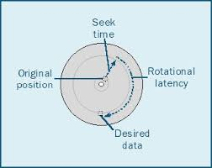
Magnetic Disks - Performance
Track
Cylinders: all the tracks under the
head at a given point on all surface
Read/write data is a three-stage process:
  Seek time: position the head/arm over the proper track
  Rotational latency: wait for desired sector to rotate under r/w head
  Transfer time: transfer a block of bits (sector) under r/w head
Sector
Head
Cylinder
Platter
Seek time = 4-8ms
One rotation = 1-2ms
(3600-7200 RPM)

Slide 19
Magnetic Disks - Queuing
Track
Cylinders: all the tracks under the
head at a given point on all surface
Read/write data is a three-stage process:
  Seek time: position the head/arm over the proper track
  Rotational latency: wait for desired sector to rotate under r/w head
  Transfer time: transfer a block of bits (sector) under r/w head
Sector
Head
Cylinder
Platter
Disk Latency = Queueing Time + Controller time +
Seek Time + Rotation Time + Xfer Time
Software
Queue
(Device Driver)
Hardware
Controller
Media Time
(Seek+Rot+Xfer)
Request
Result

Slide 20
Typical Numbers for Magnetic Disk
Parameter | Info / Range
Space/Density | Space: 14TB (Seagate), 8 platters, in 3½ inch form factor! Areal Density: ≥ 1Terabit/square inch! (PMR, Helium, …)
Average seek time | Typically 4-6 milliseconds. Depending on reference locality, actual cost may be 25-33% of this number.
Average rotational latency | Most laptop/desktop disks rotate at 3600-7200 RPM (16-8 ms/rotation). Server disks up to 15,000 RPM. Average latency is halfway around disk so 8-4 milliseconds
Controller time | Depends on controller hardware
Transfer time | Typically 50 to 250 MB/s. Depends on: Transfer size (usually a sector): 512B – 1KB per sector Rotation speed: 3600 RPM to 15000 RPM Recording density: bits per inch on a track Diameter: ranges from 1 in to 5.25 in
Cost | Used to drop by a factor of two every 1.5 years (or even faster); now slowing down
Notes:
As far as rotational latency is concerned, most disks rotate at 3,600 RPM or approximately 16 ms per revolution.
Since on average, the information you desired is half way around the disk, the average rotational latency will be 8ms.
The transfer time is a function of transfer size, rotation speed, and recording density.
The typical transfer speed is 2 to 4 MB per second.
Notice that the transfer time is much faster than the rotational latency and seek time.
This is similar to the DRAM situation where the DRAM access time is much shorter than the DRAM cycle time.
***** Do anybody remember what we did to take advantage of the short access time versus cycle time? Well, we interleave!
New International Disk Drive, Equipment, and Materials Association standard is 4KB sectors instead of 512 byte sectors
+2 = 36 min. (Y:16)

Slide 21
Disk Performance Example
Assumptions:
  Ignoring queuing and controller times for now
  Avg seek time of 5ms,
  7200RPM ⇒ Time for rotation: 60000 (ms/min) / 7200(rev/min) ~= 8ms
  Transfer rate of 50MByte/s, block size of 4Kbyte ⇒
  4096 bytes/50×10⁶ (bytes/s) = 81.92 × 10⁻⁶ sec ≅ 0.082 ms for 1 sector
Read block from random place on disk:
  Seek (5ms) + Rot. Delay (4ms) + Transfer (0.082ms) = 9.082 ms
  Approx 9ms to fetch/put data: 4096 bytes/9.082×10⁻³ s ≅ 450 KB/s
Read block from random place in same cylinder:
  Rot. Delay (4ms) + Transfer (0.082ms) = 4.082 ms
  Approx 4ms to fetch/put data: 4096 bytes/4.082×10⁻³ s ≅ 1.0 MB/s
Read next block on same track:
  Transfer (0.082ms): 4096 bytes/0.082×10⁻³ s ≅ 50MB/sec
Key to using disk effectively (especially for file systems) is to minimize seek and rotational delays

Slide 22
(Lots of) Intelligence in the Controller
Sectors contain sophisticated error correcting codes
  Disk head magnet has a field wider than track
  Hide corruptions due to neighboring track writes
Sector sparing
  Remap bad sectors transparently to spare sectors on the same surface
Slip sparing
  Remap all sectors (when there is a bad sector) to preserve sequential behavior
Track skewing
  Sector numbers offset from one track to the next, to allow for disk head movement for sequential ops
…

Slide 23
I/O Performance
300
Response
Time (ms)
Controller
User
Thread
I/O
device
200
Queue
[OS Paths]
100
Response Time = Queue + I/O device service time
0
Performance of I/O subsystem
  Metrics: Response Time, Throughput
  Effective BW per op = transfer size / response time
    EffBW(n) = n / (S + n/B) = B / (1 + SB/n )
0%
100%
Throughput (Utilization)
(% total BW)
# of ops
time per op
Fixed overhead

Slide 24
I/O Performance
300
Response
Time (ms)
Controller
User
Thread
I/O
device
200
Queue
[OS Paths]
100
Response Time = Queue + I/O device service time
0
Performance of I/O subsystem
  Metrics: Response Time, Throughput
  Effective BW per op = transfer size / response time
    EffBW(n) = n / (S + n/B) = B / (1 + SB/n )
  Contributing factors to latency:
    Software paths (can be loosely modeled by a queue)
    Hardware controller
    I/O device service time
Queuing behavior:
  Can lead to large increases of latency as utilization increases
0%
100%
Throughput (Utilization)
(% total BW)

Slide 25
I/O Scheduling Discussion
What happens when two processes are accessing storage in different regions of the disk ?
What can the driver do?
How can buffering help?
What about non-blocking I/O?
Or threads with blocking I/O?
What limits how much reordering the OS can do?

Slide 26
Hard Drive Prices over Time

Slide 27
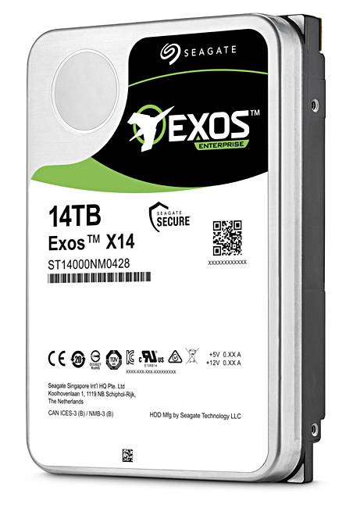
Example of Current HDDs
Seagate Exos X14 (2018)
  14 TB hard disk
    8 platters, 16 heads
    Helium filled: reduce friction and power
  4.16ms average seek time
  4096 byte physical sectors
  7200 RPMs
  6 Gbps SATA /12Gbps SAS interface
    261MB/s MAX transfer rate
    Cache size: 256MB
  Price: $615 (< $0.05/GB)
IBM Personal Computer/AT (1986)
  30 MB hard disk
  30-40ms seek time
  0.7-1 MB/s (est.)
  Price: $500 ($17K/GB, 340,000x more expensive !!)

Slide 28
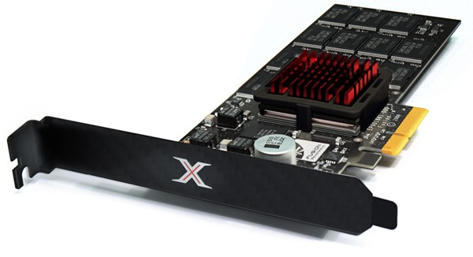
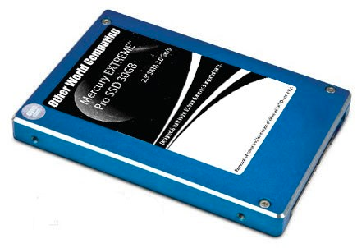
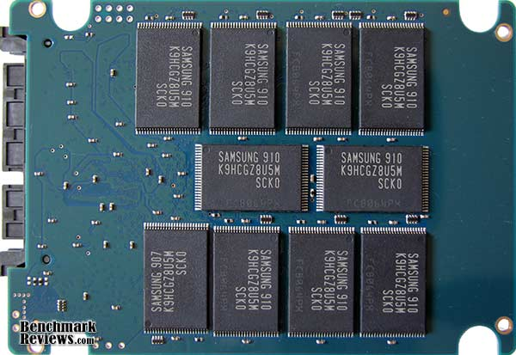
Solid State Disks (SSDs)
1995 – Replace rotating magnetic media with non-volatile memory (battery backed DRAM)
2009 – Use NAND Multi-Level Cell (2 or 3-bit/cell) flash memory
  Sector (4 KB page) addressable, but stores 4-64 “pages” per memory block
  Trapped electrons distinguish between 1 and 0
No moving parts (no rotate/seek motors)
  Eliminates seek and rotational delay (0.1-0.2ms access time)
  Very low power and lightweight
  Limited “write cycles”
Rapid advances in capacity and cost ever since!

Slide 29
SSD Architecture – Reads
NAND
NAND
NAND
NAND
NAND
NAND
NAND
NAND
Host
Buffer
Manager
(software
Queue)
Flash
Memory
Controller
NAND
NAND
NAND
NAND
SATA
NAND
NAND
NAND
NAND
NAND
NAND
NAND
NAND
DRAM
NAND
NAND
NAND
NAND
NAND
NAND
NAND
NAND
  Read 4 KB Page: ~25 usec
  No seek or rotational latency
  Transfer time: transfer a 4KB page
    SATA: 300-600MB/s => ~4 x10³ b / 400 x 10⁶ bps => 10 us
  Latency = Queuing Time + Controller time + Xfer Time
  Highest Bandwidth: Sequential OR Random reads
NAND
NAND
NAND
NAND

Slide 30
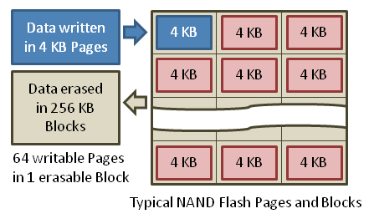
SSD Architecture – Writes
  Writing data is complex! (~200μs – 1.7ms )
  Can only write empty pages in a block
  Erasing a block takes ~1.5ms
  Controller maintains pool of empty blocks by coalescing used pages (read, erase, write), also reserves some % of capacity
Rule of thumb: writes 10x reads, erasure 10x writes
https://en.wikipedia.org/wiki/Solid-state_drive

Slide 31
SSD Architecture - Writes
SSDs provide same interface as HDDs to OS – read and write chunk (4KB) at a time
But can only overwrite data 256KB at a time!
Why not just erase and rewrite new version of entire 256KB block?
  Erasure is very slow (milliseconds)
  Each block has a finite lifetime, can only be erased and rewritten about 10K times
  Heavily used blocks likely to wear out quickly

Slide 32
Solution – Two Systems Principles
Layer of Indirection
  Maintain a Flash Translation Layer (FTL) in SSD
  Map virtual block numbers (which OS uses) to physical page numbers (which flash mem. controller uses)
  Can now freely relocate data w/o OS knowing
Copy on Write
  Don't overwrite a page when OS updates its data
  Instead, write new version in a free page
  Update FTL mapping to point to new location

Slide 33
Flash Translation Layer
No need to erase and rewrite entire 256KB block when making small modifications
SSD controller can assign mappings to spread workload across pages
  Wear Levelling
What to do with old versions of pages?
  Garbage Collection in background
  Erase blocks with old pages, add to free list

Slide 34
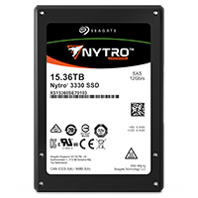
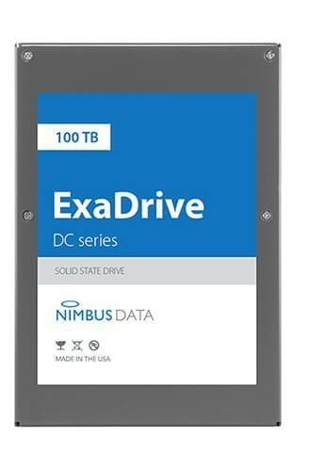
Some “Current” 3.5in SSDs
Seagate Nytro SSD: 15 TB (2017)
  Dual 12Gb/s interface
  Seq reads 860MB/s
  Seq writes 920MB/s
  Random Reads (IOPS): 102K
  Random Writes (IOPS): 15K
  Price (Amazon): $6325 ($0.41/GB)
Nimbus SSD: 100 TB (2019)
  Dual port: 12Gb/s interface
  Seq reads/writes: 500MB/s
  Random Read Ops (IOPS): 100K
  Unlimited writes for 5 years!
  Price: ~ $50K? ($0.50/GB)

Slide 35
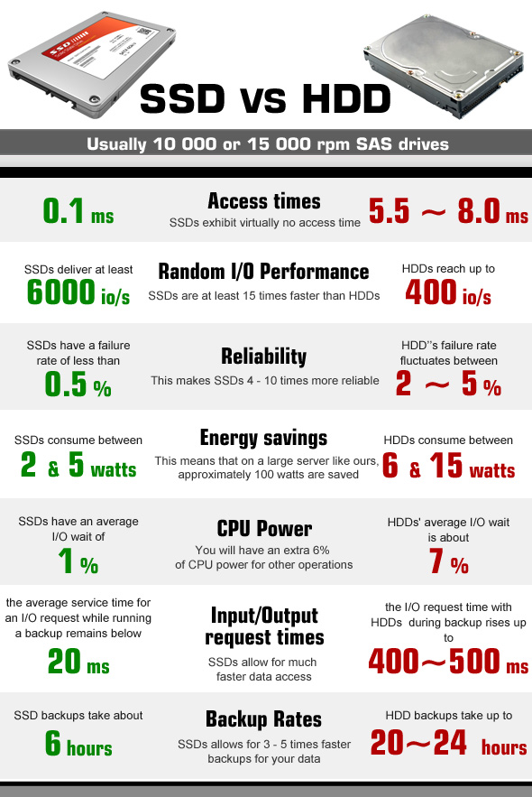
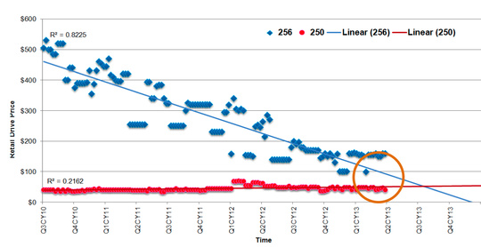
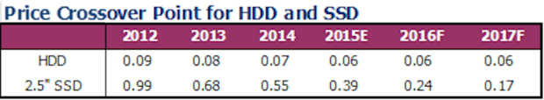
HDD vs SSD Comparison
SSD prices drop much faster than HDD

Slide 36
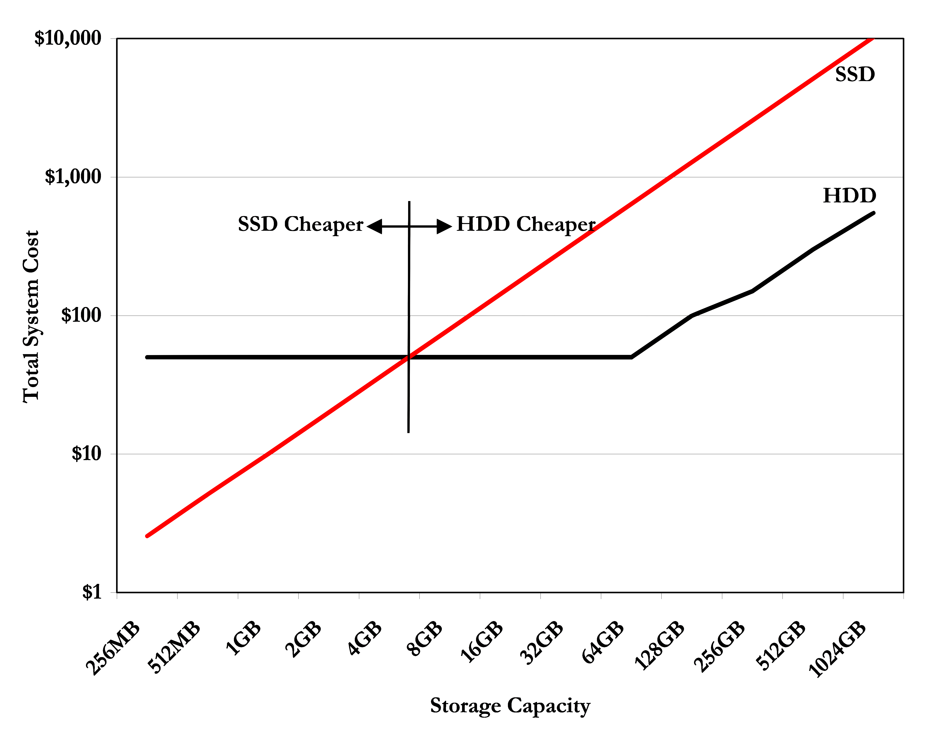
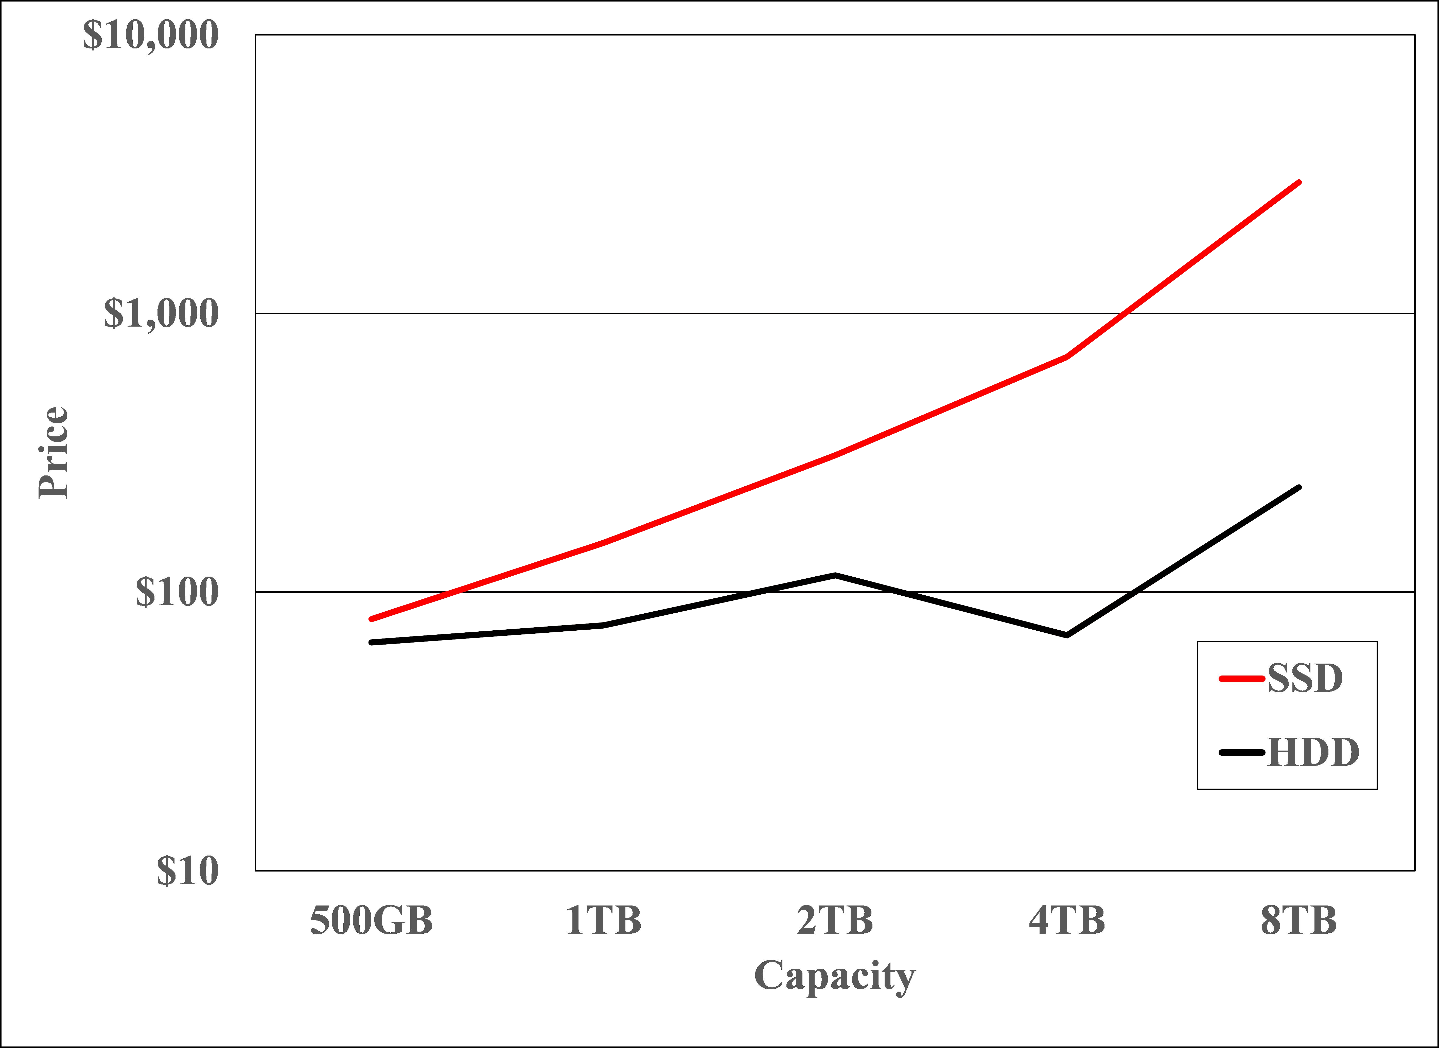
SSD Summary
Pros (vs. hard disk drives):
  Low latency, high throughput (eliminate seek/rotational delay)
  No moving parts:
    Very light weight, low power, silent, very shock insensitive
  Read at memory speeds (limited by controller and I/O bus)
Cons
  Small storage (0.1-0.5x disk), expensive (3-20x disk)
    Hybrid alternative: combine small SSD with large HDD
2007 perspective (Storage Newsletter)
2019 perspective

Slide 37
SSD Summary
Pros (vs. hard disk drives):
  Low latency, high throughput (eliminate seek/rotational delay)
  No moving parts:
    Very light weight, low power, silent, very shock insensitive
  Read at memory speeds (limited by controller and I/O bus)
Cons
  Small storage (0.1-0.5x disk), expensive (3-20x disk)
    Hybrid alternative: combine small SSD with large HDD
  Asymmetric block write performance: read pg/erase/write pg
    Controller garbage collection (GC) algorithms have major effect on performance
  Limited drive lifetime
    1-10K writes/page for MLC NAND
    Avg failure rate is 6 years, life expectancy is 9–11 years
These are changing rapidly
No longer true!

Slide 38
From Storage to File Systems
I/O API and
syscalls
Variable-Size Buffer
Memory Address
Logical Index,
Typically 4 KB
File System
Block
Flash Trans. Layer
Hardware Devices
Sector(s)
Sector(s)
Sector(s)
Phys. Block
Phys Index., 4KB
Physical Index,
512B or 4KB
Erasure Page
HDD
SSD

Slide 39
User vs. System View of a File
User’s view:
  Durable Data Structures
System’s view (system call interface):
  Collection of Bytes (UNIX)
  Oblivious to specific data structures user wants to store
System’s view (inside OS):
  File is a collection of blocks

Slide 40
Building a File System
Classic OS situation
  Take limited hardware interface (array of blocks) and provide a more convenient/useful interface with:
  Naming: Find file by name, not block numbers
    Organize file names with directories
  Organization: Map files to blocks
  Protection: Enforce access restrictions
  Reliability: Keep files intact despite crashes, hardware failures, etc.

Slide 41

Translating from User to Sys. View
File
(Bytes)
File
System
What happens if user says: "give me bytes 2 – 12?"
  Fetch block corresponding to those bytes
  Return just the correct portion of the block
What about writing bytes 2 – 12?
  Fetch block, modify relevant portion, write out block
Everything inside file system is in terms of whole-size blocks
  Actual disk I/O happens in blocks
  read/write smaller than block size needs to translate and buffer

Slide 42
What does the file system need?
Track free disk blocks
  Need to know where to put newly written data
Track which blocks contain data for which files
  Need to know where to read a file from
Track files in a directory
  Find list of file's blocks given its name
Where do we maintain all of this?
  Somewhere on disk

Slide 43
Data Structures on Disk
Bit different than data structures in memory
Access a block at a time
  Can't efficiently read/write a single word
  Have to read/write full block containing it
  Ideally want sequential access patterns
Durability
  Ideally, file system is in meaningful state upon shutdown
  This obviously isn't always the case…

Slide 44
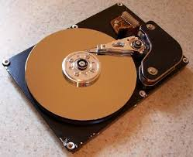
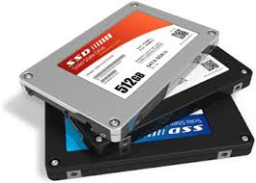

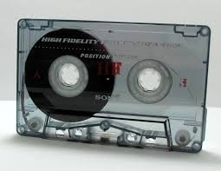
I/O & Storage Layers
Application / Service
streams
High Level I/O
handles
#4 - handle
Low Level I/O
registers
Syscall
descriptors
File System
Commands and Data Transfers
Data blocks
I/O Driver
Disks, Flash, Controllers, DMA
…
Directory Structure

Slide 45
Designing a File System …
What factors are critical to the design choices?
Durable data store => it’s all on disk
(Hard) Disks Performance !!!
  Maximize sequential access, minimize seeks
Open before Read/Write
  Can perform protection checks and look up where the actual file resource are, in advance
Size is determined as they are used !!!
  Can write (or read zeros) to expand the file
  Start small and grow, need to make room
Organized into directories
  What data structure (on disk) for that?
Need to allocate / free blocks
  Such that access remains efficient

Slide 46
File
Named permanent storage
Contains
  Data
    Blocks on disk somewhere
  Metadata (Attributes)
    Owner, size, last opened, …
    Access rights
      R, W, X
      Owner, Group, Other (in Unix systems)
      Access control list in Windows system
Data blocks
File handle
…
File descriptor
File Object (inode)
Position

Slide 47
Our first filesystem: FAT (File Allocation Table)
MS-DOS, 1977, still widely used filesystem (thumb drives, boot, …)
Assume (for now) we have a
way to translate a path to
a “file number”
  i.e., a directory structure
Disk Storage is a collection of Blocks
  Just hold file data (offset o = < B, x >)
Example: file_read 31, < 2, x >
  Index into FAT with file number
  Follow linked list to block
  Read the block from disk
  into memory
FAT
Disk Blocks
0:
0:
File number
31:
File 31, Block 0
File 31, Block 1
File 31, Block 2
N-1:
N-1:
memory

Slide 48
FAT Properties
File is collection of disk blocks
FAT is linked list 1-1 with blocks
File Number is index of root
of block list for the file
File offset (o = < B, x >)
Follow list to get block #
Unused blocks ⬄ Marked free (no ordering, must scan to find)
FAT
Disk Blocks
0:
0:
File number
31:
File 31, Block 0
File 31, Block 1
free
File 31, Block 2
N-1:
N-1:
memory

Slide 49
FAT Properties
File is collection of disk blocks
FAT is linked list 1-1 with blocks
File Number is index of root
of block list for the file
File offset (o = < B, x > )
Follow list to get block #
Unused blocks ⬄ Marked free (no ordering, must scan to find)
Ex: file_write(31, < 3, y >)
  Grab free block
  Linking them into file
FAT
Disk Blocks
0:
0:
File number
31:
31:
File 31, Block 0
File 31, Block 1
File 31, Block 3
free
File 31, Block 2
N-1:
N-1:
memory

Slide 50
FAT Properties
File is collection of disk blocks
FAT is linked list 1-1 with blocks
File Number is index of root
of block list for the file
Grow file by allocating free blocks
and linking them in
Ex: Create file, write, write
FAT
Disk Blocks
0:
0:
File 1 number
31:
File 31, Block 0
free
File 31, Block 1
File 63, Block 1
File 31, Block 3
63:
File 63, Block 0
File 2 number
File 31, Block 2
N-1:
N-1:
memory

Slide 51
FAT Assessment
FAT32 (32 instead of 12 bits) used in Windows, USB drives,
SD cards, …
Where is FAT stored?
  On Disk, on boot cache in memory,
  second (backup) copy on disk
What happens when you format a disk?
  Zero the blocks, Mark FAT entries “free”
What happens when you
quick format a disk?
  Mark all entries in FAT as free
Simple
  Can implement in
  device firmware
FAT
Disk Blocks
0:
0:
File 1 number
31:
File 31, Block 0
File 31, Block 1
File 63, Block 1
File 31, Block 3
63:
File 63, Block 0
File 2 number
File 31, Block 2
N-1:
N-1:
memory

Slide 52
FAT Assessment – Issues
Time to find block (large files) ??
Block layout for file ???
Sequential Access ???
Random Access ???
Fragmentation ???
  MSDOS defrag tool
Small files ???
Big files ???
FAT
Disk Blocks
0:
0:
File 1 number
31:
File 31, Block 0
File 31, Block 1
File 63, Block 1
File 31, Block 3
63:
File 63, Block 0
File 2 number
File 31, Block 2
N-1:
N-1:
memory

Slide 53
Components of a File System
File path
Directory
Structure
File Index
Structure
One Block = multiple sectors
Ex: 512 sector, 4K block
File number
“inumber”
Data blocks
“inode”
…

Slide 54
Components of a file system
file name
offset
file number
offset
Storage block
directory
index structure
Open performs Name Resolution
  Translates pathname into a “file number”
    Used as an “index” to locate the blocks
  Creates a file descriptor in PCB within kernel
  Returns a “handle” (another integer) to user process
Read, Write, Seek, and Sync operate on handle
  Mapped to file descriptor and to blocks
4 components: directory, index structure, blocks, free space map

Slide 55
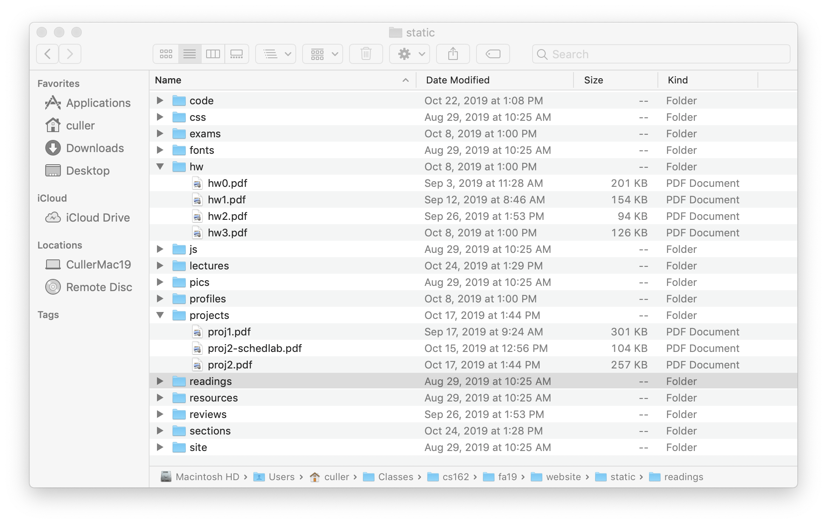
Directories

Slide 56
Directory
Basically a hierarchical structure
Each directory entry is a collection of
  Files
  Directories
    links to other entries
Each has a name and attributes
  Files have data
Links (hard links) make it a DAG, not just a tree
  Softlinks (aliases) are another name for an entry

Slide 57
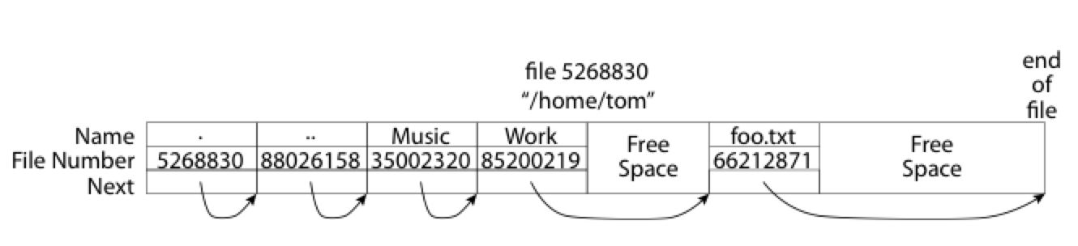
What about the Directory - FAT?
Essentially a file containing <file_name: file_number> mappings
Free space for new entries
In FAT: file attributes are kept in directory (!!!)
Each directory a linked list of entries
Where do you find root directory ( “/” )?

Slide 58
FAT Directory Structure (cont’d)
How many disk accesses to resolve “/my/book/count”?
  Read in file header for root (fixed spot on disk)
  Read in first data block for root
    Table of file name/index pairs. Search linearly – ok since directories typically very small
  Read in file header for “my”
  Read in first data block for “my”; search for “book”
  Read in file header for “book”
  Read in first data block for “book”; search for “count”
  Read in file header for “count”
Current working directory: Per-address-space pointer to a directory used for resolving file names
  Allows user to specify relative filename instead of absolute path (say CWD=“/my/book” can resolve “count”)

Slide 59
Many Huge FAT Security Holes!
FAT has no access rights
FAT has no header in the file blocks
Just gives an index into the FAT
  (file number = block number)

Slide 60
Summary (1/3) - Devices
I/O Devices Types:
  Many different speeds (0.1 bytes/sec to GBytes/sec)
  Different Access Patterns:
    Block Devices, Character Devices, Network Devices
  Different Access Timing:
    Blocking, Non-blocking, Asynchronous
I/O Controllers: Hardware that controls actual device
  Processor Accesses through I/O instructions, load/store to special physical memory
Notification mechanisms
  Interrupts
  Polling: Report results through status register that processor looks at periodically
Device drivers interface to I/O devices
  Provide clean Read/Write interface to OS above
  Manipulate devices through PIO, DMA & interrupt handling
  Three types: block, character, and network

Slide 61
Summary (2/3) - Storage
Disk Performance:
  Queuing time + Controller + Seek + Rotational + Transfer
  Rotational latency: on average ½ rotation
  Transfer time: spec of disk depends on rotation speed and bit storage density
Devices have complex interaction and performance characteristics
  Response time (Latency) = Queue + Overhead + Transfer
    Effective BW = BW * T/(S+T)
  HDD: Queuing time + controller + seek + rotation + transfer
  SDD: Queuing time + controller + transfer (erasure & wear)
Systems (e.g., file system) designed to optimize performance and reliability
  Relative to performance characteristics of underlying device
Bursts & High Utilization introduce queuing delays

Slide 62
Summary (3/3) - File Systems
File System:
  Transforms blocks into Files and Directories
  Optimize for size, access and usage patterns
  Maximize sequential access, allow efficient random access
  Projects the OS protection and security regime (UGO vs ACL)
Naming: translating from user-visible names to actual sys resources
  Directories provide naming for local file systems
  Linked or tree structure stored in files
Components: directory, index, storage blocks, free list
File Allocation Table (FAT) – simple and primitive
  I-number = FAT index, FAT 1-1 with disk blocks, file is singly-link list of FAT=Blocks, directory is essentially file of <name, index, attributes> at known location
  Linear search – for block, for i-number

