Slide 1
Kubernetes:
The Path to Cloud Native
Eric Brewer
VP, Infrastructure
November 2019

Slide 2
“Cloud Native” Applications
Middle of a great transition
unlimited “ethereal” resources in the Cloud
an environment of services not machines
thinking in APIs and co-designed services
high availability offered and expected

Slide 3
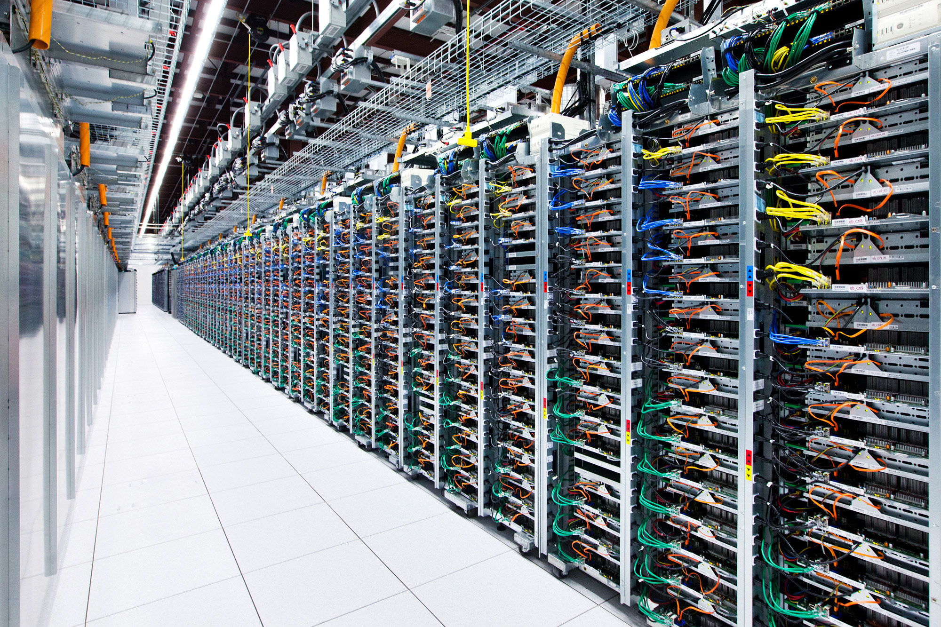
Google has been developing and using containers to manage our applications for over 10 years.
4B launched per week
simplifies management
performance isolation
efficiency
Images by Connie Zhou

Slide 4
Merging Two Kinds of Containers
Docker
It’s about packaging
Control:
packages
versions
(some config)
Layered file system
=> Prod matches testing
Linux Containers
It’s about isolation … performance isolation
not security isolation … use VMs for that
Manage CPUs, memory, bandwidth, …
Nested groups
Notes:
This slide will be left out for Next Web, but used elsewhere

Slide 5
Google Platform Layering
GAE
App Engine, Cloud Run, Functions: Language based
KubernetesGKE
Containers: Process based
Easy to use,
Flexible
GCE
Infrastructure: Machines
Notes:
This slide will be skipped for Next Web, but used elsewhere

Slide 6
Kubernetes: Higher level of Abstraction
Think About
Composition of services
Load-balancing
Names of services
State management
Monitoring and Logging
Upgrading
Don’t Worry About
OS details
Packages — no conflicts
Machine sizes (much)
Mixing languages
Port conflicts

Slide 7
Evolution is the Real Value
Apps Structured as Independent Microservices
Encapsulated state with APIs (like “objects”)
Mixture of languages
Mixture of teams
Services are Abstract
A “Service” is just a long-lived abstract name
Varied implementations over time (versions)
Kubernetes routes to the right implementation

Slide 8
Service-Oriented Architecture?
This is similar, but a also new
Practical difference:
Simple network RPCs now common
JSON/http for REST (or gRPC for sessions)
Much better structure
Micro ⇒ smaller services and more of them
New in Kubernetes: modular sub-services

Slide 9
A Quick Look @ Your Code
Notes:
I think we’ve already learned this with our coding practices. The object oriented and software engineer patterns revolution of the 1990s has made people think about modular code, and this modularity has led to patterns that favor de-coupling and code re-use

Slide 10
& Your Code Community
Customized
Use
Trade Secret
Contribute
Notes:
And this extends to the open source community, there are parts of your code that you use and contribute changes to. There are parts of your code that you wrote and that you share with the outside world, there are parts of your code that you simply consume, and there are parts of your code that are your core business logic or intellectual property and you keep those solely inside your code.

Slide 11
SOA… wrong granularity
Notes:
But this isn’t really true in distributed applications today (even containerized applications), each layer is generally just an individual container (e.g. Redis, MySQL, NodeJS etc), it’s like we’re back in the world of monolithic C programs.

Slide 12
Kubernetes: sub-structure
Container is not the application boundary...
… more like a big persistent OO class..
Or a reusable building block
Notes:
When the time comes to build, redesign, extend or enhance, think about designing your containers like you would classes in an object-oriented language. Design them for re-use, modularity, parameterization and composition. Build containers that are generally useful to the world, not just to your specific application, and re-use containers that others have built.

Slide 13
Substructure
Pod
Containers:
Handle package dependencies
Different versions, same machine
No “DLL hell”
/data
Pods:
Co-locate containers
Shared volumes
IP address, independent port space
Unit of deployment, migration
MyService
MySQL
python 3.4.2
python 2.7.9
glibc 2.21
glibc 2.19
Notes:
mention packages by name due to small font

Slide 14
Ambassador Pattern
Ambassadors represent and present
Pod
Application Container
Ambassador Container
PHP app
redis proxy
Redis
Shards
localhost
Notes:
In the ambassador pattern (like elsewhere) the ambassador container represents the application container to the outside world. Because the two containers share a network namespace, the appliaction container can simply talk to “localhost” to talk to the ambassador, the ambassador is responsible for proxing the communication to the outside world.
In this context, twemproxy is responsible for consistent sharding of the memcache protocol out to a collection of memcache servers.
As before, the separation of concerns means that two teams can own the two different pieces, and many different applications can re-use the same ambassador container.

Slide 15
Sidecar Pattern
Use a logging container from another team
Pod
Logging System
Application Container
Adapter Container
logging
log exporter
Other
adapters
localhost
Notes:
Adapters adapt hetereogenous containers to present the same interface to the world. They may share network namespace, filesystem or IPC.
In this example, the monitoring system expects a homogenous interface for monitoring. But each application exports its statistics in many different ways, depending on when it was written and who wrote it (statsd, JMX, prometheus, etc). Many different adapter containers can be built, each one that knows how to adapt the application to the unified interface.
The composite container pattern enables users to achieve this without modifying the original application (which is often owned by a different project) and yet achieve the consistent interface required by their monitoring system.

Slide 16
Dependencies: Services
Service IP
Service:
Replicated pods
Source pod is a template
Auto-restart member pods
Abstract name (DNS)
IP address for the service
in addition to the members
Load balancing among replicas
Load Balancer

Slide 17
Example: Rolling Upgrade with Labels
v1.2
v1.3
frontend
replicas: 1
replicas: 2
replicas: 3
replicas: 4
replicas: 4
replicas: 3
replicas: 2
replicas: 1
replicas: 0
Replication Controller
Replication Controller
Pods:
Labels:
frontend
frontend
frontend
frontend
frontend
frontend
frontend
frontend
v1.2
v1.2
v1.2
v1.2
v1.3
v1.3
v1.3
v1.3
Notes:
explain graphic in commentary due to small fonts

Slide 18
What about state? (“stateful services”)
Easy option today:
Services can be stateful, but they use storage services underneath
(BigTable, Spanner, MySQL, … SAP)
Can we containerize the storage services?
Yes — all of Google’s storage systems are built this way
Current state: pods with durable disks as building blocks
Enables MySQL, Cassandra, etc.

Slide 19
Service Mesh: Applications are collections of services
Not uncommon to have 100s of small services
Some with state, some without…
Goals:
Deploy service updates independently
Need versioning
Uniform and easy support for services
Decouple operations from development
E.g. changing logging without redeploying services

Slide 20
Istio: insert a services control layer using L7 proxy
Simple k8s: services have a load balancer
Istio: services have an extensible L7 proxy
Advanced load balancing
Telemetry: uniform data collection about services
E.g. latency distribution
Security: handle auth and access control
Quota: limit usage by some callers
Uniform policies
Most important: change policies without changing application code

Slide 21
Service Mesh

Slide 22
Open Source
Key decision: core pieces are open source
Kubernetes
Tensorflow for ML
Istio service mesh (launched with IBM and Lyft)
gRPC (fast streaming RPC)
Bazel (large-scale build system)
Kubernetes and Tensorflow are both top 0.01% projects on github
Roughly rebuilding Google in open source...

Slide 23
What about “serverless”
Literally means you don’t have to manage servers
But also usage-based billing (vs resource based, eg. VMs)
Often means “functions”
Function model by itself is not great
Hard to manage state
Expensive
Hard to debug above a certain size
Many “functions as a service” (FaaS) being built on Kubernetes
Kubernetes is really a platform for platforms

Slide 24
Hybrid Cloud and Multi-Cloud
Strong demand to mix on prem and Cloud(s)
Open Source makes this vastly easier
Two models, both are used together:
Partition services — run different things in different places
Secure bidirectional traffic with direct peering
Consistent Environment
Run services in either place without code changes
May involve some storage replication for latency/cost

Slide 25
Summary
“Cloud” should run at a higher level of abstraction
… but still be able to run all the things
Containers -> pods -> services -> service mesh
Google roughly built this way internally, with some rougher edges
Open Source is a key part of driving adoption
Freedom to change environments

Slide 26
BACKUP

Slide 27
How?
Implemented by a number of (unrelated) Linux APIs:
cgroups: Restrict resources a process can consume
CPU, memory, disk IO, ...
namespaces: Change a process’s view of the system
Network interfaces, PIDs, users, mounts, ...
capabilities: Limits what a user can do
mount, kill, chown, ...
chroots: Determines what parts of the filesystem a user can see

