Slide 1
CS 162: Operating Systems and Systems Programming
Lecture 25: End-to-End Architecture and TCP
November 26, 2019
Instructor: David E. Culler
https://cs162.eecs.berkeley.edu

Slide 2
Recall: Two-Phase Commit
Consensus Goal: Everyone agrees on the state of the distributed system
  Doesn’t depend who you ask. Doesn’t matter if nodes go down
Distributed Transactions
  Atomic, can’t revert once agreement is reached
Voting protocol requires unanimity
Transaction committed if and only if: all workers and coordinator vote to commit
  Nodes never take back their vote
  Nodes work in lock step (for an item)
    Don’t perform new transactions until old one is resolved
    Stall until transaction is resolved
Majority-based protocols make progress despite failed nodes
  Add considerable complexity

Slide 3
Bottom line: in a network . . .
All distributed systems boil down to message passing
  Across a network, the internet
  Spread across the world
Things fail
  Nodes die, software crashes, routers too, messages get corrupted in flight, …
  Dealing with reliability / failure is inherent
  Many techniques to utilize
Limited knowledge of what happened is fundamental
Question is what steps are taken at what level ?
  What is the “contract” with the infrastructure?
  What can we reason from and what can we not?

Slide 4
The E2E Concept
Traditional Engineering Goal: design the infrastructure to meet application requirements
  Optimizing for Cost, Reliability, Performance, …
Challenge: infrastructure is most costly & difficult to create and evolves most slowly
  Applications evolve rapidly, as does technology
End-to-end Design Concept
  Utilize intelligence at the point of application
  Infrastructure need not meet all application requirements directly
  Only what the end-points cannot reasonably do themselves
    Avoid redundancy, semantic mismatch, …
  Enable applications and incorporate technological advance
Design for Change! - and specialization
  Layers & protocols

Slide 5
Recall: Sockets over TCP/IP
Server
Socket
Request Connection
new
socket
socket
Connection
socket
connection
connection
Client
Server
Special kind of socket: server socket
  Has file descriptor
  Can’t read or write
Two operations:
  listen(): Start allowing clients to connect
  accept(): Create a new socket for a particular client connection

Slide 6
Socket Setup over TCP/IP
Server
Socket
Request Connection
new
socket
socket
Connection
socket
connection
connection
Client
Server
5-Tuple identifies each connection:
  Source IP Address
  Destination IP Address
  Source Port Number
  Destination Port Number
  Protocol (TCP here)
  Often, Client Port “randomly” assigned
    Done by OS during client socket setup
  Server Port often “well known”
    80 (web), 443 (secure web), 25 (sendmail), etc
    Well-known ports from 0—1023

Slide 7
Recall: Sockets in Schematic
Client
Server
Create Server Socket
Create Client Socket
Bind it to an Address
(host:port)
Connect it to server (host:port)
Listen for Connection
Accept syscall()
Connection Socket
Connection Socket
write request
read request
read response
write response
Close Client Socket
Close Connection Socket
Close Server Socket

Slide 8
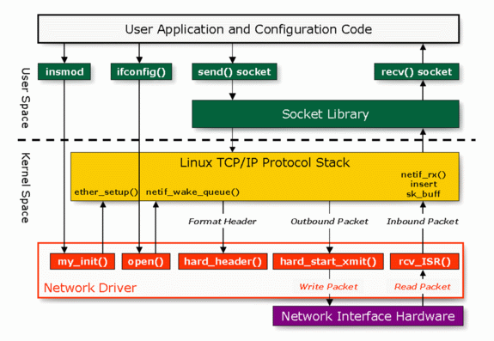
Linux Network Architecture

Slide 9
Networking Challenge
Many different applications
  Email, Web, Online Games, etc.
Many different network types and technologies
  Wireless, Wired, Optical, etc.
Inherently distributed, parts can fail, no overall management authority, …
How do we manage this complexity?
Such that the whole is more “reliable” than its parts
  Available, despite underlying unreliability

Slide 10
Networking Challenge
Application
Skype
SSH
NFS
HTTP
Transmission
Media
Coaxial
cable
Fiber
optic
Packet
Radio
Re-implement every application for every technology?
No

Slide 11
Networking Challenge
Application
Skype
SSH
NFS
HTTP
Sockets
UDP/IPv4
UDP/IPv6
TCP/IPv4
TCP/IPv6
Transmission
Media
Coaxial
cable
Fiber
optic
Re-implement sockets for every technology?
No

Slide 12
Layering
Complex services from simpler ones
  Physical and Link Layers (Wi-Fi, Ethernet, …)
    Unreliable, local exchange of limited-size frames
  Network (IP) – routing between local networks
    Unreliable, global exchange of limited-size packets
  Transport (e.g., TCP or UDP) – Glue
    Reliable (with retries), ordering, stream of bytes
    Not-neccesarily reliable datagrams (UDP)
  Application – Everything on top of sockets

Slide 13
The Internet Hourglass
SMTP
HTTP
DNS
NTP
Applications
Sockets – the OS “Hourglass”
TCP
UDP
Transport
Waist
IP
Data Link
Ethernet
SONET
802.11
Physical
Copper
Fiber
Radio
The Hourglass Model

Slide 14

Internet Protocol (IP)
Application
Present.
Session
Transport
Network
Datalink
Internet Protocol: Internet’s network layer
Service it provides: “Best-Effort” Packet Delivery
  Tries it’s “best” to deliver packet to its destination
  Packets may be lost
  Packets may be corrupted
  Packets may be delivered out of order
Physical
source
destination
IP network

Slide 15
Internet: Network of Networks
Hierarchy of Networks: Scales to billions of hosts
Other
subnets
subnet1
Router
Transcontinental
Link
Router
Other
subnets
Router
subnet3
subnet2

Slide 16
Internet Protocol Features
Routing – an IP packet goes anywhere
  Just need the destination IP address
Fragmentation – split big messages into smaller pieces
  Think about downloading a file
  Maximum size 64K
  Reassemble at destination
  Hides differences in link/physical layers
Multiple protocols running on top
  ICMP, TCP, UDP, …

Slide 17
Internet Protocol "Non-Features"
Unreliable Delivery ("Best Effort")
  IP packet delivery not guaranteed
  May be lost by underlying physical layer (e.g., radio noise)
  May be dropped in transit
Out-of-order/duplicate delivery
  Tolerance of physical layer retrying transmission
  Tolerance of multiple paths

Slide 18
Internet Architecture: The Five Layers
Lower three layers implemented everywhere
Top two layers implemented only at hosts
Logically, layers interacts with peer’s corresponding layer
Application
sockets
sockets
Application
Transport
Transport
Network
Network
Network
Datalink
Datalink
Datalink
Physical
Physical
Physical
Host A
Router
Host B

Slide 19
Physical Communication
Communication goes down to physical network
Then from network peer to peer
Then up to relevant layer
Application
Application
Transport
Transport
Network
Network
Network
Datalink
Datalink
Datalink
Physical
Physical
Physical
Host A
Router
Host B

Slide 20
Implications of Hourglass
There is only one Network-Layer Protocol: IP
Allows networks to interoperate
Above IP: Applications function on all networks
Below IP: Change network’s construction without disturbing applications
One drawback: Changing IP itself (e.g. transitioning to IPv6) very involved

Slide 21
End-to-End Principal
Seen as a guiding principle of the Internet
Some types of network functionality can only be correctly implemented end-to-end
  Reliability, security, etc.
Implementing complex functionality in the network:
  Doesn’t necessarily reduce complexity on end hosts
  Does increase network complexity
  Imposes a cost on all applications, even if they don’t need the functionality

Slide 22
Example: Reliable File Transfer
Host A
Host B
Appl.
Appl.
OS
OS
OK
Solution 1: make each step reliable, and then concatenate them
Solution 2: end-to-end check and try again if necessary

Slide 23
Summary: Network Layers
Link Layer (local network)
  Send frames addressed to neighboring machines
  Ethernet, Wi-Fi
Network layer (connecting local networks)
  Forwarding between local networks
  Send packets addressed to machines anywhere
  IP
Transport Layer (making streams)
  Turn sequence of packets into reliable byte stream
  TCP
OS: Sockets abstraction : Application
  File Handle, Read/Write like files
  But setup/teardown very different from open/close

Slide 24
Layering: Packets in Envelopes
Application Layer
Application Layer
Data
Data
Transport Layer
Trans.
Hdr.
Data
Trans.
Hdr.
Data
Transport Layer
Network Layer
Net.
Hdr.
Trans.
Hdr.
Data
Net.
Hdr.
Trans.
Hdr.
Data
Network Layer
Datalink Layer
Frame
Hdr.
Net.
Hdr.
Trans.
Hdr.
Data
Frame
Hdr.
Net.
Hdr.
Trans.
Hdr.
Data
Datalink Layer
Physical Layer
Physical Layer
101010100110101110
101010100110101110

Slide 25
Ordered Messages: Problem
Want to divide a message into packets / frames
Think about downloading a file over IP
  64K max packet size
IP might reorder these packets
  Imagine receiving the end of a file before the beginning!

Slide 26
Ordered Messages: Solution
Simulate ordered messages on top of unordered messages
Assign each packet a sequence number: 0, 1, 2, 3, …
  If packets arrive out of order, hold on to them
  Deliver them in order to user (through socket interface)
Example: Hold on to #3 until #2 arrives, etc.

Slide 27
Reliable Message Delivery: Problem
All physical networks can garble or drop packets
  Physical hardware problems (bad wire, bad signal)
Therefore, IP can garble or drop packets
  It doesn't repair this itself (end-to-end principle!)
Building reliable message delivery
  Confirm that packets aren't garbled
  Confirm that packets arrive exactly once

Slide 28
Using Acknowledgements
A
B
A
B
Packet
Packet
Timeout
ack
Packet
ack
Checksum: Detect garbled packets
Receiver sends a packet to acknowledge when a packet received and ungarbled
  No acknowledgement? Resend after timeout
What if acknowledgement dropped?
  Packet is resent (wasteful), second chance to acknowledge

Slide 29
What about duplicates?
Add a Sequence Number
Wait for its Ack before sending the next
  “stop and wait”
Latency limits bandwidth
  Remember Little’s Law
  N = L*B
With sequence #s can detect duplicates and maintain order
A
B
Pkt #0
Ack #0
Pkt #1
Ack #1
Pkt #2
Ack #2

Slide 30
Window-Based Acknowledgements
Windowing protocol (not quite TCP)
Send up to N packets without ack
  Allows pipelining of packets
  N limits queue size
Both source and destination need to store N packets (why?)
Each packet has sequence number
  ACK says "Received all packets up to number X"
  Advances window
A
B
N=5
pkt#0
pkt#4
Queue
ack#0
ack#4

Slide 31
Transport Layer (4)
Application
Present.
Session
Transport
Service:
  Provide end-to-end communication between processes
  Demultiplexing of communication between hosts
  Possible other services:
    Reliability in the presence of errors
    Timing properties
    Rate adaption (flow-control, congestion control)
Interface: send message to “specific process” at given destination; local process receives messages sent to it
  How are they named?
Protocol: port numbers, perhaps implement reliability, flow control, packetization of large messages, framing
Prime Examples: TCP and UDP
Network
Datalink
Physical

Slide 32
Internet Transport Protocols
Application
Present.
Session
Transport
Datagram service (UDP)
  No-frills extension of “best-effort” IP
  Multiplexing/Demultiplexing among processes
Reliable, in-order delivery (TCP)
  Connection set-up & tear-down
  Discarding corrupted packets (segments)
  Retransmission of lost packets (segments)
  Flow control
  Congestion control
Services not available
  Delay and/or bandwidth guarantees
  Sessions that survive change-of-IP-address
Network
Datalink
Physical

Slide 33
Application Layer (7 - not 5!)
Application
Present.
Session
Transport
Service: any service provided to the end user
Interface: depends on the application
Protocol: depends on the application
Examples: Skype, SMTP (email), HTTP (Web), Halo, BitTorrent …
What happened to layers 5 & 6?
  “Session” and “Presentation” layers
  Part of OSI architecture, but not Internet architecture
  Their functionality is provided by application layer
Network
Datalink
Physical

Slide 34



Socket API
Base level Network programming interface
Application
Socket
API
Transport
TCP
UDP
Network
IP

Slide 35
BSD Socket API
Created at UC Berkeley (1980s)
Most popular network API
Ported to various OSes, various languages
  Windows Winsock, BSD, OS X, Linux, Solaris, …
  Socket modules in Java, Python, Perl, …
Similar to Unix file I/O API
  In the form of file descriptor (sort of handle).
  Can share same read()/write()/close() system calls

Slide 36
TCP: Transport Control Protocol
Reliable, in-order, and at most once delivery
Stream oriented: messages can be of arbitrary length
Provides multiplexing/demultiplexing to IP
Provides congestion and flow control
Application examples: file transfer, chat, http

Slide 37
TCP Service
Open connection: 3-way handshaking
Reliable byte stream transfer from
(IPa, TCP_Port1) to (IPb, TCP_Port2)
  Indication if connection fails: Reset
Close (tear-down) connection

Slide 38
Recall: Socket creation and connection
File systems provide a collection of permanent objects in structured name space
  Processes open, read/write/close them
  Files exist independent of the processes
Sockets provide a means for processes to communicate (transfer data) to other processes.
Creation and connection is more complex
Form 2-way pipes between processes
  Possibly worlds away

Slide 39
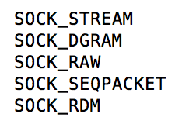
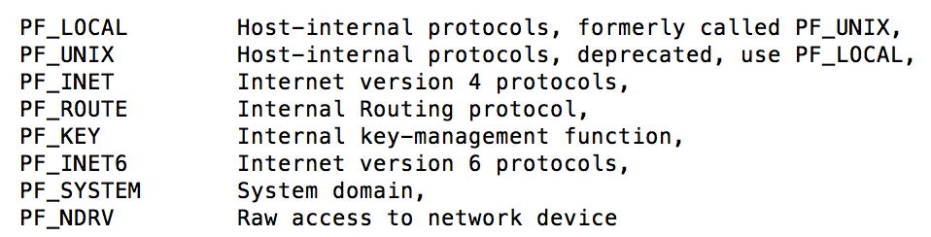
Recall: Client Protocol
char *hostname;
int sockfd, portno;
struct sockaddr_in serv_addr;
struct hostent *server;
server = buildServerAddr(&serv_addr, hostname, portno);
/* Create a TCP socket */
sockfd = socket(AF_INET, SOCK_STREAM, 0)
/* Connect to server on port */
connect(sockfd, (struct sockaddr *) &serv_addr, sizeof(serv_addr)
printf("Connected to %s:%d\n",server->h_name, portno);
/* Carry out Client-Server protocol */
client(sockfd);
/* Clean up on termination */
close(sockfd);
Notes:
Addressing Family, vs Protocol Family. Still see PF_INET in the man page. But AF_INET is what is used everywhere

Slide 40
Recall: Sockets in Schematic
Client
Server
Create Server Socket
Create Client Socket
Bind it to an Address
(host:port)
Connect it to server (host:port)
Listen for Connection
Accept syscall()
Connection Socket
Connection Socket
write request
read request
read response
write response
Close Client Socket
Close Connection Socket
Close Server Socket

Slide 41
Open Connection: 3-Way Handshaking
Goal: agree on a set of parameters, i.e., the start sequence number for each side
  Starting sequence number: sequence of first byte in stream
  Starting sequence numbers are random

Slide 42
Open Connection: 3-Way Handshaking
Server waits for new connection calling listen()
Sender call connect() passing socket which contains server’s IP address and port number
  OS sends a special packet (SYN) containing a proposal for first sequence number, x
Client (initiator)
Server
Active
Open
connect()
listen()
SYN, SeqNum = x
Passive
Open
time

Slide 43
Open Connection: 3-Way Handshaking
If it has enough resources, server calls accept() to accept connection, and sends back a SYN ACK packet containing
  Client’s sequence number incremented by one, (x + 1)
    Why is this needed?
  A sequence number proposal, y, for first byte server will send
Client (initiator)
Server
Active
Open
connect()
listen()
SYN, SeqNum = x
Passive
Open
accept()
SYN and ACK, SeqNum = y and Ack = x + 1
time
ACK, Ack = y + 1
allocate
buffer space

Slide 44
3-Way Handshaking (cont’d)
Three-way handshake adds 1 RTT delay
Why?
  Congestion control: SYN (40 byte) acts as cheap probe
  Protects against delayed packets from other connection (would confuse receiver)

Slide 45
Close Connection
Goal: both sides agree to close the connection
4-way connection tear down
Host 1
Host 2
close
FIN
FIN ACK
data
FIN
close
FIN ACK
closed
Can retransmit FIN ACK
if it is lost
timeout
closed

Slide 46
Recall: Sockets in Schematic
Client
Server
Create Server Socket
Create Client Socket
Bind it to an Address
(host:port)
Connect it to server (host:port)
Listen for Connection
Accept syscall()
Connection Socket
Connection Socket
write request
read request
read response
write response
Close Client Socket
Close Connection Socket
Close Server Socket

Slide 47
The Transfer Part - Reliability

Slide 48
TCP Sliding Window
0 1 2 3 4 5 6 7
ACK 0
0 1 2 3 4 5 6 7
Window represents packets:
  That might need to be re-sent (dropped, garbled)
  That receiver needs to buffer (in-order delivery to user)

Slide 49
Transmission Control Protocol (TCP)
Stream in:
Stream out:
Router
Router
zyxwvuts
gfedcba
Reliable byte stream between two processes on different machines, over the Internet
Bi-directional: two streams for every connection
Segments byte streams into “packets”, hands those to IP
  IP may “fragment” into link frames
Window-based acknowledgement protocol
Automatically retransmits lost packets
Adjusts rate of transmission to avoid congestion
  How? Window Size

Slide 50
Reliable Transfer
Retransmit missing packets
  Numbering of packets and ACKs
Do this efficiently
  Keep transmitting whenever possible
  Detect missing packets and retransmit quickly
Two schemes
  Stop & Wait
  Sliding Window (Go-back-n and Selective Repeat)

Slide 51
Window-Based Acknowledgement
Packet lost?
  Resent after timeout (no ACK received)
Acknowledgement lost?
  Packet resent, causing ACK to be resent, too
Discard out-of-order packets?
  If no, need some way to indicate holes in window

Slide 52
Detecting Packet Loss?
Timeouts
  Sender timeouts on not receiving ACK
Missing ACKs
  Receiver ACKs each packet
  Sender detects a missing packet when seeing a gap in the sequence of ACKs
  Need to be careful! Packets and ACKs might be reordered
NACK: Negative ACK
  Receiver sends a NACK specifying a packet it is missing

Slide 53
Stop & Wait w/o Errors
Send; wait for ack; repeat
RTT: Round Trip Time (RTT): time it takes a packet to travel from sender to receiver and back
  One-way latency (d): one way delay from sender and receiver
Sender
Receiver
1
d
RTT = 2*d
(if latency is
symmetric)
RTT
ACK 1
2
RTT
ACK 2
3
Time

Slide 54
Stop & Wait w/o Errors
How many packets can you send?
1 packet / RTT
Throughput: number of bits delivered to receiver per sec
Sender
Receiver
1
RTT
ACK 1
2
RTT
ACK 2
3
Time

Slide 55
Stop & Wait w/o Errors
Say, RTT = 100ms
1 packet = 1500 bytes
Throughput = 1500*8bits/0.1s = 120 Kbps
Sender
Receiver
1
RTT
ACK 1
2
RTT
ACK 2
3
Time

Slide 56
Stop & Wait w/o Errors
Can be very inefficient for high capacity links
Throughput doesn’t depend on the network capacity → even if capacity is 1Gbps, we can only send 120 Kbps!
Sender
Receiver
1
RTT
ACK 1
2
RTT
ACK 2
3
Time

Slide 57
Stop & Wait with Errors
If a loss wait for a retransmission timeout and retransmit
How do you pick the timeout?
Sender
Receiver
1
RTT
ACK 1
timeout
1
Time

Slide 58
Sliding Window
window = set of adjacent sequence numbers
The size of the set is the window size
Assume window size is n
Let A be the last ACK’d packet of sender without gap; then window of sender = {A+1, A+2, …, A+n}
Sender can send packets in its window
Let B be the last received packet without gap by receiver, then window of receiver = {B+1,…, B+n}
Receiver can accept out of sequence, if in window

Slide 59
Sliding Window w/o Errors
Throughput = W*packet_size/RTT
Unacked packets
in sender’s window
Out-o-seq packets
in receiver’s window
Window size (W) = 3 packets
{1}
1
{1, 2}
2
{}
{1, 2, 3}
3
{}
{2, 3, 4}
4
{}
{3, 4, 5}
5
.
.
.
{4, 5, 6}
6
.
.
.
Time
Sender
Receiver

Slide 60
Example: Sliding Window w/o Errors
Assume
  Link capacity, C = 1Gbps
  Latency between end-hosts, RTT = 80ms
  packet_length = 1000 bytes
What is the window size W to match link’s capacity, C?
Solution
  We want Throughput = C
  Throughput = W*packet_size/RTT
  C = W*packet_size/RTT
  W = C*RTT/packet_size = 10⁹bps*80*10⁻³s/(8000b) = 10⁴ packets
Window size ~ Bandwidth (Capacity), delay (RTT/2)

Slide 61
Sliding Window with Errors
Two approaches
  Go-Back-n (GBN)
  Selective Repeat (SR)
In the absence of errors they behave identically
Go-Back-n (GBN)
  Transmit up to n unacknowledged packets
  If timeout for ACK(k), retransmit k, k+1, …
  Typically uses NACKs instead of ACKs
    Recall, NACK specifies first in-sequence packet missed by receiver

Slide 62
GBN Example with Errors
Out-o-seq packets
in receiver’s window
Window size (W) = 3 packets
1
2
{}
{}
{}
3
4
5
4 is
missing
Timeout
Packet 4
6
{5}
{5,6}
NACK 4
NACK 4
4
Why doesn’t sender retransmit packet 4 here?
5
Assume packet 4 lost!
6
{}
Sender
Receiver

Slide 63
Selective Repeat (SR)
Sender: transmit up to n unacknowledged packets
Assume packet k is lost
Receiver: indicate packet k is missing (use ACKs)
Sender: retransmit packet k

Slide 64
SR Example with Errors
Unacked packets
in sender’s window
Window size (W) = 3 packets
{1}
1
{1, 2}
2
{1, 2, 3}
3
{2, 3, 4}
4
{3, 4, 5}
5
{4, 5, 6}
6
ACK 5
{4,5,6}
4
ACK 6
Time
{7}
7
Sender
Receiver

Slide 65
TCP Windows and Seq. Numbers
Sequence Numbers
Sent
acked
Sent
not acked
Not yet
sent
Sender
Received
Given to app
Received
Buffered
Not yet
received
Receiver
Sender has three regions:
  Sent and acknowledged
  Sent and not acknowledged
  Not yet sent

Slide 66
TCP Windows and Seq. Numbers
Sequence Numbers
Sent
acked
Sent
not acked
Not yet
sent
Sender
Received
Given to app
Received
Buffered
Not yet
received
Receiver
Receiver has three regions:
  Received and acknowledged
  Received and buffered
  Not yet received

Slide 67
Window-Based Acknowledgements
100
140
190
230
260
300
340
380
400
Seq:100
Size:40
Seq:140
Size:50
Seq:190
Size:40
Seq:230
Size:30
Seq:260
Size:40
Seq:300
Size:40
Seq:340
Size:40
Seq:380
Size:20
A:100/300
Seq:100
A:140/260
Seq:140
A:190/210
Seq:230
A:190/210
Seq:260
A:190/210
Seq:300
A:190/210
Retransmit!
Seq:190
A:340/60
Seq:340
A:380/20
Seq:380
A:400/0

Slide 68
Congestion
Too much data trying to flow through some part of the network
IP's solution: Drop packets
What happens to TCP connection?
  Lots of retransmission – wasted work
  Lots of waiting for timeouts – underutilized connection

Slide 69
Congestion Avoidance
Solution: Adjust Window Size
AIMD: Additive Increase, Multiplicative Decrease
  When packet dropped (missed ack), cut window size in half
  If no timeouts, increase window size by C for each acknowledgement received
    Until half the old window then slower

Slide 70
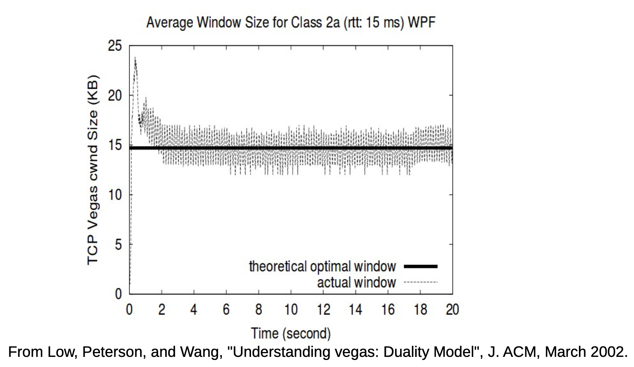
Congestion Avoidance: Changing Window

Slide 71
Congestion Avoidance
Congestion
  How long should timeout be for re-sending messages?
    Too long → wastes time if message lost
    Too short → retransmit even though ACK will arrive shortly
  Stability problem: more congestion ⇒ ACK is delayed ⇒ unnecessary timeout ⇒ more traffic ⇒ more congestion
    Closely related to window size at sender: too big means putting too much data into network
How does the sender’s window size get chosen?
  Must be less than receiver’s advertised buffer size
  Try to match the rate of sending packets with the rate that the slowest link can accommodate
  Sender uses an adaptive algorithm to decide size of N
    Goal: fill network between sender and receiver
    Basic technique: slowly increase size of window until acknowledgements start being delayed/lost
TCP solution: “slow start” (start sending slowly)
  If no timeout, slowly increase window size (throughput) by 1 for each ACK received
  Timeout ⇒ congestion, so cut window size in half
  “Additive Increase, Multiplicative Decrease”
Notes:
2nd thing we use window-based acknowledgment protocol for:
Avoid overwhelming network

Slide 72
Summary: Network Layers
Link Layer (local network)
  Send frames addressed to neighboring machines
  Ethernet, Wi-Fi
Network layer (connecting local networks)
  Forwarding between local networks
  Send packets addressed to machines anywhere
  IP
Transport Layer (making streams)
  Turn sequence of packets into reliable byte stream
  TCP

Slide 73
Glue: Adding Functionality
Physical Reality: Frames | Abstraction: Stream
Limited Size | Arbitrary Size
Unordered (sometimes) | Ordered
Unreliable | Reliable
Machine-to-Machine | Process-to-Process
Only on Local Area Net | Routed Anywhere
Asynchronous | Synchronous

Slide 74
Glue: Adding Functionality
Network Layer: IP
Physical Reality: Frames | Abstraction: Stream
Limited Size | Arbitrary Size
Unordered (sometimes) | Ordered
Unreliable | Reliable
Machine-to-Machine | Process-to-Process
Only on Local Area Net | Routed Anywhere
Asynchronous | Synchronous

Slide 75
Glue: Adding Functionality
Transport Layer: TCP
Physical Reality: Frames | Abstraction: Stream
Limited Size | Arbitrary Size
Unordered (sometimes) | Ordered
Unreliable | Reliable
Machine-to-Machine | Process-to-Process
Only on Local Area Net | Routed Anywhere
Asynchronous | Synchronous

Slide 76
Summary: TCP
Syn | Syn-Ack | Ack to realize Connect/Listen Accept
  vs Open for a file
  Demultiplex to processes based on Port
Use sequence numbers to solve out-of-order delivery problem
Use acknowledgements to solve reliable delivery problem
  For better utilization, allow a window of unacknowledged packets
  Adjust window size in response to perceived congestion events
FIN | FIN ACK in both direction to tear down
  Upon close

Slide 77
Summary: TCP
Use sequence numbers to solve out-of-order delivery problem
Use acknowledgements to solve reliable delivery problem
For better utilization, allow a window of unacknowledged packets
Adjust window size in response to perceived congestion events

Slide 78
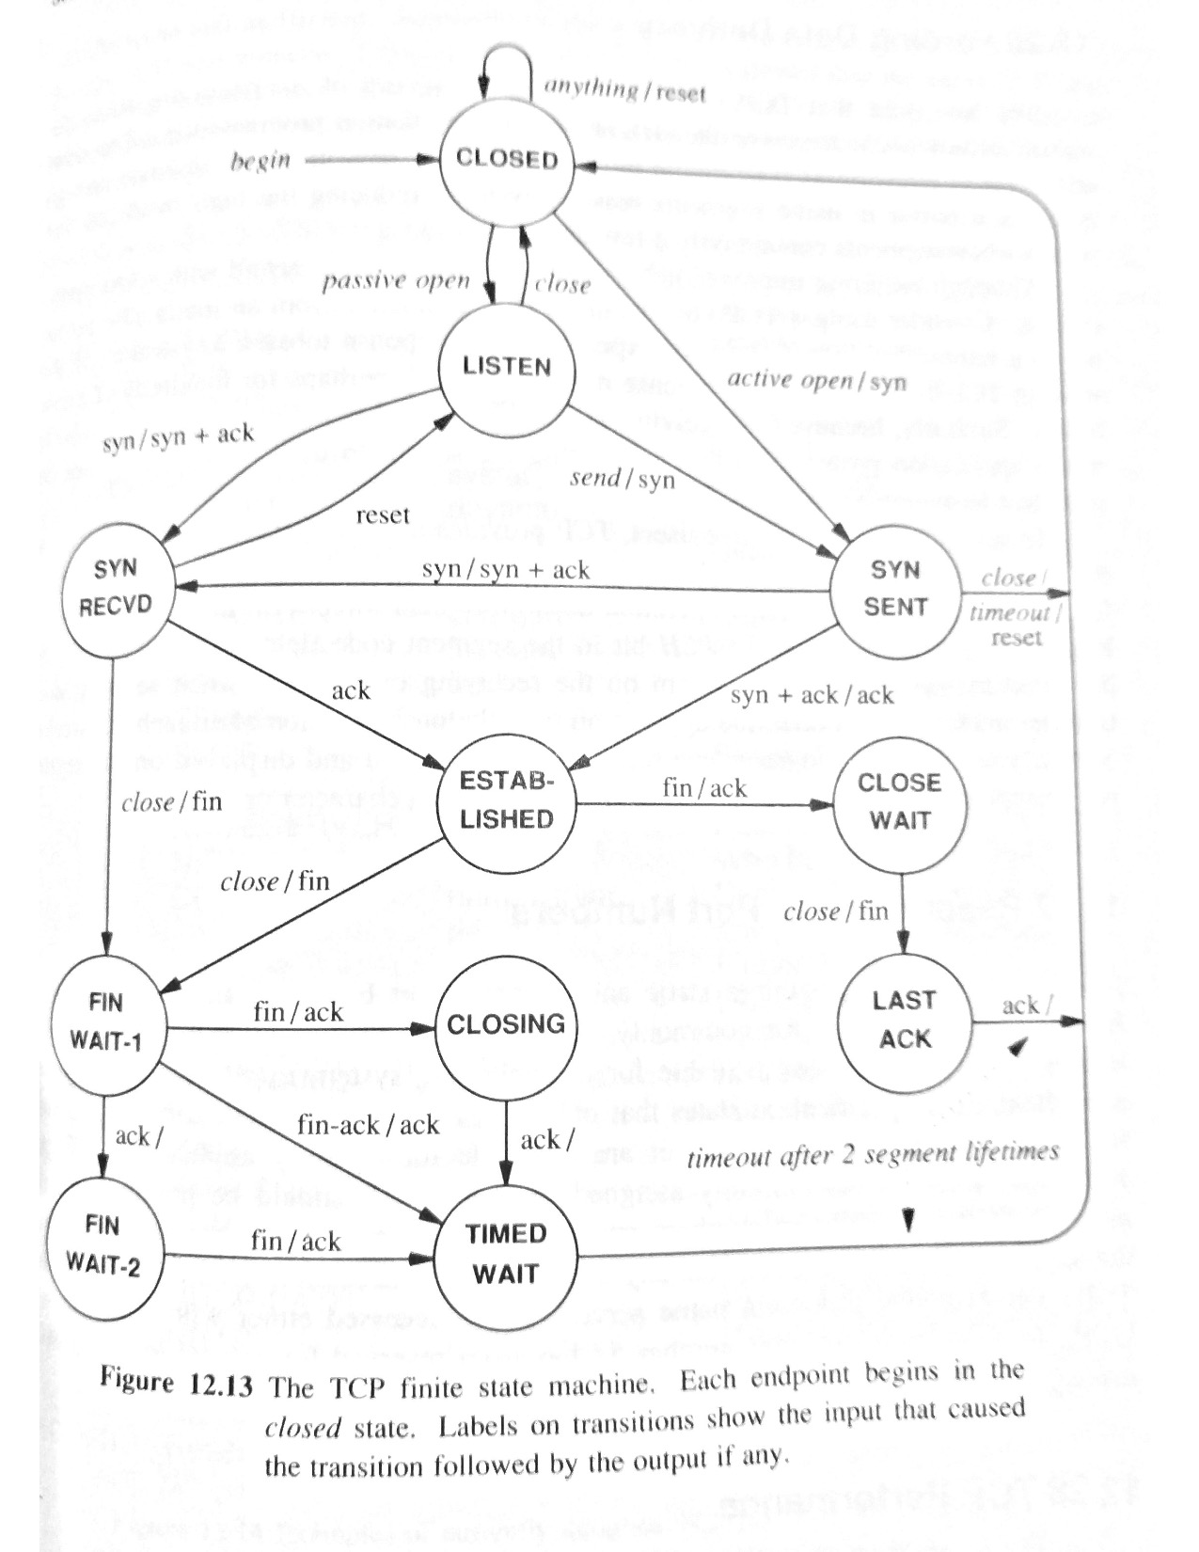
TCP State Machine
From Comer, Internetworking with TCP/IP

