Slide 1
CS 162: Operating Systems and Systems Programming
Lecture 6: Scheduling - Basics
September 17, 2019
Instructor: David Culler
https://cs162.eecs.berkeley.edu
Read: 3 Easy Pieces: ch 7
A&D 7.1
HW 1 Dues Wed 9/18
Proj 1 Design Doc

Slide 2
Where are we?
You are here

Slide 3
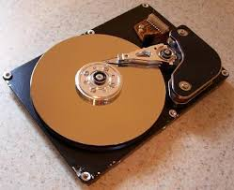
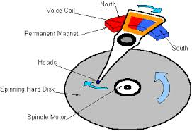


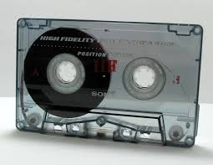

Recall: What’s below the surface ??
File descriptor number
- an int
Application / Service
High Level I/O
streams
Low Level I/O
handles
Syscall
registers
File System
descriptors
File Descriptors
a struct with all the info about the files
I/O Driver
Commands and Data Transfers
Disks, Flash, Controllers, DMA

Slide 4
Recall: Layer by layer
User App
length = read(input_fd, buffer, BUFFER_SIZE);
User library
ssize_t read(int, void *, size_t){
marshal args into registers
issue syscall
register result of syscall to rtn value
};
Exception U→K, interrupt processing
Void syscall_handler (struct intr_frame *f) {
unmarshall call#, args from regs
dispatch : handlers[call#](args)
marshal results fo syscall ret
}
ssize_t vfs_read(struct file *file, char __user *buf, size_t count, loff_t *pos)
{
UserProcess/File System relationship
call device driver to do the work
}
Device Driver

Slide 5
Recall: C Low Level I/O Operations
ssize_t read (int filedes, void *buffer, size_t maxsize)
- returns bytes read, 0 => EOF, -1 => error
ssize_t write (int filedes, const void *buffer, size_t size)
- returns bytes written
off_t lseek (int filedes, off_t offset, int whence)
int fsync (int fildes) – wait for i/o to finish
void sync (void) – wait for ALL to finish
When write returns, data is on its way to disk and can be read, but it may not actually be permanent!
Low I/O has int “descriptors” – kernel holds real descriptor in PCB, just a handle
Buffering reflects a kernel/user “compromise” protocol
  Kernel will read/write what it can buffer and tell the user what it did
  User needs to loop on read/write to complete the entire transfer
What type of object is written/read?

Slide 6
Recall: Kernel-Supported Threads
Kernel-Supported Thread: OS stores thread control block, schedules thread directly
  Block independently on I/O, processes may wait on multiple events

Slide 7
Recap So Far: Kernel Structure
Kernel
Code
Process 1
Process 2
PCB 1
PCB 2
Globals
Kernel
Stack
Kernel
Stack
Heap
Process 1
Thread
Process 2
Thread
Stack
Stack
Code
Code
Globals
Globals
Heap
Heap

Slide 8
Recap So Far: Kernel Structure
Process 1
Process 2
Kernel
Code
PCB 1
PCB 2
Globals
TCB 1.A
TCB 1.B
TCB 2.A
Heap
Kernel
Stack
Kernel
Stack
Kernel
Stack
Process 1
Process 2
Thread A
Thread A
Thread B
Stack
Stack
Stack
Code
Code
Globals
Globals
Heap
Heap

Slide 9
Recap So Far: Kernel Structure
Process 1
Process 2
Kernel
Code
Kernel
Thread 1
Kernel
Thread 2
PCB 1
PCB 2
Globals
TCB 1
TCB 2
TCB 1.A
TCB 1.B
TCB 2.A
Heap
Kernel
Stack
Kernel
Stack
Kernel
Stack
Kernel
Stack
Kernel
Stack
Process 1
Process 2
Thread A
Thread A
Thread B
Stack
Stack
Stack
Code
Code
Globals
Globals
Heap
Heap

Slide 10
Recall: Possible Executions

Slide 11
Fork-Join Pattern
create
exit
join
Main thread creates (forks) collection of sub-threads passing them args to work on, joins with them, collecting results.

Slide 12
Recall: Synchronization
Mutual Exclusion: Ensuring only one thread does a particular thing at a time (one thread excludes the others)
Critical Section: Code exactly one thread can execute at once
  Result of mutual exclusion

Slide 13
Recall: Locks
Lock: An object only one thread can hold at a time
  Provides mutual exclusion
Offers two atomic operations:
  Lock.Acquire() – wait until lock is free; then grab
  Lock.Release() – Unlock, wake up waiters

Slide 14
Recall: Basic Lock Implementation
Running TCB
Value{busy/free}
Waiting TCBs
Ready TCBs
Scheduler
State?
Release(*lock) {
disable interrupts;
if (any TCB on lock wait_Q) {
“i.e., lock busy”;
take thread off wait queue
Place on ready queue;
} else {
lock->value = FREE;
}
enable interrupts;
}
Acquire(*lock) {
disable interrupts;
if (lock->value == BUSY) {
put thread on lock’s wait_Q
“i.e, Go to sleep”
allow a ready thread to run
} else {
lock->value = BUSY;
}
enable interrupts;
}

Slide 15
Today: Scheduler
if ( readyThreads(TCBs) ) {
nextTCB = selectThread(TCBs);
run( nextTCB );
} else {
run_idle_thread();
}
Scheduler: Which thread should run on
the CPU next?

Slide 16
Scheduling: All About Queues

Slide 17
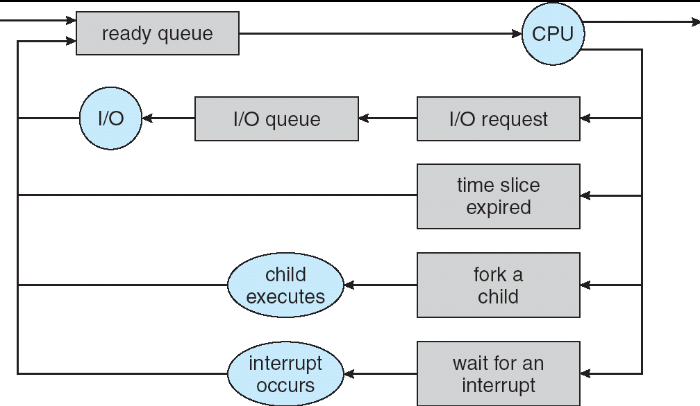
Scheduling: All About Queues
Processor Scheduling: Which thread to remove from ready queue?

Slide 18
Scheduling: All about trade-offs
Individuals care about getting their task done quickly
System cares about overall efficiency
  Utilize multiple HW resources well, low overhead, …
Huge variation in job characteristics
Fairness ???
Utility function
  deadlines?, interactivity?
…

Slide 19
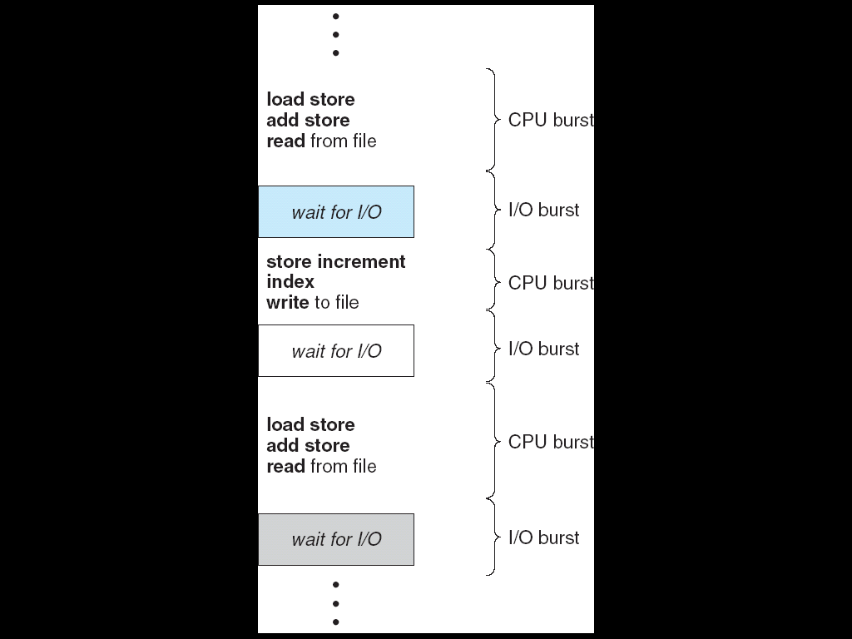
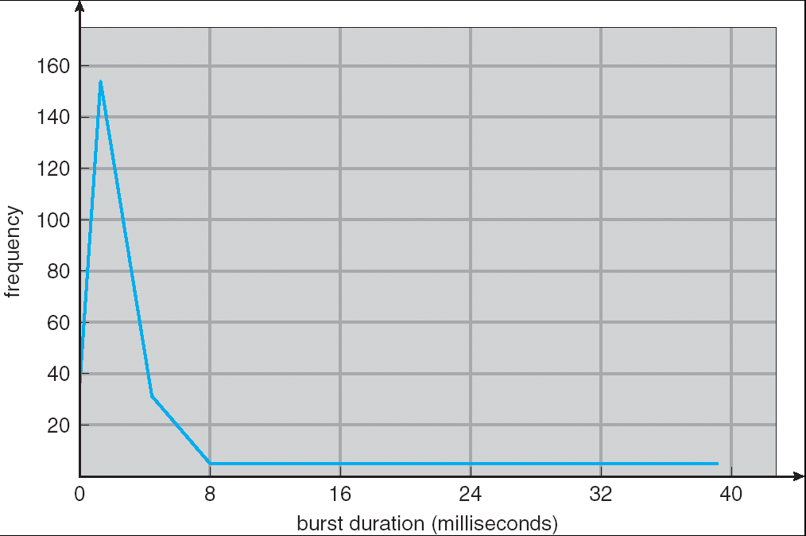
CPU & I/O Bursts
Programs alternate between bursts of CPU, I/O activity
Scheduler: Which thread (CPU burst) to run next?
Interactive programs vs Compute Bound vs Streaming

Slide 20
Evaluating Schedulers
Response Time (ideally low)
  What user sees: from keypress to character on screen
  Or completion time for non-interactive
Throughput (ideally high)
  Total operations (jobs) per second
  Overhead (e.g. context switching), artificial blocks
Fairness
  Fraction of resources provided to each
  May conflics with best avg. throughput, resp. time

Slide 21
Scheduling Assumptions
Equal or variable job length ?
Run to completion vs preemption ?
Arrival time (at once vs varied) ?
Resources: CPU(s), I/O, Network, … ?
Advanced Knowledge of Job characteristics or need
  Off-line scheduling is given the entire collection of tasks and computes a schedule
  On-line scheduling makes decisions as tasks arrive

Slide 22
First-Come First-Served (FCFS)
Also: "First In First Out"
Example: Process Burst Time
P₁ 24
P₂ 3
P₃ 3
Arrival Order: P₁, P₂, then P₃ (essentially at time 0)
P₁
P₂
P₃
0
24
27
30
Asmpt: V, RTC, AT=0, CPU, none

Slide 23
First-Come First-Served (FCFS)
P₁
P₂
P₃
0
24
27
30
Response Times: P1 = 24, P2 = 27, P3 = 30
Average Response Time = (24+27+30)/3 = 27
Waiting times: P1 = 0, P2 = 24, P3 = 27
Average Wait Time = (0 + 24 + 27)/3 = 17
Convoy Effect: Short processes stuck behind long processes
  P2, P3 arrive any time <24 wait

Slide 24
Slightly different arrival order?
P₂
P₃
P₁
0
3
6
30
P2 < P3 < P1
Response Time: P1 = 30, P2 = 3, P3 = 6
Average Response Time = (30 + 3 + 6)/3 = 13
  versus 27 with P1 < P2 < P3
Waiting Time: P1 = 6, P2 = 0, P3 = 3
Average Waiting Time = (6+0+3)/3 = 3
Asmpt: V, RTC, AT=0, CPU, none

Slide 25
How does kernel implement FCFS ?
Comes down to scheduling queue data structure
  FIFO
  eg., push_front, pop_back

Slide 26
Peer discussion
If we have 1 long task (say 100 units) and n little tasks (say 1 unit), that all arrive in random order
How long should a little task expect to wait?
What’s the chance of getting stuck behind the large one?
What might we do to avoid this situation?

Slide 27
Convoy effect
Scheduled Task (process, thread)
time
Scheduling queue
arrivals
With FCFS non-preemptive scheduling, convoys of small tasks tend to build up when a large one is running.

Slide 28
Preemption
Give out small units of CPU time ("time quantum")
  Typically 10 – 100 milliseconds
When quantum expires, preempt, and schedule
  Round Robin: add to end of the queue
Each of N processes gets ~1/N of CPU (in window)
  With quantum length Q ms, process waits at most
  (N-1)*Q ms to run again
Downside: More context switches
  What should Q be?
  Too high: back to FCFS, Too Low: context switch overhead

Slide 29
Our example (Q=10)
P₁
P₂
P₃
P₁
0
10
13
16
30
Regardless of arrival order, short jobs gets a chance early
Much less sensitive to arrival order
How much context switch overhead?

Slide 30
Our example (Q=2)
P₁
P₂
P₃
P₁
P₂
P₃
P₁
0
2
4
6
8
9
10
30
Smaller Q, more interactive and fair
More overhead

Slide 31
Round Robin Example (Q = 20)
P₁
P₂
P₃
P₄
P₁
P₃
P₄
P₁
P₃
P₃
0
20
28
48
68
88
108
112
125
145
153
Example: Process Burst Time
P₁ 53
P₂ 8
P₃ 68
P₄ 24
Average response time = (125+28+153+112)/4 = 104.5
Waiting time for P₁=(68-20)+(112-88)=72 P₂=(20-0)=20
P₃=(28-0)+(88-48)+(125-108)=85
P₄=(48-0)+(108-68)=88
Average waiting time = (72+20+85+88)/4 = 66.25
And don't forget context switch overhead!

Slide 32
Round Robin Quantum
Assume there is no context switching overhead
What happens when we decrease Q?
Avg. response time always decreases or stays the same
Avg. response time always increases or stays the same
Avg. response time can increase, decrease, or stays the same

Slide 33
Decrease Response Time
P₁: Burst Length 10
P₂: Burst Length 1
Q = 10
Average Response Time = (10 + 11)/2 = 10.5
Q = 5
Average Response Time = (6 + 11)/2 = 8.5
P₁
P₂
0
10
11
P₁
P₂
P₁
0
5
6
11

Slide 34
Same Response Time
P₁: Burst Length 1
P₂: Burst Length 1
Q = 10
Average Response Time = (1 + 2)/2 = 1.5
Q = 1
Average Response Time = (1 + 2)/2 = 1.5
P₁
P₂
0
1
2
P₁
P₂
0
1
2

Slide 35
Increase Response Time
P₁: Burst Length 1
P₂: Burst Length 1
Q = 1
Average Response Time = (1 + 2)/2 = 1.5
Q = 0.5
Average Response Time = (1.5 + 2)/2 = 1.75
P₁
P₂
0
1
2
0
2

Slide 36
How does kernel realize round-robin scheduling?
Project 2.1
Notes:
Need timer-tick interrupt
Run scheduler every Q or upon syscall, intr
FIFO queue

Slide 37
Recall: Interrupt Handling
Save PC
Disable Ints
Kernel Mode
Executing User
Code
Save all registers
Dispatch to Handler
(via Interrupt Vector)
…
Interrupt Handler
…
Restore all registers
Clear current Int
External Interrupt
Pipeline Flush
Resume User
Code
Restore PC
Enable Ints
User Mode
An interrupt is a hardware-invoked trap to the kernel
  No separate step to choose what to run next
  Always run the interrupt handler immediately

Slide 38
Recall: Kernel Stack
Use protected region of memory for stack when running in Kernel Mode
While thread is running user's code:
User Stack
Kernel Stack
A()
ret addr.
B()
ret addr.
C()
ret addr.

Slide 39
Recall: Kernel Stack
When an Interrupt Occurs:
User Stack
Kernel Stack
A()
ret addr.
IntHandler()
ret addr.
B()
ret addr.
C()
ret addr.

Slide 40
Recall: Kernel Stack
When a Thread is Ready, but not Running
  Waiting for return to switch from another thread
User Stack
Kernel Stack
A()
ret addr.
IntHandler()
ret addr.
B()
ret addr.
run_new_thread
ret. addr.
C()
ret addr.
Switch()

Slide 41
Scheduling Opportunities
Every “yield”
Every syscall
Every timer tick (interrupt)
Every interrupt

Slide 42
Strawman: What would LCFS scheduling do?
Stack (LIFO) as a scheduling data structure
Late arrivals get fast service
Early ones wait – extremely unfair
In the worst case – starvation
When would this occur?
  When arrival rate (offered load) exceeds service rate (delivered load)
  Queue builds up faster than it drains
Queue can build in FIFO too, but ”serviced in the order received”…

Slide 43
Priority
Lots of basic tasks, versus payroll processing on Friday…
Interactive vs compute bound

Slide 44
Priority Scheduling
Priority 3
Job 1
Job 2
Job 3
Priority 2
Job 4
Priority 1
Priority 0
Job 5
Job 6
Job 7
Something gives jobs (processes) priority
  Usually the user sets it explicitly, perhaps based on $ rate
Always run the ready thread with highest priority
  Low priority thread might never run!
  Starvation
Part of Project 2

Slide 45
Policy based on Priority Scheduling Mechanism
Priority 3
Job 1
Job 2
Job 3
Priority 2
Job 4
Priority 1
Priority 0
Job 5
Job 6
Job 7
Systems may try to set priorities according to some policy goal
Example: Give interactive higher priority than long calculation
  Prefer jobs waiting on I/O to those consuming lots of CPU
Try to achieve fairness: elevate priority of threads that don't get CPU time (ad-hoc, bad if system overload)

Slide 46
How does kernel do Priority Scheduling?
Scheduling queue data structure determines next thread of those in the ready queue.
Why might a thread not be in the ready queue?
Waiting on I/O
Locks?
Notes:
Array of queues (unneccesary)
Add priority field, sort queue by priority (or maintain sorted)
Lists vs other data structures

Slide 47

Priority and Locks
Priority 3
Job 3
Priority 2
Job 2
Priority 1
Job 1
Acquire()
At this point, which job does the scheduler choose?
Job 3 (Highest Priority)

Slide 48
Priority and Locks
Priority 3
Job 3
Acquire()
Priority 2
Job 2
Priority 1
Job 1
Job 3 attempts to acquire lock held by Job 1

Slide 49
Priority and Locks
Job 3
Blocked on Acquire
Priority 3
Priority 2
Job 2
Priority 1
Job 1
At this point, which job does the scheduler choose?
Job 2 (Medium Priority)
Priority Inversion

Slide 50
Priority Inversion
Where high priority task is blocked waiting on low priority task
Low priority one must run for high priority to make progress
When might priority lead to starvation or “live lock” ?
High Priority
Low Priority
while (try_lock) {
…
}
lock.acquire(…)
…
lock.release(…)

Slide 51
One Solution: Priority Donation
Priority 3
Job 1
Release()
Priority 2
Job 2
Priority 1
Job 3 temporarily grants Job 1 its “highest priority” to run on its behalf

Slide 52
Priority and Locks
Priority 3
Job 3
Priority 2
Job 2
Priority 1
Job 1 completes critical section and releases lock
Job 3 acquires lock, runs again
How does scheduler know?
Project 2.2

Slide 53
Break

Slide 54
Logistics
Reminder: submit anonymous feedback on the class at http://bit.ly/cs162fa19anon

Slide 55
Scheduling Wisdom
Modern schedulers use knowledge about program to make better scheduling decisions
Provided by the user (servers vs background)
Estimate future based on the past

Slide 56
What if we know how much time each process needs in advance?
Key Idea: remove convoy effect
  Short jobs always stay ahead of long ones
Non-preemptive: Shortest Job First
  Like FCFS if we always chose the best possible ordering
Preemptive Version: Shortest Remaining Time First
  A newly ready process (e.g., just finished an I/O operation) with shorter time replaces the current one

Slide 57
SRTF Example
Three jobs in system
  A and B are CPU calculations that take a week to run
  C: Continuous loop of 1ms CPU time, 9ms of I/O time
FCFS? A or B starve C
  I/O throughput problem: lose opportunity to do work for C while CPU runs A or B
A or B
C
C’s
I/O
C’s
I/O
C’s
I/O

Slide 58
SRTF Example
Disk Utilization:
9/201 ~ 4.5%
C
A
B
C
RR 100ms time slice
Disk Utilization:
~90% but lots of wakeups!
C’s
I/O
C’s
I/O
CABAB…
C
RR 1ms time slice
C’s
I/O
C’s
I/O
Disk Utilization:
90%
C
A
A
A
SRTF
C’s
I/O
C’s
I/O

Slide 59
Shortest Job/Remaining Time First
Provably Optimal with respect to Response Time
But Starvation is possible
  What if new short jobs keep arriving?

Slide 60
Shortest Job/Remaining Time First
How do we know the time a job/process will take?
  Usually, we don't
Ask the users?
  They can try to estimate…
  Or guess, or game the system, …

Slide 61
Observing Process Behavior
Consider jobs scheduled by Round Robin
Process exhausts quantum, has to be preempted
  Consuming all of the CPU time it can, "CPU-Bound"
Process blocks on I/O before quantum exhausted
  "I/O-Bound"
Past behavior is good indicator of future behavior
  I/O-bound now, likely to be I/O-bound later

Slide 62
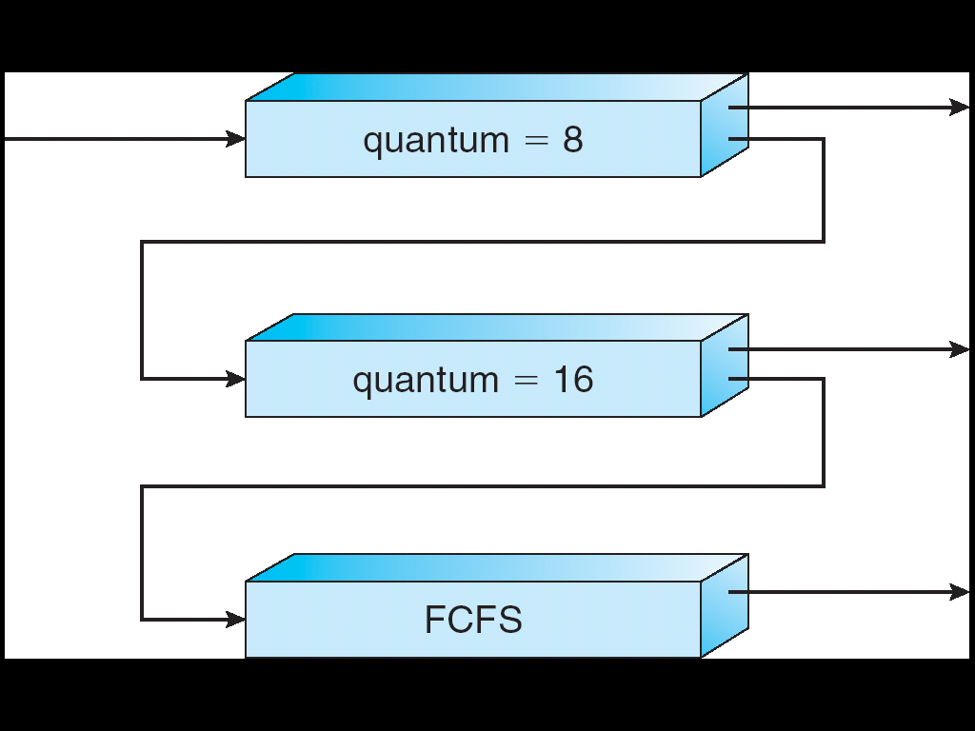
Multi-Level Feedback Scheduling
Multiple queues, each of different priority
  Round Robin within each queue
  Different quantum length for each queue
Favor I/O-bound jobs for interactivity
  Get click or kick off I/O transfer
Low overhead for CPU bound
Long-Running Compute
Tasks Demoted to
Low Priority
Project 2.3

Slide 63
Multi-Level Feedback Scheduling
Intuition: Priority Level proportional to burst length
Job Exceeds Quantum: Drop to lower queue
Job Doesn't Exceed Quantum: Raise to higher queue
Long-Running Compute
Tasks Demoted to
Low Priority

Slide 64
Multi-Level Feedback Scheduling
Approximates Shortest Remaining Time First
  CPU-bound have lowest priority (run last)
  I/O-bound (short CPU bursts) have highest priority
  (run first)
Low overhead
  Easy to update priority of a job
  Easy to find next ready task to run
Can a process cheat?
  Yes, add meaningless I/O operations (but has a cost)

Slide 65
Multi-Level Feedback Scheduling
What about starvation?
Long-running jobs fall into low priority, may never get the CPU
  Time-slice among the queues (e.g., 70% to highest priority, 20% to middle, 10% to low)
  Artificially boost priority of a starved job
These solutions improve fairness but hurt response time

Slide 66
Do you need arrays of queues?
How might you leverage priority-based scheduling mechanism (and its data structure)?

Slide 67
Linux O(1) Scheduler
Kernel/Realtime Tasks
User Tasks
0
100
139
MLFQ-Like Scheduler with 140 Priority Levels
  40 for user tasks, 100 "realtime" tasks
  All algorithms O(1) complexity – low overhead
Active and expired queues at each priority
  Once active is empty, swap them (pointers)
  Round Robin within each queue (varying quanta)

Slide 68
Linux O(1) Scheduler
Lots of ad-hoc heuristics
  Try to boost priority of I/O-bound tasks
  Try to boost priority of starved tasks

Slide 69
Classification
One
Many
# of addr spaces:
# threads
Per AS:
One
MS/DOS, early Macintosh
Traditional UNIX
Many
Embedded systems (Geoworks, VxWorks, JavaOS,etc)
JavaOS, Pilot(PC)
Mach, OS/2, HP-UX, Win NT to 8, Solaris, OS X, Android, iOS
Real operating systems have either
  One or many address spaces
  One or many threads per address space

Slide 70
So does the OS schedule processes or threads?
We've been talking about processes assuming the "old model" -> one thread per process
  And many textbooks say this as well
Usually it's really: threads (e.g., in Linux)
More on some of these issues later
One point to notice: switching threads vs. switching processes incurs different costs:
  Switch threads: Save/restore registers
  Switch processes: Change active address space too!
    Expensive
    Disrupts caching

Slide 71
User-level threads?
Can multiple threads be implemented entirely at user level?
Most other aspects of system virtualize.

Slide 72
Kernel-Supported Threads
Threads run and block (e.g., on I/O) independently
One process may have multiple threads waiting on different things
Two mode switches for every context switch (expensive)
Create threads with syscalls
Alternative: multiplex several streams of execution (at user level) on top of a single OS thread
  E.g., Java, Go, … (and many many user-level threads libraries before it)

Slide 73
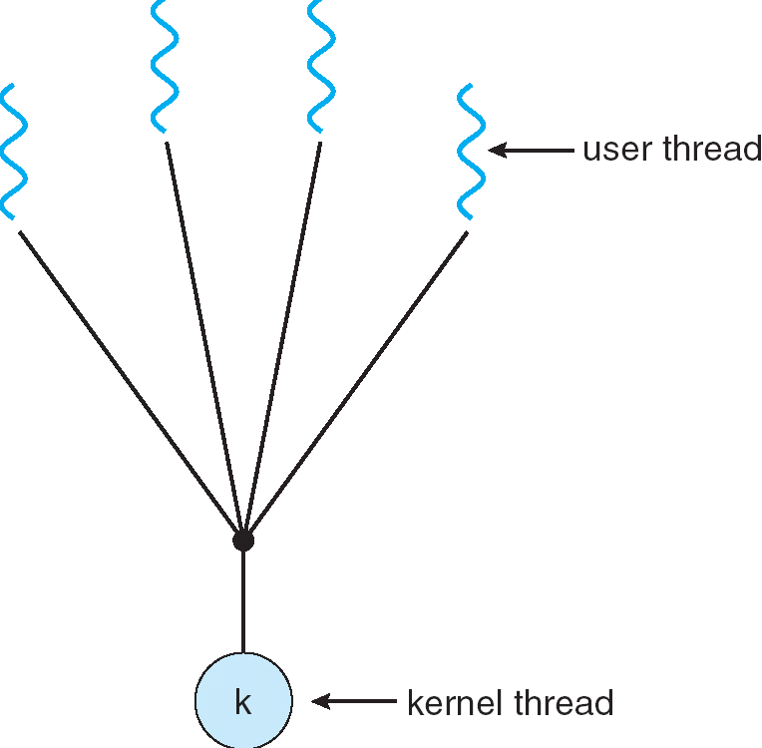
User-Mode Threads
User program contains its own
scheduler
Several user threads per kernel thd.
User threads may be scheduled
non-preemptively
  Only switch on yield
Context switches cheaper
  Copy registers and jump (switch in userspace)

Slide 74
Thread Yield
Kernel-Supported Threads
User-Mode Threads
ComputePI
ComputePI
yield (syscall)
Library Function
Call (Cheap)
yield
Trap to OS
(Expensive)
kernel_yield
Stack growth
run_new_user_
thread
Stack growth
run_new_kernel_
thread
switch
switch

Slide 75
Thread I/O
Kernel-Supported Threads
User-Mode Threads
CopyFile
CopyFile
read
read
Trap to OS
Stack growth
Trap to OS
Stack growth
kernel_read
kernel_read
run_new_thread
run_new_thread
switch
switch
Selects a new kernel thread to run
Bypassing user-level scheduler

Slide 76
User-Mode Threads: Problems
One user-level thread blocks on I/O: they all do
  Kernel cannot adjust scheduling among threads it doesn’t know about
Multiple Cores?
Can't completely avoid blocking (syscalls, page fault)
One Solution: Scheduler Activations
  Have kernel inform user-level scheduler when a thread blocks
Evolving the contract between OS and application.

Slide 77
Going back …
Why do we need to disable interrupts at all?
  Avoid interruption between checking and setting lock value
  Otherwise two threads could think that they both have lock
Acquire() {
disable interrupts;
if (value == BUSY) {
put thread on wait queue;
Go to sleep();
// Enable interrupts?
} else {
value = BUSY;
}
enable interrupts;
}
Critical
Section

Slide 78
Recall: Basic Lock Implementation
Running TCB
Value{busy/free}
Waiting TCBs
Ready TCBs
Scheduler
State?
Release(*lock) {
disable interrupts;
if (any TCB on lock wait_Q) {
“i.e., lock busy”;
take thread off wait queue
Place on ready queue;
} else {
lock->value = FREE;
}
enable interrupts;
}
Acquire(*lock) {
disable interrupts;
if (lock->value == BUSY) {
put thread on lock’s wait_Q
“i.e, Go to sleep”
allow a ready thread to run
} else {
lock->value = BUSY;
}
enable interrupts;
}

Slide 79
Reenabling Interrupts When Waiting
Acquire() {
disable interrupts;
if (value == BUSY) {
put thread on wait queue;
run_new_thread()
} else {
value = BUSY;
}
enable interrupts;
}
enable interrupts
enable interrupts
Before on the queue?
  Release might not wake up this thread!
After putting the thread on the queue?
  Gets woken up, but immediately switches away

Slide 80
Reenabling Interrupts When Waiting
Acquire() {
disable interrupts;
if (value == BUSY) {
put thread on wait queue;
run_new_thread()
} else {
value = BUSY;
}
enable interrupts;
}
enable interrupts
Best solution: after the current thread suspends
How?
  run_new_thread() should do it!
  Part of returning from switch()

Slide 81
How to Re-enable After Sleep()?
In scheduler, since interrupts are disabled when you call sleep:
  Responsibility of the next thread to re-enable ints
  When the sleeping thread wakes up, returns to acquire and
  re-enables interrupts
  Thread A Thread B
  .
  .
  disable ints
  sleep
  sleep return
  enable ints
  .
  .
  .
  disable int
  sleep
  sleep return
  enable ints
  .
  .
context
switch
context
switch

Slide 82
Impacts of Scheduling on …
Lot’s of attention to algorithmic complexity of operations on the scheduling data structure
  These queues don’t get that long. Otw, buy more hardware
Interactions of scheduling with memory hierarchy
  Locality is fundamentally at odds with fairness
  “Cache / VM / File buffer affinity”
Interactions of scheduling with multiple processors
  Processor / Core affinity is really about caches
Memory performance (locality) is critical

Slide 83
Summary
First-Come First-Served: Simple, vulnerable to convoy effect
Round-Robin: Fixed CPU time quantum, cycle between ready threads
Priority: Respect differences in importance
Shortest Job/Remaining Time First: Optimal for average response time, but unrealistic
Multi-Level Feedback Queue: Use past behavior to approximate SRTF and mitigate overhead

Slide 84
System Design …
Sophisticated policies (often with deep theoretical basis) boil down into simple manipulation of data structures.
And understanding multi-dimensional interactions
We’ll return to advanced scheduling (with randomness) later in the term

