Slide 1
CS 162: Operating Systems and Systems Programming
Lecture 7: Synchronization Operations
September 19, 2019
Instructor: David Culler
https://cs162.eecs.berkeley.edu
Read: A&D Ch 5

Slide 2
What’s a Process?
The execution instance of a program
Comprised of
  One or more threads of execution
    Processor registers, stack, OS support
  A virtual address space
    Page table maps resident pages to memory
  Set of open file descriptors & buffers
    User gets handle, OS holds the real thing
  Whatever else the OS needs to load, run, manage, and terminate it

Slide 3
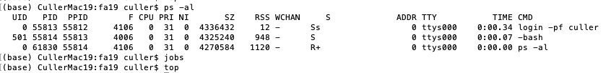
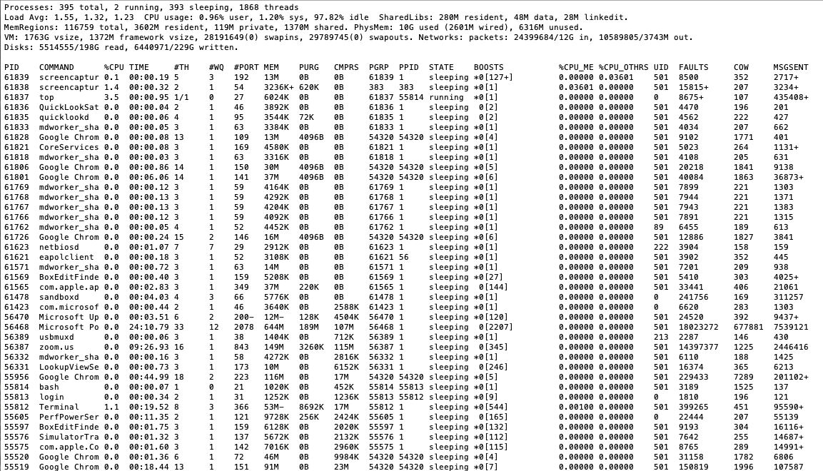
Grounding Demo

Slide 4
Recall: Scheduling
First-Come First-Served: Simple, vulnerable to convoy effect
Round-Robin: Fixed CPU time quantum, cycle between ready threads
Priority: Respect differences in importance
Shortest Job/Remaining Time First: Optimal for average response time, but unrealistic
Multi-Level Feedback Queue: Use past behavior to approximate SRTF and mitigate overhead

Slide 5
Impacts of Scheduling on …
Lot’s of attention to algorithmic complexity of operations on the scheduling data structure
  These queues don’t get that long. Otw, buy more hardware
Interactions of scheduling with memory hierarchy
  Locality is fundamentally at odds with fairness
  “Cache / VM / File buffer affinity”
Interactions of scheduling with multiple processors
  Processor / Core affinity is really about caches
Memory performance (locality) is critical

Slide 6
System Design …
Sophisticated policies (often with deep theoretical basis) boil down into simple manipulation of data structures.
And understanding multi-dimensional interactions
We’ll return to advanced scheduling (with randomness) later in the term

Slide 7
Going back – to a subtle connection between scheduling and synchronization
Why do we need to disable interrupts at all?
  Avoid interruption between checking and setting lock value
  Otherwise two threads could think that they both have lock
Acquire() {
disable interrupts;
if (value == BUSY) {
put thread on wait queue;
Go to sleep();
// Enable interrupts?
} else {
value = BUSY;
}
enable interrupts;
}
Critical
Section

Slide 8
Recall: Basic Lock Implementation
Running TCB
Value{busy/free}
Waiting TCBs
Ready TCBs
Scheduler
State?
Release(*lock) {
disable interrupts;
if (any TCB on lock wait_Q) {
“i.e., lock busy”;
take thread off wait queue
Place on ready queue;
} else {
lock->value = FREE;
}
enable interrupts;
}
Acquire(*lock) {
disable interrupts;
if (lock->value == BUSY) {
put thread on lock’s wait_Q
“i.e, Go to sleep”
allow a ready thread to run
} else {
lock->value = BUSY;
}
enable interrupts;
}

Slide 9
Reenabling Interrupts When Waiting
Acquire() {
disable interrupts;
if (value == BUSY) {
put thread on wait queue;
run_new_thread()
} else {
value = BUSY;
}
enable interrupts;
}
enable interrupts
enable interrupts
Before on the queue?
  Release might not wake up this thread!
After putting the thread on the queue?
  Gets woken up, but immediately switches away

Slide 10
Reenabling Interrupts When Waiting
Acquire() {
disable interrupts;
if (value == BUSY) {
put thread on wait queue;
run_new_thread()
} else {
value = BUSY;
}
enable interrupts;
}
enable interrupts
Best solution: after the current thread suspends
How?
  run_new_thread() should do it!
  Part of returning from switch()

Slide 11
How to Re-enable After Sleep()?
In scheduler, since interrupts are disabled when you call sleep:
  Responsibility of the next thread to re-enable ints
  When the sleeping thread wakes up, returns to acquire and
  re-enables interrupts
  Thread A Thread B
  .
  .
  disable ints
  sleep
  sleep return
  enable ints
  .
  .
  .
  disable int
  sleep
  sleep return
  enable ints
  .
  .
context
switch
context
switch

Slide 12
User-level threads?
Can multiple threads be implemented entirely at user level?
Most other aspects of system virtualize.

Slide 13
Kernel-Supported Threads
Threads run and block (e.g., on I/O) independently
One process may have multiple threads waiting on different things
Two mode switches for every context switch (expensive)
Create threads with syscalls
Alternative: multiplex several streams of execution (at user level) on top of a single OS thread
  E.g., Java, Go, … (and many many user-level threads libraries before it)

Slide 14
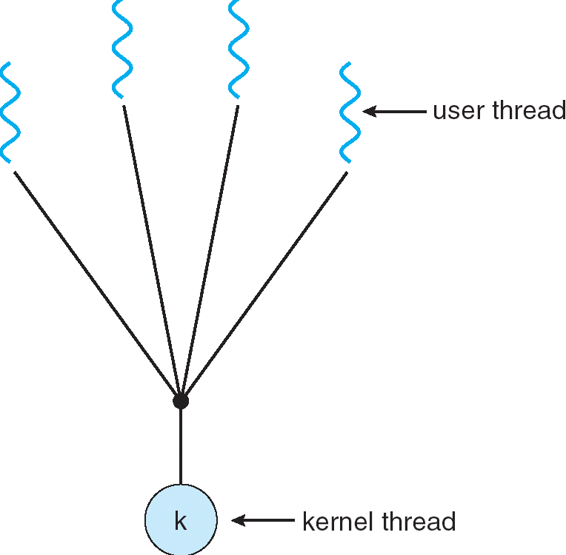
User-Mode Threads
User program contains its own
scheduler
Several user threads per kernel thd.
User threads may be scheduled
non-preemptively
  Only switch on yield
Context switches cheaper
  Copy registers and jump (switch in userspace)

Slide 15
Thread Yield
Kernel-Supported Threads
User-Mode Threads
ComputePI
ComputePI
yield (syscall)
Library Function
Call (Cheap)
yield
Trap to OS
(Expensive)
kernel_yield
Stack growth
run_new_user_
thread
Stack growth
run_new_kernel_
thread
switch
switch

Slide 16
Thread I/O
Kernel-Supported Threads
User-Mode Threads
CopyFile
CopyFile
read
read
Trap to OS
Stack growth
Trap to OS
Stack growth
kernel_read
kernel_read
run_new_thread
run_new_thread
switch
switch
Selects a new kernel thread to run
Bypassing user-level scheduler

Slide 17
User-Mode Threads: Problems
One user-level thread blocks on I/O: they all do
  Kernel cannot adjust scheduling among threads it doesn’t know about
Multiple Cores?
Can't completely avoid blocking (syscalls, page fault)
One Solution: Scheduler Activations
  Have kernel inform user-level scheduler when a thread blocks
Evolving the contract between OS and application.

Slide 18
Recall: Multithreaded Server
Bounded pool of worker threads
  Allocated in advance: no thread creation overhead
  Queue of pending requests
Master Thread
Client
Request
Queue
Thread Pool
Response

Slide 19
Simple Performance Model
Given that the overhead of a critical section is X
  User->Kernel Context Switch
  Acquire Lock
  Kernel->User Context Switch
  <perform exclusive work>
  User->Kernel Context Switch
  Release Lock
  Kernel->User Context Switch
Even if everything else is infinitely fast, with any number of threads and cores
What is the maximum rate of operations that involve this overhead?

Slide 20
Highly Contended Case – in a picture
P
º º º
All try to grab lock
X
Time = p*X sec
Rate = 1/X ops/sec, regardless of # cores
º º º

Slide 21
Back to system performance
X = 1ms => 1,000 ops/sec

Slide 22
Uncontended Many-Lock Case
º º º
What if sys overhead is Y, even when the lock is free?
What if the OS can only handle one lock operation at a time?
º º º

Slide 23
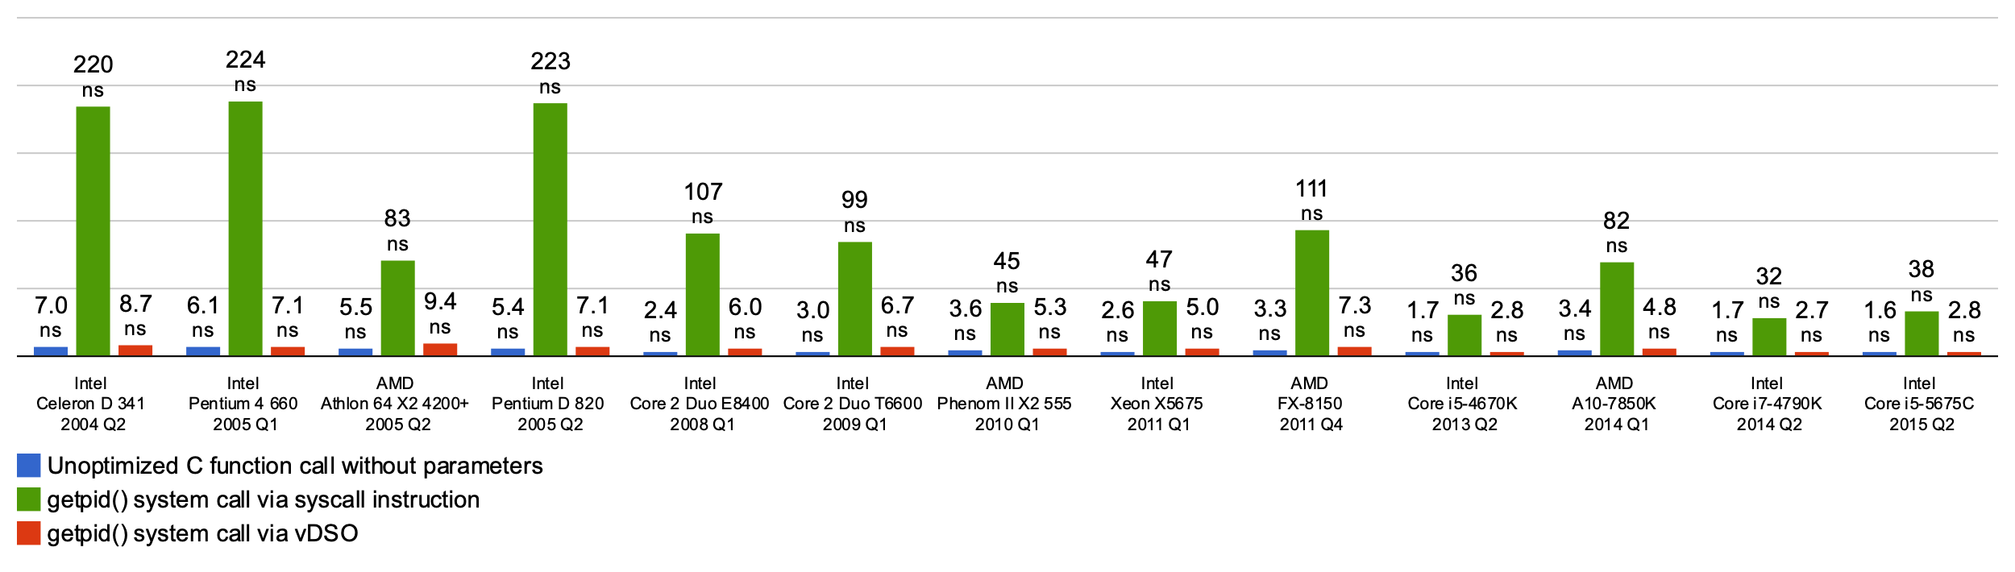
Basic cost of a system call
Min System call ~ 25x cost of function call
Scheduling could be many times more
Streamline system processing as much as possible
Other optimizations seek to process as much of the call in user space as possible (eg, Linux vDSO)

Slide 24
A Better Lock Implementation
Interrupt-based solution works for single core, but costly
Doesn't work well on multi-core machines
  Disable intr on all cores?
Solution: Utilize hardware support for atomic operations

Slide 25
Recall: Atomic Operations
Definition: An operation runs to completion or not at all
Foundation for synchronization primitives
Example: Loading or storing a word

Slide 26
Atomic Read-Modify-Write Instructions
Problems with previous solution:
  Works only in system Privilege level, not User level
  Doesn’t work well on multiprocessor
    Disabling interrupts on all processors time consuming and undermines HW parallelism
Alternative: atomic instruction sequences
  These instructions read a value and write a new value atomically
  Hardware is responsible for implementing this correctly
    on both uniprocessors (not too hard)
    and multiprocessors (requires help from cache coherence protocol)
  Unlike disabling interrupts, can be used on both uniprocessors and multiprocessors
  Natural extensions to user-level locking

Slide 27
Examples of Read-Modify-Write
test&set (&address) { /* most architectures */
result = M[address]; // return result from “address” and
M[address] = 1; // set value at “address” to 1
return result;
}
swap (&address, register) { /* x86 */
temp = M[address]; // swap register’s value to
M[address] = register; // value at “address”
register = temp;
}
compare&swap (&address, reg1, reg2) { /* 68000 */
if (reg1 == M[address]) { // If memory still == reg1,
M[address] = reg2; // then put reg2 => memory
return success;
} else { // Otherwise do not change memory
return failure;
}
}
load-linked&store-conditional(&address) { /* R4000, alpha */
loop:
ll r1, M[address];
movi r2, 1; // Can do arbitrary computation
sc r2, M[address];
beqz r2, loop;
}
as if it happened all at once

Slide 28
Implementing Locks with test&set
Simple, but flawed, solution:
int value = 0; // Free
Acquire() {
while (test&set(value)) {}; // spin while busy
}
Release() {
value = 0; // atomic store
}
Simple explanation:
  If lock is free, test&set reads 0 and sets value=1, so lock is now busy. It returns 0 so while exits.
  If lock is busy, test&set reads 1 and sets value=1 (no change)
  It returns 1, so while loop continues.
  When we set value = 0, someone else can get lock.
Busy-Waiting: thread consumes cycles while waiting
  For multiprocessors: every test&set() is a write, which makes value ping-pong around in cache (using lots of memory BW)

Slide 29
Problem: Busy-Waiting for Lock
Positives for this solution
  Machine can receive interrupts
  User code can use this lock (poorly)
  Works on a multiprocessor
Negatives
  This is very inefficient as thread will consume cycles waiting
  Waiting thread may take cycles away from thread holding lock (no one wins!)
  Priority Inversion: If busy-waiting thread has higher priority than thread holding lock ⇒ no progress!
For semaphores (and monitors), waiting thread may wait for an arbitrary long time!
  Thus even if busy-waiting was OK for locks, definitely not ok for other primitives
  Homework/exam solutions should avoid busy-waiting!

Slide 30
Multiprocessor Spin Locks: test&test&set
A better solution for multiprocessors:
int mylock = 0; // Free
Acquire() {
do {
while(mylock); // Wait until might be free
} while(test&set(&mylock)); // exit if get lock
}
Release() {
mylock = 0;
}
Simple explanation:
  Wait until lock might be free (only reading – stays in cache)
  Then, try to grab lock with test&set
  Repeat if fail to actually get lock
Issues with this solution:
  Busy-Waiting: thread still consumes cycles while waiting
    However, it does not impact other processors!

Slide 31
Better Locks using test&set
Can we build test&set locks without busy-waiting?
  Can’t entirely, but can minimize!
  Idea: only busy-wait to atomically check lock value
Note: sleep has to be sure to reset the guard variable
  Why can’t we do it just before or just after the sleep?
int guard = 0;
int value = FREE;
Acquire() {
// Short busy-wait time
while (test&set(guard));
if (value == BUSY) {
put thread on wait queue;
go to sleep() & guard = 0;
} else {
value = BUSY;
guard = 0;
}
}
Release() {
// Short busy-wait time
while (test&set(guard));
if anyone on wait queue {
take thread off wait queue
Place on ready queue;
} else {
value = FREE;
}
guard = 0;

Slide 32
Locks using Interrupts vs. test&set
Recall “disable interrupt” solution
Basically we replaced:
  disable interrupts → while (test&set(guard));
  enable interrupts → guard = 0;
int value = FREE;
Acquire() {
disable interrupts;
if (value == BUSY) {
put thread on wait queue;
Go to sleep();
// Enable interrupts?
} else {
value = BUSY;
}
enable interrupts;
}
Release() {
disable interrupts;
if (anyone on wait queue) {
take thread off wait queue
Place on ready queue;
} else {
value = FREE;
}
enable interrupts;
}

Slide 33
Recap: Locks using interrupts
int value = 0;
Acquire() {
// Short busy-wait time
disable interrupts;
if (value == 1) {
put thread on wait-queue;
go to sleep() //??
} else {
value = 1;
enable interrupts;
}
}
Acquire() {
disable interrupts;
}
lock.Acquire();
…
critical section;
…
lock.Release();
Release() {
enable interrupts;
}
Release() {
// Short busy-wait time
disable interrupts;
if anyone on wait queue {
take thread off wait-queue
Place on ready queue;
} else {
value = 0;
}
enable interrupts;
}
If one thread in critical section, no other activity (including OS) can run!

Slide 34
Recap: Locks using test & set
int guard = 0;
int value = 0;
Acquire() {
// Short busy-wait time
while(test&set(guard));
if (value == 1) {
put thread on wait-queue;
go to sleep()& guard = 0;
} else {
value = 1;
guard = 0;
}
}
int value = 0;
Acquire() {
while(test&set(value));
}
lock.Acquire();
…
critical section;
…
lock.Release();
Release() {
value = 0;
}
Release() {
// Short busy-wait time
while (test&set(guard));
if anyone on wait queue {
take thread off wait-queue
Place on ready queue;
} else {
value = 0;
}
guard = 0;
}
Threads waiting to enter critical section busy-wait

Slide 35
Higher-level Primitives
Goal of last couple of lectures:
  What is right abstraction for synchronizing threads that share memory?
  Want as high a level primitive as possible
Good primitives and practices important!
  Since execution is not entirely sequential, really hard to find bugs, since they happen rarely
  UNIX is pretty stable now, but up until about mid-80s
  (10 years after started), systems running UNIX would crash every week or so – concurrency bugs
Synchronization is a way of coordinating multiple concurrent activities that are using shared state
  Requires both mutual exclusion and cooperation (or orchestration)

Slide 36
Producer-Consumer with a Bounded Buffer
Producer
Buffer
Consumer
Producer
Consumer
Consumer
Problem Definition
  Producers puts things into a shared buffer
  Consumers takes them out
Don’t want producers and consumers to have to work in lockstep, so put a buffer (bounded) between them
  Need synchronization to maintain integrity of the data structure and coordinate producers/consumers
  Producer needs to wait if buffer is full
  Consumer needs to wait if buffer is empty
GCC compiler – simple 1-1
  cpp | cc1 | cc2 | as | ld
Web servers,Routers, …

Slide 37
Circular Buffer Data Structure (sequential case)
w
typedef struct buf {
int write_index;
int read_index;
<type> *entries[BUFSIZE];
} buf_t;
r
d_{i+2}
d_{i}
d_{i+1}
Insert: write & bump write ptr (enqueue)
Remove: read & bump read ptr (dequeue)
How to tell if Full (on insert) Empty (on remove)?
And what do you do if it is?
What needs to be atomic?

Slide 38
Producer/Consumer Correctness
With multiple threads, each waits for the other to make process
Scheduling constraints:
  Consumer waits for producer if buffer is empty
  Producer waits for consumer if buffer is full
Mutual Exclusion: Only one thread manipulates the buffer data structure at a time

Slide 39
Lock Solution – first cut
mutex buf_lock = <initially unlocked>
Producer(item) {
lock buffer
while (buffer full) {}; // Wait for a free slot
Enqueue(item);
unlock buffer
}
Will we ever come out of the wait loop?
Consumer() {
lock buffer
while (buffer empty) {}; // Wait for arrival
item = queue();
unlock buffer
return item
}

Slide 40
Lock Solution – 2nd cut
mutex buf_lock = <initially unlocked>
Producer(item) {
lock buffer
while (buffer full) {unlock; lock;};
Enqueue(item);
unlock buffer
}
What happens when one is waiting for the other?
- Multiple cores ?
- Single core ?
Consumer() {
lock buffer
while (buffer empty) {unlock; lock;};
item = queue();
unlock buffer
return item
}

Slide 41
Explore semaphore solution
One semaphore per constraint
  Mutex (mutual exclusion)
  Filled Slots (consumer waits if necessary)
  Empty Slots (producer waits if necessary)

Slide 42
Producer/Consumer Code
Semaphore fullSlots = 0; // Buffer empty to start
Semaphore emptySlots = bufSize; // All slots empty
Semaphore mutex = 1; // No one in critical sect.
Producer(item) {
emptySlots.P(); // Wait for a free slot
mutex.P(); // down
Enqueue(item);
mutex.V(); // up
fullSlots.V(); // Tell consumers about new data
}
Notes:
Where is the wait loop
Can you use the semaphore value as the write/read pointer?

Slide 43
Producer/Consumer Code
Semaphore fullSlots = 0; // Queue empty to start
Semaphore emptySlots = bufSize; // All slots empty
Semaphore mutex = 1; // No one in critical sect.
Consumer() {
fullSlots.P(); // Wait for an item to be present
mutex.P();
item = Dequeue();
mutex.V();
emptySlots.V(); // Tell producers about new slot
return item;
}

Slide 44
Producer/Consumer Code
Semaphore fullSlots = 0; // Queue empty to start
Semaphore emptySlots = bufSize; // All slots empty
Semaphore mutex = 1; // No one in critical sect.
Producer(item) {
emptySlots.P();
mutex.P();
Enqueue(item);
mutex.V();
fullSlots.V();
}
Consumer() {
fullSlots.P();
mutex.P();
item = Dequeue();
mutex.V();
emptySlots.V();
return item;
}

Slide 45
Discussion
What if we wrote the following?
Producer(item) {
mutex.P();
emptySlots.P();
Enqueue(item);
mutex.V();
fullSlots.V();
}
Consumer() {
fullSlots.P();
mutex.P();
item = Dequeue();
mutex.V();
emptySlots.V();
return item;
}
Deadlock ... More on this later

Slide 46
Discussion
What about this?
Producer(item) {
emptySlots.P();
mutex.P();
Enqueue(item);
fullSlots.V();
mutex.V();
}
Consumer() {
fullSlots.P();
mutex.P();
item = Dequeue();
mutex.V();
emptySlots.V();
return item;
}
Correct, possibly less efficient

Slide 47
Problems with Semaphores
More powerful (and primitive) than locks
Argument: Clearer to have separate constructs for
  Mutual Exclusion: One thread can do something at a time
  Waiting for a condition to become true
Need to make sure a thread calls P() for every V()
  Other tools are more flexible than this

Slide 48
Break

Slide 49
Condition Variables
Collection of threads waiting inside a critical section
Operations:
  wait(&lock): Atomically release lock and go to sleep. Re-acquire the lock before returning.
  signal(): Wake up on waiting thread (if there is one)
  broadcast(): Wake up all waiting threads
Rule: Hold lock when using a condition variable

Slide 50
Lock Solution – 2nd cut
mutex buf_lock = <initially unlocked>
Condvar buf_signal = <initially nobody>
Producer(item) {
lock buffer
while (buffer full) {cond_wait(buf_signal, buf_lock) };
Enqueue(item);
unlock buffer
}
Release lock; signal others to run; reacquire on resume
n.b. OS must do the reacquire
Why User must recheck?
Consumer() {
lock buffer
while (buffer empty) {cond_wait(buf_signal, buf_lock) };
item = queue();
unlock buffer
return item
}
Notes:
Cond_wait does not mean that the condition is satisfied. Only that something was signaled. Thread has regained the lock, but the condition may still be pending.
Termination is

Slide 51
Why the while Loop?
When a thread is woken up by signal(), it is simply put on the ready queue
It may or may not reacquire the lock immediately!
  Another thread could be scheduled first and "sneak in" to empty the queue
  Need a loop to re-check condition on wakeup

Slide 52
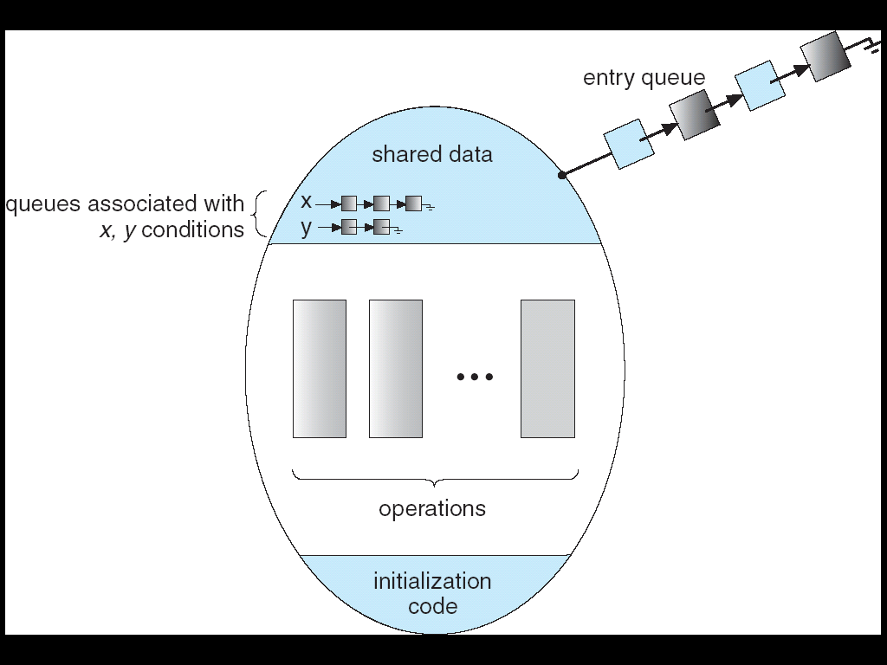
Monitors
Lock: protects access to shared data
Always acquire lock when accessing
Queue of threads waiting to enter the monitor

Slide 53
Monitors in practice
Locks for mutual exclusion
Condition variables for waiting
A monitor is a lock and zero or more condition variables with some associated data and operations
  Java provides this natively
  POSIX threads: Provides locks and condvars, have to build your own

Slide 54
Monitors
Condition Variables: queue of threads waiting for something to become true inside critical sect.
Atomically release lock and start waiting
  Another thread using the monitor will signal them
The condition: Some function of monitor's data

Slide 55
Why the while Loop?
Can we "hand off" the lock directly to the signaled thread so no other thread "sneaks in?"
  Yes. Called Hoare-Style Monitors
  Many textbooks describe this scheme
Most OSs implement Mesa-Style Monitors
  Allows other threads to sneak in
  Much easier to implement
  Even easier if you allow "spurious wakeups"
  wait() can return when no signal occurred, in rare cases
  POSIX allows spurious wakeups

Slide 56
Interlude: Concurrency Is Hard
Even for practicing engineers trying to write mission-critical, bulletproof code!
Therac-25: Radiation Therapy Machine with Unintended Overdoses (reading on course site)
Mars Pathfinder Priority Inversion (JPL Account)
Toyota Uncontrolled Acceleration (CMU Talk)
  256.6K Lines of C Code, ~9-11K global variables
  Inconsistent mutual exclusion on reads/writes

Slide 57
Comparing Synchronization
Semaphores can implement locks
  Acquire() { semaphore.P(); }
  Release() { semaphore.V(); }
and Condition Variables
Monitors combine locks and CVs in a structured fashion
Modern view: concurrent objects (e.g., Java)
Can monitors implement semaphores?
Are there other important common patterns?

Slide 58
Time Permitting …

Slide 59

Reader/Writer Problem
Read
Shared
Database
Write
Read
Shared Database
  Many readers – never modify the database
  Few writers – read and modify database
Single lock sufficient?

Slide 60
Reader/Writer Correctness
Readers can access when no writers
Writers can access when no readers and no other writers
A lock will satisfy these requirements
  But we want to allow multiple readers
  Better efficiency

Slide 61
Reader/Writer with Monitors
Reader() {
Wait until no active writers
Access database
Maybe wake up a writer
}
Writer() {
Wait until no active readers or writers
Access database
Maybe wakeup reader or writer
}
Lock (for mutual exclusion)
int activeReaders, condVar okToRead
int activeWriters, condVar okToWrite

Slide 62
Reader Version 1
Reader() {
// First check self into system
lock.Acquire();
while (AW > 0) { // Is it safe to read?
okToRead.wait(&lock); // Sleep on cond var
}
AR++; // Now we are active!
lock.release();
// Perform actual read-only access
AccessDatabase(ReadOnly);
// Now, check out of system
lock.Acquire();
AR--; // No longer active
if (AR == 0) // No other active readers
okToWrite.signal(); // Wake up one writer
lock.Release();
}

Slide 63
Writer Version 1
Writer() {
// First check self into system
lock.Acquire();
while (AR > 0 || AW > 0) { // Is it safe to write?
okToWrite.wait(&lock); // Sleep on cond var
}
AW++; // Now we are active!
lock.release();
// Perform actual read/write access
AccessDatabase(ReadWrite);
// Now, check out of system
lock.Acquire();
AW--; // No longer active
okToWrite.signal(); // Wake up one writer
okToRead.broadcast(); // Wake up all readers
lock.Release();
}

Slide 64
Writer Version 1: Starvation
Writer() {
// First check self into system
lock.Acquire();
while (AR > 0 || AW > 0) { // Is it safe to write?
okToWrite.wait(&lock); // Sleep on cond var
}
AW++; // Now we are active!
lock.release();
// Perform actual read/write access
AccessDatabase(ReadWrite);
// Now, check out of system
lock.Acquire();
AW--; // No longer active
okToWrite.signal(); // Wake up one writer
okToRead.broadcast(); // Wake up all readers
lock.Release();
}
If there are always readers, this is always true! Writer starves

Slide 65
Writer Version 1: Conflict
Writer() {
// First check self into system
lock.Acquire();
while (AR > 0 || AW > 0) { // Is it safe to write?
okToWrite.wait(&lock); // Sleep on cond var
}
AW++; // Now we are active!
lock.release();
// Perform actual read/write access
AccessDatabase(ReadWrite);
// Now, check out of system
lock.Acquire();
AW--; // No longer active
okToWrite.signal(); // Wake up one writer
okToRead.broadcast(); // Wake up all readers
lock.Release();
}
Relies on waiting threads double-checking condition

Slide 66
Writer Version 1: Conflict
Writer() {
// First check self into system
lock.Acquire();
while (AR > 0 || AW > 0) { // Is it safe to write?
okToWrite.wait(&lock); // Sleep on cond var
}
AW++; // Now we are active!
lock.release();
// Perform actual read/write access
AccessDatabase(ReadWrite);
// Now, check out of system
lock.Acquire();
AW--; // No longer active
okToWrite.signal(); // Wake up one writer
okToRead.broadcast(); // Wake up all readers
lock.Release();
}
Everyone races, all but 1 thread just goes back to sleep
Notes:
Ideas? How do we avoid the rush? Create a line. Or in GB – a queue!

Slide 67
Reader/Writer with Monitors v2
Reader() {
Wait until no active or waiting writers
Access database
Maybe wake up a writer
}
Writer() {
Wait until no active readers or writers
Access database
If waiting writer, wake it up;
Otherwise, wakeup readers;
}
int waitingWriters

Slide 68
Reader Version 2
Reader() {
// First check self into system
lock.Acquire();
while (AW > 0 || WW > 0) { // Is it safe to read?
okToRead.wait(&lock); // Sleep on cond var
}
AR++; // Now we are active!
lock.release();
// Perform actual read-only access
AccessDatabase(ReadOnly);
// Now, check out of system
lock.Acquire();
AR--; // No longer active
if (AR == 0) // No other active readers
okToWrite.signal(); // Wake up one writer
lock.Release();
}

Slide 69
Writer Version 2
Writer() {
// First check self into system
lock.Acquire();
while (AR > 0 || AW > 0) { // Is it safe to write?
WW++;
okToWrite.wait(&lock); // Sleep on cond var
WW--;
}
AW++; // Now we are active!
lock.release();
// Perform actual read/write access
AccessDatabase(ReadWrite);
// Now, check out of system
lock.Acquire();
AW--; // No longer active
if (WW > 0)
okToWrite.signal(); // Wake up one writer
else
okToRead.broadcast(); // Wake up all readers
lock.Release();
}

Slide 70
Simulation of Reader/Writer
Sequence of arrivals: R1, R2, W1, R3
On entry each reader checks
while (AW > 0 || WW > 0) { // Is it safe to read?
okToRead.wait(&lock); // Sleep on cond var
}
First R1 enters (no waiting)
  AR = 1, AW = 0, WW = 0
Then R2 enters (no waiting)
  AR = 2, AW = 0, WW = 0

Slide 71
Simulation of Reader/Writer
Sequence of arrivals: R1, R2, *W1, R3
R1, R2 still running (AR = 2)
W1 does a check: AR > 0, waits on okToWrite
while (AR > 0 || AW > 0) { // Is it safe to write?
WW++;
okToWrite.wait(&lock); // Sleep on cond var
WW--;
}
Now AR = 2, AW = 0, WW = 1
R3: WW > 0, waits on okToRead

Slide 72
Simulation of Reader/Writer
R1 finishes, does not wake anyone up
  AR = 1, AW = 0, WW = 1
R2 finishes
  AR = 0, AW = 0, WW = 1
  Wakes up W1 (signals okToWrite)
W1 runs and finishes
  AR = 1, AW = 1 then 0, WW = 0
  Wakes up R3 (okToRead.Broadcast())

Slide 73
Reader/Writer Design Choices
Reader starvation:
while (AW > 0 || WW > 0) { // Safe to read?
okToRead.wait(&lock); // Sleep on cond var
}
"Writer-biased" Lock
  Can favor readers by changing conditions on wait loops
  Other possibilities, e.g. track readers waiting since before current writer started

Slide 74
Summary
Scheduling and Synchronization are Deeply Interrelated
Synchronization overhead is a critical performance factor
User-level Threads can remove OS-switch cost of synchronization, but lose the connection with scheduler
  With lots of cores, this matters less
Disabling interrupts is brute-force way to implement synchronization operations.
  Does not play well with multiple cores. Cannot be used at User Level
Hardware atomic read-modify-write provides a better solution
Must be constructed carefully – spin on simple read (test & test-and-set)
Synchronization involves both Mutual Exclusion and Signaling
  Locks for Mutex, Condition Variables for signaling (cooperation)
Semaphores: More primitive & general than locks, but used in both ways
Alternative: Monitors
  One lock, zero or more condition variables
Reader/Writer Synchronization
  Treat readers differently from writers for efficiency

