Slide 1
CS162
Operating Systems and
Systems Programming
Lecture 1
What is an Operating System?
August 26th, 2020
Prof. John Kubiatowicz
http://cs162.eecs.Berkeley.edu

Slide 2
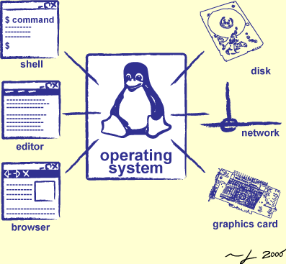
Goals for Today
What is an Operating System?
  And – what is it not?
What makes Operating Systems so exciting?
Oh, and “How does this class operate?”
Interactive is important!
Ask Questions!
Slides courtesy of David Culler, Anthony D. Joseph, John Kubiatowicz, AJ Shankar, George Necula, Alex Aiken, Eric Brewer, Ras Bodik, Ion Stoica, Doug Tygar, and David Wagner.

Slide 3
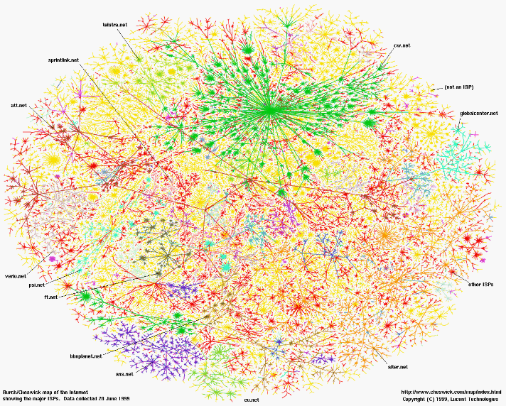
Greatest Artifact of Human Civilization…

Slide 4
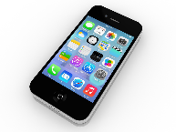
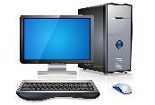
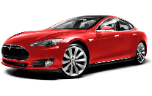
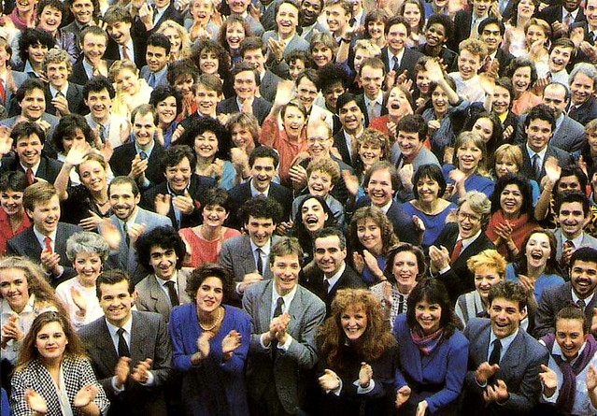

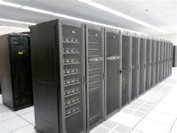
Greatest Artifact of Human Civilization…
The Internet!

Slide 5
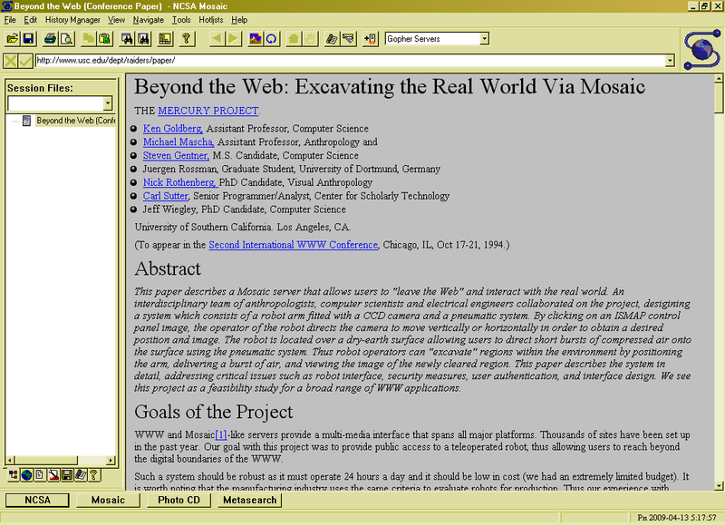
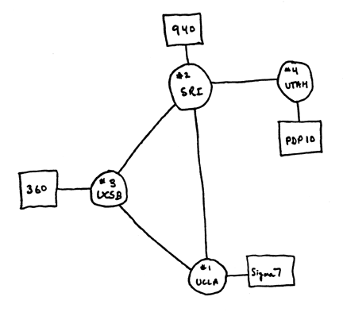
Running Systems at Internet Scale
Internet
WWW
RFC 675 TCP/IP
ARPANet
HTTP 0.9
1969
1974
1990

Slide 6
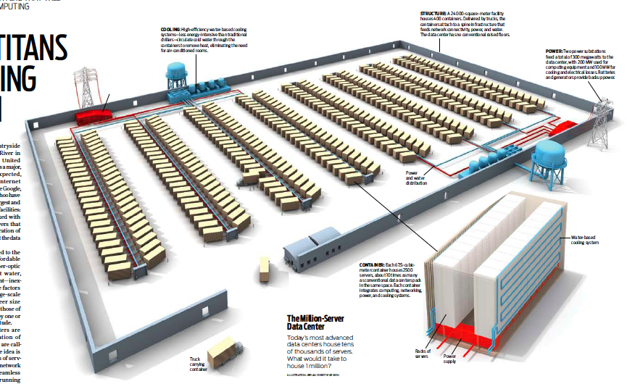
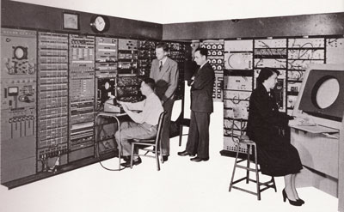
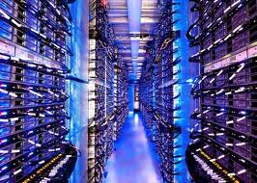
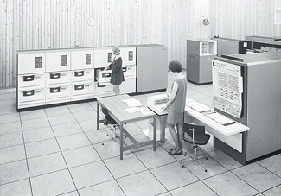
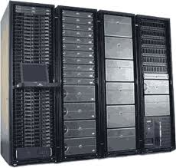
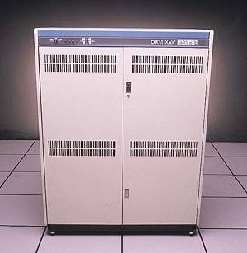
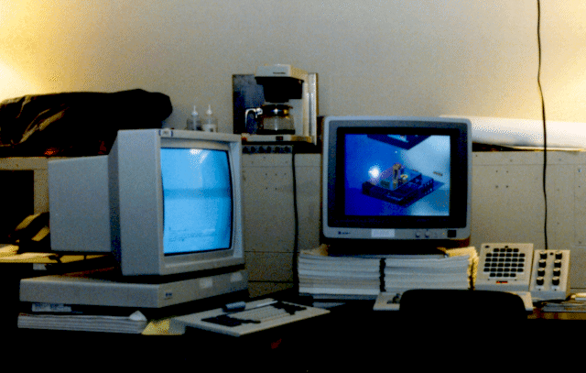
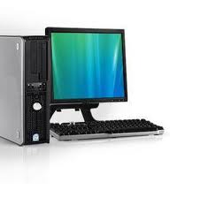
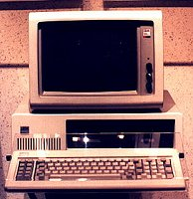
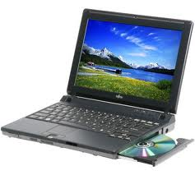
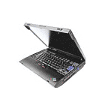
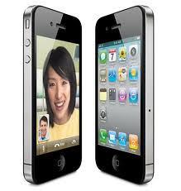


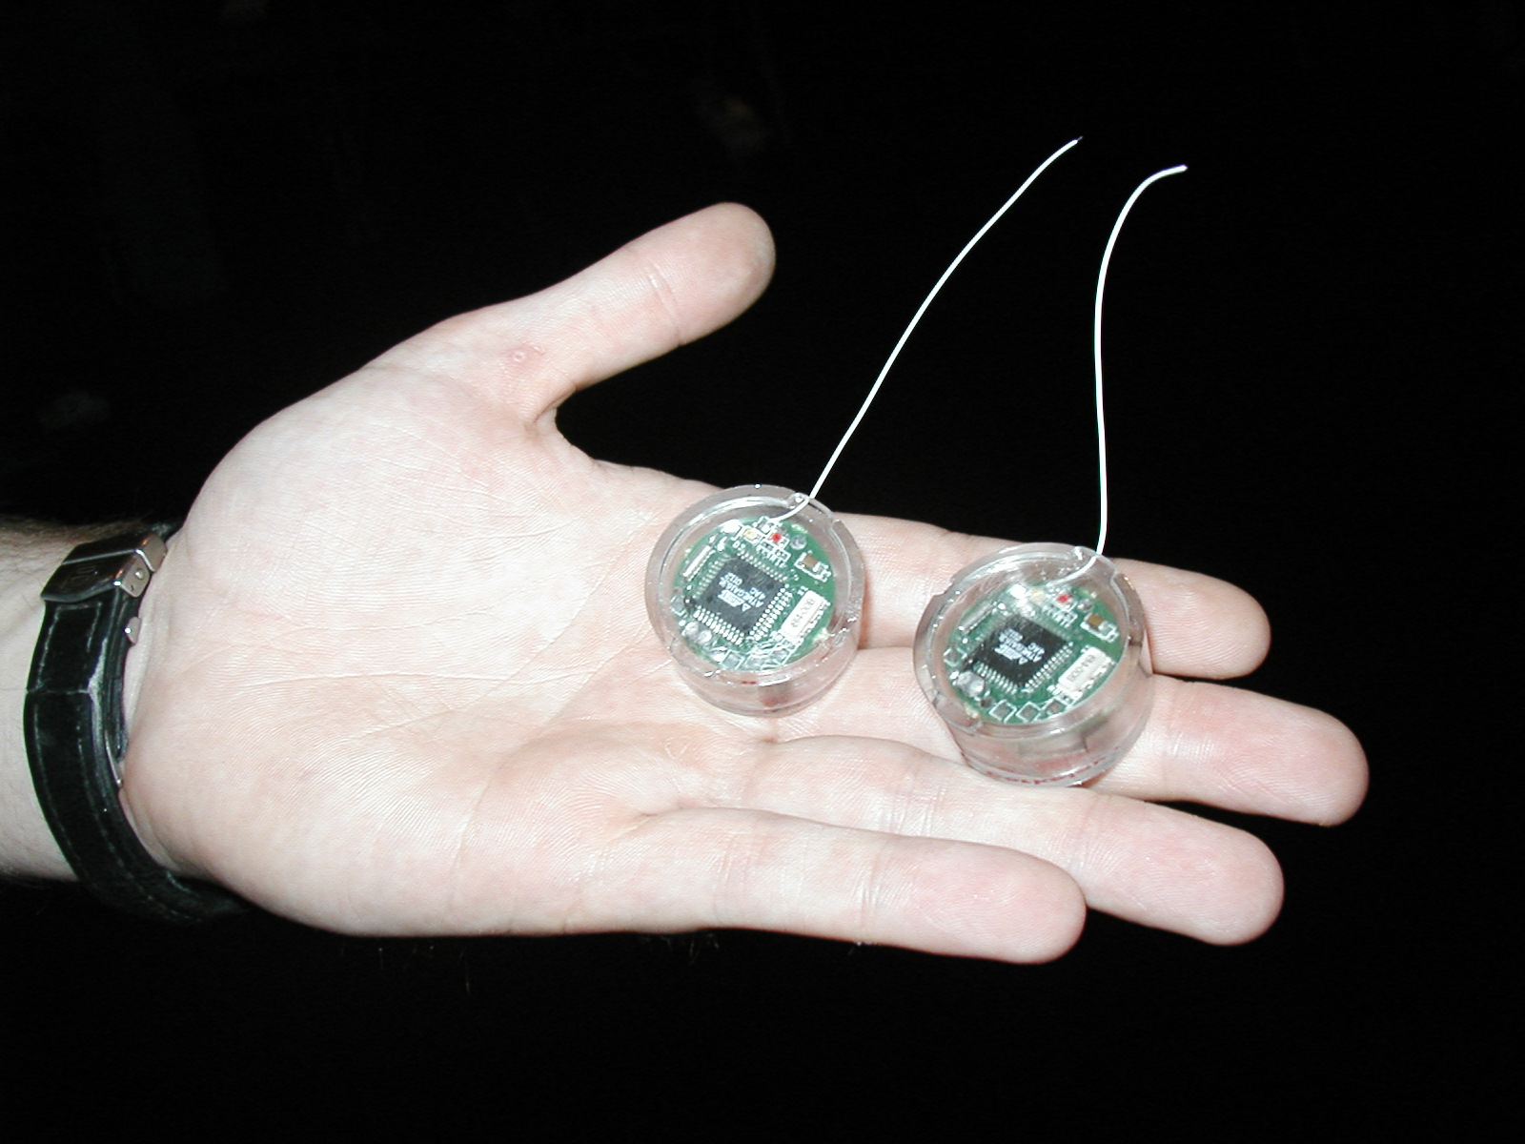
Across Incredible Diversity
Computers
Per Person
Number crunching, Data Storage, Massive Inet Services,
ML, …
1:10⁶
Mainframe
Bell’s Law: New computer class every 10 years
Mini
1:10³
Workstation
Productivity,
Interactive
PC
Laptop
1:1
PDA
Cell
Streaming from/to the physical world
10³:1
years
Mote!
The Internet of Things!

Slide 7
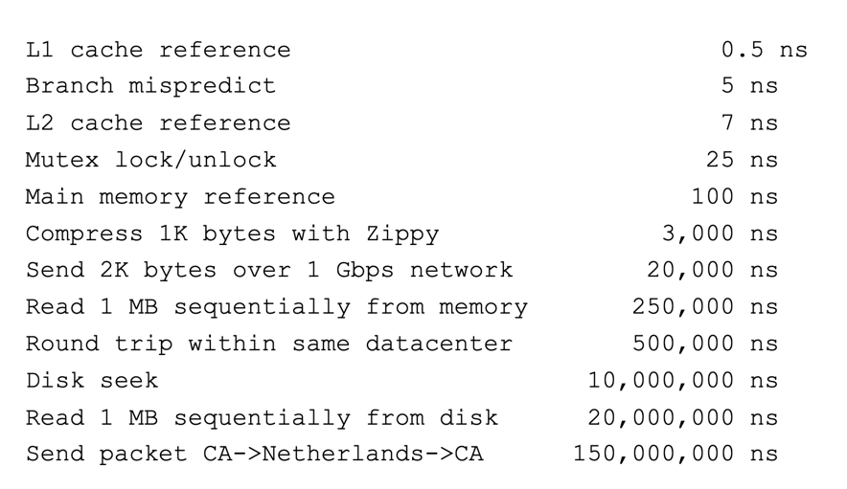
And Range of Timescales
Jeff Dean: “Numbers Everyone Should Know”

Slide 8
Operating Systems are at the Heart of it All!
Make the incredible advance in the underlying technology available to a rapidly evolving body of applications
  Provide consistent abstractions to applications, even on different hardware
  Manage sharing of resources among multiple applications
The key building blocks:
  Processes
  Threads, Concurrency, Scheduling, Coordination
  Address Spaces
  Protection, Isolation, Sharing, Security
  Communication, Protocols
  Persistent storage, transactions, consistency, resilience
  Interfaces to all devices

Slide 9

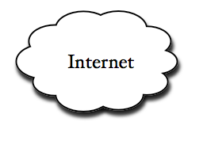
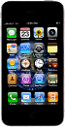

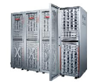
Example: What’s in a Search Query?
DNS
Servers
Datacenter
DNS
request
create
result
page
Search
Index
Page store
Load
balancer
Ad Server
Complex interaction of multiple components in multiple administrative domains
  Systems, services, protocols, …
Notes:
In this course we are not focusing on a single node system but on the end-to-end system. The reason is very simple: today the majority of applications we use does not run on our system. Social networks, e-mail, google docs, online gamming, etc.

Slide 10
But: What is an operating system?

Slide 11
What does an Operating System do?
Most Likely:
  Memory Management
  I/O Management
  CPU Scheduling
  Communications? (Does Email belong in OS?)
  Multitasking/multiprogramming?
What about?
  File System?
  Multimedia Support?
  User Interface?
  Internet Browser? ☺
Is this only interesting to Academics??

Slide 12
Definition of an Operating System
No universally accepted definition
“Everything a vendor ships when you order an operating system” is good approximation
  But varies wildly
“The one program running at all times on the computer” is the kernel
  Everything else is either a system program (ships with the operating system) or an application program

Slide 13
One Definition of an Operating System
Special layer of software that provides application software access to hardware resources
  Convenient abstraction of complex hardware devices
  Protected access to shared resources
  Security and authentication
  Communication
appln
appln
appln
OS
Hardware

Slide 14
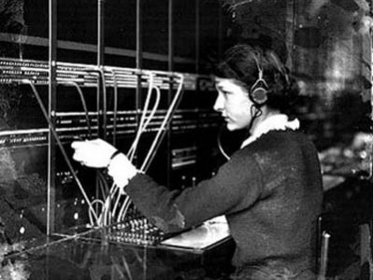
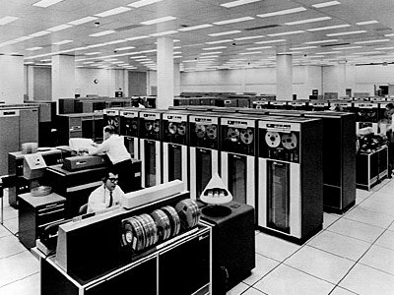
Operating System
Operating System
Switchboard Operator
Computer Operators

Slide 15
Operating System
What makes something a system?
Multiple interrelated parts
  Each potentially interacts with the others
Robustness requires an engineering mindset
  Meticulous error handling, defending against malicious careless users
  Treating the computer as a concrete machine, with all of its limitations and possible failure cases
System programming is an important part of this class!

Slide 16


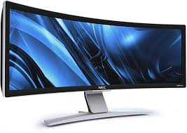

Hardware/Software Interface
Running Program
Software
What you learned in CS 61C – Machine Structures (and C)
Instruction Set Architecture (ISA)
Hardware
Memory
Page
Table
& TLB
Processor
Cache
OS Memory
Networks
The OS abstracts these hardware details from the application
Ctrlr
Storage
Displays
Inputs

Slide 17

What is an Operating System?
Illusionist
  Provide clean, easy-to-use abstractions of physical resources
    Infinite memory, dedicated machine
    Higher level objects: files, users, messages
    Masking limitations, virtualization

Slide 18
OS Basics: Virtualizing the Machine
Compiled
Program
System Libs
Process: Execution environment with restricted rights provided by OS
Threads
Address Spaces
Files
Sockets
Operating System
ISA
Processor
PgTbl
& TLB
Storage
Networks
Memory
Hardware
OS Mem
I/O Ctrlr

Slide 19
Compiled Program’s View of the World
Compiled
Program
System Libs
Process: Execution environment with restricted rights provided by OS
Threads
Address Spaces
Files
Sockets
Operating System
ISA
Application’s “machine” is the process abstraction provided by the OS
Each running program runs in its own process
Processes provide nicer interfaces than raw hardware
Processor
PgTbl
& TLB
Storage
Networks
Memory
Hardware
OS Mem
I/O Ctrlr

Slide 20

System Programmer’s View of the World
Program
System Libs
Linker
Compiler
Process: Execution environment with restricted rights provided by OS
Threads
Address Spaces
Files
Sockets
Operating System
ISA
Application’s “machine” is the process abstraction provided by the OS
Each running program runs in its own process
Processes provide nicer interfaces than raw hardware
Processor
PgTbl
& TLB
Storage
Networks
Memory
Hardware
OS Mem
I/O Ctrlr

Slide 21
What’s in a Process?
A process consists of:
Address Space
One or more threads of control executing in that address space
Additional system state associated with it
  Open files
  Open sockets (network connections)
  …

Slide 22
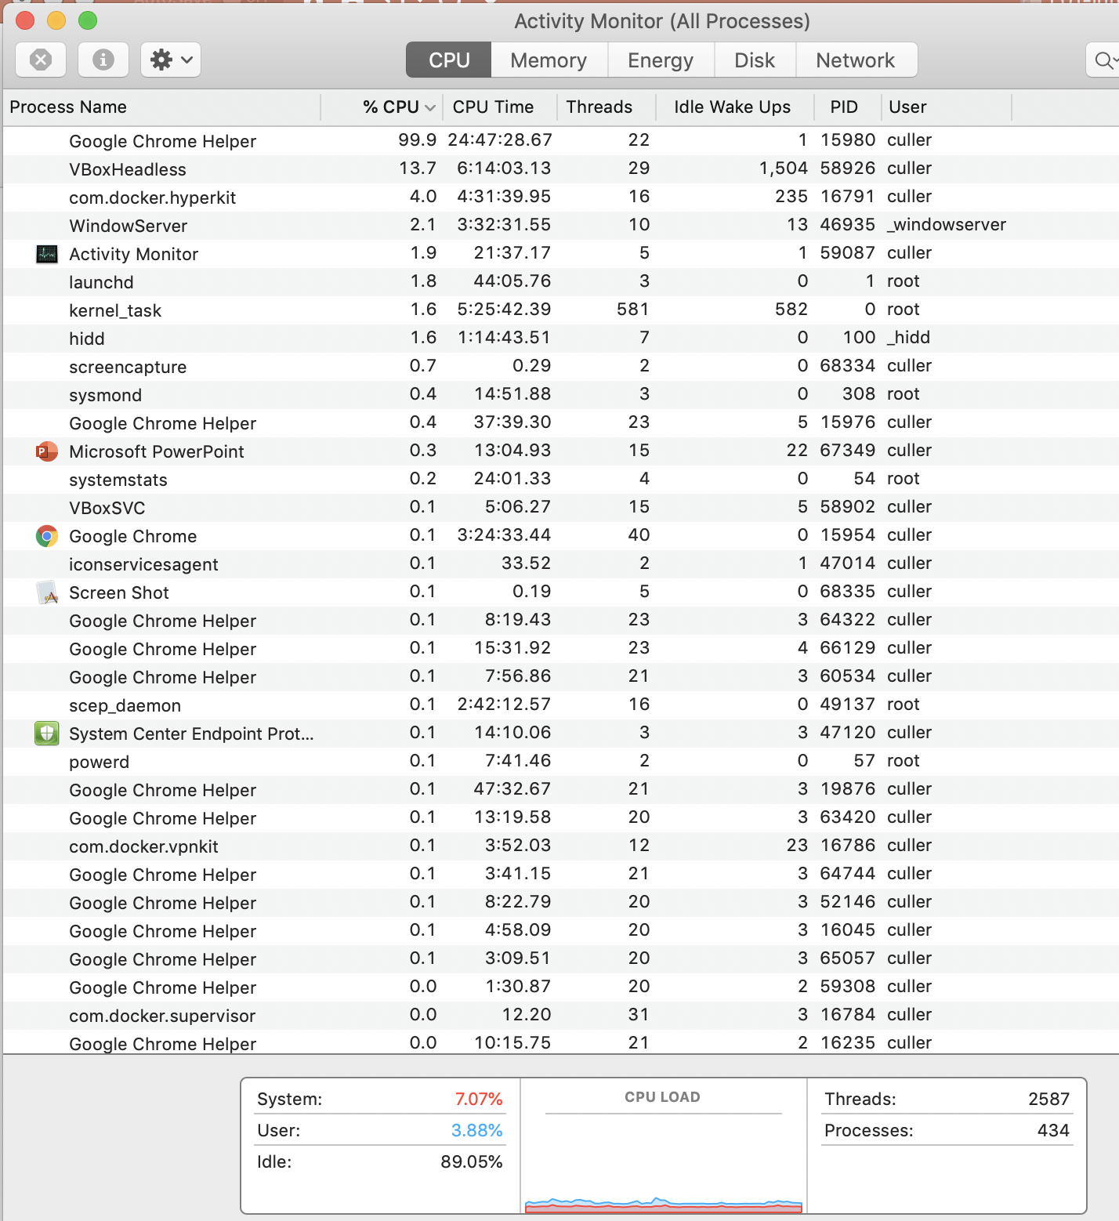
For Example…

Slide 23
Operating System’s View of the World
Compiled
Program 1
Compiled
Program 2
System Libs
System Libs
Compiler
Process 1
Process 2
Threads
Address Spaces
Files
Sockets
Threads
Address Spaces
Files
Sockets
Operating System
ISA
Processor
PgTbl
& TLB
Storage
Networks
Memory
Hardware
OS Mem
I/O Ctrlr

Slide 24
Operating System’s View of the World
Running
Program 1
Running
Program 2
OS translates from hardware interface to application interface
OS provides each running program with its own process
System Libs
System Libs
Compiler
Process 1
Process 2
Threads
Address Spaces
Files
Sockets
Threads
Address Spaces
Files
Sockets
Operating System
ISA
Processor
PgTbl
& TLB
Storage
Networks
Memory
Hardware
OS Mem
I/O Ctrlr

Slide 25

What is an Operating System?
Referee
  Manage protection, isolation, and sharing of resources
    Resource allocation and communication
Illusionist
  Provide clean, easy-to-use abstractions of physical resources
    Infinite memory, dedicated machine
    Higher level objects: files, users, messages
    Masking limitations, virtualization

Slide 26
OS Basics: Running a Process
Compiled
Program 1
Compiled
Program 2
System Libs
System Libs
Compiler
Process 1
Process 2
Threads
Address Spaces
Files
Sockets
Threads
Address Spaces
Files
Sockets
Operating System
ISA
Processor
PgTbl
& TLB
Storage
Networks
Memory
Hardware
I/O Ctrlr

Slide 27
OS Basics: Switching Processes
Compiled
Program 1
Compiled
Program 2
System Libs
System Libs
Compiler
Process 1
Process 2
Threads
Address Spaces
Files
Sockets
Threads
Address Spaces
Files
Sockets
Operating System
ISA
Processor
PgTbl
& TLB
Storage
Networks
Memory
Hardware
OS
Mem
I/O Ctrlr

Slide 28
OS Basics: Switching Processes
Compiled
Program 1
Compiled
Program 2
System Libs
System Libs
Compiler
Process 1
Process 2
Threads
Address Spaces
Files
Sockets
Threads
Address Spaces
Files
Sockets
Operating System
ISA
Processor
PgTbl
& TLB
Storage
Networks
Memory
Hardware
OS
Mem
I/O Ctrlr

Slide 29
OS Basics: Switching Processes
Compiled
Program 1
Compiled
Program 2
System Libs
System Libs
Compiler
Process 1
Process 2
Threads
Address Spaces
Files
Sockets
Threads
Address Spaces
Files
Sockets
Operating System
ISA
Processor
PgTbl
& TLB
Storage
Networks
Memory
Hardware
OS
Mem
I/O Ctrlr

Slide 30
OS Basics: Switching Processes
Compiled
Program 1
Compiled
Program 2
System Libs
System Libs
Compiler
Process 1
Process 2
Threads
Address Spaces
Files
Sockets
Threads
Address Spaces
Files
Sockets
Operating System
ISA
Processor
PgTbl
& TLB
Storage
Networks
Memory
Hardware
OS
Mem
I/O Ctrlr

Slide 31
OS Basics: Protection
Compiled
Program 1
Compiled
Program 2
System Libs
System Libs
Compiler
Process 1
Process 2
Threads
Address Spaces
Files
Sockets
Threads
Address Spaces
Files
Sockets
Operating System
ISA
Processor
PgTbl
& TLB
Storage
Networks
Memory
Hardware
OS
Mem
I/O Ctrlr

Slide 32
OS Basics: Protection
Segmentation fault (core dumped)
Compiled
Program 1
Compiled
Program 2
System Libs
System Libs
Compiler
Process 1
Process 2
Threads
Address Spaces
Files
Sockets
Threads
Address Spaces
Files
Sockets
Operating System
ISA
Processor
PgTbl
& TLB
Storage
Networks
Memory
Hardware
OS
Mem
I/O Ctrlr

Slide 33
OS Basics: Protection
Process 1
Process 2
Process 3
OS isolates processes from each other
OS isolates itself from other processes
… even though they are actually running on the same hardware!
Software
OS Hardware Virtualization
Hardware
ISA
Memory
Processor
Protection Boundary
OS Memory
Ctrlr
Networks
Displays
Storage
Inputs

Slide 34

What is an Operating System?
Referee
  Manage protection, isolation, and sharing of resources
    Resource allocation and communication
Illusionist
  Provide clean, easy-to-use abstractions of physical resources
    Infinite memory, dedicated machine
    Higher level objects: files, users, messages
    Masking limitations, virtualization
Glue
  Common services
    Storage, Window system, Networking
    Sharing, Authorization
    Look and feel

Slide 35
OS Basics: I/O
Process 1
Process 2
Process 3
Software
OS Hardware Virtualization
Hardware
ISA
Memory
OS provides common services in the form of I/O
Processor
Protection Boundary
OS Memory
Ctrlr
Networks
Displays
Storage
Inputs

Slide 36
OS Basics: Look and Feel
Compiled
Program
System Libs
Compiler
Process: Execution environment with restricted rights provided by OS
Threads
Address Spaces
Files
Sockets
Windows
Operating System
ISA
Processor
PgTbl
& TLB
Storage
Networks
Displays
Memory
Hardware
OS Mem
I/O Ctrlr

Slide 37

OS Basics: Background Management
Compiled
Program
System Libs
Compiler
Process: Execution environment with restricted rights provided by OS
Threads
Address Spaces
Files
Sockets
Windows
Operating System
Network Manager
Power Manager
ISA
Processor
PgTbl
& TLB
Storage
Networks
Displays
Battery
Memory
Hardware
OS Mem
I/O Ctrlr

Slide 38
What is an Operating System?
Referee
  Manage protection, isolation, and sharing of resources
    Resource allocation and communication
Illusionist
  Provide clean, easy-to-use abstractions of physical resources
    Infinite memory, dedicated machine
    Higher level objects: files, users, messages
    Masking limitations, virtualization
Glue
  Common services
    Storage, Window system, Networking
    Sharing, Authorization
    Look and feel

Slide 39
Why take CS162?
Some of you will actually design and build operating systems or components of them.
  Perhaps more now than ever
Many of you will create systems that utilize the core concepts in operating systems.
  Whether you build software or hardware
  The concepts and design patterns appear at many levels
All of you will build applications, etc. that utilize operating systems
  The better you understand their design and implementation, the better use you’ll make of them.

Slide 40
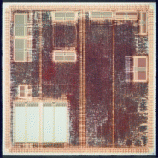
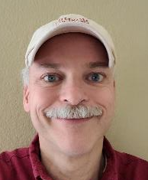
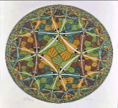



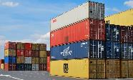
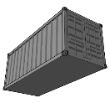
Who am I?
Professor John Kubiatowicz (Prof “Kubi”)
  Background in Hardware Design
    Alewife project at MIT
    Designed CMMU, Modified SPAR C processor
    Helped to write operating system
  Background in Operating Systems
    Worked for Project Athena (MIT)
    OS Developer (device drivers, network file systems)
    Worked on Clustered High-Availability systems.
  Peer-to-Peer
    OceanStore project – Store your data for 1000 years
    Tapestry and Bamboo – Find you data around globe
    One of the first cloud storage projects! (Before the cloud!)
  Quantum Computing
    Exploring architectures for quantum computers
    CAD tool set yields some interesting results
  SwarmLAB/Berkeley Lab for Intelligent Edge
    Global Data Plane (GDP)/DataCapsules
    Fog Robotics
    Hardened Data Containers
Alewife
Tessellation
John Kubiatowicz
(KUBI)
OceanStore
Global Data
Plane

Slide 41
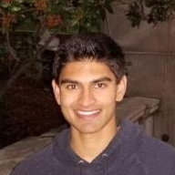



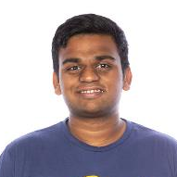


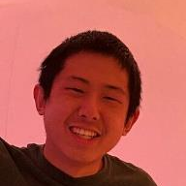
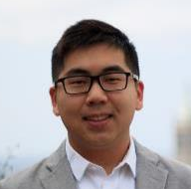
CS162 TAs: Sections TBA
Neil Kulkarni
(Head TA)
Alina Dan
William Hsu
John Markham
Taj Shaik
Akshat Gokhale
(Head TA)
Kevin Svetlitski
Allan Yu
Kevin Yu

Slide 42
Enrollment
Class has 428 limit
  Probably won’t make class larger
This is an Early Drop Deadline course (September 4th)
  If you are not serious about taking, please drop early
  Department will continue to admit students as other students drop
  Really hard to drop afterwards!
    Don’t forget to keep up with work if you are still on the waitlist!
We are serious about requiring CAMERAs
  Zoom proctoring of exams
  Required sections, design reviews, interactions with your group (screen shots!)
  This is part of keeping people from falling off into /dev/null in cyberspace!
On the waitlist/Concurrent enrollment ???
  Unfortunately, we maxed out sections and TA Support
  If people drop, we can move others off waitlist
  Concurrent enrollment is after the waitlist

Slide 43
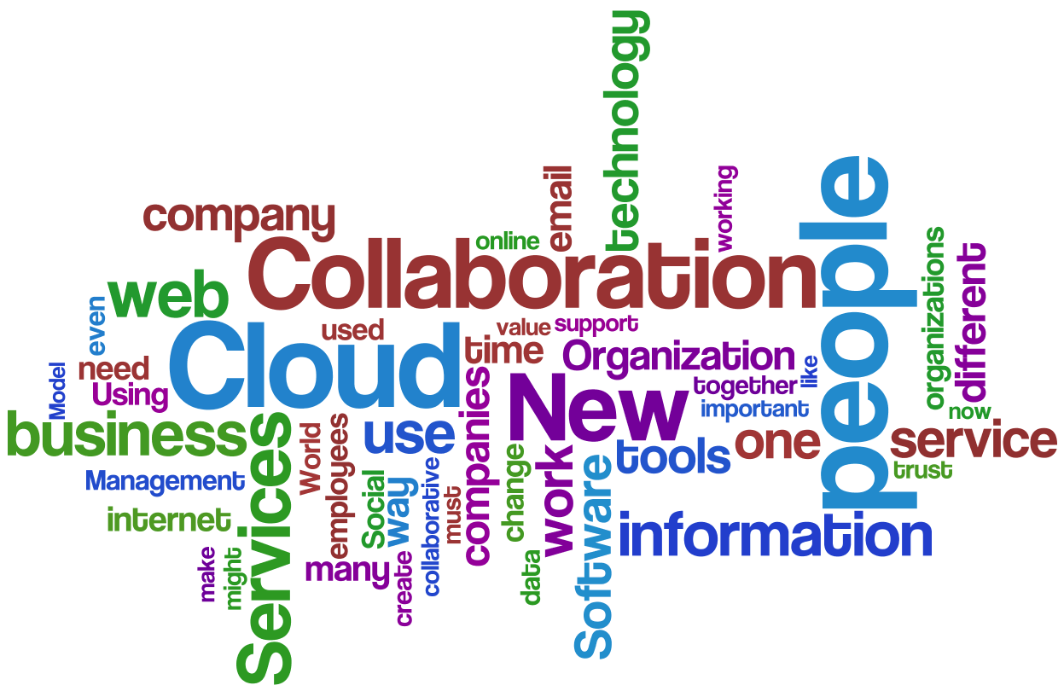
CS162 in the age of COVID-19

Slide 44
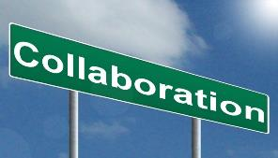




CS162 in the age of COVID-19
Well, things are considerably different this term!
  Even different than last term, since we are starting off remote
  Everything is remote – all term!
Most important thing: People, Interactions, Collaboration
  How do we recover collaboration without direct interaction?
  Remember group meetings?
Must Work to bring everyone along (virtually)!
  Cameras are essential components of this class
    Must have a camera and plan to turn it on
    Will need it for exams, discussion sections, design reviews, OH
  Need to bring back personal interaction – even if it is virtual
    Humans not good at interacting text-only
    Virtual coffee hours with your group (camera turned on!)
  Required attendance at: Discussion sections, Design Reviews
    With camera turned on!
Hello!
Hi!

Slide 45
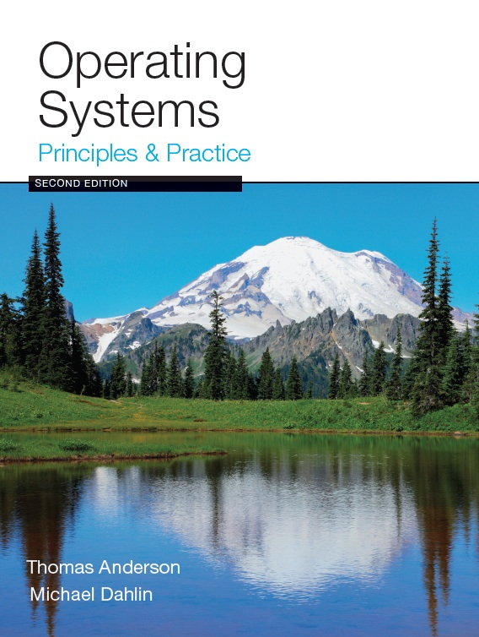
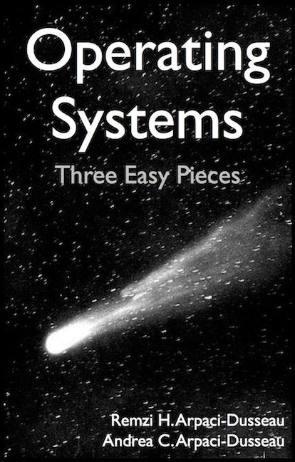
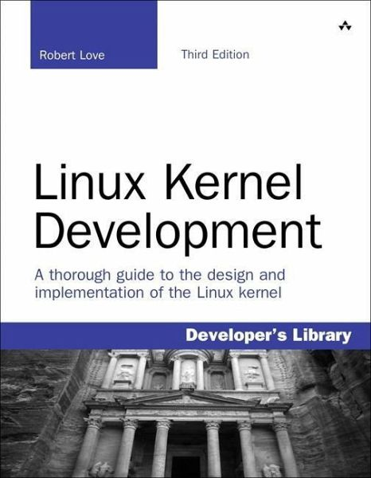
Infrastructure, Textbook & Readings
Infrastructure
  Website: http://cs162.eecs.berkeley.edu
  Piazza: https://piazza.com/berkeley/fall2020/cs162
  Lecture Recordings: Tentatively as links off main class page (next day)
Textbook: Operating Systems: Principles and Practice
(2nd Edition) Anderson and Dahlin
  Suggested readings posted along with lectures
  Try to keep up with material in book as well as lectures
Supplementary Material
  Operating Systems: Three Easy Pieces,
  by Remzi and Andrea Arpaci-Dusseau, available for free online
  Linux Kernel Development, 3rd edition, by Robert Love
Online supplements
  See course website
  Includes Appendices, sample problems, etc.
  Networking, Databases, Software Eng, Security
  Some Research Papers!

Slide 46
Syllabus
OS Concepts: How to Navigate as a Systems Programmer!
  Process, I/O, Networks and Virtual Machines
Concurrency
  Threads, scheduling, locks, deadlock, scalability, fairness
Address Space
  Virtual memory, address translation, protection, sharing
File Systems
  I/O devices, file objects, storage, naming, caching, performance, paging, transactions, databases
Distributed Systems
  Protocols, N-Tiers, RPC, NFS, DHTs, Consistency, Scalability, multicast
Reliability & Security
  Fault tolerance, protection, security
Cloud Infrastructure

Slide 47

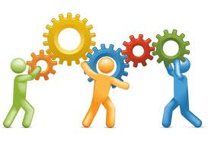
Learning by Doing
Individual Homeworks (2 weeks) - preliminary
  0. Tools & Environment, Autograding, recall C, executable
  1. Lists in C
  2. Basic Threads
  3. BYOS – build your own shell
  4. Sockets & Threads in HTTP server
  5. Memory mapping and management (MALLOC)
  6. SBRK and the Heap
Three (and ½) Group Projects
  0. Getting Started (Individual, before you have a group)
  1. User-programs (exec & syscall)
  2. Threads & Scheduling
  3. File Systems

Slide 48
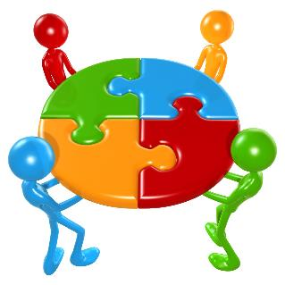
Group Projects
Project teams have 4 members!
  never 5, 3 requires serious justification
  Must work in groups in “the real world”
  Same section (at least same TA)
Communication and cooperation will be essential
  Regular meetings WITH CAMERA TURNED ON!
    Extra credit for screen shots of all of you together in zoom with camera enabled
  Design Documents
  Slack/Messenger/whatever doesn’t replace face-to-face!
Everyone should do work and have clear responsibilities
  You will evaluate your teammates at the end of each project
  Dividing up by Task is the worst approach. Work as a team.
Communicate with supervisor (TAs)
  What is the team’s plan?
  What is each member’s responsibility?
  Short progress reports are required
  Design Documents: High-level description for a manager!

Slide 49
Getting started
Time-zone Survey!
  We need to know where you are so that we can plan section/midterm times
Start homework 0 and Project 0 right away (hopefully Today!)
  Github account
  Registration survey
  Vagrant virtualbox – VM environment for the course
    Consistent, managed environment on your machine
  Get familiar with all the cs162 tools
  Submit to autograder via git
Sections on Friday – attend any section you want
  We’ll assign permanent sections after forming project groups
  Section attendance will be mandatory after we form groups
  These section times will be adjusted after we have a better idea where people are

Slide 50
Preparing Yourself for this Class
The projects will require you to be very comfortable with programming and debugging C
  Pointers (including function pointers, void*)
  Memory Management (malloc, free, stack vs heap)
  Debugging with GDB
You will be working on a larger, more sophisticated code base than anything you've likely seen in 61C!
Review Session on C/C++:
  Thursday, 9/03, Time and logistics TBA
"Resources" page on course website
  Ebooks on “git” and “C”
C programming reference (still in beta):
  https://cs162.eecs.berkeley.edu/ladder/
First two sections are also dedicated to programming and debugging review:
  Attend ANY sections in first two weeks

Slide 51
Grading (Tentative breakdown)
36% three midterms (12% each)
  Thursday, 10/01, TBA, time set after survey
  Thursday, 10/29, TBA, time set after survey
  Thursday, 12/03, TBA, time set after survey
  These will be ZOOM-Proctored. Camera REQUIRED.
36% projects
18% homework
10% participation (Sections, Lecture, …)
No final exam
Projects
  Initial design document, Design review, Code, Final design
  Submission via git push triggers autograder

Slide 52
Personal Integrity
UCB Academic Honor Code: "As a member of the UC Berkeley community, I act with honesty, integrity, and respect for others."
http://asuc.org/honorcode/resources/HC%20Guide%20for%20Syllabi.pdf

Slide 53


CS 162 Collaboration Policy
Explaining a concept to someone in another group
Discussing algorithms/testing strategies with other groups
Discussing debugging approaches with other groups
Searching online for generic algorithms (e.g., hash table)
Sharing code or test cases with another group
Copying OR reading another group’s code or test cases
Copying OR reading online code or test cases from prior years
Helping someone in another group to debug their code
We compare all project submissions against prior year submissions and online solutions and will take actions (described on the course overview page) against offenders
Don’t put a friend in a bad position by asking for help that they shouldn’t give!

Slide 54
Lecture Goal
Interactive!!!
Ask Questions in Chat

Slide 55
What makes Operating Systems Exciting and Challenging?

Slide 56
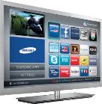

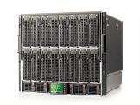

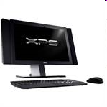


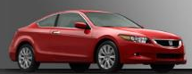



Societal Scale Information Systems
(Or the “Internet of Things”?)
Massive Cluster
The world is a large distributed system
  Microprocessors in everything
  Vast infrastructure behind them
Gigabit Ethernet
Clusters
Massive Cluster
Clusters
Gigabit Ethernet
Internet
Connectivity
Scalable, Reliable,
Secure Services
Databases
Information Collection
Remote Storage
Online Games
Commerce
…
MEMS for
Sensor Nets
Notes:
Of the enormous variety of CITRIS projects going on at Berkeley, I will present one set that is tied together by this picture: the design, construction and use of MEMS devices, the sensor networks containing them, and making the information from these networks available to widely distributed users as scalable, reliable and secure services.
The name we give to such an integrated system is a Societal Scale Information System, a name meant to evoke its scale – enormous - and purpose – benefiting people and the economy.
I will leave the details of all the specific applications that Ruzena mentioned, be it to energy efficiency or education or disaster response the social sciences, and indeed most details, to later talks and posters.

Slide 57



Technology Trends: Moore’s Law
Moore’s Law
2X transistors/Chip Every 1.5 years
Called “Moore’s Law”
Gordon Moore (co-founder of Intel) predicted in 1965 that the transistor density of semiconductor chips would double roughly every 18 months
Microprocessors have become smaller, denser, and more powerful

Slide 58
Big Challenge: Slowdown in Joy’s law of Performance
3X
From Hennessy and Patterson, Computer Architecture: A Quantitative Approach, 4th edition, Sept. 15, 2006
⇒ Sea change in chip design: multiple “cores” or processors per chip
VAX : 25%/year 1978 to 1986
RISC + x86 : 52%/year 1986 to 2002
RISC + x86 : ??%/year 2002 to present

Slide 59

Another Challenge: Power Density
Moore’s law extrapolation
  Potential power density reaching amazing levels!
Flip side: battery life very important
  Moore’s law yielded more functionality at equivalent
  (or less) total energy consumption

Slide 60


ManyCore Chips: The future arrived in 2007
Intel 80-core multicore chip (Feb 2007)
  80 simple cores
  Two FP-engines / core
  Mesh-like network
  100 million transistors
  65nm feature size
Intel Single-Chip Cloud
Computer (August 2010)
  24 “tiles” with two cores/tile
  24-router mesh network
  4 DDR3 memory controllers
  Hardware support for message-passing
How to program these?
  Use 2 CPUs for video/audio
  Use 1 for word processor, 1 for browser
  76 for virus checking???
Parallelism must be exploited at all levels
Amazon X1 instances (2016)
  128 virtual cores, 2 TB RAM

Slide 61

But then Moore’s Law Ended…
Moore’s Law has (officially) ended -- Feb 2016
  No longer getting 2 x transistors/chip every 18 months…
  or even every 24 months
May have only 2-3 smallest geometry fabrication plants left:
  Intel and Samsung and/or TSMC
Vendors moving to 3D stacked chips
  More layers in old geometries

Slide 62

Storage Capacity is Still Growing!

Slide 63
Society is Increasingly Connected…

Slide 64

Network Capacity Still Increasing
(source: http://www.ospmag.com/issue/article/Time-Is-Not-Always-On-Our-Side )
Notes:
Networking bandwidth is expected to also outpace the CPU power, so more bandwidth per core.

Slide 65

Not Only PCs connected to the Internet
In 2011, smartphone shipments exceeded PC shipments!
2011 shipments:
  487M smartphones
  414M PC clients
    210M notebooks
    112M desktops
    63M tablets
  25M smart TVs
4 billion phones in the world → smartphones over next few years
Then…
1.53B in 2017
262.5M in 2017
164M in 2017
39.5M in 2017

Slide 66
People-to-Computer Ratio Over Time
Computers
Per Person
Number crunching, Data Storage, Massive Inet Services,
ML, …
1:10⁶
Mainframe
Mini
1:10³
Workstation
Productivity,
Interactive
PC
Laptop
1:1
PDA
Cell
Streaming from/to the physical world
10³:1
years
Mote!
The Internet of Things!
Bell’s Law: new computer class per 10 years

Slide 67



What is an Operating System Again?
Referee
  Manage sharing of resources, Protection, Isolation
    Resource allocation, isolation, communication
Illusionist
  Provide clean, easy to use abstractions of physical resources
    Infinite memory, dedicated machine
    Higher level objects: files, users, messages
    Masking limitations, virtualization
Glue
  Common services
    Storage, Window system, Networking
    Sharing, Authorization
    Look and feel

Slide 68
Challenge: Complexity
Applications consisting of…
  … a variety of software modules that …
  … run on a variety of devices (machines) that
    … implement different hardware architectures
    … run competing applications
    … fail in unexpected ways
    … can be under a variety of attacks
Not feasible to test software for all possible environments and combinations of components and devices
  The question is not whether there are bugs but how serious are the bugs!

Slide 69

The World Is Parallel: Intel SkyLake (2017)
Up to 28 Cores, 56 Threads
  694 mm² die size (estimated)
Many different instructions
  Security, Graphics
Caches on chip:
  L2: 28 MiB
  Shared L3: 38.5 MiB
  (non-inclusive)
  Directory-based cache coherence
Network:
  On-chip Mesh Interconnect
  Fast off-chip network directlry supports 8-chips connected
DRAM/chips
  Up to 1.5 TiB
  DDR4 memory

Slide 70

HW Functionality comes with great complexity!
Intel Skylake-X
I/O Configuration
Proc
Caches
Busses
adapters
Memory
Controllers
Disks
Displays
Keyboards
I/O Devices:
Networks

Slide 71
Increasing Software Complexity
Millions of Lines of Code
(source https://informationisbeautiful.net/visualizations/million-lines-of-code/)

Slide 72

Example: Some Mars Rover (“Pathfinder”) Requirements
Pathfinder hardware limitations/complexity:
  20Mhz processor, 128MB of DRAM, VxWorks OS
  cameras, scientific instruments, batteries, solar panels, and locomotion equipment
  Many independent processes work together
Can’t hit reset button very easily!
  Must reboot itself if necessary
  Must always be able to receive commands from Earth
Individual Programs must not interfere
  Suppose the MUT (Martian Universal Translator Module) buggy
  Better not crash antenna positioning software!
Further, all software may crash occasionally
  Automatic restart with diagnostics sent to Earth
  Periodic checkpoint of results saved?
Certain functions time critical:
  Need to stop before hitting something
  Must track orbit of Earth for communication
A lot of similarity with the Internet of Things?
  Complexity, QoS, Inaccessbility, Power limitations … ?
Notes:
Distance 186 light secs to 21 light minutes one-way
Nearly two earth years

Slide 73
Questions
Does the programmer need to write a single program that performs many independent activities?
Does every program have to be altered for every piece of hardware?
Does a faulty program crash everything?
Does every program have access to all hardware?
Hopefully, no!
Operating Systems help the programmer write robust programs!

Slide 74
OS Abstracts the Underlying Hardware
Processor → Thread
Memory → Address Space
Disks, SSDs, … → Files
Networks → Sockets
Machines → Processes
OS as an Illusionist:
  Remove software/hardware quirks (fight complexity)
  Optimize for convenience, utilization, reliability, … (help the programmer)
For any OS area (e.g. file systems, virtual memory, networking, scheduling):
  What hardware interface to handle? (physical reality)
  What’s software interface to provide? (nicer abstraction)
Application
Operating System
Hardware
Abstract Machine Interface
Physical Machine Interface

Slide 75

OS Protects Processes and the Kernel
Run multiple applications and:
  Keep them from interfering with or crashing the operating system
  Keep them from interfering with or crashing each other

Slide 76

Basic Tool: Dual-Mode Operation
Hardware provides at least two modes:
  Kernel Mode (or “supervisor” mode)
  User Mode
Certain operations are prohibited when running in user mode
  Changing the page table pointer, disabling interrupts, interacting directly w/ hardware, writing to kernel memory
Carefully controlled transitions between user mode and kernel mode
  System calls, interrupts, exceptions

Slide 77

UNIX System Structure

Slide 78


Virtualization: Execution Environments for Systems
Additional layers of protection and isolation can help further manage complexity

Slide 79
What is an Operating System,… Really?
Most Likely:
  Memory Management
  I/O Management
  CPU Scheduling
  Communications? (Does Email belong in OS?)
  Multitasking/multiprogramming?
What about?
  File System?
  Multimedia Support?
  User Interface?
  Internet Browser? ☺
Is this only interesting to Academics??

Slide 80
Operating System Definition (Cont.)
No universally accepted definition
“Everything a vendor ships when you order an operating system” is good approximation
  But varies wildly
“The one program running at all times on the computer” is the kernel
  Everything else is either a system program (ships with the operating system) or an application program

Slide 81
“In conclusion…Operating Systems:”
Provide convenient abstractions to handle diverse hardware
  Convenience, protection, reliability obtained in creating the illusion
Coordinate resources and protect users from each other
  Using a few critical hardware mechanisms
Simplify application development by providing standard services
Provide fault containment, fault tolerance, and fault recovery
CS162 combines things from many other areas of computer science:
  Languages, data structures, hardware, and algorithms

