Slide 1
CS162
Operating Systems and
Systems Programming
Lecture 24
Networking and TCP/IP (Con’t), RPC,
Distributed File Systems
November 23rd, 2020
Prof. John Kubiatowicz
http://cs162.eecs.Berkeley.edu

Slide 2
Recall: Distributed Consensus Making
Consensus problem
  All nodes propose a value
  Some nodes might crash and stop responding
  Eventually, all remaining nodes decide on the same value from set of proposed values
Distributed Decision Making
  Choose between “true” and “false”
  Or Choose between “commit” and “abort”
Equally important (but often forgotten!): make it durable!
  How do we make sure that decisions cannot be forgotten?
    This is the “D” of “ACID” in a regular database
  In a global-scale system?
    What about erasure coding or massive replication?
    Like BlockChain applications!

Slide 3
Recall: Two-Phase Commit Protocol
Persistent stable log on each machine: keep track of whether commit has happened
  If a machine crashes, when it wakes up it first checks its log to recover state of world at time of crash
Prepare Phase:
  The global coordinator requests that all participants will promise to commit or rollback the transaction
  Participants record promise in log, then acknowledge
  If anyone votes to abort, coordinator writes "Abort" in its log and tells everyone to abort; each records "Abort" in log
Commit Phase:
  After all participants respond that they are prepared, then the coordinator writes "Commit" to its log
  Then asks all nodes to commit; they respond with ACK
  After receive ACKs, coordinator writes "Got Commit" to log
Log used to guarantee that all machines either commit or don’t

Slide 4
Recall: Network Protocols
Networking protocols: many levels
  Physical level: mechanical and electrical network (e.g., how are 0 and 1 represented)
  Link level: packet formats/error control (for instance, the CSMA/CD protocol)
  Network level: network routing, addressing
  Transport Level: reliable message delivery
Protocols on today’s Internet:
WWW
e-mail
NFS
ssh
RPC
Transport
UDP
TCP
Network
IP
Physical/Link
Ethernet
WiFi
LTE

Slide 5
Network Layering
Layering: building complex services from simpler ones
  Each layer provides services needed by higher layers by utilizing services provided by lower layers
The physical/link layer is pretty limited
  Packets are of limited size (called the “Maximum Transfer Unit or MTU: often 200-1500 bytes in size)
  Routing is limited to within a physical link (wire) or perhaps through a switch
Our goal in the following is to show how to construct a secure, ordered, message service routed to anywhere:
Physical Reality: Packets | Abstraction: Messages
Limited Size (MTU) | Arbitrary Size
Unordered (sometimes) | Ordered
Unreliable | Reliable
Machine-to-machine | Process-to-process
Only on local area net | Routed anywhere
Asynchronous | Synchronous
Insecure | Secure

Slide 6
Recall: IPv4 Packet Format
IP Packet Format:
IP Datagram: an unreliable, unordered, packet sent from source to destination
  Function of network – deliver datagrams!
IP Header
Length
Size of datagram
(header+data)
Flags &
Fragmentation
to split large
messages
0
15
16
31
IP Ver4
4
IHL
ToS
Total length(16-bits)
16-bit identification
flags
13-bit frag off
IP header
20 bytes
Time to
Live (hops)
TTL
protocol
16-bit header checksum
32-bit source IP address
Type of
transport
protocol
32-bit destination IP address
options (if any)
Data

Slide 7
Building a messaging service on IP
Process to process communication
  Basic routing gets packets from machine→machine
  What we really want is routing from process→process
    Add “ports”, which are 16-bit identifiers
    A communication channel (connection) defined by 5 items:
    [source addr, source port, dest addr, dest port, protocol]
For example: The Unreliable Datagram Protocol (UDP)
  Layered on top of basic IP (IP Protocol 17)
    Datagram: an unreliable, unordered, packet sent from source user → dest user (Call it UDP/IP)
  Important aspect: low overhead!
    Often used for high-bandwidth video streams
    Many uses of UDP considered “anti-social” – none of the “well-behaved” aspects of (say) TCP/IP
IP Header
(20 bytes)
16-bit source port
16-bit destination port
16-bit UDP length
16-bit UDP checksum
UDP Data

Slide 8
Internet Architecture: Five Layers
Lower three layers implemented everywhere
Top two layers implemented only at hosts
Application
sockets
sockets
Application
Transport
Transport
Network
Network
Network
Datalink
Datalink
Datalink
Physical
Physical
Physical
Host A
Router
Host B

Slide 9
Internet Architecture: Five Layers
Communication goes down to physical network
Then from network peer to peer
Then up to relevant layer
Application
sockets
sockets
Application
Transport
Transport
Network
Network
Network
Datalink
Datalink
Datalink
Physical
Physical
Physical
Host A
Router
Host B

Slide 10
Layering Analogy: Packets in Envelopes
Application
Present.
Session
Transport
Application Layer
Application Layer
Network
Data
Data
Datalink
Physical
Transport Layer
Trans.
Hdr.
Data
Trans.
Hdr.
Data
Transport Layer
Network Layer
Net.
Hdr.
Trans.
Hdr.
Data
Net.
Hdr.
Trans.
Hdr.
Data
Network Layer
Datalink Layer
Frame
Hdr.
Net.
Hdr.
Trans.
Hdr.
Data
Frame
Hdr.
Net.
Hdr.
Trans.
Hdr.
Data
Datalink Layer
Physical Layer
Physical Layer
101010100110101110
101010100110101110

Slide 11
Internet Transport Protocols
Application
Present.
Session
Datagram service (UDP): IP Protocol 17
  No-frills extension of “best-effort” IP
  Multiplexing/Demultiplexing among processes
Reliable, in-order delivery (TCP): IP Protocol6
  Connection set-up & tear-down
  Discarding corrupted packets (segments)
  Retransmission of lost packets (segments)
  Flow control
  Congestion control
Other examples:
  DCCP (33), Datagram Congestion Control Protocol
  RDP (26), Reliable Data Protocol
  SCTP (132), Stream Control Transmission Protocol
Transport
Network
Datalink
Physical

Slide 12
Recall: Sockets in concept
Client
Server
Create Server Socket
Create Client Socket
Bind it to an Address
(host:port)
Connect it to server (host:port)
Listen for Connection
Accept syscall()
Connection Socket
Connection Socket
write request
read request
read response
write response
Close Client Socket
Close Connection Socket
Close Server Socket

Slide 13
Reliable Message Delivery: the Problem
All physical networks can garble and/or drop packets
  Physical media: packet not transmitted/received
    If transmit close to maximum rate, get more throughput – even if some packets get lost
    If transmit at lowest voltage such that error correction just starts correcting errors, get best power/bit
  Congestion: no place to put incoming packet
    Point-to-point network: insufficient queue at switch/router
    Broadcast link: two host try to use same link
    In any network: insufficient buffer space at destination
    Rate mismatch: what if sender send faster than receiver can process?
Reliable Message Delivery on top of Unreliable Packets
  Need some way to make sure that packets actually make it to receiver
    Every packet received at least once
    Every packet received at most once
  Can combine with ordering: every packet received by process at destination exactly once and in order

Slide 14
Transmission Control Protocol (TCP)
Stream in:
Stream out:
Router
Router
..zyxwvuts
gfedcba
Transmission Control Protocol (TCP)
  TCP (IP Protocol 6) layered on top of IP
  Reliable byte stream between two processes on different machines over Internet (read, write, flush)
TCP Details
  Fragments byte stream into packets, hands packets to IP
    IP may also fragment by itself
  Uses window-based acknowledgement protocol (to minimize state at sender and receiver)
    “Window” reflects storage at receiver – sender shouldn’t overrun receiver’s buffer space
    Also, window should reflect speed/capacity of network – sender shouldn’t overload network
  Automatically retransmits lost packets
  Adjusts rate of transmission to avoid congestion
    A “good citizen”

Slide 15
Problem: Dropped Packets
All physical networks can garble or drop packets
  Physical hardware problems (bad wire, bad signal)
Therefore, IP can garble or drop packets
  It doesn't repair this itself (end-to-end principle!)
Building reliable message delivery
  Confirm that packets aren't garbled
  Confirm that packets arrive exactly once

Slide 16
Using Acknowledgements
A
B
A
B
Packet
Packet
Timeout
ACK
Packet
ACK
How to ensure transmission of packets?
  Detect garbling at receiver via checksum, discard if bad
  Receiver acknowledges (by sending “ACK”) when packet received properly at destination
  Timeout at sender: if no ACK, retransmit
Some questions:
  If the sender doesn’t get an ACK, does that mean the receiver didn’t get the original message?
    No
  What if ACK gets dropped? Or if message gets delayed?
    Sender doesn’t get ACK, retransmits, Receiver gets message twice, ACK each
Notes:
- So how can we ensure delivery of packets over an unreliable network?

Slide 17
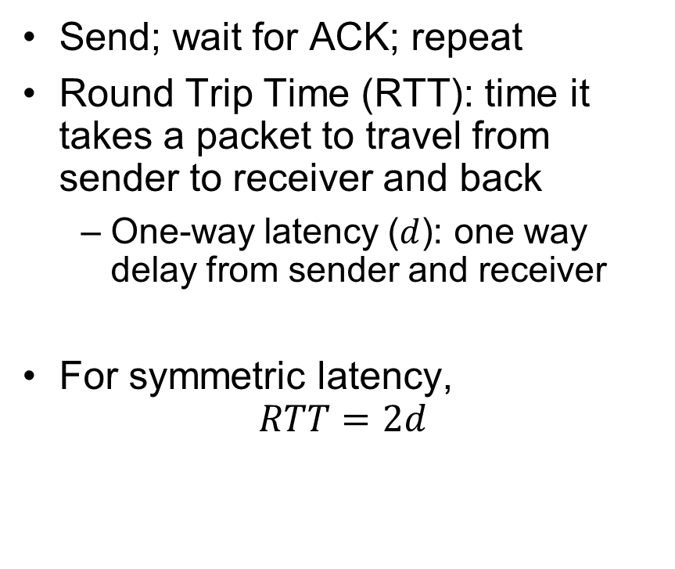
Stop-and-Wait (No Packet Loss)
Send; wait for ACK; repeat
Round Trip Time ($\text{RTT}$): time it takes a packet to travel from sender to receiver and back
  One-way latency ($d$): one way delay from sender and receiver
For symmetric latency,
$$RTT=2d$$
Sender
Receiver
1
d
RTT
ACK 1
2
RTT
ACK 2
3
Time

Slide 18
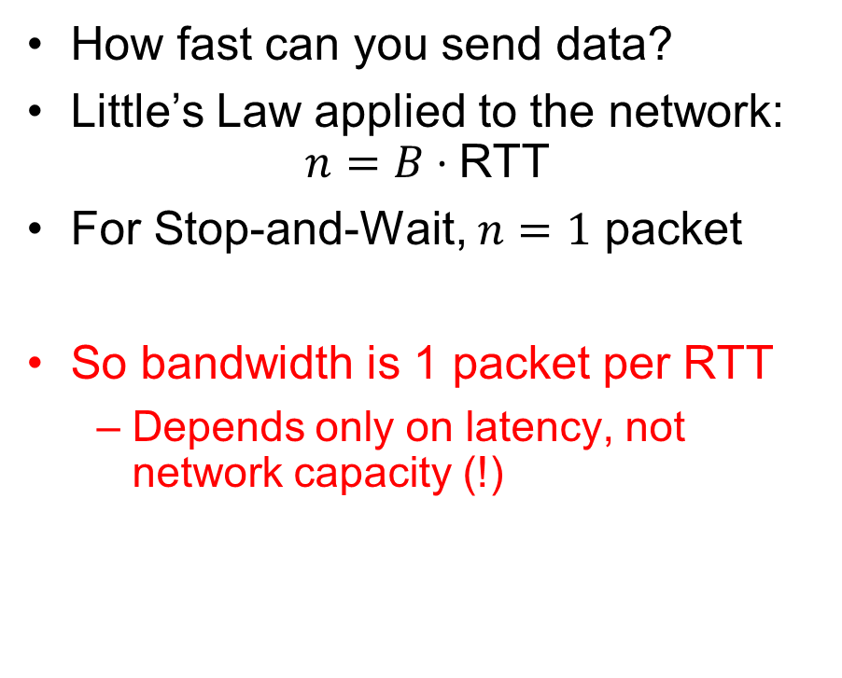
Stop-and-Wait (No Packet Loss)
How fast can you send data?
Little’s Law applied to the network:
$$n=B⋅\text{RTT}$$
For Stop-and-Wait, $n=1$ packet
So bandwidth is 1 packet per RTT
  Depends only on latency, not network capacity (!)
Sender
Receiver
1
d
RTT
ACK 1
2
RTT
ACK 2
3
Time

Slide 19
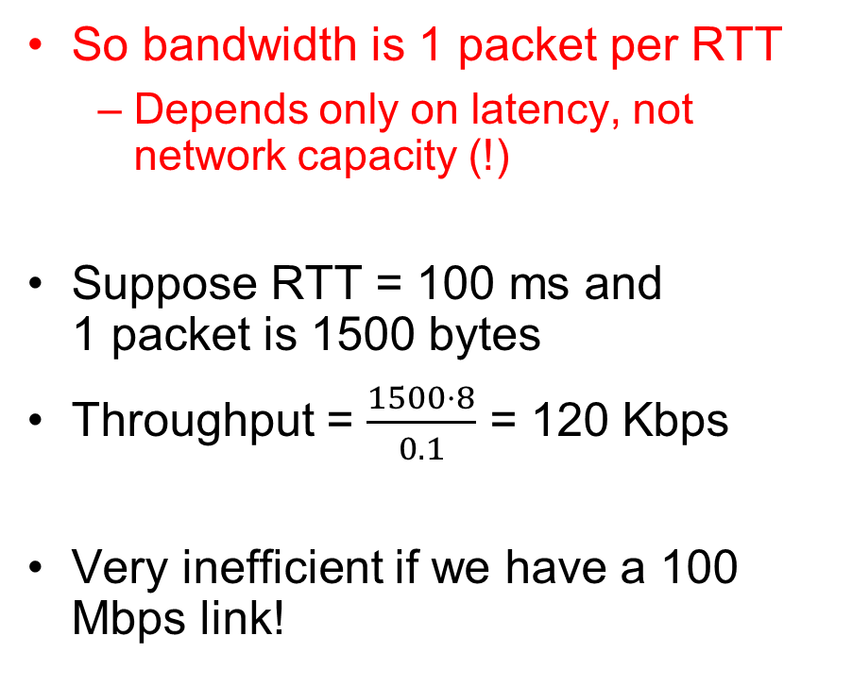
Stop-and-Wait (No Packet Loss)
So bandwidth is 1 packet per RTT
  Depends only on latency, not network capacity (!)
Suppose RTT = 100 ms and
1 packet is 1500 bytes
Throughput = $\frac{1500⋅8}{0.1}$ = 120 Kbps
Very inefficient if we have a 100 Mbps link!
Sender
Receiver
1
d
RTT
ACK 1
2
RTT
ACK 2
3
Time

Slide 20
Stop-and-Wait with Packet Loss
Loss recovery relies on timeouts
How to choose a good timeout?
  Too short – lots of duplication
  Too long – packet loss is really disruptive!
How to deal with duplication?
  Retransmission certainly opens up the possibility for
Sender
Receiver
1
RTT
ACK 1
timeout
1
Time

Slide 21
How to Deal with Message Duplication?
Solution: put sequence number in message to identify re-transmitted packets
  Receiver checks for duplicate number’s; Discard if detected
Requirements:
  Sender keeps copy of unACK’d messages
    Easy: only need to buffer messages
  Receiver tracks possible duplicate messages
    Hard: when ok to forget about received message?
Alternating-bit protocol:
  Send one message at a time; don’t send
  next message until ACK received
  Sender keeps last message; receiver tracks
  sequence number of last message received
Pros: simple, small overhead
Con: doesn’t work if network can delay
or duplicate messages arbitrarily
Sender
Receiver
Pkt #0
ACK #0
Pkt #1
ACK #1
Pkt #0
ACK #0

Slide 22
Advantages of Moving Away From Stop-and-Wait
Larger space of acknowledgements
  Pipelining: don’t wait for ACK before sending next packet
ACKs serve dual purpose:
  Reliability: Confirming packet received
  Ordering: Packets can be reordered at destination
How much data is in flight now?
  Bytes in-flight: W_{send} = RTT × B
  Here B is in “bytes/second”
  W_{send} ≡ Sender’s “Window Size”
  Packets in flight = (W_{send} / packet size)
How long does the sender have to keep the packets around?
How long does the receiver have to keep the packets’ data?
What if sender is sending packets faster than the receiver can process the data?
Sender
Receiver
RTT
d
Time

Slide 23
Administrivia
Midterm 3: Thursday 12/3: 5-7PM as before
  Material up to Lecture 25
  Cameras and Zoom screen sharing again as with Midterm 2
  Review session TBA
Lecture 26 will be a fun lecture
  Let me know if there are topics you would like to discuss!

Slide 24


Recall: CS 162 Collaboration Policy
Explaining a concept to someone in another group
Discussing algorithms/testing strategies with other groups
Discussing debugging approaches with other groups
Searching online for generic algorithms (e.g., hash table)
Sharing code or test cases with another group
Copying OR reading another group’s code or test cases
Copying OR reading online code or test cases from prior years
Helping someone in another group to debug their code
We compare all project submissions against prior year submissions and online solutions and will take actions (described on the course overview page) against offenders
Don’t put a friend in a bad position by asking for help that they shouldn’t give!

Slide 25
Recall: Communication Between Processes
write(wfd, wbuf, wlen);
Process A
Process B
In-Memory Queue
n = read(rfd,rbuf, rmax);
Data written by A is held in memory until B reads it
Queue has a fixed capacity
  Writing to the queue blocks if the queue if full
  Reading from the queue blocks if the queue is empty
POSIX provides this abstraction in the form of pipes

Slide 26
Buffering in a TCP Connection
Host 1
Host 2
Process A
Process B
Send Queue
Data (Packets)
Receive Queue
Separate pair of queues per TCP connection
Receive Queue
Data (Packets)
Send Queue
A single TCP connection needs four in-memory queues:
  Send buffer: add data on write syscall, remove data when ACK received
  Receive buffer: add data when packets received, remove data on read syscall

Slide 27
Window Size: Space in Receive Queue
Host 1
Host 2
Process A
Process B
Send Queue
Data (Packets)
Receive Queue
Separate pair of queues per TCP connection
Receive Queue
Data (Packets)
Send Queue
A host’s window size for a TCP connection is how much remaining space it has in its receive queue
A host advertises its window size in every TCP packet it sends!
Sender never sends more than receiver’s advertised window size

Slide 28
Sliding Window Protocol
TCP sender knows receiver’s window size, and aims never to exceed it
But packets that it previously send may arrive, filling the window size!
Rule: TCP sender ensures that:
Number of Sent but UnACKed Bytes < Receiver’s Advertised Window Size
Can send new packets as long as sent-but-unacked packets haven’t already filled the advertised window size

Slide 29
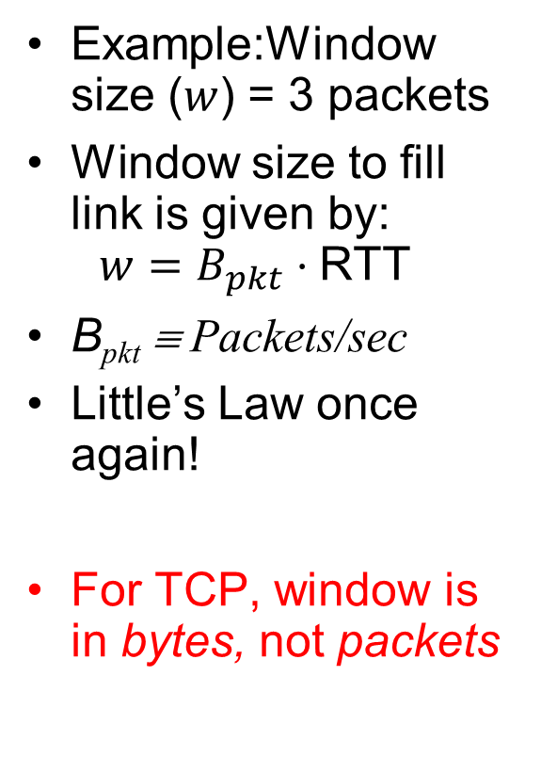
Sliding Window (No Packet Loss)
Example:Window size ($w$) = 3 packets
Window size to fill link is given by:
$w=B_{pkt}⋅\text{RTT}$
B_{pkt} ≡ Packets/sec
Little’s Law once again!
For TCP, window is in bytes, not packets
Unacked packets that sender sent
Out-of-seq packets
in receiver’s window
{1}
1
{1, 2}
2
{}
{1, 2, 3}
3
{}
{2, 3, 4}
4
{}
{3, 4, 5}
5
.
.
.
{4, 5, 6}
6
.
.
.
Time
Sender
Receiver

Slide 30
TCP Windows and Sequence Numbers: PER BYTE!
Sequence Numbers
Sent
ACK’d
Sent
not ACK’d
Not yet
sent
Sender
Received
Given to app
Received
Buffered
Not yet
received
Receiver
Sender has three regions:
  Sequence regions
    sent and ACK’d
    sent and not ACK’d
    not yet sent
  Window (colored region) adjusted by sender
Receiver has three regions:
  Sequence regions
    received and ACK’d (given to application)
    received and buffered
    not yet received (or discarded because out of order)

Slide 31
Window-Based Acknowledgements (TCP)
100
140
190
230
260
300
340
380
400
Seq:100
Size:40
Seq:140
Size:50
Seq:190
Size:40
Seq:230
Size:30
Seq:260
Size:40
Seq:300
Size:40
Seq:340
Size:40
Seq:380
Size:20
A:100/300
Seq:100
A:140/260
Seq:140
A:190/210
Seq:230
A:190/210
Seq:260
A:190/210
Seq:300
A:190/210
Retransmit!
Seq:190
A:340/60
Seq:340
A:380/20
Seq:380
A:400/0

Slide 32
Congestion
Too much data trying to flow through some part of the network
IP’s solution: Drop packets
What happens to TCP connection?
  Lots of retransmission – wasted work and wasted bandwidth (when bandwidth is scarce)

Slide 33
Congestion Avoidance
Congestion
  How long should timeout be for re-sending messages?
    Too long → wastes time if message lost
    Too short → retransmit even though ACK will arrive shortly
  Stability problem: more congestion ⇒ ACK is delayed ⇒ unnecessary timeout ⇒ more traffic ⇒ more congestion
    Closely related to window size at sender: too big means putting too much data into network
How does the sender’s window size get chosen?
  Must be less than receiver’s advertised buffer size
  Try to match the rate of sending packets with the rate that the slowest link can accommodate
  Sender uses an adaptive algorithm to decide size of N
    Goal: fill network between sender and receiver
    Basic technique: slowly increase size of window until acknowledgements start being delayed/lost
TCP solution: “slow start” (start sending slowly)
  If no timeout, slowly increase window size (throughput) by 1 for each ACK received
  Timeout ⇒ congestion, so cut window size in half
  “Additive Increase, Multiplicative Decrease”
Notes:
2nd thing we use window-based acknowledgment protocol for:
Avoid overwhelming network

Slide 34
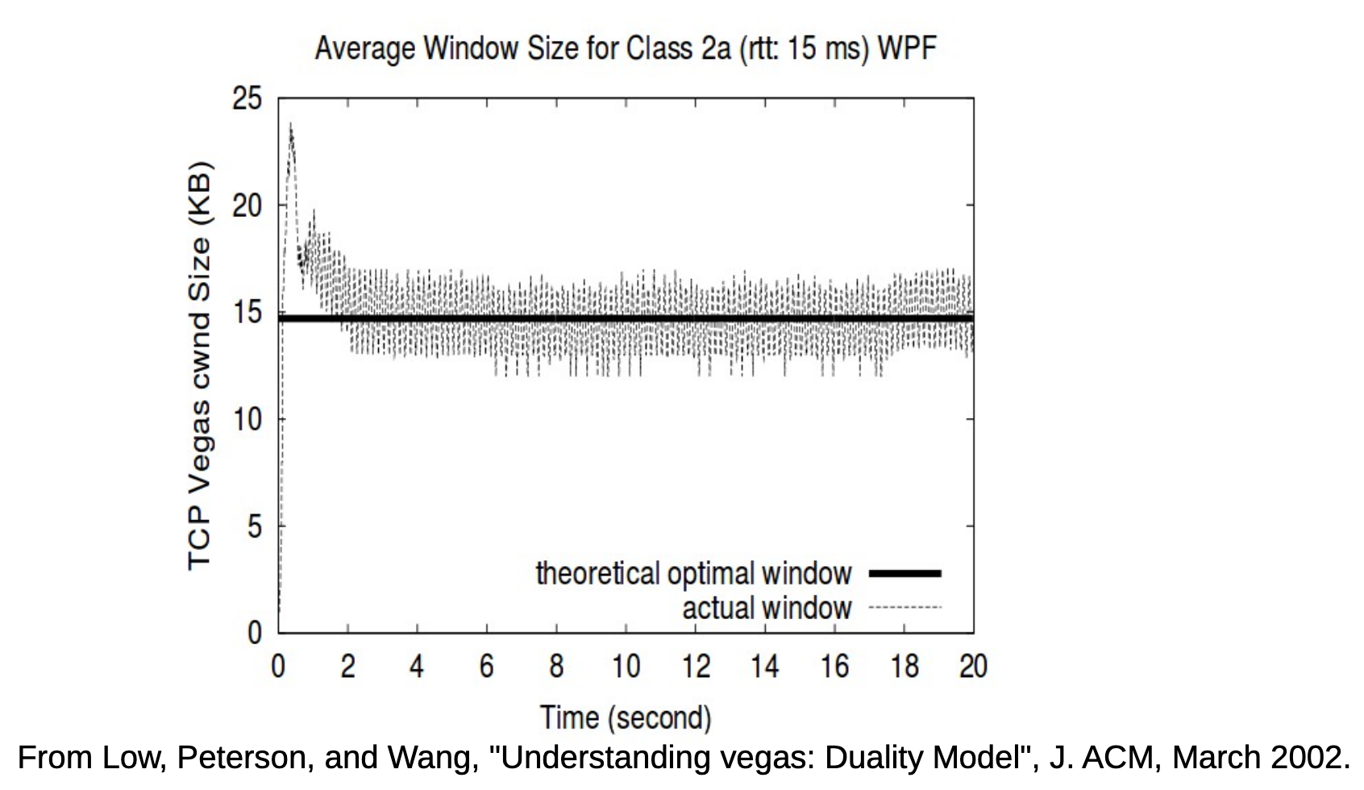
Congestion Management
TCP artificially restricts the window size if it sees packet loss
Careful control loop to make sure:
  We don’t send too fast and overwhelm the network
  We utilize most of the bandwidth the network has available
  In general, these are conflicting goals!

Slide 35
Recall: Connection Setup over TCP/IP
Server
Socket
Request Connection
new
socket
socket
Connection
socket
connection
Client
Server
5-Tuple identifies each connection:
  Source IP Address
  Destination IP Address
  Source Port Number
  Destination Port Number
  Protocol (always TCP here)
Often, Client Port “randomly” assigned
  Done by OS during client socket setup
Server Port often “well known”
  80 (web), 443 (secure web), 25 (sendmail), etc
  Well-known ports from 0—1023

Slide 36
Establishing TCP Service
Open connection: 3-way handshaking
Reliable byte stream transfer from (IPa, TCP_Port1) to (IPb, TCP_Port2)
  Indication if connection fails: Reset
Close (tear-down) connection

Slide 37
Sockets in concept
Client
Server
Create Server Socket
Create Client Socket
Bind it to an Address
(host:port)
Connect it to server (host:port)
Listen for Connection
Accept syscall()
Connection Socket
Connection Socket
write request
read request
read response
write response
Close Client Socket
Close Connection Socket
Close Server Socket

Slide 38
Open Connection: 3-Way Handshake
Client (initiator)
Server
Server calls listen() to wait for a new connection
Client calls connect() providing server’s IP address and port number
Each side sends SYN packet proposing an initial sequence number (one for each sender) and ACKs the other
listen()
connect()
SYN, SeqNum = x
SYN and ACK, SeqNum = y and Ack = x + 1
time
ACK, Ack = y + 1
allocate
buffer space,
connection
enqueued
accept() dequeues connection

Slide 39
Sockets in concept
Client
Server
Create Server Socket
Create Client Socket
Bind it to an Address
(host:port)
Connect it to server (host:port)
Listen for Connection
Accept syscall()
Connection Socket
Connection Socket
write request
read request
read response
write response
Close Client Socket
Close Connection Socket
Close Server Socket

Slide 40
Close Connection: 4-Way Teardown
Connection is not closed until both sides agree
Host 1
Host 2
close()
FIN
FIN ACK
If multiple FDs on Host 1 refer to this connection, all of them must be closed
Same for close() call on Host 2
Any calls to read() return 0
data
OS discards data (no socket to give it to)
FIN
close()
FIN ACK
OS deallocates connection state
Can retransmit FIN
ACK if it is lost
timeout
OS deallocates connection state

Slide 41
Recall: Distributed Applications Build With Messages
How do you actually program a distributed application?
  Need to synchronize multiple threads, running on different machines
    No shared memory, so cannot use test&set
  One Abstraction: send/receive messages
    Already atomic: no receiver gets portion of a message and two receivers cannot get same message
Interface:
  Mailbox (mbox): temporary holding area for messages
    Includes both destination location and queue
  Send(message,mbox)
    Send message to remote mailbox identified by mbox
  Receive(buffer,mbox)
    Wait until mbox has message, copy into buffer, and return
    If threads sleeping on this mbox, wake up one of them
Send
Network
Receive

Slide 42
Question: Data Representation
An object in memory has a machine-specific binary representation
  Threads within a single process have the same view of what’s in memory
  Easy to compute offsets into fields, follow pointers, etc.
In the absence of shared memory, externalizing an object requires us to turn it into a sequential sequence of bytes
  Serialization/Marshalling: Express an object as a sequence of bytes
  Deserialization/Unmarshalling: Reconstructing the original object from its marshalled form at destination

Slide 43
Simple Data Types
uint32_t x;
Suppose I want to write a x to a file
First, open the file: FILE* f = fopen(“foo.txt”, “w”);
Then, I have two choices:
  fprintf(f, “%lu”, x);
  fwrite(&x, sizeof(uint32_t), 1, f);
    Or equivalently, write(fd, &x, sizeof(uint32_t)); (perhaps with a loop to be safe)
Neither one is “wrong” but sender and receiver should be consistent!

Slide 44
Machine Representation
Consider using the machine representation:
  fwrite(&x, sizeof(uint32_t), 1, f);
How do we know if the recipient represents x in the same way?
  For pipes, is this a problem?
  What about for sockets?

Slide 45
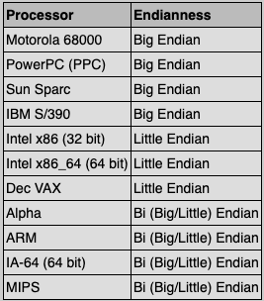
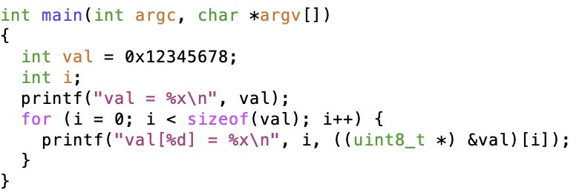
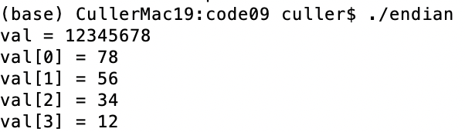
Endianness
For a byte-address machine, which end of a machine-recognized object (e.g., int) does its byte-address refer to?
Big Endian: address is the most-significant bits
Little Endian: address is the least-significant bits

Slide 46
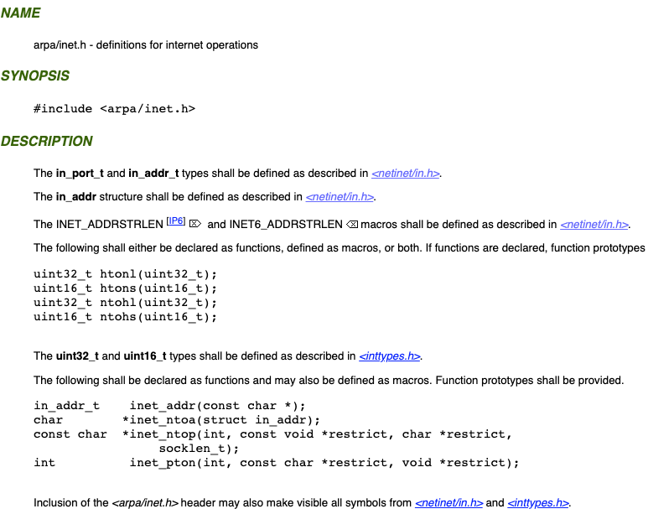
What Endian is the Internet?
Big Endian
  Network byte order
  Vs. “host byte order”

Slide 47
Dealing with Endianness
Decide on an “on-wire” endianness
Convert from native endianness to “on-wire” endianness before sending out data (serialization/marshalling)
  uint32_t htonl(uint32_t) and uint16_t htons(uint16_t) convert from native endianness to network endianness (big endian)
Convert from “on-wire” endianness to native endianness when receiving data (deserialization/unmarshalling)
  uint32_t ntohl(uint32_t) and uint16_t ntohs(uint16_t) convert from network endianness to native endianness (big endian)

Slide 48
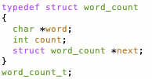
What About Richer Objects?
Consider word_count_t of Homework 0 and 1 …
Each element contains:
  An int
  A pointer to a string (of some length)
  A pointer to the next element
fprintf_words writes these as a sequence of lines (character strings with \n) to a file stream
What if you wanted to write the whole list as a binary object (and read it back as one)?
  How do you represent the string?
  Does it make any sense to write the pointer?

Slide 49
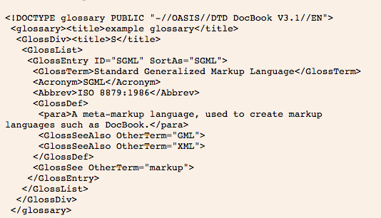
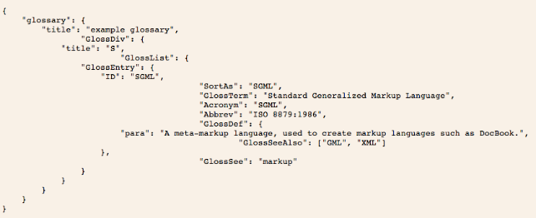
Data Serialization Formats
JSON and XML are commonly used in web applications
Lots of ad-hoc formats

Slide 50
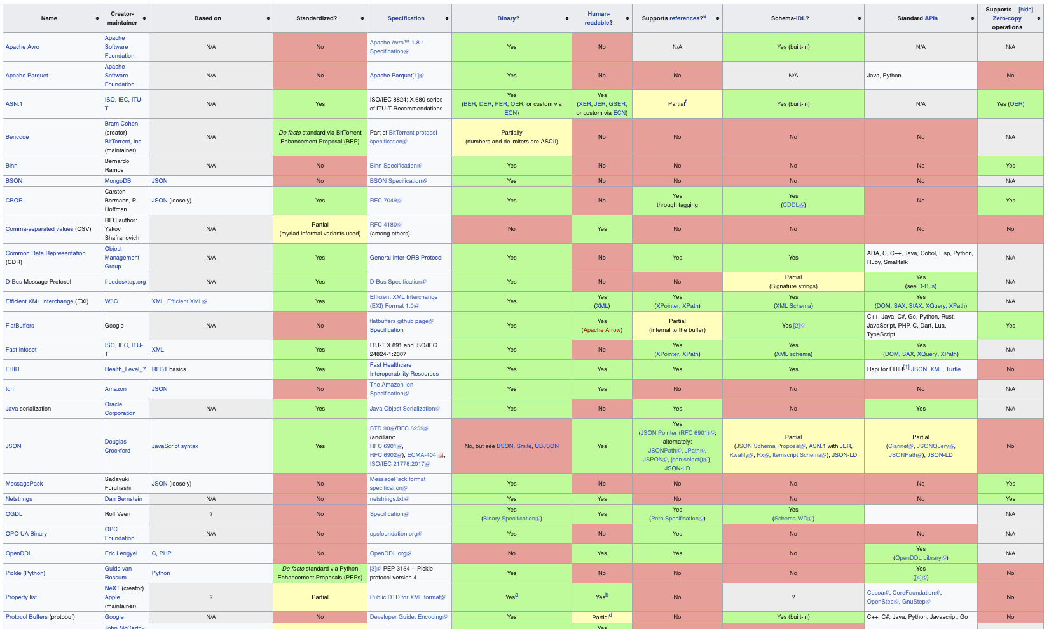
Data Serialization Formats

Slide 51
Remote Procedure Call (RPC)
Raw messaging is a bit too low-level for programming
  Must wrap up information into message at source
  Must decide what to do with message at destination
  May need to sit and wait for multiple messages to arrive
  And must deal with machine representation by hand
Another option: Remote Procedure Call (RPC)
  Calls a procedure on a remote machine
  Idea: Make communication look like an ordinary function call
  Automate all of the complexity of translating between representations
  Client calls:
  remoteFileSystem→Read("rutabaga");
  Translated automatically into call on server:
  fileSys→Read("rutabaga");

Slide 52
RPC Concept
bundle
args
Client (caller)
r = f(v1, v2);
call
Client
Stub
send
return
receive
unbundle
ret vals
bundle
ret vals
Server (callee)
res_t f(a1, a2)
return
Server
Stub
send
call
receive
unbundle
args

Slide 53
RPC Information Flow
bundle
args
Client (caller)
r = f(v1, v2);
call
Client
Stub
send
Packet
Handler
return
receive
unbundle
ret vals
Machine A
Network
Network
Machine B
bundle
ret vals
Server (callee)
res_t f(a1, a2)
return
Server
Stub
send
Packet
Handler
Server
Stub
call
receive
unbundle
args
unbundle
args

Slide 54
RPC Implementation
Request-response message passing (under covers!)
“Stub” provides glue on client/server
  Client stub is responsible for “marshalling” arguments and “unmarshalling” the return values
  Server-side stub is responsible for “unmarshalling” arguments and “marshalling” the return values.
Marshalling involves (depending on system)
  Converting values to a canonical form, serializing objects, copying arguments passed by reference, etc.

Slide 55
RPC Details (1/3)
Equivalence with regular procedure call
  Parameters ⇔ Request Message
  Result ⇔ Reply message
  Name of Procedure: Passed in request message
  Return Address: mbox2 (client return mail box)
Stub generator: Compiler that generates stubs
  Input: interface definitions in an “interface definition language (IDL)”
    Contains, among other things, types of arguments/return
  Output: stub code in the appropriate source language
    Code for client to pack message, send it off, wait for result, unpack result and return to caller
    Code for server to unpack message, call procedure, pack results, send them off
Notes:
…
- You might imagine that this stub code, to marshal arguments and make requests over the network, looks similar for many different remote function calls. We can actually generate it automatically, with a compiler!

Slide 56
RPC Details (2/3)
Cross-platform issues:
  What if client/server machines are different architectures/ languages?
    Convert everything to/from some canonical form
    Tag every item with an indication of how it is encoded (avoids unnecessary conversions)
How does client know which mbox (destination queue) to send to?
  Need to translate name of remote service into network endpoint (Remote machine, port, possibly other info)
  Binding: the process of converting a user-visible name into a network endpoint
    This is another word for “naming” at network level
    Static: fixed at compile time
    Dynamic: performed at runtime

Slide 57
RPC Details (3/3)
Dynamic Binding
  Most RPC systems use dynamic binding via name service
    Name service provides dynamic translation of service → mbox
  Why dynamic binding?
    Access control: check who is permitted to access service
    Fail-over: If server fails, use a different one
What if there are multiple servers?
  Could give flexibility at binding time
    Choose unloaded server for each new client
  Could provide same mbox (router level redirect)
    Choose unloaded server for each new request
    Only works if no state carried from one call to next
What if multiple clients?
  Pass pointer to client-specific return mbox in request

Slide 58
Problems with RPC: Non-Atomic Failures
Different failure modes in dist. system than on a single machine
Consider many different types of failures
  User-level bug causes address space to crash
  Machine failure, kernel bug causes all processes on same machine to fail
  Some machine is compromised by malicious party
Before RPC: whole system would crash/die
After RPC: One machine crashes/compromised while others keep working
Can easily result in inconsistent view of the world
  Did my cached data get written back or not?
  Did server do what I requested or not?
Answer? Distributed transactions/Byzantine Commit

Slide 59
Problems with RPC: Performance
RPC is not performance transparent:
  Cost of Procedure call « same-machine RPC « network RPC
  Overheads: Marshalling, Stubs, Kernel-Crossing, Communication
Programmers must be aware that RPC is not free
  Caching can help, but may make failure handling complex

Slide 60
Cross-Domain Communication/Location Transparency
How do address spaces communicate with one another?
  Shared Memory with Semaphores, monitors, etc…
  File System
  Pipes (1-way communication)
  “Remote” procedure call (2-way communication)
RPC’s can be used to communicate between address spaces on different machines or the same machine
  Services can be run wherever it’s most appropriate
  Access to local and remote services looks the same
Examples of RPC systems:
  CORBA (Common Object Request Broker Architecture)
  DCOM (Distributed COM)
  RMI (Java Remote Method Invocation)

Slide 61
Microkernel operating systems
Example: split kernel into application-level servers.
  File system looks remote, even though on same machine
Why split the OS into separate domains?
  Fault isolation: bugs are more isolated (build a firewall)
  Enforces modularity: allows incremental upgrades of pieces of software (client or server)
  Location transparent: service can be local or remote
    For example in the X windowing system: Each X client can be on a separate machine from X server; Neither has to run on the machine with the frame buffer.
App
App
App
App
File
sys
windows
file system
Windowing
address
spaces
RPC
VM
Networking
Threads
threads
Monolithic Structure
Microkernel Structure

Slide 62


Network-Attached Storage and the CAP Theorem
Network
Consistency:
  Changes appear to everyone in the same serial order
Availability:
  Can get a result at any time
Partition-Tolerance
  System continues to work even when network becomes partitioned
Consistency, Availability, Partition-Tolerance (CAP) Theorem: Cannot have all three at same time
  Otherwise known as “Brewer’s Theorem”

Slide 63
Summary
TCP: Reliable byte stream between two processes on different machines over Internet (read, write, flush)
  Uses window-based acknowledgement protocol
  Congestion-avoidance dynamically adapts sender window to account for congestion in network
Remote Procedure Call (RPC): Call procedure on remote machine or in remote domain
  Provides same interface as procedure
  Automatic packing and unpacking of arguments without user programming (in stub)
  Adapts automatically to different hardware and software architectures at remote end
Distributed File System:
  Transparent access to files stored on a remote disk
  Caching for performance

