Slide 1
CS162
Operating Systems and
Systems Programming
Lecture 16
Memory 4: Demand Paging
October 19th, 2021
Prof. Ion Stoica
http://cs162.eecs.Berkeley.edu

Slide 2
Putting Everything Together: Address Translation
Physical
Memory:
Virtual Address:
Virtual
P1 index
Virtual
P2 index
Offset
PageTablePtr
Physical Address:
Physical
Page #
Offset
Page Table
(1st level)
Page Table
(2nd level)

Slide 3
Putting Everything Together: TLB
Physical
Memory:
Virtual Address:
Virtual
P1 index
Virtual
P2 index
Offset
PageTablePtr
Physical Address:
Physical
Page #
Physical
Page #
Offset
Page Table
(1st level)
Page Table
(2nd level)
TLB:
…

Slide 4
Putting Everything Together: Cache
Physical
Memory:
Virtual Address:
Virtual
P1 index
Virtual
P2 index
Offset
PageTablePtr
Physical Address:
Physical
Page #
Offset
Page Table
(1st level)
tag
index
byte
cache:
Page Table
(2nd level)
tag:
block:
TLB:
…
…

Slide 5
Page Fault
The Virtual-to-Physical Translation fails
  PTE marked invalid, Priv. Level Violation, Access violation, or does not exist
  Causes a Fault / Trap
    Not an interrupt because synchronous to instruction execution
  May occur on instruction fetch or data access
  Protection violations typically terminate the instruction
Other Page Faults engage operating system to fix the situation and retry the instruction
  Allocate an additional stack page, or
  Make the page accessible - Copy on Write,
  Bring page in from secondary storage to memory – demand paging
Fundamental inversion of the hardware / software boundary

Slide 6
Demand Paging
Modern programs require a lot of physical memory
  Memory per system growing faster than 25%-30%/year
But they don’t use all their memory all of the time
  90-10 rule: programs spend 90% of their time in 10% of their code
  Wasteful to require all of user’s code to be in memory
Solution: use main memory as “cache” for disk
Processor
caching
paging
Control
Tertiary
Storage
(Tape)
Second
Level
Cache
(SRAM)
Main
Memory
(DRAM)
Secondary
Storage
(Disk)
Datapath
On-Chip
Cache

Slide 7
Page Fault ⇒ Demand Paging
Process
virtual address
physical address
MMU
page#
PT
instruction
frame#
retry
page fault
offset
exception
frame#
Operating System
offset
update PT entry
Page Fault Handler
load page from disk
scheduler

Slide 8
Demand Paging as Caching, …
What “block size”? - 1 page (e.g, 4 KB)
What “organization” ie. direct-mapped, set-assoc., fully-associative?
  Fully associative since arbitrary virtual → physical mapping
How do we locate a page?
  First check TLB, then page-table traversal
What is page replacement policy? (i.e., LRU, Random…)
  This requires more explanation… (kinda LRU)
What happens on a miss?
  Go to lower level to fill miss (i.e., disk)
What happens on a write? (write-through, write back)
  Definitely write-back – need dirty bit!

Slide 9
Illusion of Infinite Memory
∞
TLB
Page
Table
Physical
Memory
512 MB
Disk
500GB
Virtual
Memory
4 GB
Disk/SSD is larger than physical memory ⇒
  In-use virtual memory can be bigger than physical memory
  Combined memory of running processes much larger than physical memory
    More programs fit into memory, allowing more concurrency
Principle: Transparent Level of Indirection (page table)
  Supports flexible placement of physical data
    Data could be on disk or somewhere across network
  Variable location of data transparent to user program
    Performance issue, not correctness issue

Slide 10
Review: What is in a PTE?
What is in a Page Table Entry (or PTE)?
  Pointer to next-level page table or to actual page
  Permission bits: valid, read-only, read-write, write-only
Example: Intel x86 architecture PTE:
  2-level page tabler (10, 10, 12-bit offset)
  Intermediate page tables called “Directories”
  P: Present (same as “valid” bit in other architectures)
  W: Writeable
  U: User accessible
  PWT: Page write transparent: external cache write-through
  PCD: Page cache disabled (page cannot be cached)
  A: Accessed: page has been accessed recently
  D: Dirty (PTE only): page has been modified recently
  PS: Page Size: PS=1⇒4MB page (directory only).
  Bottom 22 bits of virtual address serve as offset
Page Frame Number
(Physical Page Number)
Free
(OS)
0
PS
D
A
PCD
PWT
U
W
P
31-12
11-9
8
7
6
5
4
3
2
1
0

Slide 11
Demand Paging Mechanisms
PTE makes demand paging implementatable
  Valid ⇒ Page in memory, PTE points at physical page
  Not Valid ⇒ Page not in memory; use info in PTE to find it on disk when necessary
Suppose user references page with invalid PTE?
  Memory Management Unit (MMU) traps to OS
    Resulting trap is a “Page Fault”
  What does OS do on a Page Fault?:
    Choose an old page to replace
    If old page modified (“D=1”), write contents back to disk
    Change its PTE and any cached TLB to be invalid
    Load new page into memory from disk
    Update page table entry, invalidate TLB for new entry
    Continue thread from original faulting location
  TLB for new page will be loaded when thread continued!
  While pulling pages off disk for one process, OS runs another process from ready queue
    Suspended process sits on wait queue
Cache

Slide 12
Origins of Paging
Keep most of the address space on disk
Disks provide most of the storage
Actively swap pages to/from
Relatively small memory, for many processes
Keep memory full of the frequently accesses pages
P
Many clients on dumb terminals running different programs
. . .

Slide 13

Very Different Situation Today
Powerful system
Huge memory
Huge disk
Single user

Slide 14
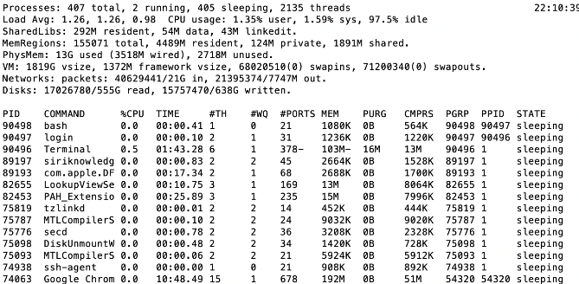
A Picture on one machine
Memory stays about 80% used
A lot of it is shared 1.9 GB

Slide 15
Many Uses of Virtual Memory and “Demand Paging” …
Extend the stack
  Allocate a page and zero it
Process Fork
  Create a copy of the page table
  Entries refer to parent pages – NO-WRITE
  Shared read-only pages remain shared
  Copy page on write
Exec
  Only bring in parts of the binary in active use
  Do this on demand
Extend the heap (sbrk and mmap)
mmap to explicitly share region (or to access a file as RAM)

Slide 16
Classic: Loading an executable into memory
disk (huge)
memory
info
data
code
exe
.exe
  lives on disk in the file system
  contains contents of code & data segments, relocation entries and symbols
  OS loads it into memory, initializes registers (and initial stack pointer)
  program sets up stack and heap upon initialization:
  crt0 (C runtime init)

Slide 17
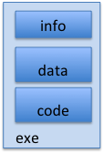
Create Virtual Address Space of the Process
disk (huge)
process VAS
memory
kernel
user page
frames
stack
sbrk
user pagetable
heap
data
kernel code & data
code
Utilized pages in the VAS are backed by a page block on disk
  Called the backing store or swap file
  Typically, in an optimized block store, but can think of it like a file

Slide 18
Create Virtual Address Space of the Process
disk (huge, TB)
process VAS (GBs)
memory
kernel
stack
user page
frames
stack
heap
heap
user pagetable
data
data
code
kernel code & data
code
User Page table maps entire VAS
All the utilized regions are backed on disk
  swapped into and out of memory as needed
For every process

Slide 19
Create Virtual Address Space of the Process
VAS
[per process]
disk (huge, TB)
PT
memory
kernel
stack
user page
frames
stack
heap
heap
user pagetable
data
data
code
kernel code & data
code
User Page table maps entire VAS
  Resident pages to the frame in memory they occupy
  The portion of it that the HW needs to access must be resident in memory

Slide 20
Provide Backing Store for VAS
VAS
[per process]
disk (huge, TB)
memory
kernel
stack
user page
frames
stack
heap
heap
user pagetable
data
data
code
kernel code & data
code
User Page table maps entire VAS
Resident pages mapped to memory frames
For all other pages, OS must record where to find them on disk

Slide 21
What Data Structure Maps Non-Resident Pages to Disk?
FindBlock(PID, page#) → disk_block
  Like the PT, but purely software
Where to store it?
  In memory – can be compact representation if swap storage is contiguous on disk
  Could use hash table (like Inverted PT)
Usually want backing store for resident pages too
May map code segment directly to on-disk image
  Saves a copy of code to swap file
May share code segment with multiple instances of the program

Slide 22
Provide Backing Store for VAS
disk (huge, TB)
VAS 1
PT 1
memory
kernel
stack
stack
user page
frames
stack
heap
heap
heap
data
VAS 2
PT 2
data
user pagetable
data
code
kernel
code
kernel code & data
stack
heap
data
code

Slide 23
On page Fault …
disk (huge, TB)
VAS 1
PT 1
memory
kernel
stack
stack
user page
frames
stack
heap
heap
heap
data
VAS 2
PT 2
data
user pagetable
data
code
kernel
code
kernel code & data
stack
heap
data
active process & PT
code

Slide 24
On page Fault … find & start load
disk (huge, TB)
VAS 1
PT 1
memory
kernel
stack
stack
user page
frames
stack
heap
heap
heap
data
VAS 2
PT 2
data
user pagetable
data
code
kernel
code
kernel code & data
stack
heap
data
active process & PT
code

Slide 25
On page Fault … schedule other P or T
disk (huge, TB)
VAS 1
PT 1
memory
kernel
stack
stack
user page
frames
stack
heap
heap
heap
data
VAS 2
PT 2
data
user pagetable
data
code
kernel
code
kernel code & data
stack
heap
data
active process & PT
code

Slide 26
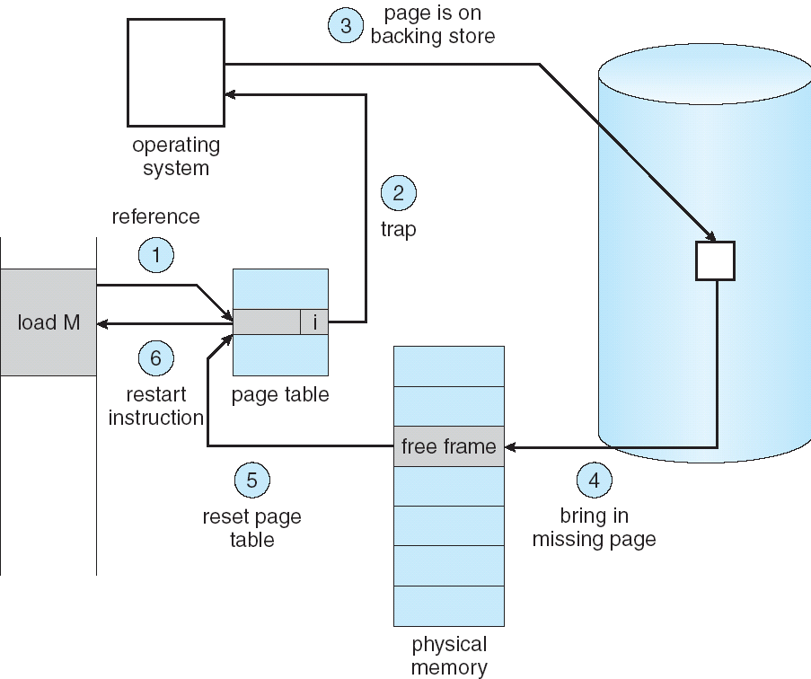
Summary: Steps in Handling a Page Fault

Slide 27
Announcements
Homework 4 released.
Attend design reviews this week on time
(starts at the hour, not Berkeley time)
Reminder to participate during design reviews.
Make progress on HW 4, project 2, and midterm 2 studying starting this week.
  Even though there’s nothing due for the next two weeks, the week of November 1st has a lot of important deadlines.

Slide 28
Some questions we need to answer!
During a page fault, where does the OS get a free frame?
  Keeps a free list
  Unix runs a “reaper” if memory gets too full
    Schedule dirty pages to be written back on disk
    Zero (clean) pages which haven’t been accessed in a while
  As a last resort, evict a dirty page first
How can we organize these mechanisms?
  Work on the replacement policy
How many page frames/process?
  Like thread scheduling, need to “schedule” memory resources:
    Utilization? fairness? priority?
  Allocation of disk paging bandwidth

Slide 29
Working Set Model
As a program executes it transitions through a sequence of “working sets” consisting of varying sized subsets of the address space
Address
Time

Slide 30
Cache Behavior under WS model
1
new working set fits
Hit Rate
0
Cache Size
Amortized by fraction of time the Working Set is active
Transitions from one WS to the next
Capacity, Conflict, Compulsory misses
Applicable to memory caches and pages. Others ?

Slide 31
Another model of Locality: Zipf
Likelihood of accessing item of rank r is α 1/rª
Although rare to access items below the top few, there are so many that it yields a “heavy tailed” distribution
Substantial value from even a tiny cache
Substantial misses from even a very large cache

Slide 32
Demand Paging Cost Model
Since Demand Paging like caching, can compute average access time! (“Effective Access Time”)
  EAT = Hit Rate x Hit Time + Miss Rate x Miss Time (Hit Rate + Mis Rate = 1)
  EAT = Hit Time + Miss Rate x Miss Penalty (Miss Penalty = Miss Time – Hit Time)
Example:
  Memory access time = 200 nanoseconds
  Average page-fault service time (Miss Penalty) = 8 milliseconds
  Suppose p = Probability of miss, 1-p = Probably of hit
  Then, we can compute EAT as follows:
EAT = 200ns + p x 8 ms
= 200ns + p x 8,000,000ns
If one access out of 1,000 causes a page fault, then EAT = 8.2 μs:
  This is a slowdown by a factor of 40x !
What if want slowdown by less than 10%?
  EAT < 200ns x 1.1 ⇒ p < 2.5 x 10⁻⁶
  This is about 1 page fault in 400,000!

Slide 33
What Factors Lead to Misses in Page Cache?
Compulsory Misses:
  Pages that have never been paged into memory before
  How might we remove these misses?
    Prefetching: loading them into memory before needed
    Need to predict future somehow! More later
Capacity Misses:
  Not enough memory. Must somehow increase available memory size.
  Can we do this?
    One option: Increase amount of DRAM (not quick fix!)
    Another option: If multiple processes in memory: adjust percentage of memory allocated to each one!
Conflict Misses:
  Technically, conflict misses don’t exist in virtual memory, since it is a “fully-associative” cache
Policy Misses:
  Caused when pages were in memory, but kicked out prematurely because of the replacement policy
  How to fix? Better replacement policy

Slide 34
Page Replacement Policies
Why do we care about Replacement Policy?
  Replacement is an issue with any cache
  Particularly important with pages
    The cost of being wrong is high: must go to disk
    Must keep important pages in memory, not toss them out
FIFO (First In, First Out)
  Throw out oldest page. Be fair – let every page live in memory for same amount of time.
  Bad – throws out heavily used pages instead of infrequently used
RANDOM:
  Pick random page for every replacement
  Typical solution for TLB’s. Simple hardware
  Pretty unpredictable – makes it hard to make real-time guarantees
MIN (Minimum):
  Replace page that won’t be used for the longest time
  Great (provably optimal), but can’t really know future…
  But past is a good predictor of the future …

Slide 35
Replacement Policies (Con’t)
LRU (Least Recently Used):
  Replace page that hasn’t been used for the longest time
  Programs have locality, so if something not used for a while,
  unlikely to be used in the near future.
  Seems like LRU should be a good approximation to MIN.
How to implement LRU? Use a list:
  On each use, remove page from list and place at head
  LRU page is at tail
Problems with this scheme for paging?
  Need to know immediately when page used so that can change position in list…
  Many instructions for each hardware access
In practice, people approximate LRU (more later)
Page 6
Page 7
Page 1
Page 2
Head
Tail (LRU)

Slide 36
Example: FIFO (strawman)
Suppose we have 3 page frames, 4 virtual pages, and following reference stream:
  A B C A B D A D B C B
Consider FIFO Page replacement:
FIFO: 7 faults
When referencing D, replacing A is bad choice, since need A again right away
Ref:
Page:
A
B
C
A
B
D
A
D
B
C
B
1
A
D
C
2
B
A
3
C
B

Slide 37
Example: MIN / LRU
Suppose we have the same reference stream:
  A B C A B D A D B C B
Consider MIN Page replacement:
MIN: 5 faults
  Where will D be brought in? Look for page not referenced farthest in future
What will LRU do?
  Same decisions as MIN here, but won’t always be true!
Ref:
Page:
A
B
C
A
B
D
A
D
B
C
B
1
A
C
2
B
3
C
D

Slide 38
Is LRU guaranteed to perform well?
Consider the following: A B C D A B C D A B C D
LRU Performs as follows (same as FIFO here):
  Every reference is a page fault!
Fairly contrived example of working set of N+1 on N frames
Ref:
Page:
A
B
C
D
A
B
C
D
A
B
C
D
1
A
D
C
B
2
B
A
D
C
3
C
B
A
D

Slide 39
When will LRU perform badly?
Consider the following: A B C D A B C D A B C D
LRU Performs as follows (same as FIFO here):
  Every reference is a page fault!
MIN Does much better:
Ref:
Page:
A
B
C
D
A
B
C
D
A
B
C
D
1
A
D
C
B
2
B
A
D
C
3
C
B
A
D
Ref:
Page:
A
B
C
D
A
B
C
D
A
B
C
D
1
A
B
2
B
C
3
C
D

Slide 40
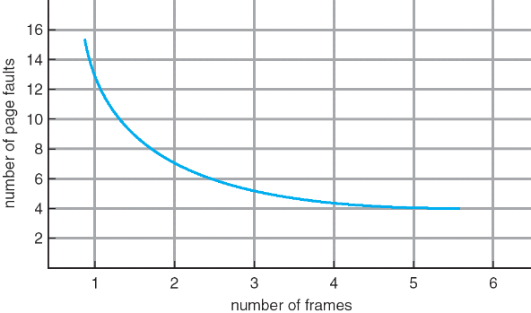
Graph of Page Faults Versus The Number of Frames
One desirable property: When you add memory the miss rate drops (stack property)
  Does this always happen?
  Seems like it should, right?
No: Bélády’s anomaly
  Certain replacement algorithms (FIFO) don’t have this obvious property!

Slide 41
Adding Memory Doesn’t Always Help Fault Rate
Does adding memory reduce number of page faults?
  Yes for LRU and MIN
  Not necessarily for FIFO! (Called Bélády’s anomaly)
After adding memory:
  With FIFO, contents can be completely different
  In contrast, with LRU or MIN, contents of memory with X pages are a subset of contents with X+1 Page
Ref:
Page:
A
B
C
D
A
B
E
A
B
C
D
E
1
A
D
E
2
B
A
C
9 page faults
3
C
B
D
Ref:
Page:
A
B
C
D
A
B
E
A
B
C
D
E
1
A
E
D
2
B
A
E
10 page faults!
3
C
B
4
D
C

Slide 42
Approximating LRU: Clock Algorithm
Set of all pages
in Memory
Single Clock Hand:
  Advances only on page fault!
  Check for pages not used recently
  Mark pages as not used recently
Clock Algorithm: Arrange physical pages in circle with single clock hand
  Approximate LRU (approximation to approximation to MIN)
  Replace an old page, not the oldest page
Details:
  Hardware “use” bit per physical page (called “accessed” in Intel architecture):
    Hardware sets use bit on each reference
    If use bit isn’t set, means not referenced in a long time
    Some hardware sets use bit in the TLB; must be copied back to page TLB entry gets replaced
  On page fault:
    Advance clock hand (not real time)
    Check use bit: 1→ used recently; clear and leave alone
    0→ selected candidate for replacement

Slide 43
Clock Algorithm Example
Free frame
Page
use: 1
use: 1
use: 0
use: 1

Slide 44
Clock Algorithm Example: Page Fault
Free frame
Page
use: 1
use: 1
use: 0
use: 1

Slide 45
Clock Algorithm Example: Page Fault
Free frame
Page
use: 0
use: 1
use: 0
use: 1

Slide 46
Clock Algorithm Example: Page Fault
Free frame
Page
use: 0
use: 0
use: 0
use: 1

Slide 47
Clock Algorithm Example: Page Fault
Free frame
Page
use: 0
use: 0
This is ”0”. We can replace it!
use: 0
use: 1

Slide 48
Clock Algorithm Example: Page Fault
Free frame
Page
use: 0
use: 0
Save the page, if “dirty”; invalidate TLB and PTE
use: 0
use: 1

Slide 49
Clock Algorithm Example: Page Fault
Free frame
Page
use: 0
use: 0
Load page; update PTE
use: 1
use: 1

Slide 50
Clock Algorithm Example
Free frame
Access page (red or write)
Page
use: 1
use: 0
use: 1
use: 1

Slide 51
Clock Algorithm Example: Another Page Fault
Free frame
Page
use: 1
use: 0
use: 0
use: 1

Slide 52
Clock Algorithm Example: Another Page Fault
Free frame
Page
use: 1
use: 0
use: 0
use: 0

Slide 53
Clock Algorithm Example: Another Page Fault
Free frame
Page
use: 1
use: 0
use: 0
use: 0

Slide 54
Clock Algorithm Example: Another Page Fault
Free frame
Page
use: 1
use: 0
use: 1
use: 0
use: 0
Free frame; Load page; update PTE

Slide 55
Clock Algorithm: More details
Set of all pages
in Memory
Single Clock Hand
Will always find a page or loop forever?
  Even if all use bits set, will eventually loop
  all the way around ⇒ FIFO
What if hand moving slowly?
  Good sign or bad sign?
    Not many page faults
    or find page quickly
What if hand is moving quickly?
  Lots of page faults and/or lots of reference bits set
One way to view clock algorithm:
  Crude partitioning of pages into two groups: young and old
  Why not partition into more than 2 groups?

Slide 56
N^{th} Chance version of Clock Algorithm
N^{th} chance algorithm: Give page N chances
  OS keeps counter per page: # sweeps
  On page fault, OS checks use bit:
    1 → clear use and also clear counter (used in last sweep)
    0 → increment counter; if count=N, replace page
  Means that clock hand has to sweep by N times without page being used before page is replaced
How do we pick N?
  Why pick large N? Better approximation to LRU
    If N ~ 1K, really good approximation
  Why pick small N? More efficient
    Otherwise might have to look a long way to find free page
What about “modified” (or “dirty”) pages?
  Takes extra overhead to replace a dirty page, so give dirty pages an extra chance before replacing?
  Common approach:
    Clean pages, use N=1
    Dirty pages, use N=2 (and write back to disk when N=1)

Slide 57
Recall: Meaning of PTE bits
Which bits of a PTE entry are useful to us for the Clock Algorithm? Remember Intel PTE:
  The “Present” bit (called “Valid” elsewhere):
    P==0: Page is invalid and a reference will cause page fault
    P==1: Page frame number is valid and MMU is allowed to proceed with translation
  The “Writable” bit (could have opposite sense and be called “Read-only”):
    W==0: Page is read-only and cannot be written.
    W==1: Page can be written
  The “Accessed” bit (called “Use” elsewhere):
    A==0: Page has not been accessed (or used) since last time software set A→0
    A==1: Page has been accessed (or used) since last time software set A→0
  The “Dirty” bit (called “Modified” elsewhere):
    D==0: Page has not been modified (written) since PTE was loaded
    D==1: Page has changed since PTE was loaded
PTE:
Page Frame Number
(Physical Page Number)
Free
(OS)
0
PS
D
A
PCD
PWT
U
W
P
31-12
11-9
8
7
6
5
4
3
2
1
0

Slide 58
Clock Algorithms Variations
Do we really need hardware-supported “modified” bit?
  No. Can emulate it using read-only bit
    Need software DB of which pages are allowed to be written (needed this anyway)
    We will tell MMU that pages have more restricted permissions than the actually do to force page faults (and allow us notice when page is written)
  Algorithm (Clock-Emulated-M):
    Initially, mark all pages as read-only (W→0), even writable data pages.
    Further, clear all software versions of the “modified” bit → 0 (page not dirty)
    Writes will cause a page fault. Assuming write is allowed, OS sets software “modified” bit → 1, and marks page as writable (W→1).
    Whenever page written back to disk, clear “modified” bit → 0, mark read-only

Slide 59
Clock Algorithms Variations (continued)
Do we really need a hardware-supported “use” bit?
  No. Can emulate it similar to above (e.g. for read operation)
    Kernel keeps a “use” bit and “modified” bit for each page
  Algorithm (Clock-Emulated-Use-and-M):
    Mark all pages as invalid, even if in memory.
    Clear emulated “use” bits → 0 and “modified” bits → 0 for all pages (not used, not dirty)
    Read or write to invalid page traps to OS to tell use page has been used
    OS sets “use” bit → 1 in software to indicate that page has been “used”.
    Further:
    1) If read, mark page as read-only, W→0 (will catch future writes)
    2) If write (and write allowed), set “modified” bit → 1, mark page as writable (W→1)
    When clock hand passes, reset emulated “use” bit → 0 and mark page as invalid again
    Note that “modified” bit left alone until page written back to disk
Remember, however, clock is just an approximation of LRU!
  Can we do a better approximation, given that we have to take page faults on some reads and writes to collect use information?
  Need to identify an old page, not oldest page!
  Answer: second chance list

Slide 60
Summary
Demand Paging: Treating the DRAM as a cache on disk
  Page table tracks which pages are in memory
  Any attempt to access a page that is not in memory generates a page fault, which causes OS to bring missing page into memory
Replacement policies
  FIFO: Place pages on queue, replace page at end
  MIN: Replace page that will be used farthest in future
  LRU: Replace page used farthest in past
Clock Algorithm: Approximation to LRU
  Arrange all pages in circular list
  Sweep through them, marking as not “in use”
  If page not “in use” for one pass, than can replace
N^{th}-chance clock algorithm: Another approximate LRU
  Give pages multiple passes of clock hand before replacing

