Slide 1
CS162 Operating Systems and Systems Programming Lecture 1 What is an Operating System?
Professor Natacha Crooks
https://cs162.org/
Slides based on prior slide decks from David Culler, Ion Stoica, John Kubitawociz, Alison Norman and Lorenzo Alvisi

Slide 2
Intros - Natacha Crooks
Assistant Professor in EECS
723 Soda Hall (Sky Lab), http://nacrooks.github.io
Member of Sky Lab
Research areas:
Large Scale Distributed Systems And Databases
Decentralized Systems
Outside Activities
Consultant for Blockchain companies and Data Orchestration Companies.

Slide 3
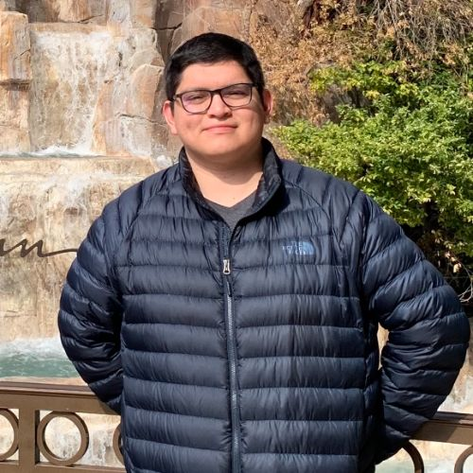
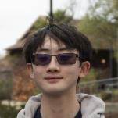
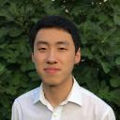
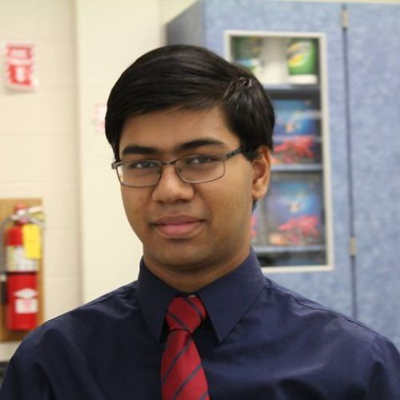
Intros - CS162’s Mighty TAs
Carlos Huerta
Wilson Nguyen (Head TA)
Alvin Xu
Ryan Alameddine
Shreyas Kallingal
Sohom Paul (Head TA)
Tiffany Wang
Micah Murray
Claire Wen

Slide 4
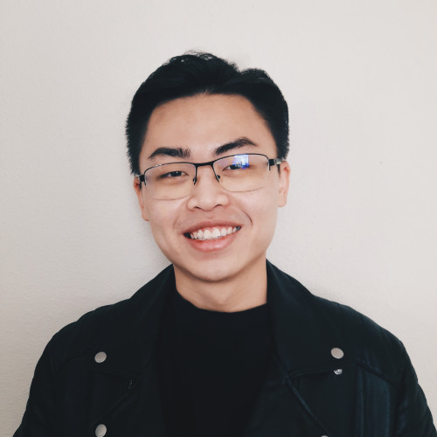
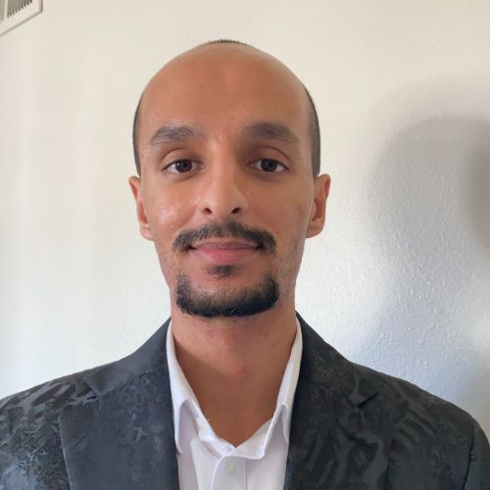
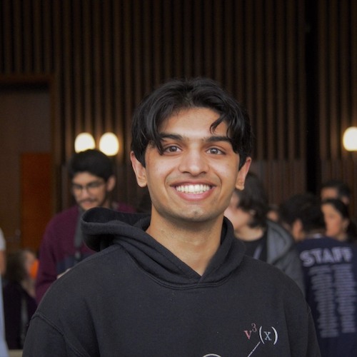
Intros - CS162’s Mighty Readers
Duc Nguyen
Gaurav Bhatnagar
Ashwin Chugh
Edrees Saied
Vivek Verma

Slide 5
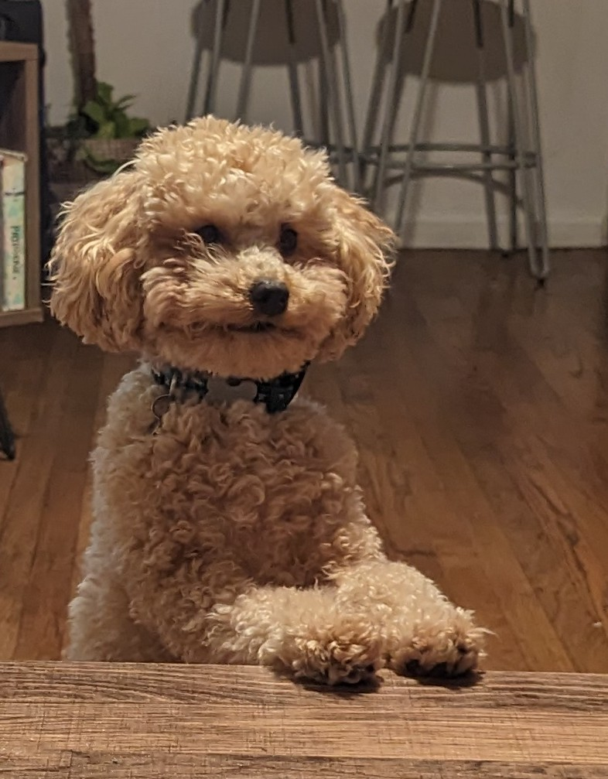
We don’t bite!

Slide 6
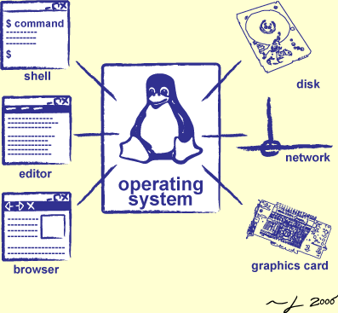
Goals for Today
Why should you care?
Why is it hard?
What is an Operating System?
Administratrivia & Course Policy

Slide 7
Goal 1: Why should you care?

Slide 8
The OS is everywhere
Every device, from your smartwatch, your smart light bulb, to your mobile phone and laptop runs an operating system
Every program you will ever write will run on an operating system
Its performance and execution behaviour will depend on the operating system

Slide 9
Goal 2: Why is designing an OS hard?

Slide 10
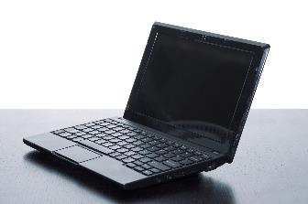
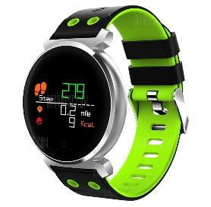
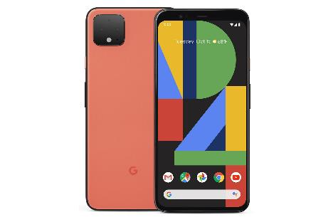
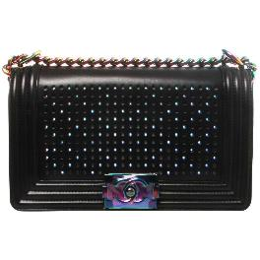
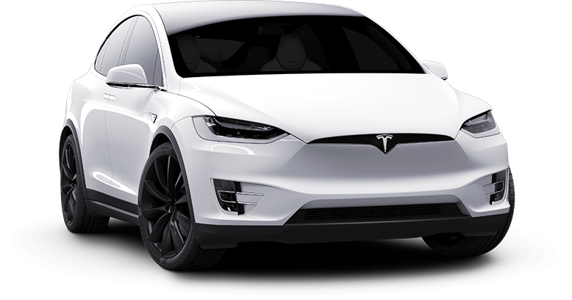
What do these have in common?

Slide 11
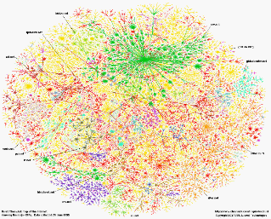
Across many devices
Have an operating system
Communicate over the Internet
Interface across huge diversity of devices

Slide 12
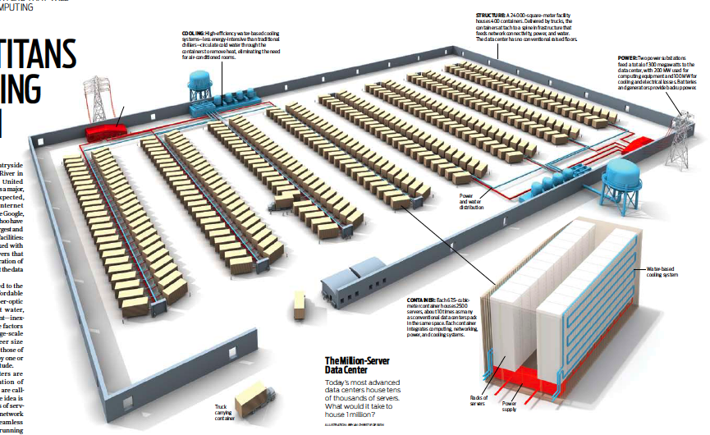
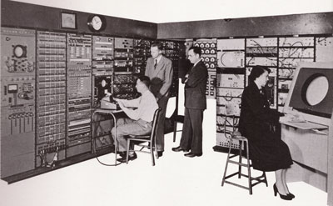
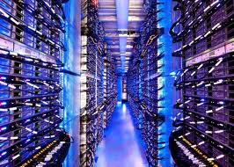
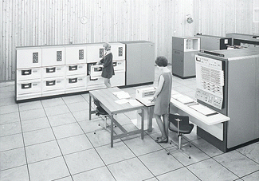
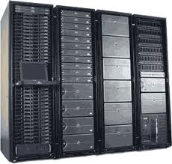
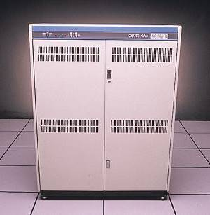
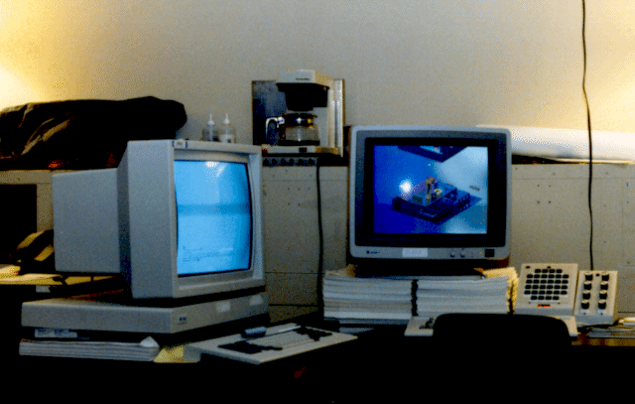
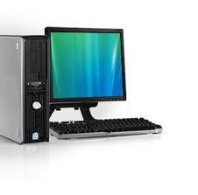
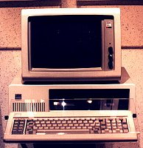
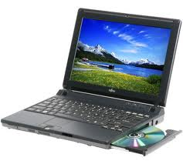
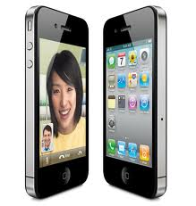
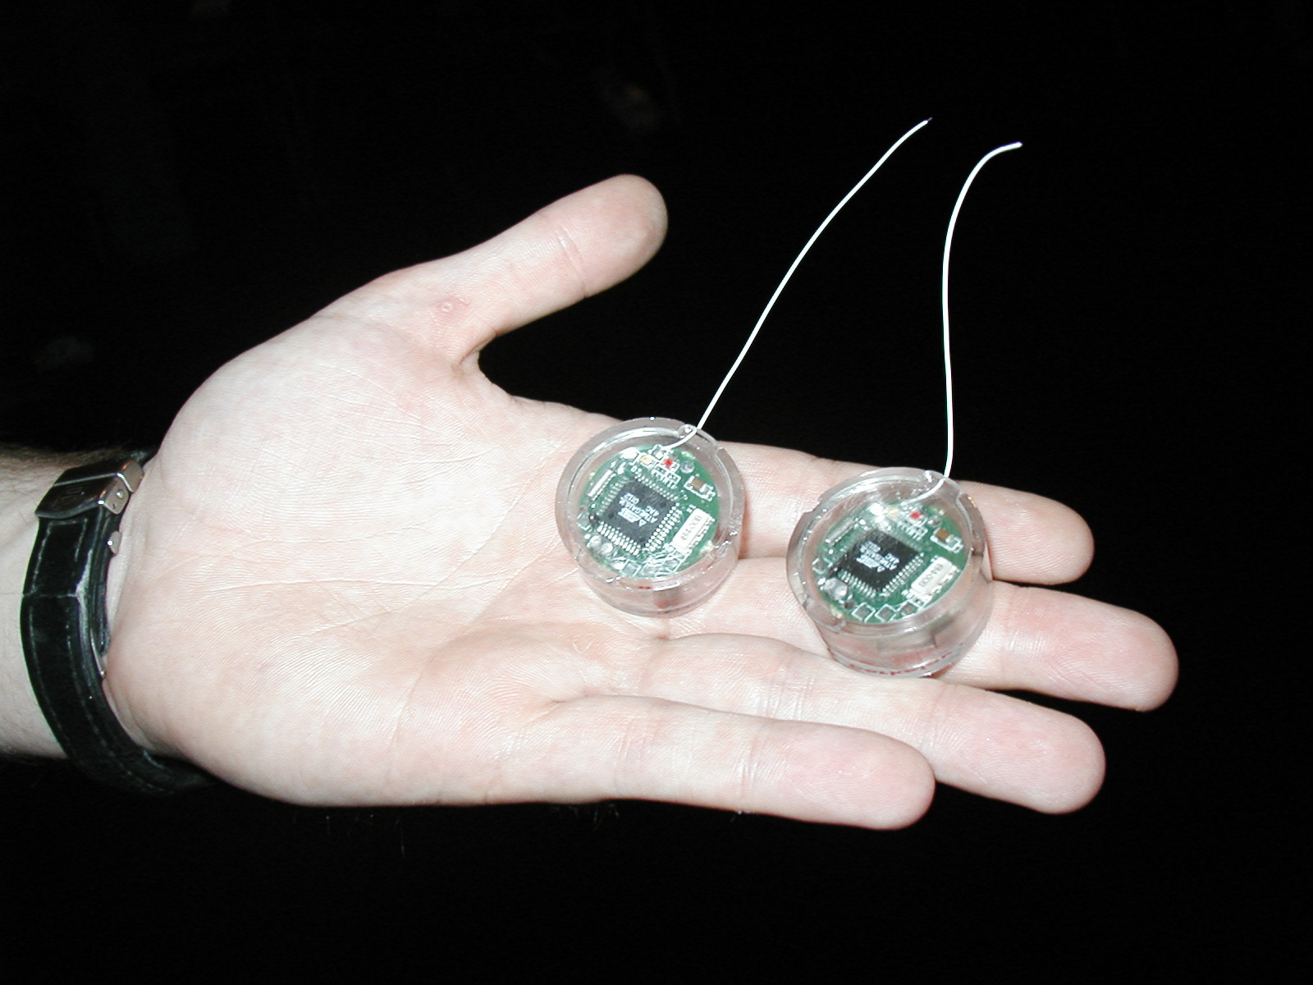
Bell’s Law
Computers
Per Person
Number crunching, Data Storage, Massive Inet Services,
ML, …
1:10⁶
Mainframe
Mini
1:10³
Workstation
PC
Productivity,
Interactive
Laptop
1:1
PDA
Cell
Streaming from/to the physical world
10³:1
years
One new device class every 10 years

Slide 13
Across many timescales
Jeff Dean’s Numbers Everyone Should Know

Slide 14
With increased complexity

Slide 15
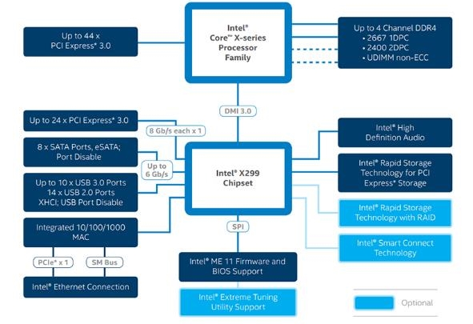
Why so much complexity?
Hardware is becoming smarter!
Better reliability and security
Better performance (more efficient code, more parallel code)
Better energy efficiency
Legacy

Slide 16
Goal 3: What is an Operating System?

Slide 17
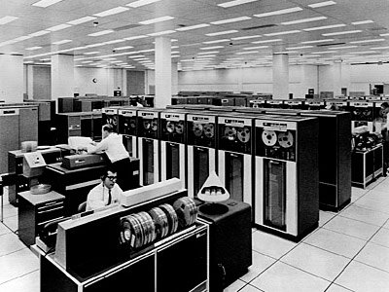
Operating System
Operating
System
Manages multiple tasks and users
A set of interconnected components with an expected behaviour observed at the interface with its environment

Slide 18
Operating System (v1)
An operating system is the layer of software that interfaces between (diverse) hardware resources and the (many) applications running on the machine
Application 1
Application 2
Application 3
Operating System
Hardware

Slide 19
Operating System (v2)
An operating system implements a virtual machine for the application whose interface is more convenient than the raw hardware interface (convenient = security, reliability, portability)
Application 1
Application 2
Application 3
Operating System
Hardware

Slide 20
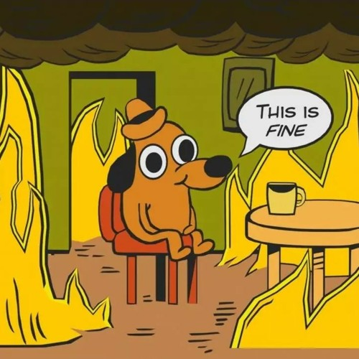
How I view an OS

Slide 21
Three main hats
Referee
Manage protection, isolation, and sharing of resources
Illusionist
Provide clean, easy-to-use abstractions of physical resources
Glue
Provides a set of common services

Slide 22
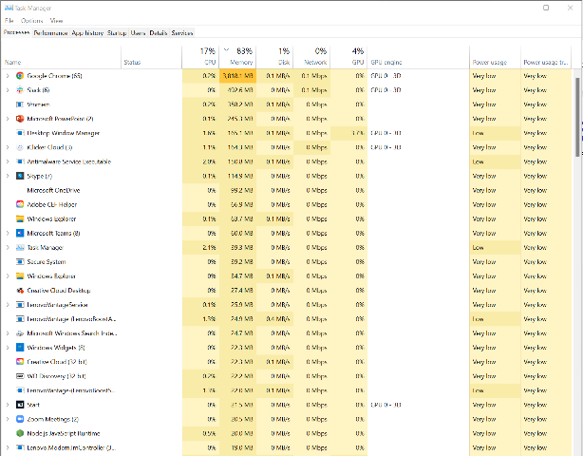
OS as a referee
Allow multiple (untrusted) applications to run concurrently

Slide 23
OS as a referee
Fault Isolation
Isolate programs from each other
Isolate OS from other programs
Resource Sharing
How to choose which task to run next?
How to split physical resources?
Communication
How can OS support communication to share results?
Pipes/Sockets
Process
Dual Mode Execution
Scheduling

Slide 24
What does this program do? (CS61C)
crooks@laptop> gcc –o cpu cpu.c -Wall
crooks@laptop> ./cpu A
#include <stdio.h>
#include <stdlib.h>
#include <sys/time.h>
#include <assert.h>
int main(int argc, char *argv[]){
char *str = argv[1];
while (1) {
printf("%s\n", str);
}
return 0;
}
A
A
A
A …
crooks@laptop> ./cpu A & ./cpu B & ./cpu C
A
A
A
A …
A
B
C
A B
C
…
A
B
B
A
C B
C
…
a)
b)
c)
crooks@laptop> ./cpu & ; ./cpu B
Segmentation Fault
B
…

Slide 25
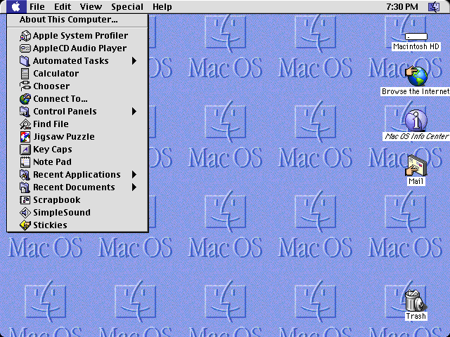
Refereeing is hard!
Mac V8 (1997)
OS cannot force program to give up control!
crooks@very-old-laptop>
./cpu A & ./cpu B & ./cpu C
A
A
A
A
A
A
A …

Slide 26
Three main hats
Referee
Manage protection, isolation, and sharing of resources
Illusionist
Provide clean, easy-to-use abstractions of physical resources

Slide 27
OS as Illusionist
Mask the restrictions inherent in computer hardware through virtualization
All alone
Provide abstraction that application has exclusive use of resources
All powerful
Provide abstraction that hardware resources are infinite
All expressive
Provide abstraction of hardware capabilities that are not physically present

Slide 28
What does this program do? (CS61C)
crooks@laptop> gcc –o memory memory.c -Wall
crooks@laptop> ./memory
(120) p: 0x200000
(120) p: 1
(120) p: 2
(120) p: 3
(120) p: 4
#include <stdio.h>
#include <stdlib.h>
#include <unistd.h>
int main(int argc, char *argv[]){
int *p = malloc(sizeof(int));
printf("(%d) p: %p\n", getpid(), p);
*p = 0;
while (1) {
*p = *p + 1;
printf("(%d) p: %d\n", getpid(), *p);
}
return 0;
}
crooks@laptop> ./memory & ./memory
(120) p: 0x200000
(254) p: 0x200000
a)
(120) p: 1
(254) p: 2
(120) p: 3
(254) p: 4
(120) p: 5
(254) p: 6
…
b)
(120) p: 1
(254) p: 1
(120) p: 2
(254) p: 2
(120) p: 3
(254) p: 3
…

Slide 29
Three main hats
Referee
Manage protection, isolation, and sharing of resources
Illusionist
Provide clean, easy-to-use abstractions of physical resources
Glue
Provides a set of common services

Slide 30
OS as Glue
Provide set of common, standard services to applications to simplify and regularize their design
Make sharing easier
Simpler if all assume same basic primitives
Maximise reuse
Avoid re-implementing functionality from scratch.
Evolve components independently
File System, User Interface, Network, etc.

Slide 31
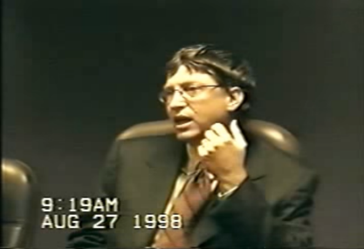
Web browsers?
Are web browsers part of the OS?
United States of America v. Microsoft Corporation

Slide 32
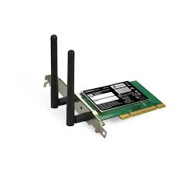
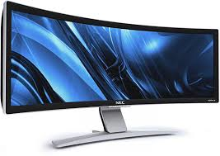
Putting it all together
Referee + illusionist + Glue
=> Easy to use virtual machine
Program 1
Program 2
Program 1
Software
OS Hardware Virtualization
ISA
Infinite Processors
Infinite Memory
Hardware
Memory
Storage Mger
Network Mger
Processor
GUI
Ctrlr
Program 2
Displays
Storage
Networks
Infinite Processors
Infite Memory
Storage Mger
Network Mger
Inputs
GUI

Slide 33
Evaluation Criteria: Performance
OS must implement the abstraction efficiently, with low overhead, and equitably
Overhead: added resource cost of implementing an abstraction
Fairness: How “well” are resources distributed across applications
Response time: how long does it take for a task to complete
Throughput: Rate at which group of tasks can be completed
Predictability: Are performance metrics constant over time?

Slide 34
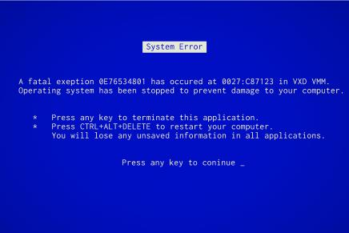
Evaluation Criteria: Reliability
System does what it is supposed to do
OS failures catastrophic!
Availability: mean time to failure + mean time to repair

Slide 35
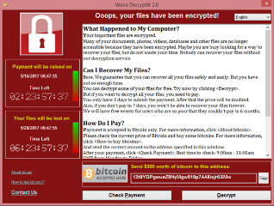
Evaluation Criteria: Security
Minimize vulnerability to attack
Integrity: Computer’s operation cannot be compromised by a malicious attacker
Privacy: data stored on computer accessible to authorized users
Enforcement Policy
How the OS ensures only permitted actions are allowed
Security Policy
What is permitted

Slide 36
Evaluation Criteria: Portability
A portable abstraction does not change as the hardware changes
Can’t rewrite application (or OS!) every time
Must plan for hardware that does not exist yet!
Application
Abstract Machine Interface
Operating System
Hardware Abstraction Layer
Hardware

Slide 37
Three “Prongs” for the Class
Understanding OS principles
System Programming
Map Concepts to Real Code

Slide 38
Topic Breakdown
Process Abstraction and API
Threads and Concurrency
Virtualizing the CPU
Scheduling
Virtual Memory
Virtualizing Memory
Paging
IO devices
Persistence
File Systems
Challenges with distribution
Distributed Systems
Data Processing & Storage

Slide 39
Admistratrivia
This Photo by Unknown Author is licensed under CC BY-SA-NC

Slide 40
Enrollment
Class has 360 limit
No guaranteed expansion
This is an Early Drop Deadline course (September 1st)
If you are not serious about taking, please drop early
Department will continue to admit students as other students drop
Really hard to drop afterwards!
Don’t forget to keep up with work if you are still on the waitlist!
On the waitlist/Concurrent enrollment?
If people drop, we can move others off waitlist
Concurrent enrollment is after the waitlist

Slide 41
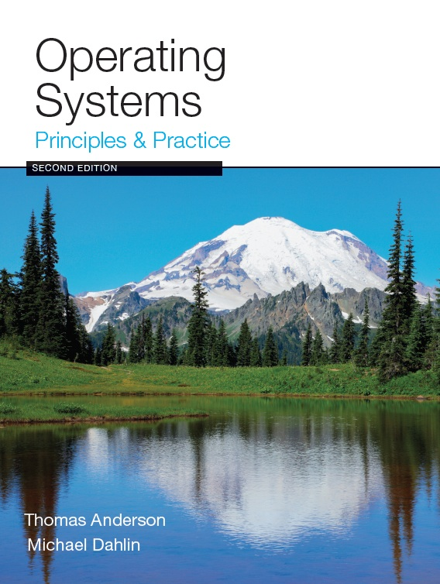
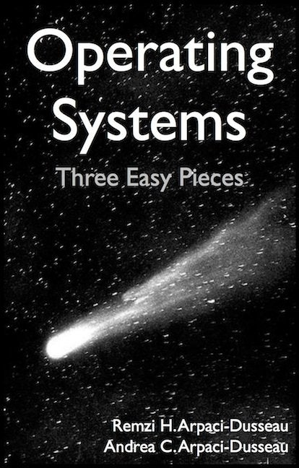
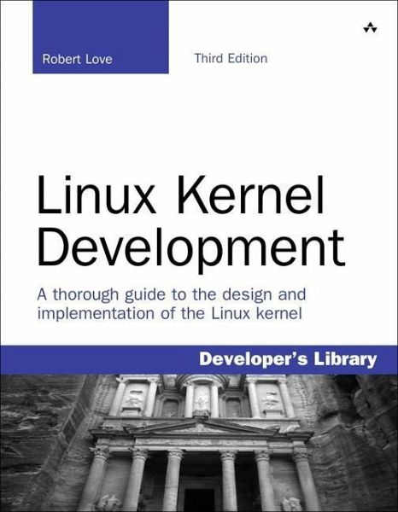
Infrastructure, Textbook & Readings
Infrastructure
Website: http://cs162.org
EdStem: https://edstem.org/us/courses/25794
Textbook: Operating Systems: Principles and Practice (2nd Edition) Anderson and Dahlin
Suggested readings posted along with lectures
Try to keep up with material in book as well as lectures
Supplementary Material
Operating Systems: Three Easy Pieces, by Remzi and Andrea Arpaci-Dusseau, available for free online
Linux Kernel Development, 3rd edition, by Robert Love

Slide 42
Class Expectations
Lectures
Come! Cannot guarantee content will be identical to previous years.
Electronic devices used only for note taking.
Sections
Attendance mandatory
Meet your fellow students, they are your future colleagues!
Office Hours
Come and ask for help early. No stupid question.
We like teaching and want to meet you!

Slide 43
Communication Policy
Communicate with course staff through EdStem rather than Email.
Check Website for EdStem etiquette. Posts will be deleted if they do not follow guidelines

Slide 44
Learning by Doing
Individual Homeworks (2 weeks) - preliminary
0. Tools & Environment, Autograding, recall C, executable
1. Lists in C
2. BYOS – build your own shell
3. Memory & Management
4. Sockets & Threads in HTTP server
5. Distributed Systems
Three (and ½) Group Projects
0. Getting Started (Individual, before you have a group)
1. User-programs (exec & syscall)
2. Threads & Scheduling
3. File Systems

Slide 45
Group Projects
Project teams have 4 members!
Never 5, 3 requires serious justification
Must work in groups in “the real world”
Same section (at least same TA)
Everyone should do work and have clear responsibilities
You will evaluate your teammates at the end of each project
Dividing up by Task is the worst approach. Work as a team.
Communicate with supervisor (TAs)
What is the team’s plan?
What is each member’s responsibility?
Short progress reports are required
Design Documents: High-level description for a manager!

Slide 46
Getting started
Start homework 0 and Project 0 right away when released
Github account
Registration survey
Vagrant virtualbox – VM environment for the course
Consistent, managed environment on your machine
Get familiar with all the cs162 tools
Submit to autograder via git
Sections on Wednesday – attend any section you want
We’ll assign permanent sections after forming project groups
Section attendance will be mandatory after we form groups

Slide 47
Preparing Yourself for this Class
Projects will require you to be very comfortable with programming and debugging C
Pointers (including function pointers, void*)
Memory Management (malloc, free, stack vs heap)
Debugging with GDB
You will be working on a larger, more sophisticated code base than anything you've likely seen in 61C!
Review Session on C/C++:
TBA
"Resources" page on course website
Ebooks on “git” and “C”
C programming reference (still in beta):
https://cs162.org/ladder/
First two sections are also dedicated to programming and debugging review. Attend ANY sections in first two weeks

Slide 48
Grading (Tentative breakdown)
36% three midterms (12% each)
36% projects
18% homework
10% participation (Sections, Lecture, …)
Projects
Initial design document, Design review, Code, Final design, Peer Review
Submission via git push triggers autograder

Slide 49
Personal Integrity
UCB Academic Honor Code: "As a member of the UC Berkeley community, I act with honesty, integrity, and respect for others.“
https://asuc.org/honor-code-landing/
All academic violations will be reported

Slide 50
CS 162 Collaboration Policy
Explaining a concept to someone in another group
Discussing algorithms/testing strategies with other groups
Discussing debugging approaches with other groups
Searching online for generic algorithms (e.g., hash table)
Sharing code or test cases with another group
Copying OR reading another group’s code or test cases
Copying OR reading online code or test cases from prior years
Helping someone in another group to debug their code
We compare all project submissions against prior year submissions and online solutions
Don’t put a friend in a bad position by asking for help that they shouldn’t give!

Slide 51
Course Environment
Implicit Bias A form of bias that occurs automatically and unintentionally, that nevertheless affects judgments, decisions, and behaviors.
Every student has the right to learn and work in a safe environment
Ask yourself: I think/said X of/to student Y. Why?
Please reach out to course staff or Title IX office if there is an issue

Slide 52
Summary: Goals for Today
Why should you care?
Why is it hard?
What is an Operating System?

Slide 53
Summary: Goals for Today
Why should you care?
Why is it hard?
What is an Operating System?
The OS is everywhere
Deal with many different devices, many different time scales. Safety-critical
Three roles: illusionist, referee and glue
Provides abstraction of a simple, infinite virtual machine
A good OS cares about performance, reliability, security and portability

