Slide 1
CS162
Operating Systems and
Systems Programming
Lecture 19
File Systems (Con’t),
MMAP, Buffer Cache
April 6th, 2016
Prof. Anthony D. Joseph
http://cs162.eecs.Berkeley.edu

Slide 2
Recall: Building a File System
File System: Layer of OS that transforms block interface of disks (or other block devices) into Files, Directories, etc.
File System Components
  Disk Management: collecting disk blocks into files
  Naming: Interface to find files by name, not by blocks
  Protection: Layers to keep data secure
  Reliability/Durability: Keeping of files durable despite crashes, media failures, attacks, etc
User vs. System View of a File
  User’s view:
    Durable Data Structures
  System’s view (system call interface):
    Collection of Bytes (UNIX)
    Doesn’t matter to system what kind of data structures you want to store on disk!
  System’s view (inside OS):
    Collection of blocks (a block is a logical transfer unit, while a sector is the physical transfer unit)
    Block size ≥ sector size; in UNIX, block size is 4KB

Slide 3
Recall: Components of a File System
File path
Directory
Structure
File Index
Structure
One Block = multiple sectors
Ex: 512 sector, 4K block
File number
“inumber”
Data blocks
“inode”
…

Slide 4
Recall: FAT (File Allocation Table) filesystem
The most commonly used filesystem in the world!
  Simple
Linked-list for blocks of a file
Many performance issues
  Lots of seeks
  Poor sequential access
  Very poor random access
  Fragmentation over time
  Poor support for small files
  Bad support for large files
FAT
Disk Blocks
file number
0:
0:
31:
File 31, Block 0
File 31, Block 1
File 31, Block 2
N-1:
N-1:
mem

Slide 5
Recall: A “Real” File System?
Meet the inode:
file_number

Slide 6
Unix File System
Original inode format appeared in BSD 4.1
  Berkeley Standard Distribution Unix
  Part of your heritage!
  Similar structure for Linux Ext2/3
File Number is index into inode arrays
Multi-level index structure
  Great for little and large files
  Asymmetric tree with fixed sized blocks
Metadata associated with the file
  Rather than in the directory that points to it
UNIX Fast File System (FFS) BSD 4.2 Locality Heuristics:
  Block group placement
  Reserve space
Scalable directory structure

Slide 7
File Attributes
inode metadata
User
Group
9 basic access control bits
- UGO x RWX
Setuid bit
- execute at owner permissions
rather than user
Setgid bit
- execute at group’s permissions

Slide 8
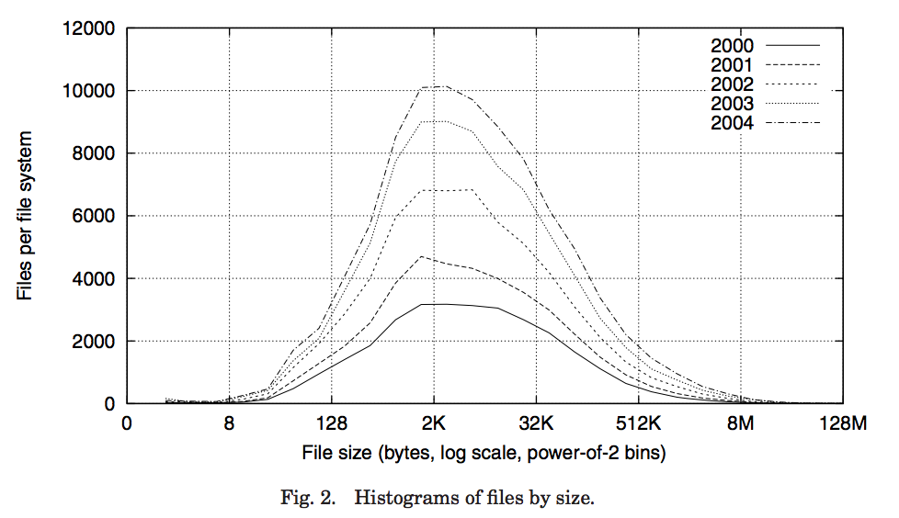
Data Storage
Small files: 12 pointers direct to data blocks
Direct pointers
4kB blocks ⇒ sufficient for files up to 48KB

Slide 9
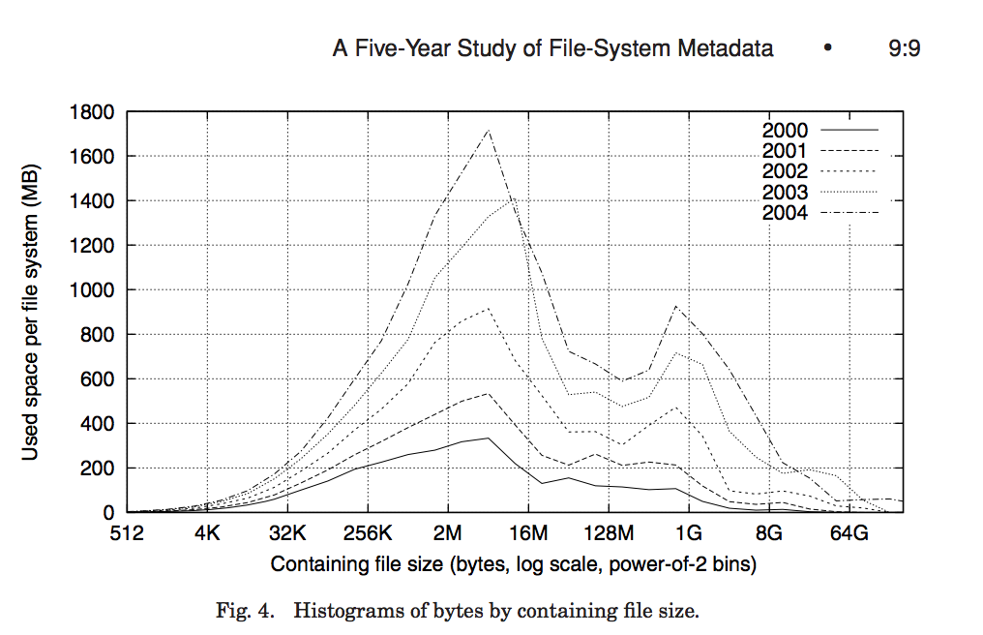
Data Storage
Large files: 1,2,3 level indirect pointers
Indirect pointers
- point to a disk block
containing only pointers
- 4 kB blocks => 1024 ptrs
=> 4 MB @ level 2
=> 4 GB @ level 3
=> 4 TB @ level 4
48 KB
+4 MB
+4 GB
+4 TB

Slide 10
UNIX BSD 4.2
Same as BSD 4.1 (same file header and triply indirect blocks), except incorporated ideas from Cray Operating System:
  Uses bitmap allocation in place of freelist
  Attempt to allocate files contiguously
  10% reserved disk space
  Skip-sector positioning (mentioned next slide)
Problem: When create a file, don’t know how big it will become (in UNIX, most writes are by appending)
  How much contiguous space do you allocate for a file?
  In BSD 4.2, just find some range of free blocks
    Put each new file at the front of different range
    To expand a file, you first try successive blocks in bitmap, then choose new range of blocks
  Also in BSD 4.2: store files from same directory near each other
Fast File System (FFS)
  Allocation and placement policies for BSD 4.2

Slide 11
Attack of the Rotational Delay
Problem 2: Missing blocks due to rotational delay
  Issue: Read one block, do processing, and read next block. In meantime, disk has continued turning: missed next block! Need 1 revolution/block!
  Solution1: Skip sector positioning (“interleaving”)
    Place the blocks from one file on every other block of a track: give time for processing to overlap rotation
  Solution2: Read ahead: read next block right after first, even if application hasn’t asked for it yet.
    This can be done either by OS (read ahead)
    By disk itself (track buffers) - many disk controllers have internal RAM that allows them to read a complete track
Important Aside: Modern disks + controllers do many complex things “under the covers”
  Track buffers, elevator algorithms, bad block filtering
Skip Sector
Track Buffer
(Holds complete track)

Slide 12
Where are inodes Stored?
In early UNIX and DOS/Windows’ FAT file system, headers stored in special array in outermost cylinders
Header not stored anywhere near the data blocks
  To read a small file, seek to get header, seek back to data
Fixed size, set when disk is formatted
  At formatting time, a fixed number of inodes are created
  Each is given a unique number, called an “inumber”

Slide 13
Where are inodes Stored?
Later versions of UNIX moved the header information to be
closer to the data blocks
  Often, inode for file stored in same “cylinder group” as parent directory of the file (makes an ls of that directory run fast)
Pros:
  UNIX BSD 4.2 puts bit of file header array on many cylinders
  For small directories, can fit all data, file headers, etc. in same cylinder ⇒ no seeks!
  File headers much smaller than whole block (a few hundred bytes), so multiple headers fetched from disk at same time
  Reliability: whatever happens to the disk, you can find many of the files (even if directories disconnected)
Part of the Fast File System (FFS)
  General optimization to avoid seeks

Slide 14
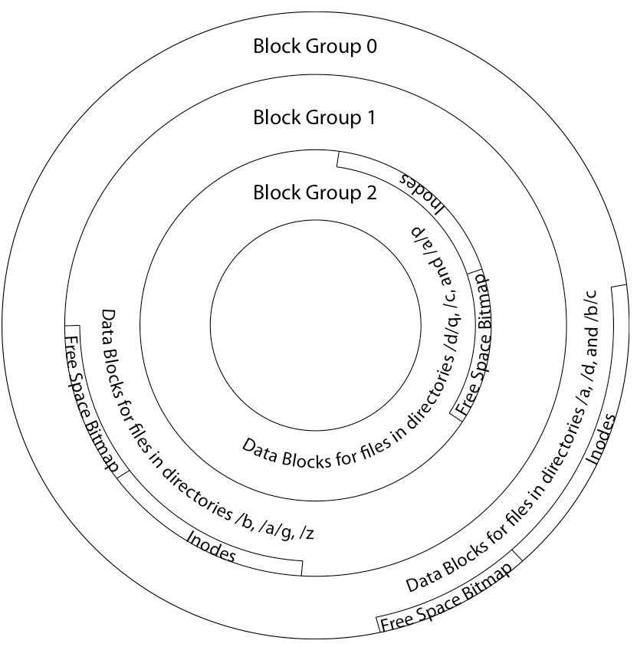
4.2 BSD Locality: Block Groups
File system volume is divided into a set of block groups
  Close set of tracks
Data blocks, metadata, and free space
interleaved within block group
  Avoid huge seeks between user data
  and system structure
Put directory and its files in common
block group
First-Free allocation of new
file blocks
  To expand file, first try
  successive blocks in bitmap, then
  choose new range of blocks
  Few little holes at start, big sequential
  runs at end of group
  Avoids fragmentation
  Sequential layout for big files
Important: keep 10% or more free!
  Reserve space in the Block Group

Slide 15
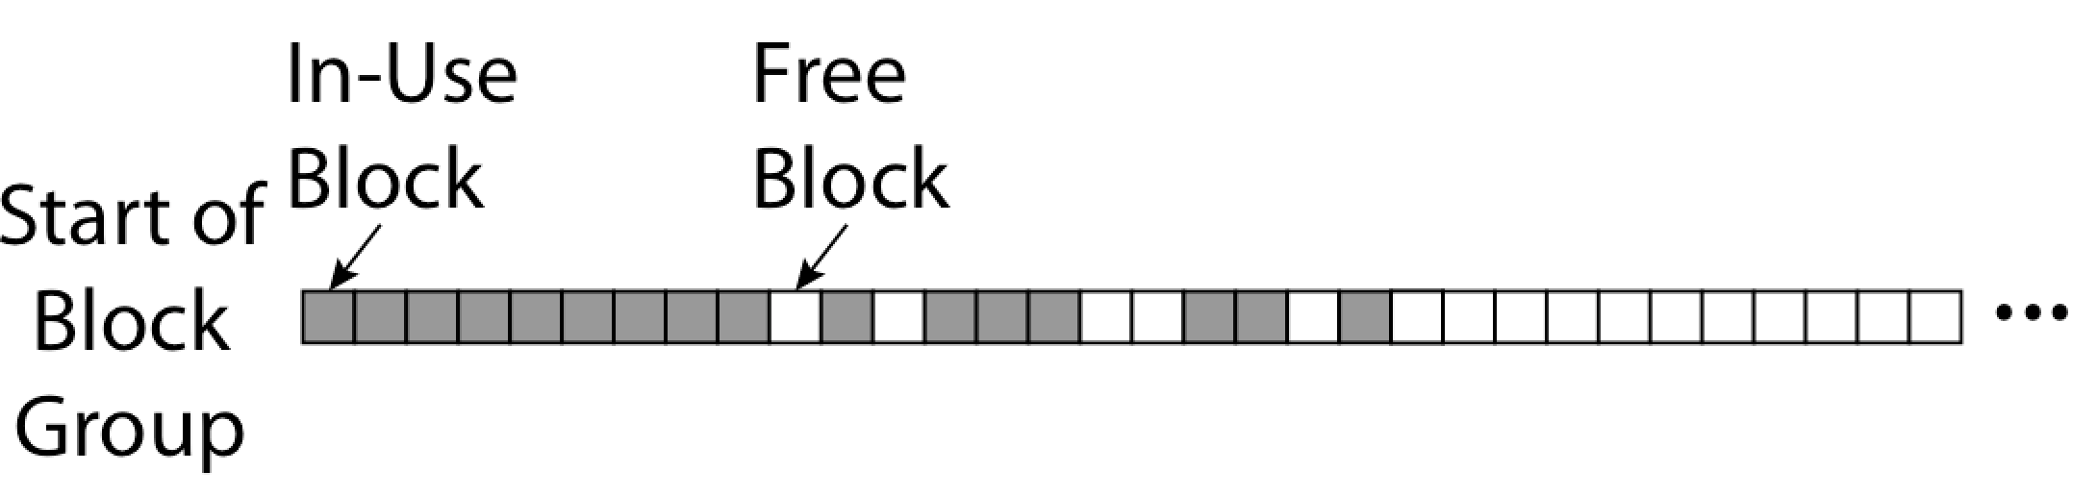
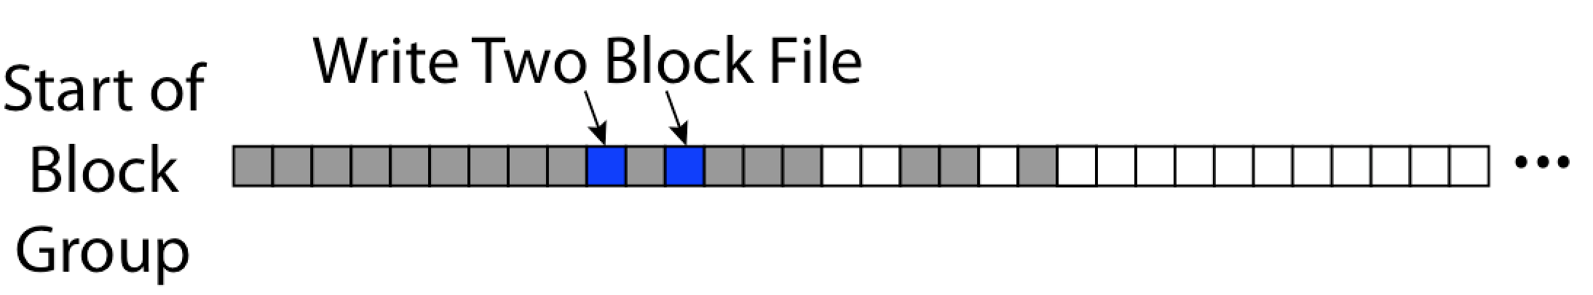
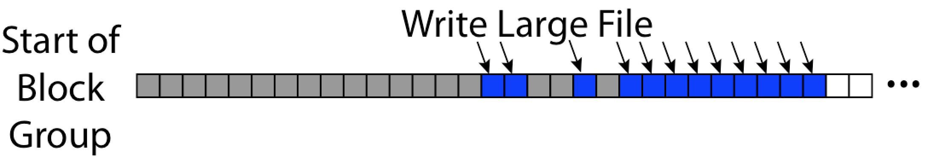
UNIX 4.2 BSD FFS First Fit Block Allocation
Fills in the small holes at the start of block group
Avoids fragmentation, leaves contiguous free space at end

Slide 16
UNIX 4.2 BSD FFS
Pros
  Efficient storage for both small and large files
  Locality for both small and large files
  Locality for metadata and data
Cons
  Inefficient for tiny files (a 1 byte file requires both an inode and a data block)
  Inefficient encoding when file is mostly contiguous on disk
  Need to reserve 10-20% of free space to prevent fragmentation

Slide 17
Administrivia
HW4 – Releases on Monday 4/11 (Due 4/25)
Project 2 code due Monday 4/11
Midterm II: Coming up in 2 weeks! (4/20)
  6-7:30PM (aa-eh 10 Evans, ej-oa 155 Dwinelle)
  Covers lectures #13 to 21 (assumes knowledge of #1 – 12)
  1 page of hand-written notes, both sides
  Review session TBD

Slide 18
break

Slide 19
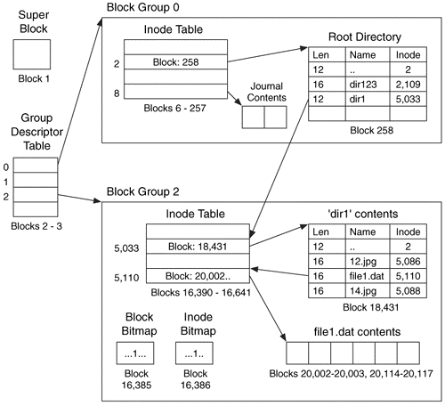
Linux Example: Ext2/3 Disk Layout
Disk divided into block groups
  Provides locality
  Each group has two block-sized bitmaps (free blocks/inodes)
  Block sizes settable
  at format time:
  1K, 2K, 4K, 8K…
Actual inode structure similar to 4.2 BSD
  with 12 direct pointers
Ext3: Ext2 with Journaling
  Several degrees of protection with comparable overhead
Example: create a file1.dat
under /dir1/ in Ext3

Slide 20
A bit more on directories
Stored in files, can be read, but typically don’t
  System calls to access directories
  Open / Creat traverse the structure
  mkdir /rmdir add/remove entries
  Link / Unlink
    Link existing file to a directory
      Not in FAT !
    Forms a DAG
When can file be deleted?
  Maintain ref-count of links to the file
  Delete after the last reference is gone
libc support
  DIR * opendir (const char *dirname)
  struct dirent * readdir (DIR *dirstream)
  int readdir_r (DIR *dirstream, struct dirent *entry,
  struct dirent **result)
/usr
/usr/lib
/usr/lib4.3
/usr/lib/foo
/usr/lib4.3/foo

Slide 21
Links
Hard link
  Sets another directory entry to contain the file number for the file
  Creates another name (path) for the file
  Each is “first class”
Soft link or Symbolic Link
  Directory entry contains the name of the file
  Map one name to another name

Slide 22
Large Directories: B-Trees (dirhash)
in FreeBSD, NetBSD, OpenBSD

Slide 23
NTFS
New Technology File System (NTFS)
  Common on Microsoft Windows systems
Variable length extents
  Rather than fixed blocks
Everything (almost) is a sequence of <attribute:value> pairs
  Meta-data and data
Mix direct and indirect freely
Directories organized in B-tree structure by default

Slide 24
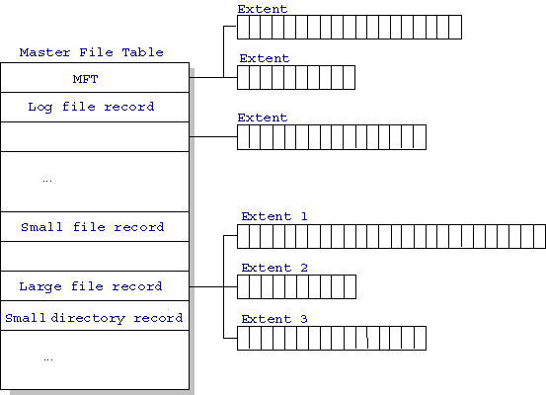
NTFS
Master File Table
  Database with Flexible 1KB entries for metadata/data
  Variable-sized attribute records (data or metadata)
  Extend with variable depth tree (non-resident)
Extents – variable length
contiguous regions
  Block pointers cover
  runs of blocks
  Similar approach in
  Linux (ext4)
  File create can provide
  hint as to size of file
Journaling for reliability
  Discussed later
http://ntfs.com/ntfs-mft.htm

Slide 25
NTFS Small File
Create time, modify time, access time,
Owner id, security specifier, flags (RO, hidden, sys)
data attribute
Attribute list

Slide 26
NTFS Medium File

Slide 27
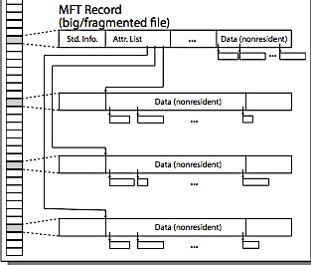
NTFS Multiple Indirect Blocks

Slide 29
Memory Mapped Files
Traditional I/O involves explicit transfers between buffers in process address space to/from regions of a file
  This involves multiple copies into caches in memory, plus system calls
What if we could “map” the file directly into an empty region of our address space
  Implicitly “page it in” when we read it
  Write it and “eventually” page it out
Executable files are treated this way when we exec the process!!

Slide 30
Recall: Who Does What, When?
Process
virtual address
physical address
MMU
page#
PT
instruction
frame#
retry
page fault
offset
exception
frame#
Operating System
offset
update PT entry
Page Fault Handler
load page from disk
scheduler

Slide 31
Using Paging to mmap() Files
Process
virtual address
physical address
MMU
page#
PT
instruction
frame#
offset
retry
page fault
exception
Read File contents
from memory!
Operating System
Create PT entries
for mapped region
as “backed” by file
Page Fault Handler
File
scheduler
mmap() file to region of VAS

Slide 32
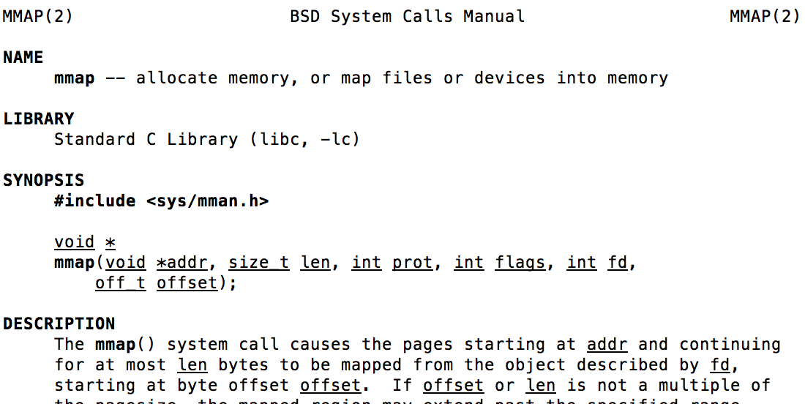
mmap() system call
May map a specific region or let the system find one for you
  Tricky to know where the holes are
Used both for manipulating files and for sharing between processes

Slide 33
An mmap() Example
#include <sys/mman.h> /* also stdio.h, stdlib.h, string.h, fcntl.h, unistd.h */
int something = 162;
int main (int argc, char *argv[]) {
int myfd;
char *mfile;
printf("Data at: %16lx\n", (long unsigned int) &something);
printf("Heap at : %16lx\n", (long unsigned int) malloc(1));
printf("Stack at: %16lx\n", (long unsigned int) &mfile);
/* Open the file */
myfd = open(argv[1], O_RDWR | O_CREAT);
if (myfd < 0) { perror("open failed!");exit(1); }
/* map the file */
mfile = mmap(0, 10000, PROT_READ|PROT_WRITE, MAP_FILE|MAP_SHARED, myfd, 0);
if (mfile == MAP_FAILED) {perror("mmap failed"); exit(1);}
printf("mmap at : %16lx\n", (long unsigned int) mfile);
puts(mfile);
strcpy(mfile+20,"Let's write over it");
close(myfd);
return 0;
}
$ ./mmap test
Data at: 105d63058
Heap at : 7f8a33c04b70
Stack at: 7fff59e9db10
mmap at : 105d97000
This is line one
This is line two
This is line three
This is line four
$ cat test
This is line one
ThiLet's write over its line three
This is line four

Slide 34
break

Slide 35
Sharing through Mapped Files
VAS 1
VAS 2
0x000…
0x000…
instructions
instructions
data
data
File
heap
heap
Memory
stack
stack
OS
OS
0xFFF…
0xFFF…
Also: anonymous memory between parents and children
  no file backing – just swap space

Slide 36
System-V-style Shared Memory
Common chunk of read/write memory among processes
MAX
Shared Memory
(unique key)
Create
ptr
ptr
Attach
0
Attach
Proc. 1
Proc. 2
ptr
ptr
ptr
Proc. 3
Proc. 4
Proc. 5

Slide 37
Creating Shared Memory
// Create new segment
int shmget(key_t key, size_t size, int shmflg);
Example:
  key_t key;
  int shmid;
  key = ftok(“<somefile>", ‘A');
  shmid = shmget(key, 1024, 0644 | IPC_CREAT);
  Special key: IPC_PRIVATE (create new segment)
  Flags: IPC_CREAT (Create new segment)
  IPC_EXCL (Fail if segment with key already exists)
  lower 9 bits – permissions use on new segment
Filename and path only used to generate a key – not for storage

Slide 38
Attach and Detach Shared Memory
// Attach
void *shmat(int shmid, void *shmaddr, int shmflg);
    Flags: SHM_RDONLY, SHM_REMAP
// Detach
int shmdt(void *shmaddr);
  Example:
    key_t key;
    int shmid;
    char *sharedmem;
    key = ftok("<somefile>", ‘A');
    shmid = shmget(key, 1024, 0644);
    sharedmem = shmat(shmid, (void *)0, 0); // Attach smem
    // Use shared memory segment (address is in sharedmem)
    …
    shmdt(sharedmem); // Detach smem (all finished)

Slide 39
File System Caching
Key Idea: Exploit locality by caching data in memory
  Name translations: Mapping from paths→inodes
  Disk blocks: Mapping from block address→disk content
Buffer Cache: Memory used to cache kernel resources, including disk blocks and name translations
  Can contain “dirty” blocks (blocks not yet on disk)
Replacement policy? LRU
  Can afford overhead of timestamps for each disk block
  Advantages:
    Works very well for name translation
    Works well in general as long as memory is big enough to accommodate a host’s working set of files
  Disadvantages:
    Fails when some application scans through file system, thereby flushing the cache with data used only once
    Example: find . –exec grep foo {} \;
Other Replacement Policies?
  Some systems allow applications to request other policies
  Example, ‘Use Once’:
    File system can discard blocks as soon as they are used

Slide 40
File System Caching (con’t)
Cache Size: How much memory should the OS allocate to the buffer cache vs using for virtual memory?
  Too much memory to the file system cache ⇒ won’t be able to run many applications at once
  Too little memory to file system cache ⇒ many applications may run slowly (disk caching not effective)
  Solution: adjust boundary dynamically so that the disk access rates for paging and file access are balanced
Read Ahead Prefetching: fetch sequential blocks early
  Key Idea: exploit fact that most common file access is sequential by prefetching subsequent disk blocks ahead of current read request (if they are not already in memory)
  Elevator algorithm can efficiently interleave groups of prefetches from concurrent applications
  How much to prefetch?
    Too many imposes delays on requests by other applications
    Too few causes many seeks (and rotational delays) among concurrent file requests

Slide 41
File System Caching (con’t)
Delayed Writes: Writes to files not immediately sent out to disk
  Instead, write() copies data from user space buffer to kernel buffer (in cache)
    Enabled by presence of buffer cache: can leave written file blocks in cache for a while
    If some other application tries to read data before written to disk, file system will read from cache
  Flushed to disk periodically (e.g. in UNIX, every 30 sec)
Advantages:
  Disk scheduler can efficiently order lots of requests
  Disk allocation algorithm can be run with correct size value for a file
  Some files need never get written to disk! (e.g., temporary scratch files written to /tmp often don’t exist for 30 sec)
Disadvantages
  What if system crashes before file has been written out?
  Worse yet, what if system crashes before a directory file has been written out? (lose pointer to inode!)

Slide 42
Important “ilities”
Availability: the probability that the system can accept and process requests
  Often measured in “nines” of probability. So, a 99.9% probability is considered “3-nines of availability”
  Key idea here is independence of failures
Durability: the ability of a system to recover data despite faults
  This idea is fault tolerance applied to data
  Doesn’t necessarily imply availability: information on pyramids was very durable, but could not be accessed until discovery of Rosetta Stone
Reliability: the ability of a system or component to perform its required functions under stated conditions for a specified period of time (IEEE definition)
  Usually stronger than simply availability: means that the system is not only “up”, but also working correctly
  Includes availability, security, fault tolerance/durability
  Must make sure data survives system crashes, disk crashes, other problems

Slide 43
How to Make File System Durable?
Disk blocks contain Reed-Solomon error correcting codes (ECC) to deal with small defects in disk drive
  Can allow recovery of data from small media defects
Make sure writes survive in short term
  Either abandon delayed writes or
  use special, battery-backed RAM (called non-volatile RAM or NVRAM) for dirty blocks in buffer cache
Make sure that data survives in long term
  Need to replicate! More than one copy of data!
  Important element: independence of failure
    Could put copies on one disk, but if disk head fails…
    Could put copies on different disks, but if server fails…
    Could put copies on different servers, but if building is struck by lightning….
    Could put copies on servers in different continents…
World Backup Day March 31

Slide 44
RAID: Redundant Arrays of Inexpensive Disks
Invented by David Patterson, Garth A. Gibson, and Randy Katz here at UCB in 1987
Data stored on multiple disks (redundancy)
Either in software or hardware
  In hardware case, done by disk controller; file system may not even know that there is more than one disk in use
Initially, five levels of RAID (more now)

Slide 45
File System Summary (1/2)
File System:
  Transforms blocks into Files and Directories
  Optimize for size, access and usage patterns
  Maximize sequential access, allow efficient random access
  Projects the OS protection and security regime (UGO vs ACL)
File defined by header, called “inode”
Naming: translating from user-visible names to actual sys resources
  Directories used for naming for local file systems
  Linked or tree structure stored in files
Multilevel Indexed Scheme
  inode contains file info, direct pointers to blocks, indirect blocks, doubly indirect, etc..
  NTFS: variable extents not fixed blocks, tiny files data is in header

Slide 46
File System Summary (2/2)
4.2 BSD Multilevel index files
  Inode contains ptrs to actual blocks, indirect blocks, double indirect blocks, etc.
  Optimizations for sequential access: start new files in open ranges of free blocks, rotational optimization
File layout driven by freespace management
  Integrate freespace, inode table, file blocks and dirs into block group
Deep interactions between mem management, file system, sharing
  mmap(): map file or anonymous segment to memory
  ftok/shmget/shmat: Map (anon) shared-memory segments
Buffer Cache: Memory cache of disk blocks and name translations
  Can contain “dirty” blocks (blocks yet on disk)
Important system properties
  Availability: how often is the resource available?
  Durability: how well is data preserved against faults?
  Reliability: how often is resource performing correctly?

