Slide 1
CS162
Operating Systems and
Systems Programming
Lecture 2
Introduction to the Process
January 25th, 2016
Prof. Anthony D. Joseph
http://cs162.eecs.Berkeley.edu

Slide 2
Recall: What is an operating system?
Special layer of software that provides application software access to hardware resources
  Convenient abstraction of complex hardware devices
  Protected access to shared resources
  Security and authentication
  Communication amongst logical entities
appln
appln
appln
OS
Hardware

Slide 3



Review: What is an Operating System?
Referee
  Manage sharing of resources, Protection, Isolation
    Resource allocation, isolation, communication
Illusionist
  Provide clean, easy to use abstractions of physical resources
    Infinite memory, dedicated machine
    Higher level objects: files, users, messages
    Masking limitations, virtualization
Glue
  Common services
    Storage, Window system, Networking
    Sharing, Authorization
    Look and feel

Slide 4
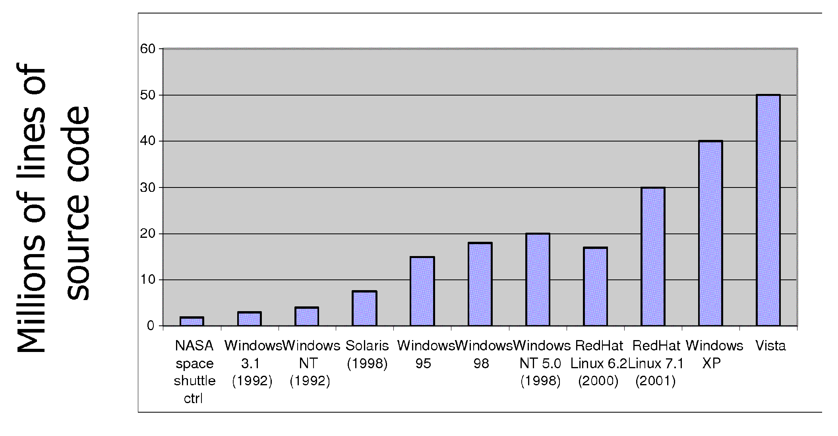
Review: Increasing Software Complexity
From MIT’s 6.033 course

Slide 5


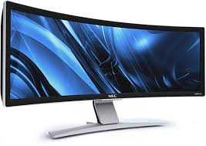

Recall: Loading
Threads
Address Spaces
Windows
Processes
Files
Sockets
Software
OS Hardware Virtualization
Hardware
Instruction Set Architecture
Memory
Processor
Protection Boundary
OS
Ctrlr
storage
Networks
Displays
Inputs

Slide 6
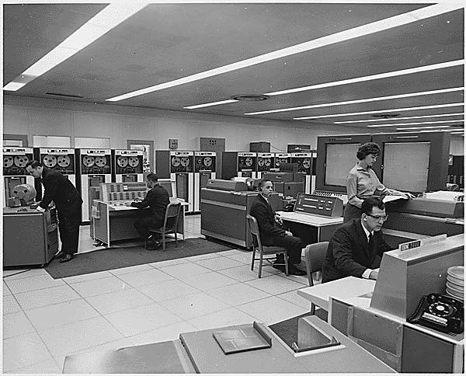
Very Brief History of OS
Several Distinct Phases:
  Hardware Expensive, Humans Cheap
    Eniac, … Multics
  Hardware Cheaper, Humans Expensive
    PCs, Workstations, Rise of GUIs
  Hardware Really Cheap, Humans Really Expensive
    Ubiquitous devices, Widespread networking
“I think there is a world market for maybe five computers.” – Thomas Watson, chairman of IBM, 1943

Slide 7
Very Brief History of OS
Several Distinct Phases:
  Hardware Expensive, Humans Cheap
    Eniac, … Multics
  Hardware Cheaper, Humans Expensive
    PCs, Workstations, Rise of GUIs
  Hardware Really Cheap, Humans Really Expensive
    Ubiquitous devices, Widespread networking
Thomas Watson was often called “the worlds greatest salesman” by the time of his death in 1956
Notes:
That’s what you call “managing expectations”

Slide 8
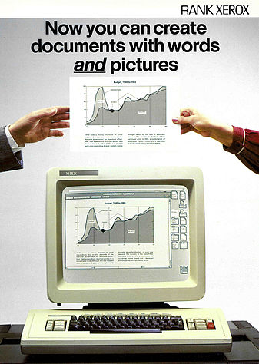
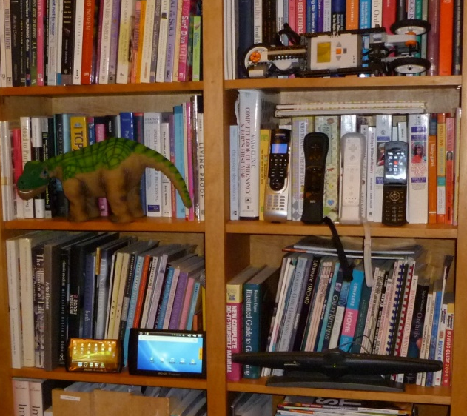
Very Brief History of OS
Several Distinct Phases:
  Hardware Expensive, Humans Cheap
    Eniac, … Multics
  Hardware Cheaper, Humans Expensive
    PCs, Workstations, Rise of GUIs
  Hardware Really Cheap, Humans Really Expensive
    Ubiquitous devices, Widespread networking
Notes:
Gone from people serving computers to computers serving people.
Except for the odd outlier like Pleo, that people need to take care of, virtually feed and play with.

Slide 9
Very Brief History of OS
Several Distinct Phases:
  Hardware Expensive, Humans Cheap
    Eniac, … Multics
  Hardware Cheaper, Humans Expensive
    PCs, Workstations, Rise of GUIs
  Hardware Really Cheap, Humans Really Expensive
    Ubiquitous devices, Widespread networking
Rapid Change in Hardware Leads to changing OS
  Batch ⇒ Multiprogramming ⇒ Timesharing ⇒ Graphical UI ⇒ Ubiquitous Devices
  Gradual Migration of Features into Smaller Machines
Situation today is much like the late 60s
  Small OS: 100K lines/Large: 10M lines (5M browser!)
  100-1000 people-years

Slide 10
OS Archaeology
Because of the cost of developing an OS from scratch, most modern OSes have a long lineage:
Multics → AT&T Unix → BSD Unix → Ultrix, SunOS, NetBSD,…
Mach (micro-kernel) + BSD → NextStep → XNU →
Apple OS X, iPhone iOS
MINIX → Linux → Android OS, Chrome OS, RedHat, Ubuntu, Fedora, Debian, Suse,…
CP/M → QDOS → MS-DOS → Windows 3.1 → NT → 95 → 98 → 2000 → XP → Vista → 7 → 8 → 10 → phone → …
Notes:
Multics: MIT, GE, Bell Labs, 1969
Revolutionary but “bloated” at 135kB
Famous “failures”: Multics, Mach, NextStep: innovative but too flawed to succeed.
Microsoft established itself by writing an OS to compete with CP/M which IBM couldn’t negotiate with its author. They instead bought QDOS from a small code author who had written it from the CP/M manual.
Interestingly, there were some other OSes that didn’t have such a long lineage (e.g. IBM OS/2)

Slide 11
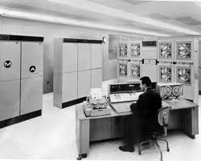
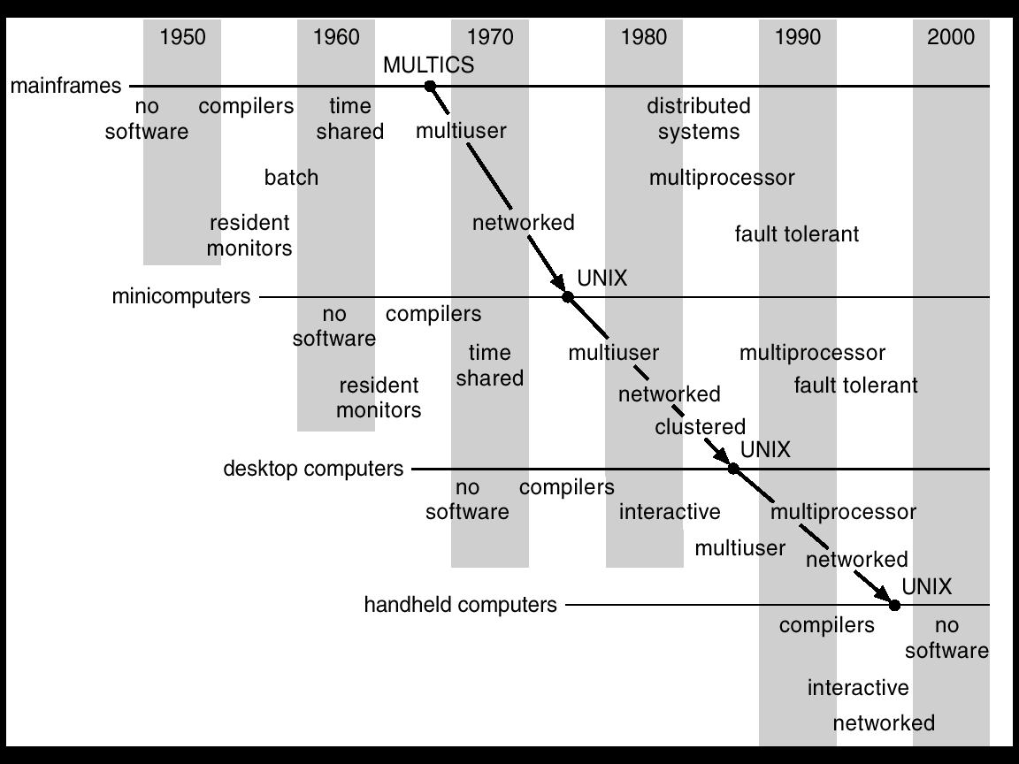
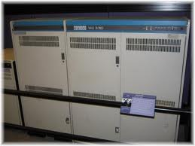
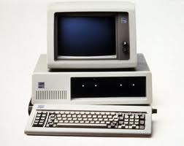
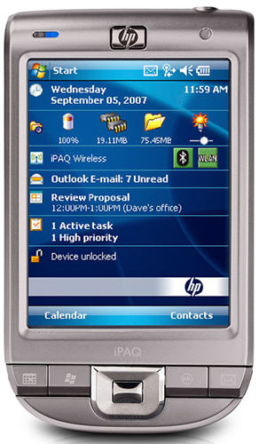
Migration of OS Concepts and Features

Slide 12
Today: Four Fundamental OS Concepts
Thread
  Single unique execution context
  Program Counter, Registers, Execution Flags, Stack
Address Space with Translation
  Programs execute in an address space that is distinct from the memory space of the physical machine
Process
  An instance of an executing program is a process consisting of an address space and one or more threads of control
Dual Mode operation/Protection
  Only the “system” has the ability to access certain resources
  The OS and the hardware are protected from user programs and user programs are isolated from one another by controlling the translation from program virtual addresses to machine physical addresses

Slide 13

OS Bottom Line: Run Programs
0xFFF…
Executable
Program Source
OS
int main()
{ … ;
}
compiler
data
Load & Execute
stack
editor
Memory
instructions
heap
a.out
data
foo.c
Load instruction and data segments of executable file into memory
Create stack and heap
“Transfer control to program”
Provide services to program
While protecting OS and program
instructions
0x000…
PC:
registers
Processor

Slide 14
Recall (61B): Instruction Fetch/Decode/Execute
The instruction cycle
Memory
Processor
next
PC:
Instruction fetch
instruction
Decode
decode
Registers
Execute
ALU
data

Slide 15
Recall (61C): What happens during program execution?
Addr 2³²-1
R0
…
R31
F0
…
F30
PC
…
Data1
Data0
Inst237
Inst236
…
Inst5
Inst4
Inst3
Inst2
Inst1
Inst0
Fetch
Exec
Execution sequence:
  Fetch Instruction at PC
  Decode
  Execute (possibly using registers)
  Write results to registers/mem
  PC = Next Instruction(PC)
  Repeat
PC
PC
PC
PC
Addr 0

Slide 16
First OS Concept: Thread of Control
Certain registers hold the context of thread
  Stack pointer holds the address of the top of stack
    Other conventions: Frame Pointer, Heap Pointer, Data
  May be defined by the instruction set architecture or by compiler conventions
Thread: Single unique execution context
  Program Counter, Registers, Execution Flags, Stack
A thread is executing on a processor when it is resident in the processor registers.
PC register holds the address of executing instruction in the thread.
Registers hold the root state of the thread.
  The rest is “in memory”

Slide 17
Second OS Concept: Program’s Address Space
Address space ⇒ the set of accessible addresses + state associated with them:
  For a 32-bit processor there are 2³² = 4 billion addresses
What happens when you read or write to an address?
  Perhaps Nothing
  Perhaps acts like regular memory
  Perhaps ignores writes
  Perhaps causes I/O operation
    (Memory-mapped I/O)
  Perhaps causes exception (fault)
0xFFF…
stack
heap
Static Data
code
0x000…

Slide 18
Address Space: In a Picture
0xFFF…
stack
PC:
SP:
heap
Processor
registers
Static Data
instruction
Code Segment
0x000…
What’s in the code Segment? Static Data Segment?
What’s in the Stack Segment?
  How is it allocated? How big is it?
What’s in the Heap Segment?
  How is it allocated? How big?

Slide 19
Multiprogramming - Multiple Threads of Control
Proc 1
Proc 2
Proc n
stack
…
heap
Static Data
OS
code
stack
heap
Static Data
code
stack
heap
Static Data
code

Slide 20
Administrivia: Getting started
Start homework 0 immediately ⇒ Due next Monday!
  cs162-xx account, Github account, registration survey
  Vagrant and VirtualBox – VM environment for the course
    Consistent, managed environment on your machine
  Get familiar with all the cs162 tools, submit to autograder via git
  Homework slip days: You have 3 slip days
This Friday (1/29) is early drop day! Very hard to drop afterwards…
Should be going to section already!
  Light (W 11-12, W 1-2), Packed (W 4-5)
Group sign up form out next week (after drop deadline)
  Work on finding groups ASAP: 4 people in a group!
  Try to attend either same section or 2 sections by same TA

Slide 21
How can we give the illusion of multiple processors?
vCPU1
vCPU2
vCPU3
vCPU1
vCPU2
vCPU3
vCPU1
vCPU2
Shared Memory
Time
Assume a single processor. How do we provide the illusion of multiple processors?
  Multiplex in time!
Each virtual “CPU” needs a structure to hold:
  Program Counter (PC), Stack Pointer (SP)
  Registers (Integer, Floating point, others…?)
How switch from one virtual CPU to the next?
  Save PC, SP, and registers in current state block
  Load PC, SP, and registers from new state block
What triggers switch?
  Timer, voluntary yield, I/O, other things

Slide 22
The Basic Problem of Concurrency
The basic problem of concurrency involves resources:
  Hardware: single CPU, single DRAM, single I/O devices
  Multiprogramming API: processes think they have exclusive access to shared resources
OS has to coordinate all activity
  Multiple processes, I/O interrupts, …
  How can it keep all these things straight?
Basic Idea: Use Virtual Machine abstraction
  Simple machine abstraction for processes
  Multiplex these abstract machines
Dijkstra did this for the “THE system”
  Few thousand lines vs 1 million lines in OS 360 (1K bugs)

Slide 23
Properties of this simple multiprogramming technique
All virtual CPUs share same non-CPU resources
  I/O devices the same
  Memory the same
Consequence of sharing:
  Each thread can access the data of every other thread (good for sharing, bad for protection)
  Threads can share instructions
  (good for sharing, bad for protection)
  Can threads overwrite OS functions?
This (unprotected) model is common in:
  Embedded applications
  Windows 3.1/Early Macintosh (switch only with yield)
  Windows 95—ME (switch with both yield and timer)

Slide 24
Protection
Operating System must protect itself from user programs
  Reliability: compromising the operating system generally causes it to crash
  Security: limit the scope of what processes can do
  Privacy: limit each process to the data it is permitted to access
  Fairness: each should be limited to its appropriate share of system resources (CPU time, memory, I/O, etc)
It must protect User programs from one another
Primary Mechanism: limit the translation from program address space to physical memory space
  Can only touch what is mapped into process address space
Additional Mechanisms:
  Privileged instructions, in/out instructions, special registers
  syscall processing, subsystem implementation
    (e.g., file access rights, etc)

Slide 25
Third OS Concept: Process
Process: execution environment with Restricted Rights
  Address Space with One or More Threads
  Owns memory (address space)
  Owns file descriptors, file system context, …
  Encapsulate one or more threads sharing process resources
Why processes?
  Protected from each other!
  OS Protected from them
  Processes provides memory protection
  Threads more efficient than processes (later)
  Fundamental tradeoff between protection and efficiency
    Communication easier within a process
    Communication harder between processes
Application instance consists of one or more processes

Slide 26

Single and Multithreaded Processes
Threads encapsulate concurrency: “Active” component
Address spaces encapsulate protection: “Passive” part
  Keeps buggy program from trashing the system
Why have multiple threads per address space?
Notes:
Sometimes need parallelism for a single job, and processes are very expensive – to start, switch between, and to communicate between

Slide 27
Fourth OS Concept: Dual Mode Operation
Hardware provides at least two modes:
  “Kernel” mode (or “supervisor” or “protected”)
  “User” mode: Normal programs executed
What is needed in the hardware to support “dual mode” operation?
  a bit of state (user/system mode bit)
  Certain operations / actions only permitted in system/kernel mode
    In user mode they fail or trap
  User→Kernel transition sets system mode AND saves the user PC
    Operating system code carefully puts aside user state then performs the necessary operations
  Kernel→User transition clears system mode AND restores appropriate user PC
    return-from-interrupt

Slide 28
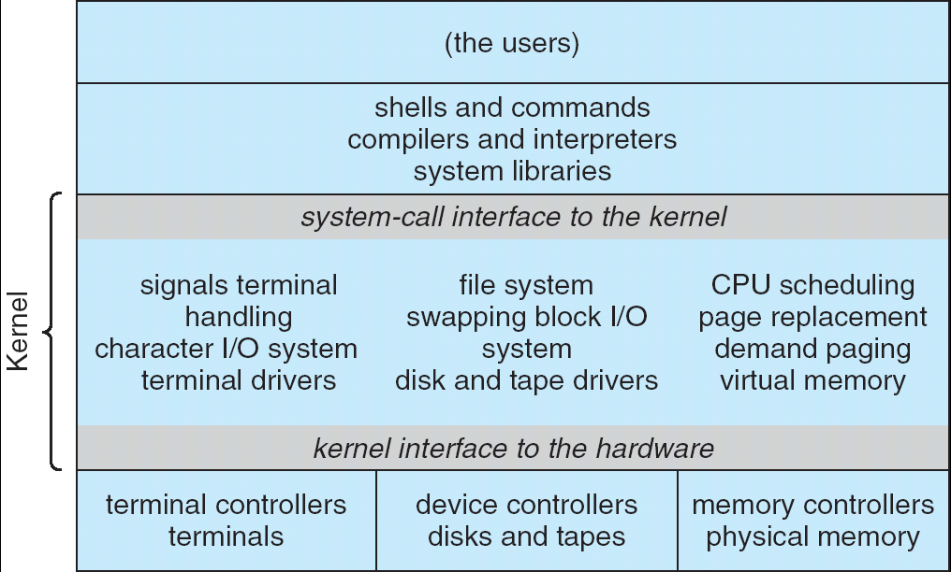
For example: UNIX System Structure
Applications
User Mode
Standard Libs
Kernel Mode
Hardware

Slide 29
User/Kernel (Privileged) Mode
User Mode
interrupt
exception
syscall
rtn
rfi
Kernel Mode
exit
exec
Limited HW access
Full HW access

Slide 30
Simple Protection: Base and Bound (B&B)
0000…
0000…
code
code
Static Data
Static Data
heap
heap
stack
Base
stack
1000…
1000…
>=
code
Program
address
Static Data
<
heap
Bound
1100…
stack
1100…
Requires relocating loader
Still protects OS and isolates program
No addition on address path
FFFF…

Slide 31
Another idea: Address Space Translation
Program operates in an address space that is distinct from the physical memory space of the machine
“physical address”
0x000…
“virtual address”
Processor
translator
Memory
0xFFF…

Slide 32
A simple address translation with Base and Bound
0000…
0000…
code
code
Static Data
Static Data
heap
heap
stack
Base Address
stack
1000…
1000…
code
Program
address
Static Data
heap
Bound
<
stack
1100…
0100…
Can the program touch OS?
Can it touch other programs?
FFFF…

Slide 33
Tying it together: Simple B&B: OS loads process
0000…
Proc 1
Proc 2
Proc n
code
…
Static Data
OS
heap
stack
sysmode
1
1000…
code
Base
xxxx …
0000…
Static Data
Bound
xxxx…
FFFF…
heap
uPC
xxxx…
stack
1100…
PC
code
3000…
regs
Static Data
…
heap
stack
3080…
FFFF…

Slide 34
Simple B&B: OS gets ready to execute process
0000…
Proc 1
Proc 2
Proc n
code
RTU
…
Static Data
OS
heap
stack
sysmode
1
1000…
code
Base
1000 …
0000…
Static Data
Bound
1100…
FFFF…
heap
uPC
0001…
stack
1100…
PC
Privileged Inst: set special registers
RTU
code
3000…
regs
00FF…
Static Data
…
heap
stack
3080…
FFFF…

Slide 35
Simple B&B: User Code Running
0000…
Proc 1
Proc 2
Proc n
code
…
Static Data
OS
heap
stack
sysmode
0
1000…
code
Base
1000 …
0000…
Static Data
Bound
1100…
FFFF…
heap
uPC
xxxx…
How does
kernel switch between processes?
First question: How to return to system?
stack
1100…
PC
0001…
code
3000…
regs
00FF…
Static Data
…
heap
stack
3080…
FFFF…

Slide 36
3 types of Mode Transfer
Syscall
  Process requests a system service, e.g., exit
  Like a function call, but “outside” the process
  Does not have the address of the system function to call
  Like a Remote Procedure Call (RPC) – for later
  Marshall the syscall id and args in registers and exec syscall
Interrupt
  External asynchronous event triggers context switch
  eg. Timer, I/O device
  Independent of user process
Trap or Exception
  Internal synchronous event in process triggers context switch
  e.g., Protection violation (segmentation fault), Divide by zero, …
All 3 are an UNPROGRAMMED CONTROL TRANSFER
  Where does it go?

Slide 37
Administrivia (Cont’d)
Midterms (3/9 and 4/20, 6-7:30P) and Final Exam (5/9, 3-6P)
  Let us know ASAP if you have valid conflicts
Joseph Office Hours: Mondays/Tuesdays 10-11 in 511 Soda
Avoid private Piazza posts – others have same question
Three Free Online Textbooks:
  Click on “Resources” link for a list of “Online Textbooks”
  Can read O'Reilly books for free as long as on campus or VPN
    One book on Git, two books on C
Webcast: https://CalCentral.Berkeley.edu/ (CalNet sign in)
  Webcast is *NOT* a replacement for coming to class!

Slide 38


CS 162 Collaboration Policy
Explaining a concept to someone in another group
Discussing algorithms/testing strategies with other groups
Helping debug someone else’s code (in another group)
Searching online for generic algorithms (e.g., hash table)
Sharing code or test cases with another group
Copying OR reading another group’s code or test cases
Copying OR reading online code or test cases from from prior years
We compare all project submissions against prior year submissions and online solutions and will take actions (described on the course overview page) against offenders

Slide 39
How do we get the system target address of the “unprogrammed control transfer?”

Slide 40
Interrupt Vector
Address and properties of each interrupt handler
interrupt number (i)
intrpHandler_i () {
….
}
Where else do you see this dispatch pattern?

Slide 41
Simple B&B: User => Kernel
0000…
Proc 1
Proc 2
Proc n
code
…
Static Data
OS
heap
stack
sysmode
0
1000…
code
Base
1000 …
0000…
Static Data
Bound
1100…
FFFF…
heap
uPC
xxxx…
stack
1100…
PC
0000 1234
code
3000…
regs
00FF…
Static Data
How to return to system?
…
heap
stack
3080…
FFFF…

Slide 42
Simple B&B: Interrupt
0000…
Proc 1
Proc 2
Proc n
code
…
Static Data
OS
heap
stack
sysmode
1
1000…
code
Base
1000 …
0000…
Static Data
Bound
1100 …
FFFF…
heap
uPC
0000 1234
stack
1100…
PC
IntrpVector[i]
code
3000…
regs
00FF…
Static Data
How to save registers and set up system stack?
…
heap
stack
3080…
FFFF…

Slide 43
Simple B&B: Switch User Process
0000…
Proc 1
Proc 2
Proc n
code
RTU
…
Static Data
OS
heap
stack
sysmode
1
1000…
1000 …
code
Base
3000 …
0000…
Static Data
1100 …
Bound
0080 …
FFFF…
heap
0000 1234
uPC
0000 0248
regs
stack
1100…
PC
0001 0124
00FF…
code
3000…
regs
00D0…
Static Data
How to save registers and set up system stack?
…
heap
stack
3080…
FFFF…

Slide 44
Simple B&B: “resume”
0000…
Proc 1
Proc 2
Proc n
code
RTU
…
Static Data
OS
heap
stack
sysmode
0
1000…
1000 …
code
Base
3000 …
0000…
Static Data
1100 …
Bound
0080 …
FFFF…
heap
0000 1234
uPC
xxxx xxxx
regs
stack
1100…
PC
000 0248
00FF…
code
3000…
regs
00D0…
Static Data
How to save registers and set up system stack?
…
heap
stack
3080…
FFFF…

Slide 45
What’s wrong with this simplistic address translation mechanism?
Fragmentation:
  Kernel has to somehow fit whole processes into contiguous block of memory
  After a while, memory becomes fragmented!
Sharing:
  Very hard to share any data between Processes or between Process and Kernel
  Simple segmentation

Slide 46
x86 – segments and stacks
code
Static Data
heap
Processor Registers
CS
EIP
stack
SS
ESP
CS:
EIP:
code
EAX
DS
EBX
ES
ECX
Static Data
EDX
ESI
EDI
heap
Start address, length and access rights associated with each segment
SS:
ESP:
stack

Slide 47
Virtual Address Translation
Simpler, more useful schemes too!
Give every process the illusion of its own BIG FLAT ADDRESS SPACE
  Break it into pages
  More on this later

Slide 48
Providing Illusion of Separate Address Space:
Load new Translation Map on Switch
Code
Data
Heap
Stack
Data 2
Code
Data
Heap
Stack
Stack 1
Heap 1
Code 1
Stack 2
Prog 1
Virtual
Address
Space 1
Data 1
Prog 2
Virtual
Address
Space 2
Heap 2
Code 2
OS code
Translation Map 1
OS data
Translation Map 2
OS heap &
Stacks
Physical Address Space

Slide 49
Running Many Programs ???
We have the basic mechanism to
  switch between user processes and the kernel,
  the kernel can switch among user processes,
  Protect OS from user processes and processes from each other
Questions ???
How do we decide which user process to run?
How do we represent user processes in the OS?
How do we pack up the process and set it aside?
How do we get a stack and heap for the kernel?
Aren’t we wasting are lot of memory?
…

Slide 50
Process Control Block
Kernel represents each process as a process control block (PCB)
  Status (running, ready, blocked, …)
  Register state (when not ready)
  Process ID (PID), User, Executable, Priority, …
  Execution time, …
  Memory space, translation, …
Kernel Scheduler maintains a data structure containing the PCBs
Scheduling algorithm selects the next one to run

Slide 51
Scheduler
if ( readyProcesses(PCBs) ) {
nextPCB = selectProcess(PCBs);
run( nextPCB );
} else {
run_idle_process();
}
Scheduling: Mechanism for deciding which processes/threads receive the CPU
Lots of different scheduling policies provide …
  Fairness or
  Realtime guarantees or
  Latency optimization or ..

Slide 52
Putting it together: web server
syscall
syscall
RTU
RTU
wait
wait
interrupt
interrupt

Slide 53
Conclusion: Four fundamental OS concepts
Thread
  Single unique execution context
  Program Counter, Registers, Execution Flags, Stack
Address Space with Translation
  Programs execute in an address space that is distinct from the memory space of the physical machine
Process
  An instance of an executing program is a process consisting of an address space and one or more threads of control
Dual Mode operation/Protection
  Only the “system” has the ability to access certain resources
  The OS and the hardware are protected from user programs and user programs are isolated from one another by controlling the translation from program virtual addresses to machine physical addresses

