Slide 1
CS162
Operating Systems and
Systems Programming
Lecture 11
Scheduling (finished),
Deadlock, Address Translation
March 5th, 2018
Prof. John Kubiatowicz
http://cs162.eecs.Berkeley.edu

Slide 2
Recall: Scheduling Policy Goals/Criteria
Minimize Response Time
  Minimize elapsed time to do an operation (or job)
  Response time is what the user sees:
    Time to echo a keystroke in editor
    Time to compile a program
    Real-time Tasks: Must meet deadlines imposed by World
Maximize Throughput
  Maximize operations (or jobs) per second
  Throughput related to response time, but not identical:
    Minimizing response time will lead to more context switching than if you only maximized throughput
  Two parts to maximizing throughput
    Minimize overhead (for example, context-switching)
    Efficient use of resources (CPU, disk, memory, etc)
Fairness
  Share CPU among users in some equitable way
  Fairness is not minimizing average response time:
    Better average response time by making system less fair
Notes:
What does CPU scheduling have to do with efficient use of the disk?
A lot! Have to have the CPU to make a disk request
Fairness: Minimize # of angry phone calls? Minimize my response time?

Slide 3
Recall: What if we Knew the Future?
Could we always mirror best FCFS?
Shortest Job First (SJF):
  Run whatever job has the least amount of
  computation to do
  Sometimes called “Shortest Time to
  Completion First” (STCF)
Shortest Remaining Time First (SRTF):
  Preemptive version of SJF: if job arrives and has a shorter time to completion than the remaining time on the current job, immediately preempt CPU
  Sometimes called “Shortest Remaining Time to Completion First” (SRTCF)
These can be applied either to a whole program or the current CPU burst of each program
  Idea is to get short jobs out of the system
  Big effect on short jobs, only small effect on long ones
  Result is better average response time
Notes:
Rich get richer, and poor get poorer = short jobs get through the system faster, long jobs take even longer

Slide 4
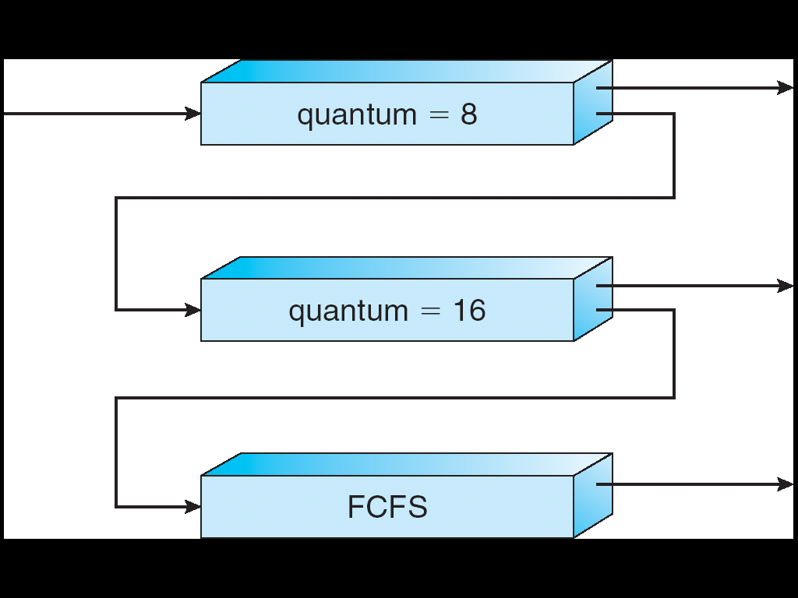
Recall: Multi-Level Feedback Scheduling
Another method for exploiting past behavior
  First used in CTSS
  Multiple queues, each with different priority
    Higher priority queues often considered “foreground” tasks
  Each queue has its own scheduling algorithm
    e.g. foreground – RR, background – FCFS
    Sometimes multiple RR priorities with quantum increasing exponentially (highest:1ms, next:2ms, next: 4ms, etc)
Adjust each job’s priority as follows (details vary)
  Job starts in highest priority queue
  If timeout expires, drop one level
  If timeout doesn’t expire, push up one level (or to top)
Long-Running Compute
Tasks Demoted to
Low Priority

Slide 5
Case Study: Linux O(1) Scheduler
Kernel/Realtime Tasks
User Tasks
0
100
139
Priority-based scheduler: 140 priorities
  40 for “user tasks” (set by “nice”), 100 for “Realtime/Kernel”
  Lower priority value ⇒ higher priority (for nice values)
  Highest priority value ⇒ Lower priority (for realtime values)
  All algorithms O(1)
    Timeslices/priorities/interactivity credits all computed when job finishes time slice
    140-bit bit mask indicates presence or absence of job at given priority level
Two separate priority queues: “active” and “expired”
  All tasks in the active queue use up their timeslices and get placed on the expired queue, after which queues swapped
Timeslice depends on priority – linearly mapped onto timeslice range
  Like a multi-level queue (one queue per priority) with different timeslice at each level
  Execution split into “Timeslice Granularity” chunks – round robin through priority

Slide 6
O(1) Scheduler Continued
Heuristics
  User-task priority adjusted ±5 based on heuristics
    p->sleep_avg = sleep_time – run_time
    Higher sleep_avg ⇒ more I/O bound the task, more reward (and vice versa)
  Interactive Credit
    Earned when a task sleeps for a “long” time
    Spend when a task runs for a “long” time
    IC is used to provide hysteresis to avoid changing interactivity for temporary changes in behavior
  However, “interactive tasks” get special dispensation
    To try to maintain interactivity
    Placed back into active queue, unless some other task has been starved for too long…
Real-Time Tasks
  Always preempt non-RT tasks
  No dynamic adjustment of priorities
  Scheduling schemes:
    SCHED_FIFO: preempts other tasks, no timeslice limit
    SCHED_RR: preempts normal tasks, RR scheduling amongst tasks of same priority

Slide 7
Linux Completely Fair Scheduler (CFS)
First appeared in 2.6.23, modified in 2.6.24
“CFS doesn't track sleeping time and doesn't use heuristics to identify interactive tasks—it just makes sure every process gets a fair share of CPU within a set amount of time given the number of runnable processes on the CPU.”
Inspired by Networking “Fair Queueing”
  Each process given their fair share of resources
  Models an “ideal multitasking processor” in which N processes execute simultaneously as if they truly got 1/N of the processor
    Tries to give each process an equal fraction of the processor
  Priorities reflected by weights such that increasing a task’s priority by 1 always gives the same fractional increase in CPU time – regardless of current priority

Slide 8
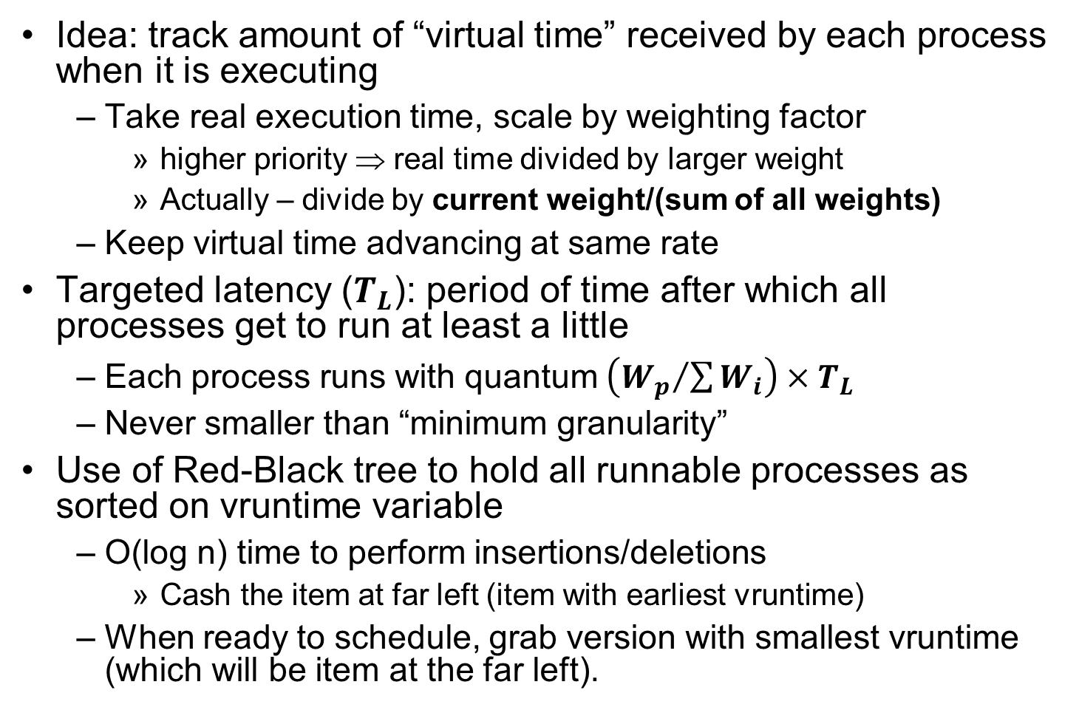
CFS (Continued)
Idea: track amount of “virtual time” received by each process when it is executing
  Take real execution time, scale by weighting factor
    higher priority ⇒ real time divided by larger weight
    Actually – divide by current weight/(sum of all weights)
  Keep virtual time advancing at same rate
Targeted latency ($T_{L}$): period of time after which all processes get to run at least a little
  Each process runs with quantum $\left({W_{p}}/{\sum{W_{i}}}\right)×T_{L}$
  Never smaller than “minimum granularity”
Use of Red-Black tree to hold all runnable processes as sorted on vruntime variable
  O(log n) time to perform insertions/deletions
    Cash the item at far left (item with earliest vruntime)
  When ready to schedule, grab version with smallest vruntime (which will be item at the far left).

Slide 9
CFS Examples
Suppose Targeted latency = 20ms,
Minimum Granularity = 1ms
Two CPU bound tasks with same priorities
  Both switch with 10ms
Two CPU bound tasks separated by nice value of 5
  Nice values scale weights exponentially: Weight=1024/(1.25)^{nice}
  Since (1.25)⁵ ≈ 3, one task gets 5ms, another gets 15ms
40 tasks: each gets 1ms (no longer totally fair)
One CPU bound task, one interactive task same priority
  While interactive task sleeps, CPU bound task runs and increments vruntime
  When interactive task wakes up, runs immediately, since it is behind on vruntime
Group scheduling facilities (2.6.24)
  Can give fair fractions to groups (like a user or other mechanism for grouping processes)
  Two users, one starts 1 process, other starts 40, each gets 50% of CPU

Slide 10
Real-Time Scheduling (RTS)
Efficiency is important but predictability is essential:
  We need to predict with confidence worst case response times for systems
  In RTS, performance guarantees are:
    Task- and/or class centric and often ensured a priori
  In conventional systems, performance is:
    System/throughput oriented with post-processing (… wait and see …)
  Real-time is about enforcing predictability, and does not equal fast computing!!!
Hard Real-Time
  Attempt to meet all deadlines
  EDF (Earliest Deadline First), LLF (Least Laxity First),
  RMS (Rate-Monotonic Scheduling), DM (Deadline Monotonic Scheduling)
Soft Real-Time
  Attempt to meet deadlines with high probability
  Minimize miss ratio / maximize completion ratio (firm real-time)
  Important for multimedia applications
  CBS (Constant Bandwidth Server)

Slide 11
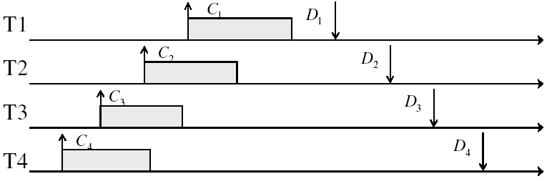
Example: Workload Characteristics
Tasks are preemptable, independent with arbitrary arrival (=release) times
Tasks have deadlines (D) and known computation times (C)
Example Setup:

Slide 12
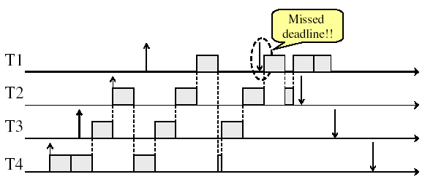
Example: Round-Robin Scheduling Doesn’t Work
Time

Slide 13
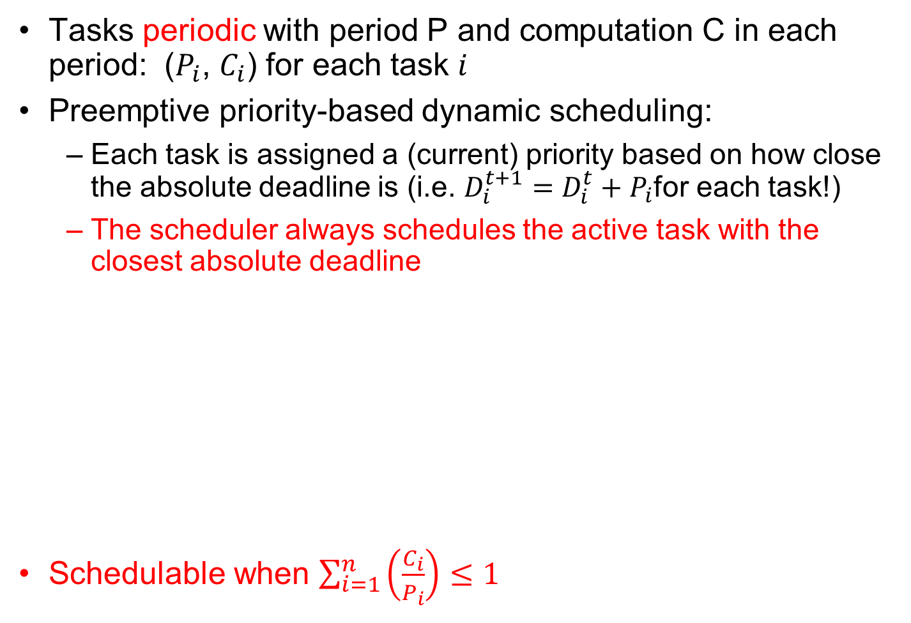
Earliest Deadline First (EDF)
Tasks periodic with period P and computation C in each period: ($P_{i}$, $C_{i}$) for each task $i$
Preemptive priority-based dynamic scheduling:
  Each task is assigned a (current) priority based on how close the absolute deadline is (i.e. $D_{i}^{t+1}=D_{i}^{t}+P_{i}$for each task!)
  The scheduler always schedules the active task with the closest absolute deadline
Schedulable when $\sum_{i=1}^{n}{\left(\frac{C_{i}}{P_{i}}\right)≤1}$
0
5
10
15

Slide 14
A Final Word On Scheduling
When do the details of the scheduling policy and fairness really matter?
  When there aren’t enough resources to go around
When should you simply buy a faster computer?
  (Or network link, or expanded highway, or …)
  One approach: Buy it when it will pay
  for itself in improved response time
    Perhaps you’re paying for worse response
    time in reduced productivity, customer angst,
    etc…
    Might think that you should buy a faster X
    when X is utilized 100%, but usually, response
    time goes to infinity as utilization⇒100%
An interesting implication of this curve:
  Most scheduling algorithms work fine in the “linear” portion of the load curve, fail otherwise
  Argues for buying a faster X when hit “knee” of curve
Response
time
100%
Utilization

Slide 15
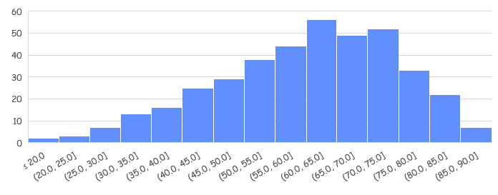
Administrivia
Midterm I graded:
  Mean 60.27, Std Dev: 14.71, Low: 16.25, High: 89.75
  Regrade requests before Monday 3/11 @midnight
Solutions are posted
Homework 2 due Today!
Project 1 code due on Friday (3/8)
Don’t forget to allocate memory for objects!
  If a structure is declared locally to a procedure, then it will go away when procedure returns!!!
  Lots of page faults are likely caused by bad memory allocation!

Slide 16
Starvation vs Deadlock
Starvation: thread waits indefinitely
  Example, low-priority thread waiting for resources constantly in use by high-priority threads
Deadlock: circular waiting for resources
  Thread A owns Res 1 and is waiting for Res 2
  Thread B owns Res 2 and is waiting for Res 1
Deadlock ⇒ Starvation but not vice versa
  Starvation can end (but doesn’t have to)
  Deadlock can’t end without external intervention
Thread
A
Wait
For
Owned
By
Res 1
Res 2
Owned
By
Wait
For
Thread
B
Notes:
Now let's look at some key problems we face when synchronizing or scheduling concurrent tasks.

Slide 17
Conditions for Deadlock
Deadlock not always deterministic – Example 2 mutexes:
Thread A Thread B
x.P(); y.P();
y.P(); x.P();
y.V(); x.V();
x.V(); y.V();
  Deadlock won’t always happen with this code
    Have to have exactly the right timing (“wrong” timing?)
    So you release a piece of software, and you tested it, and there it is, controlling a nuclear power plant…
Deadlocks occur with multiple resources
  Means you can’t decompose the problem
  Can’t solve deadlock for each resource independently
Example: System with 2 disk drives and two threads
  Each thread needs 2 disk drives to function
  Each thread gets one disk and waits for another one

Slide 18
Bridge Crossing Example
Honk!
Each segment of road can be viewed as a resource
  Car must own the segment under them
  Must acquire segment that they are moving into
For bridge: must acquire both halves
  Traffic only in one direction at a time
  Problem occurs when two cars in opposite directions on bridge: each acquires one segment and needs next
If a deadlock occurs, it can be resolved if one car backs up (preempt resources and rollback)
  Several cars may have to be backed up
Starvation is possible
  East-going traffic really fast ⇒ no one goes west

Slide 19
Train Example (Wormhole-Routed Network)
Circular dependency (Deadlock!)
  Each train wants to turn right
  Blocked by other trains
  Similar problem to multiprocessor networks
Fix? Imagine grid extends in all four directions
  Force ordering of channels (tracks)
    Protocol: Always go east-west first, then north-south
  Called “dimension ordering” (X then Y)
Disallowed
By Rule

Slide 20
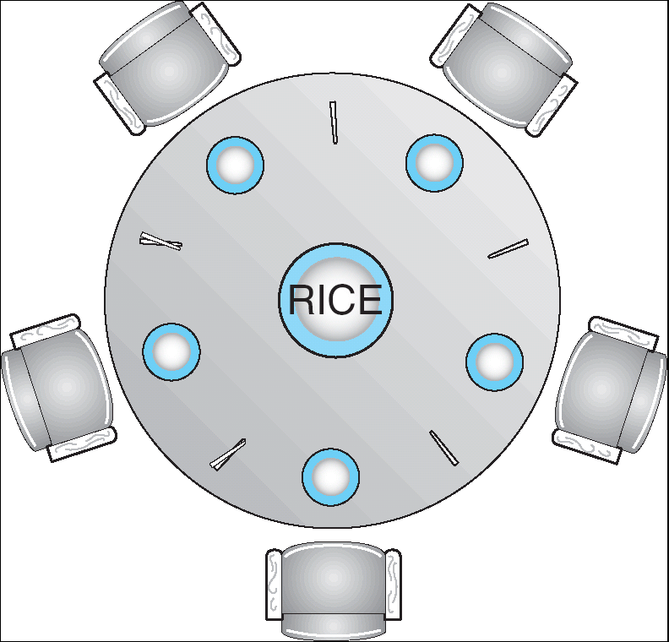
Dining Lawyers Problem
Five chopsticks/Five lawyers (really cheap restaurant)
  Free-for all: Lawyer will grab any one they can
  Need two chopsticks to eat
What if all grab at same time?
  Deadlock!
How to fix deadlock?
  Make one of them give up a chopstick (Hah!)
  Eventually everyone will get chance to eat
How to prevent deadlock?
  Never let lawyer take last chopstick if no hungry lawyer has two chopsticks afterwards

Slide 21
Four requirements for Deadlock
Mutual exclusion
  Only one thread at a time can use a resource.
Hold and wait
  Thread holding at least one resource is waiting to acquire additional resources held by other threads
No preemption
  Resources are released only voluntarily by the thread holding the resource, after thread is finished with it
Circular wait
  There exists a set {T₁, …, T_{n}} of waiting threads
    T₁ is waiting for a resource that is held by T₂
    T₂ is waiting for a resource that is held by T₃
    …
    T_{n} is waiting for a resource that is held by T₁

Slide 22
Resource-Allocation Graph
Symbols
System Model
  A set of Threads T₁, T₂, . . ., T_{n}
  Resource types R₁, R₂, . . ., R_{m}
    CPU cycles, memory space, I/O devices
  Each resource type R_{i} has W_{i} instances
  Each thread utilizes a resource as follows:
    Request() / Use() / Release()
Resource-Allocation Graph:
  V is partitioned into two types:
    T = {T₁, T₂, …, T_{n}}, the set threads in the system.
    R = {R₁, R₂, …, R_{m}}, the set of resource types in system
  request edge – directed edge T₁ → R_{j}
  assignment edge – directed edge R_{j} → T_{i}
T₁
T₂
R₁
R₂

Slide 23
Resource-Allocation Graph Examples
Model:
  request edge – directed edge T₁ → R_{j}
  assignment edge – directed edge R_{j} → T_{i}
R₁
R₂
R₁
R₂
R₁
T₂
T₁
T₂
T₃
T₁
T₂
T₃
T₁
T₃
R₃
T₄
R₄
R₃
R₂
R₄
Simple Resource
Allocation Graph
Allocation Graph
With Deadlock
Allocation Graph
With Cycle, but
No Deadlock

Slide 24
Methods for Handling Deadlocks
Allow system to enter deadlock and then recover
  Requires deadlock detection algorithm
  Some technique for forcibly preempting resources and/or terminating tasks
Ensure that system will never enter a deadlock
  Need to monitor all lock acquisitions
  Selectively deny those that might lead to deadlock
Ignore the problem and pretend that deadlocks never occur in the system
  Used by most operating systems, including UNIX
  This is not say that this is a “method”, rather intentional ignorance?
Notes:
So how can we handle deadlocks in general?

Slide 25
Deadlock Detection Algorithm
Only one of each type of resource ⇒ look for loops
More General Deadlock Detection Algorithm
  Let [X] represent an m-ary vector of non-negative
  integers (quantities of resources of each type):
  [FreeResources]: Current free resources each type
  [Request_{X}]: Current requests from thread X
  [Alloc_{X}]: Current resources held by thread X
  See if tasks can eventually terminate on their own
[Avail] = [FreeResources]
Add all nodes to UNFINISHED
do {
done = true
Foreach node in UNFINISHED {
if ([Request_{node}] <= [Avail]) {
remove node from UNFINISHED
[Avail] = [Avail] + [Alloc_{node}]
done = false
}
}
} until(done)
  Nodes left in UNFINISHED ⇒ deadlocked
R₁
T₂
T₁
T₃
T₄
R₂

Slide 26
What to do when detect deadlock?
Terminate thread, force it to give up resources
  In Bridge example, Godzilla picks up a car, hurls it into the river. Deadlock solved!
  Shoot a dining lawyer
  But, not always possible – killing a thread holding a mutex leaves world inconsistent
Preempt resources without killing off thread
  Take away resources from thread temporarily
  Doesn’t always fit with semantics of computation
Roll back actions of deadlocked threads
  Hit the rewind button on TiVo, pretend last few minutes never happened
  For bridge example, make one car roll backwards (may require others behind him)
  Common technique in databases (transactions)
  Of course, if you restart in exactly the same way, may reenter deadlock once again
Many operating systems use other options

Slide 27
Techniques for Preventing Deadlock
Infinite resources
  Include enough resources so that no one ever runs out of resources. Doesn’t have to be infinite, just large
  Give illusion of infinite resources (e.g. virtual memory)
  Examples:
    Bay bridge with 12,000 lanes. Never wait!
    Infinite disk space (not realistic yet?)
No Sharing of resources (totally independent threads)
  Not very realistic
Don’t allow waiting
  How the phone company avoids deadlock
    Call to your Mom in Toledo, works its way through the phone lines, but if blocked get busy signal.
  Technique used in Ethernet/some multiprocessor nets
    Everyone speaks at once. On collision, back off and retry
  Inefficient, since have to keep retrying
    Consider: driving to San Francisco; when hit traffic jam, suddenly you’re transported back home and told to retry!

Slide 28
Techniques for Preventing Deadlock (cont’d)
Make all threads request everything they’ll need at the beginning.
  Problem: Predicting future is hard, tend to over-estimate resources
  Example:
    If need 2 chopsticks, request both at same time
    Don’t leave home until we know no one is using any intersection between here and where you want to go; only one car on the Bay Bridge at a time
Force all threads to request resources in a particular order preventing any cyclic use of resources
  Thus, preventing deadlock
  Example (x.P, y.P, z.P,…)
    Make tasks request disk, then memory, then…
    Keep from deadlock on freeways around SF by requiring everyone to go clockwise

Slide 29
Review: Train Example (Wormhole-Routed Network)
Circular dependency (Deadlock!)
  Each train wants to turn right
  Blocked by other trains
  Similar problem to multiprocessor networks
Fix? Imagine grid extends in all four directions
  Force ordering of channels (tracks)
    Protocol: Always go east-west first, then north-south
  Called “dimension ordering” (X then Y)
Disallowed
By Rule

Slide 30
Banker’s Algorithm for Preventing Deadlock
Toward right idea:
  State maximum (max) resource needs in advance
  Allow particular thread to proceed if:
    (available resources - #requested) ≥ max
    remaining that might be needed by any thread
Banker’s algorithm (less conservative):
  Allocate resources dynamically
    Evaluate each request and grant if some
    ordering of threads is still deadlock free afterward
    Technique: pretend each request is granted, then run deadlock detection algorithm, substituting
    ([Max_{node}]-[Alloc_{node}] <= [Avail]) for ([Request_{node}] <= [Avail])
    Grant request if result is deadlock free (conservative!)

Slide 31
Banker’s Algorithm for Preventing Deadlock
Toward right idea:
  State maximum resource needs in advance
  Allow particular thread to proceed if:
    (available resources - #requested) ≥ max
    remaining that might be needed by any thread
Banker’s algorithm (less conservative):
  Allocate resources dynamically
    Evaluate each request and grant if some
    ordering of threads is still deadlock free afterward
    Technique: pretend each request is granted, then run deadlock detection algorithm, substituting
    ([Max_{node}]-[Alloc_{node}] <= [Avail]) for ([Request_{node}] <= [Avail])
    Grant request if result is deadlock free (conservative!)
[Avail] = [FreeResources]
Add all nodes to UNFINISHED
do {
done = true
Foreach node in UNFINISHED {
if ([Request_{node}] <= [Avail]) {
remove node from UNFINISHED
[Avail] = [Avail] + [Alloc_{node}]
done = false
}
}
} until(done)

Slide 32
Banker’s Algorithm for Preventing Deadlock
Toward right idea:
  State maximum resource needs in advance
  Allow particular thread to proceed if:
    (available resources - #requested) ≥ max
    remaining that might be needed by any thread
Banker’s algorithm (less conservative):
  Allocate resources dynamically
    Evaluate each request and grant if some
    ordering of threads is still deadlock free afterward
    Technique: pretend each request is granted, then run deadlock detection algorithm, substituting
    ([Max_{node}]-[Alloc_{node}] <= [Avail]) for ([Request_{node}] <= [Avail])
    Grant request if result is deadlock free (conservative!)
[Avail] = [FreeResources]
Add all nodes to UNFINISHED
do {
done = true
Foreach node in UNFINISHED {
if ([Max_{node}]-[Alloc_{node}] <= [Avail]) {
remove node from UNFINISHED
[Avail] = [Avail] + [Alloc_{node}]
done = false
}
}
} until(done)

Slide 33
Banker’s Algorithm for Preventing Deadlock
Toward right idea:
  State maximum resource needs in advance
  Allow particular thread to proceed if:
    (available resources - #requested) ≥ max
    remaining that might be needed by any thread
Banker’s algorithm (less conservative):
  Allocate resources dynamically
    Evaluate each request and grant if some
    ordering of threads is still deadlock free afterward
    Technique: pretend each request is granted, then run deadlock detection algorithm, substituting
    ([Max_{node}]-[Alloc_{node}] <= [Avail]) for ([Request_{node}] <= [Avail])
    Grant request if result is deadlock free (conservative!)
    Keeps system in a “SAFE” state, i.e. there exists a sequence {T₁, T₂, … T_{n}} with T₁ requesting all remaining resources, finishing, then T₂ requesting all remaining resources, etc..
  Algorithm allows the sum of maximum resource needs of all current threads to be greater than total resources

Slide 34
Banker’s Algorithm Example
Banker’s algorithm with dining lawyers
  “Safe” (won’t cause deadlock) if when try to grab chopstick either:
    Not last chopstick
    Is last chopstick but someone will have two afterwards
  What if k-handed lawyers? Don’t allow if:
    It’s the last one, no one would have k
    It’s 2nd to last, and no one would have k-1
    It’s 3rd to last, and no one would have k-2
    …

Slide 35
Virtualizing Resources
Physical Reality:
Different Processes/Threads share the same hardware
  Need to multiplex CPU (Just finished: scheduling)
  Need to multiplex use of Memory (starting today)
  Need to multiplex disk and devices (later in term)
Why worry about memory sharing?
  The complete working state of a process and/or kernel is defined by its data in memory (and registers)
  Consequently, cannot just let different threads of control use the same memory
    Physics: two different pieces of data cannot occupy the same locations in memory
  Probably don’t want different threads to even have access to each other’s memory if in different processes (protection)
Notes:
Now we're going to talk about other ways we can virtualize resources.
Seen: virtualizing CPU by multiplexing many processes and threads onto it (scheduling)
Now: memory

Slide 36
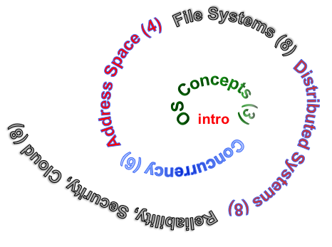
Next Objective
Dive deeper into the concepts and mechanisms of memory sharing and address translation
Enabler of many key aspects of operating systems
  Protection
  Multi-programming
  Isolation
  Memory resource management
  I/O efficiency
  Sharing
  Inter-process communication
  Debugging
  Demand paging
Today: Translation

Slide 37

Recall: Single and Multithreaded Processes
Threads encapsulate concurrency
  “Active” component of a process
Address spaces encapsulate protection
  Keeps buggy program from trashing the system
  “Passive” component of a process

Slide 38
Important Aspects of Memory Multiplexing
Protection:
  Prevent access to private memory of other processes
    Different pages of memory can be given special behavior (Read Only, Invisible to user programs, etc).
    Kernel data protected from User programs
    Programs protected from themselves
Controlled overlap:
  Separate state of threads should not collide in physical memory. Obviously, unexpected overlap causes chaos!
  Conversely, would like the ability to overlap when desired (for communication)
Translation:
  Ability to translate accesses from one address space (virtual) to a different one (physical)
  When translation exists, processor uses virtual addresses, physical memory uses physical addresses
  Side effects:
    Can be used to avoid overlap
    Can be used to give uniform view of memory to programs

Slide 39




Recall: Loading
Threads
Address Spaces
Windows
Processes
Files
Sockets
Software
OS Hardware Virtualization
Hardware
ISA
Memory
Processor
Protection Boundary
OS
Ctrlr
storage
Networks
Displays
Inputs

Slide 40
Binding of Instructions and Data to Memory
Assume 4byte words
0x300 = 4 * 0x0C0
0x0C0 = 0000 1100 0000
0x300 = 0011 0000 0000
Process view of memory
Physical addresses
  data1: dw 32
  …
  start: lw r1,0(data1)
  jal checkit
  loop: addi r1, r1, -1
  bnz r1, loop …
  checkit: …
  0x0300 00000020
  … …
  0x0900 8C2000C0
  0x0904 0C000280
  0x0908 2021FFFF
  0x090C 14200242
  …
  0x0A00

Slide 41
Binding of Instructions and Data to Memory
Physical
Memory
0x0000
0x0300
  00000020
Process view of memory
Physical addresses
  data1: dw 32
  …
  start: lw r1,0(data1)
  jal checkit
  loop: addi r1, r1, -1
  bnz r1, loop …
  checkit: …
  0x0300 00000020
  … …
  0x0900 8C2000C0
  0x0904 0C000280
  0x0908 2021FFFF
  0x090C 14200242
  …
  0x0A00
0x0900
  8C2000C0
  0C000340
  2021FFFF
  14200242
0xFFFF

Slide 42
Second copy of program from previous example
Physical
Memory
0x0000
0x0300
App X
Process view of memory
Physical addresses
  data1: dw 32
  …
  start: lw r1,0(data1)
  jal checkit
  loop: addi r1, r1, -1
  bnz r1, loop …
  checkit: …
  0x0300 00000020
  … …
  0x0900 8C2000C0
  0x0904 0C000280
  0x0908 2021FFFF
  0x090C 14200242
  …
  0x0A00
0x0900
?
0xFFFF
Need address translation!

Slide 43
Second copy of program from previous example
Physical
Memory
0x0000
0x0300
App X
Process view of memory
Physical addresses
  data1: dw 32
  …
  start: lw r1,0(data1)
  jal checkit
  loop: addi r1, r1, -1
  bnz r1, loop …
  checkit: …
  0x1300 00000020
  … …
  0x1900 8C2004C0
  0x1904 0C000680
  0x1908 2021FFFF
  0x190C 14200642
  …
  0x1A00
0x0900
0x1300
  00000020
0x1900
  8C2004C0
  0C000680
  2021FFFF
  14200642
One of many possible translations!
Where does translation take place?
    Compile time, Link/Load time, or Execution time?
0xFFFF

Slide 44
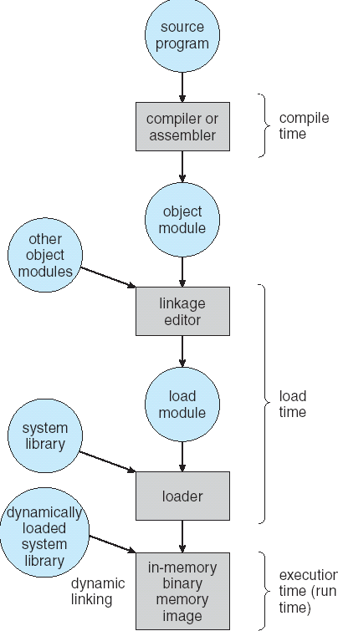
Multi-step Processing of a Program for Execution
Preparation of a program for execution involves components at:
  Compile time (i.e., “gcc”)
  Link/Load time (UNIX “ld” does link)
  Execution time (e.g., dynamic libs)
Addresses can be bound to final values anywhere in this path
  Depends on hardware support
  Also depends on operating system
Dynamic Libraries
  Linking postponed until execution
  Small piece of code, stub, used to locate appropriate memory-resident library routine
  Stub replaces itself with the address of the routine, and executes routine

Slide 45

Recall: Uniprogramming
Uniprogramming (no Translation or Protection)
  Application always runs at same place in physical memory since only one application at a time
  Application can access any physical address
  Application given illusion of dedicated machine by giving it reality of a dedicated machine
0xFFFFFFFF
Operating
System
Valid 32-bit
Addresses
Application
0x00000000

Slide 46

Multiprogramming (primitive stage)
Multiprogramming without Translation or Protection
  Must somehow prevent address overlap between threads
  Use Loader/Linker: Adjust addresses while program loaded into memory (loads, stores, jumps)
    Everything adjusted to memory location of program
    Translation done by a linker-loader (relocation)
    Common in early days (… till Windows 3.x, 95?)
With this solution, no protection: bugs in any program can cause other programs to crash or even the OS
0xFFFFFFFF
Operating
System
Application2
0x00020000
Application1
0x00000000

Slide 47
Multiprogramming (Version with Protection)
Can we protect programs from each other without translation?
  Yes: use two special registers BaseAddr and LimitAddr to prevent user from straying outside designated area
    If user tries to access an illegal address, cause an error
  During switch, kernel loads new base/limit from PCB (Process Control Block)
    User not allowed to change base/limit registers
0xFFFFFFFF
Operating
System
LimitAddr=0x10000
0x00020000
BaseAddr=0x20000
Application2
Application1
0x00000000

Slide 48
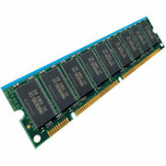
Recall: General Address translation
Virtual
Addresses
Physical
Addresses
CPU
MMU
Untranslated read or write
Recall: Address Space:
  All the addresses and state a process can touch
  Each process and kernel has different address space
Consequently, two views of memory:
  View from the CPU (what program sees, virtual memory)
  View from memory (physical memory)
  Translation box (MMU) converts between the two views
Translation makes it much easier to implement protection
  If task A cannot even gain access to task B’s data, no way for A to adversely affect B
With translation, every program can be linked/loaded into same region of user address space

Slide 49
Summary
Linux CFS Scheduler
  Fair fraction of CPU to threads, modulated by priority
  Approximates an “ideal” multitasking processor
Real-time schedulingNeed to meet a deadline, predictability essential
  Earliest Deadline First (EDF) and Rate Monotonic (RM) scheduling
Starvation vs. Deadlock
  Starvation: thread waits indefinitely
  Deadlock: circular waiting for resources
Four conditions for deadlocks
  Mutual exclusion
  Hold and wait
  No preemption
  Circular wait
Techniques for addressing Deadlock
  Allow system to enter deadlock and then recover
  Ensure that system will never enter a deadlock
  Ignore the problem and pretend that deadlocks never occur

