Slide 1
CS162
Operating Systems and
Systems Programming
Lecture 6
Concurrency (Continued),
Thread and Processes
February 7th, 2019
Prof. John Kubiatowicz
http://cs162.eecs.Berkeley.edu

Slide 2
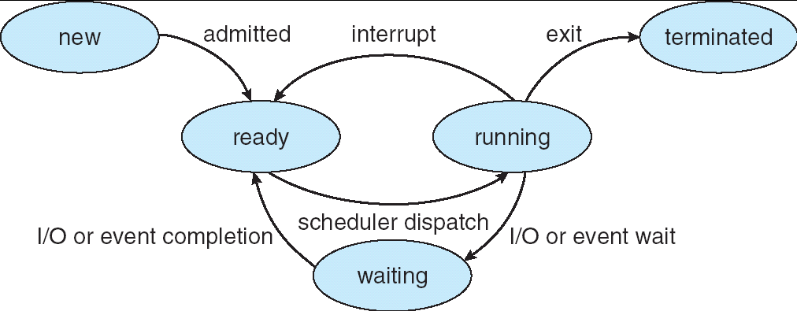
Recall: Lifecycle of a Process
As a process executes, it changes state:
  new: The process is being created
  ready: The process is waiting to run
  running: Instructions are being executed
  waiting: Process waiting for some event to occur
  terminated: The process has finished execution

Slide 3
Recall: Use of Threads
Version of program with Threads (loose syntax):
main() {
ThreadFork(ComputePI, “pi.txt” ));
ThreadFork(PrintClassList, “classlist.txt”));
}
What does ThreadFork() do?
  Start independent thread running given procedure
What is the behavior here?
  Now, you would actually see the class list
  This should behave as if there are two separate CPUs
CPU1
CPU2
CPU1
CPU2
CPU1
CPU2
Time

Slide 4
Recall: Multithreaded Stack Switching
Consider the following code blocks:
proc A() {
B();
}
proc B() {
while(TRUE) {
yield();
}
}
Suppose we have 2 threads running same code:
  Threads S and T
  Assume S and T have been running for a while
Thread S
Thread T
A
A
B(while)
B(while)
Stack growth
yield
yield
run_new_thread
run_new_thread
switch
switch

Slide 5
What happens when thread blocks on I/O?
CopyFile
read
Trap to OS
Stack growth
kernel_read
run_new_thread
switch
What happens when a thread requests a block of data from the file system?
  User code invokes a system call
  Read operation is initiated
  Run new thread/switch
Thread communication similar
  Wait for Signal/Join
  Networking

Slide 6
External Events
What happens if thread never does any I/O, never waits, and never yields control?
  Could the ComputePI program grab all resources and never release the processor?
    What if it didn’t print to console?
  Must find way that dispatcher can regain control!
Answer: utilize external events
  Interrupts: signals from hardware or software that stop the running code and jump to kernel
  Timer: like an alarm clock that goes off every some milliseconds
If we make sure that external events occur frequently enough, can ensure dispatcher runs
Notes:
Patterson’s a nice guy, so he gives up the body after using it for awhile and let’s John Kubitowicz have it.
But Kubi’s not so nice, so he won’t give up control…
If you want to wake up for a final, you set your clock, or ask your roommate to pour water over your head – OS does the same

Slide 7
Example: Network Interrupt
Raise priority
(set mask)
Reenable All Ints
Save registers
Dispatch to Handler
…
Transfer Network Packet from hardware
to Kernel Buffers
…
Restore registers
Clear current Int
Disable All Ints
Restore priority
(clear Mask)
RTI
...
add $r1,$r2,$r3
subi $r4,$r1,#4
slli $r4,$r4,#2
...
PC saved
Disable All Ints
Kernel Mode
External Interrupt
Pipeline Flush
“Interrupt Handler”
...
lw $r2,0($r4)
lw $r3,4($r4)
add $r2,$r2,$r3
sw 8($r4),$r2
...
Restore PC
Enable all Ints
User Mode
An interrupt is a hardware-invoked context switch
  No separate step to choose what to run next
  Always run the interrupt handler immediately

Slide 8
Use of Timer Interrupt to Return Control
Solution to our dispatcher problem
  Use the timer interrupt to force scheduling decisions
Timer Interrupt routine:
TimerInterrupt() {
DoPeriodicHouseKeeping();
run_new_thread();
}
Some Routine
Interrupt
TimerInterrupt
Stack growth
run_new_thread
switch

Slide 9
ThreadFork(): Create a New Thread
ThreadFork() is a user-level procedure that creates a new thread and places it on ready queue
Arguments to ThreadFork()
  Pointer to application routine (fcnPtr)
  Pointer to array of arguments (fcnArgPtr)
  Size of stack to allocate
Implementation
  Sanity check arguments
  Enter Kernel-mode and Sanity Check arguments again
  Allocate new Stack and TCB
  Initialize TCB and place on ready list (Runnable)

Slide 10
How do we initialize TCB and Stack?
Initialize Register fields of TCB
  Stack pointer made to point at stack
  PC return address ⇒ OS (asm) routine ThreadRoot()
  Two arg registers (a0 and a1) initialized to fcnPtr and fcnArgPtr, respectively
Initialize stack data?
  No. Important part of stack frame is in registers (ra)
  Think of stack frame as just before body of ThreadRoot() really gets started
ThreadRoot stub
Stack growth
Initial Stack

Slide 11
How does Thread get started?
Other Thread
ThreadRoot
A
B(while)
Stack growth
yield
run_new_thread
New Thread
switch
ThreadRoot stub
Eventually, run_new_thread() will select this TCB and return into beginning of ThreadRoot()
  This really starts the new thread

Slide 12
What does ThreadRoot() look like?
ThreadRoot() is the root for the thread routine:
ThreadRoot() {
DoStartupHousekeeping();
UserModeSwitch(); /* enter user mode */
Call fcnPtr(fcnArgPtr);
ThreadFinish();
}
Startup Housekeeping
  Includes things like recording
  start time of thread
  Other statistics
Stack will grow and shrink with
execution of thread
Final return from thread returns into ThreadRoot()
which calls ThreadFinish()
  ThreadFinish() wake up sleeping threads
ThreadRoot
Thread Code
Stack growth
Running Stack

Slide 13
Administrivia
Waitlist was closed last Friday/Early Drop passed Friday
Recommendation: Read assigned readings before lecture
Group sign up this week
  Get finding groups ASAP – deadline Friday 2/8 at 11:59PM
  4 people in a group!
Continue to attend whichever section is convenient
  Next week, we start official section attendance!
TA preference signup form due Tuesday 2/12 at 11:59PM
  Everyone in a group must have the same TA!
    Preference given to same section
  Participation: Get to know your TA!

Slide 14
Thread Abstraction
Illusion: Infinite number of processors
Notes:
Execution model: each thread runs on a dedicated virtual processor with unpredictable and variable speed.

Slide 15
Thread Abstraction
Illusion: Infinite number of processors
Reality: Threads execute with variable speed
  Programs must be designed to work with any schedule
Notes:
Execution model: each thread runs on a dedicated virtual processor with unpredictable and variable speed.

Slide 16
Programmer vs. Processor View

Slide 17
Programmer vs. Processor View

Slide 18
Programmer vs. Processor View

Slide 19
Possible Executions

Slide 20
Thread Lifecycle

Slide 21
Per Thread Descriptor
(Kernel Supported Threads)
Each Thread has a Thread Control Block (TCB)
  Execution State: CPU registers, program counter (PC), pointer to stack (SP)
  Scheduling info: state, priority, CPU time
  Various Pointers (for implementing scheduling queues)
  Pointer to enclosing process (PCB) – user threads
  … (add stuff as you find a need)
OS Keeps track of TCBs in “kernel memory”
  In Array, or Linked List, or …
  I/O state (file descriptors, network connections, etc)

Slide 22
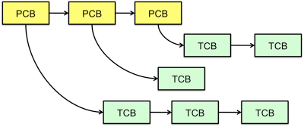
Multithreaded Processes
Process Control Block (PCBs) points to multiple Thread Control Blocks (TCBs):
Switching threads within a block is a simple thread switch
Switching threads across blocks requires changes to memory and I/O address tables

Slide 23
Examples multithreaded programs
Embedded systems
  Elevators, planes, medical systems, smart watches
  Single program, concurrent operations
Most modern OS kernels
  Internally concurrent because have to deal with concurrent requests by multiple users
  But no protection needed within kernel
Database servers
  Access to shared data by many concurrent users
  Also background utility processing must be done
Notes:
DB servers very important – provide “shared data” view to users.
Many users can read/write at once – how is consistency managed?

Slide 24
Example multithreaded programs (con’t)
Network servers
  Concurrent requests from network
  Again, single program, multiple concurrent operations
  File server, Web server, and airline reservation systems
Parallel programming (more than one physical CPU)
  Split program into multiple threads for parallelism
  This is called Multiprocessing
Some multiprocessors are actually uniprogrammed:
  Multiple threads in one address space but one program at a time

Slide 25
A Typical Use Case
Client Browser
- process for each tab
- thread to render page
- GET in separate thread
- multiple outstanding GETs
- as they complete, render
portion
Web Server
- fork process for each client connection
- thread to get request and issue response
- fork threads to read data, access DB, etc
- join and respond

Slide 26
Some Numbers
Frequency of performing context switches: 10-100ms
Context switch time in Linux: 3-4 μsecs (Intel i7 & E5)
  Thread switching faster than process switching (100 ns)
  But switching across cores ~2x more expensive than within-core
Context switch time increases sharply with size of working set*
  Can increase 100x or more
  *The working set is subset of memory used by process in a time window
Moral: context switching depends mostly on cache limits and the process or thread’s hunger for memory

Slide 27
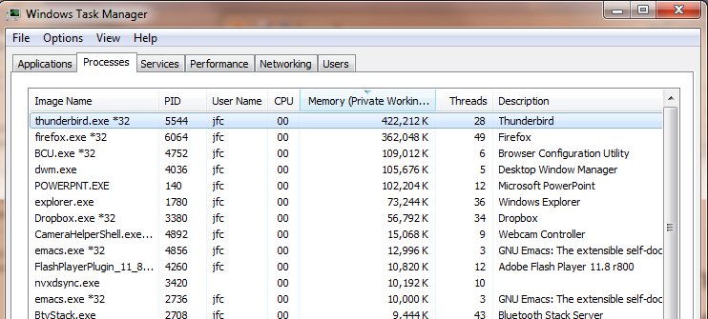
Some Numbers
Many process are multi-threaded, so thread context switches may be either within-process or across-processes

Slide 28
Kernel Use Cases
Thread for each user process
Thread for sequence of steps in processing I/O
Threads for device drivers
…

Slide 29
Putting it Together: Process
(Unix) Process
A(int tmp) {
if (tmp<2)
B();
printf(tmp);
}
B() {
C();
}
C() {
A(2);
}
A(1);
…
Memory
Stack
Resources
I/O State
(e.g., file, socket contexts)
Sequential stream of instructions
CPU state (PC, SP, registers..)
Stored in OS

Slide 30
Putting it Together: Processes
Process 1
Process 2
Process N
Switch overhead: high
  CPU state: low
  Memory/IO state: high
Process creation: high
Protection
  CPU: yes
  Memory/IO: yes
Sharing overhead: high (involves at least a context switch)
Mem.
Mem.
Mem.
IO
state
IO
state
…
IO
state
CPU
state
CPU
state
CPU
state
CPU sched.
OS
1 process at a time
CPU
(1 core)

Slide 31
Putting it Together: Threads
Process 1
Process N
Switch overhead: medium
  CPU state: low
Thread creation: medium
Protection
  CPU: yes
  Memory/IO: no
Sharing overhead: low(ish) (thread switch overhead low)
threads
threads
Mem.
Mem.
…
IO
state
…
…
IO
state
CPU
state
CPU
state
CPU
state
CPU
state
CPU sched.
OS
1 thread at a time
CPU
(1 core)

Slide 32
Kernel versus User-Mode Threads
We have been talking about kernel threads
  Native threads supported directly by the kernel
  Every thread can run or block independently
  One process may have several threads waiting on different things
Downside of kernel threads: a bit expensive
  Need to make a crossing into kernel mode to schedule
Lighter weight option: User level Threads

Slide 33
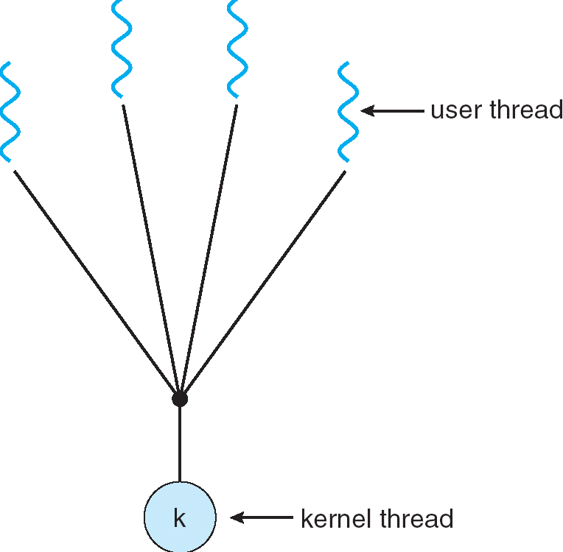
User-Mode Threads
Lighter weight option:
  User program provides scheduler and
  thread package
  May have several user threads per kernel
  thread
  User threads may be scheduled
  non-preemptively relative to each other
  (only switch on yield())
  Cheap
Downside of user threads:
  When one thread blocks on I/O, all threads block
  Kernel cannot adjust scheduling among all threads
  Option: Scheduler Activations
    Have kernel inform user level when thread blocks…

Slide 34
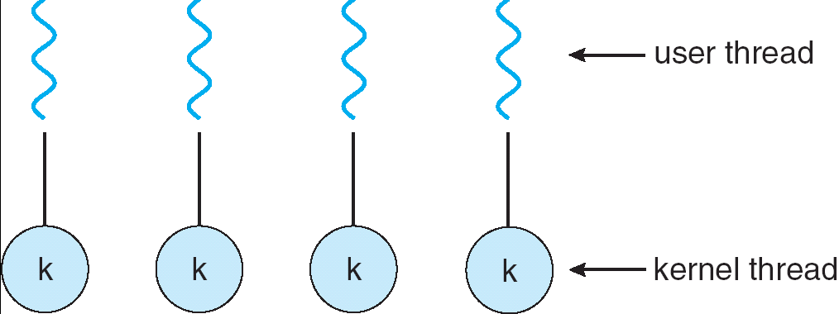
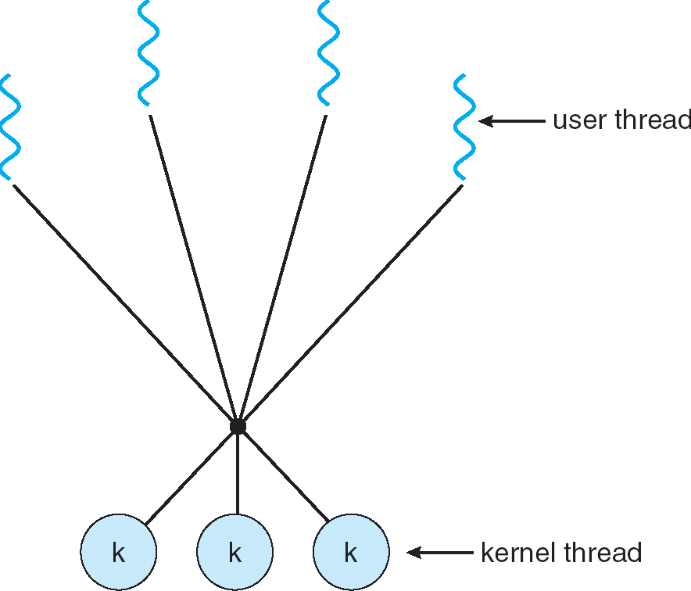
Some Threading Models
Simple One-to-One
Threading Model
Many-to-One
Many-to-Many

Slide 35
Threads in a Process
Threads are useful at user-level: parallelism, hide I/O latency, interactivity
Option A (early Java): user-level library, one multi-threaded process
  Library does thread context switch
  Kernel time slices between processes, e.g., on system call I/O
Option B (SunOS, Linux/Unix variants): many single-threaded processes
  User-level library does thread multiplexing
Option C (Windows): scheduler activations
  Kernel allocates processes to user-level library
  Thread library implements context switch
  System call I/O that blocks triggers upcall
Option D (Linux, MacOS, Windows): use kernel threads
  System calls for thread fork, join, exit (and lock, unlock,…)
  Kernel does context switching
  Simple, but a lot of transitions between user and kernel mode

Slide 36
Putting it Together: Multi-Cores
Process 1
Process N
threads
threads
Switch overhead: low (only CPU state)
Thread creation: low
Protection
  CPU: yes
  Memory/IO: No
Sharing overhead: low (thread switch overhead low, may not need to switch at all!)
Mem.
Mem.
…
IO
state
…
…
IO
state
CPU
state
CPU
state
CPU
state
CPU
state
CPU sched.
OS
4 threads at a time
Core 1
Core 2
Core 3
Core 4
CPU

Slide 37
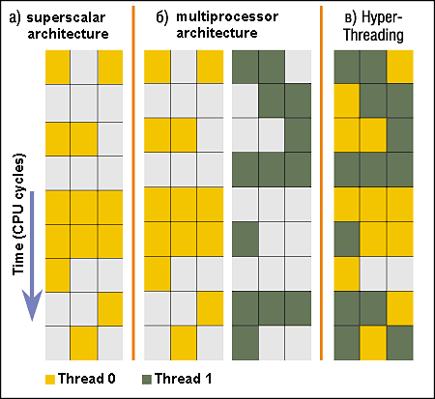
Simultaneous MultiThreading/Hyperthreading
Hardware technique
  Superscalar processors can
  execute multiple instructions
  that are independent
  Hyperthreading duplicates
  register state to make a
  second “thread,” allowing
  more instructions to run
Can schedule each thread
as if were separate CPU
  But, sub-linear speedup!
Original called “Simultaneous Multithreading”
  http://www.cs.washington.edu/research/smt/index.html
  Intel, SPARC, Power (IBM)
  A virtual core on AWS’ EC2 is basically a hyperthread
Colored blocks show
instructions executed
Notes:
Intel seems to be discarding SMT in Silvermont because of power problems

Slide 38
Putting it Together: Hyper-Threading
Process 1
Process N
threads
threads
Switch overhead between hardware-threads: very-low (done in hardware)
Contention for ALUs/FPUs may hurt performance
Mem.
Mem.
…
IO
state
…
…
IO
state
CPU
state
CPU
state
CPU
state
CPU
state
CPU sched.
OS
hardware-threads
(hyperthreading)
8 threads at a time
Core 1
Core 2
Core 3
Core 4
CPU

Slide 39
Classification
One
Many
# of addr spaces:
# threads
Per AS:
One
MS/DOS, early Macintosh
Traditional UNIX
Many
Embedded systems (Geoworks, VxWorks, JavaOS,etc)
JavaOS, Pilot(PC)
Mach, OS/2, Linux
Windows 10
Win NT to XP, Solaris, HP-UX, OS X
Most operating systems have either
  One or many address spaces
  One or many threads per address space

Slide 40
Multiprocessing vs Multiprogramming
Remember Definitions:
  Multiprocessing ≡ Multiple CPUs
  Multiprogramming ≡ Multiple Jobs or Processes
  Multithreading ≡ Multiple threads per Process
What does it mean to run two threads “concurrently”?
  Scheduler is free to run threads in any order and interleaving: FIFO, Random, …
  Dispatcher can choose to run each thread to completion or time-slice in big chunks or small chunks
A
Multiprocessing
B
C
A
B
C
Multiprogramming
A
B
C
A
B
C
B

Slide 41
Correctness for systems with concurrent threads
If dispatcher can schedule threads in any way, programs must work under all circumstances
  Can you test for this?
  How can you know if your program works?
Independent Threads:
  No state shared with other threads
  Deterministic ⇒ Input state determines results
  Reproducible ⇒ Can recreate Starting Conditions, I/O
  Scheduling order doesn’t matter (if switch() works!!!)
Cooperating Threads:
  Shared State between multiple threads
  Non-deterministic
  Non-reproducible
Non-deterministic and Non-reproducible means that bugs can be intermittent
  Sometimes called “Heisenbugs”

Slide 42
Interactions Complicate Debugging
Is any program truly independent?
  Every process shares the file system, OS resources, network, etc
  Extreme example: buggy device driver causes thread A to crash “independent thread” B
You probably don’t realize how much you depend on reproducibility:
  Example: Evil C compiler
    Modifies files behind your back by inserting errors into C program unless you insert debugging code
  Example: Debugging statements can overrun stack
Non-deterministic errors are really difficult to find
  Example: Memory layout of kernel+user programs
    depends on scheduling, which depends on timer/other things
    Original UNIX had a bunch of non-deterministic errors
  Example: Something which does interesting I/O
    User typing of letters used to help generate secure keys
Notes:
Adding printf statements can cause stack overruns or changing timing/interleaving
What if non-deterministic error only occurs once a week? You’re pulling all-nighters to find it, your eyelids droop, and whiz, the error happens and you missed it.

Slide 43
Why allow cooperating threads?
People cooperate; computers help/enhance people’s lives, so computers must cooperate
  By analogy, the non-reproducibility/non-determinism of people is a notable problem for “carefully laid plans”
Advantage 1: Share resources
  One computer, many users
  One bank balance, many ATMs
    What if ATMs were only updated at night?
  Embedded systems (robot control: coordinate arm & hand)
Advantage 2: Speedup
  Overlap I/O and computation
    Many different file systems do read-ahead
  Multiprocessors – chop up program into parallel pieces
Advantage 3: Modularity
  More important than you might think
  Chop large problem up into simpler pieces
    To compile, for instance, gcc calls cpp | cc1 | cc2 | as | ld
    Makes system easier to extend

Slide 44
High-level Example: Web Server
Server must handle many requests
Non-cooperating version:
  serverLoop() {
  con = AcceptCon();
  ProcessFork(ServiceWebPage(),con);
  }
What are some disadvantages of this technique?
Notes:
Expensive to start new process, heavyweight context switch overhead (changing address spaces)

Slide 45


Threaded Web Server
Now, use a single process
Multithreaded (cooperating) version:
  serverLoop() {
  connection = AcceptCon();
  ThreadFork(ServiceWebPage(),connection);
  }
Looks almost the same, but has many advantages:
  Can share file caches kept in memory, results of CGI scripts, other things
  Threads are much cheaper to create than processes, so this has a lower per-request overhead
Question: would a user-level (say one-to-many) thread package make sense here?
  When one request blocks on disk, all block…
What about Denial of Service attacks or digg / Slash-dot effects?

Slide 46
Thread Pools
Problem with previous version: Unbounded Threads
  When web-site becomes too popular – throughput sinks
Instead, allocate a bounded “pool” of worker threads, representing the maximum level of multiprogramming
Master
Thread
queue
Thread Pool
master() {
allocThreads(worker,queue);
while(TRUE) {
con=AcceptCon();
Enqueue(queue,con);
wakeUp(queue);
}
}
worker(queue) {
while(TRUE) {
con=Dequeue(queue);
if (con==null)
sleepOn(queue);
else
ServiceWebPage(con);
}
}

Slide 47
ATM Bank Server
ATM server problem:
  Service a set of requests
  Do so without corrupting database
  Don’t hand out too much money

Slide 48
ATM bank server example
Suppose we wanted to implement a server process to handle requests from an ATM network:
BankServer() {
while (TRUE) {
ReceiveRequest(&op, &acctId, &amount);
ProcessRequest(op, acctId, amount);
}
}
ProcessRequest(op, acctId, amount) {
if (op == deposit) Deposit(acctId, amount);
else if …
}
Deposit(acctId, amount) {
acct = GetAccount(acctId); /* may use disk I/O */
acct->balance += amount;
StoreAccount(acct); /* Involves disk I/O */
}
How could we speed this up?
  More than one request being processed at once
  Event driven (overlap computation and I/O)
  Multiple threads (multi-proc, or overlap comp and I/O)

Slide 49
Event Driven Version of ATM server
Suppose we only had one CPU
  Still like to overlap I/O with computation
  Without threads, we would have to rewrite in event-driven style
Example
BankServer() {
while(TRUE) {
event = WaitForNextEvent();
if (event == ATMRequest)
StartOnRequest();
else if (event == AcctAvail)
ContinueRequest();
else if (event == AcctStored)
FinishRequest();
}
}
  What if we missed a blocking I/O step?
  What if we have to split code into hundreds of pieces which could be blocking?
  This technique is used for graphical programming

Slide 50
Can Threads Make This Easier?
Threads yield overlapped I/O and computation without “deconstructing” code into non-blocking fragments
  One thread per request
Requests proceeds to completion, blocking as required:
Deposit(acctId, amount) {
acct = GetAccount(actId); /* May use disk I/O */
acct->balance += amount;
StoreAccount(acct); /* Involves disk I/O */
}
Unfortunately, shared state can get corrupted:
Thread 1 Thread 2
load r1, acct->balance
load r1, acct->balance
add r1, amount2
store r1, acct->balance
add r1, amount1
store r1, acct->balance

Slide 51
Summary
Processes have two parts
  Threads (Concurrency)
  Address Spaces (Protection)
Various textbooks talk about processes
  When this concerns concurrency, really talking about thread portion of a process
  When this concerns protection, talking about address space portion of a process
Concurrent threads are a very useful abstraction
  Allow transparent overlapping of computation and I/O
  Allow use of parallel processing when available
Concurrent threads introduce problems when accessing shared data
  Programs must be insensitive to arbitrary interleavings
  Without careful design, shared variables can become completely inconsistent

