Slide 1
CS162 Operating Systems and Systems Programming Lecture 2 Four Fundamental OS Concepts
January 23th, 2020
Prof. John Kubiatowicz
http://cs162.eecs.Berkeley.edu

Slide 2
Review: What is an Operating System?
Referee
Manage sharing of resources, Protection, Isolation
Resource allocation, isolation, communication
Illusionist
Provide clean, easy to use abstractions of physical resources
Infinite memory, dedicated machine
Higher level objects: files, users, messages
Masking limitations, virtualization
Glue
Common services
Storage, Window system, Networking
Sharing, Authorization
Look and feel

Slide 3
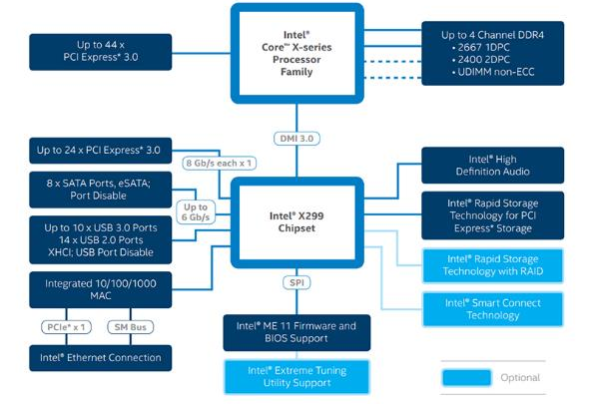
Recall: HW Functionality ⇒ great complexity!
Memory Channels
(High BW DRAM)
Really High Speed I/O (e.g. graphics)
Direct Media Interface (3.93 GBytes/sec)
High-Speed I/O devices (PCI Exp)
HD Audio
Disks (8 x SATA)
PCI/e Drives
Slower I/O (USB)
RAID 0/1/5/10
Integrated Ethernet
Smart Connect (autoupdate)
Intel Management Engine (ME) and BIOS Support
[remote management]
Intel Skylake-X I/O Configuration

Slide 4
Recall: Increasing Software Complexity
New Versions usually (much) larger older versions!
Cars getting really complex!
Millions of Lines of Code
(source https://informationisbeautiful.net/visualizations/million-lines-of-code/)

Slide 5
Recall: How do we tame complexity?
Every piece of computer hardware different
Different CPU
Pentium, PowerPC, ColdFire, ARM, MIPS
Different amounts of memory, disk, …
Different types of devices
Mice, Keyboards, Sensors, Cameras, Fingerprint readers
Different networking environment
Cable, DSL, Wireless, Firewalls,…
Questions:
Does the programmer need to write a single program that performs many independent activities?
Does every program have to be altered for every piece of hardware?
Does a faulty program crash everything?
Does every program have access to all hardware?

Slide 6
OS Abstracts underlying hardware
Processor => Thread
Memory => Address Space
Disks, SSDs, … => Files
Networks => Sockets
Machines => Processes
Application
Operating System
Hardware
Abstract Machine Interface
Physical Machine Interface
OS Goals:
Remove software/hardware quirks (fight complexity)
Optimize for convenience, utilization, reliability, … (help the programmer)
For any OS area (e.g. file systems, virtual memory, networking, scheduling):
What hardware interface to handle? (physical reality)
What’s software interface to provide? (nicer abstraction)

Slide 7
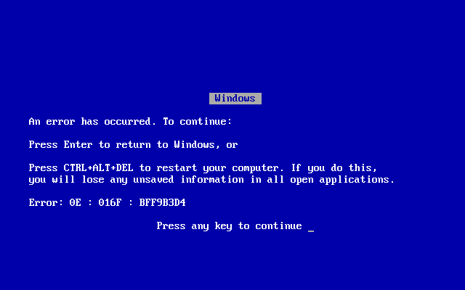
OS Goal: Protecting Processes & The Kernel
Run multiple applications and:
Keep them from interfering with or crashing the operating system
Keep them from interfering with or crashing each other

Slide 8
Virtual Machines
Virtualize every detail of a hardware configuration so perfectly that you can run an operating system (and many applications) on top of it.
VMWare Fusion, Virtual box, Parallels Desktop, Xen, Vagrant
Provides isolation
Complete insulation from change
The norm in the Cloud (server consolidation)
Long history (60’s in IBM OS development)
All our work will take place INSIDE a VM
Vagrant (new image just for you)

Slide 9
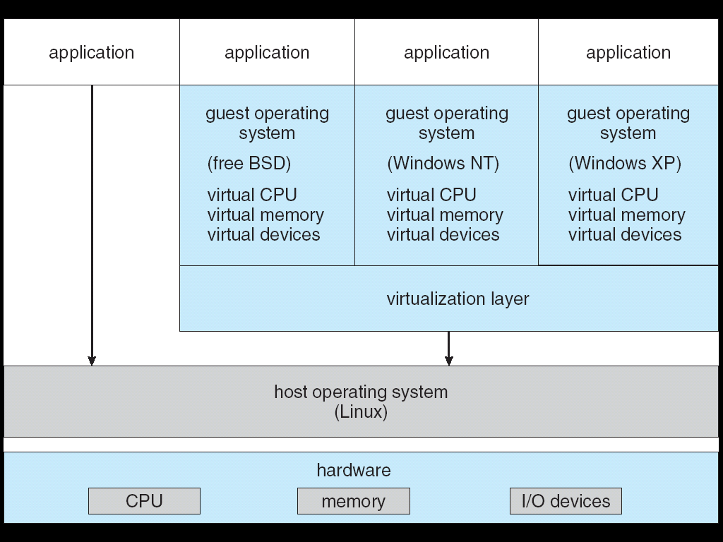
System Virtual Machines: Layers of OSs
Useful for OS development
When OS crashes, restricted to one VM
Can aid testing/running programs on other Oss
Use for deployment
Running different OSes at the same time

Slide 10
Containers virtualize the OS
Roots in OS developments to provide protected systems abstraction, not just application abstraction
User-level file system (route syscalls to user process)
Cgroups – predictable, bounded resources (CPU, Mem, BW)

Slide 11
Basic tool: Dual Mode Operation
Hardware provides at least two modes:
Kernel Mode (or "supervisor" / "protected" mode)
User Mode
Certain operations are prohibited when running in user mode
Changing the page table pointer
Carefully controlled transitions between user mode and kernel mode
System calls, interrupts, exceptions

Slide 12
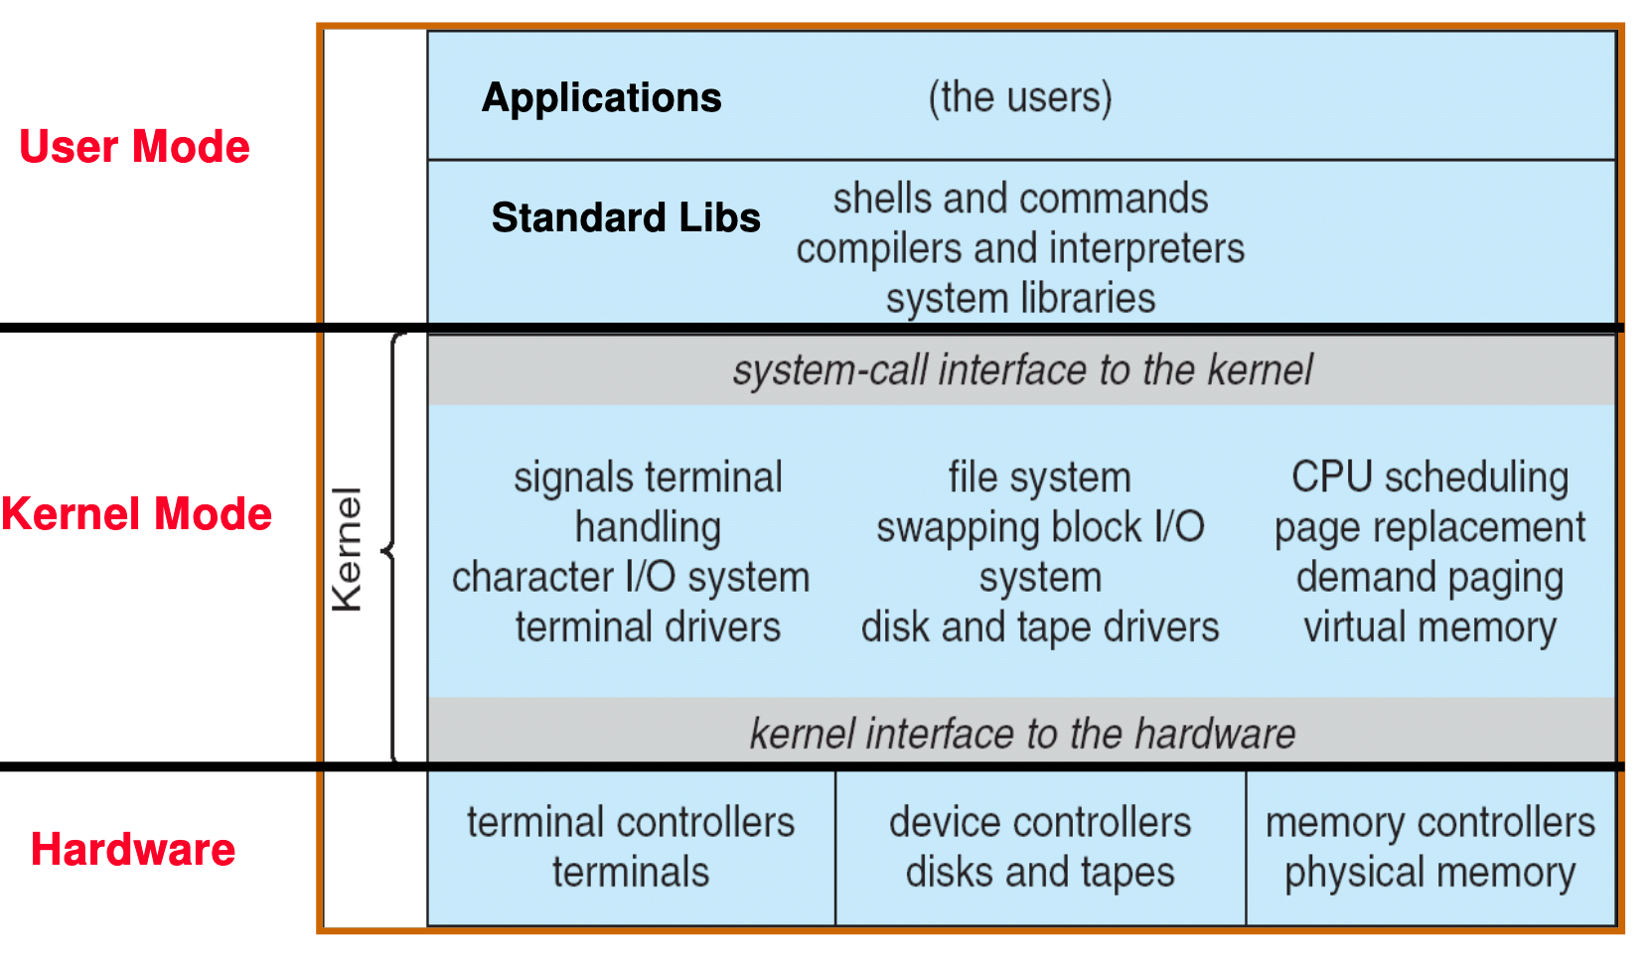
UNIX OS Structure

Slide 13
Today: Four Fundamental OS Concepts
Thread: Execution Context
Fully describes program state
Program Counter, Registers, Execution Flags, Stack
Address space (with or w/o translation)
Set of memory addresses accessible to program (for read or write)
May be distinct from memory space of the physical machine (in which case programs operate in a virtual address space)
Process: an instance of a running program
Protected Address Space + One or more Threads
Dual mode operation / Protection
Only the “system” has the ability to access certain resources
Combined with translation, isolates programs from each other and the OS from programs

Slide 14
OS Bottom Line: Run Programs
0xFFF…
Executable
Program Source
OS
int main()
{ … ;
}
compiler
data
Load & Execute
stack
editor
Memory
instructions
heap
a.out
data
foo.c
Load instruction and data segments of executable file into memory
Create stack and heap
“Transfer control to program”
Provide services to program
While protecting OS and program
instructions
0x000…
PC:
registers
Processor

Slide 15
Recall (61C): Instruction Fetch/Decode/Execute
The instruction cycle
Memory
Processor
next
PC:
Instruction fetch
instruction
Decode
decode
Registers
Execute
ALU
data

Slide 16
First OS Concept: Thread of Control
Thread: Single unique execution context
Program Counter, Registers, Execution Flags, Stack, Memory State
A thread is executing on a processor (core) when it is resident in the processor registers
Resident means: Registers hold the root state (context) of the thread:
Including program counter (PC) register & currently executing instruction
PC points at next instruction in memory
Instructions stored in memory
Including intermediate values for ongoing computations
Can include actual values (like integers) or pointers to values in memory
Stack pointer holds the address of the top of stack (which is in memory)
The rest is “in memory”
A thread is suspended (not executing) when its state is not loaded (resident) into the processor
Processor state pointing at some other thread
Program counter register is not pointing at next instruction from this thread
Often: a copy of the last value for each register stored in memory

Slide 17
Recall (61C): What happens during program execution?
Addr 2³²-1
R0
…
R31
F0
…
F30
PC
…
Data1
Data0
Inst237
Inst236
…
Inst5
Inst4
Inst3
Inst2 Inst1
Inst0
Fetch
Exec
Execution sequence:
Fetch Instruction at PC
Decode
Execute (possibly using registers)
Write results to registers/mem
PC = Next Instruction(PC)
Repeat
PC
PC
PC
PC
Addr 0

Slide 18
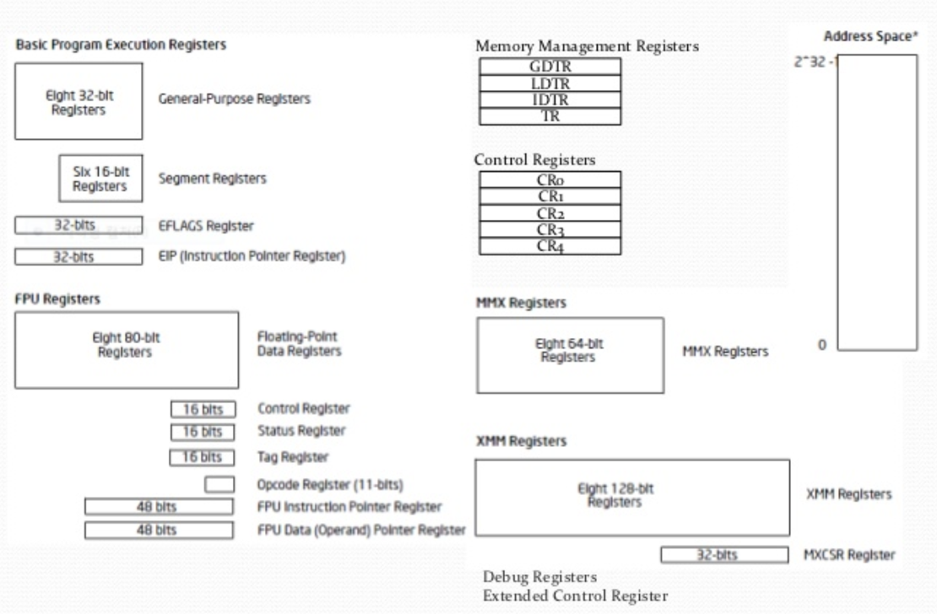
Registers: RISC-V ⇒ x86
Load/Store Arch (RISC-V)
with software conventions
Complex mem-mem arch (x86) with specialized registers and “segments”
cs61C does RISC-V. Will need to learn x86…
Section next week

Slide 19
Multiprogramming - Multiple Threads of Control
Proc 1
Proc 2
Proc n
stack
…
heap
Static Data
OS
code
stack
heap
Static Data
code
stack
heap
Static Data
code

Slide 20
Illusion of Multiple Processors
vCPU1
vCPU2
vCPU3
vCPU1
vCPU2
vCPU3
vCPU1
vCPU2
Shared Memory
Time
Assume a single processor (core). How do we provide the illusion of multiple processors?
Multiplex in time!
Threads are virtual cores
Contents of virtual core (thread):
Program counter, stack pointer
Registers
Where is “it” (the thread)?
On the real (physical) core, or
Saved in chunk of memory – called the Thread Control Block (TCB)

Slide 21
Illusion of Multiple Processors (Continued)
vCPU1
vCPU2
vCPU3
T1
T2
vCPU1
vCPU2
vCPU3
vCPU1
vCPU2
Shared Memory
Time
Consider:
At T1: vCPU1 on real core, vCPU2 in memory
At T2: vCPU2 on real core, vCPU1 in memory
What happened?
OS Ran [how?]
Saved PC, SP, … in vCPU1's thread control block (memory)
Loaded PC, SP, … from vCPU2's TCB, jumped to PC
What triggered this switch?
Timer, voluntary yield, I/O, other things we will discuss

Slide 22
OS object representing a thread?
Traditional term: Thread Control Block (TCB)
Holds contents of registers when thread is not running
What other information?
PINTOS? – read thread.h and thread.c

Slide 23
Administrivia: Getting started
Start homework 0 immediately ⇒ Due next Friday (1/31)!
cs162-xx account, Github account, registration survey
Vagrant and VirtualBox – VM environment for the course
Consistent, managed environment on your machine
Get familiar with all the cs162 tools, submit to autograder via git
Homework slip days: You have 3 slip days
Should go to section tomorrow!
Monday is an optional REVIEW session for C
In 306 Soda: Monday 1/27 @6-8pm
Won’t be webcast, no released slides!
Friday (1/31) is drop day!
Very hard to drop afterwards…
Please drop sooner if you are going to anyway ⇒ Let someone else in!

Slide 24
Administrivia (Con’t)
Midterm conflicts:
There are a couple of people with midterm conflicts – we are still figuring out what to do (if anything)
Kubiatowicz Office Hours:
1pm-2pm, Monday/Thursday
May change as need arises (still have a bit of fluidity here)
Three Free Online Textbooks:
Click on “Resources” link for a list of “Online Textbooks”
Can read O'Reilly books for free as long as on campus or VPN
One book on Git, two books on C
Webcast: https://CalCentral.Berkeley.edu/ (CalNet sign in)
Webcast is *NOT* a replacement for coming to class!

Slide 25
CS 162 Collaboration Policy
Explaining a concept to someone in another group
Discussing algorithms/testing strategies with other groups
Helping debug someone else’s code (in another group)
Searching online for generic algorithms (e.g., hash table)
Sharing code or test cases with another group
Copying OR reading another group’s code or test cases
Copying OR reading online code or test cases from from prior years
We compare all project submissions against prior year submissions and online solutions and will take actions (described on the course overview page) against offenders

Slide 26
Second OS Concept: Address Space
Address space ⇒ the set of accessible addresses + state associated with them:
For a 32-bit processor there are 2³² = 4 billion addresses
What happens when you read or write to an address?
Perhaps acts like regular memory
Perhaps ignores writes
Perhaps causes I/O operation
(Memory-mapped I/O)
Perhaps causes exception (fault)
Communicates with another program
….
0xFFF…
stack
heap
Static Data
code
0x000…

Slide 27
Address Space: In a Picture
0xFFF…
stack
PC:
SP:
heap
Processor
registers
Static Data
instruction
Code Segment
0x000…
What’s in the code segment? Static data segment?
What’s in the Stack Segment?
How is it allocated? How big is it?
What’s in the Heap Segment?
How is it allocated? How big?

Slide 28
Previous discussion of threads: Very Simple Multiprogramming
All vCPU's share non-CPU resources
Memory, I/O Devices
Each thread can read/write memory
Perhaps data of others
can overwrite OS ?
Unusable?
This approach is used in
Very early days of computing
Embedded applications
MacOS 1-9/Windows 3.1 (switch only with voluntary yield)
Windows 95-ME (switch with yield or timer)
However it is risky…

Slide 29
Simple Multiplexing has no Protection
Operating System must protect itself from user programs
Reliability: compromising the operating system generally causes it to crash
Security: limit the scope of what threads can do
Privacy: limit each thread to the data it is permitted to access
Fairness: each thread should be limited to its appropriate share of system resources (CPU time, memory, I/O, etc)
OS must protect User programs from one another
Prevent threads owned by one user from impacting threads owned by another user
Example: prevent one user from stealing secret information from another user

Slide 30
What can the hardware do to help the OS protect itself from programs???

Slide 31
Simple Protection: Base and Bound (B&B)
0000…
0000…
code
code
Static Data
Static Data
heap
heap
stack
0100…
stack
Base
0010…
1000…
1000…
code
>=
Program
address
1010…
Static Data
heap
Bound
<
1100…
stack
1100…
FFFF…

Slide 32
Simple Protection: Base and Bound (B&B)
0000…
0000…
code
code
Static Data
Static Data
heap
heap
stack
0100…
stack
Base
0010…
1000…
1000…
code
>=
Program
address
1010…
Static Data
heap
Addresses translated when program loaded
Bound
<
1100…
stack
1100…
Still protects OS and isolates program
Requires relocating loader
No addition on address path
FFFF…

Slide 33
61C Review: Relocation
Compiled .obj file linked together in an .exe
All address in the .exe are as if it were loaded at memory address 00000000
File contains a list of all the addresses that need to be adjusted when it is “relocated” to somewhere else.

Slide 34
Simple address translation with Base and Bound
0000…
code
0000…
code
Static Data
heap
Addresses translated on-the-fly
Static Data
heap
stack
0100…
stack
Base Address
1000…
code
1000…
0010…
Program
address
0010…
Static Data
1010…
heap
Bound
<
stack
1100…
0100…
Hardware relocation
Can the program touch OS?
Can it touch other programs?
FFFF…

Slide 35
x86 – segments and stacks
code
static data
heap
Processor Registers
CS
EIP
stack
SS
ESP
CS:
EIP:
code
EAX
DS
EBX
ES
ECX
static data
EDX
ESI
EDI
heap
Start address, length and access rights associated with each segment register
SS:
ESP:
stack

Slide 36
Another idea: Address Space Translation
Program operates in an address space that is distinct from the physical memory space of the machine
“physical address”
0x000…
“virtual address”
Processor
translator
Memory
Registers
0xFFF…

Slide 37
Paged Virtual Address Space
What if we break the entire virtual address space into equal size chunks (i.e., pages) have a base for each?
Treat memory as page size frames and put any page into any frame …
Another cs61C review…

Slide 38
Paged Virtual Address
Memory
Processor
Registers
<Page #>
Page Table
<Frame Addr>
instruction
<Page Offset>
Page (eg, 4 kb)
<Virtual Address> =
<Page #> <Page Offset>
PT Addr
Instructions operate on virtual addresses
Instruction address, load/store data address
Translated to a physical address (or Page Fault) through a Page Table by the hardware
Any Page of address space can be in any (page sized) frame in memory
Or not-present (access generates a page fault)
Special register holds page table base address (of the process)
Notes:
Q: For a 64-bit address space and 16kb pages, which bits are used for indexing into the page table? Which for the page offset?
Q: How many page frames in 4 GB of memory? How many bits are needed for the Frame Address field?
Q: If the entire address space of a process is mapped and each entry is 32 bits in size (4 bytes), how large is the page table?
Q: In the above, how much of the memory would it occupy?
Q: Given how address space tends to be structured, how would you reduce the storage overhead of the page table?
Q: Assuming the address space is used sparsely, how else might you compress the size of the page table?
Q: If multiple instances of the same application are running, how could you reduce the memory footprint overall?
Q: What happens if a process has multiple threads?

Slide 39
Third OS Concept: Process
Process: execution environment with Restricted Rights
(Protected) Address Space with One or More Threads
Owns memory (address space)
Owns file descriptors, file system context, …
Encapsulate one or more threads sharing process resources
Application program executes as a process
Complex applications can fork/exec child processes [later!]
Why processes?
Protected from each other!
OS Protected from them
Processes provides memory protection
Threads more efficient than processes for parallelism (later)
Fundamental tradeoff between protection and efficiency
Communication easier within a process
Communication harder between processes

Slide 40
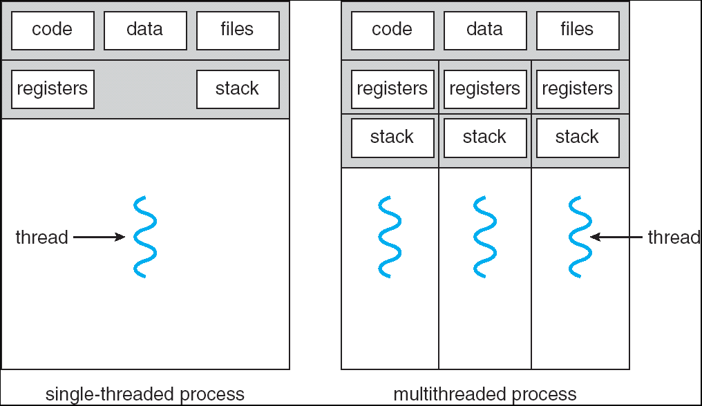
Single and Multithreaded Processes
Threads encapsulate concurrency: “Active” component
Address spaces encapsulate protection: “Passive” part
Keeps buggy program from trashing the system
Why have multiple threads per address space?
Notes:
Sometimes need parallelism for a single job, and processes are very expensive – to start, switch between, and to communicate between

Slide 41
Kernel code/data in process Virtual Address Space?
Unix: Kernel space is mapped in high - but inaccessible to user processes

Slide 42
Fourth OS Concept: Dual Mode Operation
Hardware provides at least two modes:
“Kernel” mode (or “supervisor” or “protected”)
“User” mode: Normal programs executed
What is needed in the hardware to support “dual mode” operation?
A bit of state (user/system mode bit)
Certain operations / actions only permitted in system/kernel mode
In user mode they fail or trap
User → Kernel transition sets system mode AND saves the user PC
Operating system code carefully puts aside user state then performs the necessary operations
Kernel → User transition clears system mode AND restores appropriate user PC
return-from-interrupt

Slide 43
User/Kernel (Privileged) Mode
User Mode
interrupt
exception
syscall
rtn
rfi
Kernel Mode
exit
exec
Limited HW access
Full HW access

Slide 44
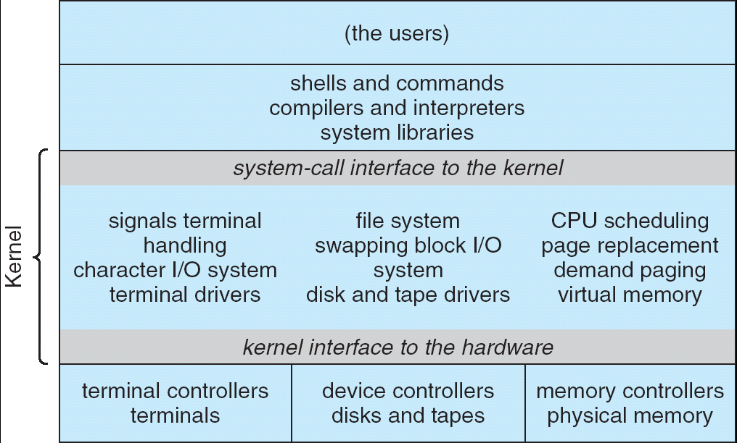
For example: UNIX System Structure
Applications
User Mode
Standard Libs
Kernel Mode
Hardware

Slide 45
Tying it together: Simple B&B: OS loads process
0000…
Proc 1
Proc 2
Proc n
code
…
Static Data
OS
heap
stack
sysmode
1
1000…
code
Base
xxxx …
0000…
Static Data
Bound
xxxx…
FFFF…
heap
uPC
xxxx…
stack
1100…
PC
code
3000…
regs
Static Data
…
heap
stack
3080…
FFFF…

Slide 46
Simple B&B: OS gets ready to execute process
0000…
Proc 1
Proc 2
Proc n
code
RTU
…
Static Data
OS
heap
stack
sysmode
1
1000…
code
Base
1000 …
0000…
Static Data
Bound
1100…
FFFF…
heap
uPC
0001…
stack
1100…
PC
Privileged Inst: set special registers
RTU (Return To Usermode)
code
3000…
regs
00FF…
Static Data
…
heap
stack
3080…
FFFF…

Slide 47
Simple B&B: User Code Running
0000…
Proc 1
Proc 2
Proc n
code
…
Static Data
OS
heap
stack
sysmode
0
1000…
code
Base
1000 …
0000…
Static Data
Bound
1100…
FFFF…
heap
uPC
xxxx…
How does kernel switch between processes?
First question: How to return to system?
stack
1100…
PC
0001…
code
3000…
regs
00FF…
Static Data
…
heap
stack
3080…
FFFF…

Slide 48
3 types of Mode Transfer
Syscall
Process requests a system service, e.g., exit
Like a function call, but “outside” the process
Does not have the address of the system function to call
Like a Remote Procedure Call (RPC) – for later
Marshall the syscall id and args in registers and exec syscall
Interrupt
External asynchronous event triggers context switch
e. g., Timer, I/O device
Independent of user process
Trap or Exception
Internal synchronous event in process triggers context switch
e.g., Protection violation (segmentation fault), Divide by zero, …
All 3 are an UNPROGRAMMED CONTROL TRANSFER
Where does it go?

Slide 49
How do we get the system target address of the “unprogrammed control transfer?”

Slide 50
Interrupt Vector
Address and properties of each interrupt handler
interrupt number (i)
intrpHandler_i () {
….
}
Where else do you see this dispatch pattern?

Slide 51
Simple B&B: User => Kernel
0000…
Proc 1
Proc 2
Proc n
code
…
Static Data
OS
heap
stack
sysmode
0
1000…
code
Base
1000 …
0000…
Static Data
Bound
1100…
FFFF…
heap
uPC
xxxx…
stack
1100…
PC
0000 1234
code
3000…
regs
00FF…
Static Data
How to return to system?
…
heap
stack
3080…
FFFF…

Slide 52
Simple B&B: Interrupt
0000…
Proc 1
Proc 2
Proc n
code
…
Static Data
OS
heap
stack
sysmode
1
1000…
code
Base
1000 …
0000…
Static Data
Bound
1100 …
FFFF…
heap
uPC
0000 1234
stack
1100…
PC
IntrpVector[i]
code
3000…
regs
00FF…
Static Data
How to save registers and set up system stack?
…
heap
stack
3080…
FFFF…

Slide 53
Simple B&B: Switch User Process
0000…
Proc 1
Proc 2
Proc n
code
RTU
…
Static Data
OS
heap
stack
sysmode
1
1000…
1000 …
code
Base
3000 …
0000…
Static Data
1100 …
Bound
0080 …
FFFF…
heap
0000 1234
uPC
0000 0248
regs
stack
1100…
PC
0001 0124
00FF…
code
3000…
regs
00D0…
Static Data
How to save registers and set up system stack?
…
heap
stack
3080…
FFFF…

Slide 54
Simple B&B: “resume”
0000…
Proc 1
Proc 2
Proc n
code
RTU
…
Static Data
OS
heap
stack
sysmode
0
1000…
1000 …
code
Base
3000 …
0000…
Static Data
1100 …
Bound
0080 …
FFFF…
heap
0000 1234
uPC
xxxx xxxx
regs
stack
1100…
PC
000 0248
00FF…
code
3000…
regs
00D0…
Static Data
How to save registers and set up system stack?
…
heap
stack
3080…
FFFF…

Slide 55
Running Many Programs ???
We have the basic mechanism to
switch between user processes and the kernel,
the kernel can switch among user processes,
Protect OS from user processes and processes from each other
Questions ???
How do we decide which user process to run?
How do we represent user processes in the OS?
How do we pack up the process and set it aside?
How do we get a stack and heap for the kernel?
Aren’t we wasting are lot of memory?
…

Slide 56
Process Control Block
Kernel represents each process as a process control block (PCB)
Status (running, ready, blocked, …)
Register state (when not ready)
Process ID (PID), User, Executable, Priority, …
Execution time, …
Memory space, translation, …
Kernel Scheduler maintains a data structure containing the PCBs
Scheduling algorithm selects the next one to run

Slide 57
Scheduler
if ( readyProcesses(PCBs) ) {
nextPCB = selectProcess(PCBs);
run( nextPCB );
} else {
run_idle_process();
}

Slide 58
Conclusion: Four Fundamental OS Concepts
Thread: Execution Context
Fully describes program state
Program Counter, Registers, Execution Flags, Stack
Address space (with or w/o translation)
Set of memory addresses accessible to program (for read or write)
May be distinct from memory space of the physical machine (in which case programs operate in a virtual address space)
Process: an instance of a running program
Protected Address Space + One or more Threads
Dual mode operation / Protection
Only the “system” has the ability to access certain resources
Combined with translation, isolates programs from each other and the OS from programs

