Slide 1
CS162
Operating Systems and
Systems Programming
Lecture 20
Filesystems (Con’t)
Reliability, Transactions
April 14th, 2020
Prof. John Kubiatowicz
http://cs162.eecs.Berkeley.edu

Slide 2
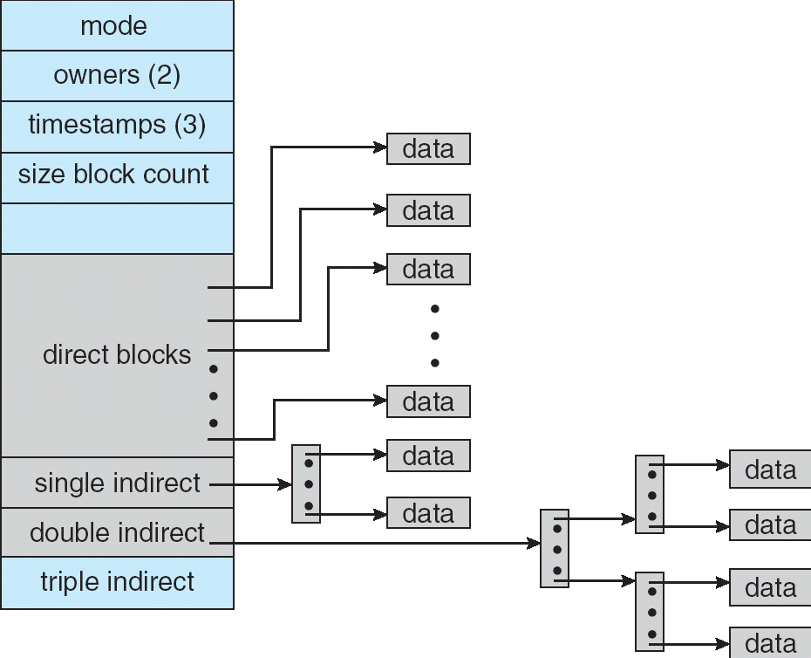
Recall: Multilevel Indexed Files (Original 4.1 BSD)
Sample file in multilevel
indexed format:
  10 direct ptrs, 1K blocks
  How many accesses for
  block #23? (assume file
  header accessed on open)?
    Two: One for indirect block,
    one for data
  How about block #5?
    One: One for data
  Block #340?
    Three: double indirect block,
    indirect block, and data
UNIX 4.1 Pros and cons
  Pros: Simple (more or less)
  Files can easily expand (up to a point)
  Small files particularly cheap and easy
  Cons: Lots of seeks (lead to 4.2 Fast File System Optimizations)
Ext2/3 (Linux):
  12 direct ptrs, triply-indirect blocks,
  settable block size (4K is common)

Slide 3
Recall: Buffer Cache
Kernel must copy disk blocks to main memory to access their contents and write them back if modified
  Could be data blocks, inodes, directory contents, etc.
  Possibly dirty (modified and not written back)
Key Idea: Exploit locality by caching disk data in memory
  Name translations: Mapping from paths→inodes
  Disk blocks: Mapping from block address→disk content
Buffer Cache: Memory used to cache kernel resources, including disk blocks and name translations
  Can contain “dirty” blocks (blocks yet on disk)

Slide 4
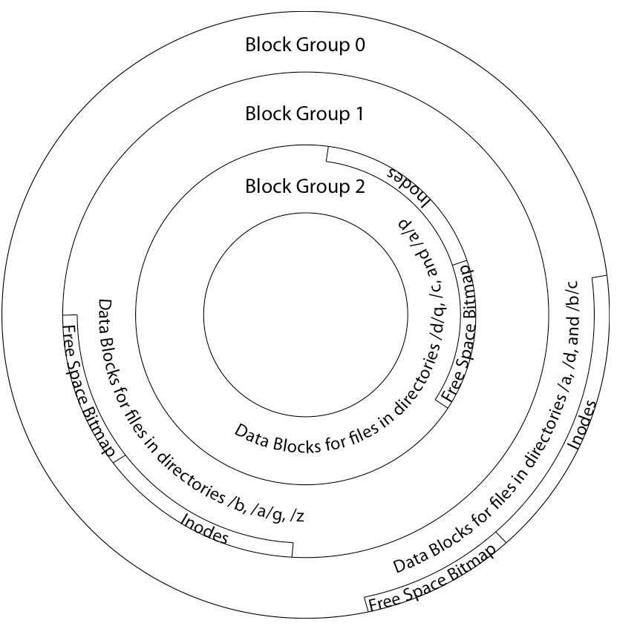
File System Buffer Cache
Data blocks
Disk
Reading
PCB
iNodes
file desc
Writing
Dir Data blocks
Free bitmap
Memory
Blocks
State
free
free
OS implements a cache of disk blocks for efficient access to data, directories, inodes, freemap

Slide 5
File System Buffer Cache: open
Data blocks
Disk
Reading
PCB
iNodes
file desc
Writing
Dir Data blocks
Free bitmap
Memory
Blocks
State
free
free
rd
dir
{load block of directory; search for map}+ ;

Slide 6
File System Buffer Cache: open
Data blocks
Disk
Reading
PCB
iNodes
file desc
Writing
Dir Data blocks
<name>:inumber
Free bitmap
Memory
Blocks
State
free
dir
inode
rd
{load block of directory; search for map}+ ; Load inode ;
Create reference via open file descriptor

Slide 7
File System Buffer Cache: Read?
Data blocks
Disk
Reading
PCB
iNodes
file desc
Writing
Dir Data blocks
<name>:inumber
Free bitmap
Memory
Blocks
State
free
dir
inode
From inode, traverse index structure to find data block; load data block; copy all or part to read data buffer

Slide 8
File System Buffer Cache: Write?
Data blocks
Disk
Reading
PCB
iNodes
file desc
Writing
Dir Data blocks
<name>:inumber
Free bitmap
Memory
Blocks
State
free
dir
inode
Process similar to read, but may allocate new blocks (update free map), blocks need to be written back to disk; inode?

Slide 9
File System Buffer Cache: Eviction?
Data blocks
Disk
Reading
PCB
iNodes
file desc
Writing
Dir Data blocks
<name>:inumber
Free bitmap
Memory
Blocks
State
free
dir
dirty
inode
Blocks being written back to disc go through a transient state

Slide 10
Buffer Cache Discussion
Implemented entirely in OS software
  Unlike memory caches and TLB
Blocks go through transitional states between free and in-use
  Being read from disk, being written to disk
  Other processes can run, etc.
Blocks are used for a variety of purposes
  inodes, data for dirs and files, freemap
  OS maintains pointers into them
Termination – e.g., process exit – open, read, write
Replacement – what to do when it fills up?

Slide 11
File System Caching
Replacement policy? LRU
  Can afford overhead full LRU implementation
  Advantages:
    Works very well for name translation
    Works well in general as long as memory is big enough to accommodate a host’s working set of files.
  Disadvantages:
    Fails when some application scans through file system, thereby flushing the cache with data used only once
    Example: find . –exec grep foo {} \;
Other Replacement Policies?
  Some systems allow applications to request other policies
  Example, ‘Use Once’:
    File system can discard blocks as soon as they are used

Slide 12
File System Caching (con’t)
Cache Size: How much memory should the OS allocate to the buffer cache vs virtual memory?
  Too much memory to the file system cache ⇒ won’t be able to run many applications at once
  Too little memory to file system cache ⇒ many applications may run slowly (disk caching not effective)
  Solution: adjust boundary dynamically so that the disk access rates for paging and file access are balanced
Read Ahead Prefetching: fetch sequential blocks early
  Key Idea: exploit fact that most common file access is sequential by prefetching subsequent disk blocks ahead of current read request (if they are not already in memory)
  Elevator algorithm can efficiently interleave groups of prefetches from concurrent applications
  How much to prefetch?
    Too many imposes delays on requests by other applications
    Too few causes many seeks (and rotational delays) among concurrent file requests

Slide 13
Delayed Writes
Delayed Writes: Writes to files not immediately sent to disk
  So, Buffer Cache is a write-back cache
write() copies data from user space buffer to kernel buffer
  Enabled by presence of buffer cache: can leave written file blocks in cache for a while
  Other apps read data from cache instead of disk
  Cache is transparent to user programs
Flushed to disk periodically
  In Linux: kernel threads flush buffer cache very 30 sec. in default setup
Disk scheduler can efficiently order lots of requests
  Elevator Algorithm can rearrange writes to avoid random seeks

Slide 14
Delayed Writes
Delay block allocation: May be able to allocate multiple blocks at same time for file, keep them contiguous
Some files never actually make it all the way to disk
  Many short-lived files
But what if system crashes before buffer cache block is flushed to disk?
And what if this was for a directory file?
  Lose pointer to inode
file systems need recovery mechanisms

Slide 15
Important “ilities”
Availability: the probability that the system can accept and process requests
  Often measured in “nines” of probability. So, a 99.9% probability is considered “3-nines of availability”
  Key idea here is independence of failures
Durability: the ability of a system to recover data despite faults
  This idea is fault tolerance applied to data
  Doesn’t necessarily imply availability: information on pyramids was very durable, but could not be accessed until discovery of Rosetta Stone
Reliability: the ability of a system or component to perform its required functions under stated conditions for a specified period of time (IEEE definition)
  Usually stronger than simply availability: means that the system is not only “up”, but also working correctly
  Includes availability, security, fault tolerance/durability
  Must make sure data survives system crashes, disk crashes, other problems

Slide 16
How to Make File System Durable?
Disk blocks contain Reed-Solomon error correcting codes (ECC) to deal with small defects in disk drive
  Can allow recovery of data from small media defects
Make sure writes survive in short term
  Either abandon delayed writes or
  Use special, battery-backed RAM (called non-volatile RAM or NVRAM) for dirty blocks in buffer cache
Make sure that data survives in long term
  Need to replicate! More than one copy of data!
  Important element: independence of failure
    Could put copies on one disk, but if disk head fails…
    Could put copies on different disks, but if server fails…
    Could put copies on different servers, but if building is struck by lightning….
    Could put copies on servers in different continents…

Slide 17
RAID: Redundant Arrays of Inexpensive Disks
Classified by David Patterson, Garth A. Gibson, and Randy Katz here at UCB in 1987
  Classic paper was first to evaluate multiple schemes
Data stored on multiple disks (redundancy)
  Berkeley researchers were looking for alternatives to big expensive disks
  Redundancy necessary because cheap disks were more error prone
Either in software or hardware
  In hardware case, done by disk controller; file system may not even know that there is more than one disk in use
Initially, five levels of RAID (more now)

Slide 18
RAID 1: Disk Mirroring/Shadowing
recovery
group
Each disk is fully duplicated onto its “shadow”
  For high I/O rate, high availability environments
  Most expensive solution: 100% capacity overhead
Bandwidth sacrificed on write:
  Logical write = two physical writes
  Highest bandwidth when disk heads and rotation fully synchronized (hard to do exactly)
Reads may be optimized
  Can have two independent reads to same data
Recovery:
  Disk failure ⇒ replace disk and copy data to new disk
  Hot Spare: idle disk already attached to system to be used for immediate replacement

Slide 19
RAID 5+: High I/O Rate Parity
Stripe
Unit
Data stripped across
multiple disks
  Successive blocks
  stored on successive
  (non-parity) disks
  Increased bandwidth
  over single disk
Parity block (in green)
constructed by XORing
data bocks in stripe
  P0=D0⊕D1⊕D2⊕D3
  Can destroy any one
  disk and still
  reconstruct data
  Suppose Disk 3 fails,
  then can reconstruct:
  D2=D0⊕D1⊕D3⊕P0
Can spread information widely across internet for durability
  RAID algorithms work over geographic scale
D0
D1
D2
D3
P0
D4
D5
D6
P1
Increasing
Logical
Disk
Addresses
D7
D8
D9
P2
D10
D11
D12
P3
D13
D14
D15
P4
D16
D17
D18
D19
D20
D21
D22
D23
P5
Disk 1
Disk 2
Disk 3
Disk 4
Disk 5

Slide 20
Allow more disks to fail!
In general: RAIDX is an “erasure code”
  Must have ability to know which disks are bad
  Treat missing disk as an “Erasure”
Today, Disks so big that: RAID 5 not sufficient!
  Time to repair disk sooooo long, another disk might fail in process!
  “RAID 6” – allow 2 disks in replication stripe to fail
But – must do something more complex that just XORing together blocks!
  Already used up the simple XOR operation across disks
Simple option: Check out EVENODD code in readings
  Will generate one additional check disks to support RAID 6
More general option for general erasure code: Reed-Solomon codes
  Based on polynomials in GF(2^{k}) (I.e. k-bit symbols)
    Gailois Field is finite version of real numbers
  Data as coefficients (a_{j}), code space as values of polynomial:
    P(x)=a₀+a₁x¹+… a_{m-1}x^{m-1}
    Coded: P(0),P(1),P(2)….,P(n-1)
  Can recover polynomial (i.e. data) as long as get any m of n; allows n-m failures!

Slide 21
Allow more disks to fail! (Con’t)
How to use Reed-Solomon code in practice?
  Each coefficient has a fixed (k) number of bits. So, must encode with symbols that size
  Example: k=16 bit symbols, m=4, encoding 16x4 bits at a time
    Take original data, split into 4 chunks. On each encoding step, grab 16 bits from each chunk to use as coefficients
    Each data point yields a 16-bit symbol, which you distributed to final encoded chunks
  (better version of Reed-Solomon code for erasure channels is the “Cauchy Reed-Solomon” code; it is isomorphic to the version here)
Examples (with k=16):
  Suppose have 6 disks, want to tolerate 2 failures
    Split data into 4 chunks, encode 16 bits from each chunk at a time, by generating 6 points (of 16 bits) on 3rd-degree polynomial
    Distribute data from polynomial to 6 disks – each disk will ultimately hold data that is ¼ size of original data
    Can handle 2 lost disks for 50% overhead
  More interesting extreme for Internet-level replication:
    Split data into 4 chunks, produce 16 chunks
    Each chunk is ¼ total size of original data, Overhead = factor of 4
    But – only need 4 of 16 fragments! REALLY DURABLE!

Slide 22
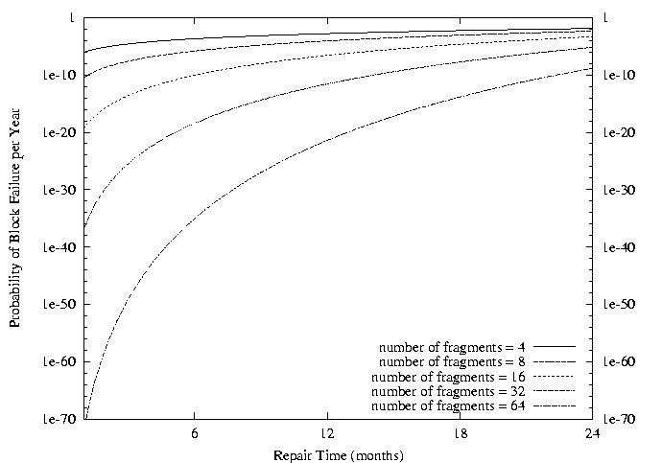
Use of Erasure Coding in general:
High Durability/overhead ratio!
Fraction Blocks Lost
Per Year (FBLPY)
Exploit law of large numbers for durability!
6 month repair, FBLPY with 4x increase in total size of data:
  Replication (4 copies): 0.03
  Fragmentation (16 of 64 fragments needed): 10⁻³⁵

Slide 23
Higher Durability/Reliability through
Geographic Replication
Highly durable – hard to destroy all copies
Highly available for reads
  Simple replication: read any copy
  Erasure coded: read m of n
Low availability for writes
  Can’t write if any one replica is not up
  Or – need relaxed consistency model
Reliability? – availability, security, durability, fault-tolerance
Replica/Frag #1
Replica/Frag #2
Replica/Frag #n

Slide 24
File System Reliability:
(Difference from Block-level reliability)
What can happen if disk loses power or software crashes?
  Some operations in progress may complete
  Some operations in progress may be lost
  Overwrite of a block may only partially complete
Having RAID doesn’t necessarily protect against all such failures
  No protection against writing bad state
  What if one disk of RAID group not written?
File system needs durability (as a minimum!)
  Data previously stored can be retrieved (maybe after some recovery step), regardless of failure

Slide 25
Storage Reliability Problem
Single logical file operation can involve updates to multiple physical disk blocks
  inode, indirect block, data block, bitmap, …
  With sector remapping, single update to physical disk block can require multiple (even lower level) updates to sectors
At a physical level, operations complete one at a time
  Want concurrent operations for performance
How do we guarantee consistency regardless of when crash occurs?

Slide 26
Threats to Reliability
Interrupted Operation
  Crash or power failure in the middle of a series of related updates may leave stored data in an inconsistent state
  Example: transfer funds from one bank account to another
  What if transfer is interrupted after withdrawal and before deposit?
Loss of stored data
  Failure of non-volatile storage media may cause previously stored data to disappear or be corrupted

Slide 27
Reliability Approach #1: Careful Ordering
Sequence operations in a specific order
  Careful design to allow sequence to be interrupted safely
Post-crash recovery
  Read data structures to see if there were any operations in progress
  Clean up/finish as needed
Approach taken by
  FAT and FFS (fsck) to protect filesystem structure/metadata
  Many app-level recovery schemes (e.g., Word, emacs autosaves)

Slide 28
FFS: Create a File
Normal operation:
Allocate data block
Write data block
Allocate inode
Write inode block
Update bitmap of free blocks and inodes
Update directory with file name → inode number
Update modify time for directory
Recovery:
Scan inode table
If any unlinked files (not in any directory), delete or put in lost & found dir
Compare free block bitmap against inode trees
Scan directories for missing update/access times
Time proportional to disk size

Slide 29
Reliability Approach #2: Copy on Write File Layout
To update file system, write a new version of the file system containing the update
  Never update in place
  Reuse existing unchanged disk blocks
Seems expensive! But
  Updates can be batched
  Almost all disk writes can occur in parallel
Approach taken in network file server appliances
  NetApp’s Write Anywhere File Layout (WAFL)
  ZFS (Sun/Oracle) and OpenZFS

Slide 30
COW with Smaller-Radix Blocks
old version
new version
Write
If file represented as a tree of blocks, just need to update the leading fringe

Slide 31
ZFS and OpenZFS
Variable sized blocks: 512 B – 128 KB
Symmetric tree
  Know if it is large or small when we make the copy
Store version number with pointers
  Can create new version by adding blocks and new pointers
Buffers a collection of writes before creating a new version with them
Free space represented as tree of extents in each block group
  Delay updates to freespace (in log) and do them all when block group is activated

Slide 32
More General Reliability Solutions
Use Transactions for atomic updates
  Ensure that multiple related updates are performed atomically
  i.e., if a crash occurs in the middle, the state of the systems reflects either all or none of the updates
  Most modern file systems use transactions internally to update filesystem structures and metadata
  Many applications implement their own transactions
Provide Redundancy for media failures
  Redundant representation on media (Error Correcting Codes)
  Replication across media (e.g., RAID disk array)

Slide 33
Transactions
Closely related to critical sections for manipulating shared data structures
They extend concept of atomic update from memory to stable storage
  Atomically update multiple persistent data structures
Many ad-hoc approaches
  FFS carefully ordered the sequence of updates so that if a crash occurred while manipulating directory or inodes the disk scan on reboot would detect and recover the error (fsck)
  Applications use temporary files and rename

Slide 34
Key Concept: Transaction
An atomic sequence of actions (reads/writes) on a storage system (or database)
That takes it from one consistent state to another
transaction
consistent state 1
consistent state 2

Slide 35
Typical Structure
Begin a transaction – get transaction id
Do a bunch of updates
  If any fail along the way, roll-back
  Or, if any conflicts with other transactions, roll-back
Commit the transaction

Slide 36
“Classic” Example: Transaction
BEGIN; --BEGIN TRANSACTION
UPDATE accounts SET balance = balance - 100.00 WHERE name = 'Alice';
UPDATE branches SET balance = balance - 100.00 WHERE name = (SELECT branch_name FROM accounts WHERE name = 'Alice');
UPDATE accounts SET balance = balance + 100.00 WHERE name = 'Bob';
UPDATE branches SET balance = balance + 100.00 WHERE name = (SELECT branch_name FROM accounts WHERE name = 'Bob');
COMMIT; --COMMIT WORK
Transfer $100 from Alice’s account to Bob’s account

Slide 37
The ACID properties of Transactions
Atomicity: all actions in the transaction happen, or none happen
Consistency: transactions maintain data integrity, e.g.,
  Balance cannot be negative
  Cannot reschedule meeting on February 30
Isolation: execution of one transaction is isolated from that of all others; no problems from concurrency
Durability: if a transaction commits, its effects persist despite crashes

Slide 38
Concept of a log
One simple action is atomic – write/append a basic item
Use that to seal the commitment to a whole series of actions
Commit Tran N
Start Tran N
Get 10$ from account A
Get 7$ from account B
Get 13$ from account C
Put 15$ into account X
Put 15$ into account Y

Slide 39
Transactional File Systems
Better reliability through use of log
  All changes are treated as transactions
  A transaction is committed once it is written to the log
    Data forced to disk for reliability
    Process can be accelerated with NVRAM
  Although File system may not be updated immediately, data preserved in the log
Difference between “Log Structured” and “Journaled”
  In a Log Structured filesystem, data stays in log form
  In a Journaled filesystem, Log used for recovery
Journaling File System
  Applies updates to system metadata using transactions (using logs, etc.)
  Updates to non-directory files (i.e., user stuff) can be done in place (without logs), full logging optional
  Ex: NTFS, Apple HFS+, Linux XFS, JFS, ext3, ext4
Full Logging File System
  All updates to disk are done in transactions

Slide 40
Journaling File Systems
Instead of modifying data structures on disk directly, write changes to a journal/log
  Intention list: set of changes we intend to make
  Log/Journal is append-only
  Single commit record commits transaction
Once changes are in the log, it is safe to apply changes to data structures on disk
  Recovery can read log to see what changes were intended
  Can take our time making the changes
    As long as new requests consult the log first
Once changes are copied, safe to remove log
But, …
  If the last atomic action is not done … poof … all gone
Basic assumption:
  Updates to sectors are atomic and ordered
  Not necessarily true unless very careful, but key assumption

Slide 41
Example: Creating a File
Find free data block(s)
Find free inode entry
Find dirent insertion point
-----------------------------------------
Write map (i.e., mark used)
Write inode entry to point to block(s)
Write dirent to point to inode
Free space map
Data blocks
…
Inode table
Directory
entries

Slide 42
Ex: Creating a file (as a transaction)
Find free data block(s)
Find free inode entry
Find dirent insertion point
---------------------------------------------------------
[log] Write map (used)
[log] Write inode entry to point to block(s)
[log] Write dirent to point to inode
Free space map
Data blocks
…
Inode table
Directory
entries
tail
head
done
pending
start
commit
Log: in non-volatile storage (Flash or on Disk)

Slide 43
“Redo Log “ – Replay Transactions
After Commit
All access to file system first looks in log
Eventually copy changes to disk
Free space map
Data blocks
…
Inode table
Directory
entries
tail
tail
tail
tail
tail
head
done
start
commit
pending
Log: in non-volatile storage (Flash or Disk)

Slide 44
Crash During Logging – Recover
Upon recovery scan the log
Detect transaction start with no commit
Discard log entries
Disk remains unchanged
Free space map
Data blocks
…
Inode table
Directory
entries
tail
head
done
pending
start
Log: in non-volatile storage (Flash or on Disk)

Slide 45
Recovery After Commit
Scan log, find start
Find matching commit
Redo it as usual
  Or just let it happen later
Free space map
Data blocks
…
Inode table
Directory
entries
tail
head
done
pending
start
commit
Log: in non-volatile storage (Flash or on Disk)

Slide 46
Journaling Summary
Why go through all this trouble?
Updates atomic, even if we crash:
  Update either gets fully applied or discarded
  All physical operations treated as a logical unit
Isn't this expensive?
Yes! We're now writing all data twice (once to log, once to actual data blocks in target file)
Modern filesystems offer an option to journal metadata updates only
  Record modifications to file system data structures
  But apply updates to a file's contents directly

Slide 47
Going Further – Log Structured File Systems
The log IS what is recorded on disk
  File system operations logically replay log to get result
  Create data structures to make this fast
  On recovery, replay the log
Index (inodes) and directories are written into the log too
Large, important portion of the log is cached in memory
Do everything in bulk: log is collection of large segments
Each segment contains a summary of all the operations within the segment
  Fast to determine if segment is relevant or not
Free space is approached as continual cleaning process of segments
  Detect what is live or not within a segment
  Copy live portion to new segment being formed (replay)
  Garbage collection entire segment
  No bit map

Slide 48
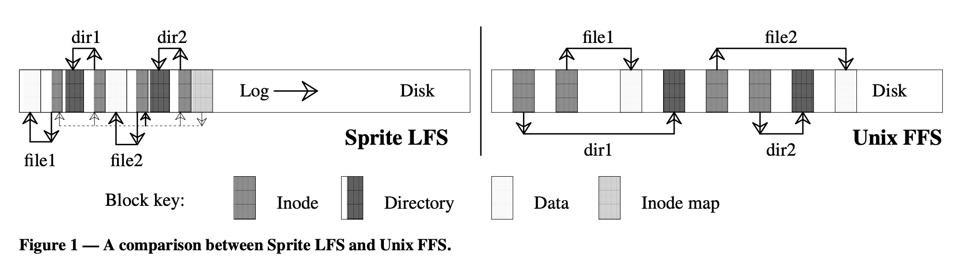
LFS Paper in Readings
LFS: write file1 block, write inode for file1, write directory page mapping “file1” in “dir1” to its inode, write inode for this directory page. Do the same for ”/dir2/file2”. Then write summary of the new inodes that got created in the segment
FFS: <left as exercise>
Reads are same in either case (pointer following)
Buffer cache likely to hold information in both cases
  But disk IOs are very different – writes sequential, reads not!
  Randomness of read layout assumed to be handled by cache

Slide 49
Example: F2FS: A Flash File System
File system used on many mobile devices
  Including the Pixel 3 from Google
  Latest version supports block-encryption for security
  Has been “mainstream” in linux for several years now
Assumes standard SSD interface
  With built-in Flash Translation Layer (FTL)
  Random reads are as fast as sequential reads
  Random writes are bad for flash storage
    Forces FTL to keep moving/coalescing pages and erasing blocks
    Sustained write performance degrades/lifetime reduced
Minimize Writes/updates and otherwise keep writes “sequential”
  Start with Log-structured file systems/copy-on-write file systems
  Keep writes as sequential as possible
  Node Translation Table (NAT) for “logical” to “physical” translation
    Independent of FTL
For more details, check out paper in Readings section of website
  “F2FS: A New File System for Flash Storage” (from 2015)
  Design of file system to leverage and optimize NAND flash solutions
  Comparison with Ext4, Btrfs, Nilfs2, etc

Slide 50
Flash-friendly on-disk Layout
Main Area:
  Divided into segments (basic unit of management in F2FS)
  4KB Blocks. Each block typed to be node or data.
Node Address Table (NAT): Independent of FTL!
  Block address table to locate all “node blocks” in Main Area
Updates to data sorted by predicted write frequency (Hot/Warm/Cold) to optimize FLASH management
Checkpoint (CP): Keeps the file system status
  Bitmaps for valid NAT/SIT sets and Lists of orphan inodes
  Stores a consistent F2FS status at a given point in time
Segment Information Table (SIT):
  Per segment information such as number of valid blocks and the bitmap for the validity of all blocks in the “Main” area
  Segments used for “garbage collection”
Segment Summary Area (SSA):
  Summary representing the owner information of all blocks in the Main area

Slide 51
LFS Index Structure:
Forces many updates when updating data

Slide 52
F2FS Index Structure:
Indirection and Multi-head logs optimize updates

Slide 53
File System Summary (1/3)
File System:
  Transforms blocks into Files and Directories
  Optimize for size, access and usage patterns
  Maximize sequential access, allow efficient random access
  Projects the OS protection and security regime (UGO vs ACL)
File defined by header, called “inode”
Naming: translating from user-visible names to actual sys resources
  Directories used for naming for local file systems
  Linked or tree structure stored in files
Multilevel Indexed Scheme
  inode contains file info, direct pointers to blocks, indirect blocks, doubly indirect, etc..
  NTFS: variable extents not fixed blocks, tiny files data is in header

Slide 54
File System Summary (2/3)
File layout driven by freespace management
  Optimizations for sequential access: start new files in open ranges of free blocks, rotational optimization
  Integrate freespace, inode table, file blocks and dirs into block group
FLASH filesystems optimized for:
  Fast random reads
  Limiting Updates to data blocks
Buffer Cache: Memory used to cache kernel resources, including disk blocks and name translations
  Can contain “dirty” blocks (blocks yet on disk)

Slide 55
File System Summary (3/3)
File system operations involve multiple distinct updates to blocks on disk
  Need to have all or nothing semantics
  Crash may occur in the midst of the sequence
Traditional file system perform check and recovery on boot
  Along with careful ordering so partial operations result in loose fragments, rather than loss
Copy-on-write provides richer function (versions) with much simpler recovery
  Little performance impact since sequential write to storage device is nearly free
Transactions over a log provide a general solution
  Commit sequence to durable log, then update the disk
  Log takes precedence over disk
  Replay committed transactions, discard partials

