Slide 1
CS162 Operating Systems and Systems Programming Lecture 4 Processes (con’t), Threads, Concurrency
January 30th, 2020
Prof. John Kubiatowicz
http://cs162.eecs.Berkeley.edu

Slide 2
Recall: Modern Process with Threads
Process: execution environment with restricted rights
Address Space with One or More Threads
One Page table per process!
Owns memory (mapped pages)
Owns file descriptors, file system context, …
Encapsulates one or more threads sharing process resources
Thread: a sequential execution stream within process (Sometimes called a “Lightweight process”)
Process still contains a single Address Space
No protection between threads
Multithreading: a single program made up of a number of different concurrent activities
Sometimes called multitasking, as in Ada …
Why separate the concept of a thread from that of a process?
Discuss the “thread” part of a process (concurrency)
Separate from the “address space” (protection)
Heavyweight Process ≡ Process with one thread

Slide 3
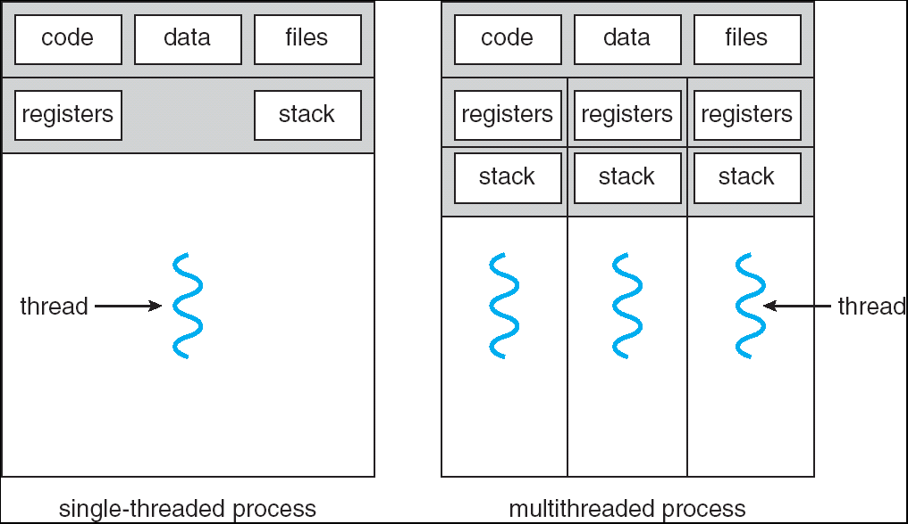
Recall: Single and Multithreaded Processes
Threads encapsulate concurrency: “Active” component
Address spaces encapsulate protection: “Passive” part
Keeps buggy program from trashing the system
Why have multiple threads per address space?
Notes:
Sometimes need parallelism for a single job, and processes are very expensive – to start, switch between, and to communicate between

Slide 4
Recall: How do we Multiplex Processes?
The current state of process held in a process control block (PCB):
This is a “snapshot” of the execution and protection environment
Only one PCB active at a time
Give out CPU time to different processes (Scheduling):
Only one process “running” at a time
Give more time to important processes
Give pieces of resources to different processes (Protection):
Controlled access to non-CPU resources
Example mechanisms:
Memory Translation: Give each process their own (protected) address space
Kernel/User duality: Arbitrary multiplexing of I/O through system calls
Process Control
Block

Slide 5
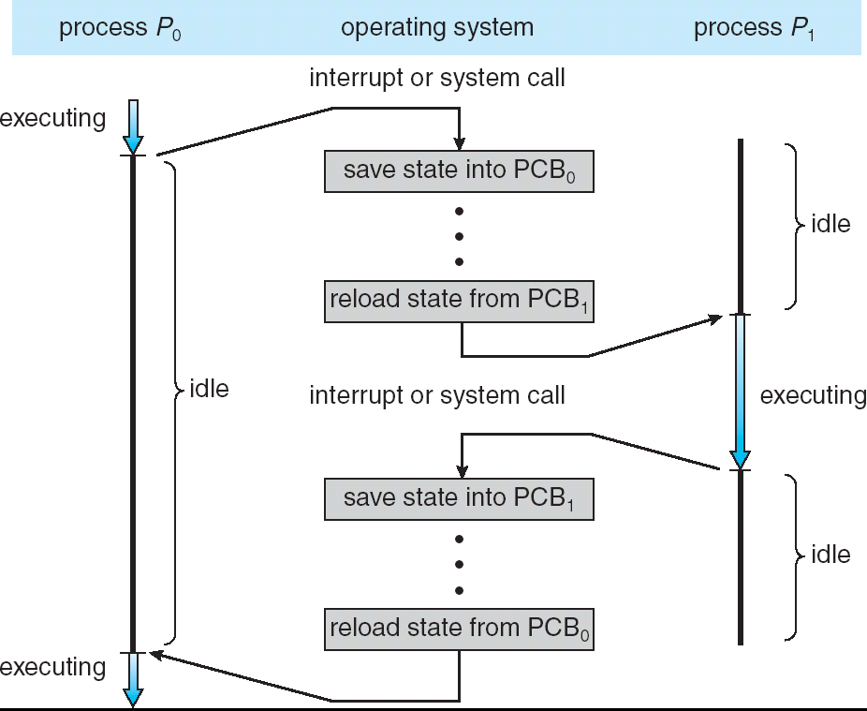
Recall: Context Switch
Privilege Level: 3 - user
Privilege Level: 0 - sys
Privilege Level: 3 - user

Slide 6
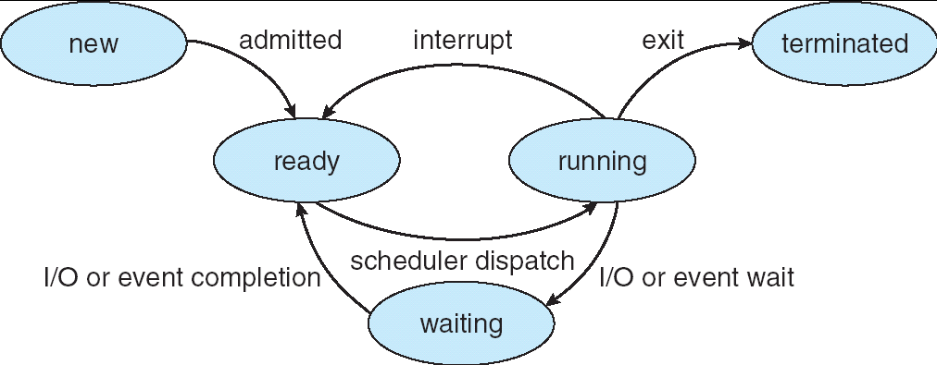
Recall: Lifecycle of a Process
As a process executes, it changes state:
new: The process is being created
ready: The process is waiting to run
running: Instructions are being executed
waiting: Process waiting for some event to occur
terminated: The process has finished execution

Slide 7
Discussion
Process is an instance of an executing program
The fundamental OS responsibility
Each instance has an identity (Process ID) or PID
Processes do their work by processing and calling file system operations
This involves interacting with the Kernel!
How do we do that?
Are their any operations on processes themselves?
create (fork) ?
terminate (exit) ?
sleep (sleep) ?
communicate with (e.g. signal)?

Slide 8
OS Run-Time Library
Proc 1
Proc 2
Proc n
…
OS
Appln
login
Window Manager
…
libc
OS library
OS library
OS library
OS

Slide 9
A Narrow Waist
Word Processing
Compilers
Web Browsers
Email
Databases
Web Servers
Application / Service
Portable OS Library
OS
User Mode
System Call
Interface
System Mode
Portable OS Kernel
Software
Platform support, Device Drivers
Hardware
x86
PowerPC
ARM
PCI
Ethernet (1Gbs/10Gbs)
802.11 a/g/n/ac/ax
SCSI
Graphics
Thunderbolt

Slide 10
pid.c
#include <stdlib.h>
#include <stdio.h>
#include <string.h>
#include <unistd.h>
#include <sys/types.h>
int main(int argc, char *argv[])
{
pid_t pid = getpid(); /* get current processes PID */
printf("My pid: %d\n", pid);
exit(0);
}
ps anyone?

Slide 11
POSIX/Unix
Portable Operating System Interface [X?]
Defines “Unix”, derived from AT&T Unix
Created to bring order to many Unix-derived OSs
Interface for application programmers (mostly)

Slide 12
System Calls
Application:
fd = open(pathname);
Library:
File *open(pathname) {
asm code … syscall # into ax
put args into registers bx, …
special trap instruction
Operating System:
get args from regs
dispatch to system func
process, schedule, …
complete, resume process
get results from regs
};
Continue with results
Pintos: userprog/syscall.c, lib/user/syscall.c

Slide 13
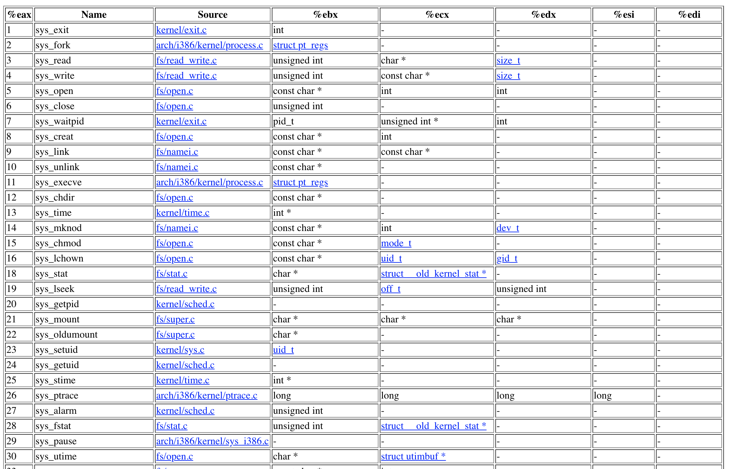
SYSCALLs (of over 300)
Pintos: syscall-nr.h

Slide 14
Recall: Kernel System Call Handler
Locate arguments
In registers or on user(!) stack
Copy arguments
From user memory into kernel memory
Protect kernel from malicious code evading checks
Validate arguments
Protect kernel from errors in user code
Copy results back
into user memory

Slide 15
Process Management
exit – terminate a process
fork – copy the current process
exec – change the program being run by the current process
wait – wait for a process to finish
kill – send a signal (interrupt-like notification) to another process
sigaction – set handlers for signals

Slide 16
Process Management
exit – terminate a process
fork – copy the current process
exec – change the program being run by the current process
wait – wait for a process to finish
kill – send a signal (interrupt-like notification) to another process
sigaction – set handlers for signals

Slide 17
Creating Processes
pid_t fork(); -- copy the current process
This means everything!
New process has different pid
Return value from fork(): pid (like an integer)
When > 0:
Running in (original) Parent process
return value is pid of new child
When = 0:
Running in new Child process
When < 0:
Error! Must handle somehow
Running in original process
If no error: State of original process duplicated in both Parent and Child!
Address Space (Memory), File Descriptors (covered later), etc…
Not as bad as it seems – really only copy page table [more later]

Slide 18
fork1.c
#include <stdlib.h>
#include <stdio.h>
#include <unistd.h>
#include <sys/types.h>
int main(int argc, char *argv[]) {
pid_t cpid, mypid;
pid_t pid = getpid(); /* get current processes PID */
printf("Parent pid: %d\n", pid);
cpid = fork();
if (cpid > 0) { /* Parent Process */
mypid = getpid();
printf("[%d] parent of [%d]\n", mypid, cpid);
} else if (cpid == 0) { /* Child Process */
mypid = getpid();
printf("[%d] child\n", mypid);
} else {
perror("Fork failed");
}
}

Slide 19
fork1.c
#include <stdlib.h>
#include <stdio.h>
#include <unistd.h>
#include <sys/types.h>
int main(int argc, char *argv[]) {
pid_t cpid, mypid;
pid_t pid = getpid(); /* get current processes PID */
printf("Parent pid: %d\n", pid);
cpid = fork();
if (cpid > 0) { /* Parent Process */
mypid = getpid();
printf("[%d] parent of [%d]\n", mypid, cpid);
} else if (cpid == 0) { /* Child Process */
mypid = getpid();
printf("[%d] child\n", mypid);
} else {
perror("Fork failed");
}
}

Slide 20
fork1.c
#include <stdlib.h>
#include <stdio.h>
#include <unistd.h>
#include <sys/types.h>
int main(int argc, char *argv[]) {
pid_t cpid, mypid;
pid_t pid = getpid(); /* get current processes PID */
printf("Parent pid: %d\n", pid);
cpid = fork();
if (cpid > 0) { /* Parent Process */
mypid = getpid();
printf("[%d] parent of [%d]\n", mypid, cpid);
} else if (cpid == 0) { /* Child Process */
mypid = getpid();
printf("[%d] child\n", mypid);
} else {
perror("Fork failed");
}
}

Slide 21
fork_race.c
int i;
cpid = fork();
if (cpid > 0) {
for (i = 0; i < 10; i++) {
printf("Parent: %d\n", i);
// sleep(1);
}
} else if (cpid == 0) {
for (i = 0; i > -10; i--) {
printf("Child: %d\n", i);
// sleep(1);
}
}
What does this print?
Would adding the calls to sleep matter?

Slide 22
Fork “race”
int i;
cpid = fork();
if (cpid > 0) {
for (i = 0; i < 10; i++) {
printf("Parent: %d\n", i);
// sleep(1);
}
} else if (cpid == 0) {
for (i = 0; i > -10; i--) {
printf("Child: %d\n", i);
// sleep(1);
}
}

Slide 23
Process Management
fork – copy the current process
exec – change the program being run by the current process
wait – wait for a process to finish
kill – send a signal (interrupt-like notification) to another process
sigaction – set handlers for signals

Slide 24
fork2.c – parent waits for child to finish
int status;
pid_t tcpid;
…
cpid = fork();
if (cpid > 0) { /* Parent Process */
mypid = getpid();
printf("[%d] parent of [%d]\n", mypid, cpid);
tcpid = wait(&status);
printf("[%d] bye %d(%d)\n", mypid, tcpid, status);
} else if (cpid == 0) { /* Child Process */
mypid = getpid();
printf("[%d] child\n", mypid);
exit(42);
}
…

Slide 25
Process Management
fork – copy the current process
exec – change the program being run by the current process
wait – wait for a process to finish
kill – send a signal (interrupt-like notification) to another process
sigaction – set handlers for signals

Slide 26
Process Management
child
pid=fork();
if (pid==0)
exec(…);
else
wait(&stat)
main() {
…
}
exec
fork
pid=fork();
if (pid==0)
exec(…);
else
wait(&stat)
parent
pid=fork();
if (pid==0)
exec(…);
else
wait(&stat)
fork
wait

Slide 27
fork3.c
…
cpid = fork();
if (cpid > 0) { /* Parent Process */
tcpid = wait(&status);
} else if (cpid == 0) { /* Child Process */
char *args[] = {“ls”, “-l”, NULL};
execv(“/bin/ls”, args);
/* execv doesn’t return when it works.
So, if we got here, it failed! */
perror(“execv”);
exit(1);
}
…

Slide 28
Shell
A shell is a job control system
Allows programmer to create and manage a set of programs to do some task
Windows, MacOS, Linux all have shells
Example: to compile a C program
cc –c sourcefile1.c
cc –c sourcefile2.c
ln –o program sourcefile1.o sourcefile2.o
./program
HW3

Slide 29
Process Management
fork – copy the current process
exec – change the program being run by the current process
wait – wait for a process to finish
kill – send a signal (interrupt-like notification) to another process
sigaction – set handlers for signals

Slide 30
inf_loop.c
#include <stdlib.h>
#include <stdio.h>
#include <sys/types.h>
#include <unistd.h>
#include <signal.h>
void signal_callback_handler(int signum) {
printf(“Caught signal!\n”);
exit(1);
}
int main() {
struct sigaction sa;
sa.sa_flags = 0;
sigemptyset(&sa.sa_mask);
sa.sa_handler = signal_callback_handler;
sigaction(SIGINT, &sa, NULL);
while (1) {}
}

Slide 31
Common POSIX Signals
SIGINT – control-C
SIGTERM – default for kill shell command
SIGSTP – control-Z (default action: stop process)
SIGKILL, SIGSTOP – terminate/stop process
Can’t be changed or disabled with sigaction
Why?

Slide 32
Administrivia
Kubiatowicz Office Hours:
1-2pm, Monday & Thursday
No one left on WaitList or Concurrent Enrollment List!
Everyone who wants to be is in the class.
TOMORROW (Friday) is Drop Deadline! VERY HARD TO DROP LATER!
Recommendation: Read assigned readings before lecture
You should be going to sections now – Important information covered in section
Any section will do until groups assigned
Group sign up via autograder form next week
Get finding groups of 4 people ASAP
Priority for same section; if cannot make this work, keep same TA
Remember: Your TA needs to see you in section!
Midterm 1 conflicts
We will handle these conflicts next week

Slide 33
Reminder: Definitions
A thread is a single execution sequence that represents a separately schedulable task
Protection is an orthogonal concept
Can have one or many threads per protection domain
Single threaded user program: one thread, one protection domain
Multi-threaded user program: multiple threads, sharing same data structures, isolated from other user programs
Multi-threaded kernel: multiple threads, sharing kernel data structures, capable of using privileged instructions

Slide 34
Threads Motivation
Operating systems need to be able to handle multiple things at once (MTAO)
processes, interrupts, background system maintenance
Servers need to handle MTAO
Multiple connections handled simultaneously
Parallel programs need to handle MTAO
To achieve better performance
Programs with user interfaces often need to handle MTAO
To achieve user responsiveness while doing computation
Network and disk bound programs need to handle MTAO
To hide network/disk latency
Sequence steps in access or communication

Slide 35
Silly Example for Threads
Imagine the following program:
main() {
ComputePI(“pi.txt”);
PrintClassList(“classlist.txt”);
}
What is the behavior here?
Program would never print out class list
Why? ComputePI would never finish

Slide 36
Adding Threads
Version of program with Threads (loose syntax):
main() {
thread_fork(ComputePI, “pi.txt” ));
thread_fork(PrintClassList, “classlist.txt”));
}
thread_fork: Start independent thread running given procedure
What is the behavior here?
Now, you would actually see the class list
This should behave as if there are two separate CPUs
CPU1
CPU2
CPU1
CPU2
CPU1
CPU2
Time

Slide 37
More Practical Motivation
Back to Jeff Dean's "Numbers everyone should know“:
Handle I/O in separate thread, avoid blocking other progress

Slide 38
Little Better Example for Threads?
Imagine the following program:
main() {
…
ReadLargeFile(“pi.txt”);
RenderUserInterface();
}
What is the behavior here?
Still respond to user input
While reading file in the background

Slide 39
Voluntarily Giving Up Control
I/O – e.g. keypress
Waiting for a signal from another thread
Thread makes system call to wait
Thread executes thread_yield()
Relinquishes CPU but puts calling thread back on ready queue

Slide 40
Adding Threads
Version of program with Threads (loose syntax):
main() {
thread_fork(ReadLargeFile, “pi.txt” );
thread_fork(RenderUserInterface, “classlist.txt”);
}
thread_fork: Start independent thread running given procedure
What is the behavior here?
Now, you would actually see the class list
This should behave as if there are two separate CPUs
CPU1
CPU2
CPU1
CPU2
CPU1
CPU2
Time

Slide 41
Thread State
State shared by all threads in process/address space
Content of memory (global variables, heap)
I/O state (file descriptors, network connections, etc)
State “private” to each thread
Kept in TCB ≡ Thread Control Block
CPU registers (including, program counter)
Execution stack – what is this?
Execution Stack
Parameters, temporary variables
Return PCs are kept while called procedures are executing

Slide 42
Shared vs. Per-Thread State

Slide 43
Execution Stack Example
A(int tmp) {
if (tmp<2)
B();
printf(tmp);
}
B() {
C();
}
C() {
A(2);
}
A(1);
A:
A+1:
A+2:
B:
B+1:
C:
C+1:
exit:
Stack holds temporary results
Permits recursive execution
Crucial to modern languages

Slide 44
Execution Stack Example
A: tmp=1
ret=exit
A(int tmp) {
if (tmp<2)
B();
printf(tmp);
}
B() {
C();
}
C() {
A(2);
}
A(1);
Stack
Pointer
A:
A+1:
A+2:
B:
B+1:
C:
C+1:
exit:
Stack holds temporary results
Permits recursive execution
Crucial to modern languages

Slide 45
Execution Stack Example
A: tmp=1
ret=exit
A(int tmp) {
if (tmp<2)
B();
printf(tmp);
}
B() {
C();
}
C() {
A(2);
}
A(1);
Stack
Pointer
A:
A+1:
A+2:
B:
B+1:
C:
C+1:
exit:
Stack holds temporary results
Permits recursive execution
Crucial to modern languages

Slide 46
Execution Stack Example
A: tmp=1
ret=exit
A(int tmp) {
if (tmp<2)
B();
printf(tmp);
}
B() {
C();
}
C() {
A(2);
}
A(1);
Stack
Pointer
A:
A+1:
A+2:
B:
B+1:
C:
C+1:
exit:
Stack holds temporary results
Permits recursive execution
Crucial to modern languages

Slide 47
Execution Stack Example
A: tmp=1
ret=exit
A(int tmp) {
if (tmp<2)
B();
printf(tmp);
}
B() {
C();
}
C() {
A(2);
}
A(1);
A:
A+1:
A+2:
B:
B+1:
C:
C+1:
exit:
B: ret=A+2
Stack
Pointer
Stack holds temporary results
Permits recursive execution
Crucial to modern languages

Slide 48
Execution Stack Example
A: tmp=1
ret=exit
A(int tmp) {
if (tmp<2)
B();
printf(tmp);
}
B() {
C();
}
C() {
A(2);
}
A(1);
A:
A+1:
A+2:
B:
B+1:
C:
C+1:
exit:
B: ret=A+2
Stack
Pointer
Stack holds temporary results
Permits recursive execution
Crucial to modern languages

Slide 49
Execution Stack Example
A: tmp=1
ret=exit
A(int tmp) {
if (tmp<2)
B();
printf(tmp);
}
B() {
C();
}
C() {
A(2);
}
A(1);
A:
A+1:
A+2:
B:
B+1:
C:
C+1:
exit:
B: ret=A+2
C: ret=B+1
Stack
Pointer
Stack holds temporary results
Permits recursive execution
Crucial to modern languages

Slide 50
Execution Stack Example
A: tmp=1
ret=exit
A(int tmp) {
if (tmp<2)
B();
printf(tmp);
}
B() {
C();
}
C() {
A(2);
}
A(1);
A:
A+1:
A+2:
B:
B+1:
C:
C+1:
exit:
B: ret=A+2
C: ret=B+1
A: tmp=2
ret=C+1
Stack
Pointer
Stack Growth
Stack holds temporary results
Permits recursive execution
Crucial to modern languages

Slide 51
Execution Stack Example
A: tmp=1
ret=exit
A(int tmp) {
if (tmp<2)
B();
printf(tmp);
}
B() {
C();
}
C() {
A(2);
}
A(1);
A:
A+1:
A+2:
B:
B+1:
C:
C+1:
exit:
B: ret=A+2
C: ret=B+1
A: tmp=2
ret=C+1
Stack
Pointer
Stack Growth
Output:
>2
Stack holds temporary results
Permits recursive execution
Crucial to modern languages

Slide 52
Execution Stack Example
A: tmp=1
ret=exit
A(int tmp) {
if (tmp<2)
B();
printf(tmp);
}
B() {
C();
}
C() {
A(2);
}
A(1);
A:
A+1:
A+2:
B:
B+1:
C:
C+1:
exit:
B: ret=A+2
C: ret=B+1
A: tmp=2
ret=C+1
Stack
Pointer
Stack Growth
Output:
>2
Stack holds temporary results
Permits recursive execution
Crucial to modern languages

Slide 53
Execution Stack Example
A: tmp=1
ret=exit
A(int tmp) {
if (tmp<2)
B();
printf(tmp);
}
B() {
C();
}
C() {
A(2);
}
A(1);
A:
A+1:
A+2:
B:
B+1:
C:
C+1:
exit:
B: ret=A+2
C: ret=B+1
Stack
Pointer
Output:
>2
Stack holds temporary results
Permits recursive execution
Crucial to modern languages

Slide 54
Execution Stack Example
A: tmp=1
ret=exit
A(int tmp) {
if (tmp<2)
B();
printf(tmp);
}
B() {
C();
}
C() {
A(2);
}
A(1);
A:
A+1:
A+2:
B:
B+1:
C:
C+1:
exit:
B: ret=A+2
Stack
Pointer
Output:
>2
Stack holds temporary results
Permits recursive execution
Crucial to modern languages

Slide 55
Execution Stack Example
A: tmp=1
ret=exit
A(int tmp) {
if (tmp<2)
B();
printf(tmp);
}
B() {
C();
}
C() {
A(2);
}
A(1);
Stack
Pointer
A:
A+1:
A+2:
B:
B+1:
C:
C+1:
exit:
Output:
>2 1
Stack holds temporary results
Permits recursive execution
Crucial to modern languages

Slide 56
Execution Stack Example
A: tmp=1
ret=exit
A(int tmp) {
if (tmp<2)
B();
printf(tmp);
}
B() {
C();
}
C() {
A(2);
}
A(1);
Stack
Pointer
A:
A+1:
A+2:
B:
B+1:
C:
C+1:
exit:
Output:
>2 1
Stack holds temporary results
Permits recursive execution
Crucial to modern languages

Slide 57
Execution Stack Example
A(int tmp) {
if (tmp<2)
B();
printf(tmp);
}
B() {
C();
}
C() {
A(2);
}
A(1);
Output:
>2 1
Stack holds temporary results
Permits recursive execution
Crucial to modern languages

Slide 58
Execution Stack Example
A: tmp=1
ret=exit
A(int tmp) {
if (tmp<2)
B();
printf(tmp);
}
B() {
C();
}
C() {
A(2);
}
A(1);
Stack
Pointer
B: ret=A+2
C: ret=b+1
A: tmp=2
ret=C+1
Stack Growth
Stack holds temporary results
Permits recursive execution
Crucial to modern languages

Slide 59
Memory Footprint: Two-Threads
If we stopped this program and examined it with a debugger, we would see
Two sets of CPU registers
Two sets of Stacks
Questions:
How do we position stacks relative to each other?
What maximum size should we choose for the stacks?
What happens if threads violate this?
How might you catch violations?
Stack 1
Stack 2
Address Space
Heap
Global Data
Code

Slide 60
Actual Thread Operations
thread_fork(func, args)
Create a new thread to run func(args)
Pintos: thread_create
thread_yield()
Relinquish processor voluntarily
Pintos: thread_yield
thread_join(thread)
In parent, wait for forked thread to exit, then return
Pintos: thread_join
thread_exit
Quit thread and clean up, wake up joiner if any
Pintos: thread_exit
pThreads: POSIX standard for thread programming [POSIX.1c, Threads extensions (IEEE Std 1003.1c-1995)]

Slide 61
Dispatch Loop
Conceptually, the dispatching loop of the operating system looks as follows:
Loop {
RunThread();
ChooseNextThread();
SaveStateOfCPU(curTCB);
LoadStateOfCPU(newTCB);
}
This is an infinite loop
One could argue that this is all that the OS does
Should we ever exit this loop???
When would that be?
Notes:
Emergency crash of operating system called “panic()”

Slide 62
Running a thread
Consider first portion: RunThread()
How do I run a thread?
Load its state (registers, PC, stack pointer) into CPU
Load environment (virtual memory space, etc)
Jump to the PC
How does the dispatcher get control back?
Internal events: thread returns control voluntarily
External events: thread gets preempted
Notes:
OS’s have almost human characteristics – unpredictable, hard to understand, …
Different things share the same CPU – one thread, then another
Similar to schizophrenia, like the movie Sybil, one body shared by several people, say we start with Dave Patterson
Threads are like the personalities of the CPU. First one thread/personality uses the CPU, then another,…

Slide 63
Internal Events
Blocking on I/O
The act of requesting I/O implicitly yields the CPU
Waiting on a “signal” from other thread
Thread asks to wait and thus yields the CPU
Thread executes a yield()
Thread volunteers to give up CPU
computePI() {
while(TRUE) {
ComputeNextDigit();
yield();
}
}
Notes:
Yield is for really nice people – Ever see two people at the supermarket checkout line? You first, no you first, …

Slide 64
Stack for Yielding Thread
ComputePI
yield
Trap to OS
kernel_yield
Stack growth
run_new_thread
switch
How do we run a new thread?
run_new_thread() {
newThread = PickNewThread();
switch(curThread, newThread);
ThreadHouseKeeping(); /* Do any cleanup */
}
How does dispatcher switch to a new thread?
Save anything next thread may trash: PC, regs, stack pointer
Maintain isolation for each thread

Slide 65
What Do the Stacks Look Like?
Consider the following code blocks:
proc A() {
B();
}
proc B() {
while(TRUE) {
yield();
}
}
Suppose we have 2 threads:
Threads S and T
Thread S
Thread T
A
A
B(while)
B(while)
Stack growth
yield
yield
run_new_thread
run_new_thread
switch
switch
Thread S's switch returns to Thread T's (and vice versa)

Slide 66
Saving/Restoring state (often called “Context Switch)
Switch(tCur,tNew) {
/* Unload old thread */
TCB[tCur].regs.r7 = CPU.r7;
…
TCB[tCur].regs.r0 = CPU.r0;
TCB[tCur].regs.sp = CPU.sp;
TCB[tCur].regs.retpc = CPU.retpc; /*return addr*/
/* Load and execute new thread */
CPU.r7 = TCB[tNew].regs.r7;
…
CPU.r0 = TCB[tNew].regs.r0;
CPU.sp = TCB[tNew].regs.sp;
CPU.retpc = TCB[tNew].regs.retpc;
return; /* Return to CPU.retpc */
}

Slide 67
Switch Details (continued)
What if you make a mistake in implementing switch?
Suppose you forget to save/restore register 32
Get intermittent failures depending on when context switch occurred and whether new thread uses register 32
System will give wrong result without warning
Can you devise an exhaustive test to test switch code?
No! Too many combinations and inter-leavings
Cautionary tale:
For speed, Topaz kernel saved one instruction in switch()
Carefully documented! Only works as long as kernel size < 1MB
What happened?
Time passed, People forgot
Later, they added features to kernel (no one removes features!)
Very weird behavior started happening
Moral of story: Design for simplicity

Slide 68
Aren't we still switching contexts?
Yes, but much cheaper than switching processes
No need to change address space
Some numbers from Linux:
Frequency of context switch: 10-100ms
Switching between processes: 3-4 μsec.
Switching between threads: 100 ns

Slide 69
Processes vs. Threads
Process 1
Process N
Switch overhead:
Same process: low
Different proc.: high
Protection
Same proc: low
Different proc: high
Sharing overhead
Same proc: low
Different proc: high
threads
threads
Mem.
Mem.
…
IO
state
…
…
IO
state
CPU
state
CPU
state
CPU
state
CPU
state
CPU sched.
OS
1 thread at a time
CPU
(1 core)

Slide 70
Processes vs. Threads
Process 1
Process N
Switch overhead:
Same process: low
Different proc.: high
Protection
Same proc: low
Different proc: high
Sharing overhead
Same proc: low
Different proc: high
threads
threads
Mem.
Mem.
…
IO
state
…
…
IO
state
CPU
state
CPU
state
CPU
state
CPU
state
CPU sched.
OS
4 threads at a time
Core 1
Core 2
Core 3
Core 4

Slide 71
What happens when thread blocks on I/O?
CopyFile
read
Trap to OS
Stack growth
kernel_read
run_new_thread
switch
What happens when a thread requests a block of data from the file system?
User code invokes a system call
Read operation is initiated
Run new thread/switch
Thread communication similar
Wait for Signal/Join
Networking

Slide 72
External Events
What happens if thread never does any I/O, never waits, and never yields control?
Could the ComputePI program grab all resources and never release the processor?
What if it didn’t print to console?
Must find way that dispatcher can regain control!
Answer: utilize external events
Interrupts: signals from hardware or software that stop the running code and jump to kernel
Timer: like an alarm clock that goes off every some milliseconds
If we make sure that external events occur frequently enough, can ensure dispatcher runs
Notes:
Patterson’s a nice guy, so he gives up the body after using it for awhile and let’s John Kubitowicz have it.
But Kubi’s not so nice, so he won’t give up control…
If you want to wake up for a final, you set your clock, or ask your roommate to pour water over your head – OS does the same

Slide 73
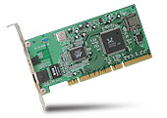
Interrupt Controller
Interrupt Mask
Priority Encoder
IntID
CPU
Interrupt
Int Disable
Timer
Software
Interrupt
Control
NMI
Network
Interrupts invoked with interrupt lines from devices
Interrupt controller chooses interrupt request to honor
Interrupt identity specified with ID line
Mask enables/disables interrupts
Priority encoder picks highest enabled interrupt
Software Interrupt Set/Cleared by Software
CPU can disable all interrupts with internal flag
Non-Maskable Interrupt line (NMI) can’t be disabled

Slide 74
Example: Network Interrupt
Raise priority
(set mask)
Reenable All Ints
Save registers
Dispatch to Handler
…
Transfer Network Packet from hardware to Kernel Buffers
…
Restore registers
Clear current Int
Disable All Ints
Restore priority
(clear Mask)
RTI
...
add $r1,$r2,$r3
subi $r4,$r1,#4
slli $r4,$r4,#2
...
PC saved
Disable All Ints
Kernel Mode
External Interrupt
Pipeline Flush
“Interrupt Handler”
...
lw $r2,0($r4)
lw $r3,4($r4)
add $r2,$r2,$r3
sw 8($r4),$r2
...
Restore PC
Enable all Ints
User Mode
An interrupt is a hardware-invoked context switch
No separate step to choose what to run next
Always run the interrupt handler immediately

Slide 75
Use of Timer Interrupt to Return Control
Solution to our dispatcher problem
Use the timer interrupt to force scheduling decisions
Timer Interrupt routine:
TimerInterrupt() { DoPeriodicHouseKeeping(); run_new_thread(); }
Some Routine
Interrupt
TimerInterrupt
Stack growth
run_new_thread
switch

Slide 76
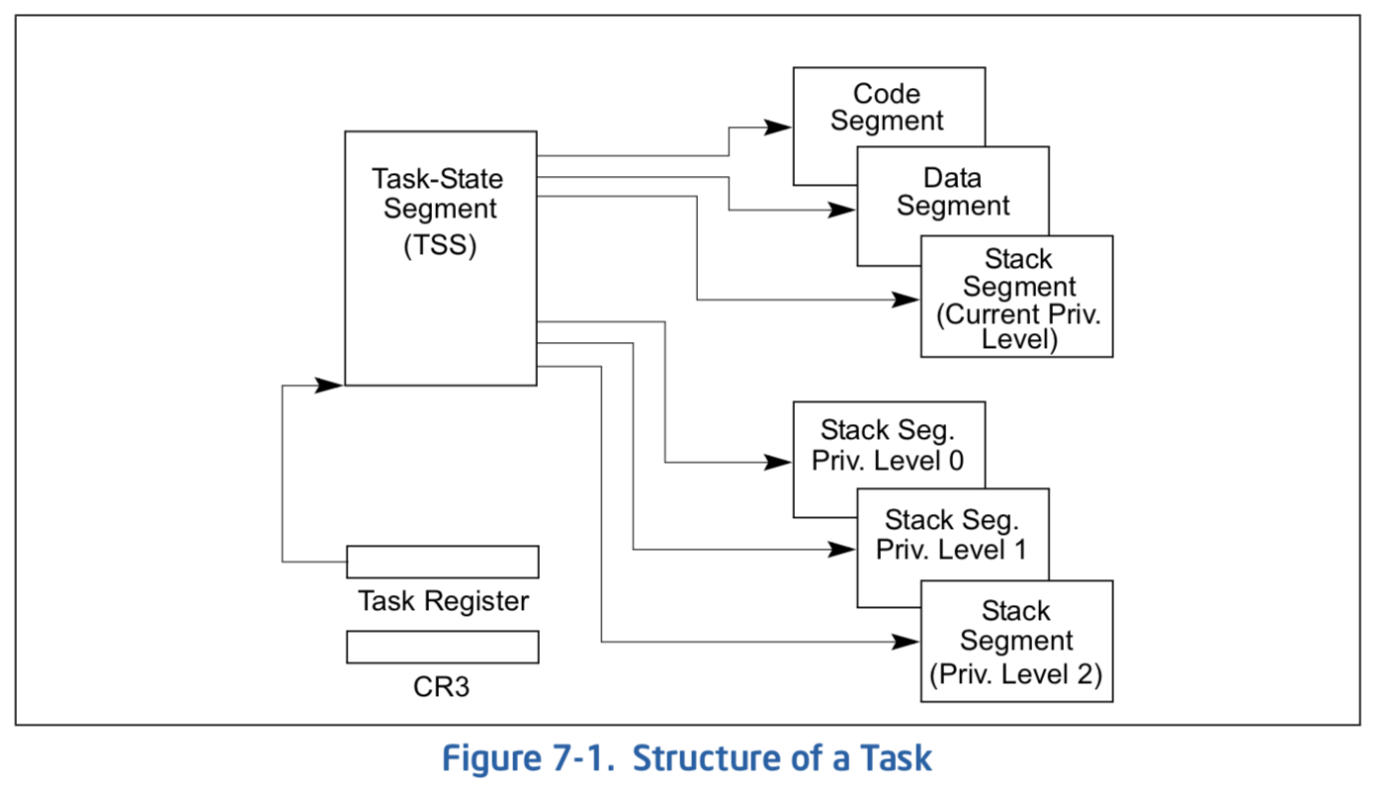
Hardware context switch support in x86
Syscall/Intr (U → K)
PL 3 → 0;
TSS ← EFLAGS, CS:EIP;
SS:SP ← k-thread stack (TSS PL 0);
push (old) SS:ESP onto (new) k-stack
push (old) eflags, cs:eip, <err>
CS:EIP ← <k target handler>
Then
Handler then saves other regs, etc
Does all its works, possibly choosing other threads, changing PTBR (CR3)
kernel thread has set up user GPRs
iret (K → U)
PL 0 → 3;
Eflags, CS:EIP ← popped off k-stack
SS:SP ← user thread stack (TSS PL 3);
pg 2,942 of 4,922 of x86 reference manual
Pintos: tss.c, intr-stubs.S

Slide 77
Pintos: Kernel Crossing on Syscall or Interrupt
Time
user
stack
user
code
cs:eip
cs:eip
cs:eip
cs:eip
cs:eip
ss:esp
ss:esp
ss:esp
ss:esp
ss:esp
PTBR
PTBR
PTBR
PTBR
PTBR
cs:eip
cs:eip
cs:eip
ss:esp
ss:esp
ss:esp
ready to resume
kernel
code
processing
saves
…
iret
syscall / interrupt
TCB
TCB
TCB
TCB
TCB
kernel
thread
stack

Slide 78
Pintos: Context Switch – Scheduling
Time
user
stack
user’
stack
user
code
Schedule
cs:eip
cs:eip
cs:eip
cs:eip
cs:eip
ss:esp
ss:esp
ss:esp
ss:esp
ss:esp’
PTBR
PTBR
PTBR
PTBR’
PTBR’
cs:eip
cs:eip
cs:eip’
ss:esp
ss:esp
ss:esp’
ready to resume
kernel
code
processing
saves
…
iret
syscall / interrupt
TCB
TCB
TCB
TCB
TCB
kernel
thread
stack
switch kernel threads
Pintos: switch.S

Slide 79
ThreadFork(): Create a New Thread
ThreadFork() is a user-level procedure that creates a new thread and places it on ready queue
Arguments to ThreadFork()
Pointer to application routine (fcnPtr)
Pointer to array of arguments (fcnArgPtr)
Size of stack to allocate
Implementation
Sanity check arguments
Enter Kernel-mode and Sanity Check arguments again
Allocate new Stack and TCB
Initialize TCB and place on ready list (Runnable)

Slide 80
How do we initialize TCB and Stack?
Initialize Register fields of TCB
Stack pointer made to point at stack
PC return address ⇒ OS (asm) routine ThreadRoot()
Two arg registers (a0 and a1) initialized to fcnPtr and fcnArgPtr, respectively
Initialize stack data?
No. Important part of stack frame is in registers (ra)
Think of stack frame as just before body of ThreadRoot() really gets started
ThreadRoot stub
Stack growth
Initial Stack

Slide 81
How does Thread get started?
Other Thread
ThreadRoot
A
B(while)
Stack growth
yield
run_new_thread
New Thread
switch
ThreadRoot stub
Eventually, run_new_thread() will select this TCB and return into beginning of ThreadRoot()
This really starts the new thread

Slide 82
What does ThreadRoot() look like?
ThreadRoot() is the root for the thread routine:
ThreadRoot() {
DoStartupHousekeeping();
UserModeSwitch(); /* enter user mode */
Call fcnPtr(fcnArgPtr);
ThreadFinish();
}
Startup Housekeeping
Includes things like recording start time of thread
Other statistics
Stack will grow and shrink with execution of thread
Final return from thread returns into ThreadRoot() which calls ThreadFinish()
ThreadFinish() wake up sleeping threads
ThreadRoot
Thread Code
Stack growth
Running Stack

Slide 83
Multiprocessing vs Multiprogramming
Remember Definitions:
Multiprocessing ≡ Multiple CPUs
Multiprogramming ≡ Multiple Jobs or Processes
Multithreading ≡ Multiple threads per Process
What does it mean to run two threads “concurrently”?
Scheduler is free to run threads in any order and interleaving: FIFO, Random, …
Dispatcher can choose to run each thread to completion or time-slice in big chunks or small chunks
A
Multiprocessing
B
C
A
B
C
Multiprogramming
A
B
C
A
B
C
B

Slide 84
Correctness for systems with concurrent threads
If dispatcher can schedule threads in any way, programs must work under all circumstances
Can you test for this?
How can you know if your program works?
Independent Threads:
No state shared with other threads
Deterministic ⇒ Input state determines results
Reproducible ⇒ Can recreate Starting Conditions, I/O
Scheduling order doesn’t matter (if switch() works!!!)
Cooperating Threads:
Shared State between multiple threads
Non-deterministic
Non-reproducible
Non-deterministic and Non-reproducible means that bugs can be intermittent
Sometimes called “Heisenbugs”

Slide 85
Interactions Complicate Debugging
Is any program truly independent?
Every process shares the file system, OS resources, network, etc
Extreme example: buggy device driver causes thread A to crash “independent thread” B
You probably don’t realize how much you depend on reproducibility:
Example: Evil C compiler
Modifies files behind your back by inserting errors into C program unless you insert debugging code
Example: Debugging statements can overrun stack
Non-deterministic errors are really difficult to find
Example: Memory layout of kernel+user programs
depends on scheduling, which depends on timer/other things
Original UNIX had a bunch of non-deterministic errors
Example: Something which does interesting I/O
User typing of letters used to help generate secure keys
Notes:
Adding printf statements can cause stack overruns or changing timing/interleaving
What if non-deterministic error only occurs once a week? You’re pulling all-nighters to find it, your eyelids droop, and whiz, the error happens and you missed it.

Slide 86
Why allow cooperating threads?
People cooperate; computers help/enhance people’s lives, so computers must cooperate
By analogy, the non-reproducibility/non-determinism of people is a notable problem for “carefully laid plans”
Advantage 1: Share resources
One computer, many users
One bank balance, many ATMs
What if ATMs were only updated at night?
Embedded systems (robot control: coordinate arm & hand)
Advantage 2: Speedup
Overlap I/O and computation
Many different file systems do read-ahead
Multiprocessors – chop up program into parallel pieces
Advantage 3: Modularity
More important than you might think
Chop large problem up into simpler pieces
To compile, for instance, gcc calls cpp | cc1 | cc2 | as | ld
Makes system easier to extend

Slide 87
High-level Example: Web Server
Server must handle many requests
Non-cooperating version:
serverLoop() {
con = AcceptCon();
ProcessFork(ServiceWebPage(),con);
}
What are some disadvantages of this technique?
Notes:
Expensive to start new process, heavyweight context switch overhead (changing address spaces)

Slide 88
Threaded Web Server
Now, use a single process
Multithreaded (cooperating) version:
serverLoop() {
connection = AcceptCon();
ThreadFork(ServiceWebPage(),connection);
}
Looks almost the same, but has many advantages:
Can share file caches kept in memory, results of CGI scripts, other things
Threads are much cheaper to create than processes, so this has a lower per-request overhead
Question: would a user-level (say one-to-many) thread package make sense here?
When one request blocks on disk, all block…
What about Denial of Service attacks or digg / Slash-dot effects?

Slide 89
Thread Pools
Problem with previous version: Unbounded Threads
When web-site becomes too popular – throughput sinks
Instead, allocate a bounded “pool” of worker threads, representing the maximum level of multiprogramming
Master
Thread
queue
Thread Pool
master() { allocThreads(worker,queue); while(TRUE) { con=AcceptCon(); Enqueue(queue,con); wakeUp(queue); } }
worker(queue) { while(TRUE) { con=Dequeue(queue); if (con==null) sleepOn(queue); else ServiceWebPage(con); } }

Slide 90
ATM Bank Server
ATM server problem:
Service a set of requests
Do so without corrupting database
Don’t hand out too much money

Slide 91
ATM bank server example
Suppose we wanted to implement a server process to handle requests from an ATM network:
BankServer() { while (TRUE) { ReceiveRequest(&op, &acctId, &amount); ProcessRequest(op, acctId, amount); } }
ProcessRequest(op, acctId, amount) { if (op == deposit) Deposit(acctId, amount); else if … }
Deposit(acctId, amount) { acct = GetAccount(acctId); /* may use disk I/O */ acct->balance += amount; StoreAccount(acct); /* Involves disk I/O */ }
How could we speed this up?
More than one request being processed at once
Event driven (overlap computation and I/O)
Multiple threads (multi-proc, or overlap comp and I/O)

Slide 92
Event Driven Version of ATM server
Suppose we only had one CPU
Still like to overlap I/O with computation
Without threads, we would have to rewrite in event-driven style
Example
BankServer() { while(TRUE) { event = WaitForNextEvent(); if (event == ATMRequest) StartOnRequest(); else if (event == AcctAvail) ContinueRequest(); else if (event == AcctStored) FinishRequest(); } }
What if we missed a blocking I/O step?
What if we have to split code into hundreds of pieces which could be blocking?
This technique is used for graphical programming

Slide 93
Can Threads Make This Easier?
Threads yield overlapped I/O and computation without “deconstructing” code into non-blocking fragments
One thread per request
Requests proceeds to completion, blocking as required:
Deposit(acctId, amount) { acct = GetAccount(actId); /* May use disk I/O */ acct->balance += amount; StoreAccount(acct); /* Involves disk I/O */ }
Unfortunately, shared state can get corrupted: Thread 1 Thread 2 load r1, acct->balance load r1, acct->balance add r1, amount2 store r1, acct->balance add r1, amount1 store r1, acct->balance

Slide 94
Summary
Processes have two parts
One or more Threads (Concurrency)
Address Spaces (Protection)
Threads: unit of concurrent execution
Useful for parallelism, overlapping computation and IO, organizing sequences of interactions (protocols)
Require: multiple stacks per address space
Thread switch:
Save/Restore registers, "return" from new thread's switch routine
Concurrency accomplished by multiplexing CPU Time:
Unloading current thread (PC, registers)
Loading new thread (PC, registers)
Such context switching may be voluntary (yield(), I/O operations) or involuntary (timer, other interrupts)
Concurrent threads introduce problems when accessing shared data
Programs must be insensitive to arbitrary interleavings
Without careful design, shared variables can become completely inconsistent

