Slide 1
CS162
Operating Systems and
Systems Programming
Lecture 5
Concurrency and Mutual Exclusion
February 4th, 2020
Prof. John Kubiatowicz
http://cs162.eecs.Berkeley.edu

Slide 2
Recall: Fork, Wait, and (optional) Exec
cpid = fork();
if (cpid > 0) { // Parent Process
mypid = getpid();
printf("[%d] parent of [%d]\n", mypid, cpid);
tcpid = wait(&status);
printf("[%d] bye %d\n", mypid, tcpid);
} else if (cpid == 0) { // Child Process
mypid = getpid();
printf("[%d] child\n", mypid);
execl(filename,(char *)0); // Opt: start new program
} else { // Error! }
Return value from Fork: integer
  When > 0: return value is pid of new child (Running in Parent)
  When = 0: Running in new Child process
  When < 0: Error! Must handle somehow
Wait() system call: wait for next child to exit
  Return value is PID of terminating child
  Argument is pointer to integer variable to hold exit status
Exec() family of calls: replace process with new executable

Slide 3
Recall: Internal Events
Blocking on I/O
  The act of requesting I/O implicitly yields the CPU
Waiting on a “signal” from other thread
  Thread asks to wait and thus yields the CPU
Thread executes a yield()
  Thread volunteers to give up CPU
  computePI() {
  while(TRUE) {
  ComputeNextDigit();
  yield();
  }
  }
Notes:
Yield is for really nice people – Ever see two people at the supermarket checkout line? You first, no you first, …

Slide 4
Recall: Stack for Yielding Thread
ComputePI
yield
Trap to OS
kernel_yield
Stack growth
run_new_thread
switch
How do we run a new thread?
run_new_thread() {
newThread = PickNewThread();
switch(curThread, newThread);
ThreadHouseKeeping(); /* Do any cleanup */
}
How does dispatcher switch to a new thread?
  Save anything next thread may trash: PC, regs, stack pointer
  Maintain isolation for each thread

Slide 5
Recall: Multithreaded Stack Switching
Consider the following code blocks:
proc A() {
B();
}
proc B() {
while(TRUE) {
yield();
}
}
Suppose we have 2 threads:
  Threads S and T
Thread S
Thread T
A
A
B(while)
B(while)
Stack growth
yield
yield
run_new_thread
run_new_thread
switch
switch
Thread S's switch returns to Thread T's (and vice versa)

Slide 6
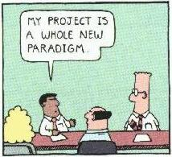
Goals for Today
Finish discussion of Threads
Concurrency and need for Synchronization Operations
Basic Synchronization through Locks
Initial Lock Implementations

Slide 7
What happens when thread blocks on I/O?
CopyFile
read
Trap to OS
Stack growth
kernel_read
run_new_thread
switch
What happens when a thread requests a block of data from the file system?
  User code invokes a system call
  Read operation is initiated
  Run new thread/switch
Thread communication similar
  Wait for Signal/Join
  Networking

Slide 8
External Events
What happens if thread never does any I/O, never waits, and never yields control?
  Could the ComputePI program grab all resources and never release the processor?
    What if it didn’t print to console?
  Must find way that dispatcher can regain control!
Answer: utilize external events
  Interrupts: signals from hardware or software that stop the running code and jump to kernel
  Timer: like an alarm clock that goes off every some milliseconds
If we make sure that external events occur frequently enough, can ensure dispatcher runs
Notes:
Patterson’s a nice guy, so he gives up the body after using it for awhile and let’s John Kubitowicz have it.
But Kubi’s not so nice, so he won’t give up control…
If you want to wake up for a final, you set your clock, or ask your roommate to pour water over your head – OS does the same

Slide 9
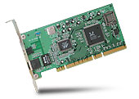
Interrupt Controller
Interrupt Mask
Priority Encoder
IntID
CPU
Interrupt
Int Disable
Timer
Software
Interrupt
Control
NMI
Network
Interrupts invoked with interrupt lines from devices
Interrupt controller chooses interrupt request to honor
  Interrupt identity specified with ID line
  Mask enables/disables interrupts
  Priority encoder picks highest enabled interrupt
  Software Interrupt Set/Cleared by Software
CPU can disable all interrupts with internal flag
Non-Maskable Interrupt line (NMI) can’t be disabled

Slide 10
Example: Network Interrupt
Raise priority
(set mask)
Reenable All Ints
Save registers
Dispatch to Handler
…
Transfer Network Packet from hardware
to Kernel Buffers
…
Restore registers
Clear current Int
Disable All Ints
Restore priority
(clear Mask)
RTI
...
add $r1,$r2,$r3
subi $r4,$r1,#4
slli $r4,$r4,#2
...
PC saved
Disable All Ints
Kernel Mode
External Interrupt
Pipeline Flush
“Interrupt Handler”
...
lw $r2,0($r4)
lw $r3,4($r4)
add $r2,$r2,$r3
sw 8($r4),$r2
...
Restore PC
Enable all Ints
User Mode
An interrupt is a hardware-invoked context switch
  No separate step to choose what to run next
  Always run the interrupt handler immediately

Slide 11
Use of Timer Interrupt to Return Control
Solution to our dispatcher problem
  Use the timer interrupt to force scheduling decisions
Timer Interrupt routine:
TimerInterrupt() {
DoPeriodicHouseKeeping();
run_new_thread();
}
Some Routine
Interrupt
TimerInterrupt
Stack growth
run_new_thread
switch

Slide 12
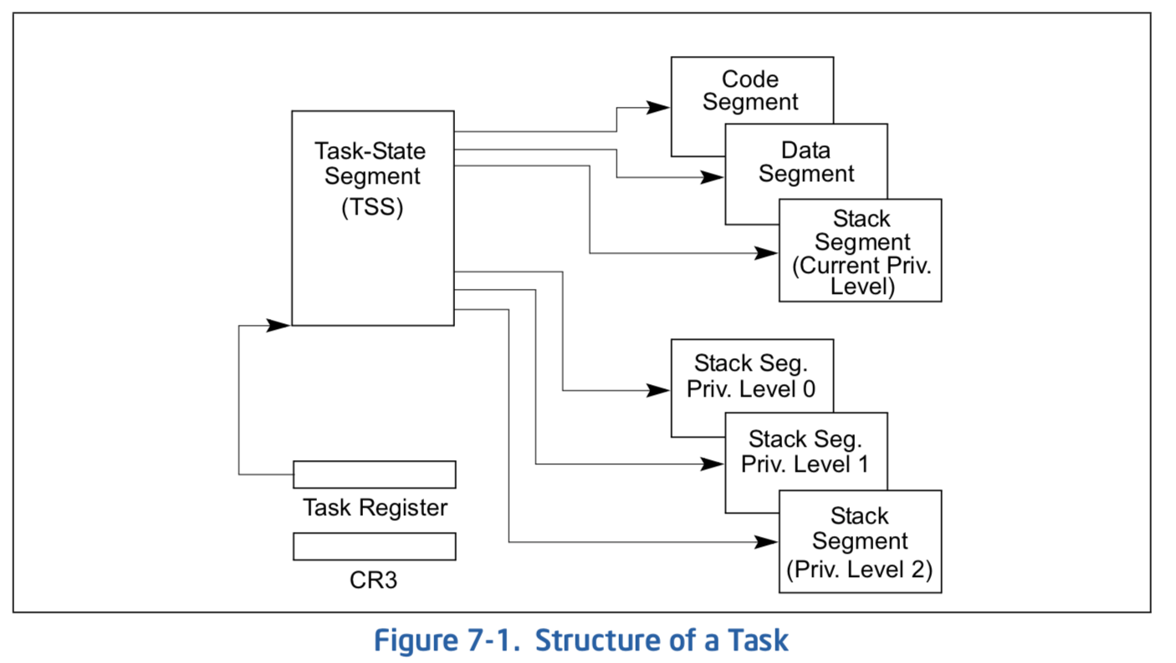
Hardware context switch support in x86
Syscall/Intr (U → K)
  PL 3 → 0;
  TSS ← EFLAGS, CS:EIP;
  SS:SP ← k-thread stack (TSS PL 0);
  push (old) SS:ESP onto (new) k-stack
  push (old) eflags, cs:eip, <err>
  CS:EIP ← <k target handler>
Then
  Handler then saves other regs, etc
  Does all its works, possibly choosing other threads, changing PTBR (CR3)
  kernel thread has set up user GPRs
iret (K → U)
  PL 0 → 3;
  Eflags, CS:EIP ← popped off k-stack
  SS:SP ← user thread stack (TSS PL 3);
pg 2,942 of 4,922 of x86 reference manual
Pintos: tss.c, intr-stubs.S

Slide 13
Pintos: Kernel Crossing on Syscall or Interrupt
Time
user
stack
user
code
cs:eip
cs:eip
cs:eip
cs:eip
cs:eip
ss:esp
ss:esp
ss:esp
ss:esp
ss:esp
PTBR
PTBR
PTBR
PTBR
PTBR
cs:eip
cs:eip
cs:eip
ss:esp
ss:esp
ss:esp
ready to resume
kernel
code
processing
saves
…
iret
syscall / interrupt
TCB
TCB
TCB
TCB
TCB
kernel
thread
stack

Slide 14
Pintos: Context Switch – Scheduling
Time
user
stack
user’
stack
user
code
Schedule
cs:eip
cs:eip
cs:eip
cs:eip
cs:eip
ss:esp
ss:esp
ss:esp
ss:esp
ss:esp’
PTBR
PTBR
PTBR
PTBR’
PTBR’
cs:eip
cs:eip
cs:eip’
ss:esp
ss:esp
ss:esp’
ready to resume
kernel
code
processing
saves
…
iret
syscall / interrupt
TCB
TCB
TCB
TCB
TCB
kernel
thread
stack
switch kernel threads
Pintos: switch.S

Slide 15
ThreadFork(): Create a New Thread
ThreadFork() is a user-level procedure that creates a new thread and places it on ready queue
Arguments to ThreadFork()
  Pointer to application routine (fcnPtr)
  Pointer to array of arguments (fcnArgPtr)
  Size of stack to allocate
Implementation
  Sanity check arguments
  Enter Kernel-mode and Sanity Check arguments again
  Allocate new Stack and TCB
  Initialize TCB and place on ready list (Runnable)

Slide 16
How do we initialize TCB and Stack?
Initialize Register fields of TCB
  Stack pointer made to point at stack
  PC return address ⇒ OS (asm) routine ThreadRoot()
  Two arg registers (say rdi and rsi for x86) initialized to fcnPtr and fcnArgPtr, respectively
Initialize stack data?
  No. Important part of stack frame is in registers (ra)
  Think of stack frame as just before body of ThreadRoot() really gets started
ThreadRoot stub
Stack growth
Initial Stack

Slide 17
How does Thread get started?
Other Thread
ThreadRoot
A
B(while)
Stack growth
yield
run_new_thread
New Thread
switch
ThreadRoot stub
Need to construct a new kernel thread that is ready to run when switch goes to it
Note that switch doesn’t know any difference between new or preexisting thread!

Slide 18
How does a thread get started?
Other Thread
SetupNewThread(tNew) {
…
TCB[tNew].regs.sp = newStackPtr;
TCB[tNew].regs.retpc = &ThreadRoot;
TCB[tNew].regs.r0 = fcnPtr
TCB[tNew].regs.r1 = fcnArgPtr
}
ThreadRoot
A
B(while)
Stack growth
yield
run_new_thread
New Thread
switch
ThreadRoot stub
How do we make a new thread?
  Setup TCB/kernel thread to point at new user stack and ThreadRoot code
  Put pointers to start function and args in registers
  This depends heavily on the calling convention (i.e. RISC-V vs x86)
Eventually, run_new_thread() will select this TCB and return into beginning of ThreadRoot()
  This really starts the new thread

Slide 19
What does ThreadRoot() look like?
ThreadRoot() is the root for the thread routine:
ThreadRoot(fcnPTR,fcnArgPtr) {
DoStartupHousekeeping();
UserModeSwitch(); /* enter user mode */
Call fcnPtr(fcnArgPtr);
ThreadFinish();
}
Startup Housekeeping
  Includes things like recording
  start time of thread
  Other statistics
Stack will grow and shrink with
execution of thread
Final return from thread returns into ThreadRoot()
which calls ThreadFinish()
  ThreadFinish() wake up sleeping threads
ThreadRoot
Thread Code
*fcnPtr()
Stack growth
Running Stack

Slide 20
Administrivia
Group Creation Deadline is TONIGHT!
  Need 4 people in a group
  If you signup with less, we may end up adding another person to your group!
All members of a group need to have the same TA
  Priority for same section; if cannot make this work, keep same TA
  Remember: Your TA needs to see you in section!

Slide 21
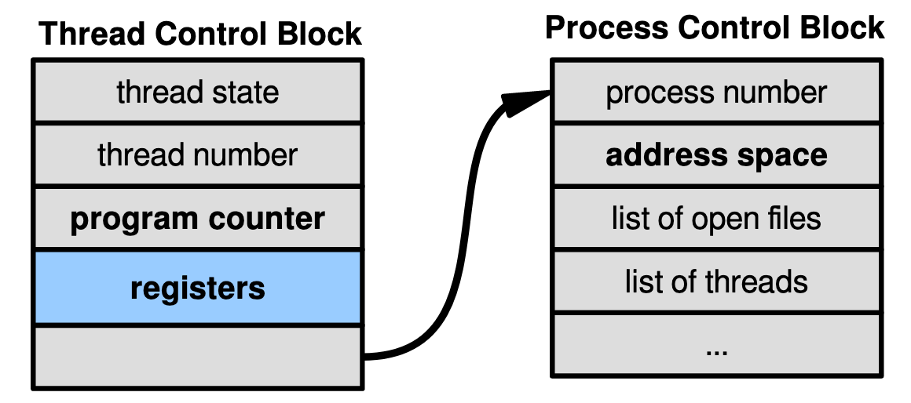
Kernel-Supported Threads
Each thread has a thread control block
  CPU registers, including PC, pointer to stack
  Scheduling info: priority, etc.
  Pointer to Process control block
OS scheduler uses TCBs, not PCBs

Slide 22
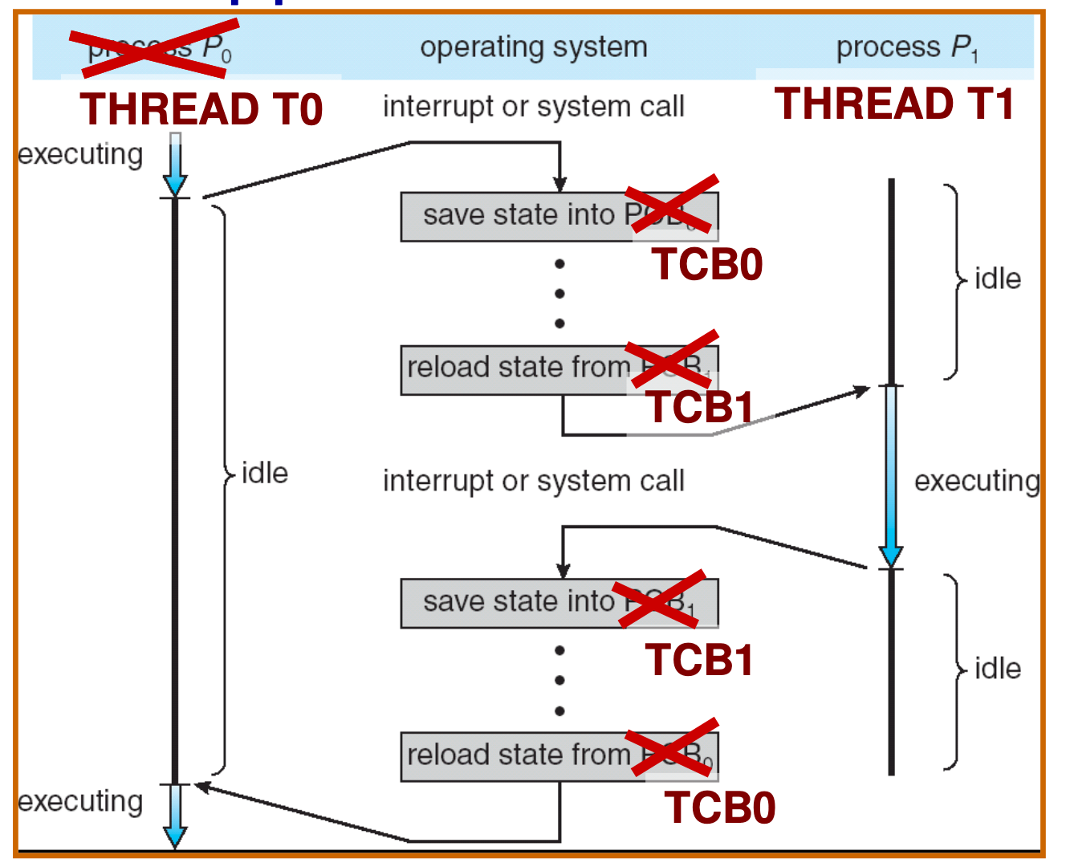
Kernel-Supported User Threads

Slide 23
User-level Multithreading: pthreads
int pthread_create(pthread_t *thread, const pthread_attr_t *attr, void *(*start_routine)(void*), void *arg);
  thread is created executing start_routine with arg as its sole argument. (return is implicit call to pthread_exit)
void pthread_exit(void *value_ptr);
  terminates and makes value_ptr available to any successful join
int pthread_join(pthread_t thread, void **value_ptr);
  suspends execution of the calling thread until the target thread terminates.
  On return with a non-NULL value_ptr the value passed to pthread_exit() by the terminating thread is made available in the location referenced by value_ptr.
man pthread
https://pubs.opengroup.org/onlinepubs/7908799/xsh/pthread.h.html

Slide 24

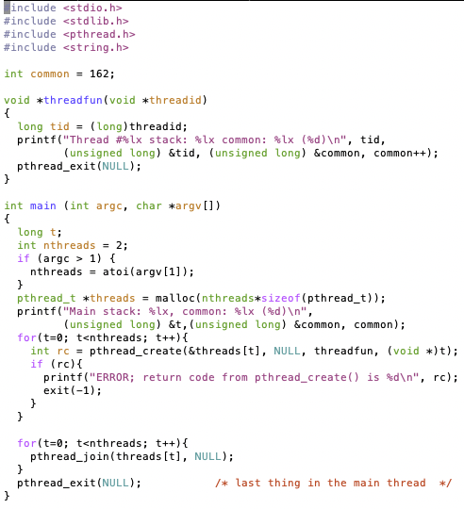
Little Example
How to tell if something is done?
Really done?
OK to reclaim its resources?

Slide 25
Fork-Join Pattern
create
exit
join
Main thread creates (forks) collection of sub-threads passing them args to work on, joins with them, collecting results.

Slide 26
Thread Abstraction
Illusion: Infinite number of processors
Notes:
Execution model: each thread runs on a dedicated virtual processor with unpredictable and variable speed.

Slide 27
Thread Abstraction
Illusion: Infinite number of processors
Reality: Threads execute with variable speed
  Programs must be designed to work with any schedule
Notes:
Execution model: each thread runs on a dedicated virtual processor with unpredictable and variable speed.

Slide 28
Programmer vs. Processor View

Slide 29
Programmer vs. Processor View

Slide 30
Programmer vs. Processor View

Slide 31
Possible Executions

Slide 32
Per Thread Descriptor
(Kernel Supported Threads)
Each Thread has a Thread Control Block (TCB)
  Execution State: CPU registers, program counter (PC), pointer to stack (SP)
  Scheduling info: state, priority, CPU time
  Various Pointers (for implementing scheduling queues)
  Pointer to enclosing process (PCB) – user threads
  … (add stuff as you find a need)
OS Keeps track of TCBs in “kernel memory”
  In Array, or Linked List, or …
  I/O state (file descriptors, network connections, etc)

Slide 33
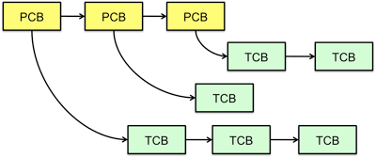
Multithreaded Processes
Process Control Block (PCBs) points to multiple Thread Control Blocks (TCBs):
Switching threads within a block is a simple thread switch
Switching threads across blocks requires changes to memory and I/O address tables

Slide 34
Multiprocessing vs Multiprogramming
Remember Definitions:
  Multiprocessing ≡ Multiple CPUs
  Multiprogramming ≡ Multiple Jobs or Processes
  Multithreading ≡ Multiple threads per Process
What does it mean to run two threads “concurrently”?
  Scheduler is free to run threads in any order and interleaving: FIFO, Random, …
  Dispatcher can choose to run each thread to completion or time-slice in big chunks or small chunks
A
Multiprocessing
B
C
A
B
C
Multiprogramming
A
B
C
A
B
C
B

Slide 35
Correctness for systems with concurrent threads
If dispatcher can schedule threads in any way, programs must work under all circumstances
  Can you test for this?
  How can you know if your program works?
Independent Threads:
  No state shared with other threads
  Deterministic ⇒ Input state determines results
  Reproducible ⇒ Can recreate Starting Conditions, I/O
  Scheduling order doesn’t matter (if switch() works!!!)
Cooperating Threads:
  Shared State between multiple threads
  Non-deterministic
  Non-reproducible
Non-deterministic and Non-reproducible means that bugs can be intermittent
  Sometimes called “Heisenbugs”

Slide 36
Interactions Complicate Debugging
Is any program truly independent?
  Every process shares the file system, OS resources, network, etc
  Extreme example: buggy device driver causes thread A to crash “independent thread” B
You probably don’t realize how much you depend on reproducibility:
  Example: Evil C compiler
    Modifies files behind your back by inserting errors into C program unless you insert debugging code
  Example: Debugging statements can overrun stack
Non-deterministic errors are really difficult to find
  Example: Memory layout of kernel+user programs
    depends on scheduling, which depends on timer/other things
    Original UNIX had a bunch of non-deterministic errors
  Example: Something which does interesting I/O
    User typing of letters used to help generate secure keys
Notes:
Adding printf statements can cause stack overruns or changing timing/interleaving
What if non-deterministic error only occurs once a week? You’re pulling all-nighters to find it, your eyelids droop, and whiz, the error happens and you missed it.

Slide 37
Why allow cooperating threads?
People cooperate; computers help/enhance people’s lives, so computers must cooperate
  By analogy, the non-reproducibility/non-determinism of people is a notable problem for “carefully laid plans”
Advantage 1: Share resources
  One computer, many users
  One bank balance, many ATMs
    What if ATMs were only updated at night?
  Embedded systems (robot control: coordinate arm & hand)
Advantage 2: Speedup
  Overlap I/O and computation
    Many different file systems do read-ahead
  Multiprocessors – chop up program into parallel pieces
Advantage 3: Modularity
  More important than you might think
  Chop large problem up into simpler pieces
    To compile, for instance, gcc calls cpp | cc1 | cc2 | as | ld
    Makes system easier to extend

Slide 38
High-level Example: Web Server
Server must handle many requests
Non-cooperating version:
  serverLoop() {
  con = AcceptCon();
  ProcessFork(ServiceWebPage(),con);
  }
What are some disadvantages of this technique?
Notes:
Expensive to start new process, heavyweight context switch overhead (changing address spaces)

Slide 39


Threaded Web Server
Now, use a single process
Multithreaded (cooperating) version:
  serverLoop() {
  connection = AcceptCon();
  ThreadFork(ServiceWebPage(),connection);
  }
Looks almost the same, but has many advantages:
  Can share file caches kept in memory, results of CGI scripts, other things
  Threads are much cheaper to create than processes, so this has a lower per-request overhead
Question: would a user-level (say one-to-many) thread package make sense here?
  When one request blocks on disk, all block…
What about Denial of Service attacks or digg / Slash-dot effects?

Slide 40
Thread Pools
Problem with previous version: Unbounded Threads
  When web-site becomes too popular – throughput sinks
Instead, allocate a bounded “pool” of worker threads, representing the maximum level of multiprogramming
Master
Thread
queue
Thread Pool
master() {
allocThreads(worker,queue);
while(TRUE) {
con=AcceptCon();
Enqueue(queue,con);
wakeUp(queue);
}
}
worker(queue) {
while(TRUE) {
con=Dequeue(queue);
if (con==null)
sleepOn(queue);
else
ServiceWebPage(con);
}
}

Slide 41
ATM Bank Server
ATM server problem:
  Service a set of requests
  Do so without corrupting database
  Don’t hand out too much money

Slide 42
ATM bank server example
Suppose we wanted to implement a server process to handle requests from an ATM network:
BankServer() {
while (TRUE) {
ReceiveRequest(&op, &acctId, &amount);
ProcessRequest(op, acctId, amount);
}
}
ProcessRequest(op, acctId, amount) {
if (op == deposit) Deposit(acctId, amount);
else if …
}
Deposit(acctId, amount) {
acct = GetAccount(acctId); /* may use disk I/O */
acct->balance += amount;
StoreAccount(acct); /* Involves disk I/O */
}
How could we speed this up?
  More than one request being processed at once
  Event driven (overlap computation and I/O)
  Multiple threads (multi-proc, or overlap comp and I/O)

Slide 43
Event Driven Version of ATM server
Suppose we only had one CPU
  Still like to overlap I/O with computation
  Without threads, we would have to rewrite in event-driven style
Example
BankServer() {
while(TRUE) {
event = WaitForNextEvent();
if (event == ATMRequest)
StartOnRequest();
else if (event == AcctAvail)
ContinueRequest();
else if (event == AcctStored)
FinishRequest();
}
}
  What if we missed a blocking I/O step?
  What if we have to split code into hundreds of pieces which could be blocking?
  This technique is used for graphical programming

Slide 44
Can Threads Make This Easier?
Threads yield overlapped I/O and computation without “deconstructing” code into non-blocking fragments
  One thread per request
Requests proceeds to completion, blocking as required:
Deposit(acctId, amount) {
acct = GetAccount(actId); /* May use disk I/O */
acct->balance += amount;
StoreAccount(acct); /* Involves disk I/O */
}
Unfortunately, shared state can get corrupted:
Thread 1 Thread 2
load r1, acct->balance
load r1, acct->balance
add r1, amount2
store r1, acct->balance
add r1, amount1
store r1, acct->balance

Slide 45
Problem is at the Lowest Level
Most of the time, threads are working on separate data, so scheduling doesn’t matter:
Thread A Thread B
x = 1; y = 2;
However, what about (Initially, y = 12):
Thread A Thread B
x = 1; y = 2;
x = y+1; y = y*2;
  What are the possible values of x?
Or, what are the possible values of x below?
Thread A Thread B
x = 1; x = 2;
  X could be 1 or 2 (non-deterministic!)
  Could even be 3 for serial processors:
    Thread A writes 0001, B writes 0010 → scheduling order ABABABBA yields 3!
Notes:
X could be (13, 5, 3)

Slide 46
Atomic Operations
To understand a concurrent program, we need to know what the underlying indivisible operations are!
Atomic Operation: an operation that always runs to completion or not at all
  It is indivisible: it cannot be stopped in the middle and state cannot be modified by someone else in the middle
  Fundamental building block – if no atomic operations, then have no way for threads to work together
On most machines, memory references and assignments (i.e. loads and stores) of words are atomic
  Consequently – weird example that produces “3” on previous slide can’t happen
Many instructions are not atomic
  Double-precision floating point store often not atomic
  VAX and IBM 360 had an instruction to copy a whole array

Slide 47
Another Concurrent Program Example
Two threads, A and B, compete with each other
  One tries to increment a shared counter
  The other tries to decrement the counter
Thread A Thread B
i = 0; i = 0;
while (i < 10) while (i > -10)
i = i + 1; i = i – 1;
printf(“A wins!”); printf(“B wins!”);
Assume that memory loads and stores are atomic, but incrementing and decrementing are not atomic
Who wins? Could be either
Is it guaranteed that someone wins? Why or why not?
What if both threads have their own CPU running at same speed? Is it guaranteed that it goes on forever?

Slide 48
Hand Simulation Multiprocessor Example
Inner loop looks like this:
Thread A Thread B
r1=0 load r1, M[i]
r1=0 load r1, M[i]
r1=1 add r1, r1, 1
r1=-1 sub r1, r1, 1
M[i]=1 store r1, M[i]
M[i]=-1 store r1, M[i]
Hand Simulation:
  And we’re off. A gets off to an early start
  B says “hmph, better go fast” and tries really hard
  A goes ahead and writes “1”
  B goes and writes “-1”
  A says “HUH??? I could have sworn I put a 1 there”
Could this happen on a uniprocessor? With Hyperthreads?
  Yes! Unlikely, but if you are depending on it not happening, it will and your system will break…

Slide 49
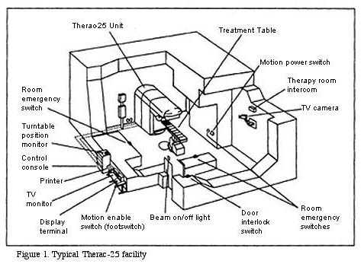
Correctness Requirements
Threaded programs must work for all interleavings of thread instruction sequences
  Cooperating threads inherently non-deterministic and non-reproducible
  Really hard to debug unless carefully designed!
Example: Therac-25
  Machine for radiation therapy
    Software control of electron
    accelerator and electron beam/
    Xray production
    Software control of dosage
  Software errors caused the
  death of several patients
    A series of race conditions on
    shared variables and poor
    software design
    “They determined that data entry speed during editing was the key factor in producing the error condition: If the prescription data was edited at a fast pace, the overdose occurred.”

Slide 50
Motivating Example: “Too Much Milk”
Great thing about OS’s – analogy between problems in OS and problems in real life
  Help you understand real life problems better
  But, computers are much stupider than people
Example: People need to coordinate:
Time
Person A
Person B
3:00
Look in Fridge. Out of milk
3:05
Leave for store
3:10
Arrive at store
Look in Fridge. Out of milk
3:15
Buy milk
Leave for store
3:20
Arrive home, put milk away
Arrive at store
3:25
Buy milk
3:30
Arrive home, put milk away
Notes:
You’re sitting in class, hot day, milk does a body good. Go home, no milk, so go to store
Roommate leaves class late because prof is more long-winded than I am. Has same idea, but result is too much milk!
Problem: two cooperating threads, not cooperating properly

Slide 51
Definitions
Synchronization: using atomic operations to ensure cooperation between threads
  For now, only loads and stores are atomic
  We are going to show that its hard to build anything useful with only reads and writes
Mutual Exclusion: ensuring that only one thread does a particular thing at a time
  One thread excludes the other while doing its task
Critical Section: piece of code that only one thread can execute at once. Only one thread at a time will get into this section of code
  Critical section is the result of mutual exclusion
  Critical section and mutual exclusion are two ways of describing the same thing

Slide 52
More Definitions
Lock: prevents someone from doing something
  Lock before entering critical section and
  before accessing shared data
  Unlock when leaving, after accessing shared data
  Wait if locked
    Important idea: all synchronization involves waiting
For example: fix the milk problem by putting a key on the refrigerator
  Lock it and take key if you are going to go buy milk
  Fixes too much: roommate angry if only wants OJ
  Of Course – We don’t know how to make a lock yet
#$@%@#$@

Slide 53
Too Much Milk: Correctness Properties
Need to be careful about correctness of concurrent programs, since non-deterministic
  Impulse is to start coding first, then when it doesn’t work, pull hair out
  Instead, think first, then code
  Always write down behavior first
What are the correctness properties for the “Too much milk” problem???
  Never more than one person buys
  Someone buys if needed
Restrict ourselves to use only atomic load and store operations as building blocks

Slide 54

Too Much Milk: Solution #1
Use a note to avoid buying too much milk:
  Leave a note before buying (kind of “lock”)
  Remove note after buying (kind of “unlock”)
  Don’t buy if note (wait)
Suppose a computer tries this (remember, only memory read/write are atomic):
  if (noMilk) {
  if (noNote) {
  leave Note;
  buy milk;
  remove note;
  }
  }
Notes:
* This is a fate worse than failure! Code that usually works is way worse than outright broken code

Slide 55
Too Much Milk: Solution #1
Use a note to avoid buying too much milk:
  Leave a note before buying (kind of “lock”)
  Remove note after buying (kind of “unlock”)
  Don’t buy if note (wait)
Suppose a computer tries this (remember, only memory read/write are atomic):
Thread A Thread B
if (noMilk) {
if (noMilk) {
if (noNote) {
if (noNote) {
leave Note;
buy Milk;
remove Note;
}
}
leave Note;
buy Milk;
remove Note;
}
}
Notes:
* This is a fate worse than failure! Code that usually works is way worse than outright broken code

Slide 56
Too Much Milk: Solution #1
Use a note to avoid buying too much milk:
  Leave a note before buying (kind of “lock”)
  Remove note after buying (kind of “unlock”)
  Don’t buy if note (wait)
Suppose a computer tries this (remember, only memory read/write are atomic):
  if (noMilk) {
  if (noNote) {
  leave Note;
  buy milk;
  remove note;
  }
  }
Result?
  Still too much milk but only occasionally!
  Thread can get context switched after checking milk and note but before buying milk!
Solution makes problem worse since fails intermittently
  Makes it really hard to debug…
  Must work despite what the dispatcher does!
Notes:
* This is a fate worse than failure! Code that usually works is way worse than outright broken code

Slide 57

Too Much Milk: Solution #1½
Clearly the Note is not quite blocking enough
  Let’s try to fix this by placing note first
Another try at previous solution:
  leave Note;
  if (noMilk) {
  if (noNote) {
  buy milk;
  }
  }
  remove Note;
What happens here?
  Well, with human, probably nothing bad
  With computer: no one ever buys milk

Slide 58
Too Much Milk Solution #2
How about labeled notes?
  Now we can leave note before checking
Algorithm looks like this:
Thread A Thread B
leave note A; leave note B;
if (noNote B) { if (noNoteA) {
if (noMilk) { if (noMilk) {
buy Milk; buy Milk;
} }
} }
remove note A; remove note B;
Does this work?
Possible for neither thread to buy milk
  Context switches at exactly the wrong times can lead each to think that the other is going to buy
Really insidious:
  Extremely unlikely this would happen, but will at worse possible time
  Probably something like this in UNIX

Slide 59

Too Much Milk Solution #2: problem!
I’m not getting milk, You’re getting milk
This kind of lockup is called “starvation!”

Slide 60
Too Much Milk Solution #3
Here is a possible two-note solution:
Thread A Thread B
leave note A; leave note B;
while (note B) {\\X if (noNote A) {\\Y
do nothing; if (noMilk) {
} buy milk;
if (noMilk) { }
buy milk; }
} remove note B;
remove note A;
Does this work? Yes. Both can guarantee that:
  It is safe to buy, or
  Other will buy, ok to quit
At X:
  If no note B, safe for A to buy,
  Otherwise wait to find out what will happen
At Y:
  If no note A, safe for B to buy
  Otherwise, A is either buying or waiting for B to quit

Slide 61
Case 1
“leave note A” happens before “if (noNote A)”
leave note A;
while (note B) {\\X
do nothing;
};
if (noMilk) {
buy milk; }
}
remove note A;
happened
before
leave note B;
if (noNote A) {\\Y
if (noMilk) {
buy milk;
}
}
remove note B;

Slide 62
Case 1
“leave note A” happens before “if (noNote A)”
leave note A;
while (note B) {\\X
do nothing;
};
if (noMilk) {
buy milk; }
}
remove note A;
happened
before
leave note B;
if (noNote A) {\\Y
if (noMilk) {
buy milk;
}
}
remove note B;

Slide 63
Case 1
“leave note A” happens before “if (noNote A)”
leave note A;
while (note B) {\\X
do nothing;
};
if (noMilk) {
buy milk; }
}
remove note A;
happened
before
leave note B;
if (noNote A) {\\Y
if (noMilk) {
buy milk;
}
}
remove note B;
Wait for note B to be removed

Slide 64
Case 2
“if (noNote A)” happens before “leave note A”
leave note A;
while (note B) {\\X
do nothing;
};
if (noMilk) {
buy milk; }
}
remove note A;
leave note B;
if (noNote A) {\\Y
if (noMilk) {
buy milk;
}
}
remove note B;
happened
before

Slide 65
Case 2
“if (noNote A)” happens before “leave note A”
leave note A;
while (note B) {\\X
do nothing;
};
if (noMilk) {
buy milk; }
}
remove note A;
leave note B;
if (noNote A) {\\Y
if (noMilk) {
buy milk;
}
}
remove note B;
happened
before

Slide 66
Case 2
“if (noNote A)” happens before “leave note A”
leave note A;
while (note B) {\\X
do nothing;
};
if (noMilk) {
buy milk; }
}
remove note A;
leave note B;
if (noNote A) {\\Y
if (noMilk) {
buy milk;
}
}
remove note B;
happened
before
Wait for note B to be removed

Slide 67
Solution #3 discussion
Our solution protects a single “Critical-Section” piece of code for each thread:
if (noMilk) {
buy milk;
}
Solution #3 works, but it’s really unsatisfactory
  Really complex – even for this simple an example
    Hard to convince yourself that this really works
  A’s code is different from B’s – what if lots of threads?
    Code would have to be slightly different for each thread
  While A is waiting, it is consuming CPU time
    This is called “busy-waiting”
There’s a better way
  Have hardware provide higher-level primitives than atomic load & store
  Build even higher-level programming abstractions on this hardware support

Slide 68
Too Much Milk: Solution #4
Suppose we have some sort of implementation of a lock
  lock.Acquire() – wait until lock is free, then grab
  lock.Release() – Unlock, waking up anyone waiting
  These must be atomic operations – if two threads are waiting for the lock and both see it’s free, only one succeeds to grab the lock
Then, our milk problem is easy:
milklock.Acquire();
if (nomilk)
buy milk;
milklock.Release();
Once again, section of code between Acquire() and Release() called a “Critical Section”
Of course, you can make this even simpler: suppose you are out of ice cream instead of milk
  Skip the test since you always need more ice cream ;-)

Slide 69
How to Implement Locks?
Lock: prevents someone from doing something
  Lock before entering critical section and
  before accessing shared data
  Unlock when leaving, after accessing shared data
  Wait if locked
    Important idea: all synchronization involves waiting
    Should sleep if waiting for a long time
Atomic Load/Store: get solution like Milk #3
  Pretty complex and error prone
Hardware Lock instruction
  Is this a good idea?
  What about putting a task to sleep?
    What is the interface between the hardware and scheduler?
  Complexity?
    Done in the Intel 432
    Each feature makes HW more complex and slow

Slide 70
Naïve use of Interrupt Enable/Disable
How can we build multi-instruction atomic operations?
  Recall: dispatcher gets control in two ways.
    Internal: Thread does something to relinquish the CPU
    External: Interrupts cause dispatcher to take CPU
  On a uniprocessor, can avoid context-switching by:
    Avoiding internal events (although virtual memory tricky)
    Preventing external events by disabling interrupts
Consequently, naïve Implementation of locks: LockAcquire { disable Ints; }
LockRelease { enable Ints; }
Problems with this approach:
  Can’t let user do this! Consider following:
    LockAcquire();
    While(TRUE) {;}
  Real-Time system—no guarantees on timing!
    Critical Sections might be arbitrarily long
  What happens with I/O or other important events?
    “Reactor about to meltdown. Help?”

Slide 71
Better Implementation of Locks by Disabling Interrupts
Key idea: maintain a lock variable and impose mutual exclusion only during operations on that variable
int value = FREE;
Acquire() {
disable interrupts;
if (value == BUSY) {
put thread on wait queue;
Go to sleep();
// Enable interrupts?
} else {
value = BUSY;
}
enable interrupts;
}
Release() {
disable interrupts;
if (anyone on wait queue) {
take thread off wait queue
Place on ready queue;
} else {
value = FREE;
}
enable interrupts;
}

Slide 72
Where are we going with synchronization?
Programs
Shared Programs
Higher-level
API
Locks Semaphores Monitors Send/Receive
Hardware
Load/Store Disable Ints Test&Set Compare&Swap
We are going to implement various higher-level synchronization primitives using atomic operations
  Everything is pretty painful if only atomic primitives are load and store
  Need to provide primitives useful at user-level

Slide 73
Summary
Concurrent threads are a very useful abstraction
  Allow transparent overlapping of computation and I/O
  Allow use of parallel processing when available
Concurrent threads introduce problems when accessing shared data
  Programs must be insensitive to arbitrary interleavings
  Without careful design, shared variables can become completely inconsistent
Important concept: Atomic Operations
  An operation that runs to completion or not at all
  These are the primitives on which to construct various synchronization primitives

