Slide 1
CS 162: Operating Systems and Systems Programming
Lecture 1: Course Intro
June 24, 2019
Instructor: Jack Kolb
https://cs162.eecs.berkeley.edu

Slide 2
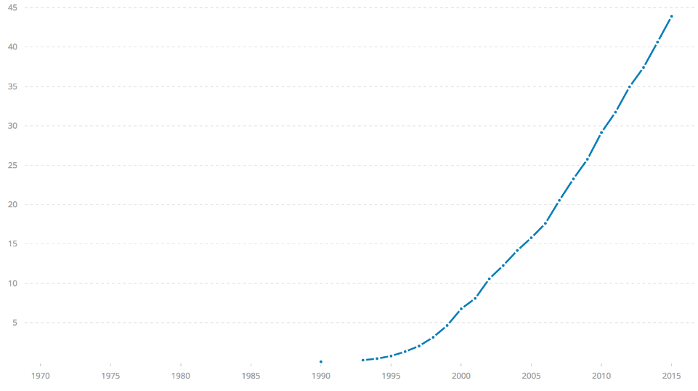
Challenge: Huge Scale
% of world’s
population
3.8 B
ARPANet
Internet
WWW
2.0 B 1/26/11
RFC 675 TCP/IP
HTTP 0.9
1969
1974
1990
2017

Slide 3
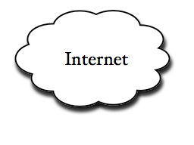
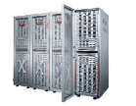
Example: What's in a search query?
DNS
Servers
Datacenter
DNS
request
create
result
page
Search
Index
Page store
Load
balancer
Ad Server
Complex interaction of multiple components in multiple administrative domains
Systems, services, protocols, …

Slide 4
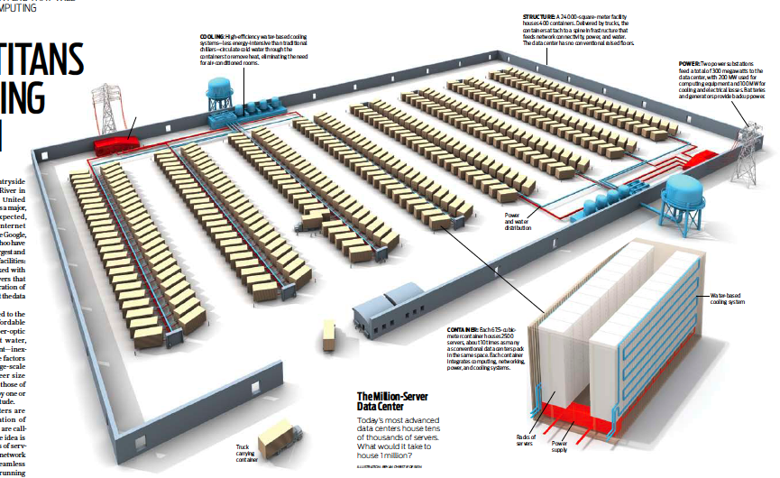
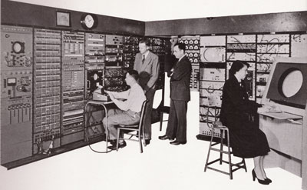
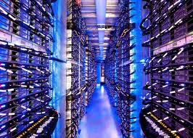
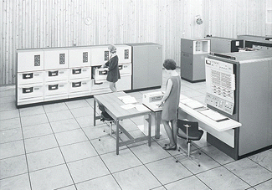
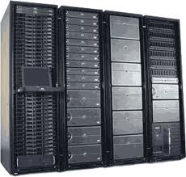
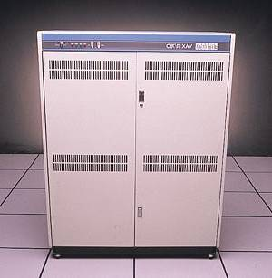
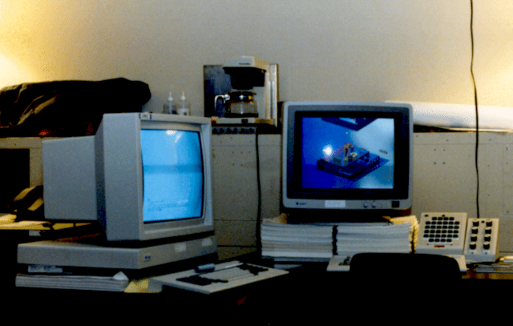
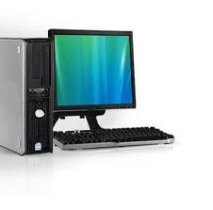
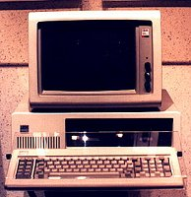
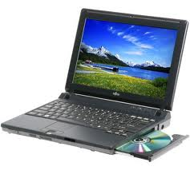
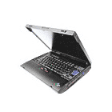
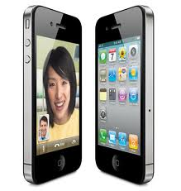
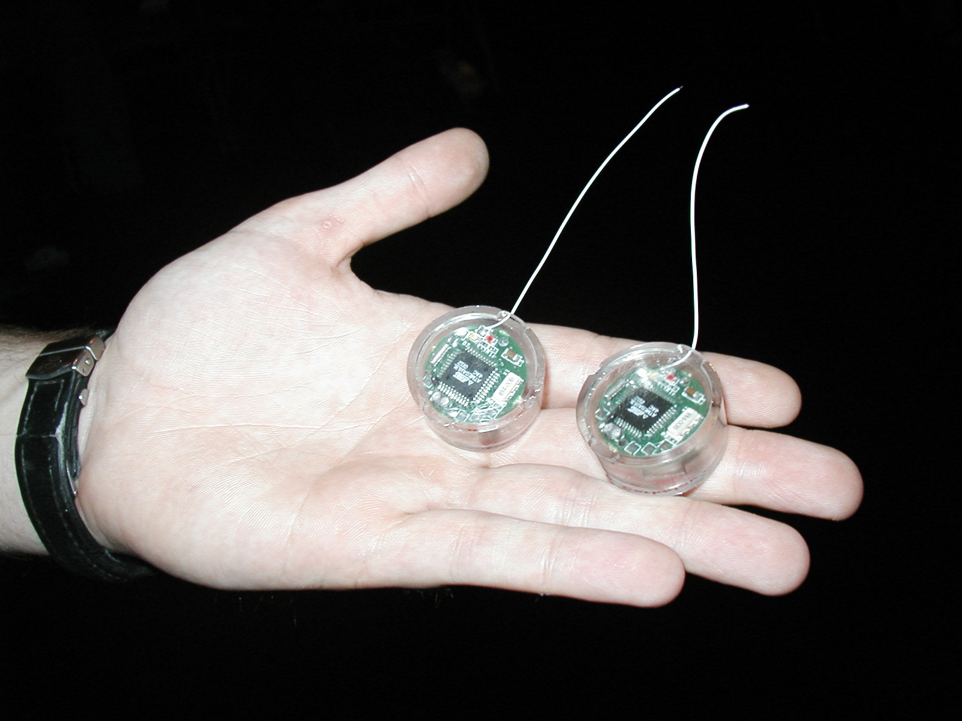
Challenge: Variety and Number of Devices
Computers
Per Person
Number crunching, Data Storage, Massive Services,
Mining
1:10⁶
Mainframe
Mini
1:10³
Workstation
Productivity,
Interactive
PC
Laptop
1:1
PDA
Cell
Streaming from/to the physical world
10³:1
years
Mote!

Slide 5
Challenge: Range of Timescales
Jeff Dean: "Numbers Everyone Should Know"

Slide 6
Operating systems are crucial to addressing these challenges!
Provide consistent abstractions to apps, even on different hardware
File systems
Processes, threads
VM, containers
Naming system
Manage resources shared among multiple applications:
Memory, CPU, storage, …
Achieve the above by implementing specific algorithms and techniques:
Scheduling
Concurrency
Transactions
Security

Slide 7
Why take CS 162?
Some of you will build operating systems or components of them
Many of you will use core concepts from operating systems in your work (hardware or software)
Caching, batching, indirection, synchronization, …
All of you will write applications that use an operating system
The better you understand the OS's design and implementation, the more effectively you can make use of it

Slide 8
Aside: Systems Programming
What makes something a system?
Frame of mind: meticulous error handling, anticipating all possible failure cases, defending against malicious/careless users
An important part of this class!

Slide 9
Today's Agenda
What is an operating system?
Logistics
Break
Unifying OS Themes & Ideas
The OS's most important job

Slide 10
What is an operating system?
Layer of software that provides application software access to hardware resources
Convenient abstraction of complex hardware
Protected access to shared resources
Security
Basic Services – Communication, Storage, …
apps
OS
Hardware

Slide 11
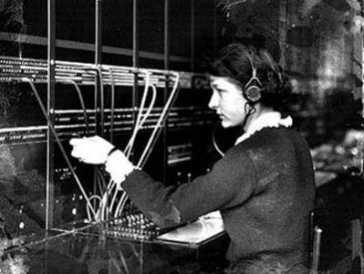
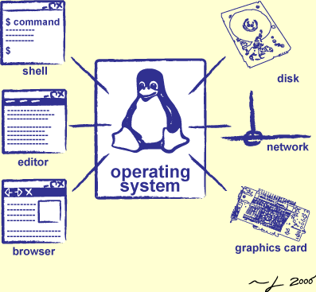
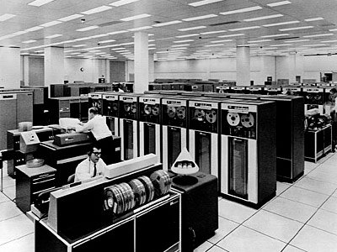
Operators Through History
Switchboard Operator
Computer Operators

Slide 12
What is an operating system?
Provides user programs with a more convenient abstract machine interface rather than the underlying physical machine

Slide 13
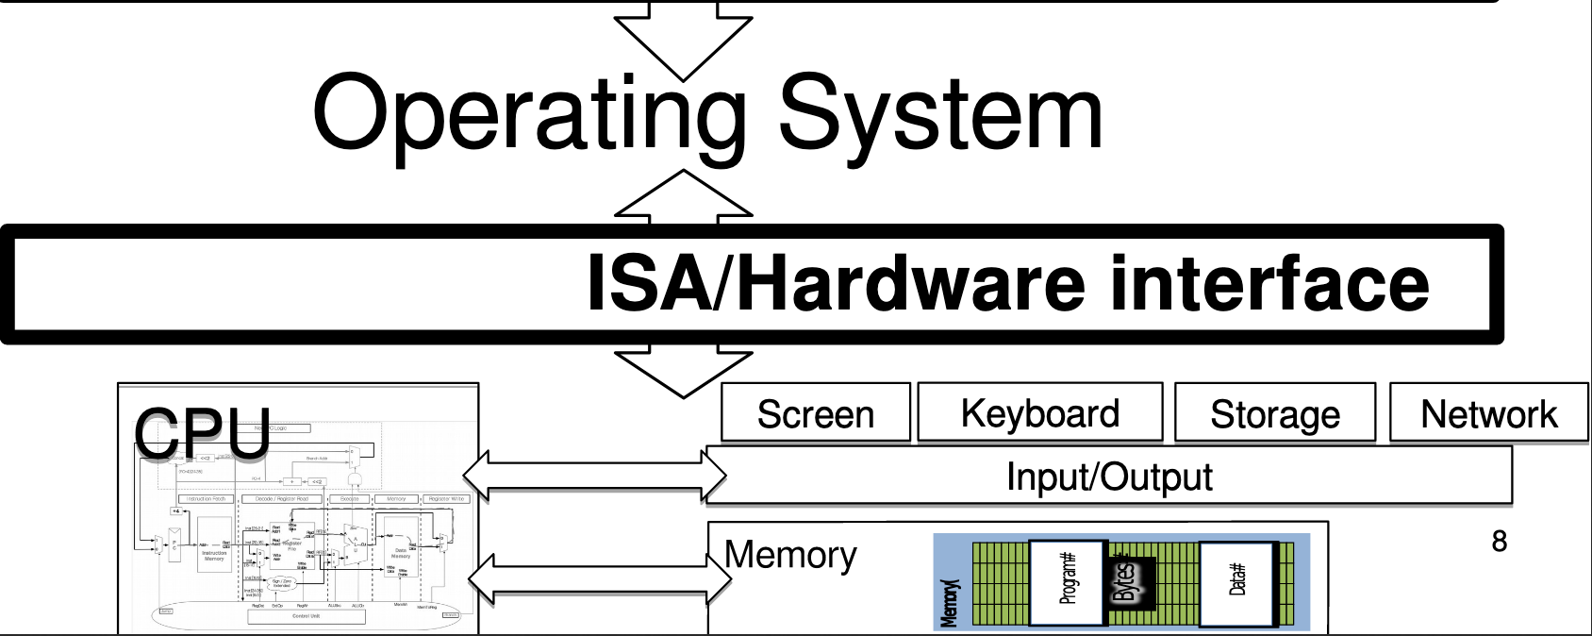
OS "Virtual Machine" Interface

Slide 14
Application View of the World
Application's "machine" is the OS
No hardware details (future-proof)
More useful interfaces than raw hardware

Slide 15
OS View of the World
Operating system translates from hardware interface
to application interface

Slide 16
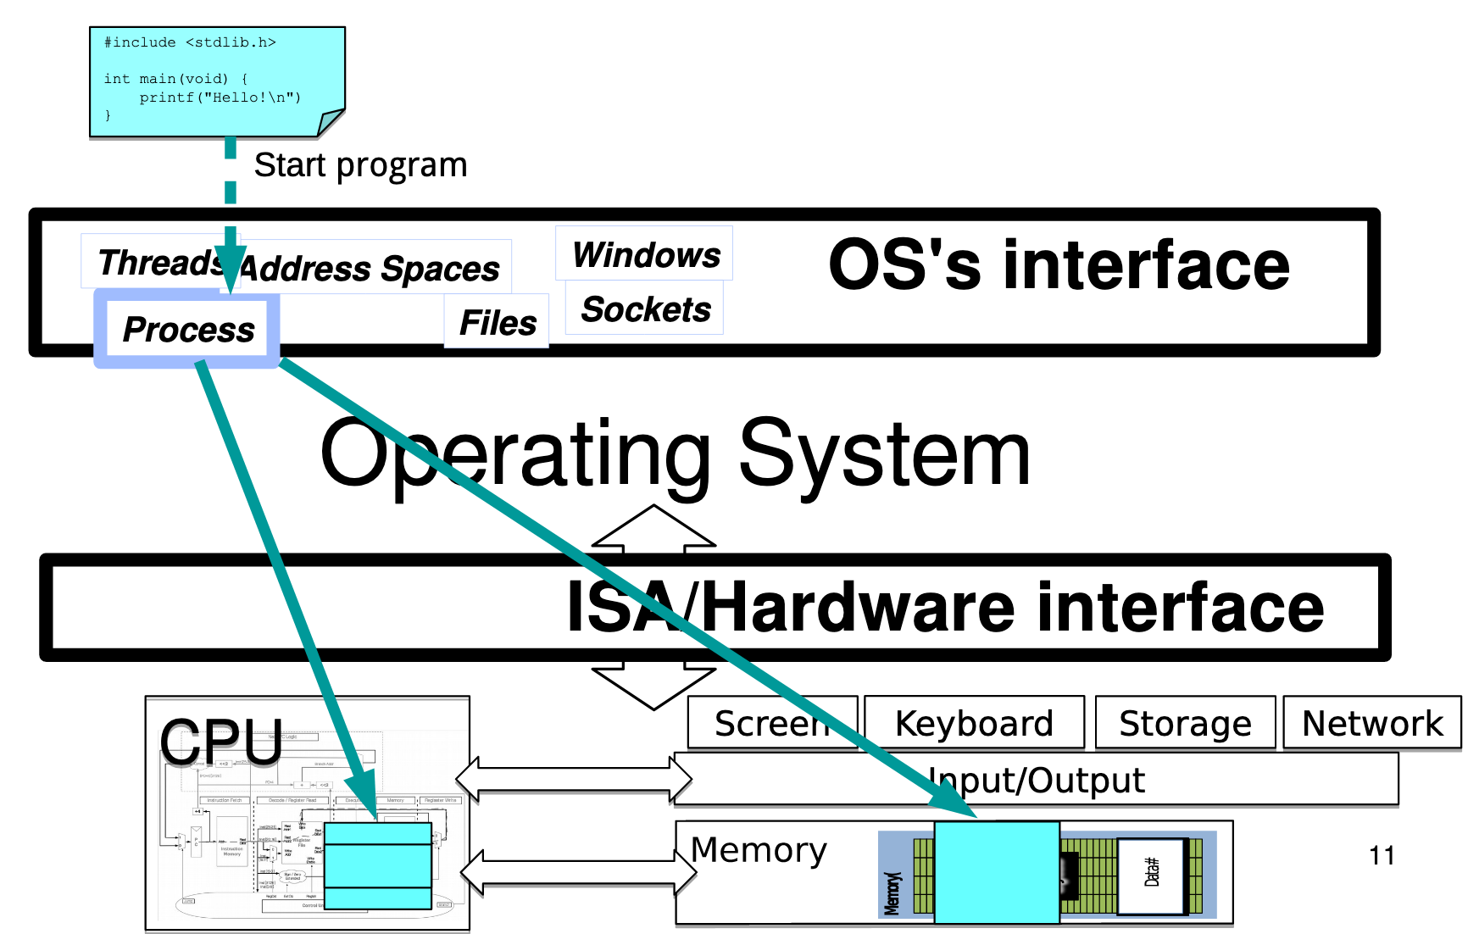
Abstraction: Program → Process

Slide 17
Multiple Processes: Context Switch

Slide 18
Abstraction: Input / Output

Slide 19
Security & Protection

Slide 20
Security & Protection

Slide 21
Course Logistics

Slide 22
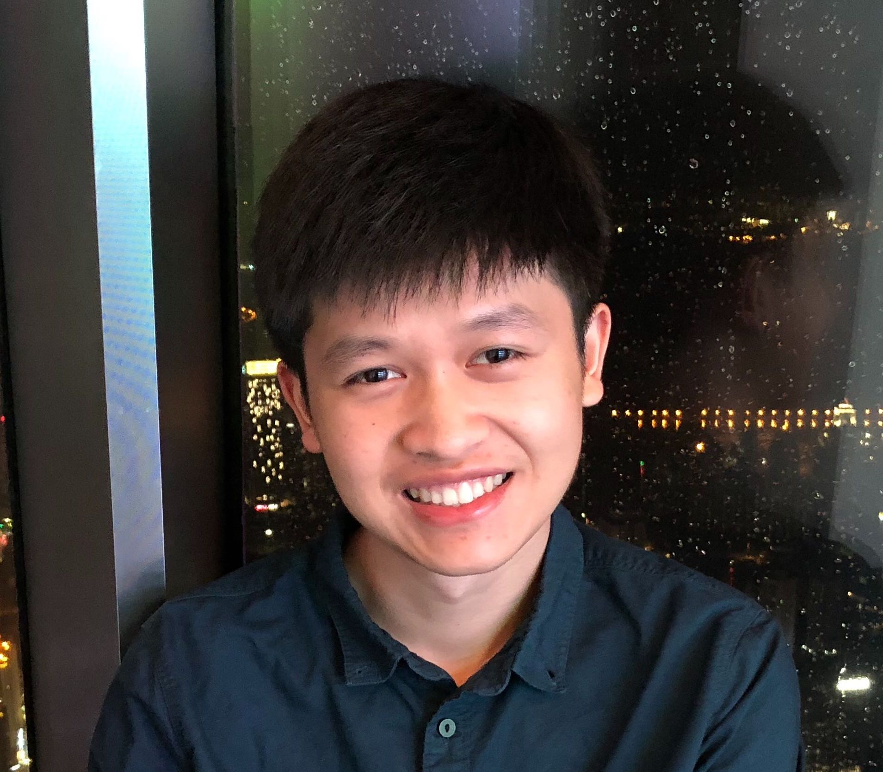
Course Staff
Instructor: Jack Kolb jkolb@berkeley.edu
OH: 1-2pm, Tuesdays, 3-5pm, Fridays; 411 Soda
Jonathan Murata jmurata@berkeley.edu
OH: 9-11am, Tuesdays, 341B Soda
Yiming Yang yangyiming@berkeley.edu
OH: 9-11am, Thursdays, 341B Soda
Jason Lee lxj@berkeley.edu
OH: 1-2pm, Tuesdays, 341B Soda

Slide 23
Infrastructure
Course Website: https://cs162.eecs.berkeley.edu
Piazza for Q&A: https://piazza.com/berkeley/summer2019/cs162
No lecture recordings available during summer term
Anonymous Feedback Form: https://tinyurl.com/cs162anonfeedback

Slide 24
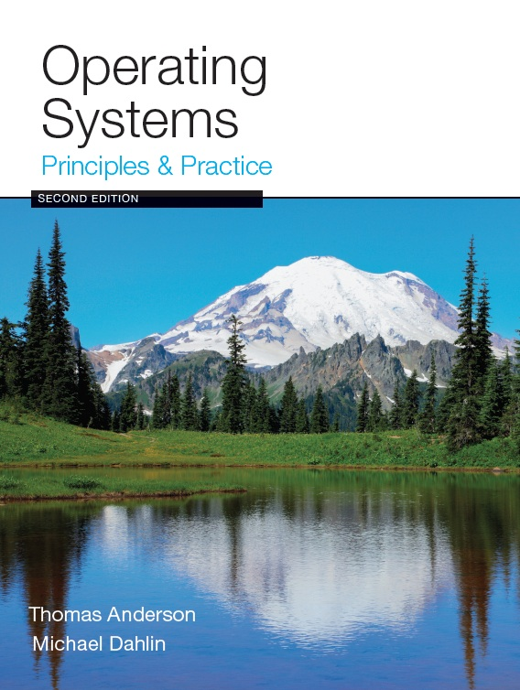
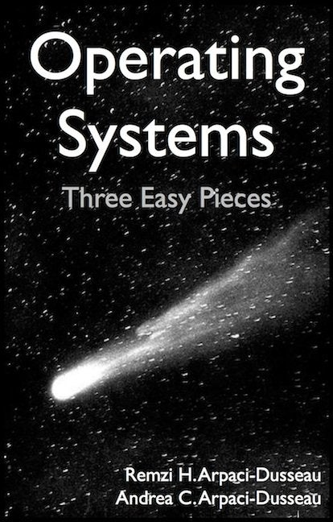
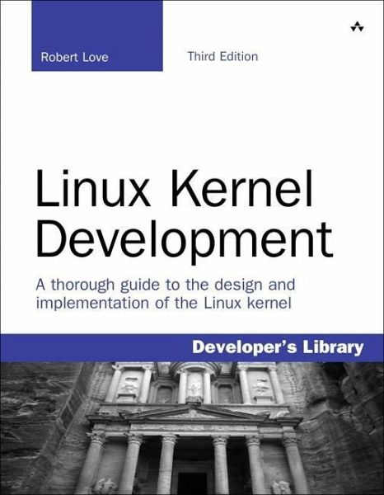
Textbook & Resources
Course text: Operating Systems, Principles and Practice, 2nd ed., by Anderson and Dahlin
Recommended Supplementary Material:
Operating Systems: Three Easy Pieces, by Remzi and Andrea Arpaci-Dusseau, available for free online at: http://pages.cs.wisc.edu/~remzi/OSTEP
Linux Kernel Development, 3rd ed., by Robert Love
Additional materials on course website "Readings" page
The Night Watch, relevant articles and papers

Slide 25
Syllabus Summary
Core OS Concepts: Processes, multiprogramming, protection
Concurrency: Threads, Scheduling, Synchronization
Input/Output & Networking: I/O Devices, Sockets, TCP, RPC
File Systems: Storage devices, Performance, Journaling, Transactions
Address Space: Virtual memory, Address translation, Paging
Distributed Computing: DHTs, Dist file systems, Consistency
Reliability & Security

Slide 26
Learning by Doing
Three group projects using Pintos and C
Threads and Scheduling
User Programs
File System
Four individual homework assignments to practice systems programming
HW0: Tools, autograding, C review, executables
HW1: Simple Shell
HW2: HTTP Server
HW3: TBA

Slide 27
Start HW0 ASAP
Due Friday at 11:59PM
Gets you set up with the autograder, github, and a local VM
Basic C programming task to serve as a refresher
Entry survey so we can learn more about you

Slide 28
Group Projects
Teams of 4 (Never 5, 3 would require serious justification)
Find teams by Friday (or we will assign you to a team)
Communication and cooperation will be essential
Design Documents
Slack/Messenger/whatever doesn’t replace face-to-face
Everyone should do work and have clear responsibilities
You will evaluate your teammates at the end of each project

Slide 29
Preparing Yourself for this Class
The projects will require you to be very comfortable with programming and debugging C
Pointers (including function pointers, void*)
Memory Management (malloc, free, stack vs heap)
Debugging with GDB
You will be working on a larger, more sophisticated code base than anything you've likely seen in 61C

Slide 30
Preparing Yourself for this Class
"Resources" page on course website
C programming reference (still in beta):
https://cs162.eecs.berkeley.edu/ladder/
Wednesday's section dedicated to programming and debugging review
Review session this Friday 11am-1pm 438 Soda Hall (Wozniak Lounge)

Slide 31
Project Grading
Initial Design Document & Design Review
Code Milestone
Final Version of Code
Peer Evaluations
Submission: git push to release branch

Slide 32
Course Grading
20% 2-Hour Midterm Exam (7/18, 5-7pm, 155 Dwinelle)
25% 3-Hour Final Exam (8/15, 5-8pm, Hearst Field Annex)
15% Homework Assignments
35% Pintos Projects
5% Participation

Slide 33
Collaboration Policy
OK:
Explaining a concept to someone in another group
Discussing algorithms/testing strategies with other groups
Helping debug someone else’s code (in another group)
Searching online for generic algorithms (e.g., hash table)
Not OK:
Sharing code or test cases with another group
Copying OR reading another group’s code or test cases
Copying OR reading online code or test cases from prior years

Slide 34
Late Policy
Deadlines are at 11:59PM Pacific Time
1 slip day to use for individual homework assignments
2 slip days to use (as a group) for projects
No credit for late work

Slide 35
Questions?

Slide 36
Break

Slide 37
What is an operating system?
Referee
Resource sharing, protection, isolation
Illusionist: clean, easy to use abstractions
Infinite memory, dedicated machine
Higher level objects: files, users, message
Masking limitations, virtualization
Glue: Common Services
Storage
Window system
Networking
Authorization

Slide 38
Unifying Theme: Complexity
All definitions of operating systems are about hiding complexity

Slide 39
The Challenge of Complexity
Competing applications with
Unexpected failures
Even malicious intentions…
Varying hardware with
Evolving interfaces
Unexpected failures
Not feasible to test all possible configurations!

Slide 40
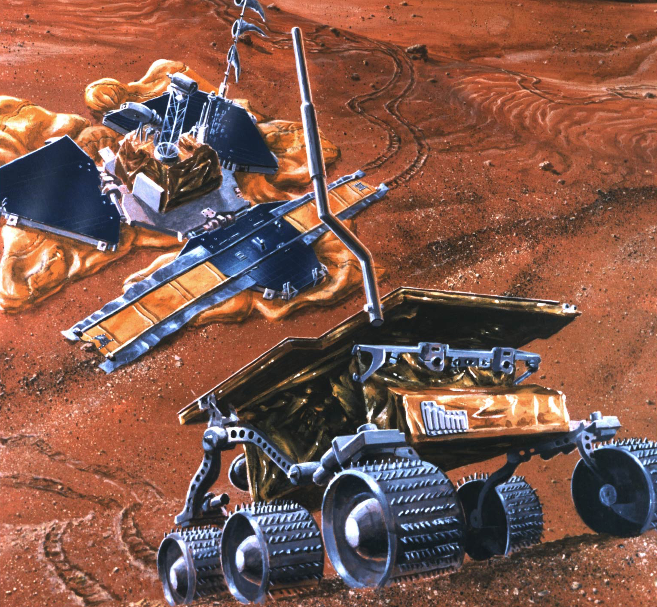
Complexity Example: Mars Pathfinder
Lots of types of hardware: Radios, science experiments, batteries, solar panels, motors and robotic equipment
Unique reliability requirements
No reset button, must reboot automatically when necessary
Must always be able to receive commands from Earth
Remote debugging
Software will crash, how is that handled?
Need to debug from Earth
Time-critical functions
Stop before hitting a Mars boulder
Earth communications

Slide 41
Complexity: Variety
Different CPUs: x86, PowerPC, ARM, MIPS
Different amounts of memory, disk space
Different types of devices
Mice, keyboards, sensors, cameras
Different networking equipment
Cable, DSL, Wireless, Ethernet

Slide 42
Questions
Does the programmer need to write a single program that performs many independent activities?
Does every program have to be altered for every piece of hardware?
Does a faulty program crash everything?
Does every program have access to all hardware?
Hopefully, no!

Slide 43
Unifying Theme: Helping the Programmer
Write program once for lots of hardware
Without reimplementing common functionality
Run alongside other programs, possibly communicating and cooperating with them (safely)
One program crashing doesn't crash everything

Slide 44
Abstract Virtual Machine Goals
Application
Operating System
Hardware
Virtual Machine Interface
Physical Machine Interface
OS Goals:
Remove software/hardware quirks (fight complexity)
Optimize for convenience, utilization, reliability, … (help the programmer)
For any OS area (e.g. file systems, virtual memory, networking, scheduling):
What hardware interface to handle? (physical reality)
What’s software interface to provide? (nicer abstraction)

Slide 45
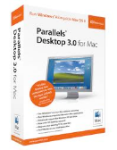
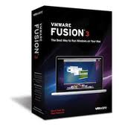
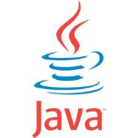
Aside: Virtual Machines
Software emulation of an abstract machine
Give programs illusion they own the machine
Make it look like hardware has features you want
Two types of “Virtual Machines”
Process VM: supports the execution of a single program; this functionality typically provided by OS
System VM: supports the execution of an entire OS and its applications (e.g., VMWare Fusion, Virtual box, Parallels Desktop, Xen)

Slide 46
Process VMs
Each process thinks…
It has all memory, CPU time, devices, …
All devices have the same convenient interface
Device interfaces more powerful than raw hardware
Bitmapped display ⇒ windowing system
Ethernet card ⇒ reliable, ordered, networking (TCP/IP)
Fault Isolation
Processes unable to directly impact other processes
Bugs cannot crash whole machine
Portability
Write your program for the OS rather than the raw hardware

Slide 47
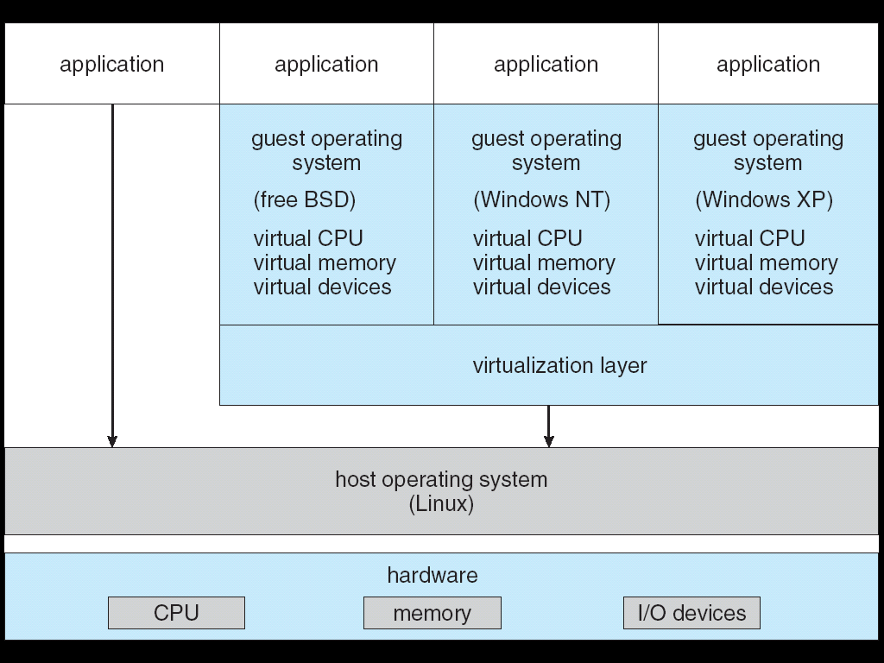
System Virtual Machines: Layers of OSs
Run entire operating systems
Good for OS development, portability, fault containment
Interface closer to raw HW
To aid porting/running OSs built to use raw HW
Different kind of "application developer" to design for

Slide 48
What is an Operating System,… Really?
Always:
Memory Management
I/O Management
CPU Scheduling
Communications?
Multitasking/multiprogramming?
Maybe:
File System?
Multimedia Support?
User Interface?
Web Browser?

Slide 49
What is an OS?
No universally accepted definition
“Everything a vendor ships when you order an operating system” is good approximation
But varies wildly!
“The one program running at all times on the computer” is the kernel
Everything else is either a system program (ships with the operating system) or an application program

Slide 50
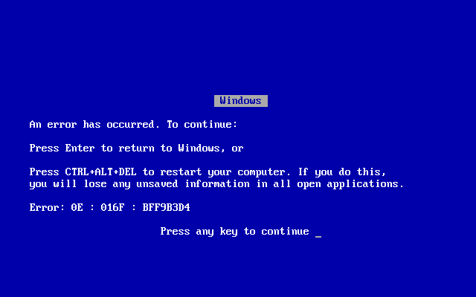
OS Goal: Protecting Processes & The Kernel
Run multiple applications and:
Keep them from interfering with or crashing the operating system
Keep them from interfering with or crashing each other

Slide 51
How do we achieve this?
Two main hardware mechanisms:
Memory address translation
Dual mode operation
Use these to enact a simple policy: Programs are not allowed to read or write the memory of other programs or of the OS

Slide 52
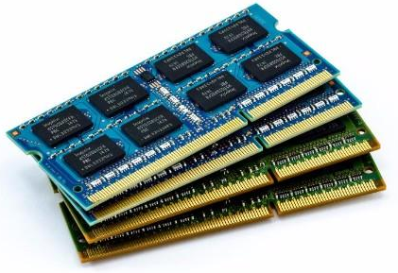
Address Translation
Abstraction: Address Space
Group of memory addresses usable by something
Each process and the kernel have distinct address spaces
Illusion of owning all memory
Mechanism: Address translation
Translate virtual addresses (used internally and emitted by CPU) to physical addresses
Usually performed in hardware by memory management unit (MMU)
CPU
Virtual Address
Physical Address
MMU

Slide 53
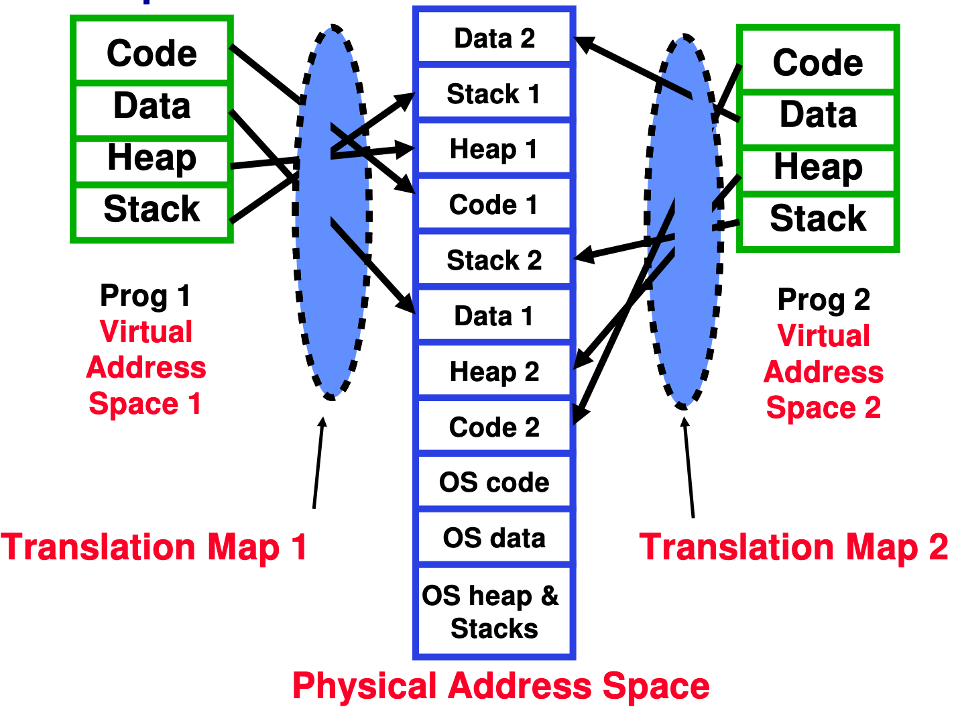
Example of Address Translation

Slide 54
Address Translation Details
Hopefully saw this in 61C?
Does this get us our desired policy?
Can't read or write if no translation to the physical memory
Problem: What if user code changes the page table pointer?

Slide 55
Dual Mode Operation
Hardware provides at least two modes:
Kernel Mode (or "supervisor" / "protected" mode)
User Mode
Certain operations are prohibited when running in user mode
Changing the page table pointer
Carefully controlled transitions between user mode and kernel mode
System calls, interrupts, exceptions

Slide 56
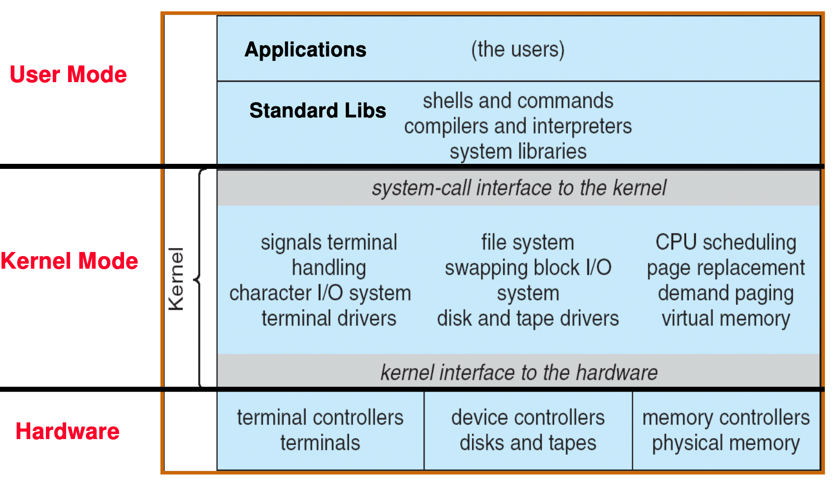
UNIX OS Structure

Slide 57
Conclusion
Operating systems:
Provide a virtual machine abstraction to handle diverse hardware
Coordinate resources and protect users from each other
Simplify application development by providing standard services
Provide fault containment, fault tolerance, and fault recovery

