Slide 1
CS 162: Operating Systems and Systems Programming
Lecture 23: mmap, Linux Virtual Memory, IPC
August 5, 2019
Instructor: Jack Kolb
https://cs162.eecs.berkeley.edu

Slide 2
Logistics
Proj 3 Due on August 12
Milestone coming up on Tuesday
HW3 Due on August 13
Last Tuesday of the class
Special Topics Lecture on 8/13
Suggest ideas on Piazza thread (currently pinned)

Slide 3
Recall: Misses with Demand Paging
Compulsory Misses: Prefetching
Capacity Misses: Can't quickly add more RAM
Conflict Misses: Don't technically occur, RAM acts as fully associative cache
Comes down to having a good page replacement policy

Slide 4
Recall: Simple Page Replacement Policies
Random
FIFO (First In/First Out): Evict the oldest page (resident in memory the longest)
Bad: Age of a page does not necessarily reflect its utility
Least Recently Used: Evict page whose last access was farthest in the past
Not practical to implement in this setting

Slide 5
Recall: Clock Algorithm
Used bit per page
Upon page fault: Scan through pages, reset the used bit back to 0
Treat pages as circular sequence ("clock") – our current position is the "clock hand"
Replacement candidates: Pages not used since previous scan (Used bit already 0)
What if we scan around and all used bits are set?
Just loops around, reverts to FIFO

Slide 6
Recall: N^{th} Chance Clock Algorithm
Replace the single bit (used since last cycle) with a counter – cycles since last reference
Reset counter to 0 if page used, otherwise increment
Candidate for eviction if counter > N
Tradeoff: Larger N means better LRU approximation, but more scanning involved

Slide 7
Recall: Second-Chance List Algorithm
LRU victim
Directly
Mapped Pages
Marked: RW
List: FIFO
Overflow
Second
Chance List
Marked: Invalid
List: LRU
Access
Page-in
From disk
New
Active Pages
New
SC Victims
Split memory in two: Active list (RW), SC list (Invalid)
If we access a page on SC list, page fault occurs
Respond by moving to front of active list
Replace a "victim" from front of SC list

Slide 8
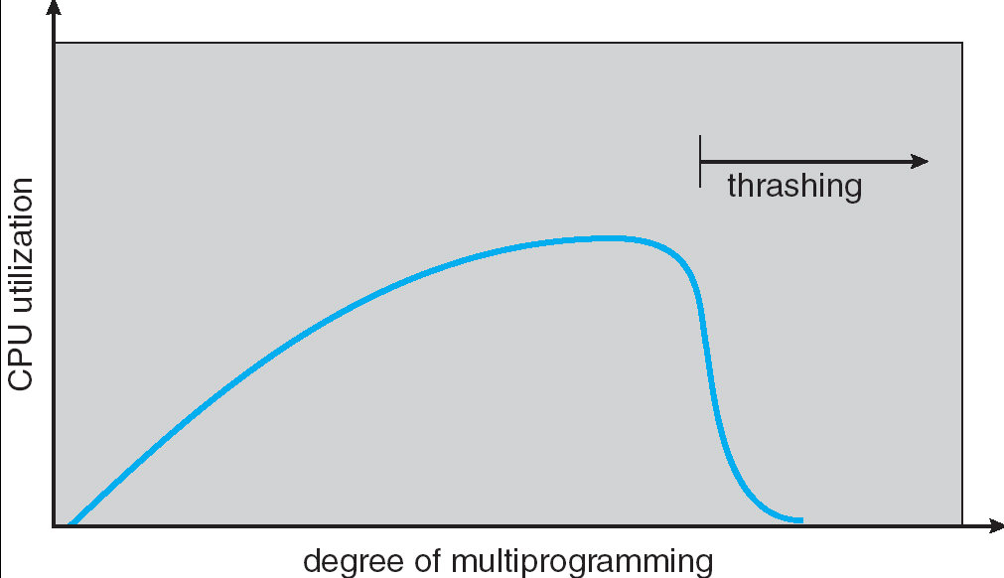
Recall: Thrashing
No individual process has enough pages to make steady progress, runs a little bit then page fault
Result: Low CPU utilization
Every process waiting on IO to bring pages into memory

Slide 9
Reverse Page Mapping: "Coremap"
Mapping from physical page frame # to all of its mappings in virtual address spaces
Example uses:
Scanning accessed/dirty bits of all of frame's PTEs
Marking a page as not present in all PTEs that refer to it when evicting the page to disk

Slide 10
Coremap
Physical Memory
Frame 1
Page Table Entry
Proc. 1
Frame 2
Frame 3
Page Table Entry
Proc. 1
⋮
Page Table Entry
Proc. 2
Frame n
Page Table Entry
Proc. 1

Slide 11
Loading Executable Into Memory
disk (huge)
memory
info
data
code
exe
View so far: OS copies each segment into memory
Then set up registers, jump to start location

Slide 12
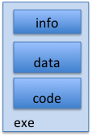
New View: Create Address Space
disk (huge, TB)
VAS – per process
kernel
stack
stack
heap
heap
data
data
code
One (very conservative) method: Every page in address space is backed by disk
Just allocate space on disk, let a page fault trigger a load into memory

Slide 13
New View: Create Address Space
disk (huge, TB)
VAS – per process
kernel
stack
stack
heap
heap
data
data
code
Note that we do not need an extra copy of read-only data already contained in a file
Executable code, memory mapped files (soon)

Slide 14
New View: Create Address Space
disk (huge, TB)
VAS – per proc.
PT
memory
kernel
stack
user page
frames
stack
heap
heap
user pagetable
data
data
kernel code & data
code
User page table maps entire virtual address space
One per process, distinguishes present from absent pages
OS needs to store mapping from virtual page to disk location

Slide 15
New View: Create Address Space
disk (huge, TB)
VAS – per proc.
PT
memory
kernel
stack
user page
frames
stack
heap
heap
user pagetable
data
data
kernel code & data
code
Backing Store
Cache

Slide 16
Provide Backing Store for VAS
disk (huge, TB)
VAS 1
PT 1
memory
kernel
stack
stack
stack
heap
user page
frames
heap
heap
data
VAS 2
PT 2
data
code
user pagetable
data
kernel
code
stack
kernel code & data
heap
data
code

Slide 17
A Page Fault
disk (huge, TB)
VAS 1
PT 1
memory
kernel
stack
stack
stack
heap
user page
frames
heap
heap
data
VAS 2
PT 2
data
code
user pagetable
data
kernel
code
stack
kernel code
& data
heap
data
active process & PT
code

Slide 18
A Page Fault: Find and Start Load
disk (huge, TB)
VAS 1
PT 1
memory
kernel
stack
stack
stack
heap
user page
frames
heap
heap
data
VAS 2
PT 2
data
code
user pagetable
data
kernel
code
stack
kernel code & data
heap
data
active process & PT
code

Slide 19
A Page Fault: Switch During IO
disk (huge, TB)
VAS 1
PT 1
memory
kernel
stack
stack
stack
heap
user page
frames
heap
heap
data
VAS 2
PT 2
data
code
user pagetable
data
kernel
code
stack
kernel code & data
heap
data
active process & PT
code

Slide 20
On Page Fault: Update PTE
disk (huge, TB)
VAS 1
PT 1
memory
kernel
stack
stack
stack
heap
user page
frames
heap
heap
data
VAS 2
PT 2
data
code
user pagetable
data
kernel
code
stack
kernel code & data
heap
data
active process & PT
code

Slide 21
Eventually Reschedule Faulting Thread
disk (huge, TB)
VAS 1
PT 1
memory
kernel
stack
stack
stack
heap
user page
frames
heap
heap
data
VAS 2
PT 2
data
code
user pagetable
data
kernel
code
stack
kernel code & data
heap
data
active process & PT
code

Slide 22
Memory-Mapped IO
IO so far: Explicit transfer between buffers in process address space to regions of a file
Overhead: multiple copies in memory, syscalls
Alternative: Map file directly into an empty region of a process address space
Implicitly page in file when we read it
Write to file and eventually page it out
Executable file is treated this way when we execute a process!

Slide 23
Using Paging to mmap Files
Process
virtual address
physical address
MMU
page#
PT
instruction
frame#
offset
retry
page fault
exception
Read File contents
from memory!
Operating System
Create PT entries
for mapped region
as “backed” by file
Page Fault Handler
File
scheduler
mmap() file to region of VAS

Slide 24
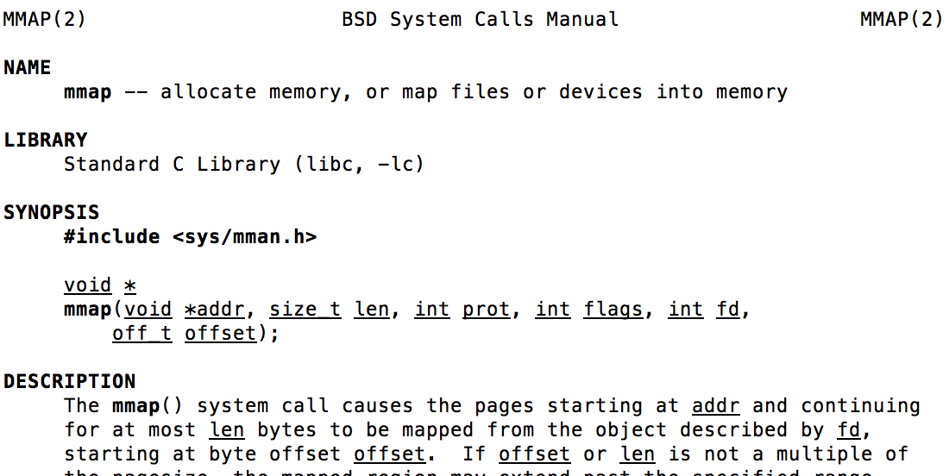
mmap system call
May map specific region or let the system find one for you
Tricky to know where a free region even would be…

Slide 25
mmap Example
$ ./mmap test
Data at: 105d63058
Heap at : 7f8a33c04b70
Stack at: 7fff59e9db10
mmap at : 105d97000
This is line one
This is line two
This is line three
This is line four
#include <sys/mman.h> /* also stdio.h, stdlib.h, string.h, fcntl.h, unistd.h */
int something = 162;
int main (int argc, char *argv[]) {
int myfd;
char *mfile;
printf("Data at: %16lx\n", (long unsigned int) &something);
printf("Heap at : %16lx\n", (long unsigned int) malloc(1));
printf("Stack at: %16lx\n", (long unsigned int) &mfile);
/* Open the file */
myfd = open(argv[1], O_RDWR | O_CREAT);
if (myfd < 0) { perror("open failed!");exit(1); }
/* map the file */
mfile = mmap(0, 10000, PROT_READ|PROT_WRITE, MAP_FILE|MAP_SHARED, myfd, 0);
if (mfile == MAP_FAILED) {perror("mmap failed"); exit(1);}
printf("mmap at : %16lx\n", (long unsigned int) mfile);
puts(mfile);
strcpy(mfile+20,"Let's write over it");
close(myfd);
return 0;
}
$ cat test
This is line one
ThiLet's write over its line three
This is line four

Slide 26
Sharing through Mapped Files
VAS 1
VAS 2
0x000…
0x000…
instructions
instructions
data
data
File
heap
heap
Memory
stack
stack
OS
OS
0xFFF…
0xFFF…

Slide 27
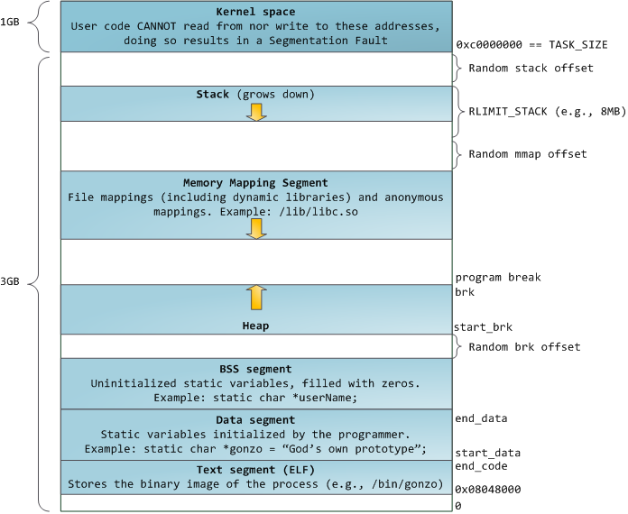
32-bit x86 Linux Memory Layout

Slide 28
32-bit x86 Linux Memory Layout
Memory Mapped Files
Extra stacks for multithreaded processes
Shared Libraries
Some Memory Allocations

Slide 29
32-bit x86 Linux Memory Layout
ASLR: Address Space Layout Randomization
Make it harder to exploit bugs to compromise system
See a security class for more…

Slide 30
32-bit x86 Linux Memory Layout
Memory Mapped Files
Extra stacks for multithreaded processes
Shared Libraries
Some Memory Allocations

Slide 31
32-bit x86 Linux Memory Layout
Kernel mapped into every process's address space
Protection bits: pages can't be accessed in user mode
Why? Faster than changing address space on every switch to kernel mode

Slide 32
Linux Virtual memory map
0xFFFFFFFF
0xFFFFFFFFFFFFFFFF
Kernel Addresses
1GB
Kernel Addresses
128TiB
896MB Physical
64 TiB Physical
0xC0000000
User Addresses
0xFFFF800000000000
3GB Total
Empty
Space
“Canonical Hole”
0x00007FFFFFFFFFFF
128TiB
User
Addresses
0x00000000
0x0000000000000000
32-Bit Virtual Address Space
64-Bit Virtual Address Space

Slide 33
Linux Virtual memory map
0xFFFFFFFF
0xFFFFFFFFFFFFFFFF
Kernel Addresses
1GB
Kernel Addresses
128TiB
896MB Physical
One-to-One maps of "bottom" of Physical Memory
64 TiB Physical
0xC0000000
User Addresses
0xFFFF800000000000
3GB Total
Empty
Space
“Canonical Hole”
0x00007FFFFFFFFFFF
128TiB
User
Addresses
0x00000000
0x0000000000000000
32-Bit Virtual Address Space
64-Bit Virtual Address Space

Slide 34
Linux Virtual memory map
0xFFFFFFFF
0xFFFFFFFFFFFFFFFF
Kernel Addresses
1GB
Kernel Addresses
128TiB
896MB Physical
Can temporarily map higher physical addresses
64 TiB Physical
0xC0000000
User Addresses
0xFFFF800000000000
3GB Total
Empty
Space
“Canonical Hole”
0x00007FFFFFFFFFFF
128TiB
User
Addresses
0x00000000
0x0000000000000000
32-Bit Virtual Address Space
64-Bit Virtual Address Space

Slide 35
January 2018 - Meltdown
Possible to inspect contents of kernel memory if it's mapped into address space (even as user!)
Fix: Kernel Page Table Isolation
Use entirely different page tables when in user mode vs. when in kernel mode
Problem: Address space change whenever an interrupt or syscall occurs!
Change page tables
Flush TLB unless it is tagged
Reduced Performance, depends on syscall workload

Slide 36
Break

Slide 37
Interprocess Communication
Thus far, we've said the following:
Hard to cooperate across processes because they're inherently isolated (separate addr. spaces)
But this is good for protection
Easy to cooperate among threads because they share an address space
But this is bad for protection
Have to use synchronization primitives like locks

Slide 38
Interprocess Communication
Allow two (or more) processes to exchange information with each other
Why use this approach rather than multithreading?
Keep most of the benefits of process isolation
Expose processes to each other only through a carefully structured interface
Ex: Google Chrome Design

Slide 39
We've Already Seen Some IPC
Two processes share a file (e.g. both mmap it)
Needs some synchronization, must structure file layout
Con: Still involves entire kernel IO infrastructure
What if file is only temporary, needed while processes are running?
Open a socket to 127.0.0.1 (localhost)
Nice if we ever want to deploy process on remote machine later on
But lots of extra work: Packet/header assembly, checksum calculation, TCP ACKs, etc.

Slide 40
IPC Example: Pipes
Use classic file-related syscalls: read, write
But avoid the overhead of actually interacting with kernel IO subsystem
Instead: writes/reads manipulate a buffer of memory maintained by the kernel

Slide 41
Pipe Syscall
PIPE(2) Linux Programmer's Manual
NAME
pipe, pipe2 - create pipe
SYNOPSIS
#include <unistd.h>
int pipe(int pipefd[2]);
DESCRIPTION
pipe() creates a pipe, a unidirectional data channel that can be used for interprocess communication. The array pipefd is used to return two file descriptors referring to the ends of the pipe. pipefd[0] refers to the read end of the pipe. pipefd[1] refers to the write end of the pipe.
Data written to the write end of the pipe is buffered by the kernel until it is read from the read end of the pipe.

Slide 42
Using Pipes – Common Pattern
Process calls pipe with 2-int array
array[0]: Read-only
array[1]: Write-only
fork()
Each pipe fd is unidirectional – parent and child each close the "end" they don't need

Slide 43
Using Pipes
int pipe_fds[2];
pid_t cpid;
pipe(pipe_fds);
cpid = fork();
if (cpid > 0) {
close(pipe_fds[0]); // Close read-only end
char *msg = "Hello, World!";
write(pipe_fds[1], msg, 13);
close(pipe_fds[1]);
waitpid(cpid, NULL, 0);
} else {
close(pipe_fds[1]); // Close write-only end
char buf[1024];
int nread = read(pipe_fds[0], &buf, 1023);
buf[nread] = '\0';
printf("Parent Sent: %s\n", buf);
close(pipe_fds[0]);
}

Slide 44
Using Pipes
Parent
Child
write pipe_fds[1]
read pipe_fds[0]
Kernel
Remember producer-consumer problem?
Pipe's buffer has maximum size
Write to full pipe blocks until space available
Read from empty pipe blocks until data available
Read from pipe with no writers returns 0
Write to pipe with no readers prompts SIGPIPE

Slide 45
UNIX Domain Sockets
Open a socket connection with a local process
Use familiar write/read calls to communicate
But don't incur usual overhead of networking
Optimized for processes on same machine

Slide 46
Using Unix Domain Sockets
Still need same sequence of syscalls: socket, bind, listen, accept to act as a server
But socket address now corresponds to an object in local machine's filesystem
Specify path on bind
Why this approach?
Filesystem gives us a namespace: any process can specify path on connect (doesn't need to be a child of server)
Filesystem enforces permissions

Slide 47
Using Unix Domain Sockets
#include <sys/un.h>
…
int fd;
struct sockaddr_un un;
un.sun_family = AF_UNIX;
strcpy(un.sun_path, "/home/oski/demo.socket");
fd = socket(AF_UNIX, SOCK_STREAM, 0);
bind(fd, (struct sockaddr*)&un, sizeof(un));

Slide 48
Many Other Forms of IPC
Named Pipes (FIFOs): Pipe interface, but given a name in the file system (man 3 mkfifo)
Named semaphores (man sem_open)
Message Queues (man 7 mq_overview)
And more…

Slide 49
Summary
Alternate view of loading a program: allocate space on disk, load in pages only when needed
Memory-Mapped IO: Map contents of file into virtual address space, store/load instead of read/write
Inter-Process Communication: Structured sharing
Pipes: Read/write ordered, in-memory buffer
Unix Domain Sockets: Avoid networking overhead

Slide 50
C Concurrency and Synch.
Standard approach: use pthreads, protect access to shared data structures
Shared Memory Paradigm
One pitfall: consistently unlocking a mutex
int Rtn() { lock.acquire(); … if (exception) { lock.release(); return errCode; } … lock.release(); return OK; }

Slide 51
Other Languages and Threading
Many other mainstream languages also focus on threads and shared memory
But offer useful libraries and built-in features to make our lives easier
Thread management libraries
Thread pools
Safer lock management
Objects as monitors

Slide 52
C++ Lock Guards
#include <mutex>
int global_i = 0;
std::mutex global_mutex;
void safe_increment() {
std::lock_guard<std::mutex> lock(global_mutex);
…
global_i++;
// Mutex released when 'lock' goes out of scope
}

Slide 53
Python with Keyword
More versatile than we'll show here (can be used to close files, server connections, etc.)
with lock: # Automatically calls acquire()
some_var += 1
…
# release() called however we leave block

Slide 54
Java Support for Synchronization
class Account { private int balance; public Account (int initialBalance) { balance = initialBalance; }
public synchronized int getBalance() { return balance; }
public synchronized void deposit(int amount) { balance += amount; } }
Every Java object has an associated lock for synchronization:
Lock is acquired on entry and released on exit from synchronized method
Lock is properly released if exception occurs inside synchronized method

Slide 55
Java Support for Synchronization
Along with a lock, every object has a single condition variable associated with it
To wait inside a synchronized method:
void wait();
void wait(long timeout);
To signal while in a synchronized method:
void notify();
void notifyAll();

Slide 56
Up Next: Go
"Goroutines": Lightweight, user-level threads
Channels: Named message queues for communication among threads
Key Idea: Prefer message passing over shared memory

Slide 57
Up Next: Go
Why this approach?
Efficiency of a shared address space
Tolerates many threads in one program
Passing data through channels: no need for explicit synchronization
Sender passes ownership to receiver

