Slide 1
CS 162: Operating Systems and Systems Programming
Lecture 7: Semaphores, Monitors, Reader/Writer
July 3, 2019
Instructor: Jack Kolb
https://cs162.eecs.berkeley.edu

Slide 2
Logistics
Project 1: Design Doc due Tonight
No class or office hours tomorrow
Resume normal schedule on Friday
Groups assigned to TAs earlier today
Pintos Overview Session: Monday
11am-1pm, Wozniak Lounge

Slide 3
Recall: Atomic Operations
Atomic load/store not good enough to build a lock
Instead: Hardware instructions that atomically read a value from (shared) memory and write a new value
Hardware responsible for making this work in spite of caches

Slide 4
Recall Locks with test&set
int guard = 0;
int value = 0;
Acquire() {
// Short busy-wait time while(test&set(guard)); if (value == 1) {
put thread on wait-queue;
go to sleep()& guard = 0; } else { value = 1; guard = 0; } }
Remember:
Lock.Acquire();
<critical section>
Lock.Release();

Slide 5
Recall Locks with test&set
Release() { // Short busy-wait time while (test&set(guard)); if anyone on wait queue { take thread off wait-queue Place on ready queue; } else { value = 0; } guard = 0; }

Slide 6
Recall: Semaphore
Definition: A non-negative integer value with two possible operations
P() or down() or wait(): atomically wait for semaphore to become positive, then decrement it by 1
V() or up() or signal(): atomically increment semaphore (waking up a P() thread)

Slide 7
Recall: Multithreaded Web Server
Bounded pool of worker threads
Allocated in advance: no thread creation overhead
Queue of pending requests
Master Thread
Client
Request
Queue
Thread Pool
Response

Slide 8
Producer/Consumer Problem
Shared buffer of fixed size
Producer inserts items
Consumer removes items
Producer/consumer don't need to work in lockstep
Example: Worker thread processes web request independent of master thread

Slide 9
Producer/Consumer Correctness
Scheduling constraints:
Consumer waits for producer if buffer is empty
Producer waits for consumer if buffer is full
Mutual Exclusion: Only one thread manipulates the buffer at a time
One semaphore per constraint
Mutex (mutual exclusion)
Filled Slots (consumer waits if necessary)
Empty Slots (producer waits if necessary)

Slide 10
Producer/Consumer Code
Semaphore fullSlots = 0; // Buffer empty to start
Semaphore emptySlots = bufSize; // All slots empty
Semaphore mutex = 1; // No one in critical sect.
Producer(item) {
emptySlots.P(); // Wait for free slot
mutex.P();
Enqueue(item); mutex.V();
fullSlots.V(); // Tell consumers about new data
}

Slide 11
Producer/Consumer Code
Semaphore fullSlots = 0; // Queue empty to start
Semaphore emptySlots = bufSize; // All slots empty
Semaphore mutex = 1; // No one in critical sect.
Consumer() {
fullSlots.P(); // Wait for item
mutex.P();
item = Dequeue();
mutex.V();
emptySlots.V(); // Tell producers about new slot
return item;
}

Slide 12
Producer/Consumer Code
Semaphore fullSlots = 0; // Queue empty to start
Semaphore emptySlots = bufSize; // All slots empty
Semaphore mutex = 1; // No one in critical sect.
Producer(item) {
emptySlots.P();
mutex.P();
Enqueue(item); mutex.V();
fullSlots.V();
}
Consumer() {
fullSlots.P();
mutex.P();
item = Dequeue();
mutex.V();
emptySlots.V();
return item;
}

Slide 13
Discussion
What if we wrote the following?
Producer(item) {
mutex.P();
emptySlots.P();
Enqueue(item); mutex.V();
fullSlots.V();
}
Consumer() {
fullSlots.P();
mutex.P();
item = Dequeue();
mutex.V();
emptySlots.V();
return item;
}
Deadlock

Slide 14
Discussion
What about this?
Producer(item) {
emptySlots.P();
mutex.P();
Enqueue(item); fullSlots.V();
mutex.V();
}
Consumer() {
fullSlots.P();
mutex.P();
item = Dequeue();
mutex.V();
emptySlots.V();
return item;
}
Correct, possibly less efficient

Slide 15
Problems with Semaphores
More powerful than simple locks
But the textbook really doesn't like them
Argument: Clearer to have separate constructs for
Mutual Exclusion: One thread can do something at a time
Waiting for a condition to become true
Need to make sure a thread calls P() for every V()
Other tools are more flexible than this (as we'll see)

Slide 16
Condition Variables
A queue of threads waiting inside a critical section
Operations:
wait(&lock): Atomically release lock and go to sleep. Re-acquire the lock before returning.
signal(): Wake up on waiting thread (if there is one)
broadcast(): Wake up all waiting threads
Rule: Hold lock when using a condition variable

Slide 17
Monitors
Locks for mutual exclusion
Condition variables for waiting
A monitor is a lock and zero or more condition variables with some associated data and operations
Java provides this natively
POSIX threads: Provides locks and condvars, have to build your own

Slide 18
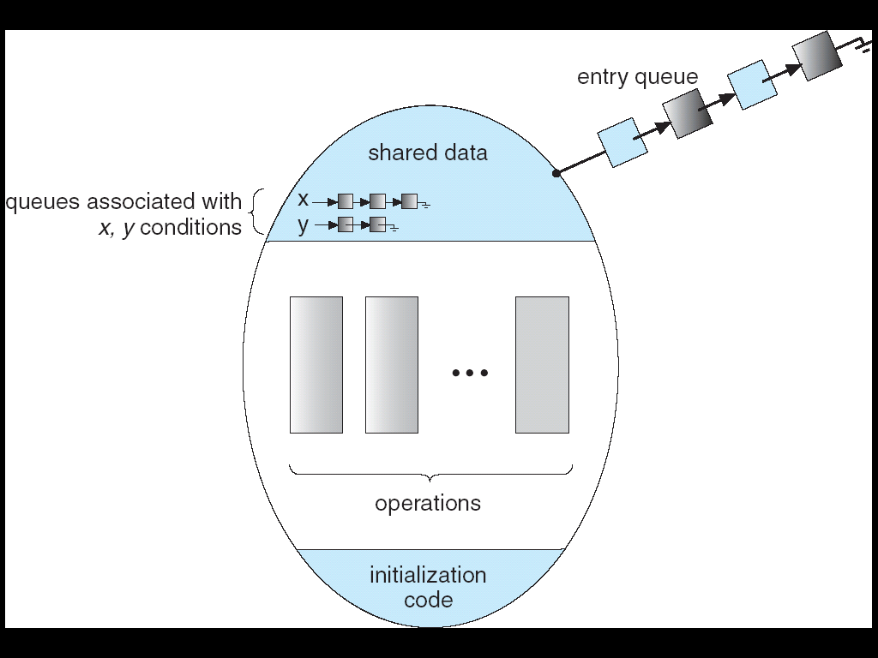
Monitors
Lock: protects access to shared data
Always acquire lock when accessing
Queue of threads waiting to enter the monitor

Slide 19
Monitors
Condition Variables: queue of threads waiting for something to become true inside critical sect.
Atomically release lock and start waiting
Another thread using the monitor will signal them
The condition: Some function of monitor's data

Slide 20
Implementing a Queue
Lock lock;
Condition dataready;
Queue queue;
AddToQueue(item) {
lock.Acquire(); // Get Lock queue.enqueue(item); // Add item dataready.signal(); // Signal any waiters lock.Release(); // Release Lock }
RemoveFromQueue() { lock.Acquire(); // Get Lock while (queue.isEmpty()) {
dataready.wait(&lock); // If nothing, sleep }
item = queue.dequeue(); // Get next item lock.Release(); // Release Lock return(item); }

Slide 21
Why the while Loop?
Why not:
while (queue.isEmpty()) {
dataready.wait(&lock); }
if (queue.isEmpty()) {
dataready.wait(&lock); }
When a thread is woken up by signal(), it is simply put on the ready queue
It may or may not reacquire the lock immediately!
Another thread could be scheduled first and "sneak in" to empty the queue
Need a loop to re-check condition on wakeup

Slide 22
Why the while Loop?
Can we "hand off" the lock directly to the signaled thread so no other thread "sneaks in?"
Yes. Called Hoare-Style Monitors
Many textbooks describe this scheme
Most OSs implement Mesa-Style Monitors
Allows other threads to sneak in
Much easier to implement
Even easier if you allow "spurious wakeups"
wait() can return when no signal occurred, in rare cases
POSIX allows spurious wakeups

Slide 23
Interlude: Concurrency Is Hard
Even for practicing engineers trying to write mission-critical, bulletproof code!
Therac-25: Radiation Therapy Machine with Unintended Overdoses (reading on course site)
Mars Pathfinder Priority Inversion (JPL Account)
Toyota Uncontrolled Acceleration (CMU Talk)
256.6K Lines of C Code, ~9-11K global variables
Inconsistent mutual exclusion on reads/writes

Slide 24
Comparing High-Level Synchronization
Semaphores can implement locks
Acquire() { semaphore.P(); }
Release() { semaphore.V(); }
Monitors are a superset of locks
Can monitors implement semaphores?

Slide 25
Semaphores With Monitors
Lock lock;
int count = initial value of semaphore;
CondVar atOne;
P() {
lock.acquire();
while (count == 0) {
atOne.wait(&lock);
}
count--;
lock.Release()
}
V() {
lock.acquire();
count++;
if (count == 1) {
atOne.Signal();
}
lock.Release()
}

Slide 26
Comparing High-Level Synchronization
Semaphores can implement locks
Acquire() { semaphore.P(); }
Release() { semaphore.V(); }
Monitors are a superset of locks
Can monitors implement semaphores? Yes
Can semaphores implement monitors?

Slide 27
CVs with Semaphores (Attempt 1)
Wait(Lock lock) {
lock.Acquire();
semaphore.P();
lock.Release();
}
Signal() {
semaphore.V();
}
Problem:
Signal affects threads in the future (semaphores are stateful)
What about doing a broadcast()?

Slide 28
CVs with Semaphores (Attempt 2)
Wait(Lock lock) {
lock.Acquire();
semaphore.P();
lock.Release():
}
Signal() {
Atomically {
if sem queue nonempty
semaphore.V();
Problem: "is queue empty" not a semaphore operation
But there is a solution

Slide 29
CVs with Semaphores
Key Idea: Queue of semaphores
Protected by a binary semaphore
Each waiting thread has its own semaphore
Call V on waiter's semaphore and remove it from queue
More in our textbook

Slide 30
Comparing High-Level Synchronization
Semaphores can implement locks
Acquire() { semaphore.P(); }
Release() { semaphore.V(); }
Monitors are a superset of locks
Can monitors implement semaphores? Yes
Can semaphores implement monitors? Yes

Slide 31
Break

Slide 32
Reader/Writer Problem
Read
Shared Database
Write
Read
Shared Database
Many readers – never modify the database
Few writers – read and modify database
Single lock sufficient?

Slide 33
Reader/Writer Correctness
Readers can access when no writers
Writers can access when no readers and no other writers
A lock will satisfy these requirements
But we want to allow multiple readers
Better efficiency

Slide 34
Reader/Writer with Monitors
Reader() {
Wait until no active writers
Access database
Maybe wake up a writer
}
Writer() {
Wait until no active readers or writers
Access database
Maybe wakeup reader or writer
}
Lock (for mutual exclusion)
int activeReaders, condVar okToRead
int activeWriters, condVar okToWrite

Slide 35
Reader Version 1
Reader() { // First check self into system lock.Acquire();
while (AW > 0) { // Is it safe to read? okToRead.wait(&lock); // Sleep on cond var }
AR++; // Now we are active! lock.release();
// Perform actual read-only access AccessDatabase(ReadOnly);
// Now, check out of system lock.Acquire(); AR--; // No longer active if (AR == 0) // No other active readers okToWrite.signal(); // Wake up one writer lock.Release(); }

Slide 36
Writer Version 1
Writer() { // First check self into system lock.Acquire();
while (AR > 0 || AW > 0) { // Is it safe to write? okToWrite.wait(&lock); // Sleep on cond var }
AW++; // Now we are active! lock.release();
// Perform actual read/write access AccessDatabase(ReadWrite);
// Now, check out of system lock.Acquire(); AW--; // No longer active
okToWrite.signal(); // Wake up one writer okToRead.broadcast(); // Wake up all readers lock.Release(); }

Slide 37
Writer Version 1: Starvation
Writer() { // First check self into system lock.Acquire();
while (AR > 0 || AW > 0) { // Is it safe to write? okToWrite.wait(&lock); // Sleep on cond var }
AW++; // Now we are active! lock.release();
// Perform actual read/write access AccessDatabase(ReadWrite);
// Now, check out of system lock.Acquire(); AW--; // No longer active
okToWrite.signal(); // Wake up one writer okToRead.broadcast(); // Wake up all readers lock.Release(); }
If there are always readers, this is always true! Writer starves

Slide 38
Writer Version 1: Conflict
Writer() { // First check self into system lock.Acquire();
while (AR > 0 || AW > 0) { // Is it safe to write? okToWrite.wait(&lock); // Sleep on cond var }
AW++; // Now we are active! lock.release();
// Perform actual read/write access AccessDatabase(ReadWrite);
// Now, check out of system lock.Acquire(); AW--; // No longer active
okToWrite.signal(); // Wake up one writer okToRead.broadcast(); // Wake up all readers lock.Release(); }
Relies on waiting threads double-checking condition

Slide 39
Writer Version 1: Conflict
Writer() { // First check self into system lock.Acquire();
while (AR > 0 || AW > 0) { // Is it safe to write? okToWrite.wait(&lock); // Sleep on cond var }
AW++; // Now we are active! lock.release();
// Perform actual read/write access AccessDatabase(ReadWrite);
// Now, check out of system lock.Acquire(); AW--; // No longer active
okToWrite.signal(); // Wake up one writer okToRead.broadcast(); // Wake up all readers lock.Release(); }
Everyone races, all but 1 thread just goes back to sleep

Slide 40
Reader/Writer with Monitors v2
Reader() {
Wait until no active or waiting writers
Access database
Maybe wake up a writer
}
Writer() {
Wait until no active readers or writers
Access database
If waiting writer, wake it up;
Otherwise, wakeup readers;
}
int waitingWriters

Slide 41
Reader Version 2
Reader() { // First check self into system lock.Acquire();
while (AW > 0 || WW > 0) { // Is it safe to read? okToRead.wait(&lock); // Sleep on cond var }
AR++; // Now we are active! lock.release();
// Perform actual read-only access AccessDatabase(ReadOnly);
// Now, check out of system lock.Acquire(); AR--; // No longer active if (AR == 0) // No other active readers okToWrite.signal(); // Wake up one writer lock.Release(); }

Slide 42
Writer Version 2
Writer() { // First check self into system lock.Acquire();
while (AR > 0 || AW > 0) { // Is it safe to write? WW++;
okToWrite.wait(&lock); // Sleep on cond var
WW--; }
AW++; // Now we are active! lock.release();
// Perform actual read/write access AccessDatabase(ReadWrite);
// Now, check out of system lock.Acquire(); AW--; // No longer active
if (WW > 0)
okToWrite.signal(); // Wake up one writer
else okToRead.broadcast(); // Wake up all readers lock.Release(); }

Slide 43
Simulation of Reader/Writer
Sequence of arrivals: R1, R2, W1, R3
On entry each reader checks
while (AW > 0 || WW > 0) { // Is it safe to read? okToRead.wait(&lock); // Sleep on cond var }
First R1 enters (no waiting)
AR = 1, AW = 0, WW = 0
Then R2 enters (no waiting)
AR = 2, AW = 0, WW = 0

Slide 44
Simulation of Reader/Writer
Sequence of arrivals: R1, R2, *W1, R3
R1, R2 still running (AR = 2)
W1 does a check: AR > 0, waits on okToWrite
while (AR > 0 || AW > 0) { // Is it safe to write?
WW++;
okToWrite.wait(&lock); // Sleep on cond var
WW--; }
Now AR = 2, AW = 0, WW = 1
R3: WW > 0, waits on okToRead

Slide 45
Simulation of Reader/Writer
R1 finishes, does not wake anyone up
AR = 1, AW = 0, WW = 1
R2 finishes
AR = 0, AW = 0, WW = 1
Wakes up W1 (signals okToWrite)
W1 runs and finishes
AR = 1, AW = 1 then 0, WW = 0
Wakes up R3 (okToRead.Broadcast())

Slide 46
Reader/Writer Design Choices
Reader starvation:
while (AW > 0 || WW > 0) { // Safe to read? okToRead.wait(&lock); // Sleep on cond var }
"Writer-biased" Lock
Can favor readers by changing conditions on wait loops
Other possibilities, e.g. track readers waiting since before current writer started

Slide 47
Summary
Semaphores: More general than locks, but used in two different ways (mutual exclusion, waiting)
Alternative: Monitors
One lock, zero or more condition variables
Reader/Writer Synchronization
Treat readers differently from writers for efficiency

