Slide 1
File Systems 3: Buffering, Transactions, and Reliability
Sam Kumar
CS 162: Operating Systems and System Programming
Lecture 21
https://inst.eecs.berkeley.edu/~cs162/su20
Read: A&D Ch 14

Slide 2
Recall: Components of a File System
File path
Directory
Structure
File Index
Structure
One Block = multiple sectors
Ex: 512 sector, 4K block
File number
“inumber”
Data blocks
“inode”
…

Slide 3
Abstract Representation of a Process
Process
Open file description is better described as remembering the inumber (file number) of the file, not its name
Thread’s Regs
Address Space (Memory)
…
User Space
Kernel Space
File Descriptors
Open File Description
3
Not shown: Initially contains 0, 1, and 2 (stdin, stdout, stderr)
File: foo.txt inumber
Position: 100

Slide 4
Abstract Representation of a Process
Process
Open file description actually remembers an in-memory inode in the system-wide open-file table
Thread’s Regs
Address Space (Memory)
…
User Space
Kernel Space
File Descriptors
Open File Description
3
Not shown: Initially contains 0, 1, and 2 (stdin, stdout, stderr)
File: foo.txt inumber pointer to in-memory inode
Position: 100

Slide 5
In-Memory File System Structures
fd
(fd)
inode
Open syscall: find inode on disk from pathname (traversing directories)
Create “in-memory inode” in system-wide open file table
One entry in this table no matter how many instances of the file are open
Read/write syscalls look up in-memory inode using the file handle

Slide 6
Recall: File Allocation Table
FAT
Disk Blocks
0:
0:
File 1 number
Where is FAT stored?
On disk
How to format a disk?
Zero the blocks, mark FAT entries “free”
How to quick format a disk?
Mark FAT entries “free”
Simple: can implement in device firmware
31:
File 31, Block 0
File 31, Block 1
File 31, Block 3
free
File 2 number
File 31, Block 2
N-1:
N-1:
memory

Slide 7
Recall: Inode Structure

Slide 8
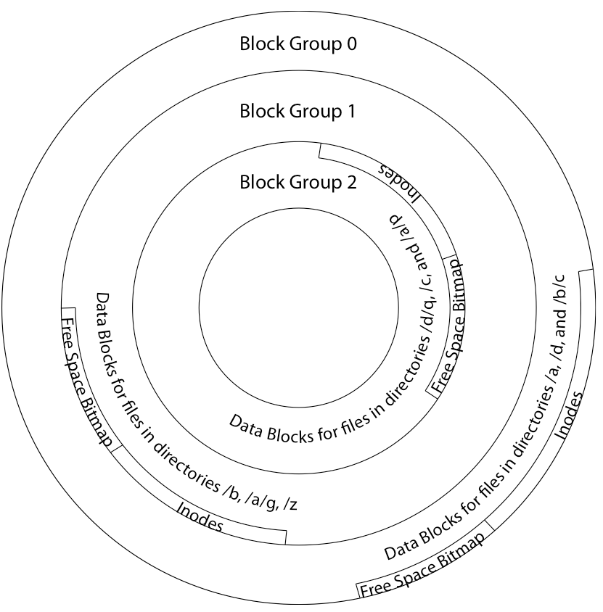
Berkeley FFS: Locality
File system volume is divided into a set of block groups
Close set of tracks (generalized term for cylinder groups)
Data blocks, metadata, and free space interleaved within block group
Avoid huge seeks between user data and system structure
Put directory and its files in common block group
Store them near each other

Slide 9
Berkeley FFS: First-Fit Block Allocation

Slide 10
Recall: Directory Abstraction
Hard link: mapping from name to file in the directory structure
First hard link to a file is made when file is initially created
Create extra hard links to a file with link syscall
Remove links with unlink (rm)
When can the file contents be deleted?
When there are no more hard links to the file
Inode maintains reference count for this purpose
/usr
/usr/lib
/usr/lib4.3
/usr/lib/foo
/usr/lib4.3/foo

Slide 11
Windows NTFS

Slide 12
New Technology File System (NTFS)
Default on modern Windows systems
Instead of FAT or inode array: Master File Table
Max 1 KB size for each table entry
Each entry in MFT contains metadata and:
File’s data directly (for small files)
A list of extents (start block, size) for file’s data
For big files: pointers to other MFT entries with more extent lists

Slide 13
NTFS Small File: Data in MFT Record

Slide 14
NTFS Medium File: Extents for File Data

Slide 15
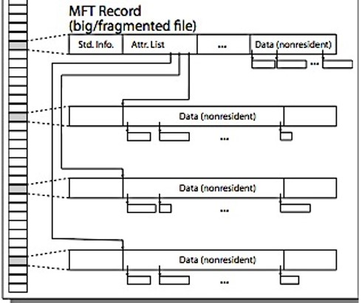
NTFS Large File: Pointers to Other MFT Records

Slide 16
NTFS Huge, Fragmented File: Many MFT Records

Slide 17
NTFS Directories
Directories implemented as B Trees
File's number identifies its entry in MFT
MFT entry always has a file name attribute
Human readable name, file number of parent dir
Hard link? Multiple file name attributes in MFT entry

Slide 18
Memory-Mapped Files

Slide 19
Memory-Mapped Files
Traditional I/O involves explicit transfers between buffers in process address space to/from regions of a file
Typically, read/write system calls
Alternative: “map” the file directly into an empty region of our address space
Implicitly “page it in” from the file when we read an address
Write to the address and “eventually” page it out to the file

Slide 20
Same Machinery as Demand Paging…
On page fault to mapped region:
Read from the correct offset of the file
(Not from the typical swap space)
If page in mapped region is chosen for eviction:
Write back dirty page to the backing file
(Not to the typical swap space)
Executable files are mapped into the code region this way!

Slide 21
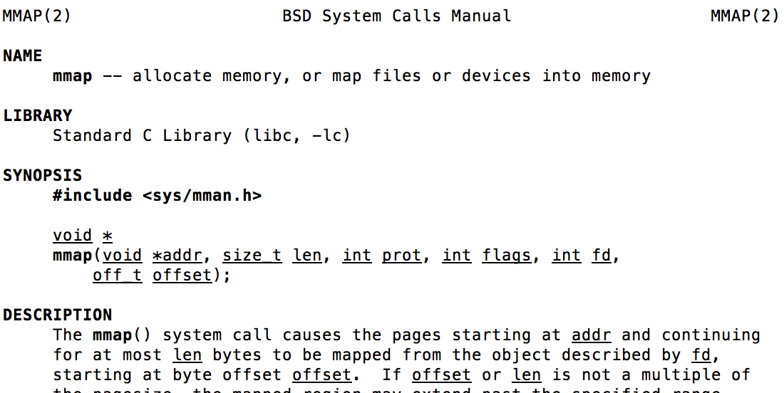
The mmap System Call
API provided by OS for a process to alter its memory map (memory regions)
Also supports anonymous mapping: memory not backed by a file
Memory regions can be
shared (inherited by child on fork)
private (not inherited by child on fork)

Slide 22
Buffering

Slide 23
Recall: Translation from User to System View
File (Bytes)
File
System
What happens if user says: “give me bytes 2 – 12?”
Fetch block corresponding to those bytes
Return just the correct portion of the block
What about writing bytes 2 – 12?
Fetch block, modify relevant portion, write out block
Everything inside file system is in terms of whole-size blocks
Actual disk I/O happens in blocks
read/write smaller than block size needs to translate and buffer

Slide 24
Buffer Cache
Kernel must copy disk blocks to main memory to access their contents and write them back if modified
Could be data blocks, inodes, directory contents, etc.
Possibly dirty (modified and not written back)
Key Idea: Exploit locality by caching disk data in memory
Name translations: Mapping from paths→inodes
Disk blocks: Mapping from block address→disk content
Buffer Cache: Memory used to cache kernel resources, including disk blocks and name translations
Can contain “dirty” blocks (with modifications not on disk)

Slide 25
File System Buffer Cache
Data blocks
Disk
OS implements a cache of disk blocks
Reading
PCB
iNodes
file desc
Writing
Dir Data blocks
Free bitmap
Memory
Blocks
State
free
free

Slide 26
File System Buffer Cache: open
Data blocks
Disk
Load block of directory
Search for mapping
Reading
PCB
iNodes
file desc
Writing
Dir Data blocks
Free bitmap
Memory
Blocks
State
dir
free
free
rd

Slide 27
File System Buffer Cache: open
Data blocks
Disk
Load block of directory
Search for mapping
Load inode
Reading
PCB
iNodes
file desc
Writing
Dir Data blocks
<name>:inumber
Free bitmap
Memory
Blocks
State
free
dir
rd
inode

Slide 28
File System Buffer Cache: open
Data blocks
Disk
Load block of directory
Search for mapping
Load inode
Create reference via open file description
Reading
PCB
iNodes
file desc
Writing
Dir Data blocks
<name>:inumber
Free bitmap
Memory
Blocks
State
free
dir
inode

Slide 29
File System Buffer Cache: read
Data blocks
Disk
From inode, traverse index structure to find data block
Load data block
Copy all or part to user data buffer
Reading
PCB
iNodes
file desc
Writing
Dir Data blocks
<name>:inumber
Free bitmap
Memory
Blocks
State
free
dir
inode

Slide 30
File System Buffer Cache: write
Data blocks
Disk
May allocate new blocks
Blocks must be written back to disk
Reading
PCB
iNodes
file desc
Writing
Dir Data blocks
<name>:inumber
Free bitmap
Memory
Blocks
State
free
dir
inode

Slide 31
File System Buffer Cache: Eviction
Data blocks
Disk
Blocks being written back to disk go through a transient state
Reading
PCB
iNodes
file desc
Writing
Dir Data blocks
<name>:inumber
Free bitmap
Memory
Blocks
State
free
dir
inode

Slide 32
Buffer Cache Discussion
Implemented entirely in OS software
Unlike memory caches and TLB
Blocks go through transitional states between free and in-use
Being read from disk, being written to disk
Other processes can run, etc.
Blocks are used for a variety of purposes
inodes, data for dirs and files, freemap
OS maintains pointers into them
Termination – e.g., process exit – open, read, write
Replacement – what to do when it fills up?

Slide 33
File System Caching
LRU Replacement policy?
Advantages:
Works very well for name translation
Works well in general if memory is big enough to accommodate a host’s working set of file blocks
Challenges:
Some application scans through file system, thereby flushing the cache with data used only once (e.g., find . –exec grep foo {} \;)
Other Replacement Policies?
Some systems allow applications to request other policies
Example, ‘Use Once’: File system can discard blocks as soon as they are used

Slide 34
File System Caching
Cache Size: How much memory should the OS allocate to the buffer cache vs virtual memory?
Too much memory to the file system cache → won’t be able to run many applications at once
Too little memory to file system cache → many applications may run slowly (disk caching not effective)
Solution: adjust boundary dynamically so that the disk access rates for paging and file access are balanced

Slide 35
File System Caching
Read-Ahead Prefetching: fetch sequential blocks early
Fast to access; File System tries to obtain sequential layout; Applications tend to do sequential reads and writes
How much to prefetch?
Too many delays on requests by other applications
Too few causes many seeks (and rotational delays) among concurrent file requests

Slide 36
Delayed Writes
Buffer cache is a writeback cache (write-behind cache)
write copies data from user space to kernel buffer cache
read are fulfilled by the cache, so reads see the results of writes
Even if the data has not reached disk
When does data from a write syscall finally reach disk?
When the buffer cache is full (e.g., we need to evict something)
Flush the buffer cache periodically (in case we crash)
Short-lived files might never make it to disk! ☺

Slide 37
Buffer Caching vs. Demand Paging
Replacement Policy?
Demand Paging: LRU is infeasible; use approximation (like NRU/Clock)
Buffer Cache: LRU is OK
Eviction Policy?
Demand Paging: evict not-recently-used pages when memory is close to full
Buffer Cache: write back dirty blocks periodically, even if used recently
Why? To minimize data loss in case of a crash

Slide 38
Announcements
Project 2 final report and scheduling lab due tonight
Submit each one to Gradescope
Separate assignment for each
Project 2 peer reviews are out
Due tomorrow
Homework 5 is out!
Get started on it early
It has two parts, 5A and 5B, each worth one homework
Quiz 3 is on Monday
Covers material up to this slide

Slide 39
Dealing with Persistent State
Buffer Cache: write back dirty blocks periodically, even if used recently
Why? To minimize data loss in case of a crash
Not foolproof! Can still crash with dirty blocks in the cache
What is the dirty block was for a directory?
Lose pointer to file’s inode (leak space)
File system now in inconsistent state ☹
Takeaway: File systems need
recovery mechanisms

Slide 40
Important Terminology
Availability: the probability that the system can accept and process requests
Often measured in “nines” of probability (e.g., 99.9% is “3-nines of availability”)
Key idea here is independence of failures
Durability: the ability of a system to recover data despite faults
This idea is fault tolerance applied to data
Doesn’t necessarily imply availability: information on pyramids was very durable, but could not be accessed until discovery of Rosetta Stone
Reliability: the ability of a system or component to perform its required functions under stated conditions for a specified period of time (IEEE definition)
Usually stronger than availability: means system is not only “up”, but also working correctly
Includes availability, security, fault tolerance/durability
Must make sure data survives system crashes, disk crashes, other problems

Slide 41
How to make File Systems more Durable?

Slide 42
How to Make File Systems more Durable?
Disk blocks contain Reed-Solomon error correcting codes (ECC) to deal with small defects in disk drive
Can allow recovery of data from small media defects
Make sure writes survive in short term
Either abandon delayed writes or
Use special, battery-backed RAM (called non-volatile RAM or NVRAM) for dirty blocks in buffer cache
Make sure that data survives in long term
Need to replicate! More than one copy of data!
Important element: independence of failure
Could put copies on one disk, but if disk head fails…
Could put copies on different disks, but if server fails…
Could put copies on different servers, but if building is struck by lightning….
Could put copies on servers in different continents…

Slide 43
RAID 1: Disk Mirroring/Shadowing
recovery
group
Each disk fully replicated onto its shadow (100% capacity overhead)
Bandwidth sacrificed on write: Logical write = two physical writes
Reads may be optimized
Can have two independent reads to same data

Slide 44
RAID 5: High I/O Rate Parity
Stripe
Unit
Data striped across multiple disks
Successive blocks stored on successive (non-parity) disks
Increased bandwidth over single disk
Parity block (in green) constructed by XORing data bocks in stripe
P0=D0⊕D1⊕D2⊕D3
Can destroy any one disk and still reconstruct data
Suppose Disk 3 fails, then can reconstruct: D2=D0⊕D1⊕D3⊕P0
Can spread information more widely for durability
RAID algorithms (and generalizations) within data center across cloud
D0
D1
D2
D3
P0
D4
D5
D6
P1
Increasing
Logical
Disk
Addresses
D7
D8
D9
P2
D10
D11
D12
P3
D13
D14
D15
P4
D16
D17
D18
D19
D20
D21
D22
D23
P5
Disk 1
Disk 2
Disk 3
Disk 4
Disk 5

Slide 45
RAID 6 and Erasure Codes
In general: RAIDX is an “erasure code” (treat missing/failed disk as an erasure)
Today, disks so big that: RAID 5 not sufficient!
Time to repair disk sooooo long, another disk might fail in process!
“RAID 6” – allow 2 disks in replication stripe to fail
Requires more complex erasure code, such as EVENODD code (see readings)
More general option for general erasure code: Reed-Solomon codes
Based on polynomials in GF(2^{k}) (I.e. k-bit symbols)
$m$ data points define a degree $m$ polynomial; encoding is $n$ points on the polynomial
Any $m$ points can be used to recover the polynomial; $n−m$ failures tolerated
Erasure codes not just for disk arrays. For example, geographic replication
E.g., split data into $m=4$ chunks, generate $n=16$ fragments and distribute across the Internet
Any 4 fragments can be used to recover the original data --- very durable!

Slide 46
How to make File Systems more Reliable?

Slide 47
Threats to Reliability
Single logical file operation can involve updates to multiple physical disk blocks
inode, indirect block, data block, bitmap, …
With sector remapping, single update to physical disk block can require multiple (even lower level) updates to sectors
Interrupted Operation
Crash or power failure in the middle of a series of related updates may leave stored data in an inconsistent state
Loss of stored data
Failure of non-volatile storage media may cause previously stored data to disappear or be corrupted

Slide 48
Two Reliability Approaches
Careful Ordering and Recovery
Versioning and Copy-on-Write
FAT & FFS + (fsck)
Each step builds structure,
Data block << inode << free << directory
Last step links it in to rest of FS
Recover scans structure looking for incomplete actions
ZFS, …
Version files at some granularity
Create new structure linking back to unchanged parts of old
Last step is to declare that the new version is ready

Slide 49
Berkeley FFS: Create a File
Normal operation:
Allocate data block
Write data block
Allocate inode
Write inode block
Update bitmap of free blocks and inodes
Update directory with file name → inode number
Update modify time for directory
Recovery:
Scan inode table
If any unlinked files (not in any directory), delete or put in lost & found dir
Compare free block bitmap against inode trees
Scan directories for missing update/access times
Time proportional to disk size

Slide 50
From Indexing to Versioning
Recall: multi-level index structure lets us find the data blocks of a file
Instead of over-writing existing data blocks and updating the index structure:
Create a new version of the file with the updated data
Reuse blocks that don’t change much of what is already in place
This is called: Copy On Write (COW)

Slide 51
Copy-on-Write Example
old version
new version
Write

Slide 52
More Systematic Approach to Reliability
Use transactions for atomic updates
Ensure that multiple related operations performed atomically
If a crash occurs in middle, state of system should reflect all or none of the operations
Most modern file systems use transactions to safely update their internals

Slide 53
Key Systems Concept: Transaction
A transaction is an atomic sequence of reads and writes that takes the system from consistent state to another.
Recall: Code in a critical section appears atomic to other threads
Transactions extend the concept of atomic updates from memory to persistent storage
transaction
consistent state 1
consistent state 2

Slide 54
Typical Transaction Structure
Begin a transaction – get transaction id
Do a bunch of updates
If any fail along the way, roll-back
Or, if any conflicts with other transactions, roll-back
Commit the transaction

Slide 55
Key Systems Concept: Log
Writing/appending a single item to a log is atomic
Like memory load/store in most architectures
Key idea: append a single item (atomic) to seal the commitment to a whole sequence of actions
Commit Tran N
Start Tran N
Get 10$ from account A
Get 7$ from account B
Get 13$ from account C
Put 15$ into account X
Put 15$ into account Y

Slide 56
Journaling File Systems
Don’t modify data structures on disk directly
Write each update as transaction recorded in a log
Commonly called a journal or intention list
Also maintained on disk (allocate blocks for it when formatting)
Once changes are in the log, they can be safely applied
e.g. modify inode pointers and directory mapping
Garbage collection: once a change is applied, remove its entry from the log

Slide 57
Creating a File (No Journaling Yet)
Find free data block(s)
Find free inode entry
Find dirent insertion point
-----------------------------------------
Write map (i.e., mark used)
Write inode entry to point to block(s)
Write dirent to point to inode
Free space map
Data blocks
…
Inode table
Directory
entries

Slide 58
Creating a File (With Journaling)
Find free data block(s)
Find free inode entry
Find dirent insertion point
-----------------------------------------
[log] Write map (i.e., mark used)
[log] Write inode entry to point to block(s)
[log] Write dirent to point to inode
Free space map
Data blocks
…
Inode table
Directory
entries
tail
head
done
pending
start
commit
Log: in non-volatile storage (Flash or on Disk)

Slide 59
After Commit, Eventually Replay Transaction
All accesses to the file system first looks in the log
Actual on-disk data structure might be stale
Eventually, copy changes to disk and discard transaction from the log
Free space map
Data blocks
…
Inode table
Directory
entries
tail
tail
tail
tail
tail
head
done
pending
start
commit
Log: in non-volatile storage (Flash or on Disk)

Slide 60
Crash Recovery: Discard Partial Transactions
Upon recovery, scan the log
Detect transaction start with no commit
Discard log entries
Disk remains unchanged
Free space map
Data blocks
…
Inode table
Directory
entries
tail
head
done
pending
start
Log: in non-volatile storage (Flash or on Disk)

Slide 61
Crash Recovery: Keep Complete Transactions
Scan log, find start
Find matching commit
Redo it as usual
Or just let it happen later
Free space map
Data blocks
…
Inode table
Directory
entries
tail
head
done
pending
start
commit
Log: in non-volatile storage (Flash or on Disk)

Slide 62
Journaling Summary
Why go through all this trouble?
Updates atomic, even if we crash:
Update either gets fully applied or discarded
All physical operations treated as a logical unit
Isn’t this expensive?
Yes! We're now writing all data twice (once to log, once to actual data blocks in target file)
Modern filesystems journal metadata updates only
Record modifications to file system data structures
But apply updates to a file’s contents directly

Slide 63
Going Further: Log-Structured File Systems
The log IS what is recorded on disk
File system operations logically replay log to get result
Create data structures to make this fast
On recovery, replay the log
Index (inodes) and directories are written into the log too
Large, important portion of the log is cached in memory
Do everything in bulk: log is collection of large segments
Each segment contains a summary of all the operations within the segment
Fast to determine if segment is relevant or not
Free space is approached as continual cleaning process of segments
Detect what is live or not within a segment
Copy live portion to new segment being formed (replay)
Garbage collection: entire segment

Slide 64
LFS Paper (see Readings)
LFS: write file1 block, write inode for file1, write directory page mapping “file1” in “dir1” to its inode, write inode for this directory page. Do the same for ”/dir2/file2”. Then write summary of the new inodes that got created in the segment
Reads are same for LFS and FFS
Buffer cache likely to hold information in both cases
But disk IOs are very different

Slide 65
Conclusion
Buffer Cache: Memory used to cache kernel resources, including disk blocks and name translations
Can contain “dirty” blocks (blocks yet on disk)
File system operations involve multiple distinct updates to blocks on disk
Need to have all or nothing semantics
Crash may occur during the sequence
Traditional file system perform check and recovery on boot
Along with careful ordering so partial operations result in loose fragments, rather than loss
Copy-on-write provides richer function (versions) with much simpler recovery
Little performance impact since sequential write to storage device is nearly free
Transactions over a log provide a general solution
Commit sequence to durable log, then update the disk
Log takes precedence over disk
Replay committed transactions, discard partials

