Slide 1
Virtual Machines
Sam Kumar
CS 162: Operating Systems and System Programming
Lecture 26
https://inst.eecs.berkeley.edu/~cs162/su20
Read: OSTEP App B

Slide 2
Recall: Based on Single-Node Experience, what do we Expect?
Within a sequential thread, a read following a write returns the value written by that write
Each write will eventually become visible to other readers
A sequence of writes will be visible in order
All readers see a consistent order
  It is as if there exists a canonical order of the operations, and each party takes samples

Slide 3
Recall: “Strong” Consistency
It is as if there exists a canonical order of the operations, and each party takes samples
When each operation is a read or write to a single object, this is called Linearizability
  Linearizability also requires the canonical order to be consistent with real time order, up to concurrent operations
When each operation is a transaction over multiple objects, this is called Serializability
  “Strict Serializability” if the canonical order is consistent with real time

Slide 4
Recall: Distributed Consensus
Consensus problem
  All nodes propose a value
  Some nodes might crash and stop responding
  Eventually, all remaining nodes decide on the same value from set of proposed values
Distributed Decision Making
  Choose between “true” and “false”
  Or choose between “commit” and “abort”
Equally important (but often forgotten!): make it durable!
  How do we make sure that decisions cannot be forgotten?

Slide 5
Recall: Two Generals’ Problem
Can messages over an unreliable network be used to guarantee two entities do something simultaneously?
  Remarkably, “no”, even if all messages get through
  No way to be sure last message gets through!
So, clearly, we need something other than simultaneity!
11 am ok?
Yes, 11 works
So, 11 it is?
Yeah, but what if you
Don’t get this ack?

Slide 6
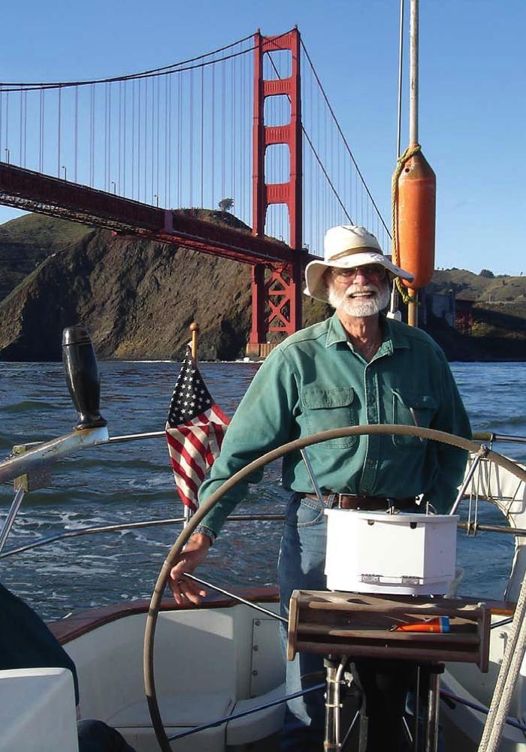
Two-Phase Commit (2PC)
Distributed transaction: Two or more machines agree to do something, or not do it, atomically
  No constraints on time, just that it will eventually happen!
Two-Phase Commit protocol: Developed by
Turing award winner Jim Gray (first Berkeley CS PhD, 1969)
High-level problem statement
  If no node fails and all nodes are ready to commit, then all nodes COMMIT
  Otherwise ABORT at all nodes
Jim Gray

Slide 7
2PC: Detailed Algorithm
Before sending, record vote in log
Coordinator Algorithm
Worker Algorithm
  Coordinator sends VOTE-REQ to all workers
Wait for VOTE-REQ from coordinator
If ready, send VOTE-COMMIT to coordinator
If not ready, send VOTE-ABORT to coordinator
  And immediately abort
Before sending, record vote in log
  If receive VOTE-COMMIT from all N workers, send GLOBAL-COMMIT to all workers
  If doesn’t receive VOTE-COMMIT from all N workers, send GLOBAL-ABORT to all workers
Record outcome in log
If receive GLOBAL-COMMIT then commit
If receive GLOBAL-ABORT then abort

Slide 8
Recall: State Machines
Distributed systems are hard to reason about
Want a precise way to express each node’s behavior that is also easy to reason about
One approach: State Machine
  Every node is in a state
  When the node receives a message (or timeout),
  it transitions to another state and
  Sends zero or more messages
In hardware, state transition is atomic by design
In software, we use mechanisms like a log to provide atomicity

Slide 9
Coordinator’s State Machine
INIT
Recv: START
Send: VOTE-REQ
Triggers change of state
Side-effect of changing state
WAIT
Recv: VOTE-ABORT
Send: GLOBAL-ABORT
Recv: all VOTE-COMMIT
Send: GLOBAL-COMMIT
ABORT
COMMIT

Slide 10
Worker’s State Machine
INIT
Recv: VOTE-REQ
Send: VOTE-ABORT
Recv: VOTE-REQ
Send: VOTE-COMMIT
READY
Recv: GLOBAL-ABORT
Recv: GLOBAL-COMMIT
ABORT
COMMIT

Slide 11
Example of Failure-Free 2PC with State
coordinator
VOTE-REQ
GLOBAL-COMMIT
worker 1
worker 2
VOTE-COMMIT
worker 3
time

Slide 12
Dealing with Worker Failures
Failure only affects states in which the coordinator is waiting for messages
In WAIT, if coordinator doesn’t receive N votes, it times out and sends GLOBAL-ABORT
INIT
Recv: START
Send: VOTE-REQ
WAIT
Recv: VOTE-ABORT
Send: GLOBAL-ABORT
Recv: VOTE-COMMIT
Send: GLOBAL-COMMIT
ABORT
COMMIT

Slide 13
Dealing with Coordinator Failure
INIT
Worker waits for VOTE-REQ in INIT
  Worker can time out and abort
Worker waits for GLOBAL message in READY
  Workers must BLOCK waiting for coordinator
  to recover
  Workers could try to consult each other
    If one of them in COMMIT or ABORT state, then they
    all know the result
    In another worker is still in INIT, it is safe to ABORT
    If all of them are in the READY state, then they must still BLOCK
  What if coordinator and worker both fail?
    Workers can consult each other, but can’t come to any decision
    This motivates Three-Phase Commit (3PC)
Recv: VOTE-REQ
Send: VOTE-ABORT
Recv: VOTE-REQ
Send: VOTE-COMMIT
READY
Recv: GLOBAL-ABORT
Recv: GLOBAL-COMMIT
ABORT
COMMIT

Slide 14
Distributed Consensus
2PC (and 3PC) make a decentralized decision
  E.g., changing the value of a key among all replicas for the key
But they are hardly the only solutions to this problem!

Slide 15
Virtual Machines

Slide 16

Recall: OS Basics—Virtualizing the Machine
Compiled
Program
System Libs
Process: Execution environment with restricted rights provided by OS
Threads
Address Spaces
Files
Sockets
Operating System
ISA
Processor
PgTbl
& TLB
Storage
Networks
Memory
Hardware
OS Mem
I/O Ctrlr

Slide 17
Recall: Compiled Program’s View of the World
Compiled
Program
System Libs
Process: Execution environment with restricted rights provided by OS
Threads
Address Spaces
Files
Sockets
Operating System
ISA
Application’s “machine” is the process abstraction provided by the OS
Each running program runs in its own process
Processes provide nicer interfaces than raw hardware
Processor
PgTbl
& TLB
Storage
Networks
Memory
Hardware
OS Mem
I/O Ctrlr

Slide 18
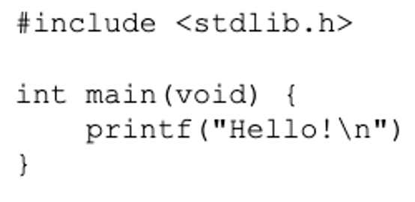
Recall: System Programmer’s View of the World
Program
System Libs
Linker
Compiler
Process: Execution environment with restricted rights provided by OS
Threads
Address Spaces
Files
Sockets
Operating System
ISA
Application’s “machine” is the process abstraction provided by the OS
Each running program runs in its own process
Processes provide nicer interfaces than raw hardware
Processor
PgTbl
& TLB
Storage
Networks
Memory
Hardware
OS Mem
I/O Ctrlr

Slide 19
Operating System’s View of the World
Compiled
Program 1
Compiled
Program 2
System Libs
System Libs
Compiler
Process 1
Process 2
Threads
Address Spaces
Files
Sockets
Threads
Address Spaces
Files
Sockets
Operating System
ISA
Processor
PgTbl
& TLB
Storage
Networks
Memory
Hardware
OS Mem
I/O Ctrlr

Slide 20
Operating System’s View of the World
Running
Program 1
Running
Program 2
OS translates from hardware interface to application interface
OS provides each running program with its own process
System Libs
System Libs
Compiler
Process 1
Process 2
Threads
Address Spaces
Files
Sockets
Threads
Address Spaces
Files
Sockets
Operating System
ISA
Processor
PgTbl
& TLB
Storage
Networks
Memory
Hardware
OS Mem
I/O Ctrlr

Slide 21
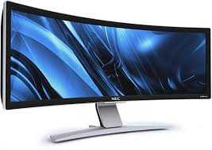
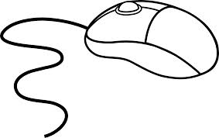
OS Software Supports User-Level Software
Illusion: virtualizes hardware resources and provides convenient high level user abstractions & services
Referee: provide isolation & protection, allocates resources to user processes
Glue: efficient access, sharing, resource management
User Software
Unprivileged Instructions
syscall handlers
Privileged Instructions
scheduler
syscall tbl
subsystems
System Software
intr tbl
intrpt handlers
Page Tables
Drivers
regs
Hardware
Processor
Memory
I/O Devices

Slide 22
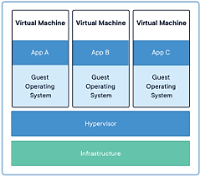
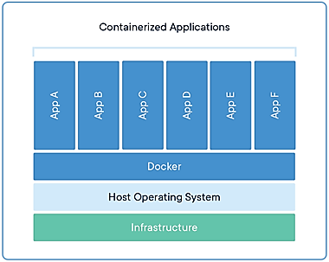
Recall: Virtualization—Execution Environments for Systems
Additional layers of protection and isolation can help further manage complexity

Slide 23
Virtual Machines
Idea: Virtualize every detail of a hardware so perfectly that you can run an operating system (and many applications) on top of it
Provides isolation
Complete insulation from change
The norm in the cloud (server consolidation)
Long history (1960s in IBM OS development)
All our work in this class has been taking place INSIDE a VM
  Consistent system environment for completing your assignments

Slide 24
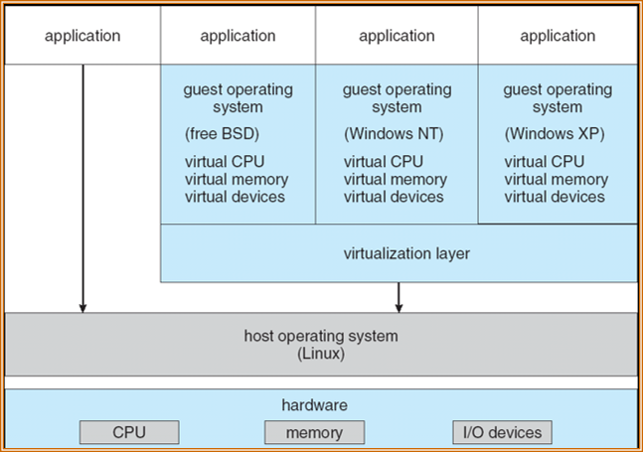
System Virtual Machine: Layers of OSes
Useful for OS development
  When OS crashes, restricted to one VM
  Can aid testing programs on other OSes

Slide 25
Motivation for Virtual Machines: 1960s
IBM developed mainframes and many operating systems for them
Very high human-to-computer ratio (mainframes were expensive!)
But fragmentation in the OS space!
  Some applications only ran on some operating systems
IBM invented virtualization to run applications that required different operating systems on the same mainframe
As the years passed, computers became cheaper, and human-to-computer ratio decreased, virtual machines all but died out…

Slide 26
Motivation for Virtual Machines: Now
An “Application” is no longer a stand-alone executable or composition of vendor-supplied software, it is often a complex platform utilizing several deep software stacks, many processes, shared libraries and services, …
  All of which evolve rapidly
To stand up a viable instance requires “all of it”, so need to wrap up the “entire stack”
  The OS and all its user-level daemons, the software installed in its file system
  The hardware itself
Want to isolate this entire ensemble from other ensembles, which may be on the same physical machine (server consolidation)

Slide 27
Our “Host Operating System”
User Software
syscall handlers
scheduler
syscall tbl
subsystems
System Software
intr tbl
intrpt handlers
Page Tables
Drivers
regs
Hardware
Processor
Memory
I/O Devices

Slide 28
User-Level “Guest Operating System”
appln
process
appln
process
User Software
Guest OS
Unprivileged Instructions
“virtual hardware”
scheduler
syscall handlers
Privileged Instructions
process & thread mgmt
syscall tbl
file systems
System Software
intr tbl
intrpt handlers
VM system
Page Tables
Drivers
ptbr:
regs
int:
Hardware
Processor
Memory
I/O Devices

Slide 29
One Approach: Software Emulation
Example: QEMU for x86
User software emulates the behavior of every single instruction
  Data structure for Processor, Memory, I/O, etc.
  Code for Instruction Cycle: Fetch Instruction, Decode, Fetch Operands, Perform Operation, Store Results, Update PC
  Emulate privilege levels, interrupts, MMU, . . . too
  Load (i.e., boot) image of the operating system
  Initializes (virtual) HW, loads programs, schedules threads, etc.
Popular in the 90’s
  run Windows (x86) on your MAC (M68000), …
  Software Fault Isolation
Dynamic translation optimizations reduce overhead from 1000x to 2-10x
  Want more like 10-20% overhead

Slide 30
Faster Approach: Execute Guest Code Directly
“Efficiency … demands that a statistically dominant subset of the virtual processor’s instructions be executed directly by the real processor, with no software intervention…”
—Popek and Goldberg, 1974
Assumption: host and guest have the ISA

Slide 31
Announcements
Quiz 3 is graded! Scores were released this morning.
Notes:
Higher average, but less spread than usual. High score was 70.

Slide 32
Announcements
Homework 5B due tonight
Project 3 due on Tuesday (code) and Wednesday (report)
Homework 6 is out
  This is optional, due on Sunday (after the final)
  Can replace lowest score out of Homework 0-4
  No slip days…
Class is optional on Wednesday and Thursday
  Summer equivalent of RRR week
Reminder to fill out course evaluations

Slide 33
Guest Virtual Hardware
VM process VAS
VM-X
mmap <file>
host file
User Software
Guest OS
appln
process
window
“virtual hardware”
Unprivileged Instructions
nw intf
mem
scsi disk
graphics
nic
scheduler
Privileged Instructions
syscall handlers
process & thread mgmt
file systems
System Software
syscall tbl
intr tbl
intrpt handlers
VM system
Page Tables
Drivers
ptbr:
regs
int:
Hardware
Processor
I/O Devices
Memory

Slide 34
Challenges in Virtualization
Guest OS executes as unprivileged, but it thinks it’s privileged
How to deal with the huge diversity of I/O devices?
How do we provide virtual address spaces for each of the guest processes?
  Host OS and Guest OS both have page tables
When Guest process does syscall (trap), how does it vector through the Guest OS syscall table?
How do interrupts get delivered to the Guest OS?
How does the Guest OS protect itself from its guest application processes and each other?

Slide 35
Challenges in Virtualization
Guest OS executes as unprivileged, but it thinks it’s privileged
How to deal with the huge diversity of I/O devices?
How do we provide virtual address spaces for each of the guest processes?
  Host OS and Guest OS both have page tables
When Guest process does syscall (trap), how does it vector through the Guest OS syscall table?
How do interrupts get delivered to the Guest OS?
How does the Guest OS protect itself from its guest application processes and each other?

Slide 36
User-Level “Guest Operating System”
VM process VAS
VM-X
mmap <file>
host file
User Software
Guest OS
appln
process
window
“virtual hardware”
Unprivileged Instructions
nw intf
mem
scsi disk
graphics
nic
scheduler
Privileged Instructions
syscall handlers
process & thread mgmt
file systems
System Software
syscall tbl
How does the Guest OS interact with virt. h/w?
Memory-mapped I/O
Modify PTBR
Register interrupts
Privileged instructions
intr tbl
intrpt handlers
VM system
Page Tables
Drivers
ptbr:
regs
int:
Hardware
Processor
I/O Devices
Memory

Slide 37
Virtual Machine Monitor
VM process VAS
VM-X
mmap <file>
host file
User Software
Guest OS
appln
process
window
“virtual hardware”
Unprivileged Instructions
nw intf
mem
scsi disk
graphics
nic
scheduler
Privileged Instructions
syscall handlers
Virtual Machine Monitor
Kernel module
Driver
process & thread mgmt
file systems
System Software
syscall tbl
intr tbl
intrpt handlers
VM system
Page Tables
Drivers
ptbr:
regs
int:
Hardware
Processor
I/O Devices
Memory

Slide 38
Key Idea: Trap and Emulate
When Guest OS tries to perform any privileged operation (e.g., accessing addresses), it traps to VMM
  Updates to page tables, scheduling threads, switching processes, interrupts,
The VMM “sees” everything the Guest OS tries to do and can act
The VMM decodes what Guest OS is doing (basic blocks of multiple instructions) and emulates them, updating the Guest OS data structures as if it had done it itself.

Slide 39
Virtualizable Instruction Set Architectures
An instruction set is virtualizable if all “sensitive” instructions cause a trap if executed in unprivileged mode…
Historically, x86 ISAs were hugely complex and were not virtualizable in a strict sense
  See VMware paper for incredible work arounds to get effective virtualizations
  Recent generations of x86 have improved support for virtualization
We’ll assume all virtualization-sensitive actions by the Guest OS cause a trap to the VMM
  Access to kernel region, Update PTBR, CLI/STI, …
  Change its page tables, …

Slide 40
Challenges in Virtualization
Guest OS executes as unprivileged, but it thinks it’s privileged
How to deal with the huge diversity of I/O devices?
How do we provide virtual address spaces for each of the guest processes?
  Host OS and Guest OS both have page tables
When Guest process does syscall (trap), how does it vector through the Guest OS syscall table?
How do interrupts get delivered to the Guest OS?
How does the Guest OS protect itself from its guest application processes and each other?

Slide 41
Dealing with I/O Diversity
Guest OS is configured with drivers for a few particular (virtual) I/O devices
  They often claim to be these old devices (SCSI disk, …)
Drivers interact with “their device” through Programmed I/O (PIO), Direct Memory Access (DMA), and Interrupts
  Device has a set of “registers” that are configured to appear at specific physical addresses; drivers read and write these addresses
When Guest OS drivers interact with virtual I/O devices, they trap to VMM
  VMM emulates these operations on the host object (file, NW, window, etc.)

Slide 42
Challenges in Virtualization
Guest OS executes as unprivileged, but it thinks it’s privileged
How to deal with the huge diversity of I/O devices?
How do we provide virtual address spaces for each of the guest processes?
  Host OS and Guest OS both have page tables
When Guest process does syscall (trap), how does it vector through the Guest OS syscall table?
How do interrupts get delivered to the Guest OS?
How does the Guest OS protect itself from its guest application processes and each other?

Slide 43
Guest User-Level Memory Access
Guest VAS : PT
Host VM-X VAS : PT
Host Physical Mem
Guest “Physical” Mem
Guest OS maintains page table mapping “virtual addresses” seen by guest user process to what it thinks are “physical addresses”
Host OS maintains page table mapping “virtual addresses” seen by Guest OS to the true “physical addresses”

Slide 44
VMM Shadow Page Tables
VMM Page Tables for VM
Guest VAS pages
Shadow VAS pages
Guest OS Page Table
Guest Physical Frames
Host VM Process Pages
Host OS Page Table for VM Process
Host Physical Frames
Host Physical Frames

Slide 45
Virtual Machine Monitor
VM process VAS
VM-X
mmap <file>
host file
User Software
Guest OS
appln
process
window
“virtual hardware”
Unprivileged Instructions
nw intf
mem
scsi disk
graphics
nic
scheduler
Privileged Instructions
syscall handlers
Virtual Machine Monitor
Kernel module
Driver
process & thread mgmt
file systems
System Software
syscall tbl
intr tbl
intrpt handlers
VM system
Page Tables
Drivers
ptbr:
regs
int:
Hardware
Processor
I/O Devices
Memory

Slide 46
VMM: Shadow Page Table
VM-X
host file
User Software
Guest OS
appln
process
window
“virtual hardware”
Unprivileged Instructions
nw intf
scheduler
VMM
Privileged Instructions
syscall handlers
process & thread mgmt
file systems
System Software
syscall tbl
intr tbl
intrpt handlers
VM system
Page Tables
Shadow PT
Drivers
ptbr:
regs
int:
Hardware
Processor
I/O Devices
Memory

Slide 47
Challenges in Virtualization
Guest OS executes as unprivileged, but it thinks it’s privileged
How to deal with the huge diversity of I/O devices?
How do we provide virtual address spaces for each of the guest processes?
  Host OS and Guest OS both have page tables
When Guest process does syscall (trap), how does it vector through the Guest OS syscall table?
How do interrupts get delivered to the Guest OS?
How does the Guest OS protect itself from its guest application processes and each other?

Slide 48
Interrupt Processing
Most interrupts have to do with hardware devices and need to be handled by Host OS
  Regardless of whether Host process, Guest OS process or Guest OS is running
But when Guest processes fault/trap it needs to be handled by the Guest OS
  syscall, divide by zero, …
  Page Fault ???
Virtual Machine Monitor needs to be involved in Interrupt handling when VM is “running”

Slide 49
VMM: Shadow Page Table
VM-X
host file
User Software
Guest OS
appln
process
window
“virtual hardware”
Unprivileged Instructions
nw intf
scheduler
VMM
Privileged Instructions
syscall handlers
process & thread mgmt
file systems
System Software
syscall tbl
intr tbl
intrpt handlers
VM system
Page Tables
Shadow PT
V Intr Tbl
Drivers
ptbr:
regs
int:
Hardware
Processor
I/O Devices
Memory

Slide 50
Guest Process Issues System Call
VM-X
host file
User Software
Guest OS
appln
process
window
“virtual hardware”
Unprivileged Instructions
nw intf
scheduler
VMM
Privileged Instructions
syscall handlers
process & thread mgmt
file systems
System Software
syscall tbl
intr tbl
intrpt handlers
VM system
Page Tables
Shadow PT
V Intr Tbl
Drivers
ptbr:
regs
int:
Hardware
Processor
I/O Devices
Memory

Slide 51
Guest OS Returns From System Call Handler
VM-X
host file
User Software
iret
Guest OS
appln
process
window
“virtual hardware”
Unprivileged Instructions
nw intf
scheduler
VMM
Privileged Instructions
syscall handlers
process & thread mgmt
file systems
System Software
syscall tbl
intr tbl
intrpt handlers
VM system
Page Tables
Shadow PT
V Intr Tbl
Drivers
ptbr:
regs
int:
Hardware
Processor
I/O Devices
Memory

Slide 52
Host Interrupt While VM is Running
VM-X
host file
User Software
Guest OS
appln
process
window
“virtual hardware”
Unprivileged Instructions
nw intf
scheduler
VMM
Privileged Instructions
syscall handlers
process & thread mgmt
file systems
System Software
syscall tbl
intr tbl
intrpt handlers
VM system
Page Tables
Shadow PT
V Intr Tbl
Drivers
ptbr:
regs
int:
Hardware
Processor
I/O Devices
Memory

Slide 53
Challenges in Virtualization
Guest OS executes as unprivileged, but it thinks it’s privileged
How to deal with the huge diversity of I/O devices?
How do we provide virtual address spaces for each of the guest processes?
  Host OS and Guest OS both have page tables
When Guest process does syscall (trap), how does it vector through the Guest OS syscall table?
How do interrupts get delivered to the Guest OS?
How does the Guest OS protect itself from its guest application processes and each other?

Slide 54
Other Forms of Virtual Machines
We have described Hosted Virtual Machines
  VMware fusion, Virtual Box, KVM, …
Para-virtualization: Guest OS is modified to work collaboratively with the Host VMM
  VMM presents simplified machine to Guest OS
Hypervisor: VMM resides under all the “Guest” OS – peers, none is the special host
  Much cleaner relationship between VMM and OS’s
OS
OS
OS
Hypervisor (VMM)
Hardware

Slide 55
If Virtual Machines are the answer, then what was the question?

Slide 56
Recall: Motivation for Virtual Machines (1960s)
IBM developed mainframes and many operating systems for them
Very low human-to-computer ratio (mainframes were expensive!)
But fragmentation in the OS space!
  Some applications only ran on some operating systems
IBM invented virtualization to run applications that required different operating systems on the same mainframe
As the years passed, computers became cheaper, and human-to-computer ratio increased, virtual machines all but died out…

Slide 57
Recall: Motivation for Virtual Machines (Now)
An “Application” is no longer a stand-alone executable or composition of vendor-supplied software, it is often a complex platform utilizing several deep software stacks, many processes, shared libraries and services, …
  All of which evolve rapidly
To stand up a viable instance requires “all of it”, so need to wrap up the “entire stack”
  The OS and all its user-level daemons, the software installed in its file system
  The hardware itself
Want to isolate this entire ensemble from other ensembles, which may be on the same physical machine (server consolidation)

Slide 58
Recall: Microkernels
Microkernel itself provides only essential services
  Communication
  Address space management
  Thread scheduling
  Almost-direct access to hardware devices (for driver processes)
App
App
App
App
File
sys
windows
file system
Windowing
address
spaces
RPC
VM
Networking
Threads
threads
Monolithic Structure
Microkernel Structure

Slide 59
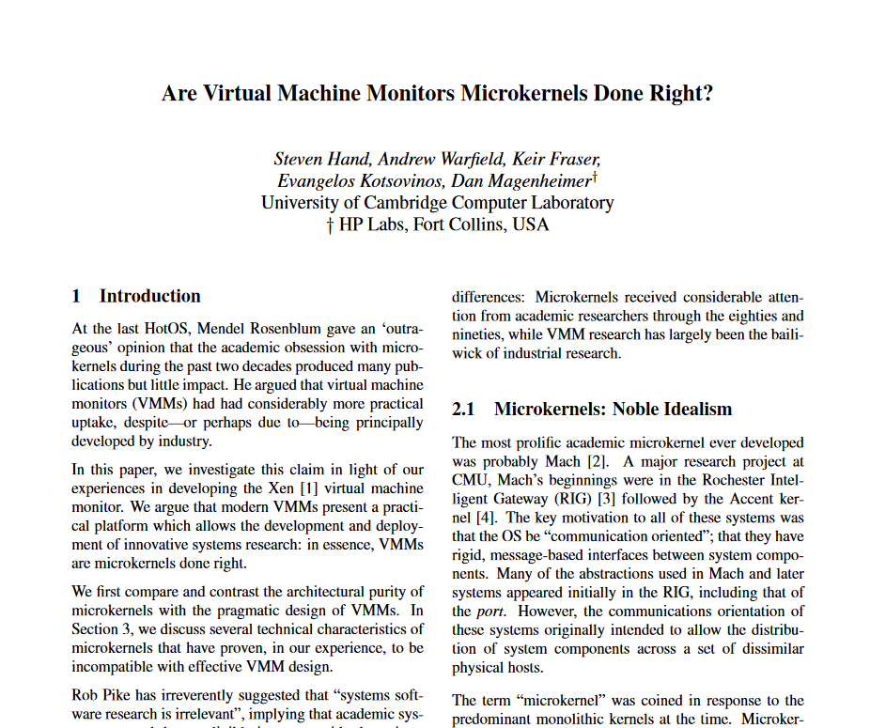
Are Virtual Machine Monitors the “True OS”?
There was a trend to move “shared drivers” into a Guest domain
VMMs evolving to look more like an OS
Stronger isolation can be a plus
What do you think?

Slide 60
Containers
Virtual machines: provide each guest with the illusion of its own dedicated hardware
Containers: provide each guest with the illusion of its own dedicated operating system
  Via resource isolation (cgroups)
  Via namespace isolation
    PID namespace
    Network namespace
    Filesystem…
  With its own binaries, libraries, and dependencies

Slide 61
Performance Isolation: CGroups
Example:
“production”
“testing”
“dev”
Idea: provide greater performance isolation between cgroups than between processes…
User Software
syscall handlers
scheduler
syscall tbl
subsystems
System Software
intr tbl
intrpt handlers
Page Tables
Drivers
Processor
Memory
Net BW
Files
Hardware

Slide 62
CGroups
Identify collections of processes that will be treated as a group for resource allocation
  Groups can have hierarchical structure
  i.e., a Group can be comprised of subgroups
  Process parent-child relationship defines a hierarchy
    Generalize this beyond fork( )
Set of key resource dimensions
  Processor share (CPU), CPU set (bound to particular cores)
  Physical memory share,
  block IO, net priority, net class
  Namespace (ns), i.e., containers
Resource limiting, prioritization, accounting and control
Containers define a collection of libraries and executables that should be a group

Slide 63
Recording and Manipulating CGroups
Unix-based systems use /proc to represent information about processes
  /proc/<pid> describes process <pid>
/proc/cgroups/*
  Describes what controllers are implemented
Each cgroup controller has a directory under /sys/fs/cgroup/<controller>
  /sys/fs/cgroup/cpu/production
  /sys/fs/cgroup/memory/foo/memory.limit_in_bytes
Kernel monitors and controls processes/threads in accordance with cgroup controllers

Slide 64
Docker
Features on top of the basic OS cgroups
  Images
  Union file system
  Tools and observability
  Container lifecycle management

Slide 65
Conclusion
Virtual machines bring the illusion down to the lowest level and provide an extreme form of resource partitioning
  Re-purpose the mechanisms used for protection, isolation and system extension (drivers) to permit near-perfect emulation
  Intricate interplay of (in kernel) Virtual Machine Monitor and (user level) VMM-X process to allow Guest OS as if on Physical Machine and Guest OS User Processes as if on Guest OS
    VMM interposes between hardware/Host OS and Guest OS (Page Table & Interrupt Tbl)
Shadow Page Table (composition of two PTs) to translate Guest OS process VAS => MMAP region => Physical
Trap and Emulate
Control Groups & Containers provide resource limiting w/o VM

