Slide 1
Abstractions 2: Files
Sam Kumar
CS 162: Operating Systems and System Programming
Lecture 4
https://inst.eecs.berkeley.edu/~cs162/su20
Read: A&D 3.2-3, 11.1-2

Slide 2
Recall: Threads
Independently schedulable execution sequence that runs concurrently with other threads
It can block waiting for something while others progress
It can work in parallel with others
Has local state (its stack) and shares static data and heap with other threads in the same process
In the absence of synchronization operations, arbitrary interleaving of threads may occur

Slide 3
Recall: Synchronization
Mutual Exclusion: Ensuring only one thread does a particular thing at a time (one thread excludes the others)
Critical Section: Code exactly one thread can execute at once
Result of mutual exclusion
Lock: An object only one thread can hold at a time
Provides mutual exclusion
Offers two atomic operations:
Lock.Acquire() – wait until lock is free; then grab
Lock.Release() – Unlock, wake up waiters
Need other tools for “cooperation”
e.g., semaphores

Slide 4
Recall: Processes
Definition: execution environment with restricted rights
One or more threads executing in a single address space
Owns file descriptors, network connections
Instance of a running program
When you run an executable, it runs in its own process
Application: one or more processes working together
Protected from each other; OS protected from them
In modern OSes, anything that runs outside of the kernel runs in a process

Slide 5
Recall: System Calls (“Syscalls”)
Word Processing
Compilers
Web Browsers
Email
Databases
Web Servers
Application / Service
Portable OS Library
OS
User
System Call
Interface
System
Portable OS Kernel
Software
Platform support, Device Drivers
Hardware
x86
PowerPC
ARM
PCI
Ethernet (1Gbs/10Gbs)
802.11 a/g/n/ac
SCSI
Graphics
Thunderbolt

Slide 6
Recall: OS Library Issues Syscalls
Proc 1
Proc 2
Proc n
…
OS
Appln
login
Window Manager
…
libc
OS library
OS library
OS library
OS

Slide 7
Putting it all Together: Web Server
Server
4. parse request
9. format reply
request
buffer
reply
buffer
network
socket
read
3. kernel
copy
10. network
socket
write
5. file
read
8. kernel
copy
syscall
syscall
Kernel
wait
RTU
11. kernel copy
from user buffer
to network buffer
RTU
interrupt
interrupt
2. copy arriving
packet (DMA)
12. format outgoing
packet and DMA
6. disk
request
7. disk data
(DMA)
Hardware
Network
interface
Disk interface
Request
Reply

Slide 8
What does pthread stand for?
pthread library: POSIX thread library
POSIX: Portable Operating System Interface (X?)
Interface for application programmers (mostly)
Defines the term “Unix,” derived from AT&T Unix
Created to bring order to many Unix-derived OSes, so applications are portable
Requires standard system call interface

Slide 9
Unix/POSIX Idea: Everything is a “File”
Identical interface for:
Files on disk
Devices (terminals, printers, etc.)
Regular files on disk
Networking (sockets)
Local interprocess communication (pipes, sockets)
Based on the system calls open(), read(), write(), and close()

Slide 10
The File System Abstraction
File
Named collection of data in a file system
POSIX File data: sequence of bytes
Could be text, binary, serialized objects, …
File Metadata: information about the file
Size, Modification Time, Owner, Security info, Access control
Directory
“Folder” containing files & directories
Hierachical (graphical) naming
Path through the directory graph
Uniquely identifies a file or directory
/home/ff/cs162/public_html/fa14/index.html
Links and Volumes (later)

Slide 11
Connecting Processes, File Systems, and Users
Every process has a current working directory
Absolute paths
/home/oski/cs162
Relative paths
index.html, ./index.html
Refers to index.html in current working directory
../index.html
Refers to index.html in parent of current working directory
~/index.html, ~cs162/index.html
Refers to index.html in the home directory

Slide 12
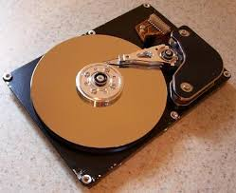
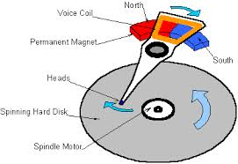
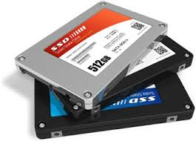
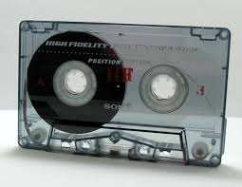
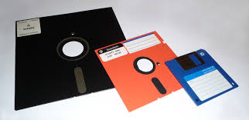
I/O and Storage Layers
Application / Service
High Level I/O
Streams
Low Level I/O
File Descriptors
Focus of today’s lecture
Syscall
open(), read(), write(), close(), …
Open File Descriptions
File System
Files/Directories/Indexes
I/O Driver
Commands and Data Transfers
Disks, Flash, Controllers, DMA

Slide 13
Today: The File Abstraction
High-Level File I/O: Streams
Low-Level File I/O: File Descriptors
How and Why of High-Level File I/O
Process State for File Descriptors
Common Pitfalls with OS Abstractions

Slide 14
Today: The File Abstraction
High-Level File I/O: Streams
Low-Level File I/O: File Descriptors
How and Why of High-Level File I/O
Process State for File Descriptors
Common Pitfalls with OS Abstractions

Slide 15
C High-Level File API – Streams
Operates on “streams” – sequence of bytes, wither text or data, with a position
#include <stdio.h>
FILE *fopen( const char *filename, const char *mode );
int fclose( FILE *fp );
Mode Text | Binary | Descriptions
r | rb | Open existing file for reading
w | wb | Open for writing; created if does not exist
a | ab | Open for appending; created if does not exist
r+ | rb+ | Open existing file for reading & writing.
w+ | wb+ | Open for reading & writing; truncated to zero if exists, create otherwise
a+ | ab+ | Open for reading & writing. Created if does not exist. Read from beginning, write as append

Slide 16
C API Standard Streams – stdio.h
Three predefined streams are opened implicitly when the program is executed.
FILE *stdin – normal source of input, can be redirected
FILE *stdout – normal source of output, can too
FILE *stderr – diagnostics and errors
STDIN / STDOUT enable composition in Unix
All can be redirected
cat hello.txt | grep “World!”
cat’s stdout goes to grep’s stdin

Slide 17
C High-Level File API
// character oriented
int fputc( int c, FILE *fp ); // rtn c or EOF on err
int fputs( const char *s, FILE *fp ); // rtn > 0 or EOF
int fgetc( FILE * fp );
char *fgets( char *buf, int n, FILE *fp );
// block oriented
size_t fread(void *ptr, size_t size_of_elements,
size_t number_of_elements, FILE *a_file);
size_t fwrite(const void *ptr, size_t size_of_elements,
size_t number_of_elements, FILE *a_file);
// formatted
int fprintf(FILE *restrict stream, const char *restrict format, ...);
int fscanf(FILE *restrict stream, const char *restrict format, ... );

Slide 18
C Streams: Char-by-Char I/O
int main(void) {
FILE* input = fopen(“input.txt”, “r”);
FILE* output = fopen(“output.txt”, “w”);
int c;
c = fgetc(input);
while (c != EOF) {
fputc(output, c);
c = fgetc(input);
}
fclose(input);
fclose(output);
}

Slide 19
C High-Level File API
// character oriented
int fputc( int c, FILE *fp ); // rtn c or EOF on err
int fputs( const char *s, FILE *fp ); // rtn > 0 or EOF
int fgetc( FILE * fp );
char *fgets( char *buf, int n, FILE *fp );
// block oriented
size_t fread(void *ptr, size_t size_of_elements,
size_t number_of_elements, FILE *a_file);
size_t fwrite(const void *ptr, size_t size_of_elements,
size_t number_of_elements, FILE *a_file);
// formatted
int fprintf(FILE *restrict stream, const char *restrict format, ...);
int fscanf(FILE *restrict stream, const char *restrict format, ... );

Slide 20
C Streams: Block-by-Block I/O
#define BUFFER_SIZE 1024
int main(void) {
FILE* input = fopen("input.txt", "r");
FILE* output = fopen("output.txt", "w");
char buffer[BUFFER_SIZE];
size_t length;
length = fread(buffer, BUFFER_SIZE, sizeof(char), input);
while (length > 0) {
fwrite(buffer, length, sizeof(char), output);
length = fread(buffer, BUFFER_SIZE, sizeof(char), input);
}
fclose(input);
fclose(output);
}

Slide 21
C Streams: Block-by-Block I/O
#define BUFFER_SIZE 1024
int main(void) {
FILE* input = fopen("input.txt", "r");
FILE* output = fopen("output.txt", "w");
char buffer[BUFFER_SIZE];
size_t length;
length = fread(buffer, BUFFER_SIZE, sizeof(char), input);
while (length > 0) {
fwrite(buffer, length, sizeof(char), output);
length = fread(buffer, BUFFER_SIZE, sizeof(char), input);
}
fclose(input);
fclose(output);
}

Slide 22
Aside: System Programming
Systems programmers are paranoid
We should really be writing things like:
FILE* input = fopen(“input.txt”, “r”);
if (input == NULL) {
// Prints our string and error msg.
perror(“Failed to open input file”)
}
Be thorough about checking return values
Want failures to be systematically caught and dealt with

Slide 23
C High-Level File API: Positioning
int fseek(FILE *stream, long int offset, int whence);
long int ftell (FILE *stream)
void rewind (FILE *stream)
offset (SEEK_SET)
offset (SEEK_END)
whence
offset (SEEK_CUR)
Preserves high level abstraction of a uniform stream of objects

Slide 24
Today: The File Abstraction
High-Level File I/O: Streams
Low-Level File I/O: File Descriptors
How and Why of High-Level File I/O
Process State for File Descriptors
Common Pitfalls with OS Abstractions [if time]

Slide 25
Low-Level File I/O
Operations on file descriptors
Integer that corresponds to an object in the kernel called an open file description
Open file description object in the kernel represents an instance of an open file
Why not just use a pointer?
#include <fcntl.h>
#include <unistd.h>
#include <sys/types.h>
int open (const char *filename, int flags [, mode_t mode])
int creat (const char *filename, mode_t mode)
int close (int filedes)
Bit vector of:
Access modes (Rd, Wr, …)
Open Flags (Create, …)
Operating modes (Appends, …)
Bit vector of Permission Bits:
User|Group|Other X R|W|X

Slide 26
C Low-Level Standard Descriptors
#include <unistd.h>
STDIN_FILENO - macro has value 0
STDOUT_FILENO - macro has value 1
STDERR_FILENO - macro has value 2
int fileno (FILE *stream)
FILE * fdopen (int filedes, const char *opentype)

Slide 27
Low-Level File API
ssize_t read (int filedes, void *buffer, size_t maxsize)
Reads up to maxsize bytes – might actually read less!
returns bytes read, 0 => EOF, -1 => error
ssize_t write (int filedes, const void *buffer, size_t size)
returns bytes written
off_t lseek (int filedes, off_t offset, int whence)

Slide 28
Example: lowio.c
int main() {
char buf[1000];
int fd = open("lowio.c", O_RDONLY, S_IRUSR | S_IWUSR);
ssize_t rd = read(fd, buf, sizeof(buf));
int err = close(fd);
ssize_t wr = write(STDOUT_FILENO, buf, rd);
}
How many bytes does this program read?

Slide 29
POSIX I/O: Design Patterns
Open before use
Access control check, setup happens here
Byte-oriented
Least common denominator
OS responsible for hiding the fact that real devices may not work this way (e.g. hard drive stores data in blocks)
Explicit close

Slide 30
POSIX I/O: Kernel Buffering
Reads are buffered
Part of making everything byte-oriented
Process is blocked while waiting for device
Let other processes run while gathering result
Writes are buffered
Complete in background (more later on)
Return to user when data is “handed off” to kernel

Slide 31
Key Unix I/O Design Concepts
Uniformity – everything is a file
file operations, device I/O, and interprocess communication through open, read/write, close
Allows simple composition of programs
find | grep | wc …
Open before use
Provides opportunity for access control and arbitration
Sets up the underlying machinery, i.e., data structures
Byte-oriented
Even if blocks are transferred, addressing is in bytes
Kernel buffered reads
Streaming and block devices looks the same, read blocks yielding processor to other task
Kernel buffered writes
Completion of out-going transfer decoupled from the application, allowing it to continue
Explicit close

Slide 32
Low-Level I/O: Other Operations
Operations specific to terminals, devices, networking, …
e.g., ioctl
Duplicating descriptors
int dup2(int old, int new);
int dup(int old);
Pipes – channel
int pipe(int pipefd[2]);
Writes to pipefd[1] can be read from pipefd[0]
File Locking
Memory-Mapping Files
Asynchronous I/O

Slide 33
Announcements
C review session tonight
6-7 PM
Quiz 0 solutions posted
Homework 0 due tonight
Homework 1 out tonight
Project 0 out
We’ll set up an open Zoom room to help you find groups

Slide 34
Today: The File Abstraction
High-Level File I/O: Streams
Low-Level File I/O: File Descriptors
How and Why of High-Level File I/O
Process State for File Descriptors
Some Pitfalls with OS Abstractions [if time]

Slide 35
High-Level vs. Low-Level File API
High-Level Operation:
Low-Level Operation:
size_t fread(…) {
Do some work like a normal fn…
asm code … syscall # into %eax
put args into registers %ebx, …
special trap instruction
ssize_t read(…) {
asm code … syscall # into %eax
put args into registers %ebx, …
special trap instruction
Kernel:
Kernel:
get args from regs
dispatch to system func
Do the work to read from the file
Store return value in %eax
get args from regs
dispatch to system func
Do the work to read from the file
Store return value in %eax
get return values from regs
Do some more work like a normal fn…
};
get return values from regs
};

Slide 36
High-Level vs. Low-Level File API
Streams are buffered in user memory:
printf("Beginning of line ");
sleep(10); // sleep for 10 seconds
printf("and end of line\n");
Prints out everything at once
Operations on file descriptors are visible immediately
write(STDOUT_FILENO, "Beginning of line ", 18);
sleep(10);
write("and end of line \n", 16);
Outputs "Beginning of line" 10 seconds earlier

Slide 37
What’s in a FILE?
What’s in the FILE* returned by fopen?
File descriptor (from call to open)
Buffer (array)
Lock (in case multiple threads use the FILE concurrently)
Of course there’s other stuff in a FILE too…
… but this is useful model to have

Slide 38
FILE Buffering
When you call fwrite, what happens to the data you provided?
It gets written to the FILE’s buffer
If the FILE’s buffer is full, then it is flushed
Which means it’s written to the underlying file descriptor
The C standard library may flush the FILE more frequently
e.g., if it sees a certain character in the stream
When you write code, make the weakest possible assumptions about how data is flushed from FILE buffers

Slide 39
Example
char x = ‘c’;
FILE* f1 = fopen(“file.txt”, “w”);
fwrite(“b”, sizeof(char), 1, f1);
FILE* f2 = fopen(“file.txt”, “r”);
fread(&x, sizeof(char), 1, f2);
The call to fread might see the latest write ‘b’
Or it might miss it see end of file (in which case x will remain ‘c’)

Slide 40
Example
char x = ‘c’;
FILE* f1 = fopen(“file.txt”, “wb”);
fwrite(“b”, sizeof(char), 1, f1);
fflush(f1);
FILE* f2 = fopen(“file.txt”, “rb”);
fread(&x, sizeof(char), 1, f2);
Now, the call to fread will see the latest write ‘b’

Slide 41
Writing Correct Code with FILE
Your code should behave correctly regardless of when C Standard Library flushes its buffer
Add your own calls to fflush so that data is written when you need to
Calls to fclose flush the buffer before deallocating memory and closing the file descriptor
With the low-level file API, we don’t have this problem
After write completes, data is visible to any subsequent reads

Slide 42
Why Buffer in Userspace? Overhead!
Syscalls are 25x more expensive than function calls (~100 ns)
read/write a file byte by byte? Max throughput of ~10MB/second
With fgetc? Keeps up with your SSD

Slide 43
Why Buffer in Userspace? Functionality!
System call operations less capable
Simplifies operating system
Example: No “read until new line” operation
Solution: Make a big read syscall, find first new line in userspace

Slide 44
Break

Slide 45
Today: The File Abstraction
High-Level File I/O: Streams
Low-Level File I/O: File Descriptors
How and Why of High-Level File I/O
Process State for File Descriptors
Some Pitfalls with OS Abstractions [if time]

Slide 46
I/O and Storage Layers
Application / Service
High Level I/O
Streams
Low Level I/O
File Descriptors
Focus of today’s lecture
Syscall
open(), read(), write(), close(), …
Open File Descriptions
File System
Files/Directories/Indexes
I/O Driver
Commands and Data Transfers
Disks, Flash, Controllers, DMA

Slide 47
Kernel Maintains State
char buffer1[100];
char buffer2[100];
int fd = open(“foo.txt”, O_RDONLY);
read(fd, buffer1, 100);
read(fd, buffer2, 100);
The kernel remembers that the int it receives (stored in fd) corresponds to foo.txt
The kernel picks up where it left off in the file

Slide 48
State Maintained by the Kernel
On a successful call to open():
A file descriptor (int) is returned to the user
An open file description is created in the kernel
For each process, the kernel maintains a mapping from file descriptor to open file description
On future system calls (e.g., read()), the kernel looks up the open file description corresponding to the provided file descriptor and uses it to service the system call

Slide 49
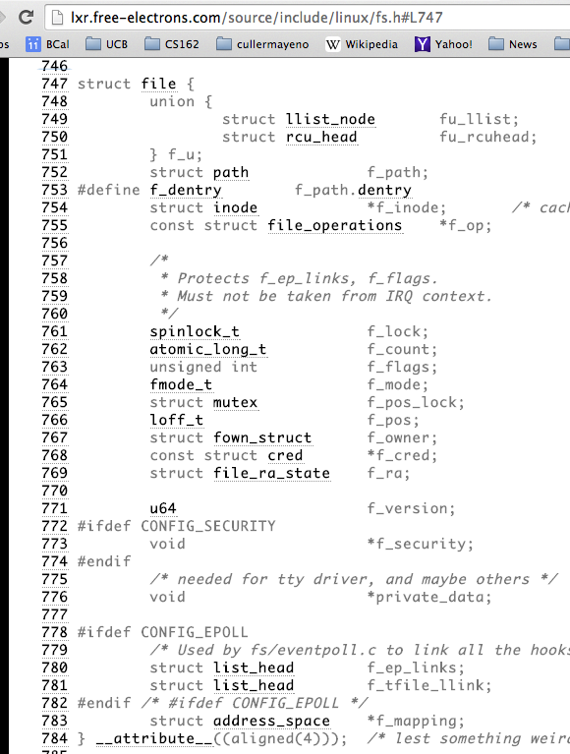
What’s in an Open File Description?
For our purposes, the two most important things are:
Where to find the file data on disk
The current position within the file

Slide 50
Abstract Representation of a Process
Process
Suppose that we execute
open(“foo.txt”)
and that the result is 3
Thread’s Regs
Address Space (Memory)
…
User Space
Kernel Space
File Descriptors
Open File Description
3
Not shown: Initially contains 0, 1, and 2 (stdin, stdout, stderr)
File: foo.txt
Position: 0

Slide 51
Abstract Representation of a Process
Process
Suppose that we execute
open(“foo.txt”)
and that the result is 3
Next, suppose that we execute
read(3, buf, 100)
and that the result is 100
Thread’s Regs
Address Space (Memory)
…
User Space
Kernel Space
File Descriptors
Open File Description
3
Not shown: Initially contains 0, 1, and 2 (stdin, stdout, stderr)
File: foo.txt
Position: 0

Slide 52
Abstract Representation of a Process
Process
Suppose that we execute
open(“foo.txt”)
and that the result is 3
Next, suppose that we execute
read(3, buf, 100)
and that the result is 100
Thread’s Regs
Address Space (Memory)
…
User Space
Kernel Space
File Descriptors
Open File Description
3
Not shown: Initially contains 0, 1, and 2 (stdin, stdout, stderr)
File: foo.txt
Position: 100

Slide 53
Abstract Representation of a Process
Process
Suppose that we execute
open(“foo.txt”)
and that the result is 3
Next, suppose that we execute
read(3, buf, 100)
and that the result is 100
Finally, suppose that we execute
close(3)
Thread’s Regs
Address Space (Memory)
…
User Space
Kernel Space
File Descriptors
Open File Description
3
Not shown: Initially contains 0, 1, and 2 (stdin, stdout, stderr)
File: foo.txt
Position: 100

Slide 54
Now, let’s fork()!
Process 1
Process 2
Thread’s Regs
Address Space (Memory)
File descriptor is copied
Open file description is aliased
Thread’s Regs
Address Space (Memory)
…
…
User Space
Kernel Space
File Descriptors
File Descriptors
Open File Description
3
3
Not shown: Initially contains 0, 1, and 2 (stdin, stdout, stderr)
File: foo.txt
Position: 100

Slide 55
Open File Description is Aliased
Process 1
Process 2
read(3, buf, 100)
Thread’s Regs
Address Space (Memory)
Thread’s Regs
Address Space (Memory)
…
…
User Space
Kernel Space
File Descriptors
File Descriptors
Open File Description
3
3
Not shown: Initially contains 0, 1, and 2 (stdin, stdout, stderr)
File: foo.txt
Position: 100

Slide 56
Open File Description is Aliased
Process 1
Process 2
read(3, buf, 100)
Thread’s Regs
Address Space (Memory)
Thread’s Regs
Address Space (Memory)
…
…
User Space
Kernel Space
File Descriptors
File Descriptors
Open File Description
3
3
Not shown: Initially contains 0, 1, and 2 (stdin, stdout, stderr)
File: foo.txt
Position: 200

Slide 57
Open File Description is Aliased
Process 1
Process 2
read(3, buf, 100)
read(3, buf, 100)
Thread’s Regs
Address Space (Memory)
Thread’s Regs
Address Space (Memory)
…
…
User Space
Kernel Space
File Descriptors
File Descriptors
Open File Description
3
3
Not shown: Initially contains 0, 1, and 2 (stdin, stdout, stderr)
File: foo.txt
Position: 200

Slide 58
Open File Description is Aliased
Process 1
Process 2
read(3, buf, 100)
read(3, buf, 100)
Thread’s Regs
Address Space (Memory)
Thread’s Regs
Address Space (Memory)
…
…
User Space
Kernel Space
File Descriptors
File Descriptors
Open File Description
3
3
Not shown: Initially contains 0, 1, and 2 (stdin, stdout, stderr)
File: foo.txt
Position: 300

Slide 59
File Descriptor is Copied
Process 1
Process 2
read(3, buf, 100)
close(3)
read(3, buf, 100)
Thread’s Regs
Address Space (Memory)
Thread’s Regs
Address Space (Memory)
…
…
User Space
Kernel Space
File Descriptors
File Descriptors
Open File Description
3
3
Not shown: Initially contains 0, 1, and 2 (stdin, stdout, stderr)
File: foo.txt
Position: 300

Slide 60
File Descriptor is Copied
Process 1
Process 2
read(3, buf, 100)
close(3)
read(3, buf, 100)
Thread’s Regs
Address Space (Memory)
Thread’s Regs
Address Space (Memory)
Open file description remains alive until no file descriptors in any process refer to it
…
…
User Space
Kernel Space
File Descriptors
File Descriptors
Open File Description
3
Not shown: Initially contains 0, 1, and 2 (stdin, stdout, stderr)
File: foo.txt
Position: 300

Slide 61
Why is Aliasing the Open File Description a Good Idea?
It allows for shared resources between processes

Slide 62
Recall: In POSIX, Everything is a “File”
Identical interface for:
Files on disk
Devices (terminals, printers, etc.)
Regular files on disk
Networking (sockets)
Local interprocess communication (pipes, sockets)
Based on the system calls open(), read(), write(), and close()

Slide 63
Example: Shared Terminal Emulator
When you fork() a process, the parent’s and child’s printf outputs go to the same terminal

Slide 64
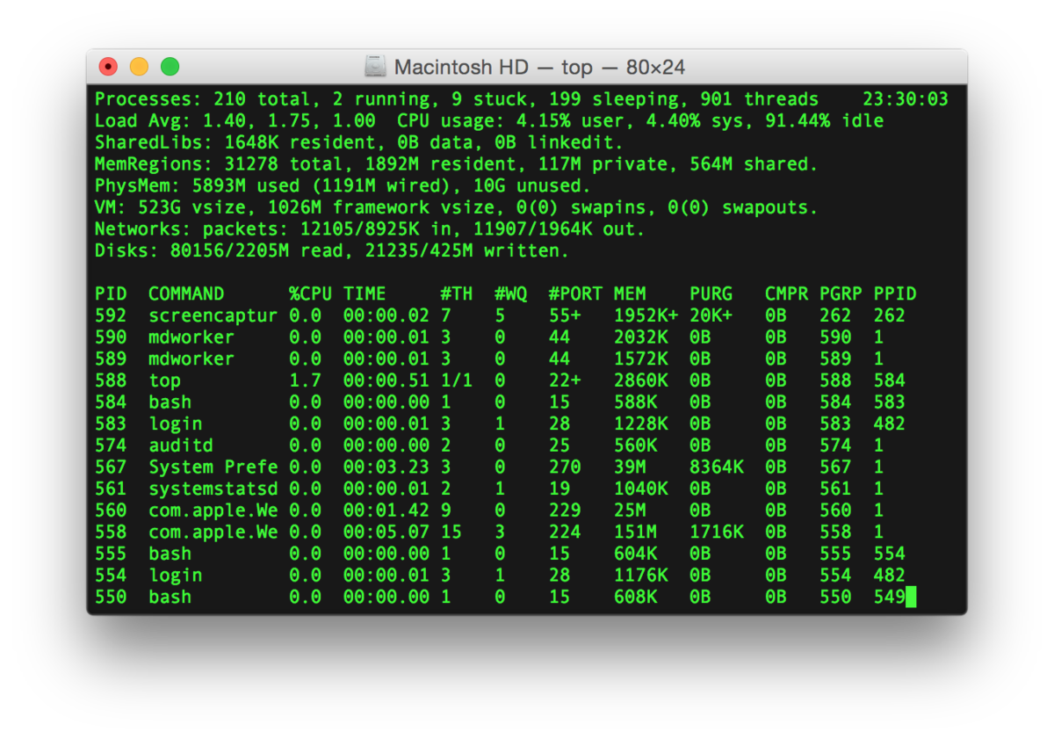
Example: Shared Terminal Emulator
Process 1
Process 2
Thread’s Regs
Address Space (Memory)
Thread’s Regs
Address Space (Memory)
…
…
User Space
Kernel Space
Terminal Emulator
File Descriptors
File Descriptors
0
1
2
0
1
2

Slide 65
Example: Shared Terminal Emulator
Process 1
Process 2
close(0)
Thread’s Regs
Address Space (Memory)
Thread’s Regs
Address Space (Memory)
…
…
User Space
Kernel Space
Terminal Emulator
File Descriptors
File Descriptors
0
1
2
0
1
2

Slide 66
Example: Shared Terminal Emulator
Process 1
Process 2
close(0)
Thread’s Regs
Address Space (Memory)
Thread’s Regs
Address Space (Memory)
If one process closes stdin (0), it remains open in other processes
…
…
User Space
Kernel Space
Terminal Emulator
File Descriptors
File Descriptors
0
1
2
0
1
2

Slide 67
Other Examples
Shared network connections after fork()
Allows handling each connection in a separate process
We’ll explore this next time
Shared access to pipes
Useful for interprocess communication
And in writing a shell (Homework 2)

Slide 68
Other Syscalls: dup and dup2
They allow you to duplicate the file descriptor
But the open file description remains aliased

Slide 69
Other Syscalls: dup and dup2
Process
Suppose that we execute
open(“foo.txt”)
and that the result is 3
Next, suppose that we execute
read(3, buf, 100)
and that the result is 100
Next, suppose that we execute
dup(3)
And that the result is 4
Finally, suppose that we execute
dup2(3, 162)
Thread’s Regs
Address Space (Memory)
…
User Space
Kernel Space
File Descriptors
Open File Description
3
4
162
Not shown: Initially contains 0, 1, and 2 (stdin, stdout, stderr)
File: foo.txt
Position: 100

Slide 70
Today: The File Abstraction
High-Level File I/O: Streams
Low-Level File I/O: File Descriptors
How and Why of High-Level File I/O
Process State for File Descriptors
Some Pitfalls with OS Abstractions [if time]

Slide 71
Don’t fork() in a process that already has multiple threads
Unless you plan to call exec() in the child process

Slide 72
fork() in Multithreaded Processes
The child process always has just a single thread
The thread in which fork() was called
The other threads just vanish

Slide 73
fork() in a Multithreaded Processes
Process 1
Process 2
Thread 1 Regs
Address Space (Memory)
Only the thread that called fork() exists in the new process
Thread 1 Regs
Address Space (Memory)
Thread 2 Regs
…
User Space
…
Kernel Space
File Descriptors
File Descriptors
Open File Description
3
3
Not shown: Initially contains 0, 1, and 2 (stdin, stdout, stderr)
File: foo.txt
Position: 100

Slide 74
Possible Problems with Multithreaded fork()
When you call fork() in a multithreaded process, the other threads (the ones that didn’t call fork()) just vanish
What if one of these threads was holding a lock?
What if one of these threads was in the middle of modifying a data structure?
No cleanup happens!
It’s safe if you call exec() in the child
Replacing the entire address space

Slide 75
Don’t carelessly mix low-level and high-level file I/O

Slide 76
Avoid Mixing FILE* and File Descriptors
char x[10];
char y[10];
FILE* f = fopen(“foo.txt”, “rb”);
int fd = fileno(f);
fread(x, 10, 1, f); // read 10 bytes from f
read(fd, y, 10); // assumes that this returns 10
Which bytes from the file are read into y?
Bytes 0 to 9
Bytes 10 to 19
None of these?

Slide 77
Avoid Mixing FILE* and File Descriptors
char x[10];
char y[10];
FILE* f = fopen(“foo.txt”, “rb”);
int fd = fileno(f);
fread(x, 10, 1, f); // read 10 bytes from f
read(fd, y, 10); // assumes that this returns 10
Which bytes from the file are read into y?
Bytes 0 to 9
Bytes 10 to 19
None of these?

Slide 78
Be careful with fork() and FILE*

Slide 79
Be Careful Using fork() with FILE*
FILE* f = fopen(“foo.txt”, “w”);
fwrite(“a”, 1, 1, f);
fork();
fclose(f);
After all processes exit, what is in foo.txt?
Could be either a or aa
Usually aa based on what I’ve observed in Linux…
Depends on whether this fwrite call flushes…

Slide 80
Be Careful Using fork() with FILE*
Process 1
Process 2
Thread’s Regs
Open File Description is aliased
But the FILE* buffer is copied!
Thread’s Regs
a
a
FILE* Buffer
FILE* Buffer
User Space
Kernel Space
File Descriptors
File Descriptors
Open File Description
3
3
Not shown: Initially contains 0, 1, and 2 (stdin, stdout, stderr)
File: foo.txt
Position: 0

Slide 81
Conclusion
Application / Service
High Level I/O
Streams
Low Level I/O
File Descriptors
Focus of today’s lecture
Syscall
open(), read(), write(), close(), …
Open File Descriptions
File System
Files/Directories/Indexes
I/O Driver
Commands and Data Transfers
Disks, Flash, Controllers, DMA

Slide 82
Conclusion
POSIX idea: “everything is a file”
All sorts of I/O managed by open/read/write/close
We added two new elements to the PCB:
Mapping from file descriptor to open file description
Current working directory

