Slide 1
Creating the Process Abstraction
Sam Kumar
CS 162: Operating Systems and System Programming
Lecture 7
https://inst.eecs.berkeley.edu/~cs162/su20
Read: A&D 3.5-6,
A fork() in the road

Slide 2
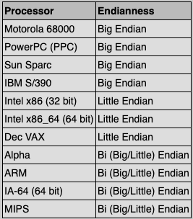
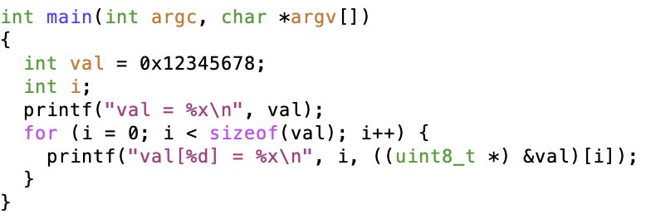
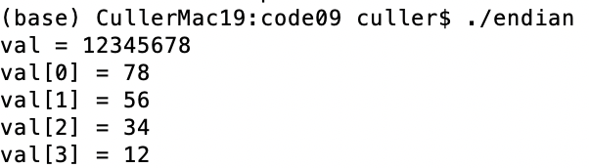
Recall: Endianness
For a byte-address machine, which end of a machine-recognized object (e.g., int) does its byte-address refer to?
Big Endian: address is the most-significant bits
Little Endian: address is the least-significant bits

Slide 3
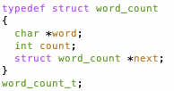
Recall: What About Richer Objects?
Consider word_count_t of Homework 0 and 1 …
Each element contains:
  An int
  A pointer to a string (of some length)
  A pointer to the next element
fprintf_words writes these as a sequence of lines (character strings with \n) to a file stream
What if you wanted to write the whole list as a binary object (and read it back as one)?
  How do you represent the string?
  Does it make any sense to write the pointer?

Slide 4
Recall: Remote Procedure Calls
Client (caller)
r = f(v1, v2);
bundle args
call
Client
Stub
send
Packet
Handler
return
receive
unbundle
ret vals
Machine A
Machine B
Network
Network
bundle
ret vals
Server (callee)
res_t f(a1, a2)
return
Server
Stub
send
Packet
Handler
call
receive
unbundle args

Slide 5
Recall: DNS
Hostname Resolution Request
Hostname Resolution Response (IP)
DNS Server
Top-level
edu
com
169.229.131.81
mit
berkeley.edu
berkeley
mit.edu
www
calmail
eecs
128.32.61.103
eecs.berkeley.edu
www
128.32.139.48

Slide 6
HTTP
Application protocol for The Web
  Retrieve a specific object, upload data, etc.
Runs on top of TCP (sockets)
Like any protocol, stipulates:
  Syntax: Content sent over socket connection
  Semantics: Meaning of a message
  Valid replies and actions taken upon message receipt
Arguably a primitive form of RPC
  Parsing text, Hardcoded operations
  No registry of available functions
  No formal marshal/unmarshal
  REST calls get a lot closer …

Slide 7


HTTP “RPC”
GET /search.html
200 OK
< HTML Content>

Slide 8
HTTP “RPC”
POST /users/oksi/photos
<image content>
201 Created

Slide 9
HTTP Messages
Text-based: We just send character strings over our TCP socket connection
To make a request, browser might write something like the following on a socket:
GET /hello.html HTTP/1.0\r\n
Host: 128.32.4.8:8000\r\n
Accept: text/html\r\n
User-Agent: Chrome/45.0.2454.93\r\n
Accept-Language: en-US,en;q=0.8\r\n
\r\n

Slide 10
HTTP Messages
Text-based: We just send strings over our TCP socket connection
We then read the following response from the web server:
HTTP/1.0 200 OK\r\n
Content-Type: text/html\r\n
Content-Length: 128\r\n
\r\n
<html>\n
<body>\n
<h1>Hello World</h1>\n
<p>\n
Hello, World!\n
</p>\n
</body>\n
</html>\n

Slide 11
HTTP and State
Remember this situation?
  remoteFile *rf = remoteio_open(ctx, "oski.txt");
  remoteio_puts(ctx, rf, "Bear\n");
  remoteio_close(ctx, rf);
Client fails: does file stay open forever?
Server maintains state between requests from client

Slide 12
HTTP and State
HTTP avoids this issue – stateless protocol
Each request is self-contained
  Treated independently of all other requests
  Even previous requests from same client!
So how do we get a session?
  Client stores a unique ID locally – a cookie
  Client adds this to each request so server can customize its response

Slide 13
REST Calls over HTTP?
HTTP GET http://www.appdomain.com/dirs/mkdir?name=cs162&mode=tmp

Slide 14
RPC Locally
Doesn’t need to be between different machines
Could just be different address spaces (processes)
Gives location transparency
  Move service implementation to wherever is convenient
  Client runs same old RPC code
Much faster implementations available locally
  (Local) Inter-process communication
  We’ll see several techniques later on

Slide 15
Recall: Process
Definition: execution environment with restricted rights
  One or more threads executing in a single address space
  Owns file descriptors, network connections
Instance of a running program
  When you run an executable, it runs in its own process
  Application: one or more processes working together
Protected from each other; OS protected from them
In modern OSes, anything that runs outside of the kernel runs in a process

Slide 16
Today: How Does the OS Support the Process Abstraction?
How does the kernel build the abstractions we have studied?
  Dual-Mode Operation and Address Spaces?
  Threads?
  File I/O?
What role does hardware play in serving syscalls/interrupts/traps?
How is the kernel structured?
And, along the way, getting you ready to tackle Project 1 …

Slide 17
Today: How Does the OS Support the Process Abstraction?
Support for threads and kernel structure
Memory layout
Support for process operations
Support for I/O
Influence of IPC/RPC on kernel structure

Slide 18
Today: How Does the OS Support the Process Abstraction?
Support for threads and kernel structure
Memory layout
Support for process operations
Support for I/O
Influence of IPC/RPC on kernel structure

Slide 19
Recall: Kernel Stacks
Interrupt handlers want a stack
System call handlers want a stack
Can't just use the user stack [why?]
One Solution: two-stack model
  Each thread has user stack and a kernel stack
  Kernel stack stores users registers during an exception
  Kernel stack used to execute exception handler in the kernel

Slide 20

Recall: Single and Multithreaded Processes
Threads encapsulate concurrency
  “Active” component
Address space encapsulate protection:
  “Passive” component
  Keeps bugs from crashing the entire system
Why have multiple threads per address space?

Slide 21
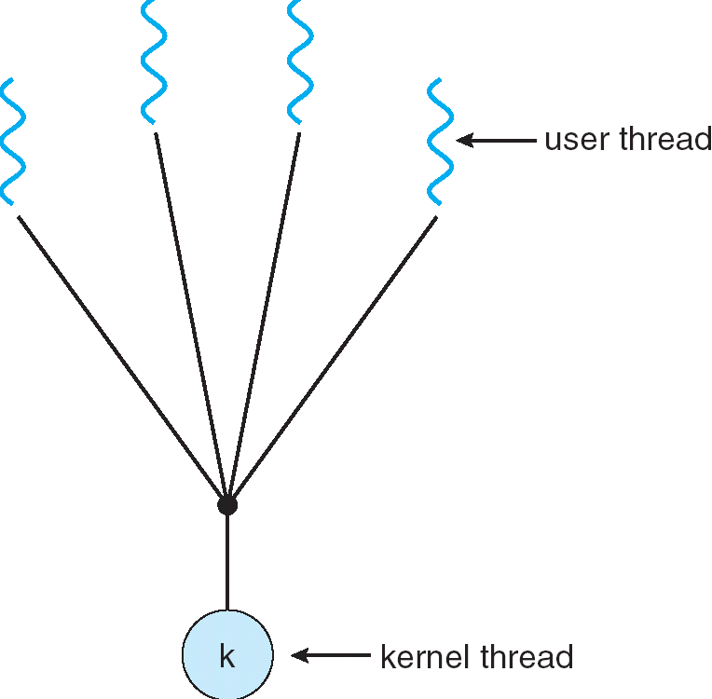
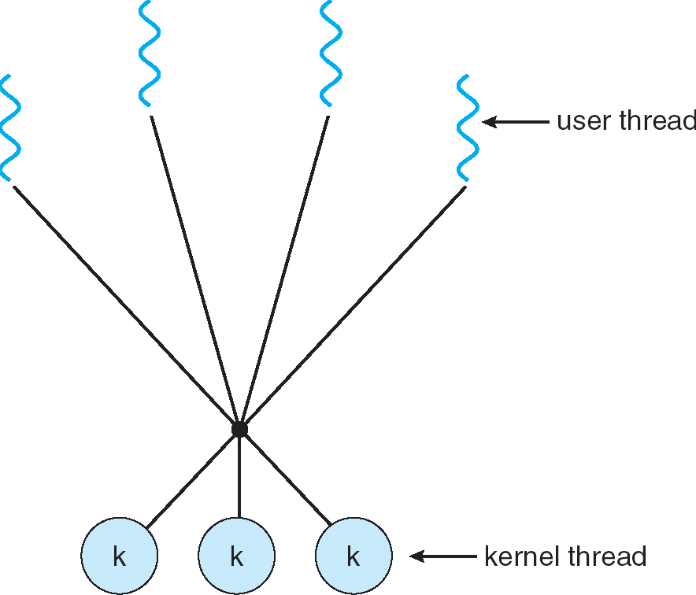
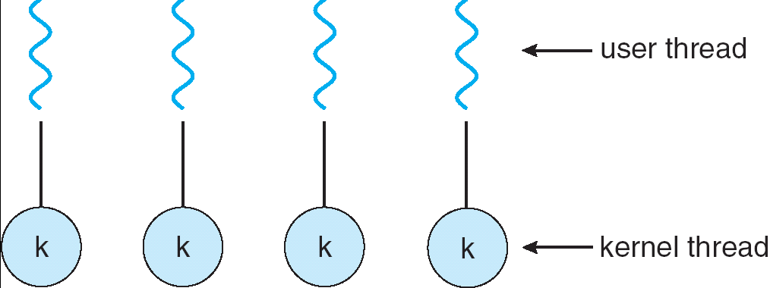
User/Kernel Threading Models
Almost all current implementations
Simple One-to-One
Threading Model
Many-to-One
Many-to-Many

Slide 22
Thread State in the Kernel
For every thread in a process, the kernel maintains:
  The thread’s TCB
  A kernel stack used for syscalls/interrupts/traps
Additionally, some threads just do work in the kernel
  Still has TCB
  Still has kernel stack
  But not part of any process, and never executes in user mode

Slide 23
Pintos Thread
Single page (4 KiB)
  Stack growing from the top (high addresses)
  struct thread at the bottom (low addresses)
struct thread defines the TCB structure in Pintos
stack
regs
4 KiB
magic
priority
stack
name
status
tid
thread
Pintos: thread.c

Slide 24
In Pintos, Processes are Single-Threaded
Processes can contain exactly one thread, for simplicity
Approach used by older systems

Slide 25
Pintos Thread
Single page (4 KiB)
  Stack growing from the top (high addresses)
  struct thread at the bottom (low addresses)
struct thread defines the TCB structure and PCB structure in Pintos
stack
regs
4 KiB
magic
… <fds>
pagedir
priority
stack
name
status
tid
Page Table
u/s
thread
Pintos: thread.c

Slide 26
Linux “Task”
2 pages (8 KiB)
  Stack and thread information on opposite sides
  Containing stack and thread information + process descriptor
stack
regs
task_struct (process descr)
8 KiB
sp
thread_info
state
priority
pid
address space
…
list elems
…
status
flags
*task

Slide 27
Multithreaded Processes (not in Pintos)
Traditional implementation strategy:
  One PCB (process struct) per process
  Each PCB contains (or stores pointers to) each thread’s TCB
Linux’s strategy:
  One task_struct per thread
  Threads belonging to the same process happen to share some resources
    Like address space, file descriptor table, etc.
To what extent does this actually matter?

Slide 28
Process Creation (Projects 0 and 1)
Allocate and initialize Process object
Allocate and initialize kernel thread mini-stack and associated Thread object
Allocate and initialize page table for process
  Referenced by process object
Load code and static data into user pages
Build initial User Stack
  Initial register contents, argv, …
Schedule (post) process/thread for execution
…
Eventually switch to user mode (switching to user stack and registers) …

Slide 29
Aside: Polymorphic Linked Lists in C
Many places in the kernel need to maintain a “list of X”
  This is tricky in C, which has no polymorphism
  Essentially adding an interface to a package
In Linux and Pintos this is done by embedding a list_elem in the struct
  Macros allow shift of view between object and list
  You saw this in Homework 1
all_threads
ready_threads
Pintos: list.c

Slide 30
Kernel Structure So Far (1/3)
Kernel
Code
Process 1
Process 2
PCB 1
PCB 2
Globals
Kernel
Stack
Kernel
Stack
Heap
Process 1
Thread
Process 2
Thread
Stack
Stack
Code
Code
Globals
Globals
Heap
Heap

Slide 31
Kernel Structure So Far (2/3)
Process 1
Process 2
Kernel
Code
PCB 1
PCB 2
Globals
TCB 1.A
TCB 1.B
TCB 2.A
Heap
Kernel
Stack
Kernel
Stack
Kernel
Stack
Process 1
Process 2
Thread A
Thread A
Thread B
Stack
Stack
Stack
Code
Code
Globals
Globals
Heap
Heap

Slide 32
Kernel Structure So Far (3/3)
Process 1
Process 2
Kernel
Code
Kernel
Thread 1
Kernel
Thread 2
PCB 1
PCB 2
Globals
TCB 1
TCB 2
TCB 1.A
TCB 1.B
TCB 2.A
Heap
Kernel
Stack
Kernel
Stack
Kernel
Stack
Kernel
Stack
Kernel
Stack
Process 1
Process 2
Thread A
Thread A
Thread B
These two threads:
Are used internally by the kernel
Don’t correspond to any particular user thread or process
Stack
Stack
Stack
Code
Code
Globals
Globals
Heap
Heap

Slide 33
Today: How Does the OS Support the Process Abstraction?
Support for threads and kernel structure
Memory layout
Support for process operations
Support for I/O
Influence of IPC/RPC on kernel structure

Slide 34
Recall: Process Control Block
Kernel representation of each process
  Status (running, ready, blocked)
  Register state (if not running)
  Thread control block(s)
  Process ID
  Execution time
  Address space
  Open files, etc.
How is this represented?

Slide 35
Recall: Address Space
Program operates in an address space that is distinct from the physical memory space of the machine
0x000…
“virtual address”
“physical address”
Processor
translator
Memory
Registers
Page Table
<Frame Addr>
0xFFF…

Slide 36
Understanding “Address Space”
Page table is the primary mechanism
Privilege Level determines which regions can be accessed
  Which entries can be used
System (PL=0) can access all, User (PL=3) only part
Each process has its own address space
The “System” part of all of them is the same
All system threads share the same system address space and same memory

Slide 37
Page Table Mapping (Rough Idea)
Code
Data
Heap
Stack
Data 2
(user process view of memory)
Code
Data
Heap
Stack
Stack 1
0x000…
Heap 1
Code
Code 1
Stack 2
Static Data
Prog 1
Virtual
Address
Space 1
Data 1
Prog 2
Virtual
Address
Space 2
Heap
Heap 2
Code 2
OS code
OS data
Stack
Translation Map 1
OS heap/
Stacks
Translation Map 2
0xFFF…
Physical Address Space

Slide 38
User Process View of Memory
Process Virtual Address Space
0xffffffff
Physical Memory
kernel
Page Table
Page
Processor
registers
0xc0000000
argv
sp
stack
ip
heap
user data
user code
0x08048000
0x00000000

Slide 39
Processor Mode (Privilege Level)
Process Virtual Address Space
0xffffffff
Physical Memory
kernel
Page Table
Page
Processor
registers
0xc0000000
argv
sp
stack
ip
u/s
heap
user data
CPL:
3 - user
user code
0x08048000
0x00000000

Slide 40
Aside: x86 (32-bit) Page Table Entry
Page Table
u/s
Controls many aspects of access
Later – discuss page table organization
  For 32 (64?) bit VAS, how large? vs size of memory?
  Used sparsely
Pintos: page_dir.c

Slide 41
User → Kernel
Process Virtual Address Space
0xffffffff
Physical Memory
kernel
Page Table
Page
Processor
registers
0xc0000000
argv
sp
stack
ip
u/s
heap
user data
CPL:
3 - user
user code
0x08048000
0x00000000

Slide 42
User → Kernel
Process Virtual Address Space
0xffffffff
Physical Memory
kernel
Page Table
Page
ker data
Processor
registers
ker code
0xc0000000
argv
sp
sp
stack
ip
u/s
ip
heap
user data
CPL:
0 - sys
user code
0x08048000
0x00000000

Slide 43
Page Table Resides in Memory*
Process Virtual Address Space
* In the simplest case. Actually more complex. More later.
0xffffffff
Physical Memory
kernel
Page Table
Page
ker data
Processor
registers
ker code
0xc0000000
argv
sp
sp
stack
ip
u/s
ip
heap
user data
CPL:
0 - sys
user code
0x08048000
0x00000000
PTBR:

Slide 44
Kernel Portion of Address Space
Kernel memory is mapped into address space of every process
Contains the kernel code
  Loaded when the machine booted
Explicitly mapped to physical memory
  OS creates the page table
Used to contain all kernel data structures
  Lists of processes/threads
  Page tables
  Open file descriptions, sockets, ttys, …
Kernel stack for each thread

Slide 45
1 Kernel Code, Many Kernel Stacks
Process Virtual Address Space
0xffffffff
Physical Memory
kernel
Page Table
Page
ker data
Processor
registers
ker code
0xc0000000
argv
sp
sp
stack
ip
u/s
ip
heap
user data
CPL:
0 - sys
user code
0x08048000
0x00000000
PTBR:

Slide 46
How to Get to the Correct Kernel Stack?
The hardware helps us out!

Slide 47
Recall: Where do User → Kernel Mode Transfers Go?
Cannot let user programs specify the exact address!
Solution: Interrupt Vector
  OS kernel specifies a set of functions that are entrypoints to kernel mode
  Appropriate function is chosen depending on the type of transition
    Interrupt Number (i)
    OS may do additional dispatch
Address and properties of each interrupt handler
interrupt number (i)
intrpHandler_i () {
…
}

Slide 48
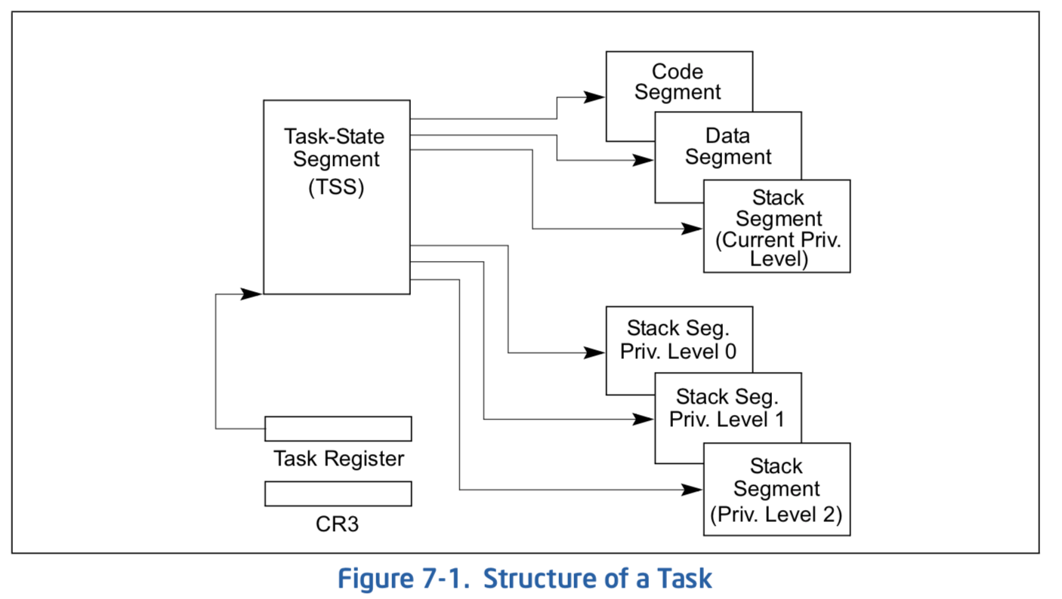
Hardware Support for Switching Stacks
Syscall/Intr (U → K)
  PL 3 → 0;
  TSS ← EFLAGS, CS:EIP;
  SS:SP ← k-thread stack (TSS PL 0);
  push (old) SS:ESP onto (new) k-stack
  push (old) eflags, cs:eip, <err>
  CS:EIP ← <k target handler>
Then
  Handler then saves other regs, etc
  Does all its works, possibly choosing other threads, changing PTBR (CR3)
  kernel thread has set up user GPRs
iret (K → U)
  PL 0 → 3;
  Eflags, CS:EIP ← popped off k-stack
  SS:SP ← user thread stack (TSS PL 3);
Pintos: tss.c, intr-stubs.S

Slide 49
Recall: The Process
Definition: execution environment with restricted rights
  Address Space with One or More Threads
    Page table per process!
  Owns memory (mapped pages)
  Owns file descriptors, file system context, …
  Encapsulates one or more threads sharing process resources
Application program executes as a process
  Complex applications can fork/exec child processes [later]
Why processes?
  Protected from each other. OS Protected from them.
  Execute concurrently [ trade-offs with threads? later ]
  Basic unit OS deals with

Slide 50
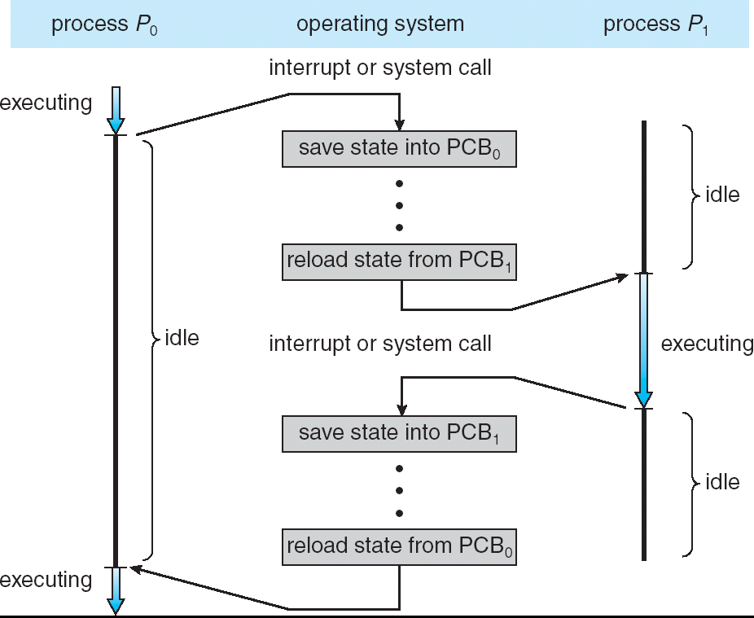
Context Switch
Diagram assumes single-threaded processes
For multi-threaded process, substitute process → thread and PCB → TCB
Privilege Level: 3 - user
Privilege Level: 0 - sys
Privilege Level: 3 - user

Slide 51
Recall: Scheduling
if ( readyThreads(TCBs) ) {
nextTCB = selectTCB(TCBs);
run( nextTCB );
} else {
run_idle_thread();
}
Scheduling: Mechanism for deciding which processes/threads receive the CPU
Lots of different scheduling policies provide …
  Fairness or
  Realtime guarantees or
  Latency optimization or …

Slide 52
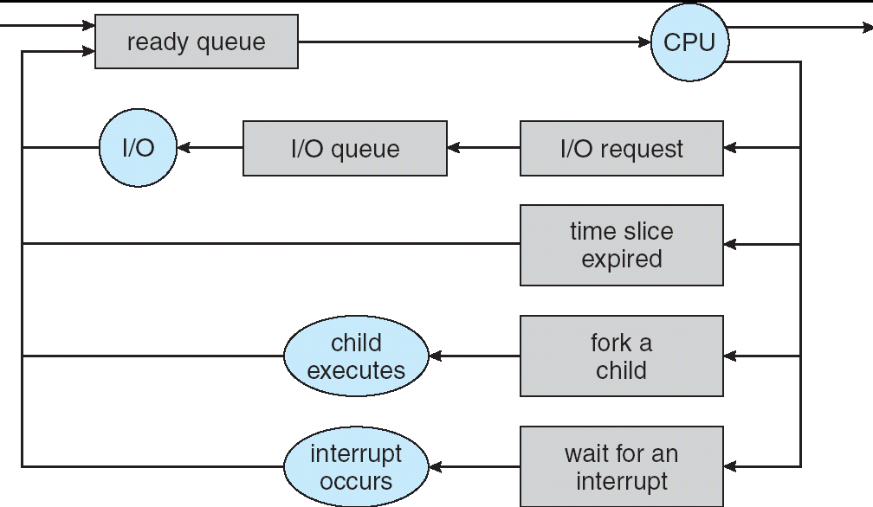
Scheduling: All About Queues
TCBs move from queue to queue
Scheduling: which order to remove from queue of “ready” threads

Slide 53
Announcements
Homework 2 out, due Monday
Project 0 due tonight tomorrow night
Project 1 will be out soon
Drop Deadline with Refund on Thursday
Project Groups Due Friday

Slide 54
Today: How Does the OS Support the Process Abstraction?
Support for threads and kernel structure
Memory layout
Support for process operations
Support for I/O
Influence of IPC/RPC on kernel structure

Slide 55
Operations on Process State
exec()
fork()
open()/close()
wait()

Slide 56

Recall: Running a Program
0xFFF…
Program Source
Executable
OS
int main()
{ … ;
}
Editor
Compiler and Linker
data
stack
OS Loader
Memory
instructions
heap
foo.c
a.out
data
Create OS “PCB”, address space, stack and heap
Load instruction and data segments of executable file into memory
“Transfer control to program”
Provide services to program
While protecting OS and program
instructions
0x000…
PC:
registers
Processor

Slide 57
Recall: Running a Program
0xFFF…
Program Source
Executable
OS
fork()
int main()
{ … ;
}
Editor
Compiler and Linker
data
stack
OS Loader
Memory
instructions
heap
foo.c
a.out
data
Create OS “PCB”, address space, stack and heap
Load instruction and data segments of executable file into memory
“Transfer control to program”
Provide services to program
While protecting OS and program
instructions
0x000…
exec(…)
PC:
registers
Processor

Slide 58
How to fork() efficiently?
Pintos doesn’t support fork(), just CreateProcess()
Alias the pages
  Same physical address!
  If we stopped here, the data would be shared (not what we want)
Mark PTEs read-only
  If a process tries to write → trap to the OS
On first write to a page after fork(), kernel copies the page, marks PTEs as writeable
Illusion of separate memory, but really aliased until first write

Slide 59
Recall: Open File Description is Aliased
Process 1
Process 2
read(3, buf, 100)
close(3)
read(3, buf, 100)
Thread’s Regs
Address Space (Memory)
Thread’s Regs
Address Space (Memory)
…
…
User Space
Kernel Space
File Descriptors
File Descriptors
Open File Description
3
3
Not shown: Initially contains 0, 1, and 2 (stdin, stdout, stderr)
File: foo.txt
Position: 300

Slide 60
Solution: Reference Counting
Process 1
Process 2
read(3, buf, 100)
read(3, buf, 100)
Thread’s Regs
Address Space (Memory)
Thread’s Regs
Address Space (Memory)
…
…
User Space
Kernel Space
File Descriptors
File Descriptors
Open File Description
3
3
Not shown: Initially contains 0, 1, and 2 (stdin, stdout, stderr)
File: foo.txt
Position: 300
Reference Count: 2
Lock

Slide 61
Solution: Reference Counting
Process 1
Process 2
read(3, buf, 100)
close(3)
read(3, buf, 100)
Thread’s Regs
Address Space (Memory)
Thread’s Regs
Address Space (Memory)
…
…
User Space
Kernel Space
File Descriptors
File Descriptors
Open File Description
3
3
Not shown: Initially contains 0, 1, and 2 (stdin, stdout, stderr)
File: foo.txt
Position: 300
Reference Count: 1
Lock

Slide 62
Solution: Reference Counting
Process 1
Process 2
read(3, buf, 100)
close(3)
read(3, buf, 100)
Thread’s Regs
Address Space (Memory)
Thread’s Regs
Address Space (Memory)
…
…
User Space
Kernel Space
File Descriptors
File Descriptors
Open File Description
3
Not shown: Initially contains 0, 1, and 2 (stdin, stdout, stderr)
File: foo.txt
Position: 300
Reference Count: 1
Lock

Slide 63
Solution: Reference Counting
Process 1
Process 2
read(3, buf, 100)
close(3)
read(3, buf, 100)
close(3)
Thread’s Regs
Address Space (Memory)
Thread’s Regs
Address Space (Memory)
…
…
User Space
Kernel Space
File Descriptors
File Descriptors
Open File Description
3
Not shown: Initially contains 0, 1, and 2 (stdin, stdout, stderr)
File: foo.txt
Position: 300
Reference Count: 1
Lock

Slide 64
Solution: Reference Counting
Process 1
Process 2
read(3, buf, 100)
close(3)
read(3, buf, 100)
close(3)
Thread’s Regs
Address Space (Memory)
Thread’s Regs
Address Space (Memory)
…
…
User Space
Kernel Space
File Descriptors
File Descriptors
Open File Description
3
Not shown: Initially contains 0, 1, and 2 (stdin, stdout, stderr)
File: foo.txt
Position: 300
Reference Count: 0
Lock

Slide 65
Solution: Reference Counting
Process 1
Process 2
read(3, buf, 100)
close(3)
read(3, buf, 100)
close(3)
Thread’s Regs
Address Space (Memory)
Thread’s Regs
Address Space (Memory)
…
…
User Space
Kernel Space
File Descriptors
File Descriptors
Not shown: Initially contains 0, 1, and 2 (stdin, stdout, stderr)

Slide 66
What about wait()?
The parent process needs to get the exit code
The following events may happen in any order (or concurrently)
  Parent process calls wait() (or exit())
  Child process calls exit()
Where should the child put its exit code?
  Needs to work even if the parent has exited
Where should the parent search for the exit code?
  Needs to work even if the child has exited already
Project 1: User Programs

Slide 67
Today: How Does the OS Support the Process Abstraction?
Support for threads and kernel structure
Memory layout
Support for process operations
Support for I/O
Influence of IPC/RPC on kernel structure

Slide 68
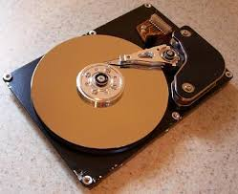
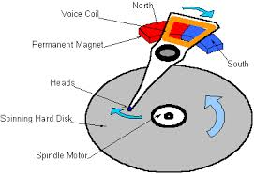
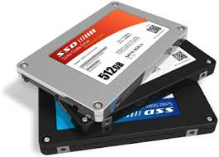

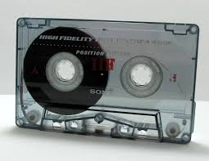
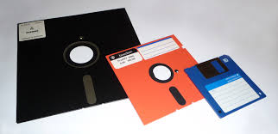
Recall: I/O and Storage Layers
Application / Service
High Level I/O
Streams
Low Level I/O
File Descriptors
What we’ve covered so far…
Syscall
open(), read(), write(), close(), …
Open File Descriptions
File System
Files/Directories/Indexes
What we’ll peek at today
I/O Driver
Commands and Data Transfers
Disks, Flash, Controllers, DMA

Slide 69
Layers…
User App
length = read(input_fd, buffer, BUFFER_SIZE);
User library
ssize_t read(int, void *, size_t){
marshal args into registers
issue syscall
register result of syscall to rtn value
};
Application / Service
High Level I/O
Low Level I/O
Exception U→K, interrupt processing
Syscall
void syscall_handler (struct intr_frame *f) {
unmarshall call#, args from regs
dispatch : handlers[call#](args)
marshal results fo syscall ret
}
File System
I/O Driver
ssize_t vfs_read(struct file *file, char __user *buf, size_t count, loff_t *pos)
{
User Process/File System relationship
call device driver to do the work
}
Device Driver

Slide 70
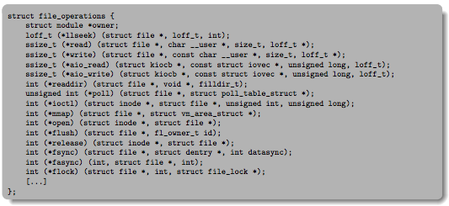
Low-Level Driver
Associated with particular hardware device
Registers / Unregisters itself with the kernel
Handler functions for each of the file operations

Slide 71
File System: From Syscall to Driver
ssize_t vfs_read(struct file *file, char __user *buf, size_t count, loff_t *pos)
{
ssize_t ret;
if (!(file->f_mode & FMODE_READ)) return -EBADF;
if (!file->f_op || (!file->f_op->read && !file->f_op->aio_read))
return -EINVAL;
if (unlikely(!access_ok(VERIFY_WRITE, buf, count))) return -EFAULT;
ret = rw_verify_area(READ, file, pos, count);
if (ret >= 0) {
count = ret;
if (file->f_op->read)
ret = file->f_op->read(file, buf, count, pos);
else
ret = do_sync_read(file, buf, count, pos);
if (ret > 0) {
fsnotify_access(file->f_path.dentry);
add_rchar(current, ret);
}
inc_syscr(current);
}
return ret;
}
Read up to “count” bytes from “file” starting from “pos” into “buf”.
Return error or number of bytes read.
Linux: fs/read_write.c

Slide 72
File System: From Syscall to Driver
ssize_t vfs_read(struct file *file, char __user *buf, size_t count, loff_t *pos)
{
ssize_t ret;
if (!(file->f_mode & FMODE_READ)) return -EBADF;
if (!file->f_op || (!file->f_op->read && !file->f_op->aio_read))
return -EINVAL;
if (unlikely(!access_ok(VERIFY_WRITE, buf, count))) return -EFAULT;
ret = rw_verify_area(READ, file, pos, count);
if (ret >= 0) {
count = ret;
if (file->f_op->read)
ret = file->f_op->read(file, buf, count, pos);
else
ret = do_sync_read(file, buf, count, pos);
if (ret > 0) {
fsnotify_access(file->f_path.dentry);
add_rchar(current, ret);
}
inc_syscr(current);
}
return ret;
}
Make sure we are allowed to read this file
Linux: fs/read_write.c

Slide 73
File System: From Syscall to Driver
ssize_t vfs_read(struct file *file, char __user *buf, size_t count, loff_t *pos)
{
ssize_t ret;
if (!(file->f_mode & FMODE_READ)) return -EBADF;
if (!file->f_op || (!file->f_op->read && !file->f_op->aio_read))
return -EINVAL;
if (unlikely(!access_ok(VERIFY_WRITE, buf, count))) return -EFAULT;
ret = rw_verify_area(READ, file, pos, count);
if (ret >= 0) {
count = ret;
if (file->f_op->read)
ret = file->f_op->read(file, buf, count, pos);
else
ret = do_sync_read(file, buf, count, pos);
if (ret > 0) {
fsnotify_access(file->f_path.dentry);
add_rchar(current, ret);
}
inc_syscr(current);
}
return ret;
}
Check if file has read methods
Linux: fs/read_write.c

Slide 74
File System: From Syscall to Driver
ssize_t vfs_read(struct file *file, char __user *buf, size_t count, loff_t *pos)
{
ssize_t ret;
if (!(file->f_mode & FMODE_READ)) return -EBADF;
if (!file->f_op || (!file->f_op->read && !file->f_op->aio_read))
return -EINVAL;
if (unlikely(!access_ok(VERIFY_WRITE, buf, count))) return -EFAULT;
ret = rw_verify_area(READ, file, pos, count);
if (ret >= 0) {
count = ret;
if (file->f_op->read)
ret = file->f_op->read(file, buf, count, pos);
else
ret = do_sync_read(file, buf, count, pos);
if (ret > 0) {
fsnotify_access(file->f_path.dentry);
add_rchar(current, ret);
}
inc_syscr(current);
}
return ret;
}
Check whether we can write to buf (e.g., buf is in the user space range)
unlikely(): hint to branch prediction this condition is unlikely
Linux: fs/read_write.c

Slide 75
File System: From Syscall to Driver
ssize_t vfs_read(struct file *file, char __user *buf, size_t count, loff_t *pos)
{
ssize_t ret;
if (!(file->f_mode & FMODE_READ)) return -EBADF;
if (!file->f_op || (!file->f_op->read && !file->f_op->aio_read))
return -EINVAL;
if (unlikely(!access_ok(VERIFY_WRITE, buf, count))) return -EFAULT;
ret = rw_verify_area(READ, file, pos, count);
if (ret >= 0) {
count = ret;
if (file->f_op->read)
ret = file->f_op->read(file, buf, count, pos);
else
ret = do_sync_read(file, buf, count, pos);
if (ret > 0) {
fsnotify_access(file->f_path.dentry);
add_rchar(current, ret);
}
inc_syscr(current);
}
return ret;
}
Check whether we read from a valid range in the file.
Linux: fs/read_write.c

Slide 76
File System: From Syscall to Driver
ssize_t vfs_read(struct file *file, char __user *buf, size_t count, loff_t *pos)
{
ssize_t ret;
if (!(file->f_mode & FMODE_READ)) return -EBADF;
if (!file->f_op || (!file->f_op->read && !file->f_op->aio_read))
return -EINVAL;
if (unlikely(!access_ok(VERIFY_WRITE, buf, count))) return -EFAULT;
ret = rw_verify_area(READ, file, pos, count);
if (ret >= 0) {
count = ret;
if (file->f_op->read)
ret = file->f_op->read(file, buf, count, pos);
else
ret = do_sync_read(file, buf, count, pos);
if (ret > 0) {
fsnotify_access(file->f_path.dentry);
add_rchar(current, ret);
}
inc_syscr(current);
}
return ret;
}
If driver provide a read function (f_op->read) use it; otherwise use do_sync_read()
Linux: fs/read_write.c

Slide 77
File System: From Syscall to Driver
ssize_t vfs_read(struct file *file, char __user *buf, size_t count, loff_t *pos)
{
ssize_t ret;
if (!(file->f_mode & FMODE_READ)) return -EBADF;
if (!file->f_op || (!file->f_op->read && !file->f_op->aio_read))
return -EINVAL;
if (unlikely(!access_ok(VERIFY_WRITE, buf, count))) return -EFAULT;
ret = rw_verify_area(READ, file, pos, count);
if (ret >= 0) {
count = ret;
if (file->f_op->read)
ret = file->f_op->read(file, buf, count, pos);
else
ret = do_sync_read(file, buf, count, pos);
if (ret > 0) {
fsnotify_access(file->f_path.dentry);
add_rchar(current, ret);
}
inc_syscr(current);
}
return ret;
}
Notify the parent of this file that the file was read (see http://www.fieldses.org/~bfields/kernel/vfs.txt)
Linux: fs/read_write.c

Slide 78
File System: From Syscall to Driver
ssize_t vfs_read(struct file *file, char __user *buf, size_t count, loff_t *pos)
{
ssize_t ret;
if (!(file->f_mode & FMODE_READ)) return -EBADF;
if (!file->f_op || (!file->f_op->read && !file->f_op->aio_read))
return -EINVAL;
if (unlikely(!access_ok(VERIFY_WRITE, buf, count))) return -EFAULT;
ret = rw_verify_area(READ, file, pos, count);
if (ret >= 0) {
count = ret;
if (file->f_op->read)
ret = file->f_op->read(file, buf, count, pos);
else
ret = do_sync_read(file, buf, count, pos);
if (ret > 0) {
fsnotify_access(file->f_path.dentry);
add_rchar(current, ret);
}
inc_syscr(current);
}
return ret;
}
Update the number of bytes read by “current” task (for scheduling purposes)
Linux: fs/read_write.c

Slide 79
File System: From Syscall to Driver
ssize_t vfs_read(struct file *file, char __user *buf, size_t count, loff_t *pos)
{
ssize_t ret;
if (!(file->f_mode & FMODE_READ)) return -EBADF;
if (!file->f_op || (!file->f_op->read && !file->f_op->aio_read))
return -EINVAL;
if (unlikely(!access_ok(VERIFY_WRITE, buf, count))) return -EFAULT;
ret = rw_verify_area(READ, file, pos, count);
if (ret >= 0) {
count = ret;
if (file->f_op->read)
ret = file->f_op->read(file, buf, count, pos);
else
ret = do_sync_read(file, buf, count, pos);
if (ret > 0) {
fsnotify_access(file->f_path.dentry);
add_rchar(current, ret);
}
inc_syscr(current);
}
return ret;
}
Update the number of read syscalls by “current” task (for scheduling purposes)
Linux: fs/read_write.c

Slide 80
Device Drivers
Device-specific code in the kernel that interacts directly with the device hardware
  Supports a standard, internal interface
  Same kernel I/O system can interact easily with different device drivers
  Special device-specific configuration supported with the ioctl() system call
Device Drivers typically divided into two pieces:
  Top half: accessed in call path from system calls
    implements a set of standard, cross-device calls like open(), close(), read(), write(), ioctl(), strategy()
    This is the kernel’s interface to the device driver
    Top half will start I/O to device, may put thread to sleep until finished
  Bottom half: run as interrupt routine
    Gets input or transfers next block of output
    May wake sleeping threads if I/O now complete

Slide 81
Recall: Inter-Process Communication (IPC)
Mechanism to create communication channel between distinct processes
  Same or different machines, same or different programming language…
Requires serialization format understood by both
Failure in one process isolated from the other
  Sharing is done in a controlled way through IPC
  Still have to be careful handling what is received via IPC
Many uses and interaction patterns
  Logging process, window management, …
  Potentially allows us to move some system functions outside of kernel to userspace

Slide 82
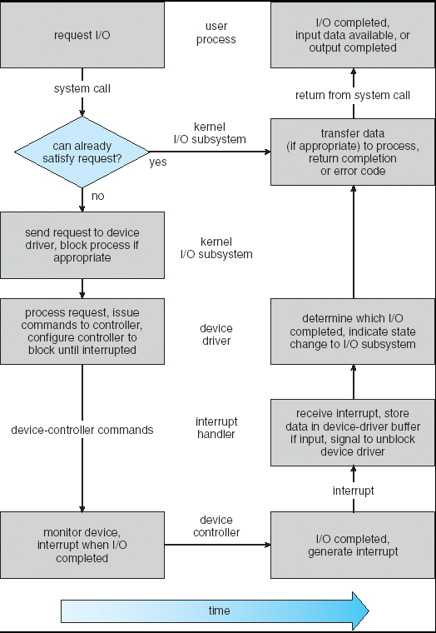
User
Program
Kernel I/O
Subsystem
Device Driver
Top Half
Device Driver
Bottom Half
Device
Hardware

Slide 83
Today: How Does the OS Support the Process Abstraction?
Support for threads and kernel structure
Memory layout
Support for process operations
Support for I/O
Influence of IPC/RPC on kernel structure

Slide 84
Recall: Using IPC to Simplify OS
IPC
App
App
App
App
App
Window
Mgr
File
Sys ???
file system
Windowing
address
spaces
VM
Networking
threads
Threads
Monolithic Structure
Partitioning ???
What if the file system is not local to the machine, but on the network?
Is there a general mechanism for providing services to other processes?
  Do the protocols we run on top of IPC generalize as well?

Slide 85
Microkernels
Split OS into separate processes
  Example: File System, Network Driver are processes outside of the kernel
Pass messages among these components (e.g., via RPC) instead of system calls
App
App
App
App
File
sys
windows
file system
Windowing
address
spaces
RPC
VM
Networking
Threads
threads
Monolithic Structure
Microkernel Structure

Slide 86
Microkernels
Microkernel itself provides only essential services
  Communication
  Address space management
  Thread scheduling
  Almost-direct access to hardware devices (for driver processes)
App
App
App
App
File
sys
windows
file system
Windowing
address
spaces
RPC
VM
Networking
Threads
threads
Monolithic Structure
Microkernel Structure

Slide 87
Why Microkernels?
Pros
Cons
Failure Isolation
Easier to update/replace parts
Easier to distribute – build one OS that encompasses multiple machines
More communication overhead and context switching
Harder to implement?

Slide 88
Flashback: What is an OS?
Always:
  Memory Management
  I/O Management
  CPU Scheduling
  Communications
  Multitasking/multiprogramming
Maybe:
  File System?
  Multimedia Support?
  User Interface?
  Web Browser?
Not provided in a strict microkernel

Slide 89
Influence of Microkernels
Many operating systems provide some services externally, similar to a microkernel
  OS X and Linux: Windowing (graphics and UI)
Some currently monolithic OSes started as microkernels
  Windows family originally had microkernel design
  OS X: Hybrid of Mach microkernel and FreeBSD monolithic kernel

Slide 90
Conclusion
We studied the structure of the kernel
  Kernel thread backing every user thread
We saw how the kernel organizes a process’ memory
  Kernel memory mapped into each process’ virtual address space
We saw how the kernel supports operations on processes
  fork, wait, exec, open file descriptions…
We saw how the kernel handles I/O
  Device drivers
We saw how IPC influences the structure of the kernel
  Service provide by other processes

Slide 91
Bonus Material (If Time)

Slide 92
Don’t fork() in a process that already has multiple threads
Unless you plan to call exec() in the child process

Slide 93
fork() in Multithreaded Processes
The child process always has just a single thread
  The thread in which fork() was called
The other threads just vanish

Slide 94
fork() in a Multithreaded Processes
Process 1
Process 2
Thread 1 Regs
Address Space (Memory)
Only the thread that called fork() exists in the new process
Thread 1 Regs
Address Space (Memory)
Thread 2 Regs
…
User Space
…
Kernel Space
File Descriptors
File Descriptors
Open File Description
3
3
Not shown: Initially contains 0, 1, and 2 (stdin, stdout, stderr)
File: foo.txt
Position: 100

Slide 95
Possible Problems with Multithreaded fork()
When you call fork() in a multithreaded process, the other threads (the ones that didn’t call fork()) just vanish
  What if one of these threads was holding a lock?
  What if one of these threads was in the middle of modifying a data structure?
  No cleanup happens!
It’s safe if you call exec() in the child
  Replacing the entire address space

Slide 96
Don’t carelessly mix low-level and high-level file I/O

Slide 97
Avoid Mixing FILE* and File Descriptors
char x[10];
char y[10];
FILE* f = fopen(“foo.txt”, “rb”);
int fd = fileno(f);
fread(x, 10, 1, f); // read 10 bytes from f
read(fd, y, 10); // assumes that this returns 10
Which bytes from the file are read into y?
  Bytes 0 to 9
  Bytes 10 to 19
  None of these?

Slide 98
Avoid Mixing FILE* and File Descriptors
char x[10];
char y[10];
FILE* f = fopen(“foo.txt”, “rb”);
int fd = fileno(f);
fread(x, 10, 1, f); // read 10 bytes from f
read(fd, y, 10); // assumes that this returns 10
Which bytes from the file are read into y?
  Bytes 0 to 9
  Bytes 10 to 19
  None of these?

Slide 99
Be careful with fork() and FILE*

Slide 100
Be Careful Using fork() with FILE*
FILE* f = fopen(“foo.txt”, “w”);
fwrite(“a”, 1, 1, f);
fork();
fclose(f);
After all processes exit, what is in foo.txt?
Could be either a or aa
Usually aa based on what I’ve observed in Linux…
Depends on whether this fwrite call flushes…

Slide 101
Be Careful Using fork() with FILE*
Process 1
Process 2
Thread’s Regs
Open File Description is aliased
But the FILE* buffer is copied!
Thread’s Regs
a
a
FILE* Buffer
FILE* Buffer
User Space
Kernel Space
File Descriptors
File Descriptors
Open File Description
3
3
Not shown: Initially contains 0, 1, and 2 (stdin, stdout, stderr)
File: foo.txt
Position: 0

