Slide 1
Routing
Link-State, Distance-Vector
CS168 Section 2

Slide 2
First off, where are we?
Application
Transport
Mostly still here
Network
Datalink
Physical

Slide 3
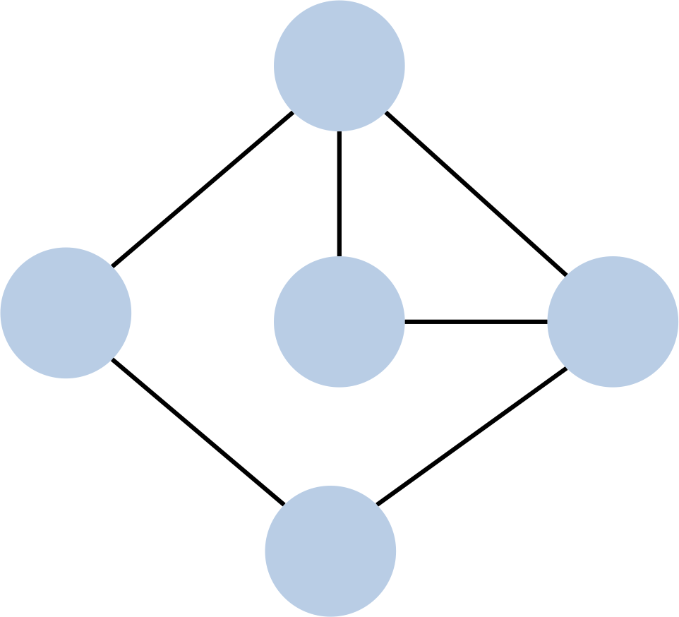
Link-State Routing
Every node has global knowledge of the entire topology and does local route computation using Djikstra’s Algorithm.

Slide 4
Djikstra’s Algorithm
Link-State Routing
1 Initialization:
2 S = {A};
3 for all nodes v
4 if v adjacent to A
5 then D(v) = c(A,v);
6 else D(v) = ;
7
8 Loop
9 find w not in S such that D(w) is a minimum;
10 add w to S;
11 update D(v) for all v adjacent to w and not in S:
12 if D(w) + c(w,v) < D(v) then
// w gives us a shorter path to v than we’ve found so far
13 D(v) = D(w) + c(w,v); p(v) = w;
14 until all nodes in S;
c(i,j): link cost from node i to j
D(v): current cost source → v
p(v): v’s predecessor along path from source to v
S: set of nodes whose least cost path definitively known

Slide 5
Link-State Routing
A
∞
S: set of nodes whose least cost path definitively known
2
7
0+2
1
B
0
C
∞
2
D
∞
Node B
0+5
Dest i | A | C | D | E
1
2
3
4
S
5
3
E
∞

Slide 6
Link-State Routing
A
2
S: set of nodes whose least cost path definitively known
2+7
2
7
1
2+1
B
0
C
∞
2
D
∞
Node B
Dest i | A | C | D | E
1 | (2, B) | ∞ | ∞ | (5, B)
2
3
4
S
BA
0+5
5
3
E
∞

Slide 7
Link-State Routing
A
2
S: set of nodes whose least cost path definitively known
2
7
1
2+7
B
0
C
3
2
D
∞
3+2
Node B
Dest i | A | C | D | E
1 | (2, B) | ∞ | ∞ | (5, B)
2 | (2, B) | (3, A) | (9, A) | (5, B)
3
4
S
BA
BAC
5
0+5
3
E
∞

Slide 8
Link-State Routing
A
2
S: set of nodes whose least cost path definitively known
2
7
1
B
0
C
3
2
D
5
Node B
Dest i | A | C | D | E
1 | (2, B) | ∞ | ∞ | (5, B)
2 | (2, B) | (3, A) | (9, A) | (5, B)
3 | (2, B) | (3, A) | (5, C) | (5, B)
4
S
BA
BAC
BACD
0+5
5+3
5
3
E
∞

Slide 9
Link-State Routing
A
2
S: set of nodes whose least cost path definitively known
2
7
1
B
0
C
3
2
D
5
Node B
Dest i | A | C | D | E
1 | (2, B) | ∞ | ∞ | (5, B)
2 | (2, B) | (3, A) | (9, A) | (5, B)
3 | (2, B) | (3, A) | (5, C) | (5, B)
4 | (2, B) | (3, A) | (5, C) | (5, B)
S
BA
BAC
BACD
BACDE
5
3
E
5

Slide 10
Distance-Vector Routing
B: 2
C: 1
D: 7
A
Every node has local knowledge about its neighbors and does global route computation using Bellman-Ford’s Algorithm.
2
7
1
A: 1
D: 2
A: 7
C: 2
E: 3
B
C
D
A:2
E: 5
2
3
5
E
B: 5
D: 3

Slide 11
Distance-Vector Routing
Node A
Nbr | Cost
A | 0
B | 2
C | 1
D | 7
To From | A | B | C | D
A | 0, A | 2, A | 1, A | 7, A
B | - | 0 | - | -
C | - | - | 0 | -
D | - | - | - | 0
To From | A | B | C | D
A | 0, A | 2, A | 1, A | 3, C
B | - | 0 | - | -
C | 1 | - | 0 | 2
D | - | - | - | 0
A
2
1
7
B
C
2
D
A:1
D:2
3
Node D
5
Nbr | Cost
A | 7
C | 2
D | 0
E | 3
To From | A | C | D | E
A | 0 | - | - | -
C | - | 0 | - | -
D | 7, D | 2, D | 0, D | 3, D
E | - | - | - | 0
To From | A | C | D | E
A | 0 | - | - | -
C | 1 | 0 | 2 | -
D | 3, C | 2, D | 0, D | 3, D
E | - | - | - | 0
E

Slide 12
Distance-Vector Routing
Node B
Nbr | Cost
A | 2
B | 0
E | 5
To From | A | B | E
A | 0 | - | -
B | 2, B | 0, B | 5, B
E | - | - | 0
To From | A | B | C | D | E
A | 0 | 2 | 1 | 3 | -
B | 2, B | 0, B | 3, A | 5, A | 5, B
E | - | - | - | - | 0
B:2
C:1
D:3
A
Node C
2
1
7
Nbr | Cost
A | 1
C | 0
D | 2
To From | A | C | D
A | 0 | - | -
C | 1, C | 0, C | 2, C
D | - | - | 0
To From | A | B | C | D
A | 0 | 2 | 1 | 3
C | 1, C | 3, A | 0, C | 2, C
D | - | - | - | 0
B
C
2
D
Node D
5
3
Nbr | Cost
A | 7
C | 2
D | 0
E | 3
To From | A | C | D | E
A | 0 | - | - | -
C | 1 | 0 | 2 | -
D | 3, C | 2, D | 0, D | 3, D
E | - | - | - | 0
To From | A | B | C | D | E
A | 0 | 2 | 1 | 3 | -
C | 1 | - | 0 | 2 | -
D | 3, C | 9, A | 2, D | 0, D | 3, D
E | - |  | - | - | 0
E

Slide 13
Distance-Vector Routing
Node A
Nbr | Cost
A | 0
B | 2
C | 1
D | 7
To From | A | B | C | D
A | 0, A | 2, A | 1, A | 3, C
B | - | 0 | - | -
C | 1 | - | 0 | 2
D | - | - | - | 0
To From | A | B | C | D | E
A | 0, A | 2, A | 1, A | 3, C | 10, D
B | - | 0 | - | - | -
C | 1 | - | 0 | 2 | -
D | 3 | 9 | 2 | 0 | 3
Node C
A
Nbr | Cost
A | 1
C | 0
D | 2
To From | A | B | C | D
A | 0 | 2 | 1 | 3
C | 1, C | 3, A | 0, C | 2, C
D | - | - | - | 0
To From | A | B | C | D | E
A | 0 | 2 | 1 | 3 | -
C | 1, C | 3, A | 0, C | 2, C | 5, D
D | 3 | 9 | 2 | 0 | 3
2
7
1
B
C
2
D
Node E
5
3
Nbr | Cost
B | 5
D | 3
E | 0
To From | B | D | E
B | 0 | - | -
D | - | 0 | -
E | 5, E | 3, E | 0, E
To From | A | B | C | D | E
B | - | 0 | - | - | -
D | 3 | 9 | 2 | 0 | 3
E | 6, D | 5, E | 5, D | 3, E | 0, E
E
A:3
B:9
C:2
E:3

Slide 14
Count­To­Infinity Problem

Slide 15
Count­To­Infinity Problem
1 -> ∞
A
B
1
C
Nbr | Cost
A | 0
B | 1
To From | A | B | C
A | 0, A | 1, A | 2, B
B | 1 | 0 | 1
Node A
Nbr | Cost
A | 1
B | 0
C | 1
To From | A | B | C
A | 0 | 1 | 2
B | 1, B | 0, B | 1, B
C | 2 | 1 | 0
Nbr | Cost
A | ∞
B | 0
C | 1
To From | A | B | C
B | 3, C | 0, B | 1, B
C | 2 | 1 | 0
To From | A | B | C
B | 5, C | 0, B | 1, B
C | 4 | 1 | 0
Node B
Nbr | Cost
B | 1
C | 0
To From | A | B | C
B | 1 | 0 | 1
C | 2, B | 1, C | 0, C
Nbr | Cost
B | 1
C | 0
To From | A | B | C
B | 3 | 0 | 1
C | 4, B | 1, C | 0, C
……
Node C
Time

Slide 16
Poison Reverse
1 -> ∞
A
B
1
C
Nbr | Cost
A | 0
B | 1
To From | A | B | C
A | 0, A | 1, A | 2, B
B | 1 | 0 | 1
Node A
Nbr | Cost
A | ∞
B | 0
C | 1
Nbr | Cost
A | 1
B | 0
C | 1
To From | A | B | C
A | 0 | 1 | ∞
B | 1, B | 0, B | 1, B
C | ∞ | 1 | 0
To From | A | B | C
B | ∞ | 0, B | 1, B
C | ∞ | 1 | 0
Node B
To From | A | B | C
B | ∞ | 0, B | 1, B
C | ∞ | 1 | 0
Nbr | Cost
B | 1
C | 0
To From | A | B | C
B | 1 | 0 | 1
C | 2, B | 1, C | 0, C
Nbr | Cost
B | 1
C | 0
To From | A | B | C
B | ∞ | 0 | 1
C | ∞ | 1, C | 0, C
Node C
Time

