Slide 1
TCP
CS 168 Discussion
Week 6
Many thanks to past EE 122 GSIs

Slide 2
These are TCP Details!
These details ARE NOT representative of all sliding window protocols!

Slide 3
TCP Sequence Numbers
Initial sequence number not necessary 0
Sequence number refers to first byte in TCP payload
e.g.
Initial Sequence Number = N
Packet with payload bytes 100 – 1000 has seq. no.
N + 100

Slide 4
TCP Acknowledgements
ACK Number = Next expected byte
ACK for Sequence Number 1000, payload size 500?
1500 (packet has bytes 1000,1001…,1499)
Cumulative ACKs

Slide 5
TCP Flow Control
Keep sender from overwhelming receiver
Window Size: Maximum number of bytes a receiver can accept
Doesn’t say anything about whether the network is overwhelmed…

Slide 6
Congestion Control
Avoid overwhelming the network
CWND – Congestion Window maintained at sender
SSTHRESH – Threshold until which exponential slow start happens
How much can a sender send?
MIN(CWND, Receiver Window Size)

Slide 7
Congestion Control: States
TCP in slow start or “Additive Increase, Multiplicative Decrease (AIMD)”
Slow Start: For Each ACK: CWND += MSS
AIMD: For Each Window: CWND += MSS

Slide 8
Congestion Control: Loss
Triple Duplicate ACK: Indicates single packet loss
Retransmit single packet
SSTHRESH = CWND/ 2
CWND = SSTHRESH
Timeout: Indicates congestion
SSTHRESH = CWND/ 2
CWND = 1

Slide 10
Worksheet!

Slide 11
Question 1: TCP Sequence Numbers
a)
Lowest: 10001 (first un-ACKed byte)
Highest: 15000 (first un-ACKed byte + window size)
b) 1501 (Sequence Number + Payload Size)
c)
Lowest: 1501
Highest: 1550
d) No – A sends MIN(CWND, Window)!

Slide 12
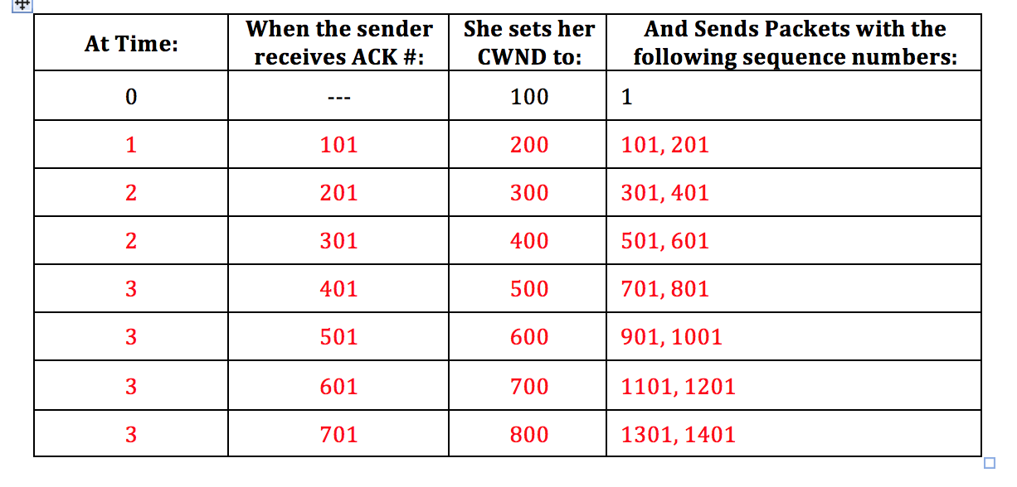
Question 2a

Slide 13
Question 2b,c
Exponential!

Slide 14
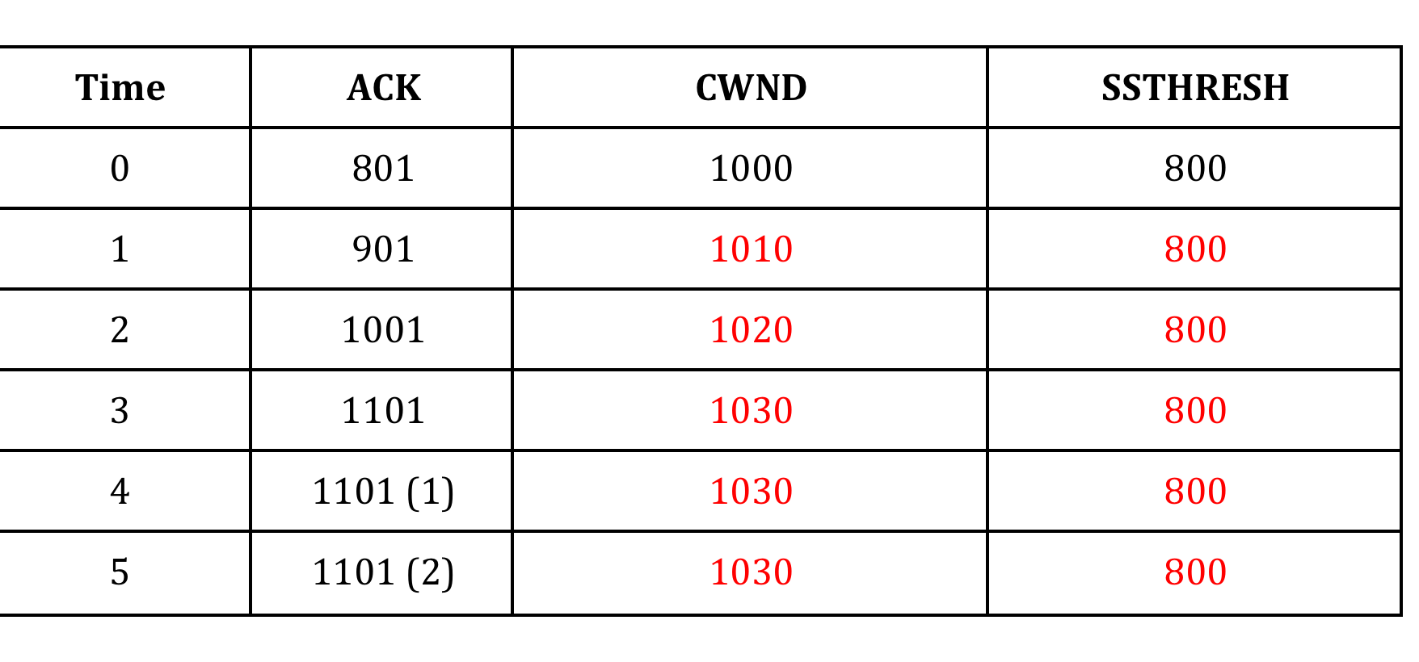
Question 3a

Slide 15
Question 3b,c
3b) Isolated Packet Loss
3c) Linear

Slide 16
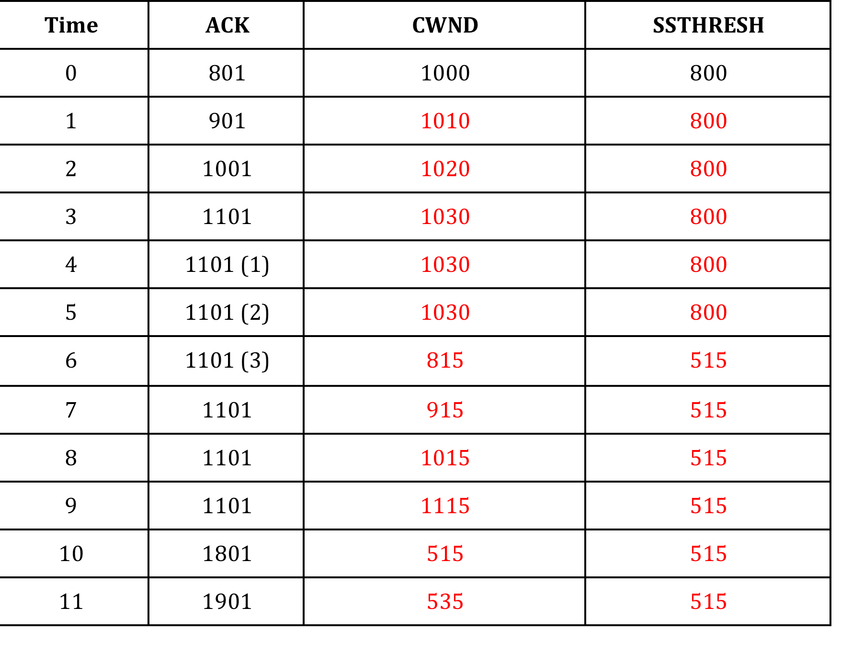
Question 3d

Slide 17
Question 3e,f
3e) Congestion in the Network
3f) No need to throttle traffic aggressively for single packet drop. When congested: need to slow down!

Slide 18
Question 4: Analyzing the TCP Congestion Window
a) 1-6, 22-25
b) 6-14, 15-21
c) Triple Duplicate ACK
d) 32
e) 20
f) 12
g)
SSTHRESH = CWND / 2 = 8 / 2 = 4
CWND = CWND / 2 = 4

