Slide 1
Wireless – there is no cat!
"You see, wire telegraph is a kind of a very, very long cat. You pull his tail in New York and his head is meowing in Los Angeles. And radio operates exactly the same way… The only difference is that there is no cat.“
Albert Einstein,
when asked to describe radio.
Yahel Ben-David
Yahel @ DeNovoGroup.Org
EE 122: Communication Networks
Materials with thanks to Scott Shenker, Jennifer Rexford, Ion Stoica, Vern Paxson and other colleagues at Princeton and UC Berkeley

Slide 2
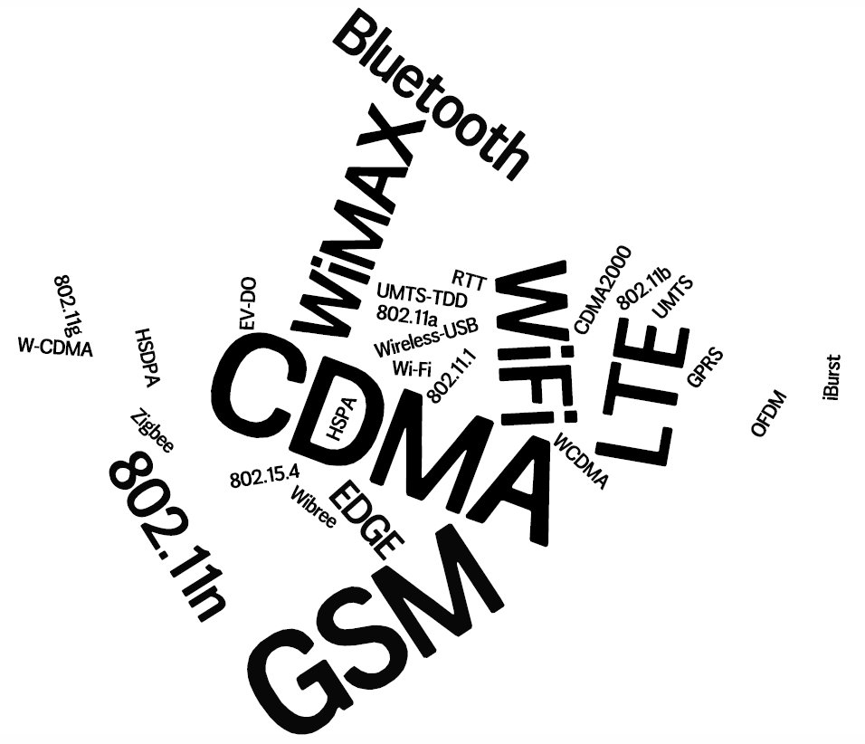
Notes:
Rapid evolution in the wireless eco-system – hard to keep up.
Both technologies and business-models

Slide 3
Metrics for evaluation / comparison of wireless technologies
Bitrate or Bandwidth
Range - PAN, LAN, MAN, WAN
Stationary / Mobile
Two-way / One-way
Digital / Analog
Multi-Access / Point-to-Point
Applications and industries
Operating environment
Frequency - Wavelength
Notes:
Bitrate or Bandwidth (not the same thing, but similar enough)
Range - PAN, LAN, MAN, WAN (lose definitions, no actual distances).
Two-way / One-way
Multi-Access / Point-to-Point (example for p2p – Microwave link – others?)
Digital / Analog (examples for analog – TV/Radio broadcast, police/EMS walkie-talkies)…
Applications and industries (military, commercial, medical, transportation, etc…)
Environments – outdoors/indoors, industrial, rural/urban, mountainous / flat-lands , etc..
Frequency – Affects most physical properties:

Slide 4
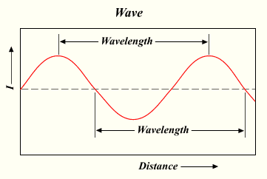
Frequency/Wave-Length –
Frequency: the number of cycles per second.
Wavelength: the length of each cycle(in meters).
Affects most physical properties: Distance (free-space loss) Penetration, Reflection, Absorption Size of antenna Energy proportionality
Policy & law: Licensed / Deregulated
Notes:
Frequency is the number of cycles per second.
Wavelength is the length of each cycle (in meters).
Energy proportionality – how much electrical power is needed for a given radio power….

Slide 5
Todo:
Graph: Evolution of wireless communication – bit-rates over time
Notes:
Evolution of wireless communication – bit-rates over time

Slide 6
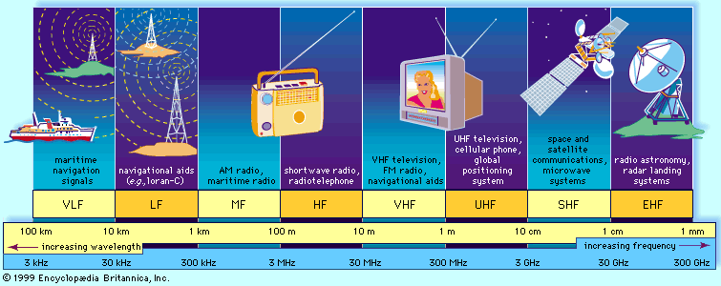
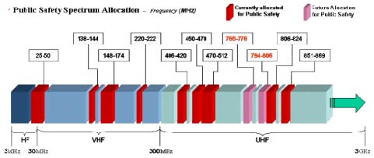
The Wireless Spectrum
Notes:
FCC allocates spectrum to users – who are these?
Govt. itself (various agencies), military, Public-safety.
Broadcasters
Telecommunications providers (aka operators) – license holders.
Different bands behave differently …
Most wave propagation properties are frequency/wave-length dependent:

Slide 7
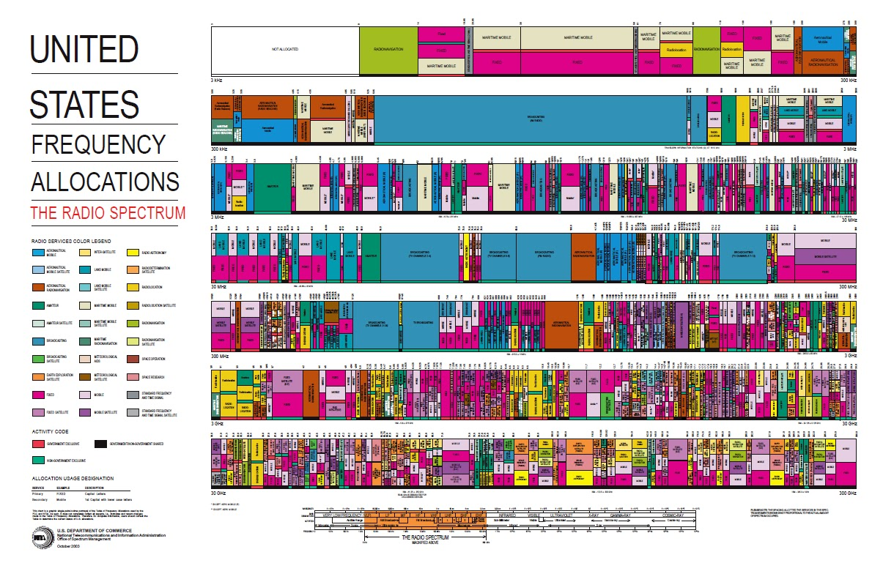
United States Frequency Allocations

Slide 8
The wireless spectrum
Allocated to license holders.
Occasionally (rarely) a chunk gets auctioned – for billions of dollars.
Q: Is spectrum a scarce resource?
Reclaim spectrum from old analog broadcasters.
White-spaces / Cognitive radios.
Tiered use policy.
Enable roaming (technically and commercially).
Notes:
Allocated to license holders.
Occasionally (rarely) a chunk gets auctioned – for billions of dollars.
Show of hands - Is spectrum a scarce resource?
Reclaim spectrum from old analog broadcasters.
White-spaces / Cognitive radios
Tiered use policy
Enable roaming (technically and commercially).

Slide 9
Old mess!
Notes:
Allocated to license holders.
Occasionally (rarely) a chunk gets auctioned – for billions of dollars.
Show of hands - Is spectrum a scarce resource?
Reclaim spectrum from old analog broadcasters.
White-spaces / Cognitive radios
Tiered use policy
Enable roaming (technically and commercially).

Slide 10
Common Wireless Standards
Cellular (Typically 800/900/1800/1900Mhz):
2G: GSM / GPRS /EDGE / CDMA / CDMA2000/
3G: UMTS/HSDPA/EVDO
4G: LTE, WiMax
IEEE 802.11 (aka WiFi):
b: 2.4Ghz band, 11Mbps (~4.5 Mbps operating rate)
g: 2.4Ghz, 54-108Mbps (~19 Mbps operating rate)
a: 5Ghz band, 54-108Mbps (~19 Mbps operating rate)
n: 2.4/5Ghz, 150-600Mbps (4x4 mimo).
ac: 2.4/5Ghz, >1Gbps (4x4 mimo) (wide channels).
IEEE 802.15 – lower power wireless:
802.15.1: 2.4Ghz, 2.1 Mbps (Bluetooth)
802.15.4: 2.4Ghz, 250 Kbps (Sensor Networks)
10

Slide 11
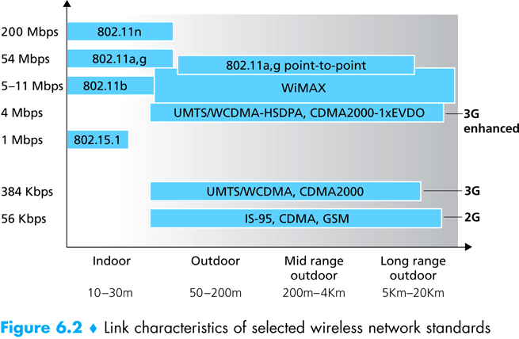
Wireless Link Characteristics
(Figure Courtesy of Kurose and Ross)
11
Notes:
Naturally – there exist technologies for longer distances…
Also – we already have affordable off-the-shelf gear for gigabit+ speeds…
Why not use any of the outdoors technologies also indoors – surely it would work…?
802.11n can do much faster today – 600Mbps (4x4 MIMO)…

Slide 12
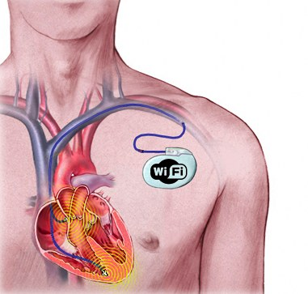
WTF?

Slide 13
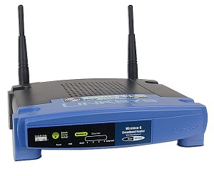
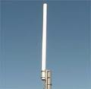
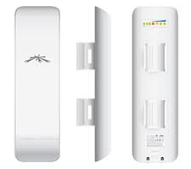
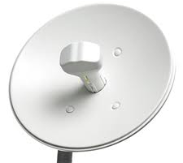
Antennas / Aerials
An electrical device which converts electric currents into radio waves, and vice versa.
Gain: 2-3dB 8-12dB 15-18dB 28-34dB
Q: What does “higher-gain antenna” mean?
A: Antennas are passive devices – more gain means focused and more directional. Directionality means more energy gets to where it needs to go and less interference everywhere.
Q: What are omni-directional antennas?

Slide 14
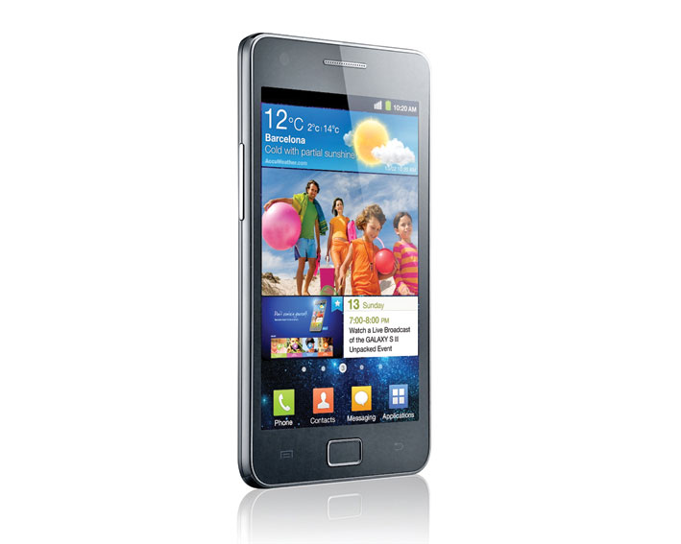
How many radios/antennas ?
WiFi 802.11n - 2.4 & 5Ghz (MiMo?)
2G – GSM “Quad band” 800/900 & 1800/1900mhz
3G – HSDPA+
4G – LTE
Bluetooth
NFC
GPS Receiver
FM-Radio receiver (antenna is the headphones cable)

Slide 15
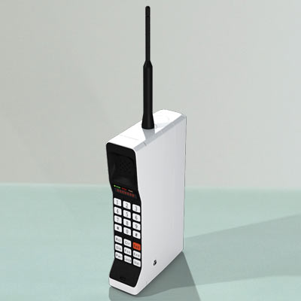
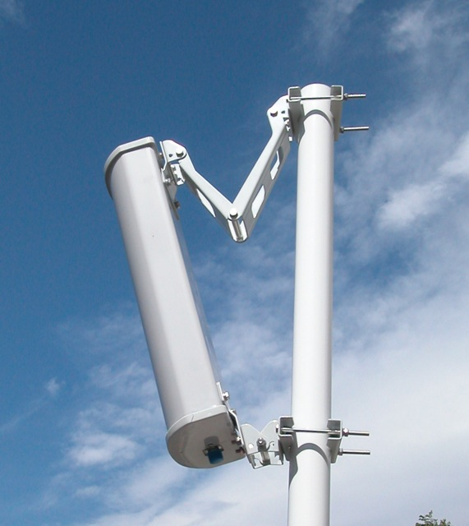
What has changed?
Notes:
I used to make calls from 40 miles away – not anymore…
Cellular towers climbed down from the mountain-tops in attempt to reduce/contain their footprint.
Antenna is bigger (a plus only if upright).
Power (and therefore battery) is higher.
Band 800Mhz AMPS.

Slide 16
What Makes Wireless Different?
Broadcast medium… - Anybody in proximity can hear and interfere
Cannot receive while transmitting… - Our own (or nearby) transmission is deafening our receiver
Signals sent by sender don’t always end up at receiver intact
Complicated physics involved, which we won’t discuss
But what can go wrong?
Notes:
Broadcast – anybody in proximity can hear and interfere (assuming the same channel)
Half-duplex: Not an engineering problem – but a fundamental physics that our strong transmission is deafening to our receiver.
Solve by different channels/bands for RX/TX

Slide 17
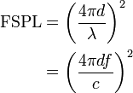
Path Loss / Path Attenuation
Free Space Path Loss:
d = distance
λ = wave length
f = frequency
c = speed of light
Reflection, Diffraction, Absorption
Terrain contours (Urban, Rural, Vegetation).
Humidity
Notes:
reduction in power density (attenuation) of an electromagnetic wave as it propagates through space.
Path loss may be due to many effects, such as free-space loss,refraction, diffraction, reflection, aperture-medium coupling loss, and absorption. Path loss is also influenced by terrain contours, environment (urban or rural, vegetation and foliage), propagation medium (dry or moist air), the distance between the transmitter and the receiver, and the height and location of antennas.

Slide 18
Multipath Effects
Ceiling
S
R
Floor
Signals bounce off surface and interfere with one another
Self-interference
18

Slide 19
Ideal Radios
(courtesy of Gilman Tolle and Jonathan Hui, ArchRock)

Slide 20
Real Radios (courtesy of Gilman Tolle and Jonathan Hui, ArchRock)

Slide 21
The Amoeboed “cell” (courtesy of David Culler, UCB)
Signal
Noise
Distance
21
Notes:
21

Slide 22
Wireless Bit Errors
The lower the SNR (Signal/Noise) the higher the Bit Error Rate (We could make the signal stronger…
Why is this not always a good idea?
Increased signal strength requires more power
Increases the interference range of the sender, so you interfere with more nodes around you
And then they increase their power…….
How would TCP behave in face of losses?
Local link-layer Error Correction schemes can correct some problems (should be TCP aware).
22

Slide 23
Bitrate (aka data-rate)
The higher the SNR (Signal to Noise Ratio) –
the higher the (theoretical) bitrate.
Modern radios use adaptive /dynamic bitrates.
Q: In face of loss, should we decrease or increase the bitrate?
A: If caused by free-space loss or multi-path fading -lower the bitrate.
If external interference - often higher bitrates (shorter bursts) are probabilistically better.

Slide 24
Interference from Other Sources
External Interference
Microwave oven is turned on and blocks your signal
Would that affect the sender or the receiver?
Internal Interference
Nodes (of the same network) within range of each other collide with one another’s transmission
We have to tolerate external interference and path loss, multipath, etc. but we can avoid internal interference!

Slide 25
802.11
aka - WiFi …
What makes it special?
Deregulation > Innovation > Adoption > Lower cost = Ubiquitous technology
25
Notes:
25

Slide 26
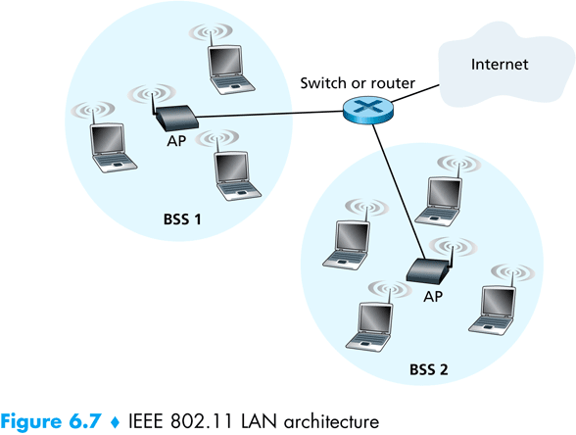
802.11 Architecture
Designed for limited area
AP’s (Access Points) set to specific channel
Broadcast beacon messages with SSID (Service Set Identifier) and MAC Address periodically
Hosts scan all the channels to discover the AP’s
Host associates with AP
802.11 frames exchanges
802.3 (Ethernet) frames exchanged
26

Slide 27
Wireless Multiple Access Technique
Collision Detection-
Where do collisions occur?
How can you detect them?
Carrier Sense-
Sender can listen before sending
What does that tell the sender?
Q: What’s the relation between propagation delay and probability of collision?
Notes:
With CS – what’s the relation between propagation delay and probability of collision?

Slide 28
Hidden Terminals
A and C can both send to B but can’t hear each other
A is a hidden terminal for C and vice versa
Carrier Sense will be ineffective
A
B
C
transmit range
28
Notes:
28

Slide 29
Exposed Terminals
Exposed node: B sends a packet to A; C hears this and decides not to send a packet to D (despite the fact that this will not cause interference)!
Carrier sense would prevent a successful transmission.
A
B
C
D
29
Notes:
29
Can both B send to A and C send to D at the same time? Yes! – no problem with that… however CS prevents such transmission … exposed node…

Slide 30
5 Minute Break
30
Notes:
30

Slide 31
Key Points
No concept of a global collision
Different receivers hear different signals
Different senders reach different receivers
Collisions are at receiver, not sender
Only care if receiver can hear the sender clearly
It does not matter if sender can hear someone else
As long as that signal does not interfere with receiver
Goal of protocol:
Detect if receiver can hear sender
Tell senders who might interfere with receiver to shut up

Slide 32
Basic Collision Avoidance
Since can’t detect collisions, we try to avoid them
Carrier sense:
When medium busy, choose random interval
Wait that many idle timeslots to pass before sending
When a collision is inferred, retransmit with binary exponential backoff (like Ethernet)
Use ACK from receiver to infer “no collision”
Use exponential backoff to adapt contention window
Notes:
Why do we wait?
Why not just send right away as medium becomes clear?

Slide 33
CSMA/CA - Collision Avoidance
sender
receiver
other node in
sender’s range
RTS
CTS
data
ACK
Before every data transmission
Sender sends a Request to Send (RTS) frame containing the length of the transmission, and the destination.
Receiver respond with a Clear to Send (CTS) frame
Sender sends data
Receiver sends an ACK; now another sender can send data
When sender doesn’t get a CTS back, it assumes collision
33
Notes:
33

Slide 34
CSMA/CA - Collision Avoidance
receiver
other node in
sender’s range
sender
RTS
CTS
data
data
If other nodes hear RTS, but not CTS: send
Presumably, destination for first sender is out of node’s range …
34
Notes:
34

Slide 35
CSMA/CA -MA with Collision Avoidance
sender
receiver
other node in
sender’s range
RTS
CTS
data
ACK
If other nodes hear RTS, but not CTS: send
Presumably, destination for first sender is out of node’s range …
… Can cause problems when a CTS is lost
When you hear a CTS, you keep quiet until scheduled transmission is over (hear ACK)
35
Notes:
35

Slide 36
RTS / CTS Protocols (CSMA/CA)
B sends to C
RTS
A
B
C
D
Overcome hidden terminal problems with contention-free protocol
B sends to C Request To Send (RTS)
A hears RTS and defers (to allow C to answer)
C replies to B with Clear To Send (CTS)
D hears CTS and defers to allow the data
B sends to C
CTS
36
Notes:
36
Does not solve the exposed terminal problem.
High overhead and especially increase latency.
assumes symmetric signal qualities - if node A hears node B - than also node B hears node A. - not always the case. (Especially local interference at receiver).

Slide 37
Channelization of spectrum
Typically, available frequency spectrum is split into multiple channels
Some channels may overlap
3 channels
8 channels
4 channels
26 MHz
100 MHz
200 MHz
150 MHz
915 MHz
2.45 GHz
5.25 GHz
5.8 GHz
250 MHz
500 MHz
1000 MHz
24.125 GHz
61.25 GHz
122.5 GHz
37
Notes:
37

Slide 38
Preventing Collisions Altogether
Frequency Spectrum partitioned into several channels
Nodes within interference range can use separate channels
Now A and C can send without any interference!
Aggregate Network throughput doubles
B
A
C
D
38

Slide 39
Using Multiple Channels
802.11: AP’s on different channels
Usually manually configured by administrator
Automatic Configuration may cause problems
Most cards have only 1 transceiver
Not Full Duplex: Cannot send and receive at the same time
Multichannel MAC Protocols
Automatically have nodes negotiate channels
Channel coordination amongst nodes is necessary
Introduces negotiation and channel-switching latency that reduce throughput
39

Slide 40
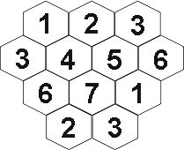
Preventing Collisions Altogether
Partition space into non-overlapping cells.
40

Slide 41
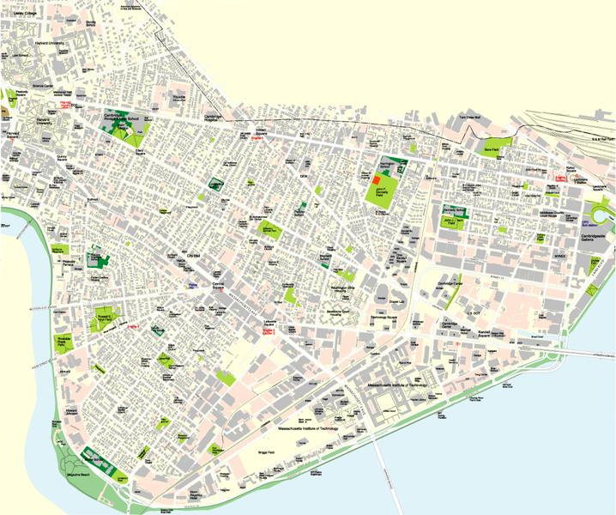
Large Multihop Network (courtesy of Sanjit Biswas, MIT)
1 kilometer

Slide 42
Multi-Hop Wireless Ad Hoc Networks
S
A
C
B
D
R
Courtesy of Tianbo Kuang and Carey Williamson University of Calgary)
Notes:
Maybe can be self-healing !
Maybe can be multipath?

Slide 43
Multi-Hop Wireless Ad Hoc Networks
S
A
C
B
D
R
43

Slide 44
Multi-Hop Wireless Ad Hoc Networks
1
2
3
4
S
5
6
7
8
9
10
11
12
A
C
B
D
R
(Assume ideal world…)
44

Slide 45
Multi-Hop Wireless Ad Hoc Networks
2
3
4
S
5
6
1
7
8
9
10
11
12
A
C
B
D
R
45

Slide 46
Multi-Hop Wireless Ad Hoc Networks
3
4
S
5
2
6
7
8
9
10
11
1
12
A
C
B
D
R
46

Slide 47
Multi-Hop Wireless Ad Hoc Networks
4
S
5
6
3
7
8
9
10
1
11
2
12
A
C
B
D
R
47

Slide 48
Multi-Hop Wireless Ad Hoc Networks
5
S
6
4
7
8
9
10
2
11
3
1
12
A
C
B
D
R
48

Slide 49
Multi-Hop Wireless Ad Hoc Networks
S
6
5
7
8
9
10
11
3
12
A
4
C
2
B
D
1
R
49

Slide 50
Multi-Hop Wireless Ad Hoc Networks
S
6
7
8
9
10
11
4
3
12
A
5
C
B
D
2
1
R
50

Slide 51
Multi-Hop Wireless Ad Hoc Networks
S
7
8
9
10
11
5
12
A
6
C
4
B
D
3
1
2
R
51

Slide 52
Multi-Hop Wireless Ad Hoc Networks
S
8
9
10
11
6
12
A
7
C
5
B
D
4
1
2
3
R
52

Slide 53
Multi-Hop Wireless Ad Hoc Networks
S
9
10
11
7
12
A
8
C
6
B
D
5
1
2
3
4
R
53

Slide 54
Multi-Hop Wireless Ad Hoc Networks
S
10
11
8
12
A
9
C
7
B
D
6
1
2
3
4
R
5
54

Slide 55
Multi-Hop Wireless Ad Hoc Networks
S
11
12
9
8
A
10
C
B
D
7
1
2
3
4
R
5
6
55

Slide 56
Multi-Hop Wireless Ad Hoc Networks
S
12
10
A
11
C
9
B
D
8
1
2
3
4
R
5
6
7
56

Slide 57
Multi-Hop Wireless Ad Hoc Networks
S
11
10
A
12
C
B
D
9
1
2
3
4
R
5
6
7
8
57

Slide 58
Multi-Hop Wireless Ad Hoc Networks
S
12
11
A
C
B
D
10
1
2
3
4
R
5
6
7
8
9
58

Slide 59
Multi-Hop Wireless Ad Hoc Networks
S
A
C
12
B
D
11
1
2
3
4
R
5
6
7
8
9
10
59

Slide 60
Multi-Hop Wireless Ad Hoc Networks
S
A
C
B
D
12
1
2
3
4
R
5
6
7
8
9
10
11
60

Slide 61
Multi-Hop Wireless Ad Hoc Networks
S
A
C
B
D
1
2
3
4
R
5
6
7
8
9
10
11
61
12

Slide 62
Wireless Multihop Networks
Vehicular Networks
Delay Tolerant (batch) sending over several hops carry data to a base station
Common in Sensor Network for periodically transmitting data
Infrastructure Monitoring
E.g., structural health monitoring of the Golden Gate Bridge

Slide 63
The end of phone companies & ISPs?
Self healing
Multipath routing
S
A
C
B
D
R
63

Slide 64
What Do YOU Think Really Happens?

Slide 65
Multi-Hop Wireless Ad Hoc Networks
(Reality check…)
1
Problem 1: node A can’t use both
of these links at the same time
- shared wireless channel
- transmit or receive, but not both
2
3
4
S
5
6
7
8
9
10
11
12
A
C
B
D
Relays needs to “Store and Forward”.
R
65

Slide 66
Multi-Hop Wireless Ad Hoc Networks
Problem 2: S and B can’t use both
of these links at same time
- range overlap at A
1
2
3
4
S
5
6
7
8
9
10
11
12
A
C
B
D
R
66

Slide 67
Multi-Hop Wireless Ad Hoc Networks
Problem 3: LOTS of contention for the channel
- in steady state, all want to send
- need RTS/CTS to resolve contention
1
2
3
4
S
5
6
7
8
9
10
11
12
A
C
B
D
RTS: Request-To-Send
CTS: Clear-To-Send
R
67

Slide 68
Multi-Hop Wireless Ad Hoc Networks
1
RTS
CTS
2
3
4
S
5
6
7
8
9
10
11
12
A
C
B
D
R
68

Slide 69
Multi-Hop Wireless Ad Hoc Networks
2
3
4
S
5
6
1
7
8
9
10
11
12
A
C
B
D
R
69

Slide 70
Multi-Hop Wireless Ad Hoc Networks
2
RTS
CTS
3
4
S
5
6
7
8
9
10
11
12
A
C
1
B
D
R
70

Slide 71
Multi-Hop Wireless Ad Hoc Networks
2
3
4
S
5
6
7
8
9
10
11
12
A
1
C
B
D
R
71

Slide 72
Multi-Hop Wireless Ad Hoc Networks
2
3
4
S
5
6
7
8
9
10
11
1
12
A
C
B
D
R
72

Slide 73
Multi-Hop Wireless Ad Hoc Networks
3
4
S
5
6
2
7
8
9
10
11
12
A
C
1
B
D
R
73

Slide 74
Multi-Hop Wireless Ad Hoc Networks
3
4
S
5
6
7
8
9
10
11
12
A
2
C
B
D
1
R
74

Slide 75
Multi-Hop Wireless Ad Hoc Networks
3
4
S
5
6
7
8
9
10
11
2
12
A
C
B
D
1
R
75

Slide 76
Multi-Hop Wireless Ad Hoc Networks
4
S
5
6
3
7
8
9
10
11
12
A
C
2
B
D
1
R
76

Slide 77
Multi-Hop Wireless Ad Hoc Networks
4
S
5
6
7
8
9
10
11
12
A
3
C
B
D
2
1
R
77

Slide 78
Multi-Hop Wireless Ad Hoc Networks
4
S
5
6
7
8
9
10
11
3
12
A
C
B
D
1
2
R
78

Slide 79
Multi-Hop Wireless Ad Hoc Networks
5
S
6
4
7
8
9
10
11
12
A
C
3
B
D
1
2
R
79

Slide 80
Multi-Hop Wireless Ad Hoc Networks
5
S
6
7
8
9
10
11
12
A
4
C
B
D
3
1
2
R
80

Slide 81
Multi-Hop Wireless Ad Hoc Networks
5
S
6
7
8
9
10
11
4
12
A
C
B
D
1
2
3
R
81

Slide 82
Multi-Hop Wireless Ad Hoc Networks
Problem 4: TCP uses ACKS to
indicate reliable data delivery
- bidirectional traffic (DATA, ACKS)
- even more contention!!!
1
2
3
4
S
5
6
7
8
9
10
11
12
A
C
B
D
R
82

Slide 83
Multi-Hop Wireless Ad Hoc Networks
2
3
4
S
5
6
1
7
8
9
10
11
12
A
C
B
D
R
83

Slide 84
Multi-Hop Wireless Ad Hoc Networks
2
3
4
S
5
6
7
8
9
10
11
12
A
1
C
B
D
R
84

Slide 85
Multi-Hop Wireless Ad Hoc Networks
2
3
4
S
5
6
7
8
9
10
11
1
12
A
C
B
D
R
85

Slide 86
Multi-Hop Wireless Ad Hoc Networks
3
4
S
5
6
2
7
8
9
10
11
12
A
C
1
B
D
R
86

Slide 87
Multi-Hop Wireless Ad Hoc Networks
3
4
S
5
6
7
8
9
10
11
12
A
2
C
B
D
1
R
87

Slide 88
Multi-Hop Wireless Ad Hoc Networks
3
4
S
5
6
7
2
8
9
10
11
2
1
12
A
C
B
2
D
1
1
1
R
88

Slide 89
Multi-Hop Wireless Ad Hoc Networks
4
S
5
6
3
7
8
9
10
11
1
12
A
C
2
B
D
1
R
89

Slide 90
Multi-Hop Wireless Ad Hoc Networks
4
S
5
6
7
8
9
10
11
1
12
A
C
3
B
D
2
1
R
90

Slide 91
Multi-Hop Wireless Ad Hoc Networks
4
S
5
6
7
8
9
10
11
12
A
C
1
3
B
D
2
1
R
91

Slide 92
Multi-Hop Wireless Ad Hoc Networks
4
S
5
6
7
8
1
9
10
11
12
A
C
3
B
D
2
1
R
92

Slide 93
Multi-Hop Wireless Ad Hoc Networks
4
S
5
6
7
8
1
9
10
11
12
A
3
C
B
D
2
1
R
93

Slide 94
Multi-Hop Wireless Ad Hoc Networks
4
S
5
6
7
8
1
9
10
11
12
A
C
B
3
D
2
1
2
R
94

Slide 95
Lesson
Multi-hop wireless is hard to make efficient
Store and forward
Halves the bandwidth for every hop.
Doubles the latency for every hop.
Increases Interference.
Horrible idea for Internet access.
Even worse for interactive applications (such as video-conferencing).

Slide 96
Summary
Wireless is a tricky beast
Distributed multiple access problem
Hidden terminals
Exposed terminals
Current protocols sufficient, given overprovisioning
Multihop even more complicated

Slide 97
Bridging the gap between research and impact
Connecting the next billion, and keeping the Internet free an uncensored.
WWW. DeNovoGroup.Org
And
WWW.FurtherReach.Net

Slide 98
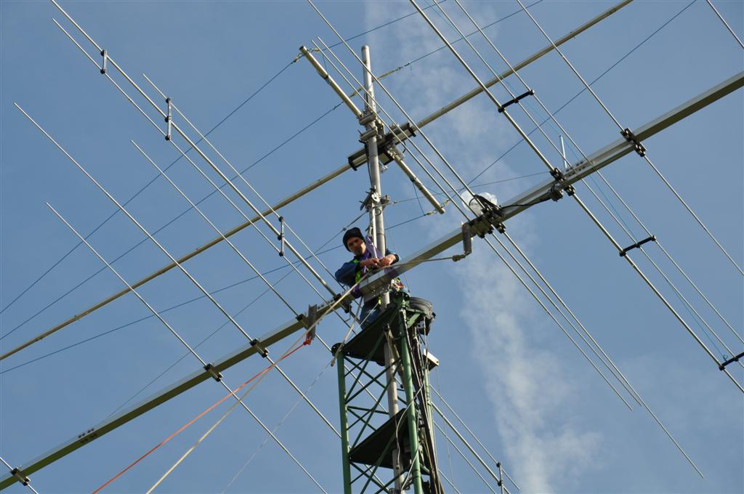
Amateur radio (aka Ham Radio)
UC-Berkeley Amateur Radio Club - W6BB
Entryway into the world of wireless…
Yahel @ EECS.Berkeley.Edu
Callsign: KK6GEN
Notes:
Who heard of Amateur radio?
Who is a licensed operator?

Slide 99
Questions ?
- Thank you -
Yahel @ EECS.Berkeley.Edu
Callsign: KK6GEN

