Slide 1
Project 3b
Stateless, Passive Firewall
(3a)
Stateful, Active Firewall
(3b)
Notes:
In the first part of project 3, you designed a stateless, passive firewall. In this part, you will extend your firewall to make stateful and active.

Slide 2
What stays…
Same framework
Same VM
Same test harness
Same tools
Same basic firewall behavior
Notes:
Most of what you’ve got used to in the first part of the project won’t change – including the framework, VM, test harness, tools and basic firewall behavior.

Slide 3
What’s new?
Three new rules:
deny tcp <IP address> <port>
deny dns <domain name>
log http <host name>
Notes:
In this part, you will implement three new rules.

Slide 4

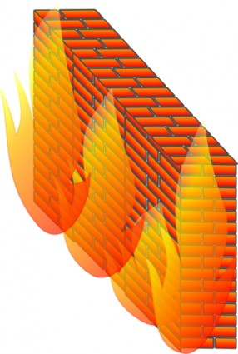

Active!
deny tcp <IP address> <port>
SYN
RST
Client
Server
Notes:
For the first kind of rule, you have to explicitly deny TCP connection requests from a specified client IP-port pair.
On intercepting a SYN packet from such a source, your firewall must not only drop the packet, but respond with a RST packet so that the client doesn’t keep trying to connect.

Slide 5
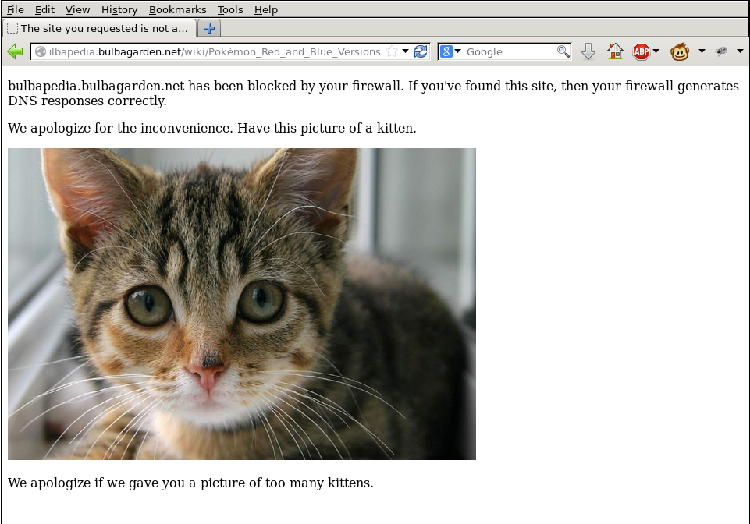
Even more active!
deny dns <domain name>
DNS Reqest
int
ext
DNS Response to
54.173.224.150

Slide 6
Stateful!
log http <host name>
Log HTTP transactions
  Request/Response pair
log http *.berkeley.edu
www-inst.eecs.berkeley.edu GET /~cs168/fa14/ HTTP/1.1 301 254
www-inst.eecs.berkeley.edu GET /~cs168/fa14/ HTTP/1.1 200 273
www-inst.eecs.berkeley.edu GET /favicon.ico HTTP/1.1 200 0
...

Slide 7
Stateful!
Handle:
  segmented TCP packets
  headers spanning multiple packets
  packet drops/re-orderings
  and more… (read project spec!)
My advice?
  Start early

Slide 8
What we won’t check…
Firewall rules from 3a
Country-based matching
Takeaway?
Don’t worry too much if your solution for 3a wasn’t complete
  But make sure the solution to this one is!
Notes:
We won’t check the most of what you were supposed to do in 3a, including the old firewall rules and country based matching.
This makes sure the grading for 3b is decoupled from the grading for 3a.
Don’t worry too much if your solution to 3a was incomplete, but ensure you complete this one.

Slide 9
NO CHEATING
WE RUN COPY CHECKER
Notes:
The final reminder: please do not copy codes from others, we will run copy checker for every submission.

Slide 10
Logistics
GSIs:
  Anurag, Shoumik and Sangjin
Additional OH:
  Will be announced on Piazza
Slides, specs (code framework same as 3a):
  Online midnight today
Due:
  At noon on Dec 3rd
Notes:
The project spec and code should be online by the end of today.
This project is led by Shoumik, Sangjin, and me.
If you have general questions about protocols, packet formats, etc., you can talk to any GSI.
But if you have more specific questions, please ask one of us.

Slide 11
Datacenters (part 2)
CS 168, Fall 2014
Sylvia Ratnasamy
http://inst.eecs.berkeley.edu/~cs168/

Slide 12
What you need to know
Characteristics of a datacenter environment
  goals, constraints, workloads, etc.
How and why DC networks are different (vs. WAN)
  e.g., latency, geo, autonomy, …
How traditional solutions fare in this environment
  E.g., IP, Ethernet, TCP, DHCP, ARP
Specific design approaches

Slide 13
Recap: Last Lecture
Key requirements
  High “bisection bandwidth”
  Low latency, even in the worst-case
  Large scale
  Low cost

Slide 14
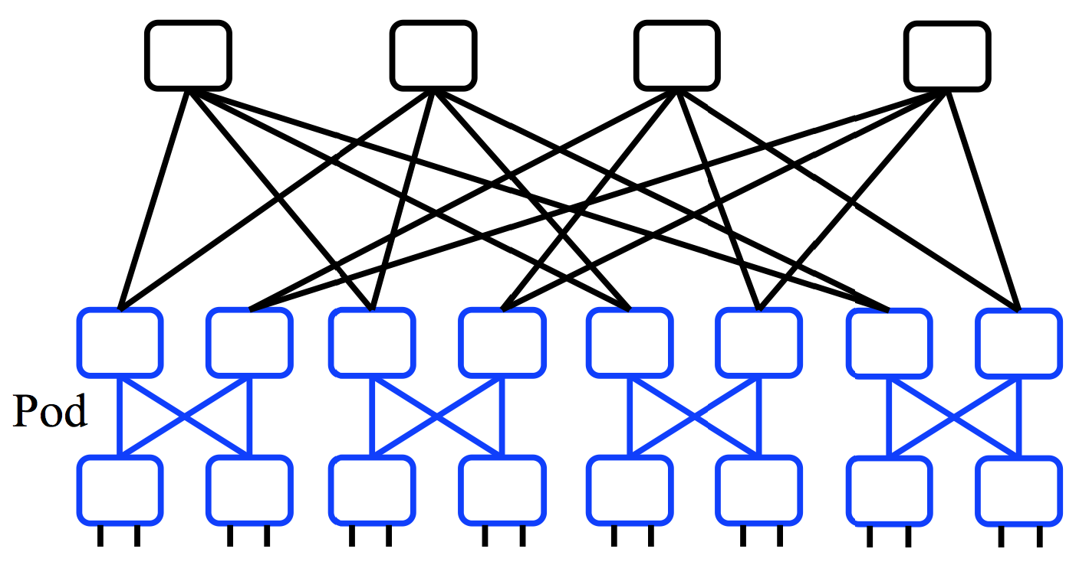
Recap: High bisection BW topology
E.g., `Clos’ topology
  Multi-stage network
  All switches have k ports
  k/2 ports up, k/2 down
All links have same speed
“scale out” approach

Slide 15
E.g., “Fat Tree” Topology [Sigcomm’08]
Notes:
Few things to notice:
3 stages (can think of as edge / aggregation / core)
All switches have same number of ports (=4) [hence k^3/4=16 end hosts]
All links have same speed
Many paths

Slide 16
Questions for today
L2/L3 design:
  addressing / routing / forwarding in the Fat-Tree
L4 design:
  Transport protocol design (w/ Fat-Tree)

Slide 17
Using multiple paths well

Slide 18
Questions for today
L2/L3 design:
  addressing / routing / forwarding in the Fat-Tree
Goals:
  Routing protocol must expose all available paths
  Forwarding must spread traffic evenly over all paths

Slide 19
Extend DV / LS ?
Routing
  Distance-Vector: Remember all next-hops that advertise equal cost to a destination
  Link-State: Extend Dijkstra’s to compute all equal cost shortest paths to each destination
Forwarding: how to spread traffic across next hops?

Slide 20
Forwarding
to D
to D
to D
from A
(to D)
from B
(to D)
from C
(to D)
Per-packet load balancing

Slide 21
Forwarding
to D
to D
to D
from A
(to D)
from B
(to D)
from C
(to D)
Per-packet load balancing
  + traffic well spread (even w/ elephant flows)
  − Interacts badly w/ TCP

Slide 22
TCP w/ per-packet load balancing
Consider:
  sender sends seq#: 1,2,3,4,5
  receiver receives: 5,4,3,2,1
  sender will enter fast retx, reduce CWND, retx #1, …
  repeatedly!
Also: one RTT and timeout estimator for multiple paths
Also: CWND halved when a packet is dropped on any path
Multipath TCP (MP-TCP) is an ongoing effort to extend TCP to coexist with multipath routing
  Value beyond datacenters (e.g., spread traffic across wifi and 4G access)

Slide 23
Forwarding
to D
to D
to D
from A
(to D)
from B
(to D)
from C
(to D)
  Per-flow load balancing (ECMP, “Equal Cost Multi Path”)
  E.g., based on HASH(source-addr, dst-addr, source-port, dst-port)

Slide 24
Forwarding
to D
to D
to D
from A
(to D)
from B
(to D)
from C
(to D)
  Per-flow load balancing (ECMP, “Equal Cost Multi Path”)
  E.g., based on HASH(source-addr, dst-addr, source-port, dst-port)
  Pro: a flow follows a single path (→ TCP is happy)
  Con: non optimal load-balancing; elephants are a problem

Slide 25
Extend DV / LS ?
How:
  Simple extensions to DV/LS
  ECMP for load balancing
Benefits
  + Simple; reuses existing solutions
Problem: scales poorly
  With N destinations, O(N) routing entries and messages
  N now in the millions!

Slide 26
You: design a scalable routing solution
Design for this specific topology
Take 5 minutes, then tell me:
  #routing entries per switch your solution needs
  many solutions possible; remember: you’re now free from backward compatibility (can redesign IP, routing algorithms, switch designs, etc.)

Slide 27
Solution 1: Topology-aware addressing
10.0.*.*
10.1.*.*
10.2.*.*
10.3.*.*
Notes:
Few things to notice:
3 stages (can think of as edge / aggregation / core)
All switches have same number of ports (=4) [hence k^3/4=16 end hosts]
All links have same speed
Many paths

Slide 28
Solution 1: Topology-aware addressing
10.0.0.*
10.0.1.*
10.1.0.*
10.1.1.*
10.2.0.*
10.2.1.*
10.3.0.*
10.3.1.*
Notes:
Few things to notice:
3 stages (can think of as edge / aggregation / core)
All switches have same number of ports (=4) [hence k^3/4=16 end hosts]
All links have same speed
Many paths

Slide 29
Solution 1: Topology-aware addressing
10.0.0.1
10.2.0.1
10.0.0.0
10.2.0.0
10.3.0.1
10.3.1.1
10.0.1.1
10.1.0.1
10.2.1.1
10.3.0.0
10.0.1.0
10.1.0.0
10.1.1.1
10.2.1.0
10.3.1.0
10.1.1.0
Notes:
Few things to notice:
3 stages (can think of as edge / aggregation / core)
All switches have same number of ports (=4) [hence k^3/4=16 end hosts]
All links have same speed
Many paths

Slide 30
Solution 1: Topology-aware addressing
10.0.*.* → 1
10.1.*.* → 2
10.2.*.* → 3
10.3.*.* → 4
4
1
2
3
10.0.0.1
10.2.0.1
10.0.0.0
10.2.0.0
10.3.0.1
10.3.1.1
10.0.1.1
10.1.0.1
10.2.1.1
10.3.0.0
10.0.1.0
10.1.0.0
10.1.1.1
10.2.1.0
10.3.1.0
10.1.1.0
Notes:
Few things to notice:
3 stages (can think of as edge / aggregation / core)
All switches have same number of ports (=4) [hence k^3/4=16 end hosts]
All links have same speed
Many paths

Slide 31
Solution 1: Topology-aware addressing
10.0.0.* → 1
10.0.1.* → 2
*.*.*.* → 3, 4
4
3
1
2
10.0.0.1
10.2.0.1
10.0.0.0
10.2.0.0
10.3.0.1
10.3.1.1
10.0.1.1
10.1.0.1
10.2.1.1
10.3.0.0
10.0.1.0
10.1.0.0
10.1.1.1
10.2.1.0
10.3.1.0
10.1.1.0
Notes:
Few things to notice:
3 stages (can think of as edge / aggregation / core)
All switches have same number of ports (=4) [hence k^3/4=16 end hosts]
All links have same speed
Many paths

Slide 32
Solution 1: Topology-aware addressing
10.0.0.* → 1
10.0.1.* → 2
*.*.*.0 → 3
*.*.*.1 → 4
4
3
1
2
10.0.0.1
10.2.0.1
10.0.0.0
10.2.0.0
10.3.0.1
10.3.1.1
10.0.1.1
10.1.0.1
10.2.1.1
10.3.0.0
10.0.1.0
10.1.0.0
10.1.1.1
10.2.1.0
10.3.1.0
10.1.1.0
Notes:
Few things to notice:
3 stages (can think of as edge / aggregation / core)
All switches have same number of ports (=4) [hence k^3/4=16 end hosts]
All links have same speed
Many paths

Slide 33
Solution 1: Topology-aware addressing
10.0.0.0 → 1
10.0.0.1 → 2
*.*.*.0 → 3
*.*.*.1 → 4
4
3
1
2
10.0.0.1
10.2.0.1
10.0.0.0
10.2.0.0
10.3.0.1
10.3.1.1
10.0.1.1
10.1.0.1
10.2.1.1
10.3.0.0
10.0.1.0
10.1.0.0
10.1.1.1
10.2.1.0
10.3.1.0
10.1.1.0
Notes:
Few things to notice:
3 stages (can think of as edge / aggregation / core)
All switches have same number of ports (=4) [hence k^3/4=16 end hosts]
All links have same speed
Many paths

Slide 34
Solution 1: Topology-aware addressing
Idea: addresses embed location in regular topology
Maximum #entries/switch: k ( = 4 in example)
  Constant, independent of #destinations!
No route computation / messages / protocols
  Topology is “hard coded”
  (but still need localized link failure detection)
Problems?
  VM migration: ideally, VM keeps its IP address when it moves
  Vulnerable to misconfiguration (in topology or addresses)
Notes:
Few things to notice:
3 stages (can think of as edge / aggregation / core)
All switches have same number of ports (=4) [hence k^3/4=16 end hosts]
All links have same speed
Many paths

Slide 35
Solution 2: Centralize + Source Routes
Centralized “controller” server knows topology and computes routes
Controller hands server all paths to each destination
  O(#destinations) state per server
  But server memory cheap (e.g., 1M routes x 100B/route=100MB)
Server inserts entire path vector into packet header (“source routing”)
  E.g., header=[dst=D | index=0 | path={S5,S1,S2,S9}]
Switch forwards based on packet header
  index++; next-hop = path[index]
Notes:
Few things to notice:
3 stages (can think of as edge / aggregation / core)
All switches have same number of ports (=4) [hence k^3/4=16 end hosts]
All links have same speed
Many paths

Slide 36
Solution 2: Centralize + Source Routes
#entries per switch?
  None!
#routing messages?
  akin to a broadcast from controller to all servers
Pro:
  switches very simple and scalable
  flexibility: end-points (hence apps) control route selection
Cons:
  scalability / robustness of controller (SDN addresses this)
  Clean-slate design of everything
Notes:
Few things to notice:
3 stages (can think of as edge / aggregation / core)
All switches have same number of ports (=4) [hence k^3/4=16 end hosts]
All links have same speed
Many paths

Slide 37
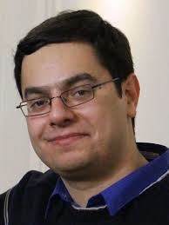
Questions for today
L2/L3 design:
  addressing / routing / forwarding in the Fat-Tree
L4 design:
  Transport protocol design (w/ Fat-Tree)
Many slides courtesy of Mohammad Alizadeh, Stanford University

Slide 38


Workloads
Partition/Aggregate
(Query)
Short messages [50KB-1MB]
(Coordination, Control state)
Large flows [1MB-50MB]
(Data update)
Delay-sensitive
Delay-sensitive
Throughput-sensitive
Slide from Mohammad Alizadeh, Stanford University
Notes:
Replace PDF

Slide 39
Tension Between Requirements
High Throughput
vs.
Low Latency
Deep queues at switches:
Queuing delays
increase latency
Shallow queues at switches:
Bad for bursts &
throughput
DCTCP
Objective:
Low Queue Occupancy & High Throughput
Slide from Mohammad Alizadeh, Stanford University
Notes:
Deep Buffers – bad for latency
Shallow Buffers – bad for bursts & throughput
Reduce RTO_{min} – no good for latency
AQM – Difficult to tune, not fast enough for incast-style micro-bursts, lose throughput in low stat-mux

Slide 40
Data Center TCP (DC-TCP)
Proposal from Microsoft Research, 2010
  Incremental fixes to TCP for DC environments
  Deployed in Microsoft datacenters (~rumor)
Leverages Explicit Congestion Notification (ECN)

Slide 41
Lec#14: Explicit Congestion Notification (ECN)
Defined in RFC 3168 using ToS/DSCP bits in the IP header
Single bit in packet header; set by congested routers
  If data packet has bit set, then ACK has ECN bit set
Routers typically set ECN bit based on average queue length
Congestion semantics exactly like that of drop
  I.e., sender reacts as though it saw a drop

Slide 42


Review: The TCP/ECN Control Loop
Sender 1
ECN = Explicit Congestion Notification
ECN Mark (1 bit)
Receiver
Sender 2
Slide from Mohammad Alizadeh, Stanford University
Notes:
DCTCP is based on the existing Explicit Congestion Notification framework in TCP.

Slide 43
DC-TCP: key ideas
React early and quickly: use ECN
React in proportion to the extent of congestion, not
its presence
ECN Marks | TCP | DCTCP
1 0 1 1 1 1 0 1 1 1 | Cut window by 50% | Cut window by 40%
0 0 0 0 0 0 0 0 0 1 | Cut window by 50% | Cut window by 5%
Slide from Mohammad Alizadeh, Stanford University

Slide 44
At the switch
  If Queue Length > K
  (note: queue length is instantaneous, not average)
    Set ECN bit in packet
K
Mark
Don’t
Mark
Slide from Mohammad Alizadeh, Stanford University

Slide 45
At the sender
  Maintain running average of the fraction of packets marked (α).
  Window adapts based on α:
  α equal to 1 (high congestion): (same as TCP!)
Slide from Mohammad Alizadeh, Stanford University

Slide 46
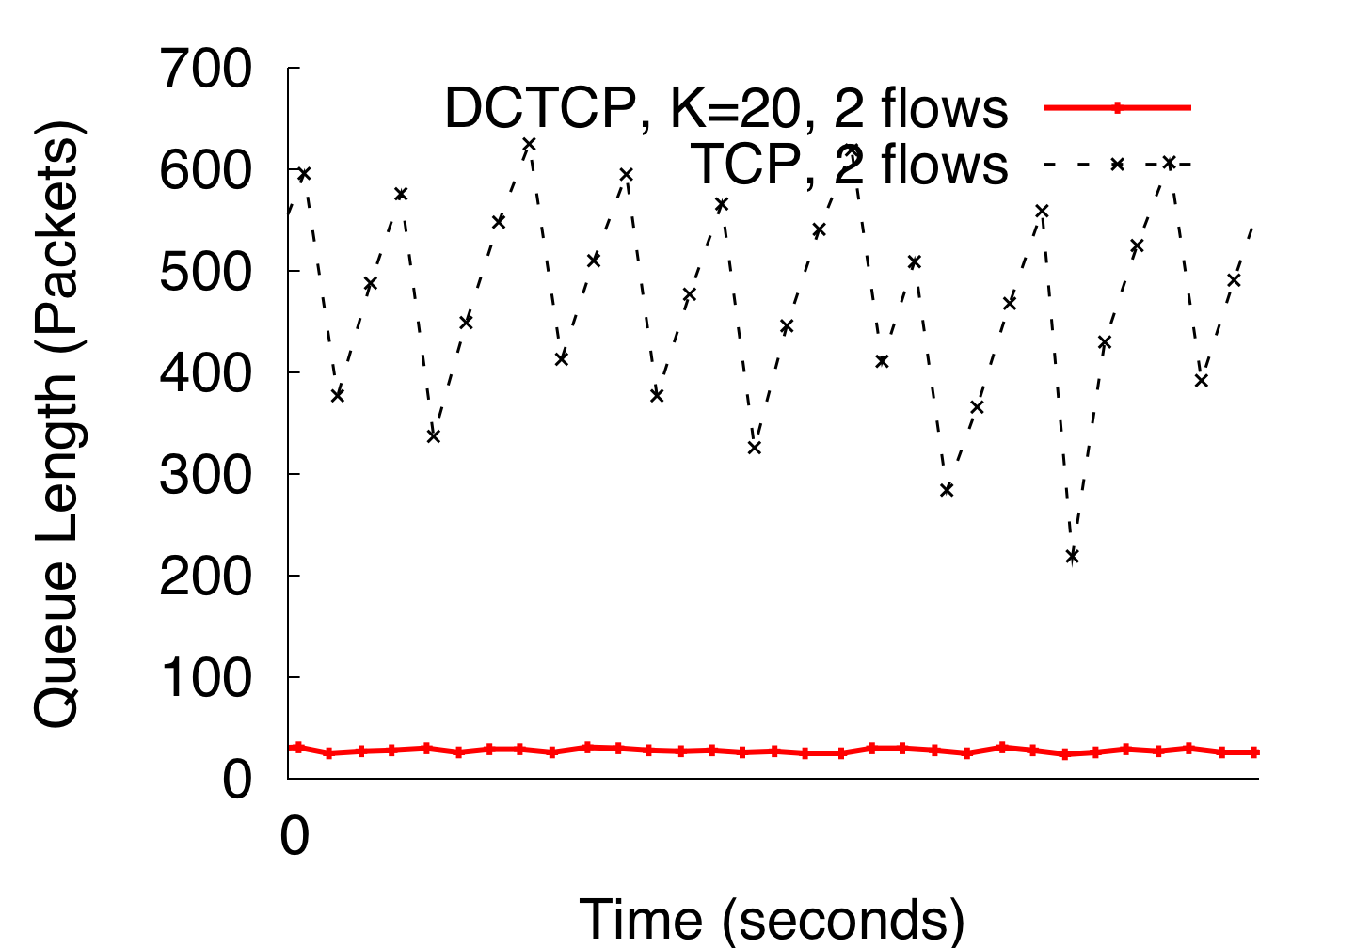
DCTCP in Action
(Kbytes)
Setup: Win 7, Broadcom 1Gbps Switch
Scenario: 2 long-lived flows, K = 30KB
Slide from Mohammad Alizadeh, Stanford University
Notes:
Not ns2.

Slide 47
DC-TCP: why it works
React early and quickly: use ECN
→ Avoid large buildup in queues → lower latency
React in proportion to the extent of congestion, not
its presence
  Maintain high throughput by not over-reacting to congestion
  Reduces variance in sending rates, lowering queue buildups
Slide from Mohammad Alizadeh, Stanford University

Slide 48
Data Center TCP (DC-TCP)
Proposal from Microsoft Research, 2010
  Incremental fixes to TCP for DC environments
  Deployed in Microsoft datacenters (~rumor)
Leverages Explicit Congestion Notification (ECN)
An improvement; but still far from “ideal”

Slide 49
What’s “ideal” ?
What is the best measure of performance for a data center transport protocol?
  When the flow is completely transferred?
  Latency of each packet in the flow?
  Number of packet drops?
  Link utilization?
  Average queue length at switches?

Slide 50
Flow Completion Time (FCT)
Time from when flow started at the sender, to when all packets in the flow were received at the receiver

Slide 51
FCT with DCTCP
Slide from Mohammad Alizadeh, Stanford University

Slide 52
  Recall: “Elephants” and “Mice”
  Web search, data mining (Microsoft) [Alizadeh 2010]
<100KB
>10MB
55% of flows
3% of bytes
5% of flows
35% of bytes
Slide from Mohammad Alizadeh, Stanford University

Slide 53
FCT with DCTCP
Problem: the mice are delayed by the elephants
Slide from Mohammad Alizadeh, Stanford University

Slide 54
Solution: use priorities!
[pFabric, Sigcomm 2013]
Packets carry a single priority number
  priority = remaining flow size (e.g., #bytes un-acked)
Switches
  very small queues (e.g., 10 packets)
  send highest priority / drop lowest priority packet
Servers
  Transmit/retransmit aggressively (at full link rate)
  Drop transmission rate only under extreme loss (timeouts)
Slide from Mohammad Alizadeh, Stanford University

Slide 55
FCT
Slide from Mohammad Alizadeh, Stanford University

Slide 56
FCT
Slide from Mohammad Alizadeh, Stanford University

Slide 57
Why does pFabric work?
Consider problem of scheduling N jobs at a single queue/processor
  J_{1,} J₂, … , J_{n} with duration T₁, T₂, …T_{n} respectively
“Shortest Job First” (SJF) scheduling minimizes average Job Completion Time
  Pick job with minimum T_{i} ; de-queue and run ; repeat
  I.e., job that requires minimum runtime has max priority
Solution for a network of queues is NP-hard
Setting priority=remaining flow size is a heuristic to approximate SJF

Slide 58
DIY exercise: why does SJF work?
Consider 4 jobs with duration 1,2,4,8
Compute finish times w/ Round-Robin vs. SJF
Assume scheduler:
  Picks best job (as per scheduling policy)
  Runs job for one time unit
  Update job durations
  repeat
Job completion times:
  With RR: 1, 5, 10, 15
  With SJF: 1, 3, 7, 15

Slide 59
Summary
Learn more:
  https://code.facebook.com/posts/360346274145943/introducing-data-center-fabric-the-next-generation-facebook-data-center-network/
Next time: Guest lecture by Stephen Strowes, IPv6!
Notes:
-- incast?
-- one big switch abstraction…

