Slide 1

Hope you had a FANTASTIC spring break!

Slide 2
Hope you had a FANTASTIC spring break!
Thanksgiving

Slide 3
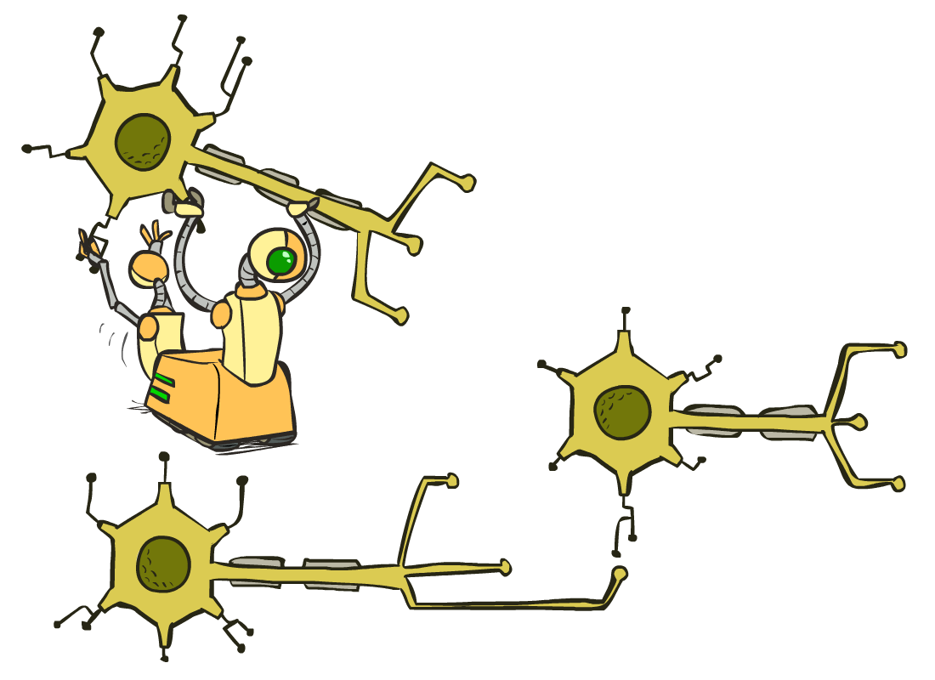
CS 188: Artificial Intelligence
Neural Nets (ctd) and IRL
Instructor: Anca Dragan --- University of California, Berkeley
[These slides were created by Dan Klein and Pieter Abbeel for CS188 Intro to AI at UC Berkeley. All CS188 materials are available at http://ai.berkeley.edu.]
Notes:
Please retain proper attribution, including the reference to ai.berkeley.edu. Thanks!

Slide 4

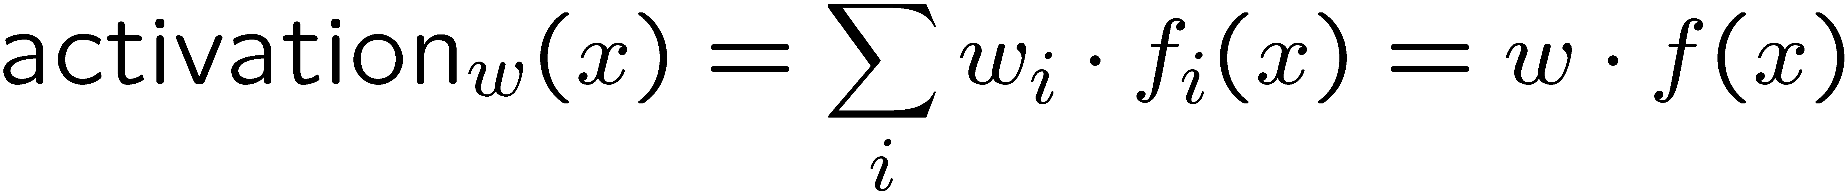
Reminder: Linear Classifiers
Inputs are feature values
Each feature has a weight
Sum is the activation
If the activation is:
  Positive, output +1
  Negative, output -1
w₁
f₁
Σ
w₂
>0?
f₂
w₃
f₃

Slide 5



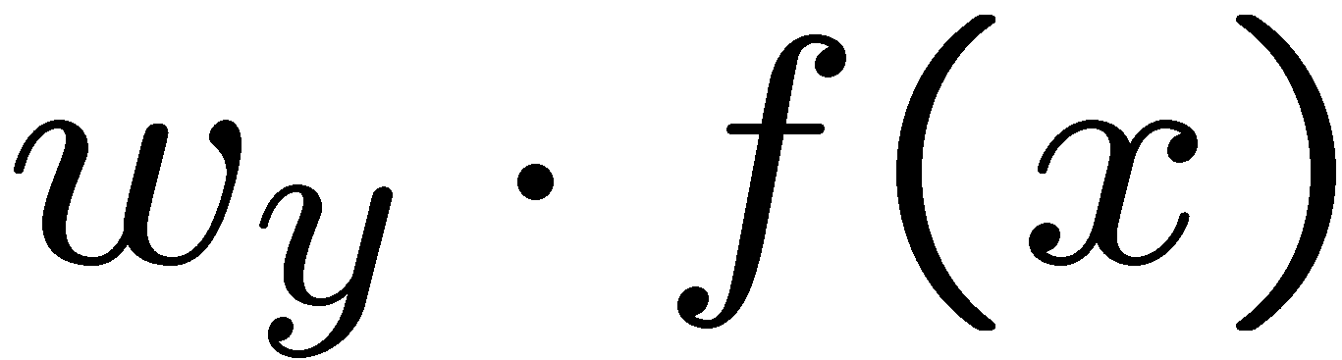


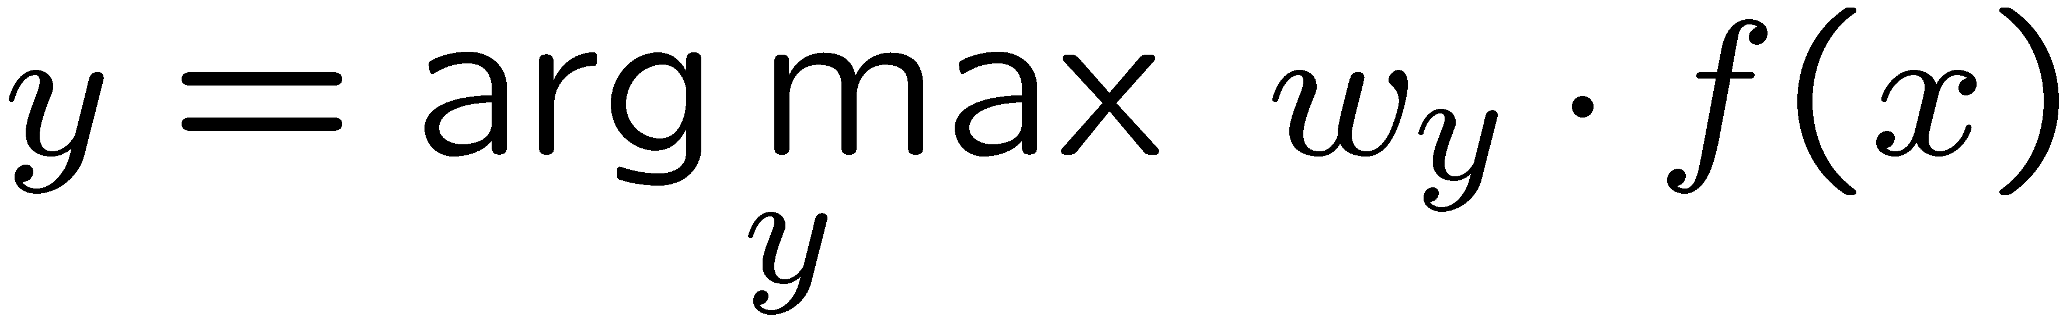
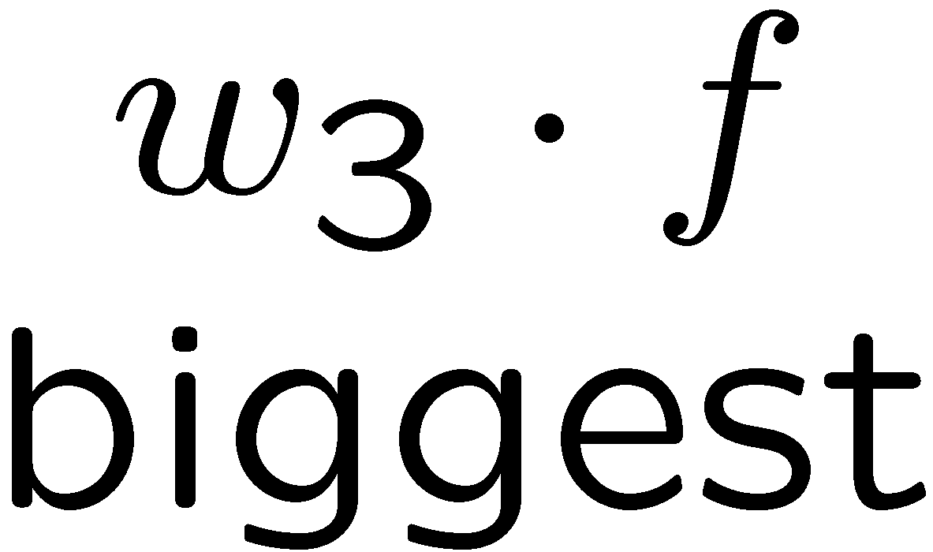
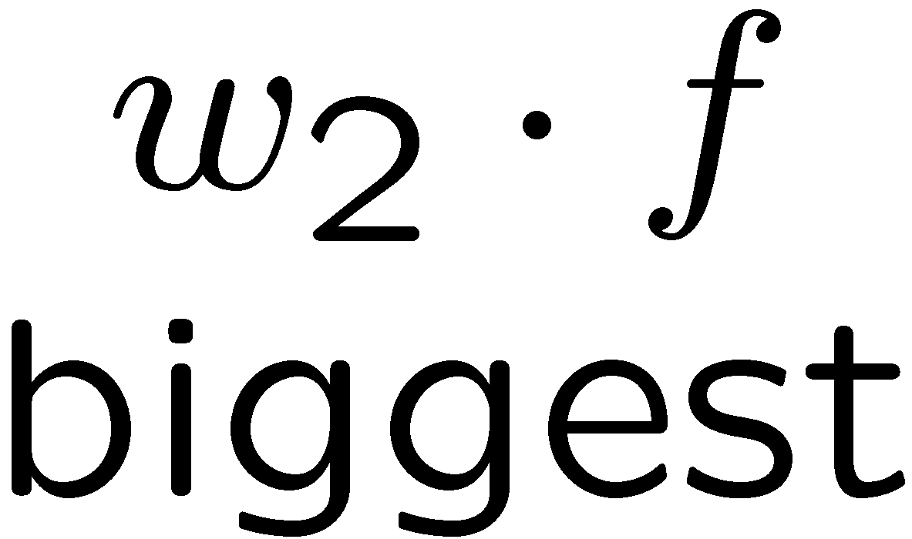
Multiclass Logistic Regression
Multi-class linear classification
  A weight vector for each class:
  Score (activation) of a class y:
  Prediction w/highest score wins:
How to make the scores into probabilities?
original activations
softmax activations

Slide 6
Best w?
Maximum likelihood estimation:
with:
= Multi-Class Logistic Regression

Slide 7
Gradient in n dimensions

Slide 8
Optimization Procedure: Gradient Ascent
init
for iter = 1, 2, …
: learning rate --- tweaking parameter that needs to be chosen carefully
How? Try multiple choices
  Crude rule of thumb: update changes about 0.1 – 1 %

Slide 9
Neural Networks

Slide 10
Multi-class Logistic Regression
= special case of neural network
f₁(x)
z₁
softmax
f₂(x)
z₂
f₃(x)
…
z₃
f_{K}(x)

Slide 11
Deep Neural Network = Also learn the features!
x₁
softmax
x₂
…
x₃
…
…
…
…
…
x_{L}
g = nonlinear activation function

Slide 12
Deep Neural Network: Also Learn the Features!
Training the deep neural network is just like logistic regression:
  just w tends to be a much, much larger vector ☺
  just run gradient ascent
  + stop when log likelihood of hold-out data starts to decrease

Slide 13
How well does it work?

Slide 14

Computer Vision
Notes:
14

Slide 15
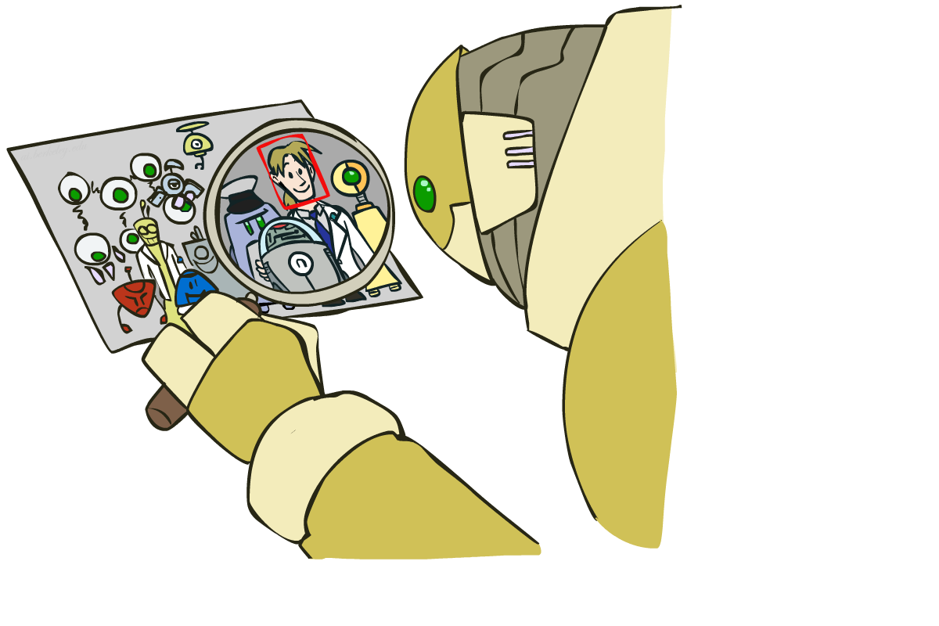
Object Detection
Notes:
15

Slide 16



Manual Feature Design
Notes:
16

Slide 17
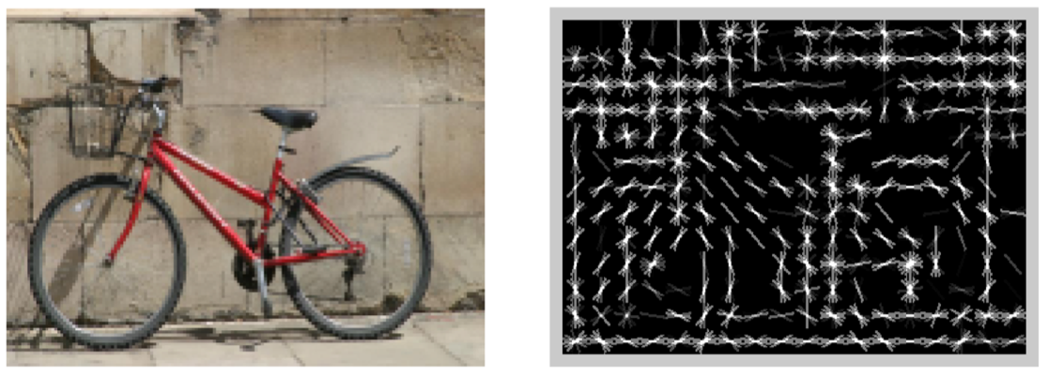
Features and Generalization
[HoG: Dalal and Triggs, 2005]
Notes:
17

Slide 18
Features and Generalization
Image
HoG
Notes:
HoG, SIFT (scale-invariant feature transform), Daisy
Deformable part models
18

Slide 19
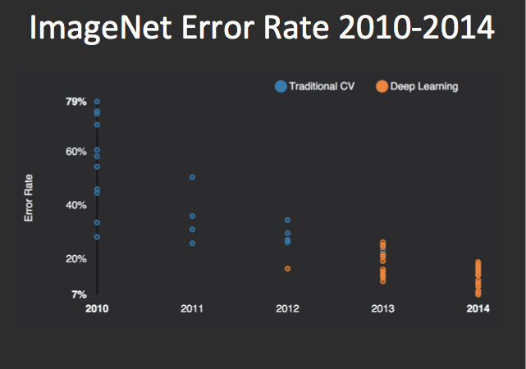
Performance
graph credit Matt Zeiler, Clarifai

Slide 20
Performance
graph credit Matt Zeiler, Clarifai

Slide 21
Performance
AlexNet
graph credit Matt Zeiler, Clarifai

Slide 22
Performance
AlexNet
graph credit Matt Zeiler, Clarifai

Slide 23
Performance
AlexNet
graph credit Matt Zeiler, Clarifai

Slide 24
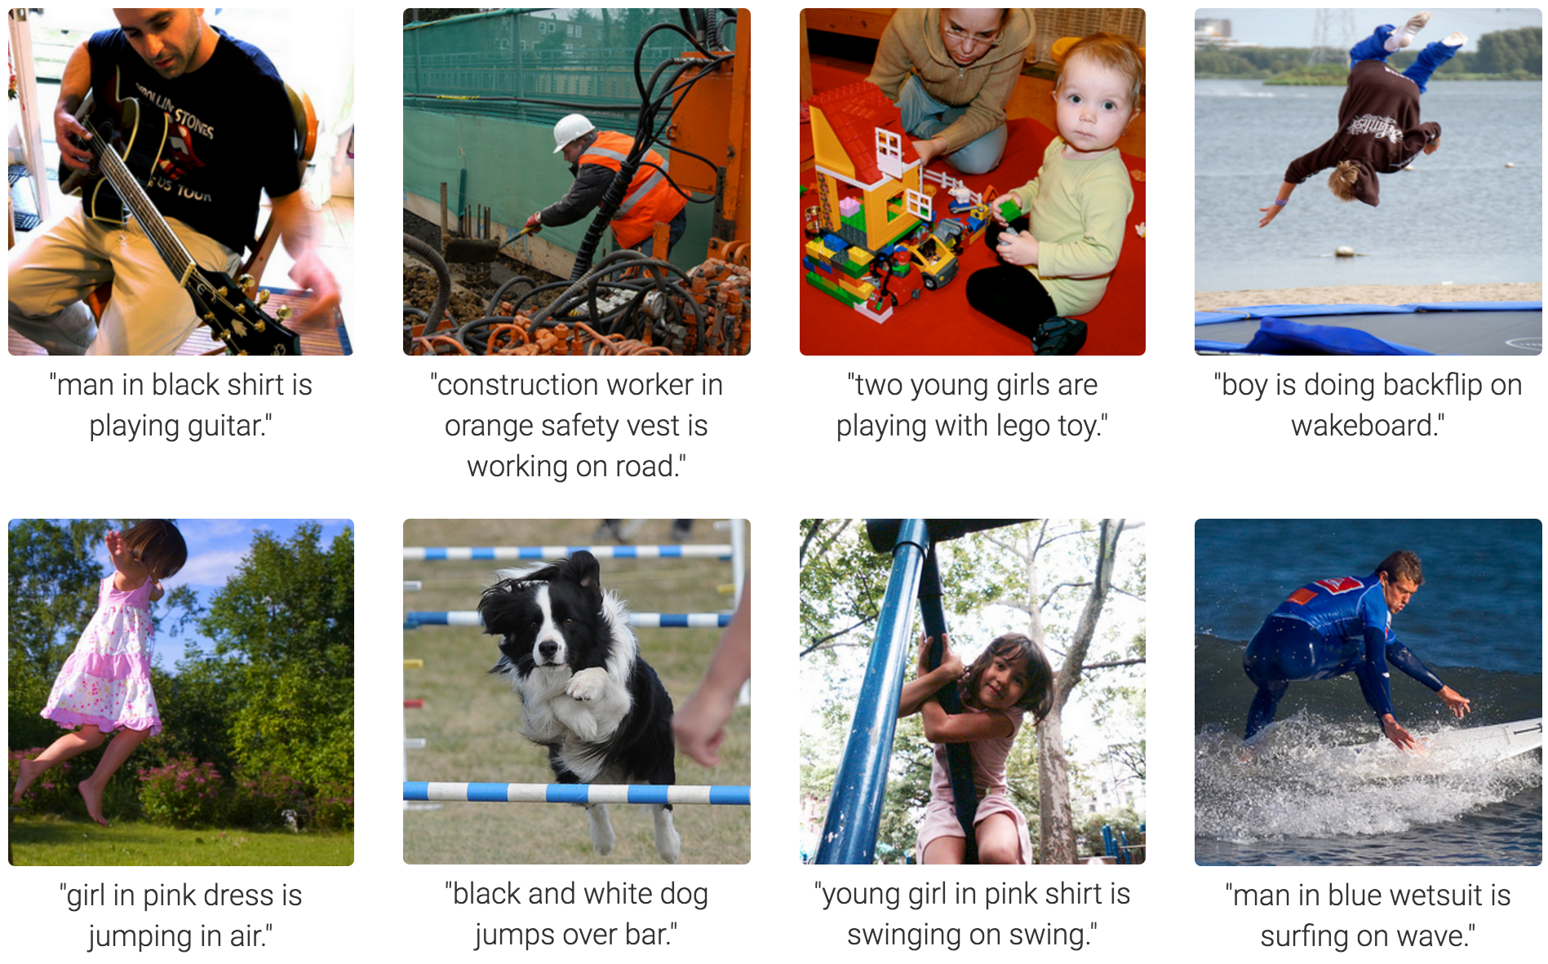
MS COCO Image Captioning Challenge
Karpathy & Fei-Fei, 2015; Donahue et al., 2015; Xu et al, 2015; many more

Slide 25
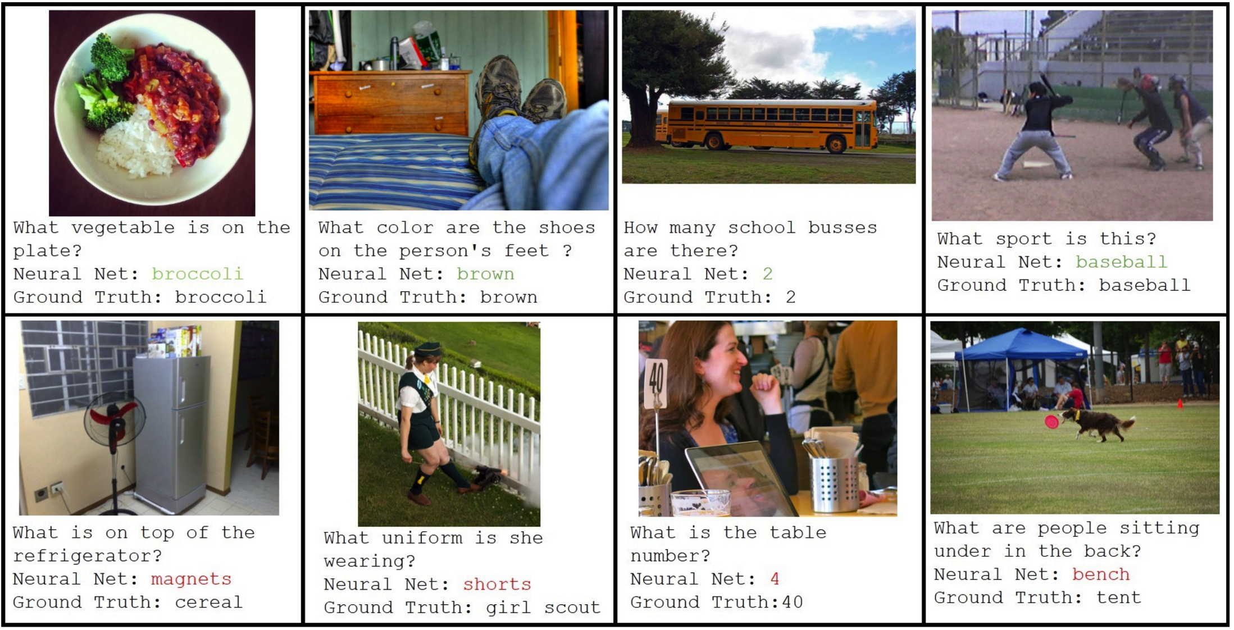
Visual QA Challenge
Stanislaw Antol, Aishwarya Agrawal, Jiasen Lu, Margaret Mitchell, Dhruv Batra, C. Lawrence Zitnick, Devi Parikh

Slide 26
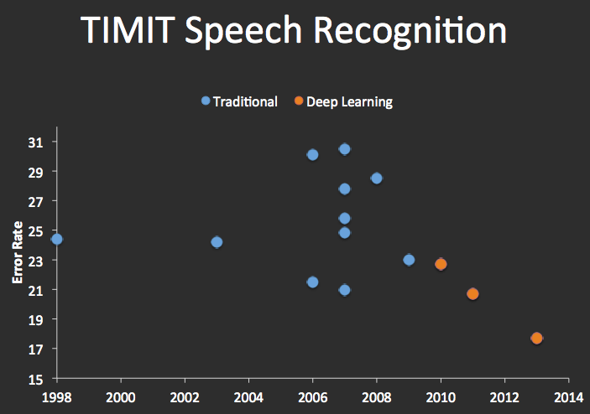


Speech Recognition
graph credit Matt Zeiler, Clarifai

Slide 27
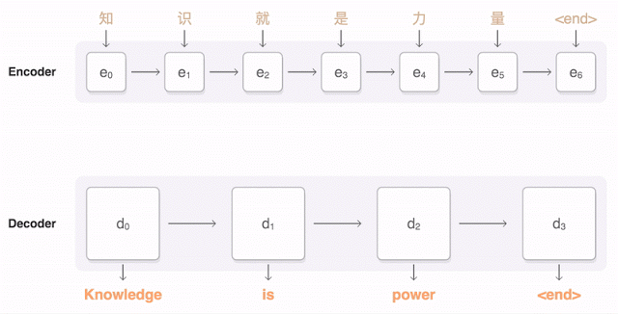
Machine Translation
Google Neural Machine Translation (in production)
Notes:
https://research.googleblog.com/2016/09/a-neural-network-for-machine.html

Slide 28
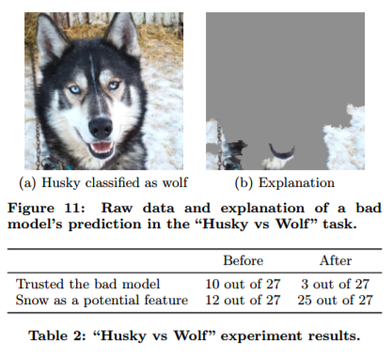
What’s still missing? – correlation \neq causation
[Ribeiro et al.]

Slide 29

What’s still missing? – covariate shift
[Carroll et al.]

Slide 30

What’s still missing? – covariate shift
[Carroll et al.]

Slide 31
What’s still missing – knowing what loss to optimize

Slide 32
CS 188: Artificial Intelligence
Neural Nets (ctd) and IRL
Instructor: Anca Dragan --- University of California, Berkeley
[These slides were created by Dan Klein and Pieter Abbeel for CS188 Intro to AI at UC Berkeley. All CS188 materials are available at http://ai.berkeley.edu.]
Notes:
Please retain proper attribution, including the reference to ai.berkeley.edu. Thanks!

Slide 33
Reminder: Optimal Policies
R(s) = -0.01
R(s) = -0.03
R(s) = -0.4
R(s) = -2.0
Notes:
R(s) = the “living reward”

Slide 34
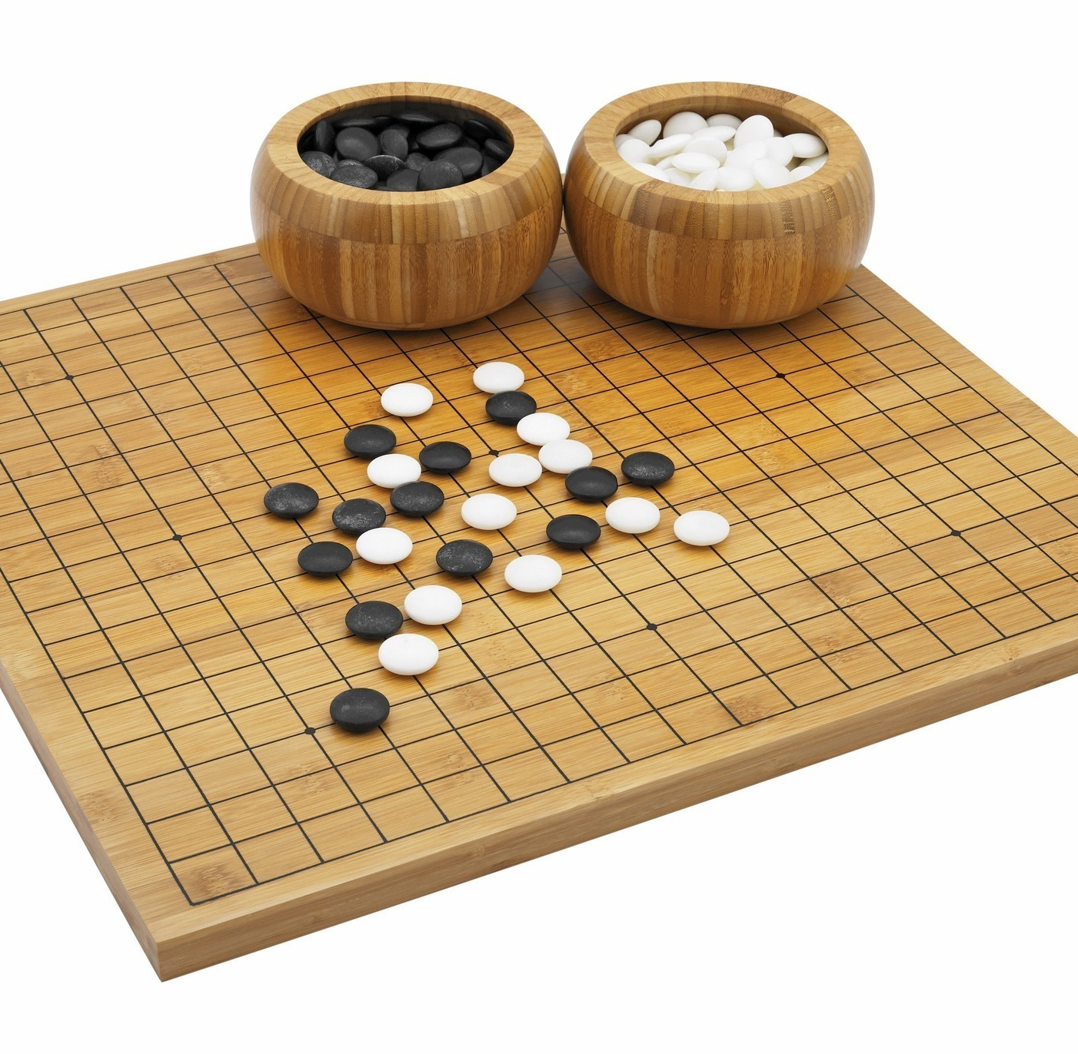
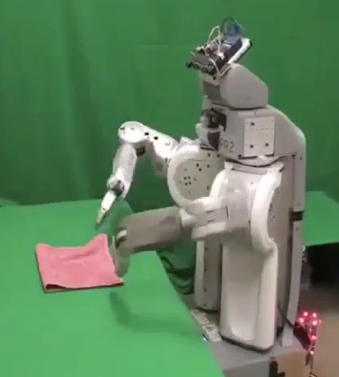
Utility?
Clear utility function
Not so clear utility function

Slide 35
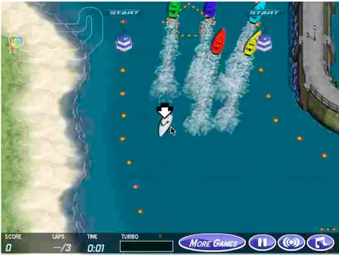

Slide 36
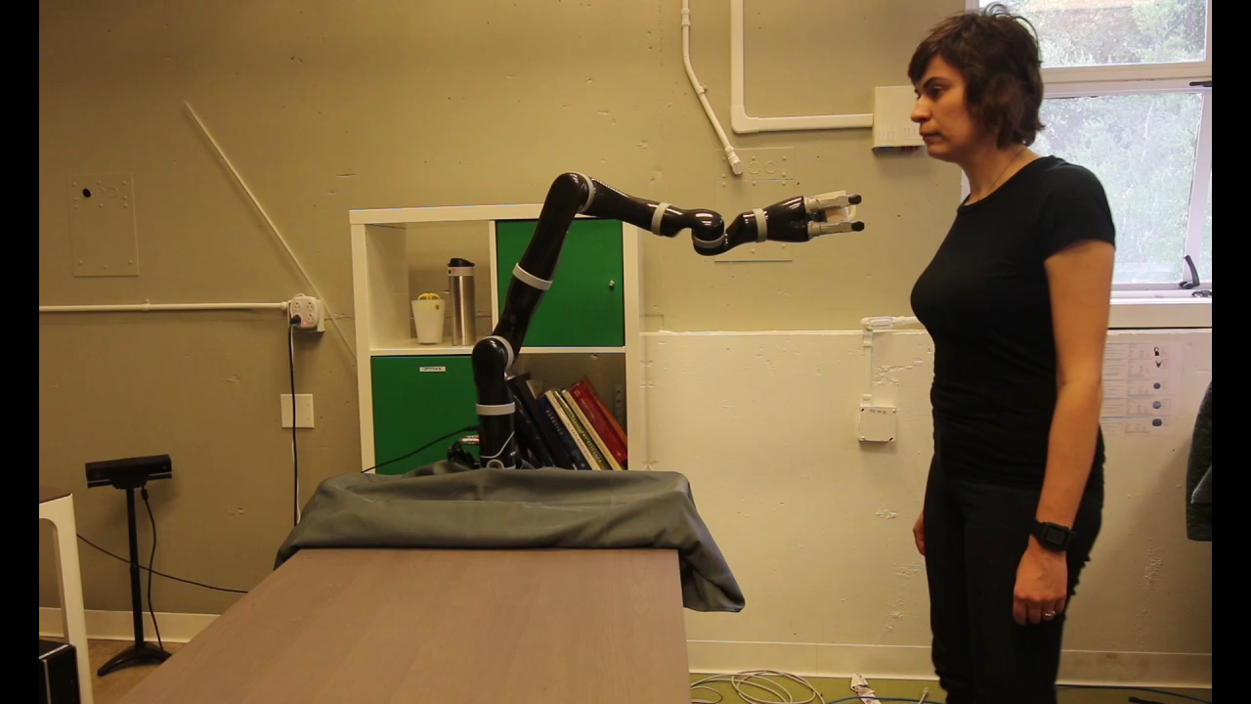



Slide 37
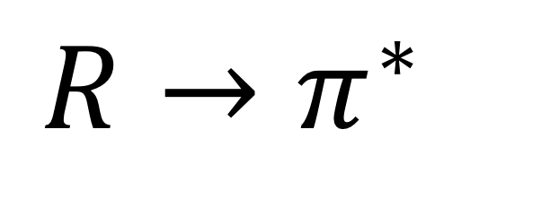
Planning/RL
$$R→π^{∗}$$

Slide 38
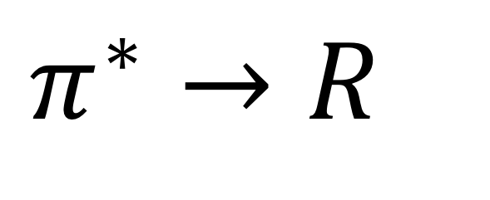
Inverse Planning/RL
$$π^{∗}→R$$

Slide 39
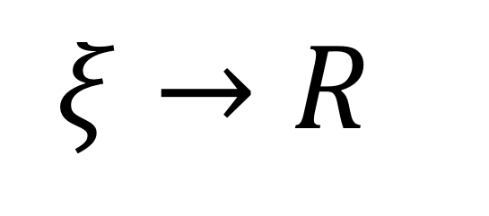
Inverse Planning/RL
$$ξ→R$$

Slide 40




Inverse Planning/RL

Slide 41
Inverse Planning/RL
Notes:
why?

Slide 42





IRL is relevant to all 3 types of people:
person in its environment
its end-user
its designer
Notes:
why not just use the demonstration

Slide 43
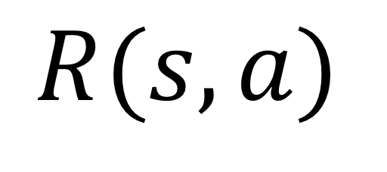

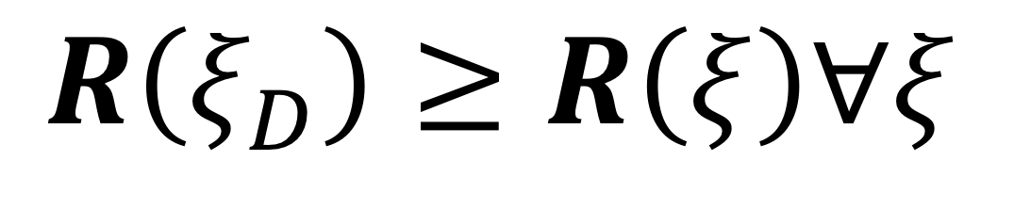
Inverse Planning/RL
$$ξ_{D}$$
given:
$$R(s,a)$$
find:
$$R\left(ξ_{D}\right)≥R\left(ξ\right)∀ξ$$
s.t.

Slide 44
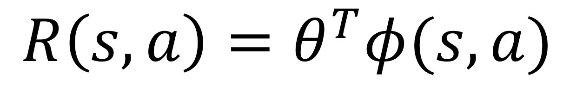
Inverse Planning/RL
$$ξ_{D}$$
given:
$$R\left(s,a\right)=θ^{T}φ(s,a)$$
find:
$$R\left(ξ_{D}\right)≥R\left(ξ\right)∀ξ$$
s.t.

Slide 45
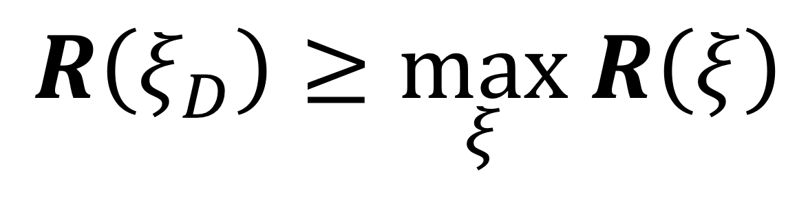
Inverse Planning/RL
$$ξ_{D}$$
given:
$$R\left(s,a\right)=θ^{T}φ(s,a)$$
find:
$$R\left(ξ_{D}\right)≥\max_{ξ} R\left(ξ\right)$$
s.t.

Slide 46
Problem
$$ξ_{D}$$
given:
zero/constant reward is a solution
$$R\left(s,a\right)=θ^{T}φ(s,a)$$
find:
$$R\left(ξ_{D}\right)≥\max_{ξ} R\left(ξ\right)$$
s.t.

Slide 47
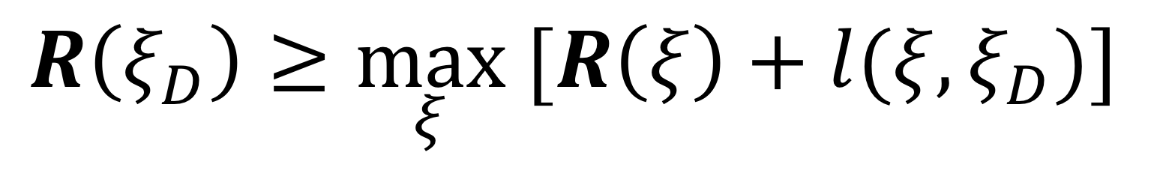
Revised formulation
$$ξ_{D}$$
given:
$$R\left(s,a\right)=θ^{T}φ(s,a)$$
find:
$$R\left(ξ_{D}\right)≥\max_{ξ} [R\left(ξ\right)+l(ξ,ξ_{D})]$$
s.t.
small close to the demonstration

Slide 48
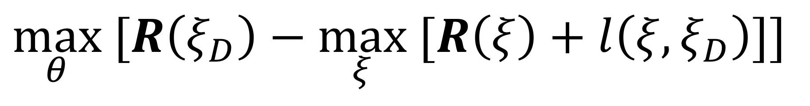
Optimization
$$\max_{θ} [R\left(ξ_{D}\right)−\max_{ξ} [R\left(ξ\right)+l\left(ξ,ξ_{D}\right)]]$$

Slide 49
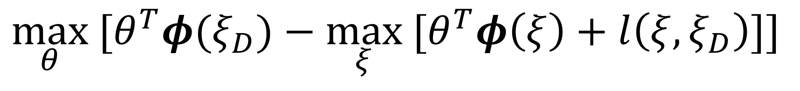
Optimization
$$\max_{θ} [θ^{T}φ(ξ_{D})−\max_{ξ} [θ^{T}φ\left(ξ\right)+l\left(ξ,ξ_{D}\right)]]$$

Slide 50
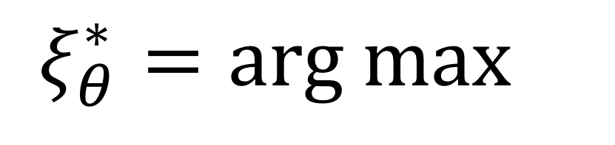
Optimization
$$ξ_{θ}^{∗}=arg max{}$$
$$\max_{θ} [θ^{T}φ(ξ_{D})−\max_{ξ} [θ^{T}φ\left(ξ\right)+l\left(ξ,ξ_{D}\right)]]$$
Notes:
how do we get this? -> planning
how do we solve this -> gradient

Slide 51
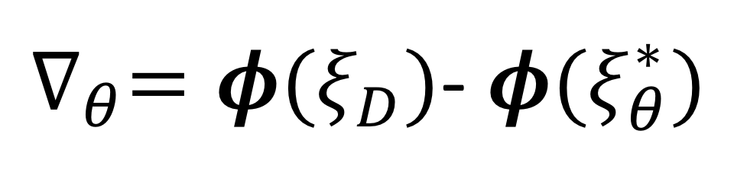
Optimization
$$\max_{θ} [θ^{T}φ(ξ_{D})−\max_{ξ} [θ^{T}φ\left(ξ\right)+l\left(ξ,ξ_{D}\right)]]$$
$∇_{θ}=φ(ξ_{D})$- $φ(ξ_{θ}^{∗})$
subgradient:

Slide 52
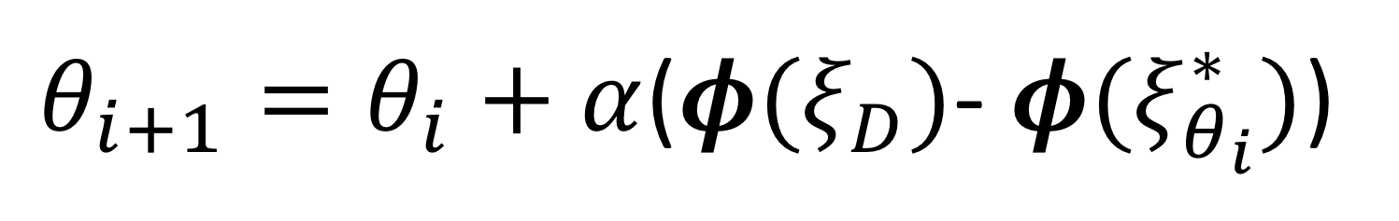
Optimization
$$\max_{θ} [θ^{T}φ(ξ_{D})−\max_{ξ} [θ^{T}φ\left(ξ\right)+l\left(ξ,ξ_{D}\right)]]$$
$∇_{θ}=φ(ξ_{D})$- $φ(ξ_{θ}^{∗})$
subgradient:
$θ_{i+1}=θ_{i}+α$($φ(ξ_{D})$- $φ(ξ_{θ_{i}}^{∗})$)

Slide 53
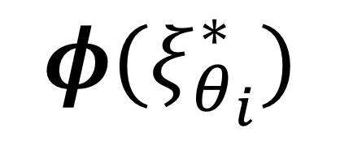
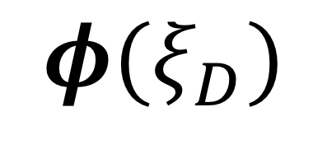
Interpretation
$$φ(ξ_{θ_{i}}^{∗})$$
goes on rocks: [1,0]
$$φ(ξ_{D})$$
goes on grass: [0,1]
$θ_{i+1}=θ_{i}+α$($φ(ξ_{D})$- $φ(ξ_{θ_{i}}^{∗})$)

Slide 54
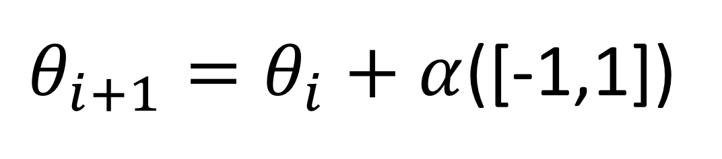
Interpretation
$$φ(ξ_{θ_{i}}^{∗})$$
goes on rocks: [1,0]
$$φ(ξ_{D})$$
goes on grass: [0,1]
$θ_{i+1}=θ_{i}+α$([-1,1])
$θ_{i+1}=θ_{i}+α$($φ(ξ_{D})$- $φ(ξ_{θ_{i}}^{∗})$)

Slide 55
Interpretation
$$φ(ξ_{θ_{i}}^{∗})$$
goes on rocks: [1,0]
$$φ(ξ_{D})$$
goes on grass: [0,1]
rocks weight goes down
grass weight goes up
$θ_{i+1}=θ_{i}+α$([-1,1])
$θ_{i+1}=θ_{i}+α$($φ(ξ_{D})$- $φ(ξ_{θ_{i}}^{∗})$)

Slide 56
Interpretation
$$φ(ξ_{θ_{i}}^{∗})$$
goes on rocks: [1,0]
$$φ(ξ_{D})$$
goes on grass: [0,1]
rocks weight goes down
grass weight goes up
The new reward likes grass more and rocks less.

Slide 57
Inverse Planning/RL
Notes:
why?

Slide 58
Inverse Planning/RL
Notes:
why?

Slide 59
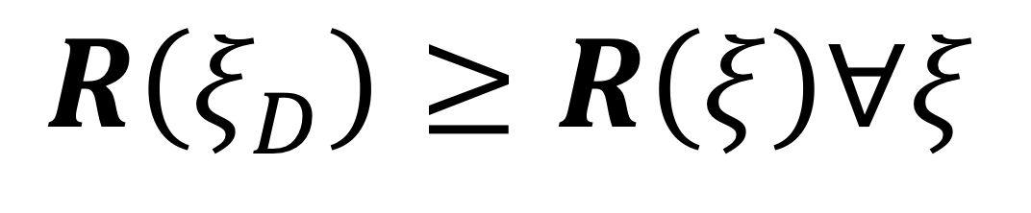
Is the demonstrator really optimal?
$$R\left(ξ_{D}\right)≥R\left(ξ\right)∀ξ$$

Slide 60
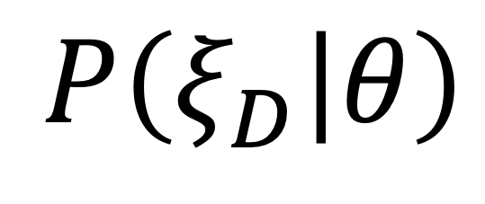
The Bayesian view
$$P\left(ξ_{D} | θ\right)$$
evidence
hidden

Slide 61
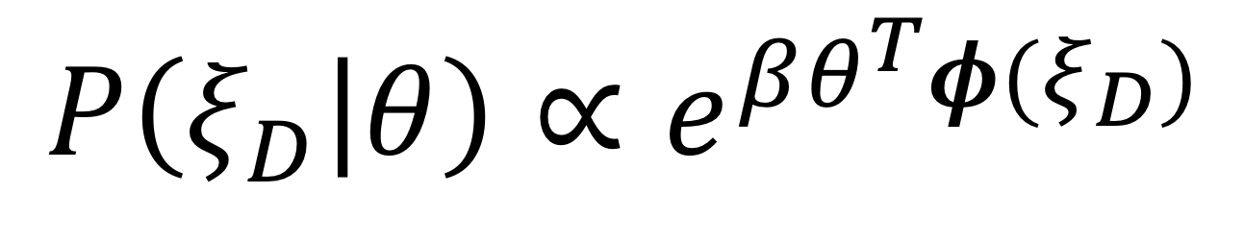
The Bayesian view
$$P\left(ξ_{D} | θ\right)∝e^{βθ^{T}φ(ξ_{D})}$$

Slide 62
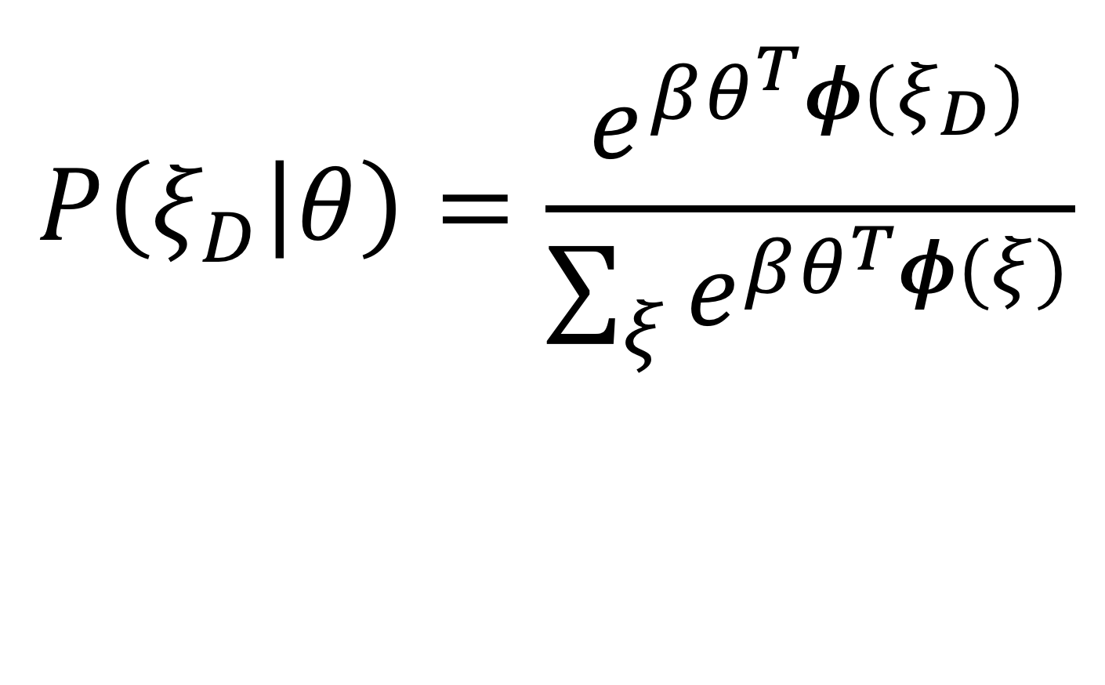
The Bayesian view
$$P\left(ξ_{D} | θ\right)=\frac{e^{βθ^{T}φ(ξ_{D})}}{\sum_{ξ}{e^{βθ^{T}φ(ξ)}}}$$
Notes:
explain how this is soft rationality because of the normalizer, explain beta
how do we do IRL with this assumption?

Slide 63
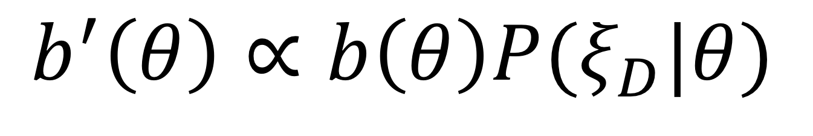
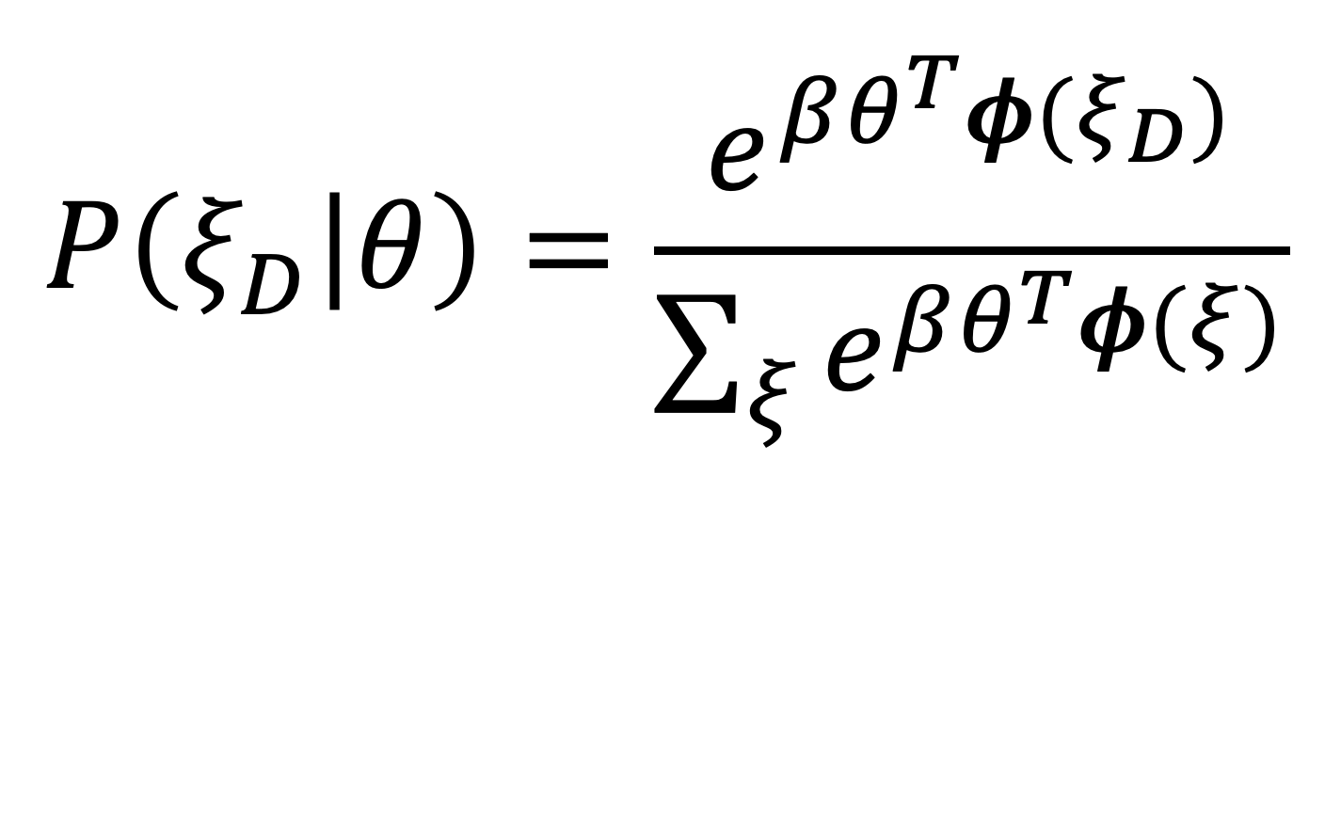
The Bayesian view
$$P\left(ξ_{D} | θ\right)=\frac{e^{βθ^{T}φ(ξ_{D})}}{\sum_{ξ}{e^{βθ^{T}φ(ξ)}}}$$
$$b^{′}\left(θ\right)∝b\left(θ\right)P(ξ_{D}|θ)$$

Slide 64
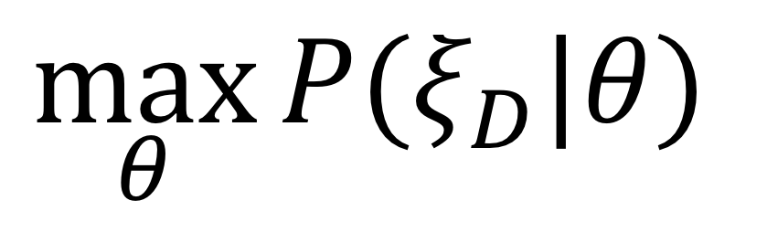
The Bayesian view
$$P\left(ξ_{D} | θ\right)=\frac{e^{βθ^{T}φ(ξ_{D})}}{\sum_{ξ}{e^{βθ^{T}φ(ξ)}}}$$
$$\max_{θ}{P(ξ_{D}|θ)}$$

Slide 65
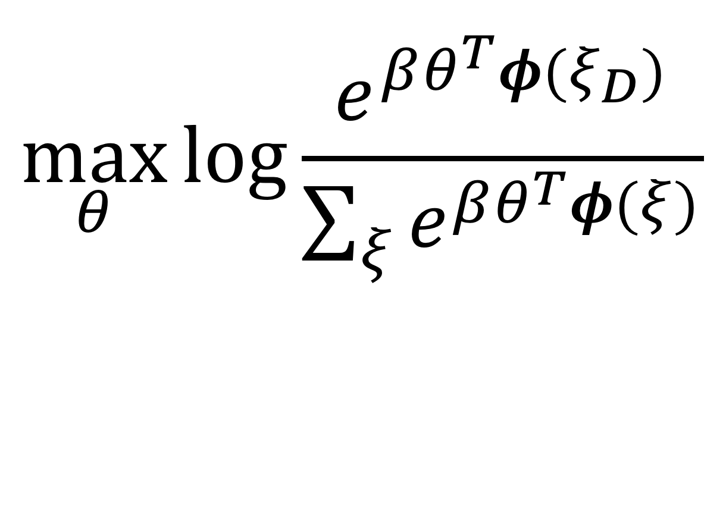
The Bayesian view
$$\max_{θ}{\log{\frac{e^{βθ^{T}φ(ξ_{D})}}{\sum_{ξ}{e^{βθ^{T}φ(ξ)}}}}}$$

Slide 66
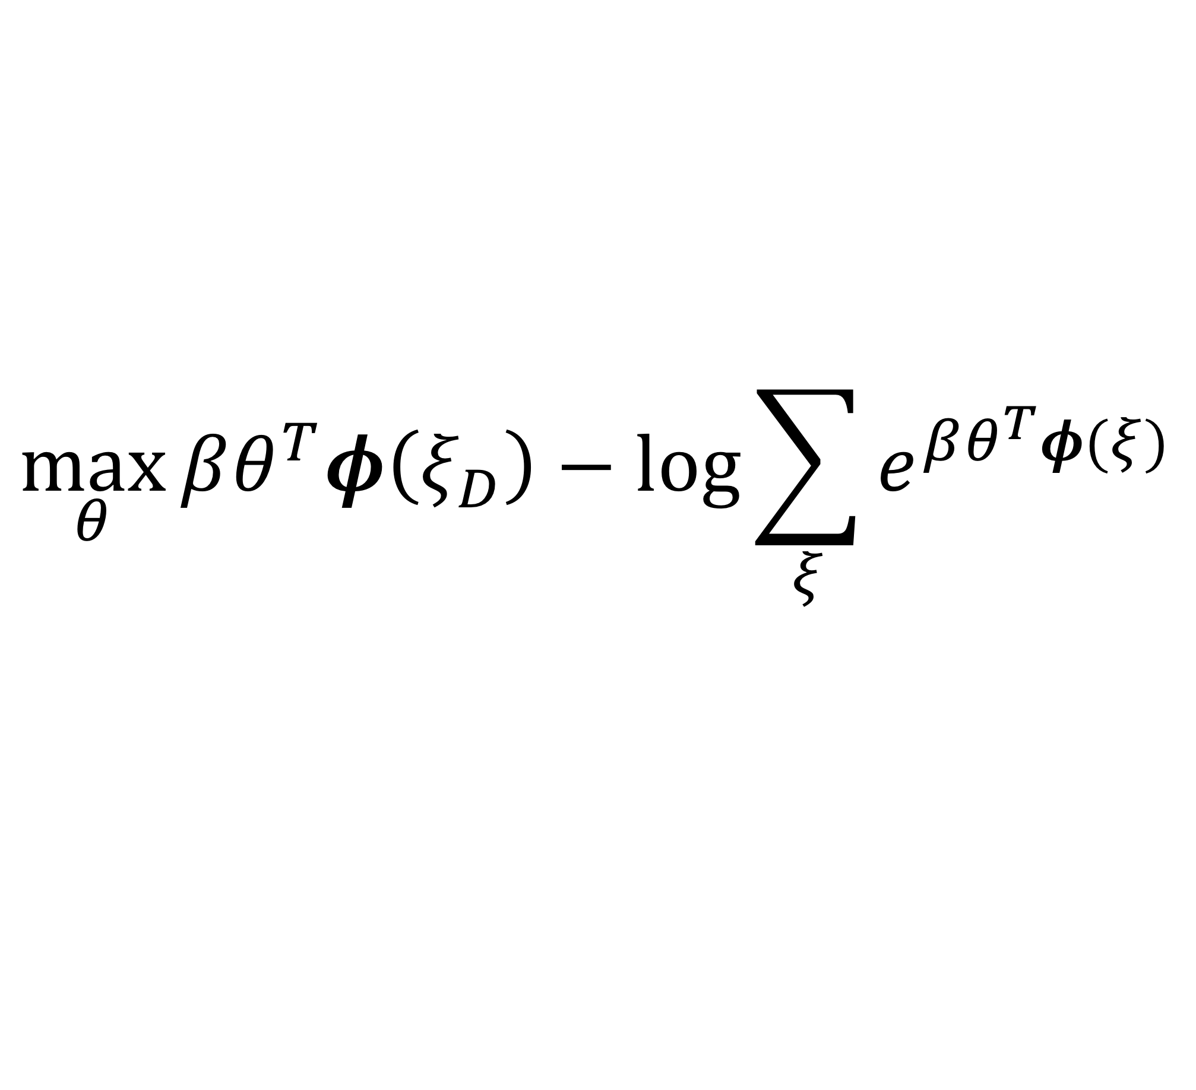
The Bayesian view
$$\max_{θ}{βθ^{T}φ\left(ξ_{D}\right)−\log{\sum_{ξ}{e^{βθ^{T}φ(ξ)}}}}$$

Slide 67
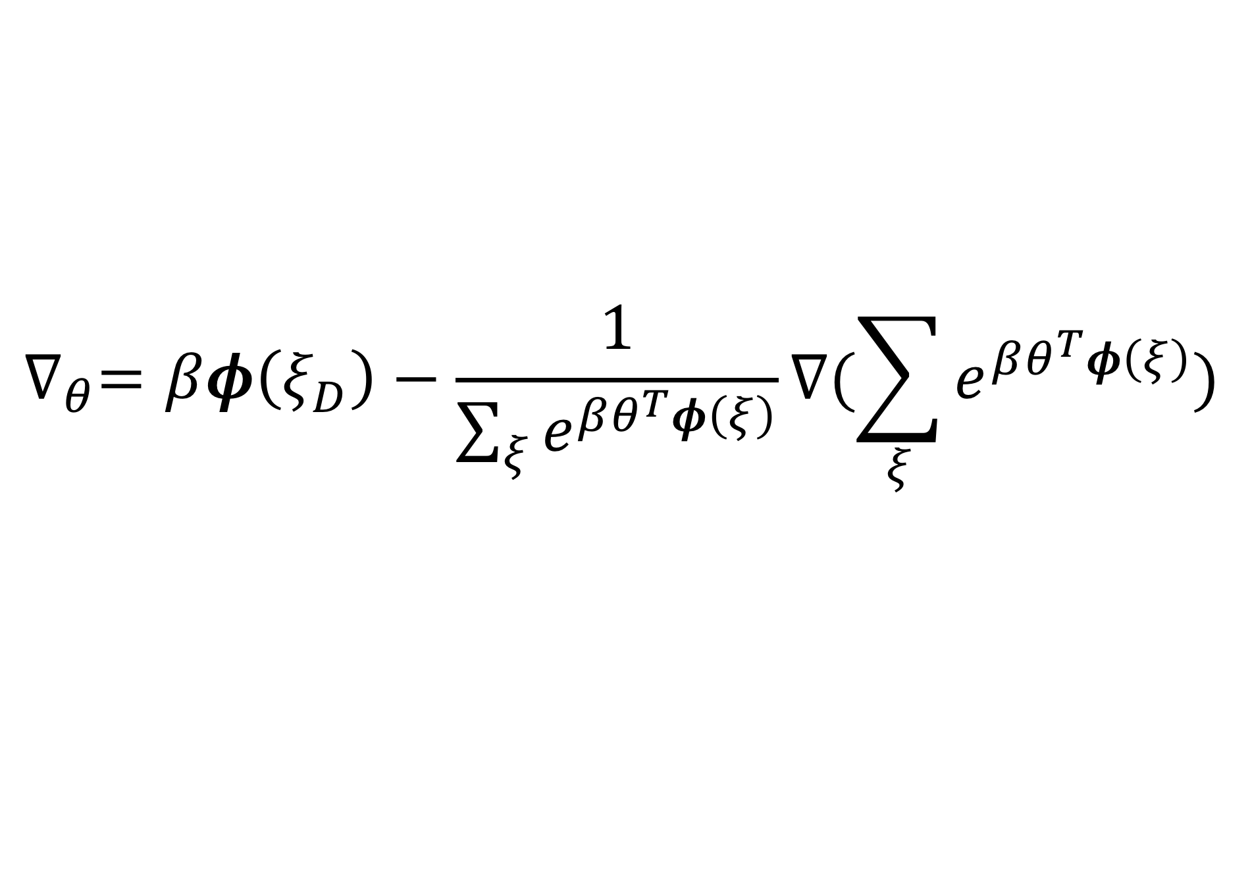
The Bayesian view
$$\max_{θ}{βθ^{T}φ\left(ξ_{D}\right)−\log{\sum_{ξ}{e^{βθ^{T}φ(ξ)}}}}$$
$$∇_{θ}=βφ\left(ξ_{D}\right)−\frac{1}{\sum_{ξ}{e^{βθ^{T}φ\left(ξ\right)}}}∇(\sum_{ξ}{e^{βθ^{T}φ\left(ξ\right)}})$$

Slide 68
The Bayesian view
$$\max_{θ}{βθ^{T}φ\left(ξ_{D}\right)−\log{\sum_{ξ}{e^{βθ^{T}φ(ξ)}}}}$$
$$∇_{θ}=βφ\left(ξ_{D}\right)−\frac{1}{\sum_{ξ}{e^{βθ^{T}φ\left(ξ\right)}}}∇(\sum_{ξ}{e^{βθ^{T}φ\left(ξ\right)}})$$

Slide 69
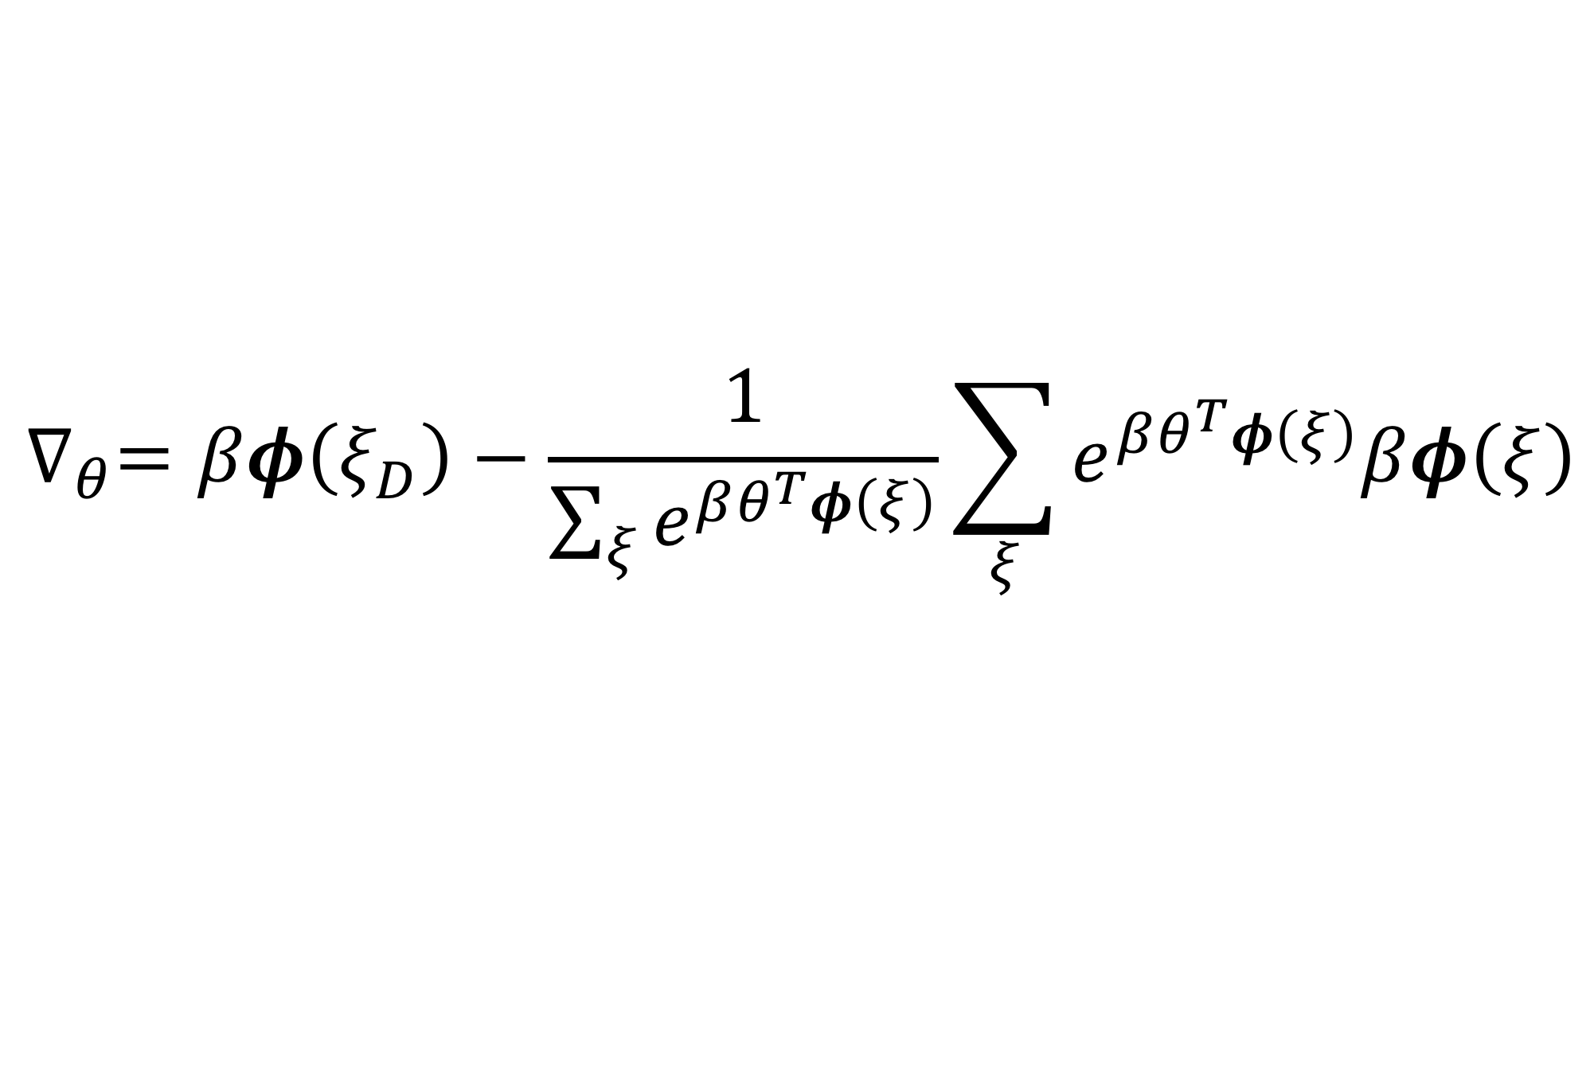
The Bayesian view
$$\max_{θ}{βθ^{T}φ\left(ξ_{D}\right)−\log{\sum_{ξ}{e^{βθ^{T}φ(ξ)}}}}$$
$$∇_{θ}=βφ\left(ξ_{D}\right)−\frac{1}{\sum_{ξ}{e^{βθ^{T}φ\left(ξ\right)}}}\sum_{ξ}{e^{βθ^{T}φ\left(ξ\right)}βφ\left(ξ\right)}$$

Slide 70
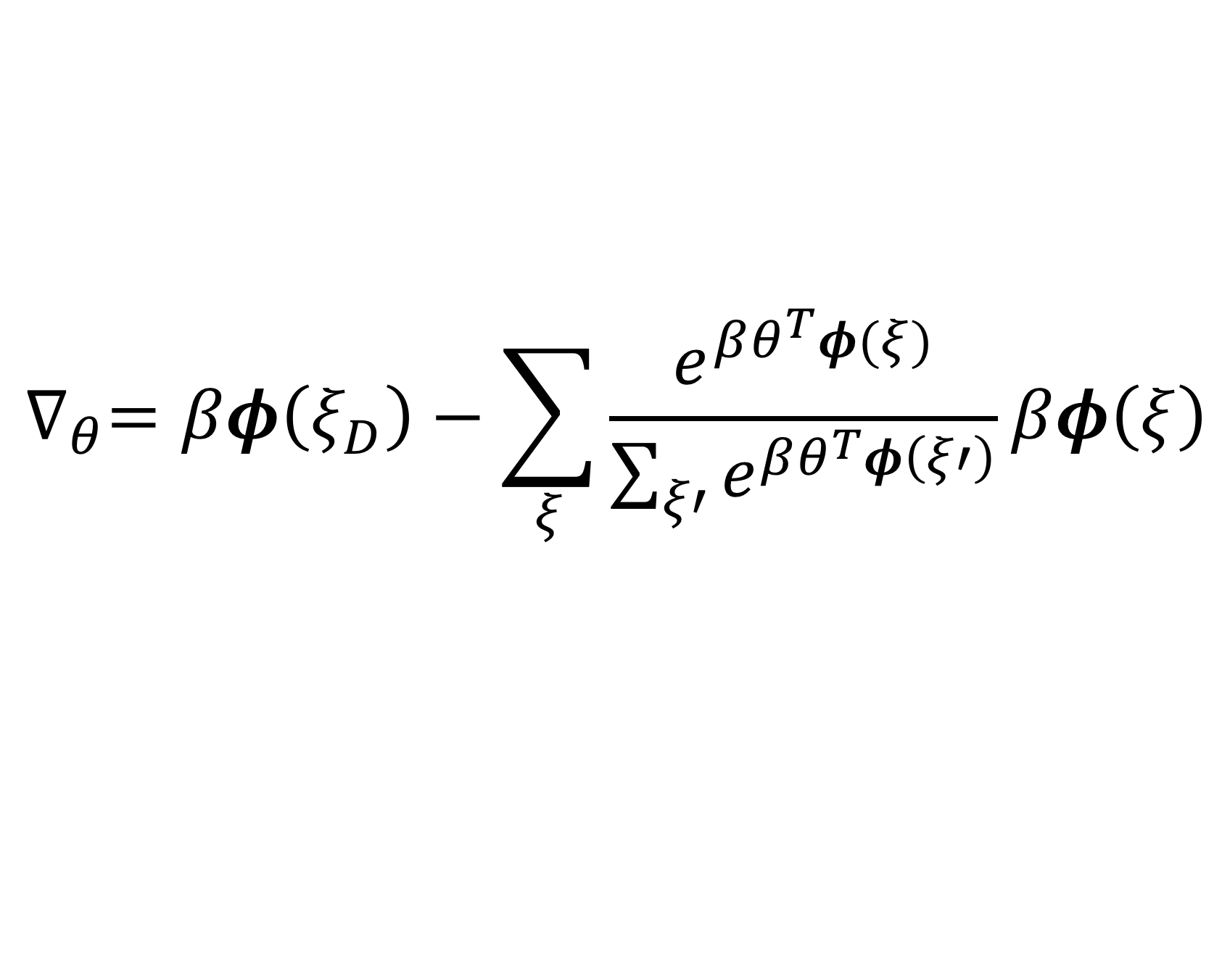
The Bayesian view
$$\max_{θ}{βθ^{T}φ\left(ξ_{D}\right)−\log{\sum_{ξ}{e^{βθ^{T}φ(ξ)}}}}$$
$$∇_{θ}=βφ\left(ξ_{D}\right)−\sum_{ξ}{\frac{e^{βθ^{T}φ(ξ)}}{\sum_{ξ′}{e^{βθ^{T}φ\left(ξ′\right)}}}βφ\left(ξ\right)}$$

Slide 71
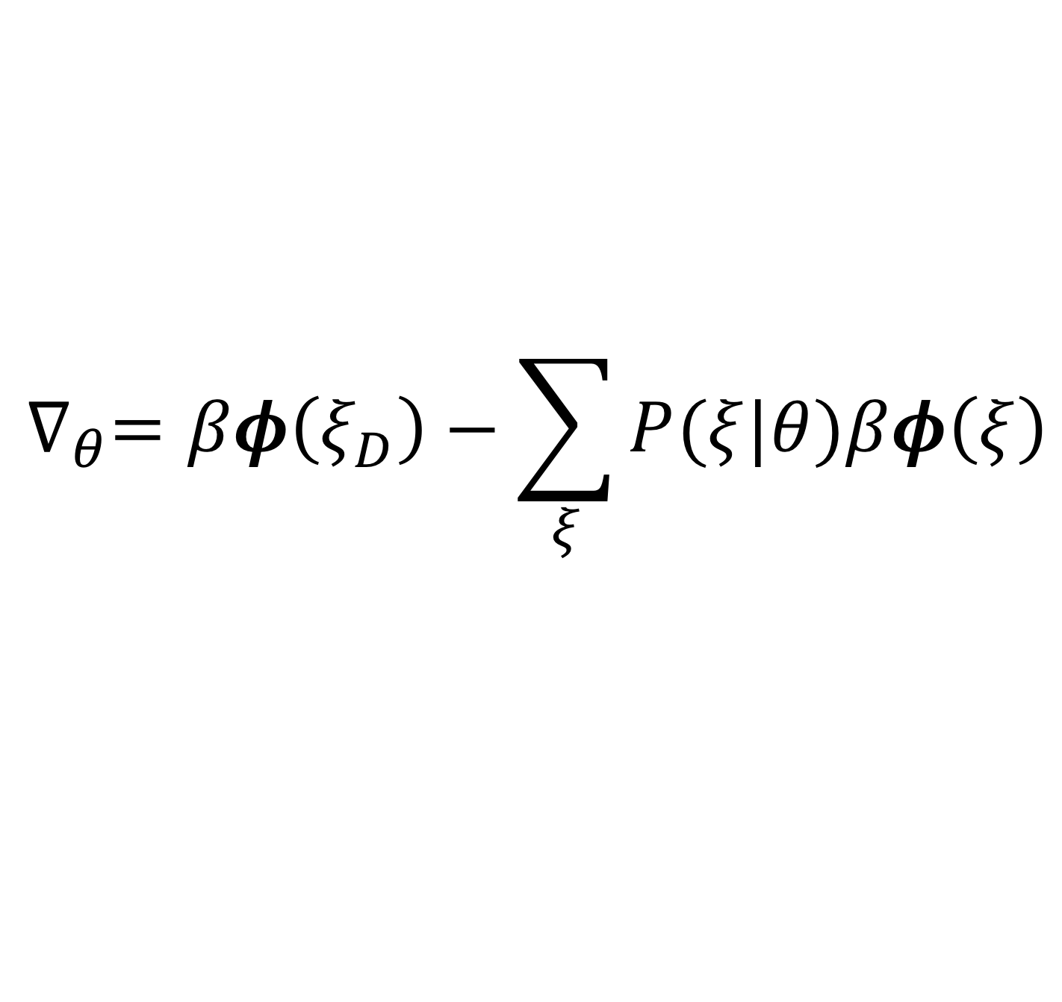
The Bayesian view
$$\max_{θ}{βθ^{T}φ\left(ξ_{D}\right)−\log{\sum_{ξ}{e^{βθ^{T}φ(ξ)}}}}$$
$$∇_{θ}=βφ\left(ξ_{D}\right)−\sum_{ξ}{P(ξ|θ)βφ\left(ξ\right)}$$

Slide 72
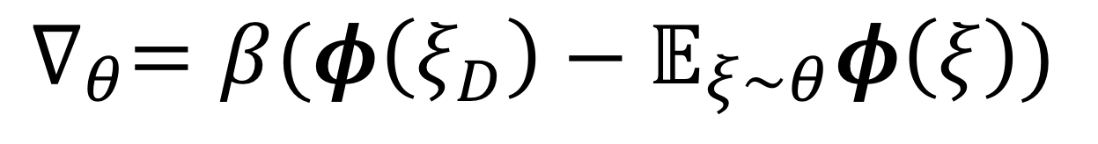
The Bayesian view
$$\max_{θ}{βθ^{T}φ\left(ξ_{D}\right)−\log{\sum_{ξ}{e^{βθ^{T}φ(ξ)}}}}$$
$$∇_{θ}=β(φ\left(ξ_{D}\right)−𝔼_{ξ\sim θ}φ\left(ξ\right))$$

Slide 73
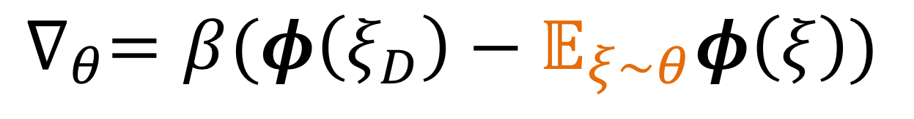
The Bayesian view
$$\max_{θ}{βθ^{T}φ\left(ξ_{D}\right)−\log{\sum_{ξ}{e^{βθ^{T}φ(ξ)}}}}$$
$$∇_{θ}=β(φ\left(ξ_{D}\right)−𝔼_{ξ\sim θ}φ\left(ξ\right))$$
expected feature values produced by the current reward

Slide 74
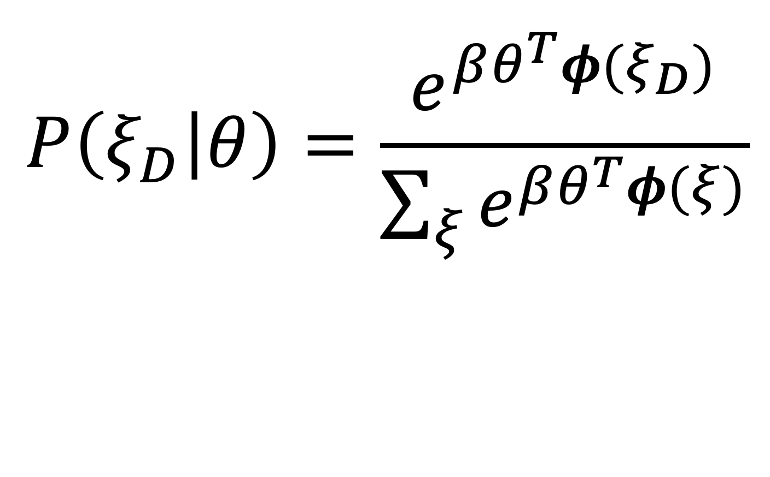
The Bayesian view
$$P\left(ξ_{D} | θ\right)=\frac{e^{βθ^{T}φ(ξ_{D})}}{\sum_{ξ}{e^{βθ^{T}φ(ξ)}}}$$
$$b^{′}\left(θ\right)∝b\left(θ\right)P(ξ_{D}|θ)$$

Slide 75


The Bayesian view (actions)
$$P\left(a_{D} | s,θ\right)=\frac{e^{βQ(s,a_{D};θ)}}{\sum_{a}{e^{βQ(s,a;θ)}}}$$
$$b^{′}\left(θ\right)∝b\left(θ\right)P(a_{D}|θ)$$

Slide 76

[Ratliff et al. Maximum Margin Planning]

Slide 77

[Levine et al. Continuous Inverse Optimal Control with Locally Linear Examples]

Slide 78


