Slide 1
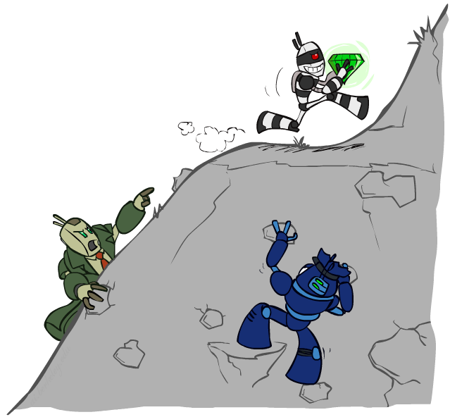
CS 188: Artificial Intelligence
Constraint Satisfaction Problems II
and Local Search
Instructors: Sergey Levine and Stuart Russell
University of California, Berkeley
[These slides were created by Dan Klein and Pieter Abbeel for CS188 Intro to AI at UC Berkeley. All CS188 materials are available at http://ai.berkeley.edu.]
Notes:
Please retain proper attribution, including the reference to ai.berkeley.edu. Thanks!

Slide 2

Today
Structure of CSPs
Local Search

Slide 3


Reminder: CSPs
CSPs:
  Variables
  Domains
  Constraints
    Implicit (provide code to compute)
    Explicit (provide a list of the legal tuples)
    Unary / Binary / N-ary
Goals:
  Here: find any solution
  Also: find all, find best, etc.

Slide 4

Standard Search Problems
Standard search problems:
  State is a black box: arbitrary data structure
  Goal test is a black box test on states
  Actions are black box data structures
  Transition model is a black box function
Consequences:
  Have to write new code for every new problem
  Have to devise heuristics for each new problem
  Cannot just choose actions that achieve the goal!
Solution: formal representation for states, actions, goals

Slide 5
Spectrum of representations
Search,
game-playing
CSPs, planning,
propositional logic,
Bayes nets, neural nets
First-order logic,
databases,
probabilistic programs

Slide 6
Backtracking Search

Slide 7
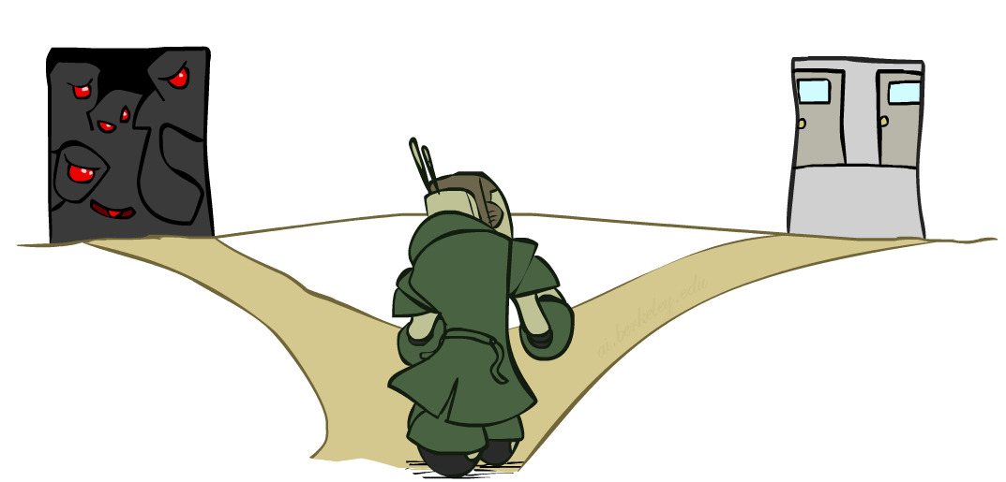

Improving Backtracking
General-purpose ideas give huge gains in speed
  … but it’s all still NP-hard
Filtering: Can we detect inevitable failure early?
Ordering:
  Which variable should be assigned next? (MRV)
  In what order should its values be tried? (LCV)
Structure: Can we exploit the problem structure?

Slide 8
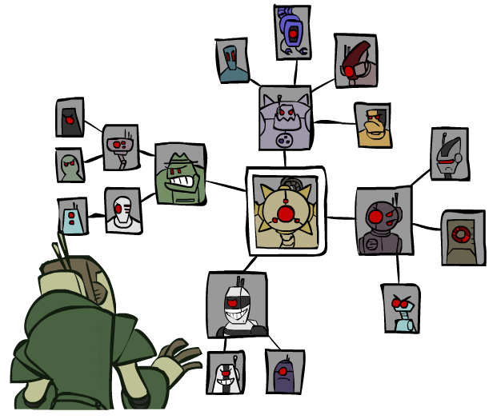
Structure

Slide 9
Problem Structure
Extreme case: independent subproblems
  Example: Tasmania and mainland do not interact
Independent subproblems are identifiable as connected components of constraint graph
Suppose a graph of n variables can be broken into n/c subproblems of only c variables each:
  Worst-case solution cost is O((n/c)(d^{c})), linear in n
  E.g., n = 80, d = 2, c =20, search 10 million nodes/sec
  2⁸⁰ = 4 billion years
  (4)(2²⁰) = 0.4 seconds

Slide 10
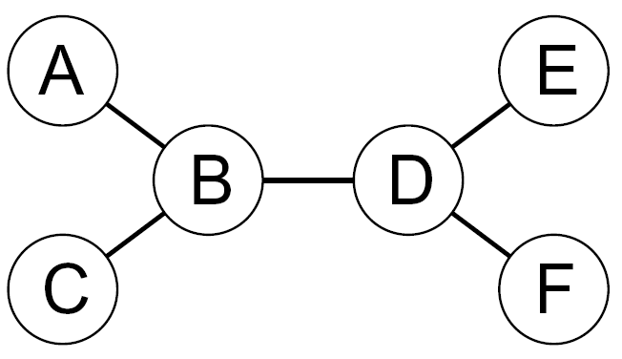
Tree-Structured CSPs
Theorem: if the constraint graph has no loops, the CSP can be solved in O(n d²) time
  Compare to general CSPs, where worst-case time is O(d^{n})
This property also applies to probabilistic reasoning in Bayes nets (later): an example of the relation between structural properties and the complexity of reasoning

Slide 11
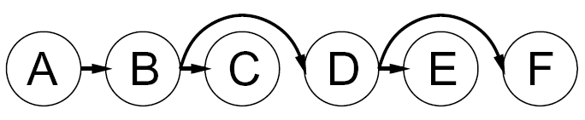
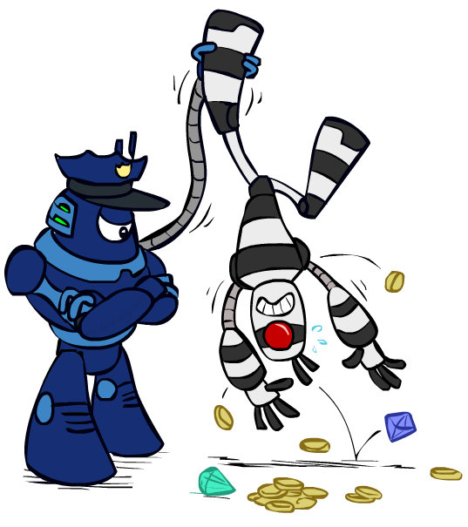

Tree-Structured CSPs
Algorithm for tree-structured CSPs:
  Order: Choose a root variable, order variables so that parents precede children
  Remove backward: For i = n : 2, apply RemoveInconsistent(Parent(X_{i}),X_{i})
  Assign forward: For i = 1 : n, assign X_{i} consistently with Parent(X_{i})
Runtime: O(n d²)
X
X
X

Slide 12
Tree-Structured CSPs
Claim 1: After backward pass, all root-to-leaf arcs are consistent
Proof: Each X→Y was made consistent at one point and Y’s domain could not have been reduced thereafter (because Y’s children were processed before Y)
Claim 2: If root-to-leaf arcs are consistent, forward assignment will not backtrack
Proof: Induction on position
Why doesn’t this algorithm work with cycles in the constraint graph?

Slide 13
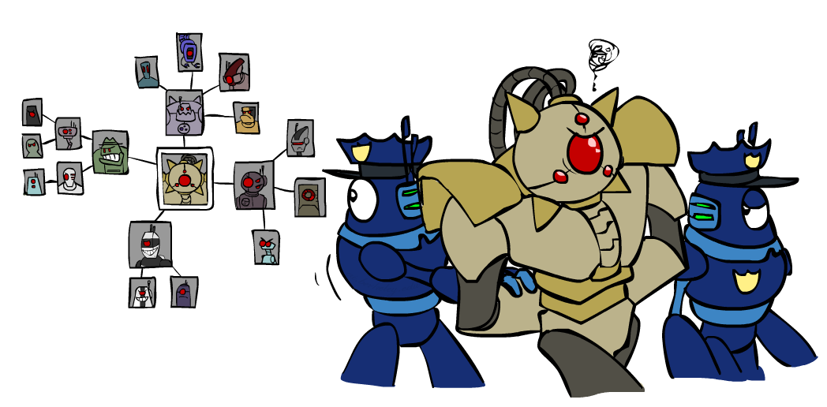
Improving Structure

Slide 14
Nearly Tree-Structured CSPs
Conditioning: instantiate a variable, prune its neighbors' domains
Cutset conditioning: instantiate (in all ways) a set of variables such that the remaining constraint graph is a tree
Cutset size c gives runtime…
  O( (d^{c}) (n-c) d² ), very fast for small c
  E.g., 80 variables, c=10, 4 billion years -> 0.029 seconds

Slide 15
Cutset Conditioning
Choose a cutset
SA
Instantiate the cutset (all possible ways)
SA
SA
SA
Compute residual CSP for each assignment
Solve the residual CSPs (tree structured)

Slide 16
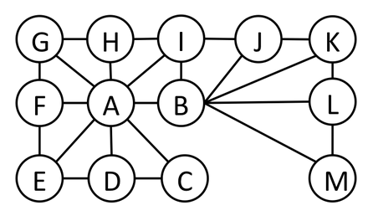
Cutset Quiz
Find the smallest cutset for the graph below.

Slide 17
Tree Decomposition*
Idea: create a tree-structured graph of mega-variables
Each mega-variable encodes part of the original CSP
Subproblems overlap to ensure consistent solutions
M1
M2
M3
M4
WA
≠
NT
NT
≠
Q
Q
≠
NSW
NSW
≠
V
≠
≠
≠
≠
≠
≠
≠
≠
SA
SA
SA
SA
Agree on shared vars
Agree on shared vars
Agree on shared vars
{(WA=r,SA=g,NT=b),
(WA=b,SA=r,NT=g),
…}
{(NT=r,SA=g,Q=b),
(NT=b,SA=g,Q=r),
…}
Agree: (M1,M2) ∈
{((WA=g,SA=g,NT=g), (NT=g,SA=g,Q=g)), …}

Slide 18
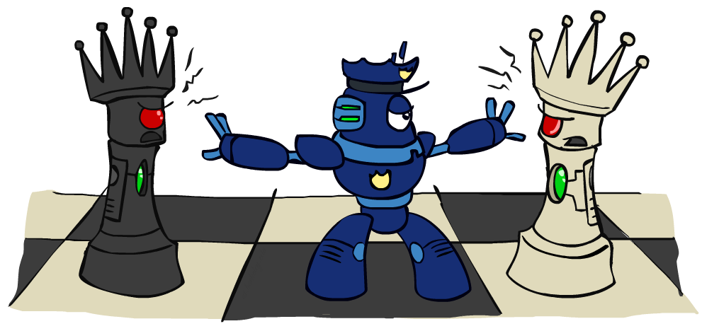
Iterative Improvement

Slide 19
Iterative Algorithms for CSPs
Local search methods typically work with “complete” states, i.e., all variables assigned
To apply to CSPs:
  Take an assignment with unsatisfied constraints
  Operators reassign variable values
  No tree, no fringe! “New age” algorithm
Algorithm: While not solved,
  Variable selection: randomly select any conflicted variable
  Value selection: min-conflicts heuristic:
    Choose a value that violates the fewest constraints

Slide 20
Example: 4-Queens
States: 4 queens in 4 columns (4⁴ = 256 states)
Operators: move queen in column
Goal test: no attacks
Evaluation: c(n) = number of attacks
  [Demo: coloring – iterative improvement]
Notes:
L5D1 – python demos
Coloring – javascript demos

Slide 21
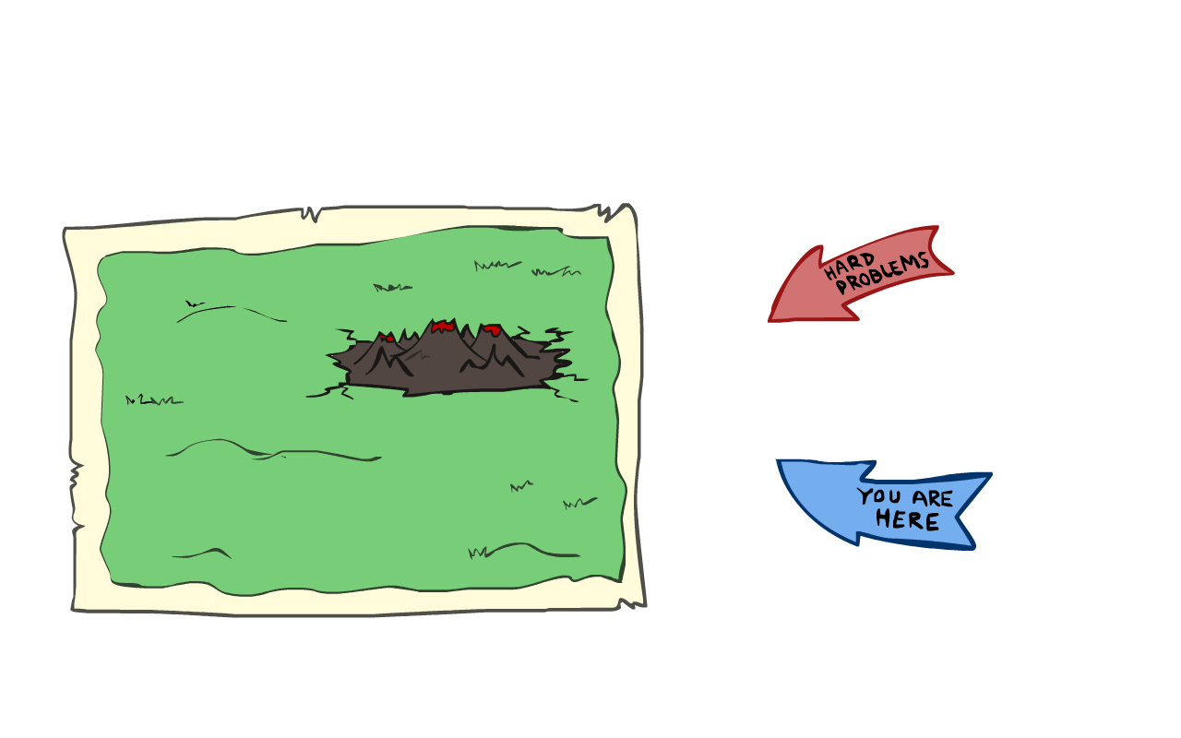
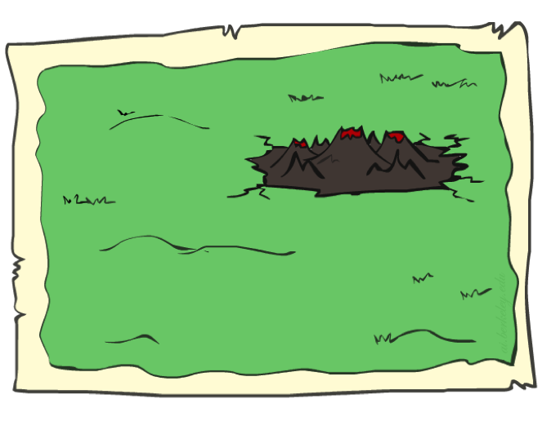
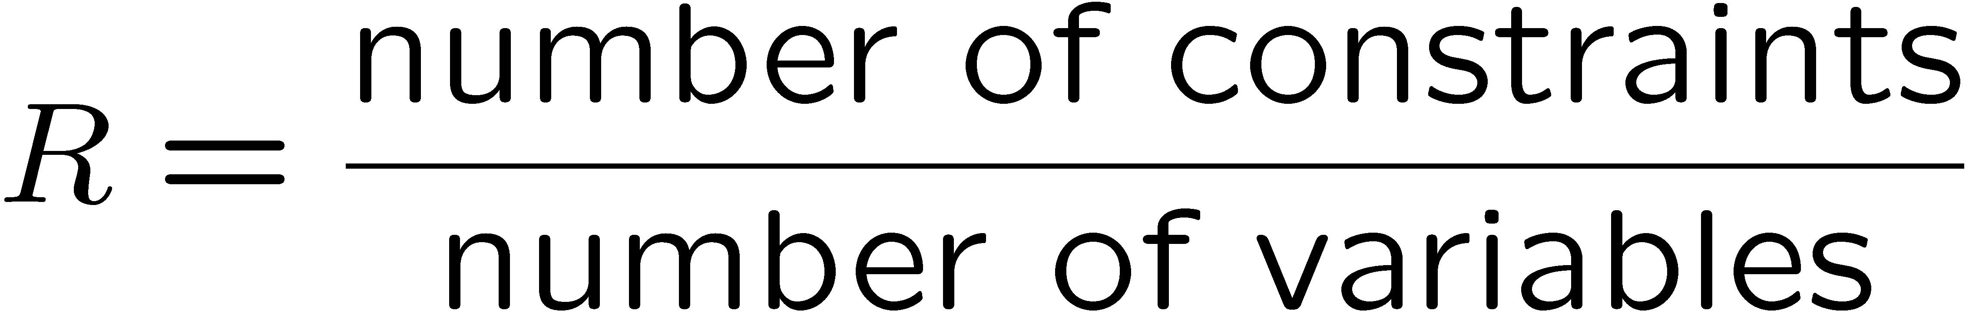
Performance of Min-Conflicts
Given random initial state, can solve n-queens in almost constant time for arbitrary n with high probability (e.g., n = 10,000,000)!
The same appears to be true for any randomly-generated CSP except in a narrow range of the ratio

Slide 22
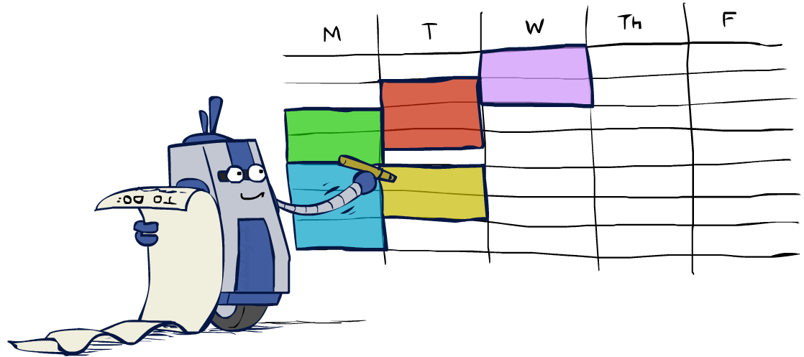
Summary: CSPs
CSPs are a special kind of search problem:
  States are partial assignments
  Goal test defined by constraints
Basic solution: backtracking search
Speed-ups:
  Ordering
  Filtering
  Structure
Iterative min-conflicts is often effective in practice

Slide 23
Break quiz
Given a search problem P expressed in the usual way:
  initial state s₀, states S, actions A, goal test G, transition model Result(s,a)
and a time horizon T, construct a CSP C such that C has a solution exactly when P has a solution of length T, and the solution to P can be read off from the solution to C
Hint: You’ll need some variables for each time step, including A_{t} (the action taken at time t). What are the constraints between time steps? Other constraints on particular time steps?

Slide 24
Break quiz answer
Variables of the CSP are
  Action variables A₀ ,…, A_{T-1} each with domain A
  State variables S₀ ,…, S_{T} , each with domain S
Constraints of the CSP are
  S₀=s₀
  S_{T} satisfies goal test G
  For t=0,…,T-1, S_{t+1}=Result(S_{t}, A_{t})

Slide 25
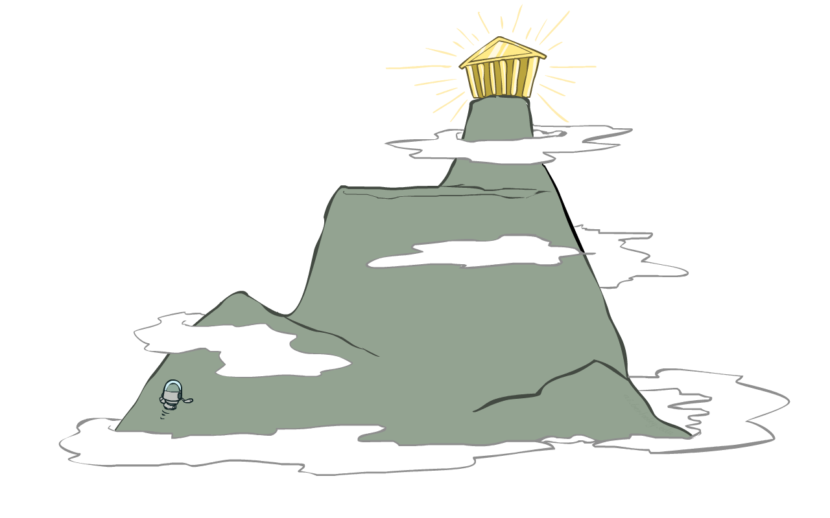
Local Search

Slide 26
Local Search
Tree search keeps unexplored alternatives on the fringe (ensures completeness)
Local search: improve a single option until you can’t make it better
New successor function: local changes
Generally much faster and more memory efficient (but incomplete and suboptimal)
Pretty much unavoidable when the state is “yourself”

Slide 27
Hill Climbing
Simple, general idea:
  Start wherever
  Repeat: move to the best neighboring state
  If no neighbors better than current, quit

Slide 28
Hill Climbing

Slide 29
Hill Climbing Diagram

Slide 30
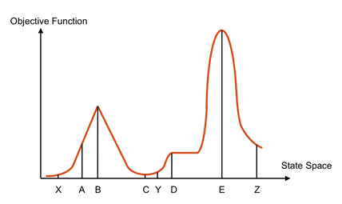
Hill Climbing Quiz
Starting from X, where do you end up ?
Starting from Y, where do you end up ?
Starting from Z, where do you end up ?

Slide 31

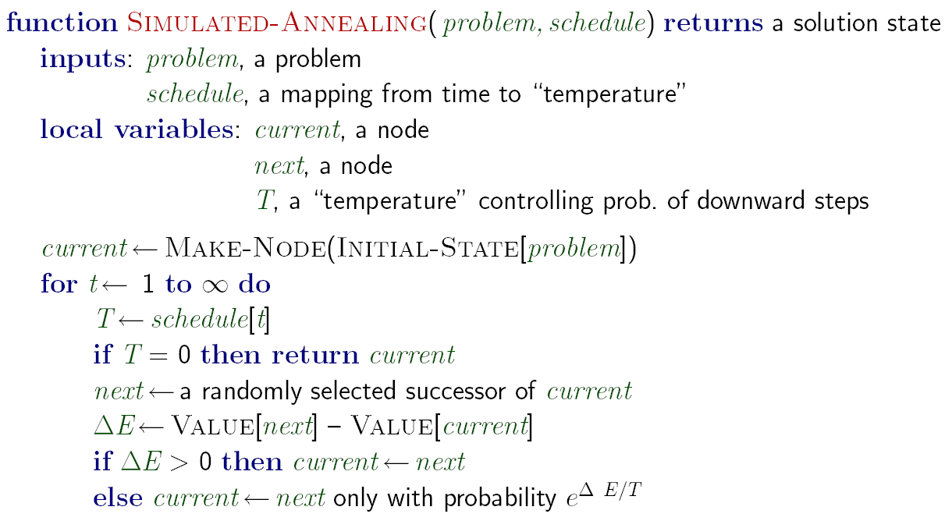
Simulated Annealing
Idea: Escape local maxima by allowing downhill moves
  But make them rarer as time goes on

Slide 32
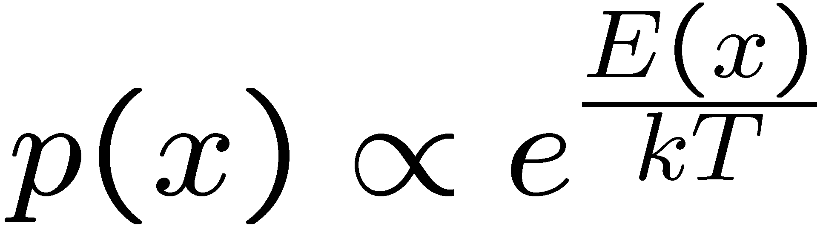
Simulated Annealing
Theoretical guarantee:
  Stationary distribution (Boltzmann):
  If T decreased slowly enough,
  will converge to optimal state!
Is this an interesting guarantee?
Sounds like magic, but reality is reality:
  The more downhill steps you need to escape a local optimum, the less likely you are to ever make them all in a row
  “Slowly enough” may mean exponentially slowly
  Random restart hillclimbing also converges to optimal state…

Slide 33
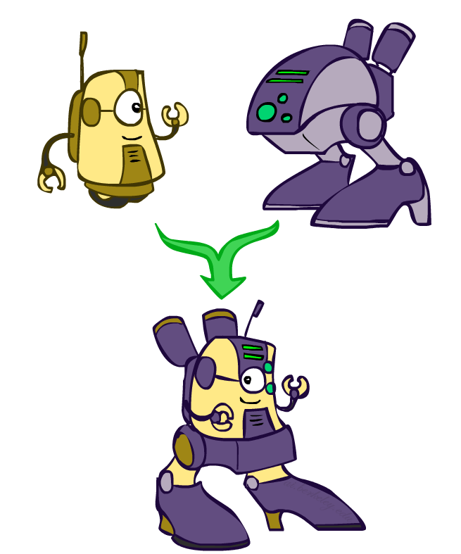
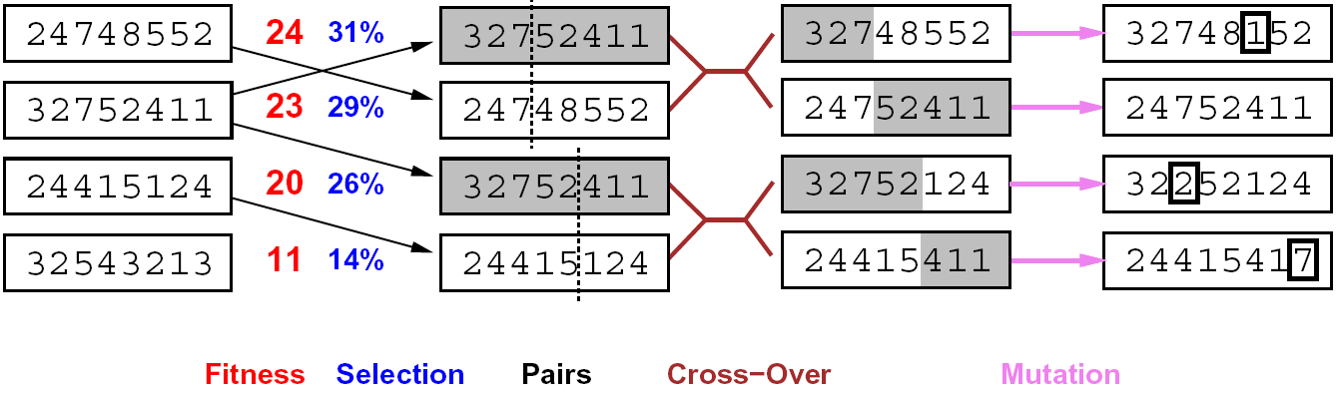
Genetic Algorithms
Genetic algorithms use a natural selection metaphor
  Keep best N hypotheses at each step (selection) based on a fitness function
  Also have pairwise crossover operators, with optional mutation to give variety
Possibly the most misunderstood, misapplied (and even maligned) technique around

Slide 34
Example: N-Queens
Why does crossover make sense here?
When wouldn’t it make sense?
What would mutation be?
What would a good fitness function be?

Slide 35
Local Search in Continuous Spaces
Put 3 airports in Romania to minimize the sum of squared distance of each city to its nearest airport
Variables: x₁,y₁,x₂,y₂,x₃,y₃
C_{i} = set of cities nearest to i
Cost f(x₁,y₁,x₂,y₂,x₃,y₃) =
(x₁,y₁)
(x₂,y₂)
(x₃,y₃)

Slide 36
Local Search in Continuous Spaces
Cost f(x₁,y₁,x₂,y₂,x₃,y₃) =
Method 1: discretize, compute empirical gradient f(x₁+dx,y₁,x₂,y₂,x₃,y₃) etc.
Method 2: stochastic descent: generate small random vector dx and accept if f(x+dx) < f(x)
(x₁,y₁)
(x₂,y₂)
(x₃,y₃)

Slide 37
Local Search in Continuous Spaces
Cost f(x₁,y₁,x₂,y₂,x₃,y₃) =
Method 3: take small step along gradient vector
(x₁,y₁)
(x₂,y₂)
(x₃,y₃)

Slide 38
Example: Fault Diagnosis
Causes
Symptoms
Fault networks:
  Variables?
  Domains?
  Constraints?
Various ways to query,
given symptoms
  Some cause (abduction)
  Simplest cause
  All possible causes
  What test is most useful?
  Prediction: cause to effect
We’ll see this idea again with Bayes’ nets
SMTP down
Can’t email
DNS down
Can’t IM
Firewall blocking
Can’t print
Printer jam

Slide 39
Beam Search
Like greedy hillclimbing search, but keep K states at all times:
Variables: beam size, encourage diversity?
The best choice in MANY practical settings
Complete? Optimal?
Why do we still need optimal methods?
Greedy Search
Beam Search

