Slide 1
Announcements
Homework 4
  Due tonight at 11:59pm
Project 3
  Due 3/8 at 4:00pm

Slide 2

CS 188: Artificial Intelligence
Constraint Satisfaction Problems
Instructor: Stuart Russell & Sergey Levine, University of California, Berkeley
[These slides were created by Dan Klein, Pieter Abbeel, Sergey Levine. http://ai.berkeley.edu.]

Slide 3

CS188 so far…
Search and planning
  Define a state space
  Define a goal test
  Find path from start to goal
Game trees
  Define utilities
  Find path from start that maximizes utility
MDPs
  Define rewards, utility = (discounted) sum of rewards
  Find policy that maximizes utility
Reinforcement learning
  Just like MDPs, only T and R are not known in advance
Today: constraint satisfaction
  Find solution that satisfies constraints
  Not just for finding a sequential plan

Slide 4

What is Search For?
Assumptions about the world: a single agent, deterministic actions, fully observed state, discrete state space
Planning: sequences of actions
  The path to the goal is the important thing
  Paths have various costs, depths
Identification: assignments to variables
  The goal itself is important, not the path
  All paths at the same depth (for some formulations)
  CSPs are a specialized class of identification problems

Slide 5

Constraint Satisfaction Problems

Slide 6

Constraint Satisfaction Problems
Standard search problems:
  State is a “black box”: arbitrary data structure
  Goal test can be any function over states
  Successor function can also be anything
Constraint satisfaction problems (CSPs):
  A special subset of search problems
  State is defined by variables X_{i} with values from a domain D (sometimes D depends on i)
  Goal test is a set of constraints specifying allowable combinations of values for subsets of variables
Simple example of a formal representation language
Allows useful general-purpose algorithms with more power than standard search algorithms

Slide 7
CSP Examples

Slide 8


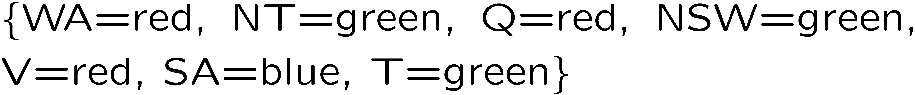
Example: Map Coloring
Variables:
Domains:
Constraints: adjacent regions must have different colors
Solutions are assignments satisfying all constraints, e.g.:
Implicit:
Explicit:

Slide 9

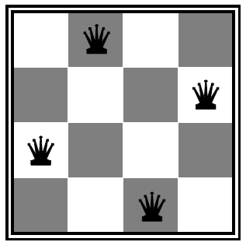
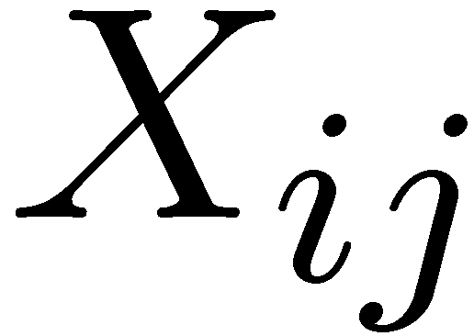

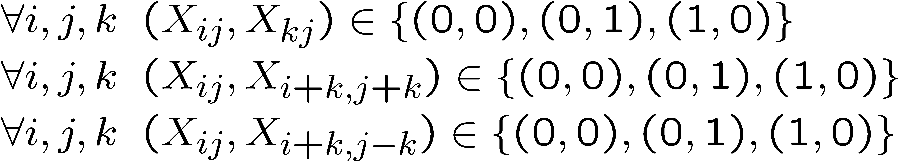
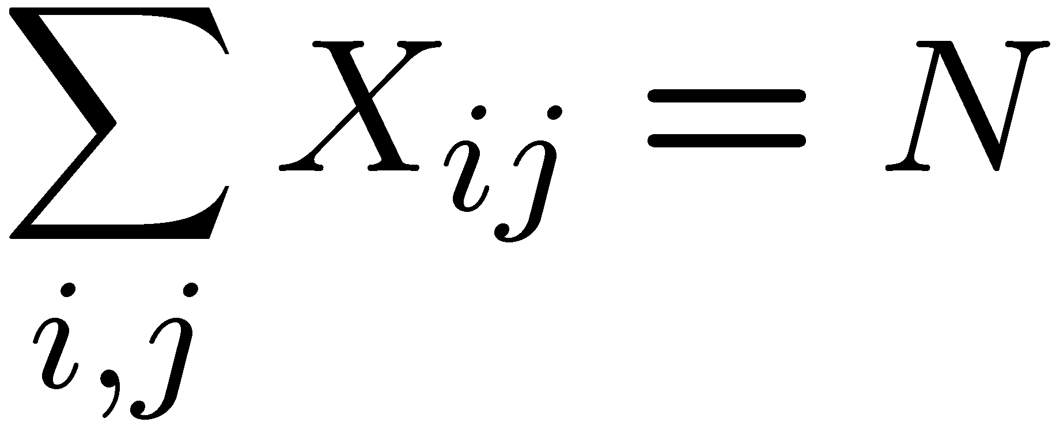
Example: N-Queens
Formulation 1:
  Variables:
  Domains:
  Constraints

Slide 10







Example: N-Queens
Formulation 2:
  Variables:
  Domains:
  Constraints:
Implicit:
Explicit:

Slide 11
Constraint Graphs

Slide 12
Constraint Graphs
Binary CSP: each constraint relates (at most) two variables
Binary constraint graph: nodes are variables, arcs show constraints
General-purpose CSP algorithms use the graph structure to speed up search. E.g., Tasmania is an independent subproblem!
Notes:
Demo:
Run constraint.jar or constraint.exe, load the 5 queens problem.
Demo is just showing the n-queens applet as illustration of constraint graph, but later in lecture we’ll interact with the applet.
aispace.org will have the latest version

Slide 13


Example: Cryptarithmetic
Variables:
Domains:
Constraints:
Notes:
0=7, R=4, W=6, U=2, T=8, F=1; 867 + 867 = 1734

Slide 14
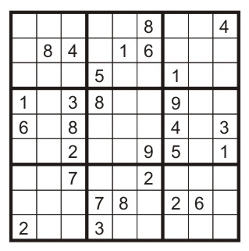
Example: Sudoku
Variables:
  Each (open) square
Domains:
  {1,2,…,9}
Constraints:
9-way alldiff for each column
9-way alldiff for each row
9-way alldiff for each region
(or can have a bunch of pairwise inequality constraints)

Slide 15
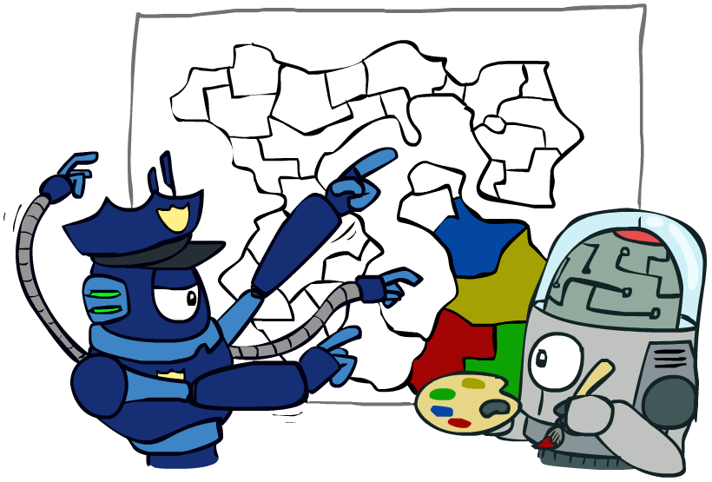
Varieties of CSPs and Constraints

Slide 16

Varieties of CSPs
Discrete Variables
  Finite domains
    Size d means O(d^{n}) complete assignments
    E.g., Boolean CSPs, including Boolean satisfiability (NP-complete)
  Infinite domains (integers, strings, etc.)
    E.g., job scheduling, variables are start/end times for each job
    Linear constraints solvable, nonlinear undecidable
Continuous variables
  E.g., start/end times for Hubble Telescope observations
  Linear constraints solvable in polynomial time by LP methods (see cs170 for a bit of this theory)

Slide 17


Varieties of Constraints
Varieties of Constraints
  Unary constraints involve a single variable (equivalent to reducing domains), e.g.:
  Binary constraints involve pairs of variables, e.g.:
  Higher-order constraints involve 3 or more variables:
  e.g., cryptarithmetic column constraints
Preferences (soft constraints):
  E.g., red is better than green
  Often representable by a cost for each variable assignment
  Gives constrained optimization problems
  (We’ll ignore these until we get to Bayes’ nets)

Slide 18
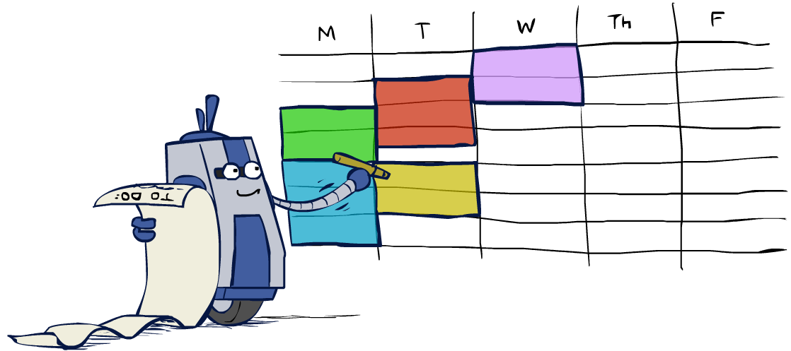
Real-World CSPs
Scheduling problems: e.g., when can we all meet?
Timetabling problems: e.g., which class is offered when and where?
Assignment problems: e.g., who teaches what class
Hardware configuration
Transportation scheduling
Factory scheduling
Circuit layout
Fault diagnosis
… lots more!
Many real-world problems involve real-valued variables…

Slide 19

Solving CSPs

Slide 20
Standard Search Formulation
Standard search formulation of CSPs
States defined by the values assigned so far (partial assignments)
  Initial state: the empty assignment, {}
  Successor function: assign a value to an unassigned variable
  Goal test: the current assignment is complete and satisfies all constraints
We’ll start with the straightforward, naïve approach, then improve it

Slide 21
Search Methods
What would BFS do?
What would DFS do?
What problems does naïve search have?
[Demo: coloring -- dfs]
Notes:
Demo:
CS188 javascript demos -> source -> exercises -> csps -> CSPs demos -> CSPs demos.html
Settings:
Graph = Simple
Algorithm = Naïve Search
Ordering = None
Filtering = None

Slide 22

Video of Demo Coloring -- DFS

Slide 23

Backtracking Search

Slide 24
Backtracking Search
Backtracking search is the basic uninformed algorithm for solving CSPs
Idea 1: One variable at a time
  Variable assignments are commutative, so fix ordering
  I.e., [WA = red then NT = green] same as [NT = green then WA = red]
  Only need to consider assignments to a single variable at each step
Idea 2: Check constraints as you go
  I.e. consider only values which do not conflict with previous assignments
  Might have to do some computation to check the constraints
  “Incremental goal test”
Depth-first search with these two improvements
is called backtracking search (not the best name)
Can solve n-queens for n ≈ 25

Slide 25
Video of Demo Coloring – Backtracking

Slide 26
Backtracking Example

Slide 27
Backtracking Search
Backtracking = DFS + variable-ordering + fail-on-violation
What are the choice points?
[Demo: coloring -- backtracking]
Notes:
Demo:
CS188 javascript demos -> source -> exercises -> csps -> CSPs demos -> CSPs demos.html
Settings:
Graph = Simple
Algorithm = Backtracking
Ordering = None
Filtering = None

Slide 28

Improving Backtracking
General-purpose ideas give huge gains in speed
Ordering:
  Which variable should be assigned next?
  In what order should its values be tried?
Filtering: Can we detect inevitable failure early?
Structure: Can we exploit the problem structure?

Slide 29

Filtering

Slide 30
Filtering: Forward Checking
Filtering: Keep track of domains for unassigned variables and cross off bad options
Forward checking: Cross off values that violate a constraint when added to the existing assignment
WA
NT
Q
SA
NSW
V
[Demo: coloring -- forward checking]
Notes:
Demo:
CS188 javascript demos -> source -> exercises -> csps -> CSPs demos -> CSPs demos.html
Settings:
Graph = Simple
Algorithm = Backtracking
Ordering = None
Filtering = Forward Checking

Slide 31
Video of Demo Coloring – Backtracking with Forward Checking

Slide 32
Filtering: Constraint Propagation
Forward checking propagates information from assigned to unassigned variables, but doesn't provide early detection for all failures:
NT and SA cannot both be blue!
Why didn’t we detect this yet?
Constraint propagation: reason from constraint to constraint
NT
Q
WA
SA
NSW
V

Slide 33

Consistency of A Single Arc
An arc X → Y is consistent iff for every x in the tail there is some y in the head which could be assigned without violating a constraint
Forward checking: Enforcing consistency of arcs pointing to each new assignment
NT
Q
WA
SA
NSW
V
Delete from the tail!

Slide 34
Arc Consistency of an Entire CSP
A simple form of propagation makes sure all arcs are consistent:
Important: If X loses a value, neighbors of X need to be rechecked!
Arc consistency detects failure earlier than forward checking
Can be run as a preprocessor or after each assignment
What’s the downside of enforcing arc consistency?
NT
Q
WA
SA
NSW
V
Remember: Delete from the tail!

Slide 35
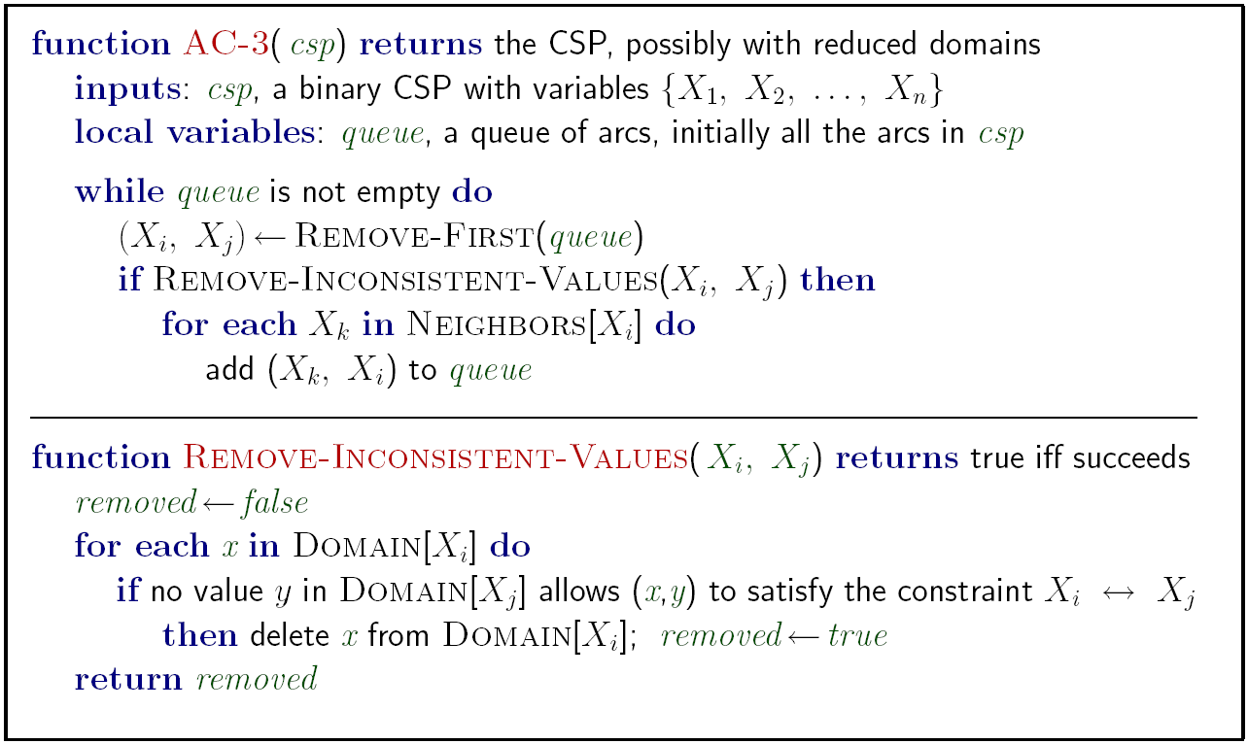
Enforcing Arc Consistency in a CSP
Runtime: O(n²d³), can be reduced to O(n²d²)
… but detecting all possible future problems is NP-hard
Notes:
Auto-consistency (note initially nothing gets deleted/pruned since there are consistent options for all constraints for initial variable domains)
Flashes whenever something needs to be re-checked

Slide 36
Limitations of Arc Consistency
After enforcing arc consistency:
  Can have one solution left
  Can have multiple solutions left
  Can have no solutions left (and not know it)
Arc consistency still runs inside a backtracking search!
What went wrong here?
[Demo: coloring -- forward checking]
[Demo: coloring -- arc consistency]
Notes:
Demo:
CS188 javascript demos -> source -> exercises -> csps -> CSPs demos -> CSPs demos.html
Settings:
Graph = Complex
Algorithm = Backtracking
Ordering = None
Filtering = Forward Checking (first) / Arc Consistency (second)

Slide 37
Video of Demo Coloring – Backtracking with Forward Checking – Complex Graph

Slide 38
Video of Demo Coloring – Backtracking with Arc Consistency – Complex Graph

Slide 39

Ordering

Slide 40

Ordering: Minimum Remaining Values
Variable Ordering: Minimum remaining values (MRV):
  Choose the variable with the fewest legal values left in its domain
Why min rather than max?
Also called “most constrained variable”
“Fail-fast” ordering

Slide 41

Ordering: Least Constraining Value
Value Ordering: Least Constraining Value
  Given a choice of variable, choose the least constraining value
  I.e., the one that rules out the fewest values in the remaining variables
  Note that it may take some computation to determine this! (E.g., rerunning filtering)
Why least rather than most?
Combining these ordering ideas makes
1000 queens feasible
[Demo: coloring – backtracking + AC + ordering]
Notes:
Demo:
CS188 javascript demos -> source -> exercises -> csps -> CSPs demos -> CSPs demos.html
Settings:
Graph = Complex
Algorithm = Backtracking
Ordering = MRV
Filtering = Forward Checking
Solves already without any need for backtracking
Note: need a bigger problem to illustrate relevance of backtracking+AC+MRV+MCV

Slide 42
Limitations of Arc Consistency
After enforcing arc consistency:
  Can have one solution left
  Can have multiple solutions left
  Can have no solutions left (and not know it)
Arc consistency still runs inside a backtracking search!
What went wrong here?
[Demo: coloring -- forward checking]
[Demo: coloring -- arc consistency]
Notes:
Demo:
CS188 javascript demos -> source -> exercises -> csps -> CSPs demos -> CSPs demos.html
Settings:
Graph = Complex
Algorithm = Backtracking
Ordering = None
Filtering = Forward Checking (first) / Arc Consistency (second)

Slide 43
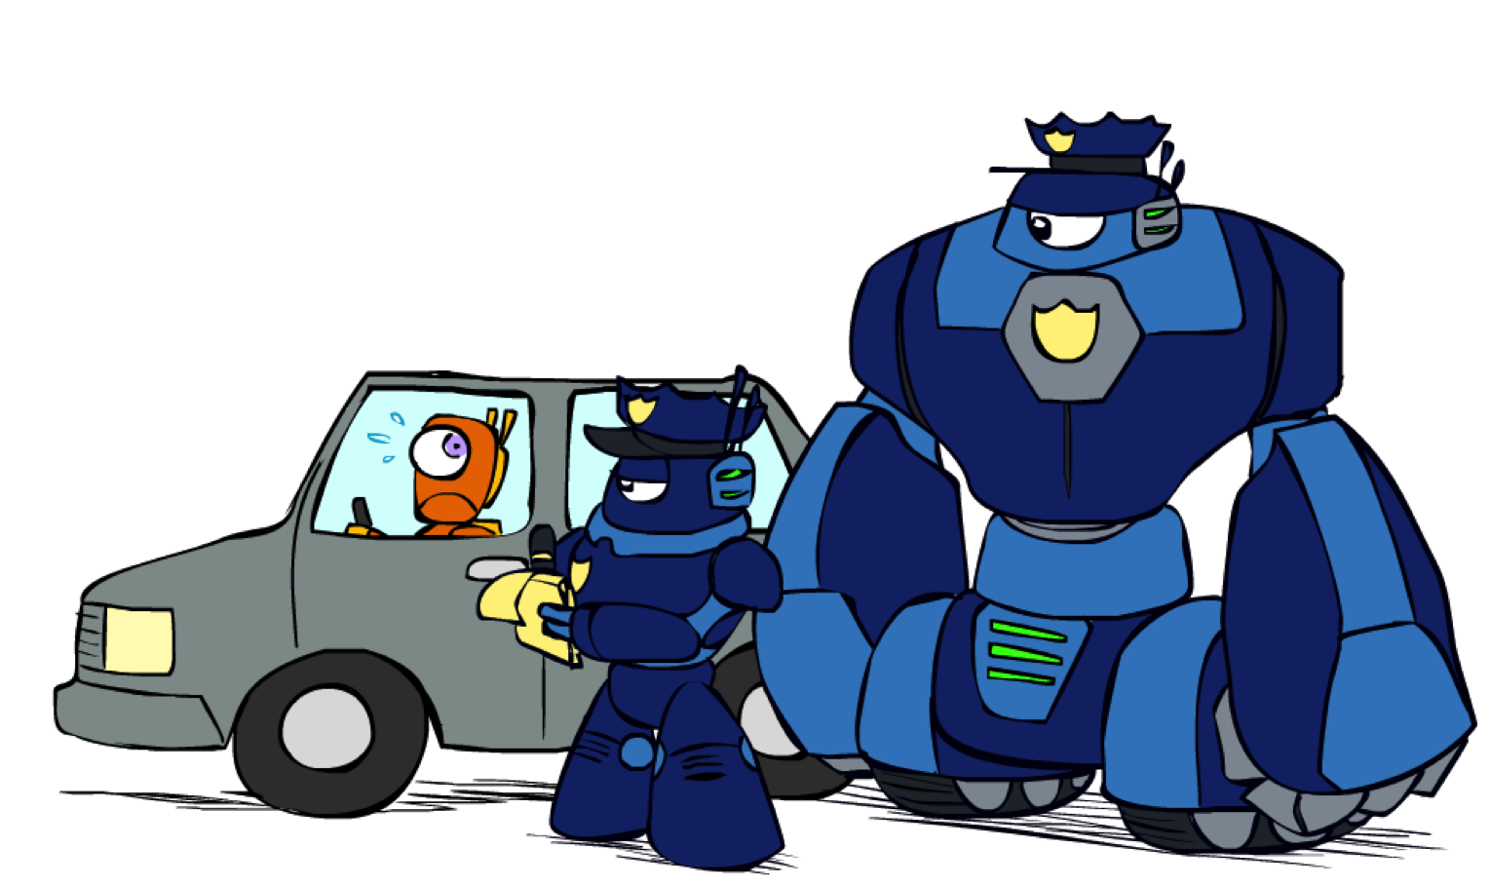
K-Consistency

Slide 44
K-Consistency
Increasing degrees of consistency
  1-Consistency (Node Consistency): Each single node’s domain has a value which meets that node’s unary constraints
  2-Consistency (Arc Consistency): For each pair of nodes, any consistent assignment to one can be extended to the other
  K-Consistency: For each k nodes, any consistent assignment to k-1 can be extended to the k^{th} node.
Higher k more expensive to compute
(You need to know the k=2 case: arc consistency)

Slide 45
Strong K-Consistency
Strong k-consistency: also k-1, k-2, … 1 consistent
Claim: strong n-consistency means we can solve without backtracking!
Why?
  Choose any assignment to any variable
  Choose a new variable
  By 2-consistency, there is a choice consistent with the first
  Choose a new variable
  By 3-consistency, there is a choice consistent with the first 2
  …
Lots of middle ground between arc consistency and n-consistency! (e.g. k=3, called path consistency)

