Slide 1
Announcements
Midterm 2 done!
Homework 6
  Due Friday 7/31 at 11:59pm
Project 4
  Due Friday 7/31 at 11:59pm

Slide 2
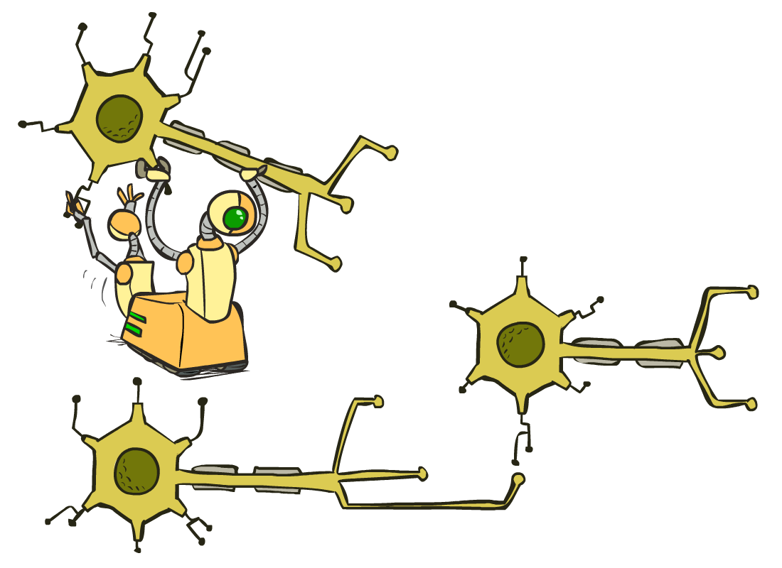
CS 188: Artificial Intelligence
Neural Nets
Instructor: Nikita Kitaev --- University of California, Berkeley
Notes:
Please retain proper attribution, including the reference to ai.berkeley.edu. Thanks!

Slide 3
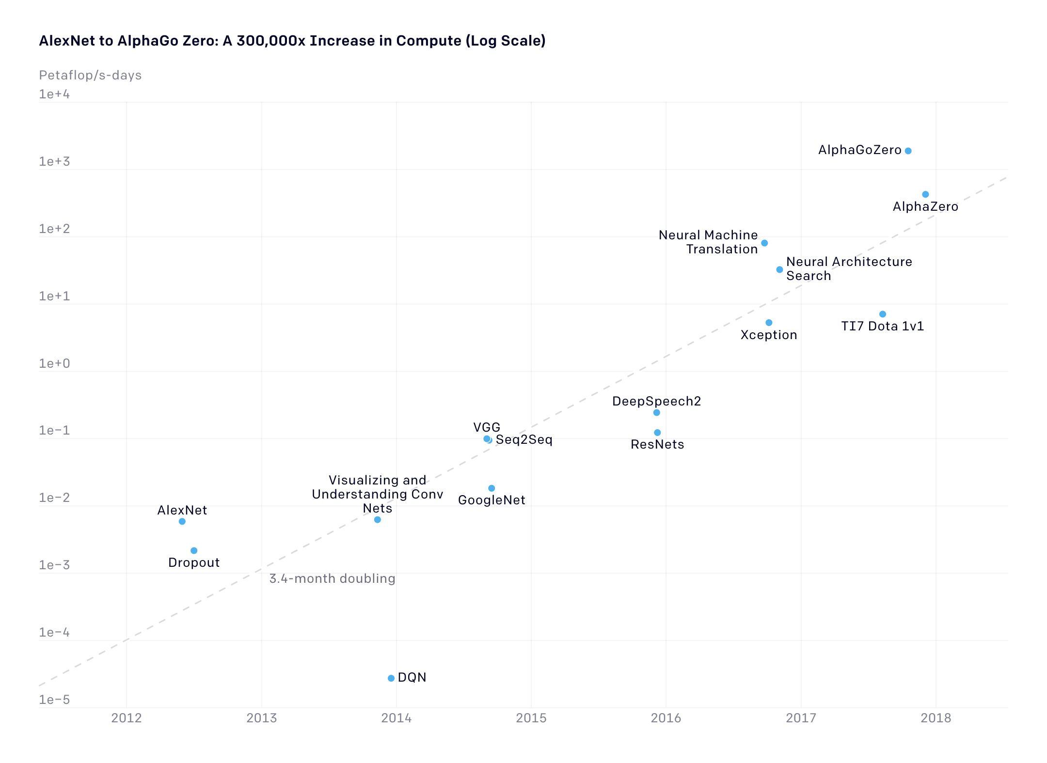
Neural Networks
[Amodei, Hernandez, et al. / OpenAI]

Slide 4
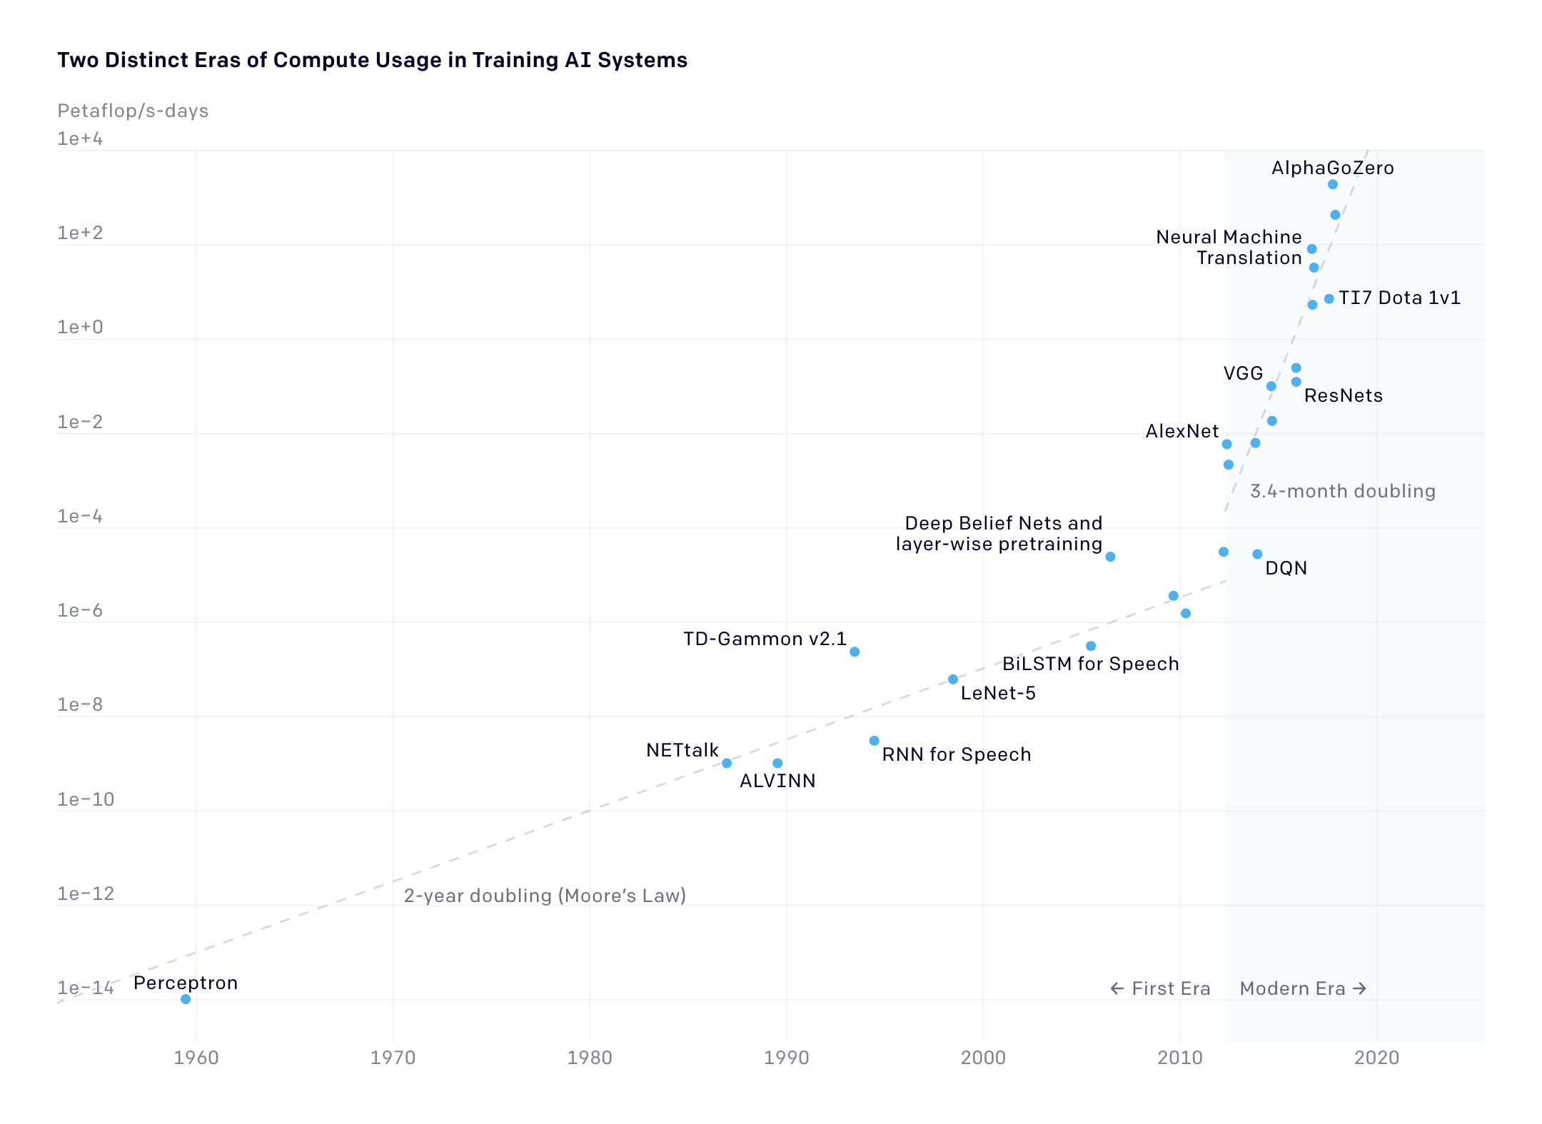
Neural Networks
[Amodei, Hernandez, et al. / OpenAI]

Slide 5
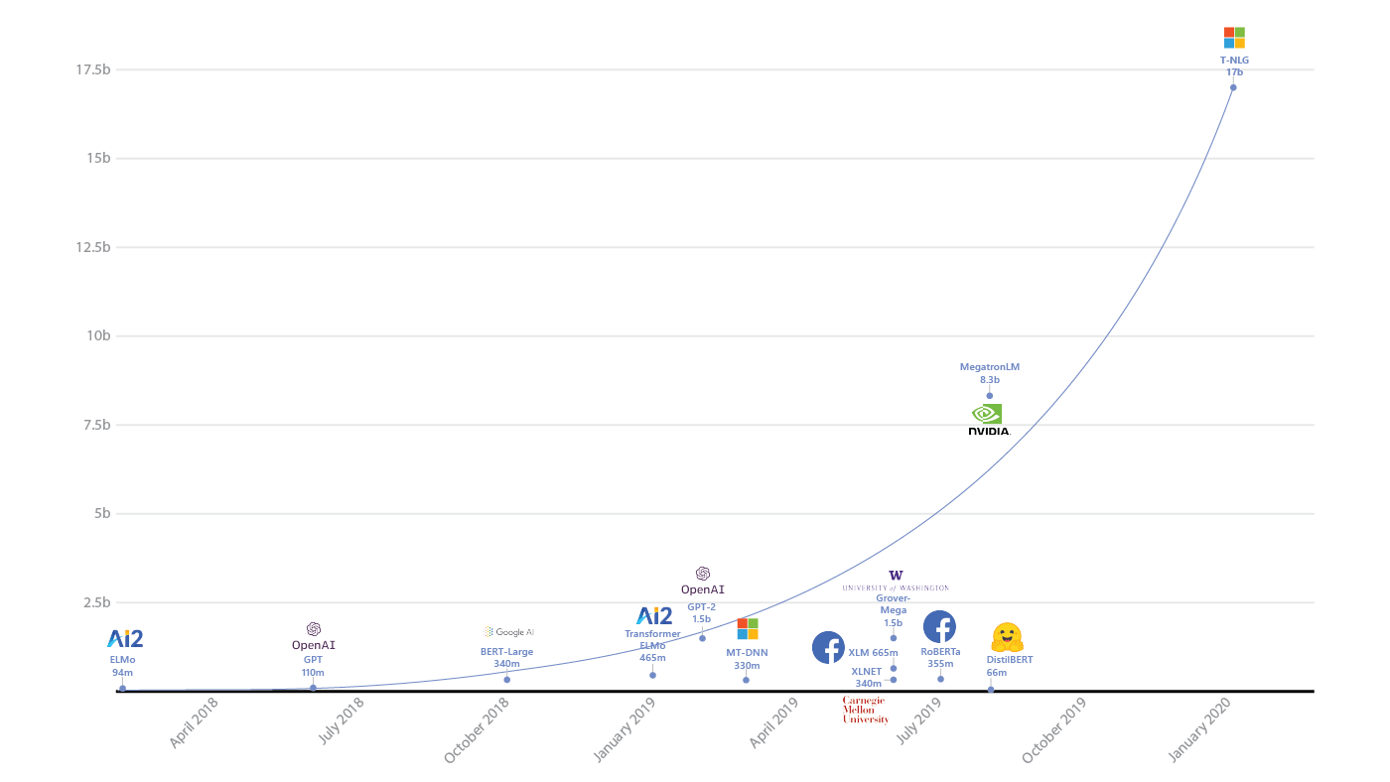
Neural Networks
[Corby Rosset / Microsoft]

Slide 6
Neural Networks
GPT-3
175B
Notes:
$4.6 million
300 billion tokens of text

Slide 7

Overfitting?
30
Neural Network with 175 Billion Parameters?
25
20
Degree 15 polynomial
15
10
5
0
-5
-10
-15
0
2
4
6
8
10
12
14
16
18
20

Slide 8
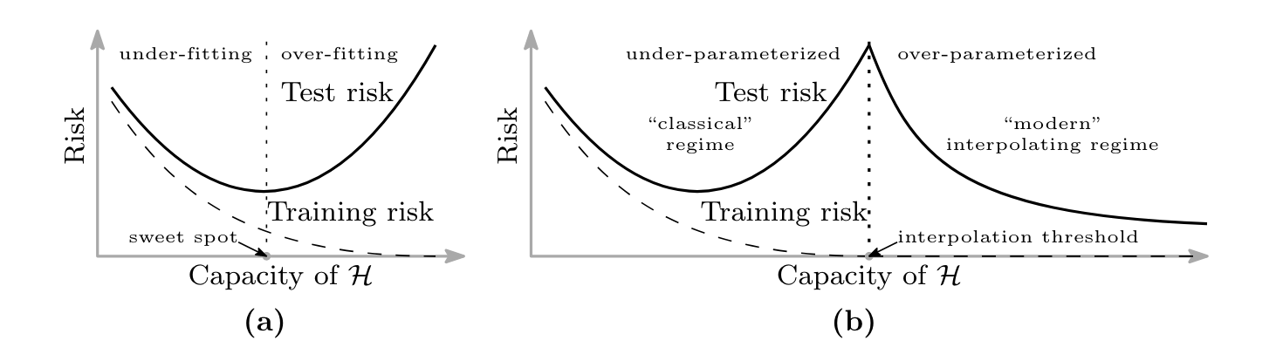
Overfitting?
[Belkin et al. 2019]

Slide 9
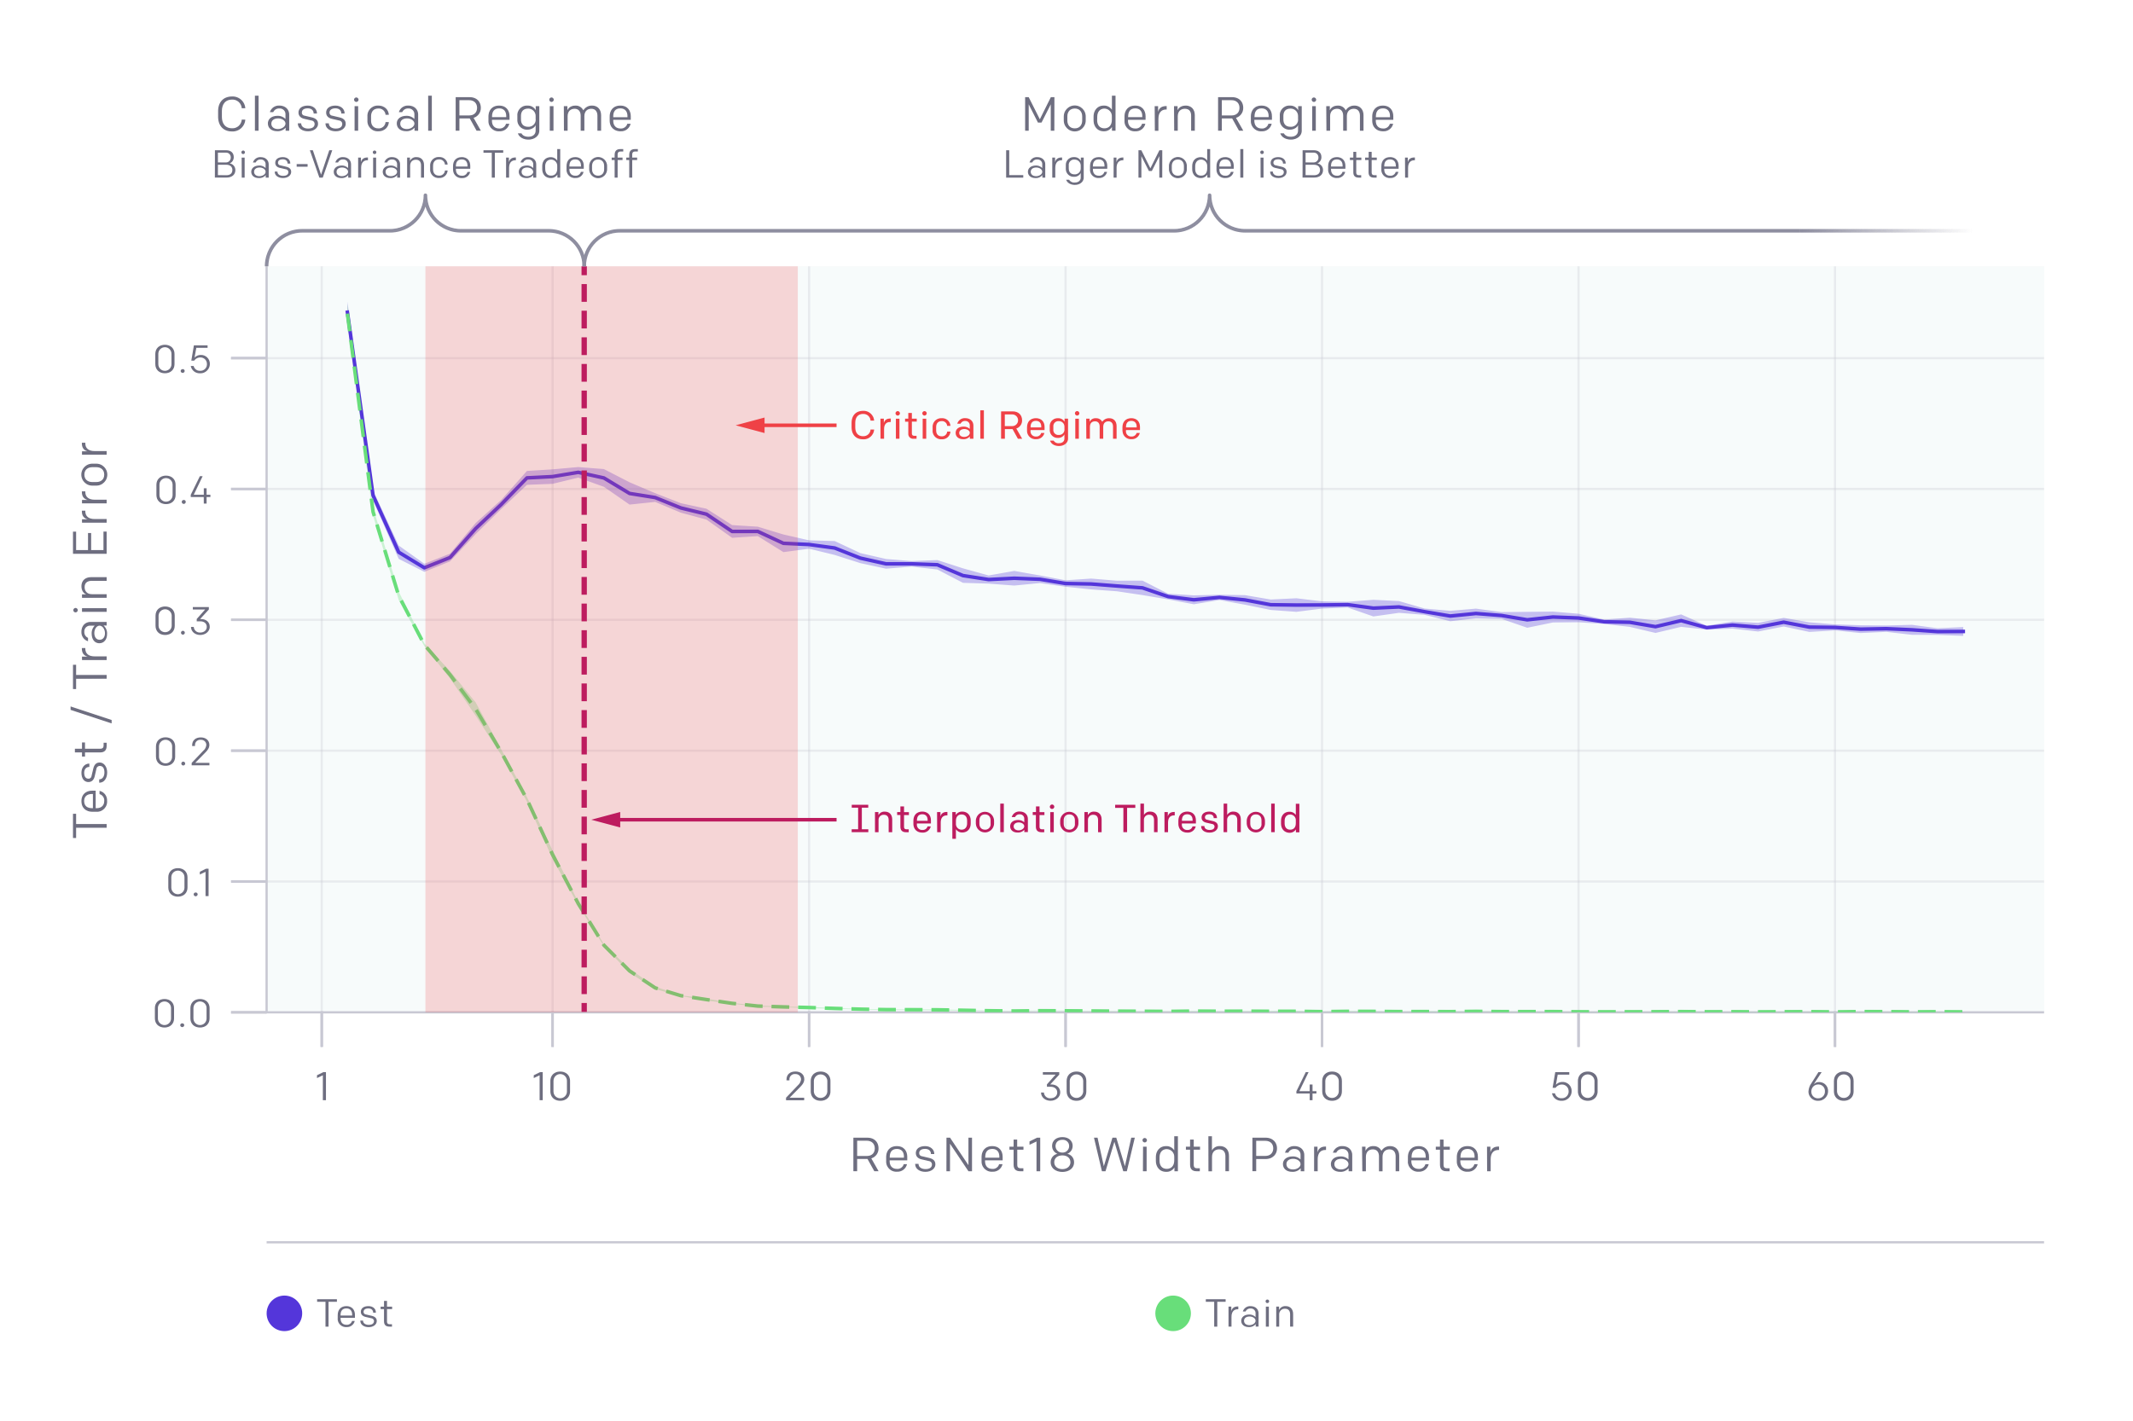
Overfitting?
[Nakkiran et al.]

Slide 10
Parameter Sharing
Text can have different lengths
Images can have different sizes
Databases can have different numbers of entries

Slide 11
Recurrent Neural Networks
x₁
softmax
x₂
…
x₃
…
…
…
…
…
x_{L}
g = nonlinear activation function

Slide 12
Recurrent Neural Networks
x₁
softmax
x₂
…
x₃
…
…
…
…
…
x_{L}
g = nonlinear activation function

Slide 13
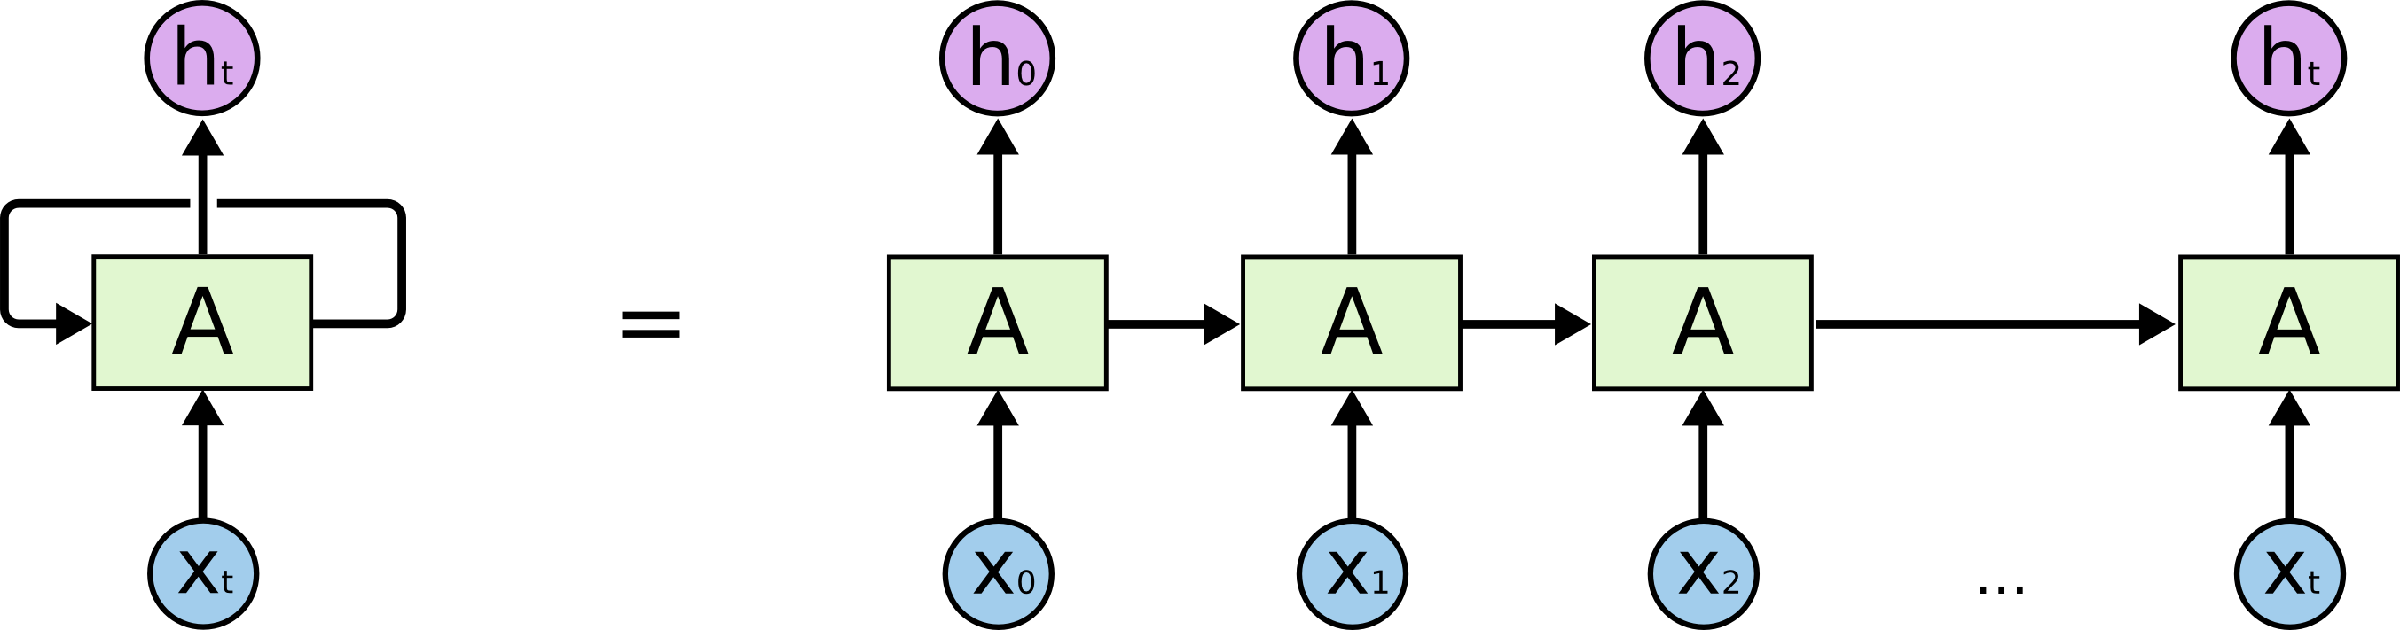
Recurrent Neural Networks

Slide 14
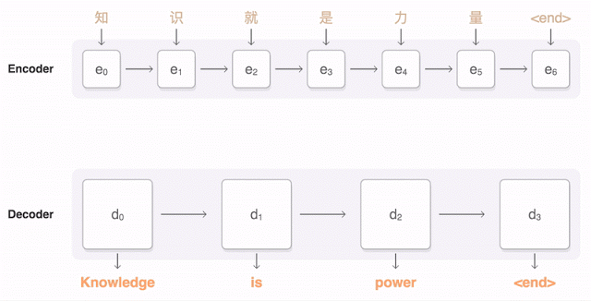
Machine Translation
Google Neural Machine Translation
Notes:
https://research.googleblog.com/2016/09/a-neural-network-for-machine.html

Slide 15
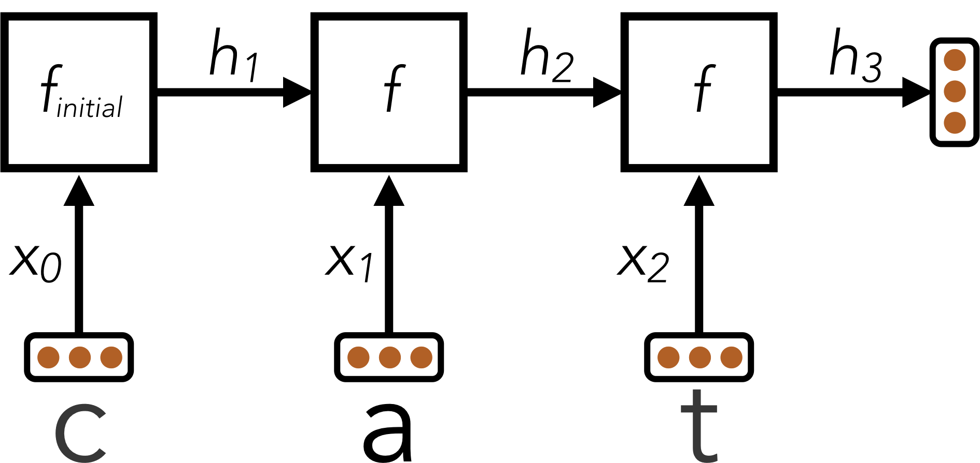
Language Identification
Project 5 (you will implement this!)
Word | Language
discussed | English
eternidad | Spanish
itseänne | Finnish
paleis | Dutch
mieszkać | Polish
Notes:
https://research.googleblog.com/2016/09/a-neural-network-for-machine.html

Slide 16
Parameter Sharing
General idea: re-use the same weights for multiple computations in a network
Especially useful for dealing with variable-size input

Slide 17
Connectivity Patterns
Deep networks (many layers) help with model quality
  Hence the name “Deep Learning”
But they can be hard to train!

Slide 18
Connectivity Patterns
x₁
softmax
x₂
…
x₃
…
…
…
…
…
x_{L}
g = nonlinear activation function

Slide 19
Connectivity Patterns
x₁
…
g = nonlinear activation function

Slide 20
Connectivity Patterns
Deep paths help with expressing complicated functions
Shallow paths are easier to train
Solution: use a mix of both!

Slide 21
Connectivity Patterns
x₁
softmax
x₂
…
x₃
…
…
…
…
…
x_{L}
g = nonlinear activation function

Slide 22
Connectivity Patterns
x₁
softmax
x₂
…
x₃
…
…
…
…
…
x_{L}
g = nonlinear activation function

Slide 23
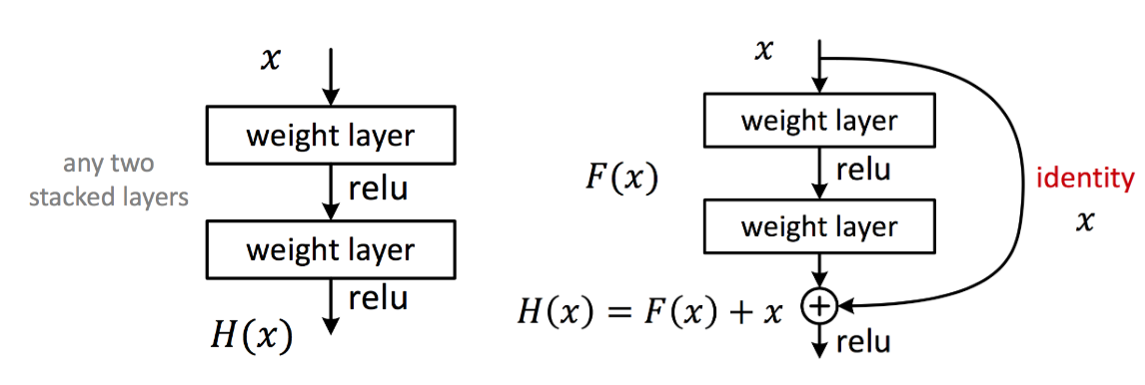
Connectivity Patterns
[He et al. 2015]

Slide 24
Residual Neural Network
[He et al. 2015]

Slide 25
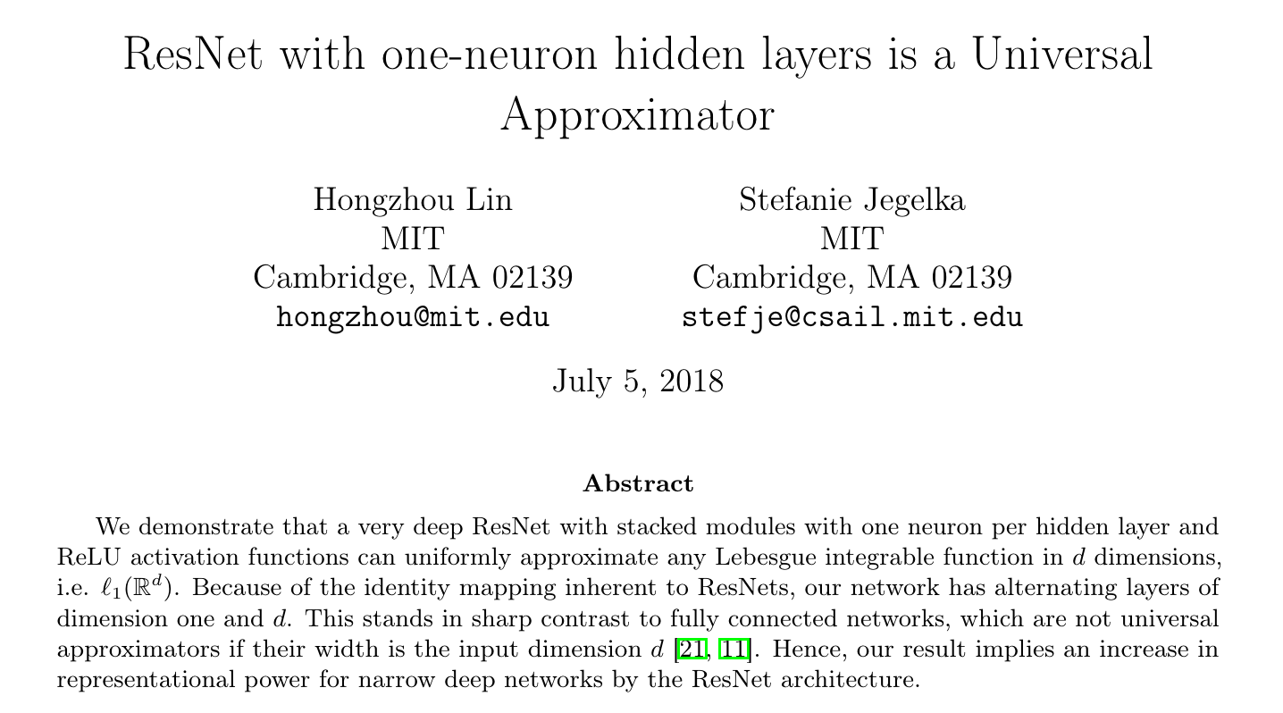
Residual Neural Network

Slide 26
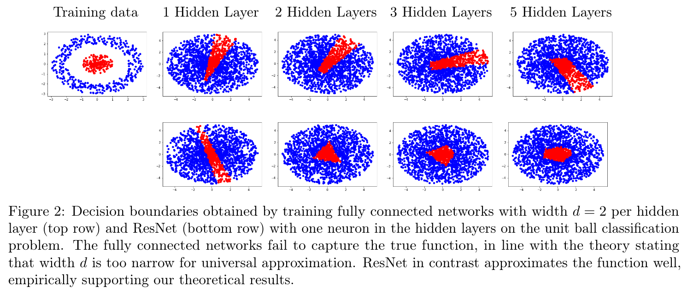
Residual Neural Network

Slide 27
Connectivity Patterns
Deep paths help with expressing complicated functions
Shallow paths are easier to train
Solution: use a mix of both!
Example: Residual Networks (ResNet)

Slide 28
Stability
Activations

Slide 29
Connectivity Patterns
x₁
…
g = nonlinear activation function

Slide 30
Stability
Activations
  Choice of how to initialize weights
  Normalization layers
Optimization
  Per-parameter learning rates
  Adaptive learning rates
  Learning rate schedules

Slide 31
Summary of Recent Trends in Neural Nets
More data, more computation, more powerful hardware
  Over-parametrization can help with generalization!
Architecture design for specific input modalities and tasks
Increasing depths, while maintaining shallow paths
Careful tuning to maintain stability
Applications to new domains, tasks, and problem formulations

