Slide 1
Announcements
Written Assessment 3 due now!
Final Exam
  Thursday 8/13 at 12pm-3pm (alternate slot 12 hours later at 12am-3am)

Slide 2
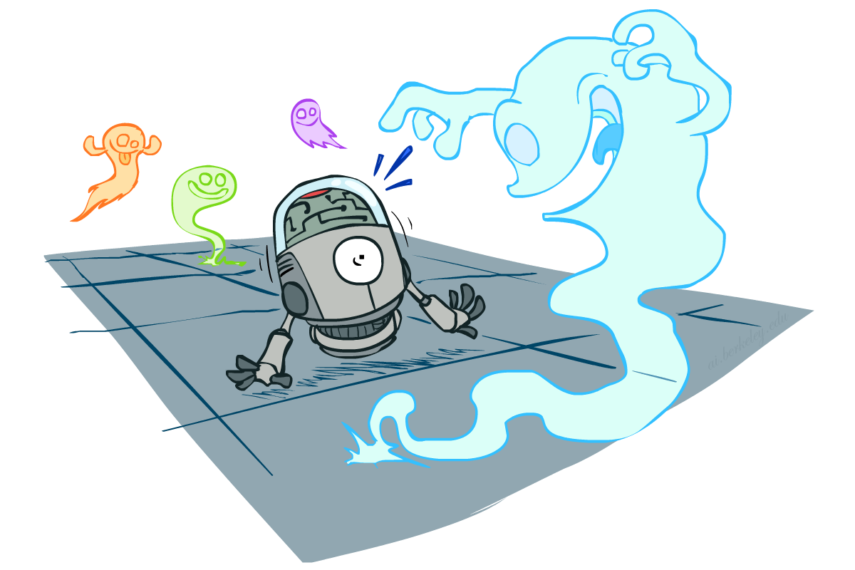
CS 188: Artificial Intelligence
Probabilistic Reasoning (Review II)
Instructor: Nikita Kitaev --- University of California, Berkeley
[Slides adapted from Dan Klein and Pieter Abbeel]
Notes:
Please retain proper attribution, including the reference to ai.berkeley.edu. Thanks!

Slide 3

Course Topics
Part I: Intelligence from Computation
  Fast search / planning (yesterday)
  Adversarial and uncertain search
    Game trees and MDPs (yesterday)
    Reinforcement learning
Part II: Intelligence from Data
  Bayes nets
  Decision theory
  Machine learning (Review III, tomorrow)

Slide 4
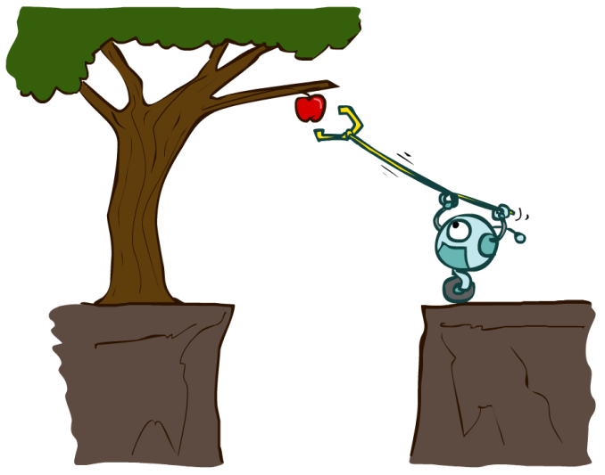
Designing Rational Agents
An agent is an entity that perceives and acts.
A rational agent selects actions that maximize its (expected) utility.
Characteristics of the percepts, environment, and action space dictate techniques for selecting rational actions
This course is about:
  General AI techniques for a variety of problem types
  Learning to recognize when and how a new problem can be solved with an existing technique
Sensors
Agent
Percepts
Environment
?
Actuators
Actions
Notes:
Quick recap: what will we do in this class?

Slide 5
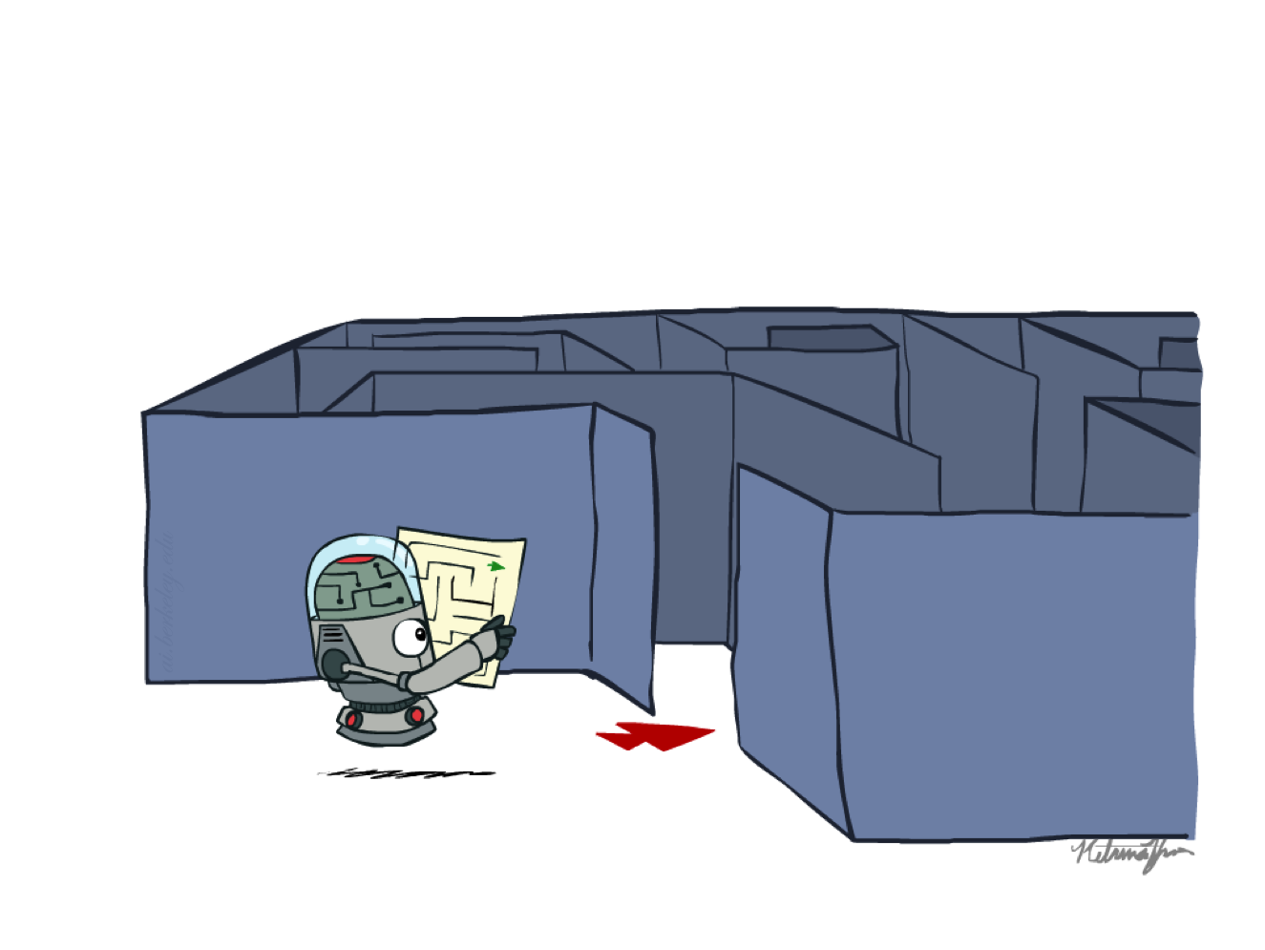
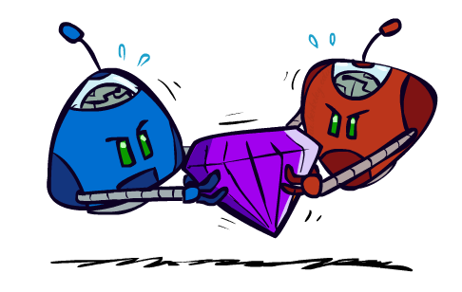

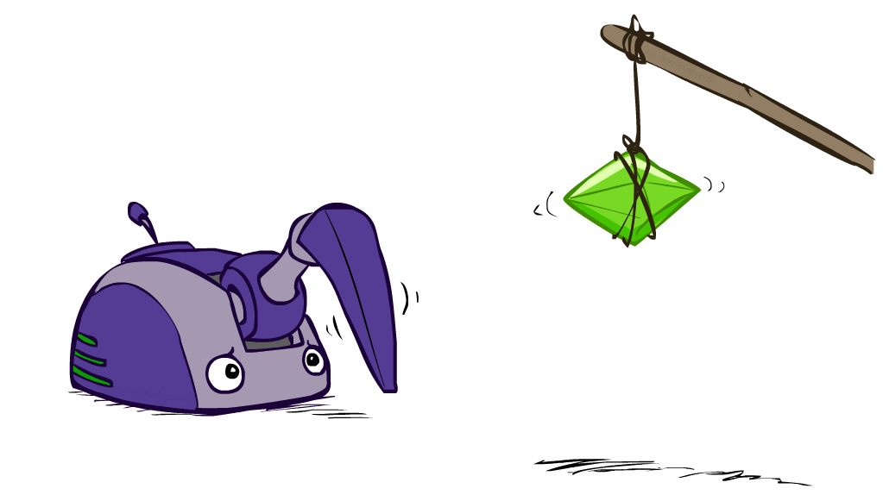
Reinforcement Learning

Slide 6

Reinforcement Learning
We still assume an MDP:
  A set of states s ∈ S
  A set of actions (per state) A
  A model T(s,a,s’)
  A reward function R(s,a,s’)
Still looking for a policy π(s)
New twist: don’t know T or R, so must try out actions
Big idea: Compute all averages over T using sample outcomes

Slide 7
MDPs and RL
Known MDP: Offline Solution
Goal Technique
Compute V*, Q*, π* Value / policy iteration
Evaluate a fixed policy π Policy evaluation
Unknown MDP: Model-Based
Unknown MDP: Model-Free
Goal Technique
Compute V*, Q*, π* VI/PI on approx. MDP
Evaluate a fixed policy π PE on approx. MDP
Goal Technique
Compute V*, Q*, π* Q-learning
Evaluate a fixed policy π Value Learning

Slide 8



Model-Based Learning
Model-Based Idea:
  Learn an approximate model based on experiences
  Solve for values as if the learned model were correct
Step 1: Learn empirical MDP model
  Count outcomes s’ for each s, a
  Normalize to give an estimate of
  Discover each when we experience (s, a, s’)
Step 2: Solve the learned MDP
  For example, use value iteration, as before

Slide 9
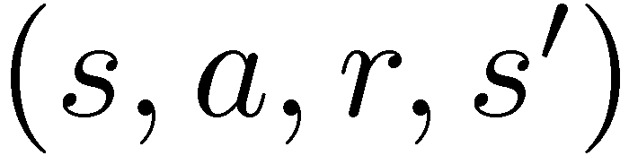
Model-Free Learning
s
Model-free learning
  Experience world through episodes
  Update estimates each transition
  Over time, updates will mimic Bellman updates
a
s, a
r
s’
a’
s’, a’
s’’

Slide 10

Passive Reinforcement Learning
Simplified task: policy evaluation
  Input: a fixed policy π(s)
  You don’t know the transitions T(s,a,s’)
  You don’t know the rewards R(s,a,s’)
  Goal: learn the state values
In this case:
  Learner is “along for the ride”
  No choice about what actions to take
  Just execute the policy and learn from experience
  This is NOT offline planning! You actually take actions in the world.

Slide 11

Why Not Use Policy Evaluation?
s
Recall: Policy Evaluation
  Unfortunately, we need T and R to perform this update!
Key question: how can we do this update to V without knowing T and R?
  In other words, how to we take a weighted average without knowing the weights?
π(s)
s, π(s)
s, π(s),s’
s’

Slide 12
Temporal Difference Learning
s
Recall: Policy Evaluation
Temporal Difference Learning
π(s)
s, π(s)
s, π(s),s’
s’
Sample of V(s):
s
Update to V(s):
π(s)
s, π(s)
Same update:
s’

Slide 13
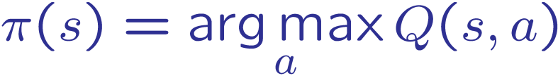
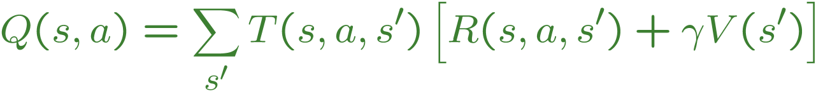
Problems with TD Value Learning
TD value leaning is a model-free way to do policy evaluation, mimicking Bellman updates with running sample averages
However, if we want to turn values into a (new) policy, we’re sunk:
Idea: learn Q-values, not values
Makes action selection model-free too!
s
a
s, a
s,a,s’
s’

Slide 14
Detour: Q-Value Iteration
Value iteration: find successive (depth-limited) values
  Start with V₀(s) = 0, which we know is right
  Given V_{k}, calculate the depth k+1 values for all states:
But Q-values are more useful, so compute them instead
  Start with Q₀(s,a) = 0, which we know is right
  Given Q_{k}, calculate the depth k+1 q-values for all q-states:

Slide 15

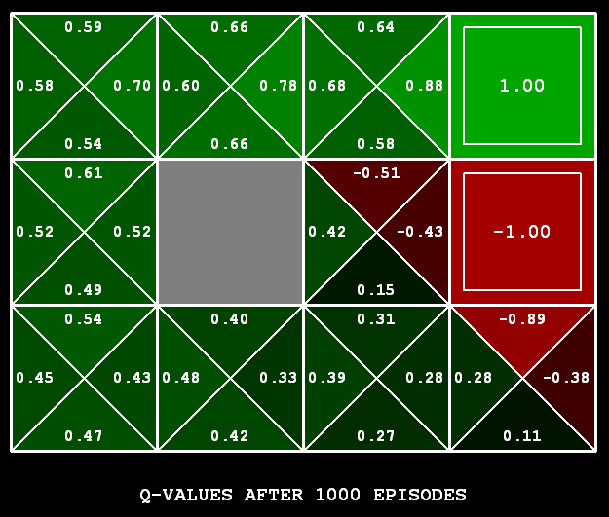
Q-Learning
Q-Learning: sample-based Q-value iteration
Learn Q(s,a) values as you go
  Receive a sample (s,a,s’,r)
  Consider your old estimate:
  Consider your new sample estimate:
  Incorporate the new estimate into a running average:

Slide 16
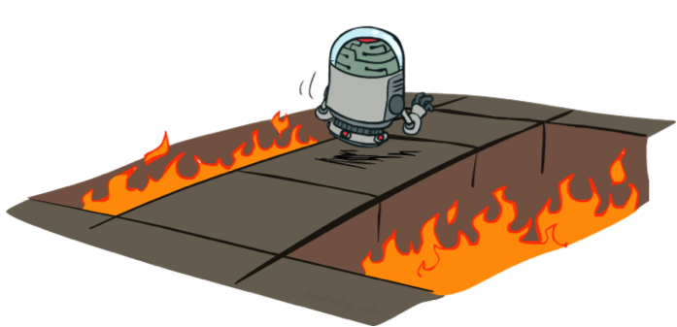
Active Reinforcement Learning
Full reinforcement learning: optimal policies
  You don’t know the transitions T(s,a,s’)
  You don’t know the rewards R(s,a,s’)
  You choose the actions now
  Goal: learn the optimal policy / values
In this case:
  Learner makes choices!
    Current Q-values can be used to decide which action to take
  This is NOT offline planning! You actually take actions in the world and find out what happens…

Slide 17

Q-Learning Properties
Amazing result: Q-learning converges to optimal policy -- even if you’re acting suboptimally!
This is called off-policy learning
Caveats:
  You have to explore enough
  You have to eventually make the learning rate
  small enough
  … but not decrease it too quickly
  Basically, in the limit, it doesn’t matter how you select actions (!)

Slide 18
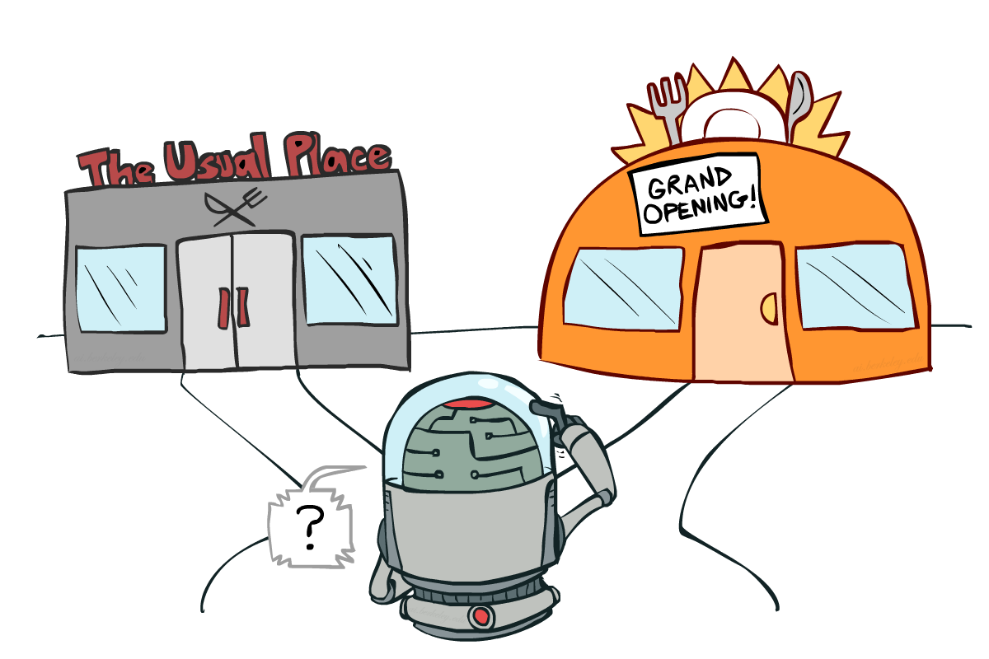
Exploration vs. Exploitation

Slide 19


How to Explore?
Several schemes for forcing exploration
  Simplest: random actions (ε-greedy)
    Every time step, flip a coin
    With (small) probability ε, act randomly
    With (large) probability 1-ε, act on current policy
  Another approach: exploration functions
    Takes a value estimate u and a visit count n, and returns an optimistic utility, e.g.
    Regular Q-Update:
    Modified Q-Update:

Slide 20
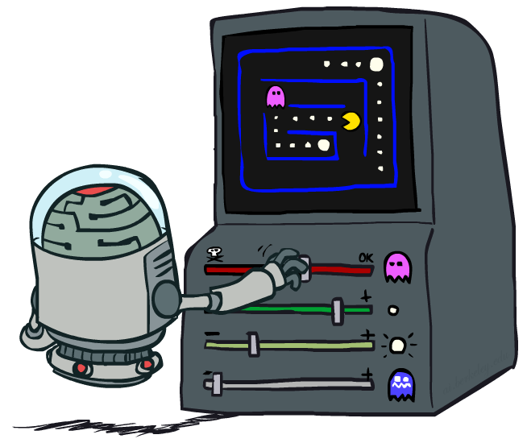
Approximate Q-Learning

Slide 21

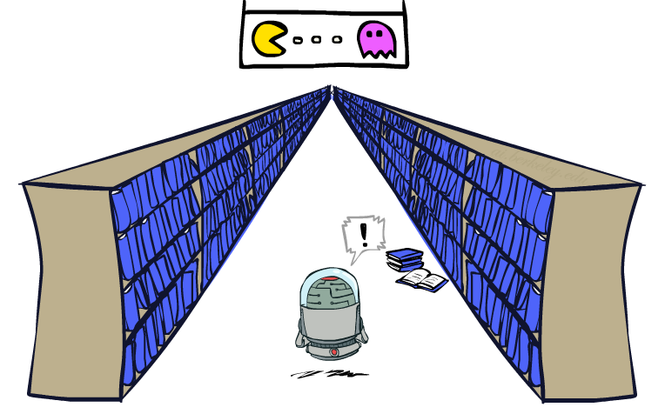
Generalizing Across States
Basic Q-Learning keeps a table of all q-values
In realistic situations, we cannot possibly learn about every single state!
  Too many states to visit them all in training
  Too many states to hold the q-tables in memory
Instead, we want to generalize:
  Learn about some small number of training states from experience
  Generalize that experience to new, similar situations
  This is a fundamental idea in machine learning, and we’ll see it over and over again
[demo – RL pacman]

Slide 22
Feature-Based Value Functions
Solution: describe a state using a vector of features (properties)
Using a feature representation, we can write a q function (or value function) for any state using a few weights:
Advantage: our experience is summed up in a few powerful numbers
Disadvantage: states may share features but actually be very different in value!

Slide 23
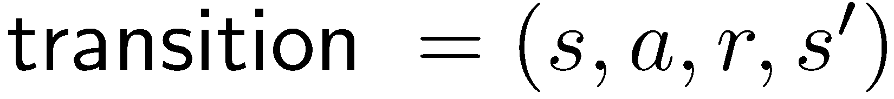
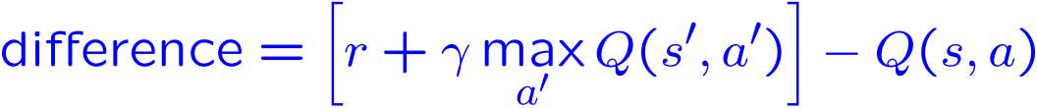
Approximate Q-Learning
Q-learning with linear Q-functions:
Intuitive interpretation:
  Adjust weights of active features
  E.g., if something unexpectedly bad happens, blame the features that were on: disprefer all states with that state’s features
Formal justification: online least squares
Exact Q’s
Approximate Q’s

Slide 24
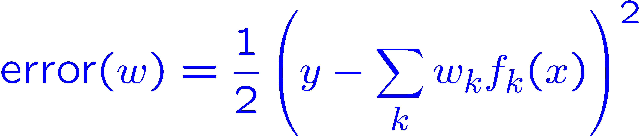
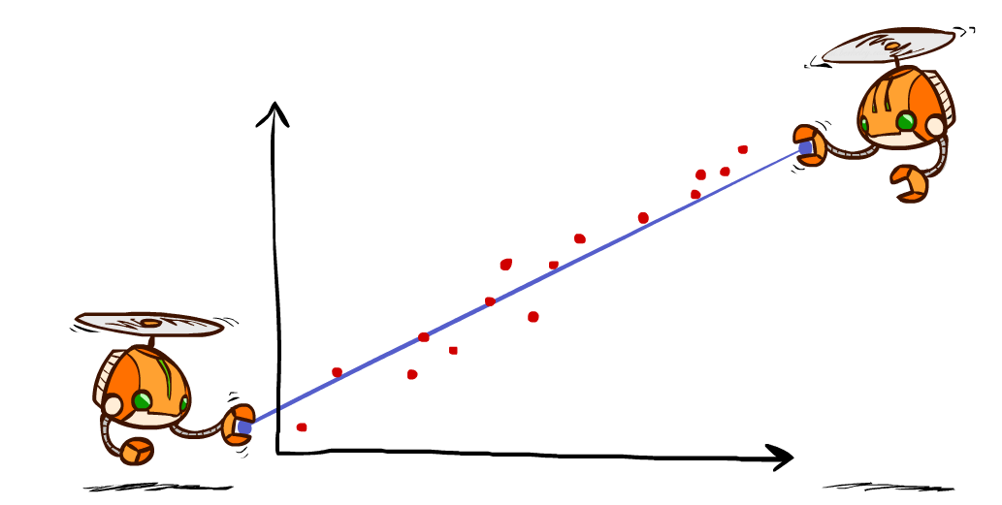
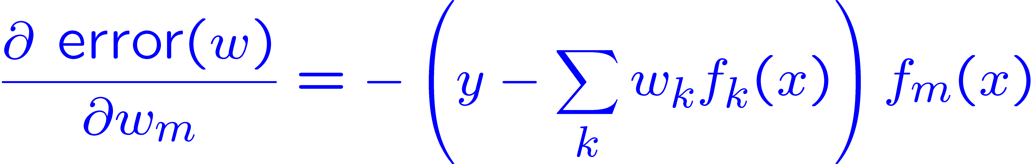
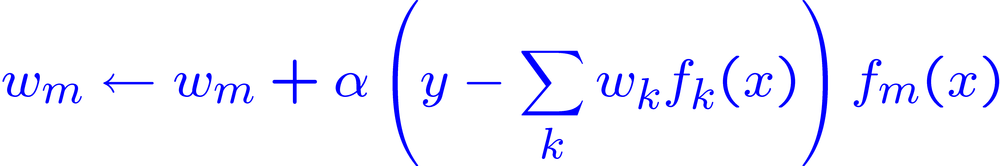
Minimizing Error
Imagine we had only one point x, with features f(x), target value y, and weights w:
Approximate q update explained:
“target”
“prediction”

Slide 25
More Powerful Function Approximation
Linear:
Polynomial:
Neural Network:
Learn These Too

Slide 26
More Powerful Function Approximation
Summary of iterative feature update equation!

Slide 27
MDPs and RL
Known MDP: Offline Solution
Goal Technique
Compute V*, Q*, π* Value / policy iteration
Evaluate a fixed policy π Policy evaluation
Unknown MDP: Model-Based
Unknown MDP: Model-Free
Goal Technique
Compute V*, Q*, π* VI/PI on approx. MDP
Evaluate a fixed policy π PE on approx. MDP
Goal Technique
Compute V*, Q*, π* Q-learning
Evaluate a fixed policy π Value Learning

Slide 28

Policy Search

Slide 29
Policy Search
Problem: often the feature-based policies that work well (win games, maximize utilities) aren’t the ones that approximate V / Q best
  E.g. your value functions from project 2 were probably horrible estimates of future rewards, but they still produced good decisions
  Q-learning’s priority: get Q-values close (modeling)
  Action selection priority: get ordering of Q-values right (prediction)
  We’ll see this distinction between modeling and prediction again later in the course
Solution: learn policies that maximize rewards, not the values that predict them
Policy search: start with an ok solution (e.g. Q-learning) then fine-tune by hill climbing on feature weights

Slide 30

Part I Done!

Slide 31


Probability
A random variable is some aspect of the world about which we (may) have uncertainty
A joint distribution over a set of random variables:
specifies a real number for each assignment (or outcome):
A joint distribution over discrete random variables can be written as a table of outcomes and probabilities
Marginal distributions are sub-tables which eliminate (sum out) certain variables
Notes:
Like “sort this list” or “add these two numbers”

Slide 32


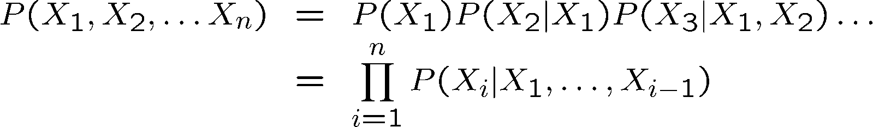
Probability
Conditional probability
Product rule
Chain rule

Slide 33


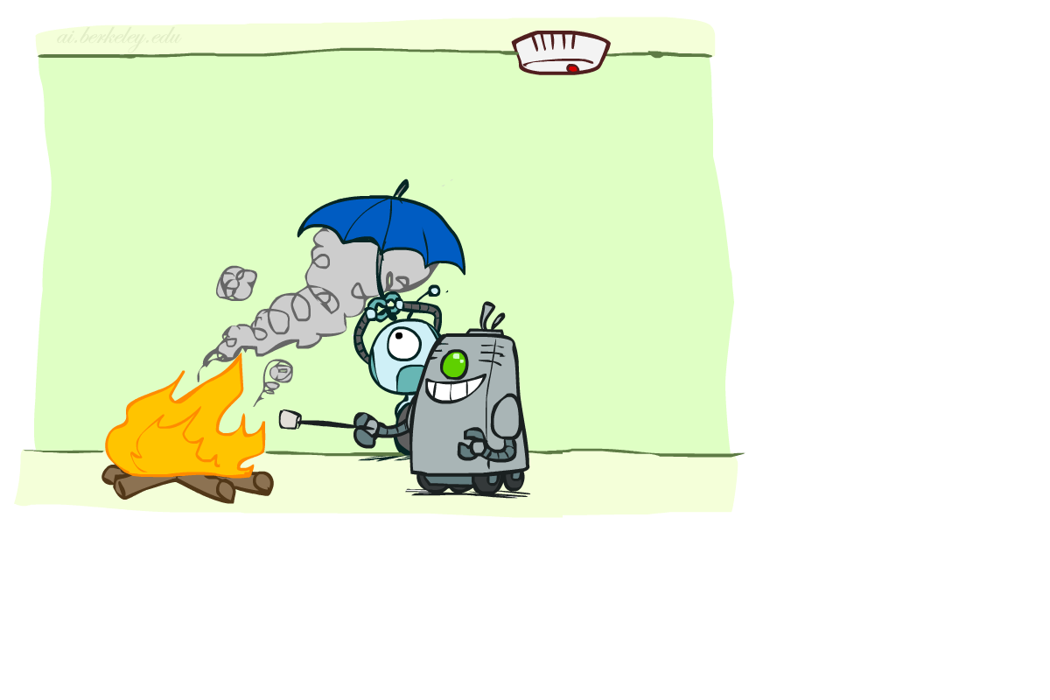

Conditional Independence
X and Y are independent if and only if
X and Y are conditionally independent given Z if and only if
(Conditional) independence is a property of a distribution
Example:
Notes:
Alarm not independent of fire, but independent given smoke (whole point of fire alarm!)
Trade off between having more edges/direct dependencies and a simpler/cheaper model

Slide 34

Probabilistic Models
Models describe how (a portion of) the world works
A probabilistic model is a joint distribution over a set of random variables
  (Random) variables with domains
  Assignments are called outcomes
  An event is a set E of outcomes
  From a joint distribution, we can calculate the probability of any event
Models are always simplifications
  May not account for every variable
  May not account for all interactions between variables
  “All models are wrong; but some are useful.”
  – George E. P. Box
Notes:
George Box: All models are wrong; some of them are useful

Slide 35
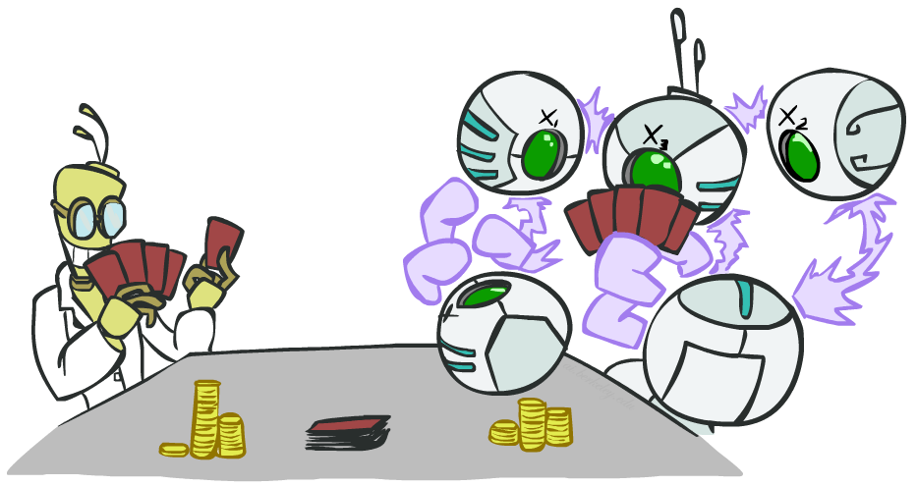
Decision-Making with Probabilistic Models

Slide 36
Decision Networks
MEU: choose the action which maximizes the expected utility given the evidence
Can directly operationalize this with decision networks
  Bayes nets with nodes for utility and actions
  Lets us calculate the expected utility for each action
New node types:
  Chance nodes (just like BNs)
  Actions (rectangles, cannot have parents, act as observed evidence)
  Utility node (diamond, depends on action and chance nodes)
Umbrella
U
Weather
Forecast
Notes:
There exists a ghostbusters demo

Slide 37
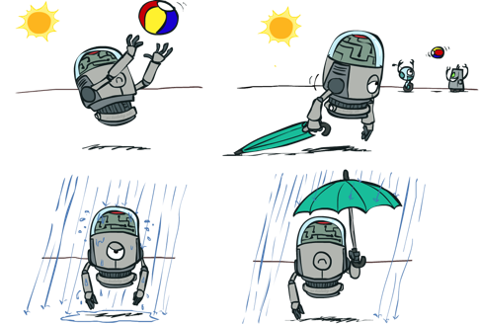




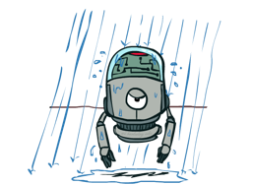
Decisions as Outcome Trees
{}
MEU({})
take
leave
Umbrella
Weather | {}
EU(take)
Weather | {}
EU(leave)
U
sun
sun
Weather
rain
rain
U(t,s)
U(t,r)
U(l,s)
U(l,r)

Slide 38

Decisions as Outcome Trees
Umbrella
{b}
MEU({F=bad})
take
leave
U
EU(leave|F=bad)
W | {b}
W | {b}
EU(take|F=bad)
Weather
sun
sun
rain
rain
U(t,s)
U(t,r)
U(l,s)
U(l,r)
Forecast
=bad

Slide 39
Decisions as Outcome Trees
MEU(F)
good
bad
{b}
MEU({F=good})
{b}
MEU({F=bad})
take
leave
take
leave
W | {b}
W | {b}
EU(leave|F=bad)
EU(take|F=good)
EU(leave|F=good)
W | {b}
EU(take|F=bad)
W | {b}
sun
sun
sun
sun
rain
rain
rain
rain
U(t,s)
U(t,r)
U(l,s)
U(l,r)
U(t,s)
U(t,r)
U(l,s)
U(l,r)

Slide 40
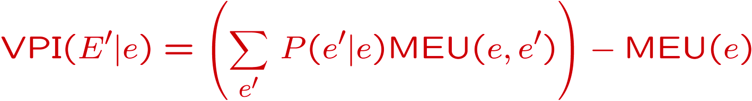
Decisions as Outcome Trees
VPI(F) = VPI(F|{}) = MEU(F) – MEU({})
MEU(F)
good
bad
{b}
MEU({F=good})
{b}
MEU({F=bad})
{}
MEU({})
take
leave
take
leave
take
leave
EU(leave|F=bad)
Weather | {}
Weather | {}
W | {b}
EU(take|F=good)
W | {b}
EU(leave|F=good)
W | {b}
EU(take|F=bad)
W | {b}
EU(take)
EU(leave)
sun
sun
sun
sun
sun
sun
rain
rain
rain
rain
rain
rain
U(t,s)
U(t,r)
U(l,s)
U(l,r)
U(t,s)
U(t,r)
U(l,s)
U(l,r)
U(t,s)
U(t,r)
U(l,s)
U(l,r)

Slide 41
Decisions as Outcome Trees
VPI(F) = VPI(F|{}) = MEU(F) – MEU({})
{}
observe F
MEU(F)
take
good
bad
leave
{b}
MEU({F=good})
{b}
MEU({F=bad})
take
leave
take
leave
W | {b}
EU(take|F=good)
W | {b}
W | {b}
W | {b}
EU(leave|F=bad)
Weather | {}
EU(take)
Weather | {}
EU(leave)
EU(leave|F=good)
EU(take|F=bad)
sun
sun
sun
sun
sun
sun
rain
rain
rain
rain
rain
rain
U(t,s)
U(t,r)
U(l,s)
U(l,r)
U(t,s)
U(t,r)
U(l,s)
U(l,r)
U(t,s)
U(t,r)
U(l,s)
U(l,r)
It is rational to observe F when VPI(F) > cost of observing F

Slide 42
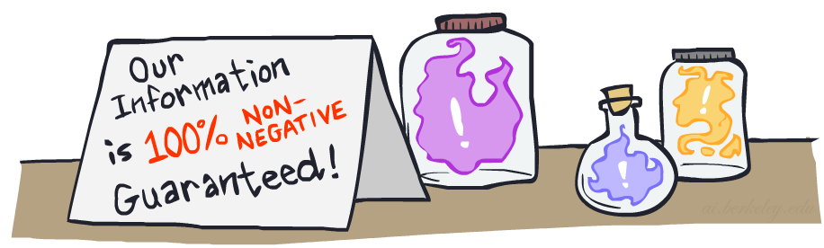

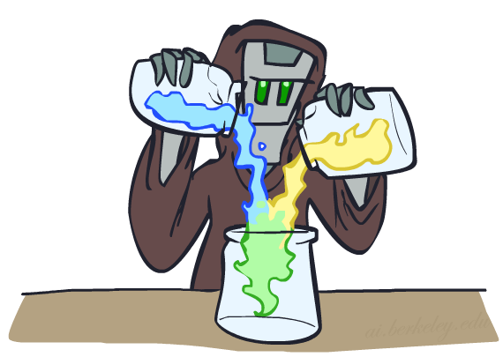
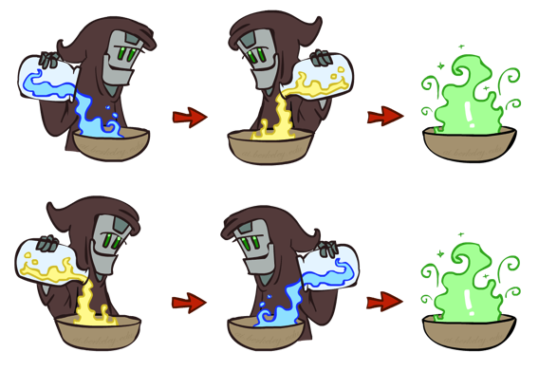
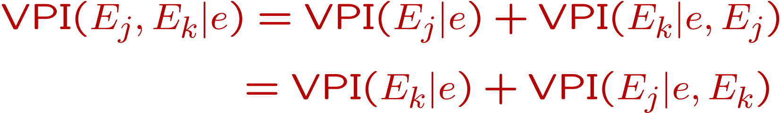
VPI Properties
Nonnegative
Nonadditive
  (think of observing E_{j} twice)
Order-independent

Slide 43
POMDPs
MDPs have:
  States S
  Actions A
  Transition function P(s’|s,a) (or T(s,a,s’))
  Rewards R(s,a,s’)
POMDPs add:
  Observations O
  Observation function P(o|s) (or O(s,o))
POMDPs are MDPs over belief
states b (distributions over S)
s
a
s, a
s,a,s’
s'
b
a
b, a
o
b'

Slide 44
Example: Ghostbusters
In (static) Ghostbusters:
  Belief state determined by evidence to date {e}
  Tree really over evidence sets
  Probabilistic reasoning needed to predict new evidence given past evidence
Solving POMDPs
  One way: use truncated expectimax to compute approximate value of actions
  What if you only considered busting or one sense followed by a bust?
  You get a VPI-based agent!
b
{e}
a
a
b, a
e, a
e’
e’
b’
{e, e’}
{e}
a_{bust}
a_{sense}
{e}, a_{sense}
U(a_{bust}, {e})
e’
{e, e’}
a_{bust}
U(a_{bust}, {e, e’})

Slide 45


Bayes Nets: Big Picture
Two problems with using full joint distribution tables as our probabilistic models:
  Unless there are only a few variables, the joint is WAY too big to represent explicitly
  Hard to learn (estimate) anything empirically about more than a few variables at a time
Bayes nets: a technique for describing complex joint distributions (models) using simple, local distributions (conditional probabilities)
  More properly called graphical models
  We describe how variables locally interact
  Local interactions chain together to give global, indirect interactions

Slide 46
Bayes Nets
Representation
Conditional Independences
Probabilistic Inference
  Enumeration (exact, exponential complexity)
  Variable elimination (exact, worst-case exponential complexity, often better)
  Inference is NP-complete
  Sampling (approximate)

Slide 47

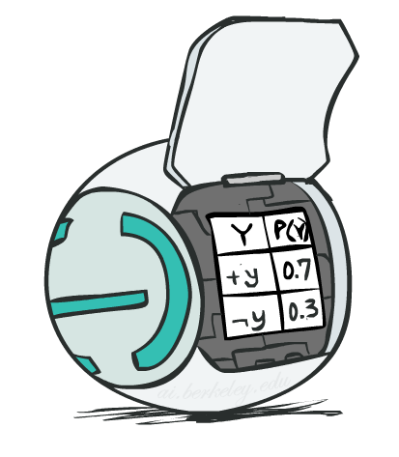
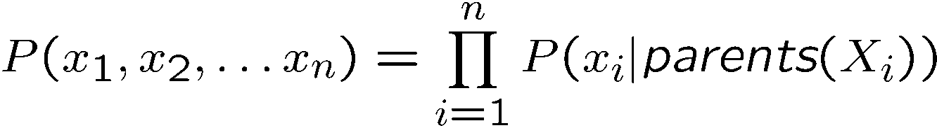
Bayes Net Representation
A directed, acyclic graph, one node per random variable
A conditional probability table (CPT) for each node
  A collection of distributions over X, one for each combination of parents’ values
Bayes nets implicitly encode joint distributions
  As a product of local conditional distributions
  To see what probability a BN gives to a full assignment, multiply all the relevant conditionals together:

Slide 48
Topology Limits Distributions
Given some graph topology G, only certain joint distributions can be encoded
The graph structure guarantees certain (conditional) independences
(There might be more independence)
Adding arcs increases the set of distributions, but has several costs
Full conditioning can encode any distribution
Y
Y
X
Z
X
Z
Y
X
Z
Y
X
Z
Y
Y
Y
X
Z
X
Z
X
Z
Y
Y
Y
X
Z
X
Z
X
Z

Slide 49

Structure Implications
Given a Bayes net structure, can run d-separation algorithm to build a complete list of conditional independences that are necessarily true of the form
This list determines the set of probability distributions that can be represented

Slide 50
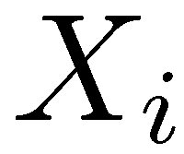
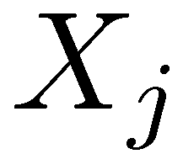

D-Separation
A condition / algorithm for answering independence queries
Query:
Check all (undirected!) paths between and
  If one or more active, then independence not guaranteed
  Otherwise (i.e. if all paths are inactive),
  then independence is guaranteed
?

Slide 51
Active / Inactive Paths
Question: Are X and Y conditionally independent given evidence variables {Z}?
  Yes, if X and Y “d-separated” by Z
  Consider all (undirected) paths from X to Y
  No active paths = independence!
A path is active if each triple is active:
  Causal chain A -> B -> C where B is unobserved (either direction)
  Common cause A <- B -> C where B is unobserved
  Common effect (aka v-structure)
  A -> B <- C where B or one of its descendants is observed
All it takes to block a path is a single inactive segment
Active Triples
Inactive Triples

Slide 52

Inference
Inference: calculating some useful quantity from a joint probability distribution
Examples:
  Posterior probability
  Most likely explanation:

Slide 53





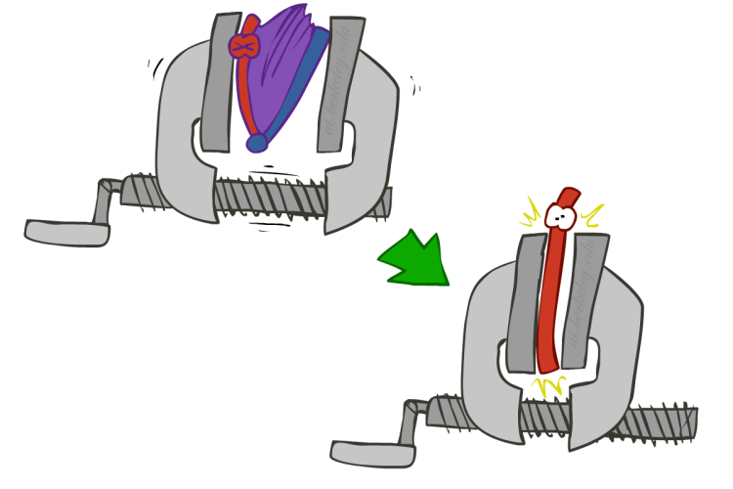
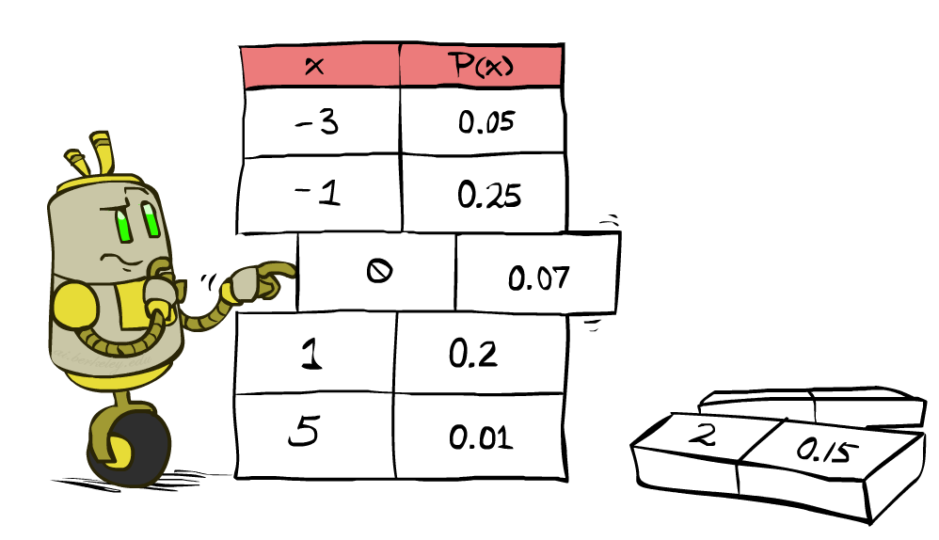


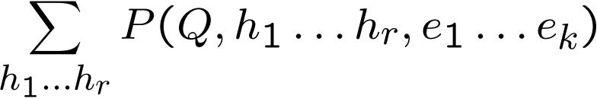
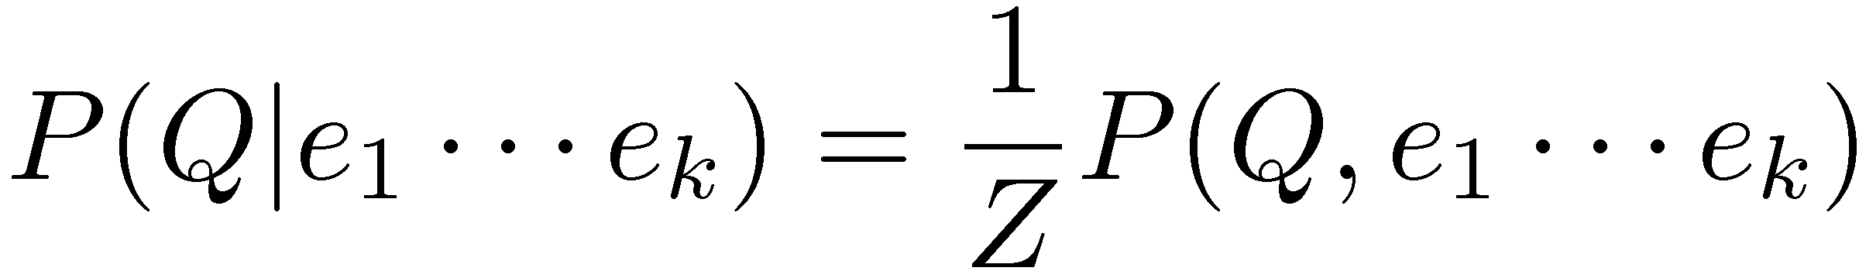
Inference by Enumeration
* Works fine with multiple query variables, too
General case:
  Evidence variables:
  Query* variable:
  Hidden variables:
We want:
All variables
Step 1: Select the entries consistent with the evidence
Step 2: Sum out H to get joint of Query and evidence
Step 3: Normalize

Slide 54
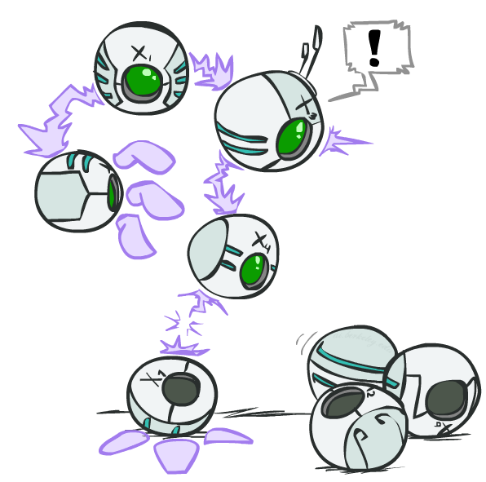






Inference by Enumeration: Procedural Outline
Track objects called factors
Initial factors are local CPTs (one per node)
Any known values are selected
  E.g. if we know , the initial factors are
Procedure: Join all factors, eliminate all hidden variables, normalize
+r | 0.1
-r | 0.9
+r | +t | 0.8
+r | -t | 0.2
-r | +t | 0.1
-r | -t | 0.9
+t | +l | 0.3
+t | -l | 0.7
-t | +l | 0.1
-t | -l | 0.9
+r | 0.1
-r | 0.9
+r | +t | 0.8
+r | -t | 0.2
-r | +t | 0.1
-r | -t | 0.9
+t | +l | 0.3
-t | +l | 0.1

Slide 55
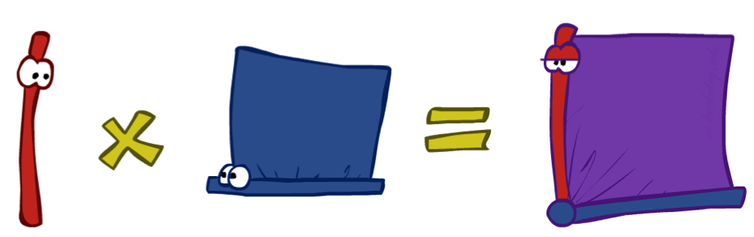




Operation 1: Join Factors
First basic operation: joining factors
Combining factors:
  Just like a database join
  Get all factors over the joining variable
  Build a new factor over the union of the variables involved
Example: Join on R
  Computation for each entry: pointwise products
R
+r | 0.1
-r | 0.9
+r | +t | 0.8
+r | -t | 0.2
-r | +t | 0.1
-r | -t | 0.9
+r | +t | 0.08
+r | -t | 0.02
-r | +t | 0.09
-r | -t | 0.81
R,T
T

Slide 56
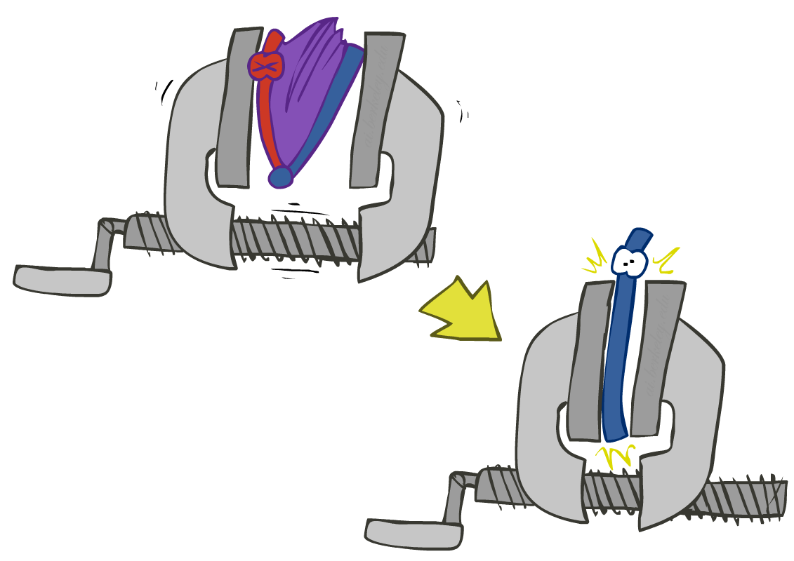


Operation 2: Eliminate
Second basic operation: marginalization
Take a factor and sum out a variable
  Shrinks a factor to a smaller one
  A projection operation
Example:
+r | +t | 0.08
+r | -t | 0.02
-r | +t | 0.09
-r | -t | 0.81
+t | 0.17
-t | 0.83

Slide 57
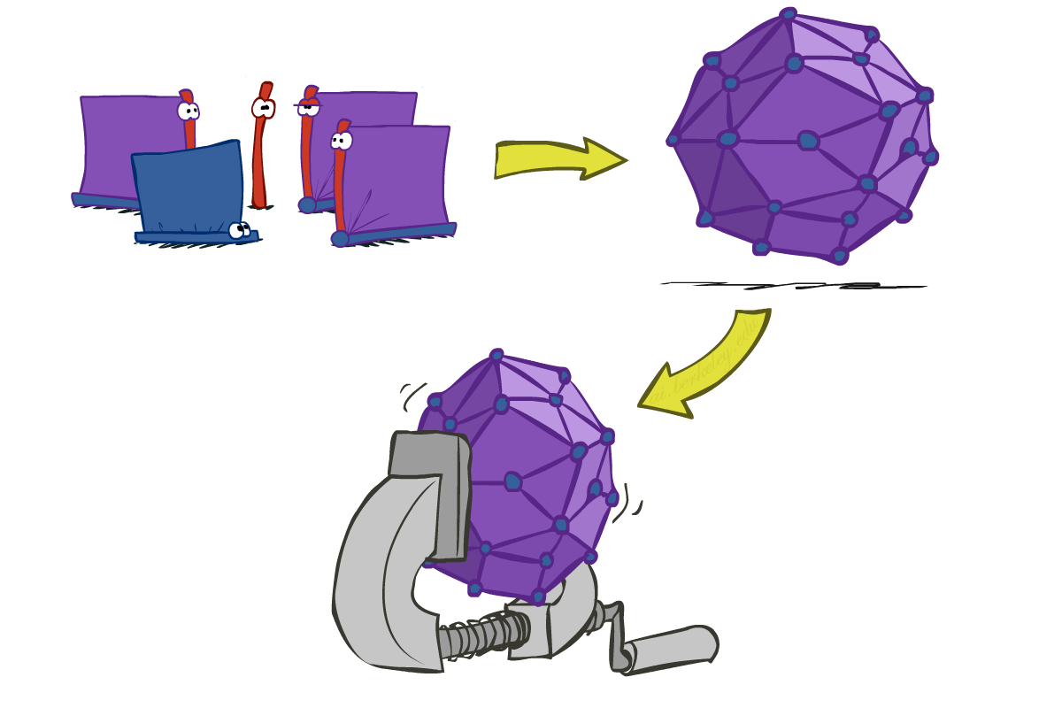
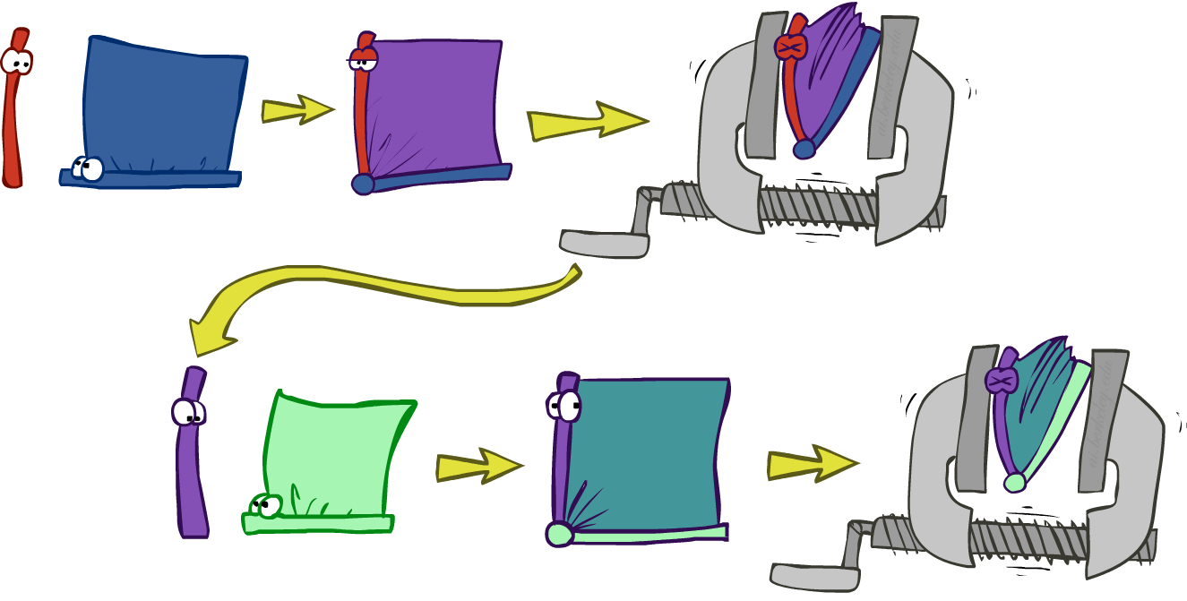
Inference by Enumeration vs. Variable Elimination
Why is inference by enumeration so slow?
  You join up the whole joint distribution before you sum out the hidden variables
Idea: interleave joining and marginalizing!
  Called “Variable Elimination”
  Still NP-hard, but usually much faster than inference by enumeration
  First we’ll need some new notation: factors

Slide 58
Inference by Enumeration vs. Variable Elimination
R
Inference by Enumeration
Variable Elimination
T
L
Join on r
Join on r
Join on t
Eliminate r
Eliminate r
Join on t
Eliminate t
Eliminate t

Slide 59

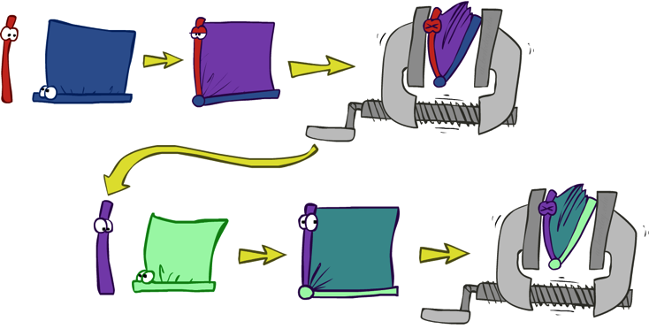


General Variable Elimination
Query:
Start with initial factors:
  Local CPTs (but instantiated by evidence)
While there are still hidden variables (not Q or evidence):
  Pick a hidden variable H
  Join all factors mentioning H
  Eliminate (sum out) H
Join all remaining factors and normalize

Slide 60










Variable Elimination
Interleave joining and marginalizing
d^{k} entries computed for a factor over k variables with domain sizes d
Ordering of elimination of hidden variables can affect size of factors generated
Worst case: running time exponential in the size of the Bayes’ net
…
…

Slide 61
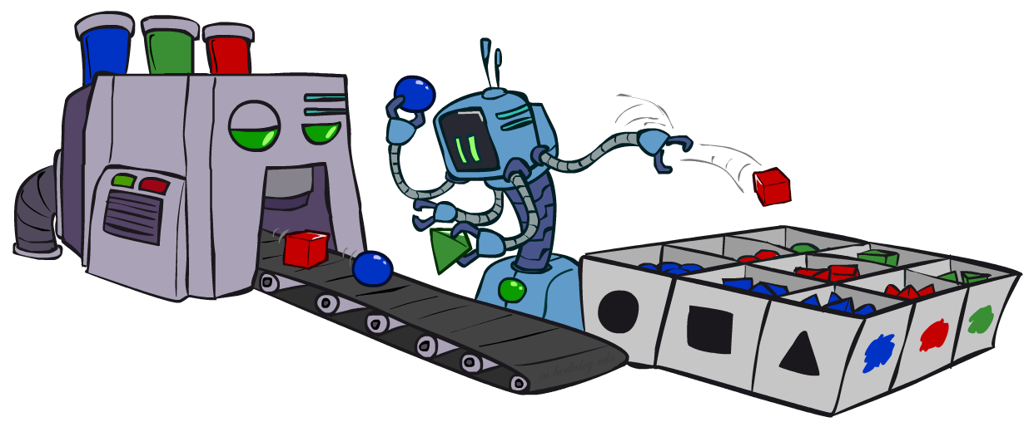
Approximate Inference: Sampling
Sampling is a lot like repeated simulation
  Predicting the weather, basketball games, …
Basic idea
  Draw N samples from a sampling distribution S
  Compute an approximate posterior probability
  Show this converges to the true probability P
Why sample?
  Learning: get samples from a distribution you don’t know
  Inference: getting a sample is faster than computing the right answer (e.g. with variable elimination)

Slide 62
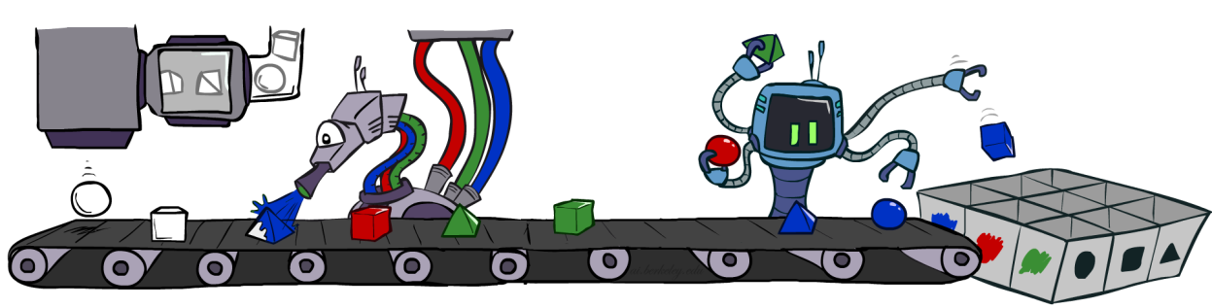
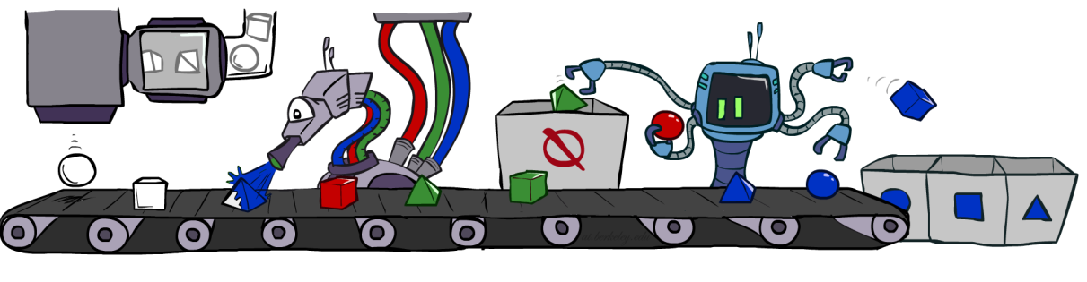
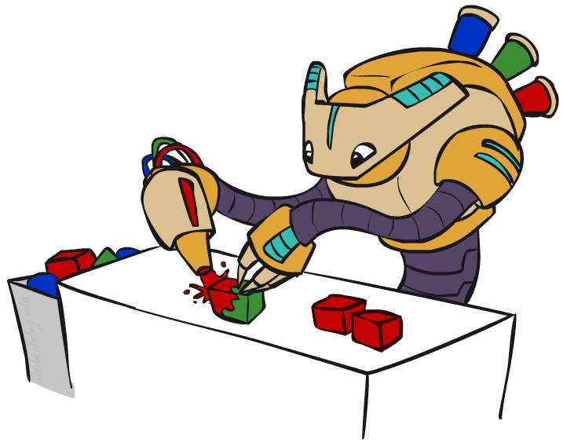
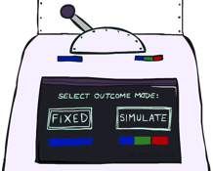
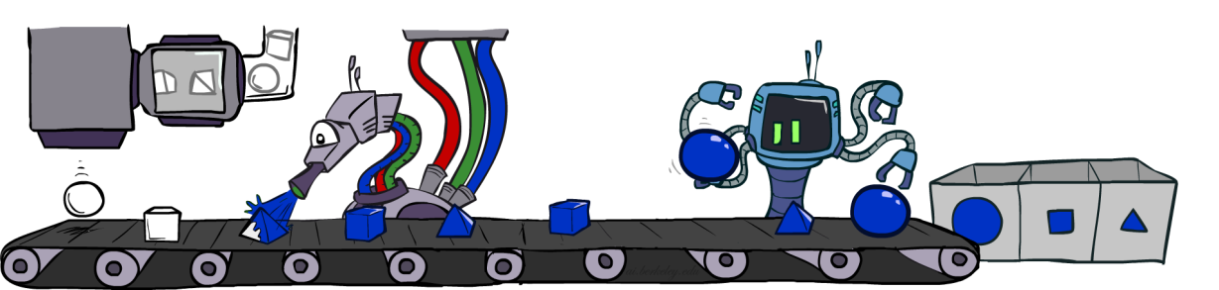
Sampling in Bayes Nets
Prior Sampling P( Q )
Likelihood Weighting P( Q | e)
Rejection Sampling P( Q | e )
Gibbs Sampling P( Q | e )

Slide 63

Prior Sampling
For i = 1, 2, …, n
  Sample x_{i} from P(X_{i} | Parents(X_{i}))
Return (x₁, x₂, …, x_{n})

Slide 64
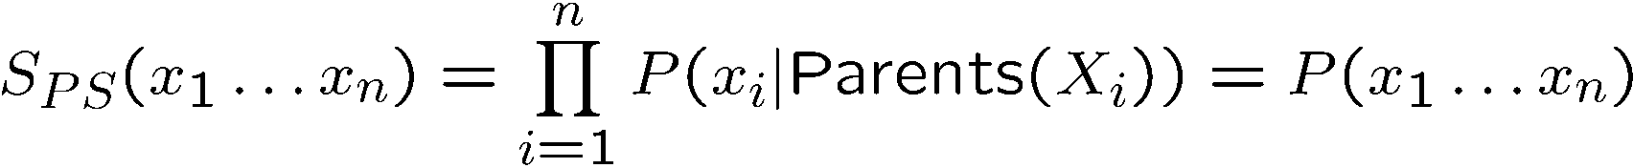


Prior Sampling
This process generates samples with probability:
…i.e. the BN’s joint probability
Let the number of samples of an event be
Then
I.e., the sampling procedure is consistent

Slide 65

Rejection Sampling
Input: evidence instantiation
For i = 1, 2, …, n
  Sample x_{i} from P(X_{i} | Parents(X_{i}))
  If x_{i} not consistent with evidence
    Reject: return – no sample is generated in this cycle
Return (x₁, x₂, …, x_{n})

Slide 66


Likelihood Weighting
Input: evidence instantiation
w = 1.0
for i = 1, 2, …, n
  if X_{i} is an evidence variable
    X_{i} = observation x_{i} for X_{i}
    Set w = w * P(x_{i} | Parents(X_{i}))
  else
    Sample x_{i} from P(X_{i} | Parents(X_{i}))
return (x₁, x₂, …, x_{n}), w

Slide 67




Likelihood Weighting
Sampling distribution if z sampled and e fixed evidence
Now, samples have weights
Together, weighted sampling distribution is consistent
Cloudy
C
S
R
W

Slide 68

Gibbs Sampling

Slide 69
Gibbs Sampling
Step 1: Fix evidence
  R = +r
Steps 3: Repeat
  Choose a non-evidence variable X
  Resample X from P( X | all other variables)
    P( X | all other variables) can be computed efficiently using only the CPTs that involve X
Step 2: Initialize other variables
  Randomly
C
C
S
+r
S
+r
W
W
C
C
C
C
C
C
S
+r
S
+r
S
+r
S
+r
S
+r
S
+r
W
W
W
W
W
W

Slide 70
Gibbs Sampling
Procedure: keep track of a full instantiation x₁, x₂, …, x_{n}. Start with an arbitrary instantiation consistent with the evidence. Sample one variable at a time, conditioned on all the rest, but keep evidence fixed. Keep repeating this for a long time.
Property: in the limit of repeating this infinitely many times the resulting samples come from the correct distribution (i.e. conditioned on evidence).
Rationale: both upstream and downstream variables condition on evidence.
In contrast: likelihood weighting only conditions on upstream evidence, and hence weights obtained in likelihood weighting can sometimes be very small. Sum of weights over all samples is indicative of how many “effective” samples were obtained, so we want high weight.

Slide 71
Bayes Nets
Representation
Conditional Independences
Probabilistic Inference
  Enumeration (exact, exponential complexity)
  Variable elimination (exact, worst-case exponential complexity, often better)
  Inference is NP-complete
  Sampling (approximate)

Slide 72
Dynamic Bayes Nets (including HMMs)
Representation
Conditional Independences
Probabilistic Inference
  Exact Inference
  Particle Filtering (approximate inference)

Slide 73

Dynamic Bayes Nets (DBNs)
We want to track multiple variables over time, using multiple sources of evidence
Idea: Repeat a fixed Bayes net structure at each time
Variables from time t can condition on those from t-1
Markov Models and HMMs are specific instances of Dynamic Bayes nets
t =1
t =2
t =3
G₁ª
G₂ª
G₃ª
G₁^{b}
G₂^{b}
G₃^{b}
E₁ª
E₁^{b}
E₂ª
E₂^{b}
E₃ª
E₃^{b}

Slide 74
Exact Inference in DBNs
Variable elimination applies to dynamic Bayes nets
Procedure: “unroll” the network for T time steps, then eliminate variables until P(X_{T}|e_{1:T}) is computed
Online belief updates: Eliminate all variables from the previous time step; store factors for current time only
t =1
t =2
t =3
G₁ª
G₂ª
G₃ª
G₃^{b}
G₁^{b}
G₂^{b}
G₃^{b}
E₁ª
E₁^{b}
E₂ª
E₂^{b}
E₃ª
E₃^{b}

Slide 75
DBN Particle Filters
A particle is a complete sample for a time step
Initialize: Generate prior samples for the t=1 Bayes net
  Example particle: G₁ª = (3,3) G₁^{b} = (5,3)
Elapse time: Sample a successor for each particle
  Example successor: G₂ª = (2,3) G₂^{b} = (6,3)
Observe: Weight each entire sample by the likelihood of the evidence conditioned on the sample
  Likelihood: P(E₁ª |G₁ª ) * P(E₁^{b} |G₁^{b} )
Resample: Select prior samples (tuples of values) in proportion to their likelihood
Notes:
Dan has a demo here.

Slide 76


Markov Models
  Value of X at a given time is called the state
  Parameters: called transition probabilities or dynamics, specify how the state evolves over time (also, initial state probabilities)
  Stationarity assumption: transition probabilities the same at all times
  Same as MDP transition model, but no choice of action
X₁
X₂
X₃
X₄

Slide 77

Conditional Independence
Basic conditional independence:
  Past and future independent given the present
  Each time step only depends on the previous
  This is called the (first order) Markov property

Slide 78


Mini-Forward Algorithm
Question: What’s P(X) at some time t?
X₁
X₂
X₃
X₄
Forward simulation

Slide 79

Stationary Distributions
For most chains:
  Influence of the initial distribution gets less and less over time.
  The distribution we end up in is independent of the initial distribution
Stationary distribution:
  The distribution we end up with is called the stationary distribution of the chain
  It satisfies

Slide 80

Hidden Markov Models
Markov chains not so useful for most agents
  Need observations to update your beliefs
Hidden Markov models (HMMs)
  Underlying Markov chain over states X
  You observe outputs (effects) at each time step
X₁
X₂
X₃
X₄
X₅
E₁
E₂
E₃
E₄
E₅

Slide 81
Conditional Independence
HMMs have two important independence properties:
  Markov hidden process: future depends on past via the present
  Current observation independent of all else given current state
Evidence variables are not guaranteed to be independent
  They tend to correlated by the hidden state
X₁
X₂
X₃
X₄
X₅
E₁
E₂
E₃
E₄
E₅

Slide 82
Filtering / Monitoring
Filtering, or monitoring, is the task of tracking the distribution B_{t}(X) = P_{t}(X_{t} | e₁, …, e_{t}) (the belief state) over time
We start with B₁(X) in an initial setting, usually uniform
As time passes, or we get observations, we update B(X)
Notes:
Dan has some demo for this

Slide 83


Passage of Time
Assume we have current belief P(X | evidence to date)
Then, after one time step passes:
Basic idea: beliefs get “pushed” through the transitions
  With the “B” notation, we have to be careful about what time step t the belief is about, and what evidence it includes
X₁
X₂
Or compactly:
Notes:
TODO: intermediate step in derivation!

Slide 84

Observation
X₁
Assume we have current belief P(X | previous evidence):
Then, after evidence comes in:
Or, compactly:
E₁
Basic idea: beliefs “reweighted” by likelihood of evidence
Unlike passage of time, we have to renormalize
Notes:
Basic idea: beliefs “reweighted” by likelihood of evidence
Unlike passage of time, we have to renormalize

Slide 85
Forward Algorithm
Every time step, we start with current P(X | evidence)
We update for time:
We update for evidence:
Don’t forget to normalize at the end!
X₁
X₂
X₂
E₂

Slide 86

Approximate Inference: Particle Filtering

Slide 87
Particle Filtering
Filtering: approximate solution
Sometimes |X| is too big to use exact inference
  |X| may be too big to even store B(X)
  E.g. X is continuous
Solution: approximate inference
  Track samples of X, not all values
  Samples are called particles
  Time per step is linear in the number of samples
  But: number needed may be large
  In memory: list of particles, not states
Particle is just new name for sample
0.0
0.1
0.0
0.0
0.0
0.2
0.0
0.2
0.5

Slide 88
Representation: Particles
Our representation of P(X) is now a list of N particles (samples)
  Generally, N << |X|
  Storing map from X to counts would defeat the point
P(x) approximated by number of particles with value x
  So, many x may have P(x) = 0!
  More particles, more accuracy
Particles:
(3,3)
(2,3)
(3,3)
(3,2)
(3,3)
(3,2)
(1,2)
(3,3)
(3,3)
(2,3)

Slide 89

Particle Filtering: Elapse Time
Each particle is moved by sampling its next position from the transition model
  This is like prior sampling – samples’ frequencies reflect the transition probabilities
  Here, most samples move clockwise, but some move in another direction or stay in place
This captures the passage of time
  If enough samples, close to exact values before and after (consistent)
Particles:
(3,3)
(2,3)
(3,3)
(3,2)
(3,3)
(3,2)
(1,2)
(3,3)
(3,3)
(2,3)
Particles:
(3,2)
(2,3)
(3,2)
(3,1)
(3,3)
(3,2)
(1,3)
(2,3)
(3,2)
(2,2)

Slide 90


Particle Filtering: Observe
Particles:
(3,2)
(2,3)
(3,2)
(3,1)
(3,3)
(3,2)
(1,3)
(2,3)
(3,2)
(2,2)
Slightly trickier:
  Don’t sample observation, fix it
  Similar to likelihood weighting, downweight samples based on the evidence
  As before, the probabilities don’t sum to one, since all have been downweighted (in fact they now sum to (N times) an approximation of P(e))
Particles:
(3,2) w=.9
(2,3) w=.2
(3,2) w=.9
(3,1) w=.4
(3,3) w=.4
(3,2) w=.9
(1,3) w=.1
(2,3) w=.2
(3,2) w=.9
(2,2) w=.4

Slide 91
Particle Filtering: Resample
Rather than tracking weighted samples, we resample
N times, we choose from our weighted sample distribution (i.e. draw with replacement)
This is equivalent to renormalizing the distribution
Now the update is complete for this time step, continue with the next one
Particles:
(3,2) w=.9
(2,3) w=.2
(3,2) w=.9
(3,1) w=.4
(3,3) w=.4
(3,2) w=.9
(1,3) w=.1
(2,3) w=.2
(3,2) w=.9
(2,2) w=.4
(New) Particles:
(3,2)
(2,2)
(3,2)
(2,3)
(3,3)
(3,2)
(1,3)
(2,3)
(3,2)
(3,2)

Slide 92
Particle Filtering
Particles: track samples of states rather than an explicit distribution
Elapse
Weight
Resample
Particles:
(3,3)
(2,3)
(3,3)
(3,2)
(3,3)
(3,2)
(1,2)
(3,3)
(3,3)
(2,3)
Particles:
(3,2)
(2,3)
(3,2)
(3,1)
(3,3)
(3,2)
(1,3)
(2,3)
(3,2)
(2,2)
Particles:
(3,2) w=.9
(2,3) w=.2
(3,2) w=.9
(3,1) w=.4
(3,3) w=.4
(3,2) w=.9
(1,3) w=.1
(2,3) w=.2
(3,2) w=.9
(2,2) w=.4
(New) Particles:
(3,2)
(2,2)
(3,2)
(2,3)
(3,3)
(3,2)
(1,3)
(2,3)
(3,2)
(3,2)

Slide 93

Most Likely Explanation

Slide 94
Inference
Inference: calculating some useful quantity from a joint probability distribution
Examples:
  Posterior probability
  Most likely explanation:

Slide 95




HMMs: MLE Queries
HMMs defined by
  States X
  Observations E
  Initial distribution:
  Transitions:
  Emissions:
New query: most likely explanation:
New method: the Viterbi algorithm
X₁
X₂
X₃
X₄
X₅
E₁
E₂
E₃
E₄
E₅

Slide 96






State Trellis
State trellis: graph of states and transitions over time
Each arc represents some transition
Each arc has weight
Each path is a sequence of states
The product of weights on a path is that sequence’s probability along with the evidence
Forward algorithm computes sums of paths, Viterbi computes best paths
sun
sun
sun
sun
rain
rain
rain
rain

Slide 97


Forward / Viterbi Algorithms
sun
sun
sun
sun
rain
rain
rain
rain
Forward Algorithm (Sum)
Viterbi Algorithm (Max)

Slide 98
[Just-in-case Example Slides]

Slide 99

Example: Snakes and Ladders

Slide 100


Snakes and Ladders: Search
Player may be located anywhere on a 4x3 board
Start at square 1
Goal is to reach square 12
At each turn, move either 2 or 3 squares forward, but…
  Landing on the bottom of a ladder moves the player to the top of the ladder
  Landing on the head of a snake moves the player to the tail square of the snake
9 | 10 | 11 | 12
8 | 7 | 6 | 5
1 | 2 | 3 | 4

Slide 101
Snakes and Ladders: Search
9 | 10 | 11 | 12
8 | 7 | 6 | 5
1 | 2 | 3 | 4
Move 2 or 3 squares each turn

Slide 102
Snakes and Ladders: Search
9 | 10 | 11 | 12
8 | 7 | 6 | 5
1 | 2 | 3 | 4
Move 2 or 3 squares each turn

Slide 103
Snakes and Ladders: Search
9 | 10 | 11 | 12
8 | 7 | 6 | 5
1 | 2 | 3 | 4
Move 2 or 3 squares each turn

Slide 104
Snakes and Ladders: Adversarial Games
Player may be located anywhere on a 4x3 board
Start at square 1
Goal is to reach square 12
At each turn, move either 2 or 3 squares forward, but…
  Landing on the bottom of a ladder moves the player to the top of the ladder
  Landing on the head of a snake moves the player to the tail square of the snake
After each turn, adversary can move the head of the snake to either square 9 or 10
9 | 10 | 11 | 12
8 | 7 | 6 | 5
1 | 2 | 3 | 4

Slide 105
Snakes and Ladders: Adversarial Games
9 | 10 | 11 | 12
8 | 7 | 6 | 5
1 | 2 | 3 | 4
Move 2 or 3 squares each turn
Adversary can move snake head!

Slide 106
Snakes and Ladders: Adversarial Games
9 | 10 | 11 | 12
8 | 7 | 6 | 5
1 | 2 | 3 | 4
Move 2 or 3 squares each turn
Adversary can move snake head!

Slide 107
Snakes and Ladders: Adversarial Games
9 | 10 | 11 | 12
8 | 7 | 6 | 5
1 | 2 | 3 | 4
Move 2 or 3 squares each turn
Adversary can move snake head!

Slide 108

Snakes and Ladders: MDP
Player may be located anywhere on a 4x3 board
Start at square 1
Goal is to reach square 12
At each turn, either
  advance 1 square
  roll a 4-sided die and advance that many squares
After each move…
  Landing on the bottom of a ladder moves the player to the top of the ladder
  Landing on the head of a snake moves the player to the tail square of the snake
9 | 10 | 11 | 12
8 | 7 | 6 | 5
1 | 2 | 3 | 4

Slide 109
Snakes and Ladders: MDP
9 | 10 | 11 | 12
8 | 7 | 6 | 5
1 | 2 | 3 | 4
Advance 1 square
Or roll a
4-sided die

Slide 110
Snakes and Ladders: MDP
9 | 10 | 11 | 12
8 | 7 | 6 | 5
1 | 2 | 3 | 4
Advance 1 square
Or roll a
4-sided die

Slide 111
Snakes and Ladders: MDP
9 | 10 | 11 | 12
8 | 7 | 6 | 5
1 | 2 | 3 | 4
Advance 1 square
Or roll a
4-sided die

Slide 112
Snakes and Ladders: MDP
9 | 10 | 11 | 12
8 | 7 | 6 | 5
1 | 2 | 3 | 4
Advance 1 square
Or roll a
4-sided die

Slide 113
Snakes and Ladders: MDP
9 | 10 | 11 | 12
8 | 7 | 6 | 5
1 | 2 | 3 | 4
Advance 1 square
Or roll a
4-sided die

Slide 114
Snakes and Ladders: MDP
9 | 10 | 11 | 12
8 | 7 | 6 | 5
1 | 2 | 3 | 4
Advance 1 square
Or roll a
4-sided die

Slide 115
Snakes and Ladders: RL
Player may be located anywhere on a 4x3 board
Start at square 1
Goal is to reach square 12
At each turn, either
  advance 1 square
  roll a mystery die that determines how many squares to advance
After each move…
  Landing on the bottom of a ladder moves the player to the top of the ladder
  Landing on the head of a snake moves the player to the tail square of the snake
9 | 10 | 11 | 12
8 | 7 | 6 | 5
1 | 2 | 3 | 4

Slide 116
Snakes and Ladders: RL
9 | 10 | 11 | 12
8 | 7 | 6 | 5
1 | 2 | 3 | 4
Advance 1 square
Or roll a
mystery die

Slide 117
Snakes and Ladders: RL
9 | 10 | 11 | 12
8 | 7 | 6 | 5
1 | 2 | 3 | 4
Advance 1 square
Or roll a
mystery die

Slide 118
Snakes and Ladders: RL
9 | 10 | 11 | 12
8 | 7 | 6 | 5
1 | 2 | 3 | 4
Advance 1 square
Or roll a
mystery die

Slide 119
Snakes and Ladders: RL
9 | 10 | 11 | 12
8 | 7 | 6 | 5
1 | 2 | 3 | 4
Advance 1 square
Or roll a
mystery die

Slide 120
Snakes and Ladders: RL
9 | 10 | 11 | 12
8 | 7 | 6 | 5
1 | 2 | 3 | 4
Advance 1 square
Or roll a
mystery die

Slide 121
Snakes and Ladders: RL
9 | 10 | 11 | 12
8 | 7 | 6 | 5
1 | 2 | 3 | 4
Advance 1 square
Or roll a
mystery die

Slide 122
Snakes and Ladders: RL
9 | 10 | 11 | 12
8 | 7 | 6 | 5
1 | 2 | 3 | 4
Advance 1 square
Or roll a
mystery die

Slide 123
Snakes and Ladders: RL
9 | 10 | 11 | 12
8 | 7 | 6 | 5
1 | 2 | 3 | 4
Advance 1 square
Or roll a
mystery die

Slide 124
Snakes and Ladders: RL
9 | 10 | 11 | 12
8 | 7 | 6 | 5
1 | 2 | 3 | 4
Advance 1 square
Or roll a
mystery die

Slide 125
Snakes and Ladders: RL
9 | 10 | 11 | 12
8 | 7 | 6 | 5
1 | 2 | 3 | 4
Advance 1 square
Or roll a
mystery die

