Slide 1
CS 188: Artificial Intelligence
Introduction
Instructor: Angela Liu, Yanlai Yang
University of California, Berkeley
(slides adapted from Dan Klein, Pieter Abbeel, Stuart Russell, Anca Dragan, et al)

Slide 2
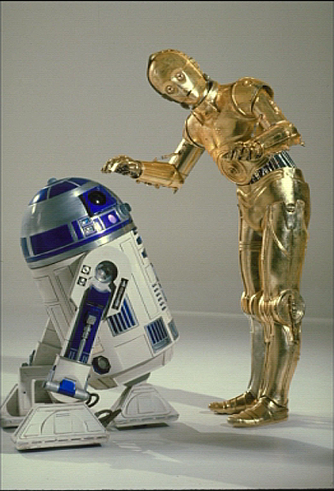
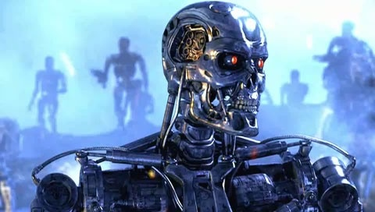
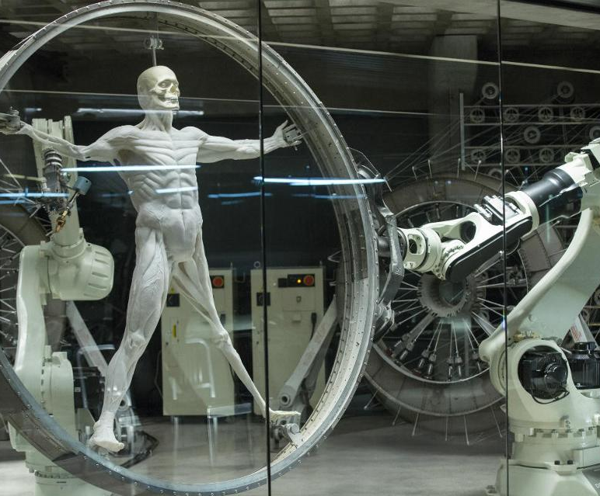
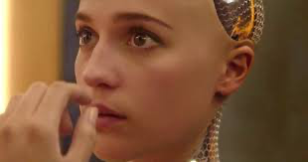
Sci-Fi AI?

Slide 3
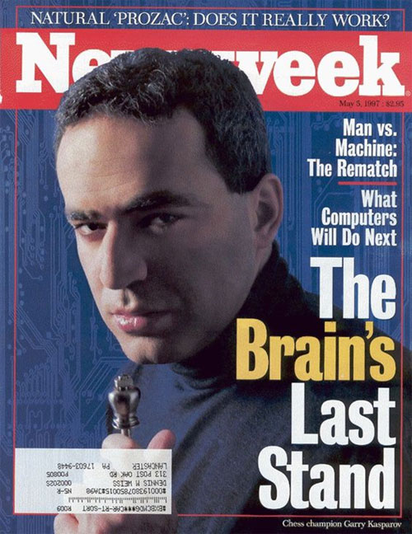
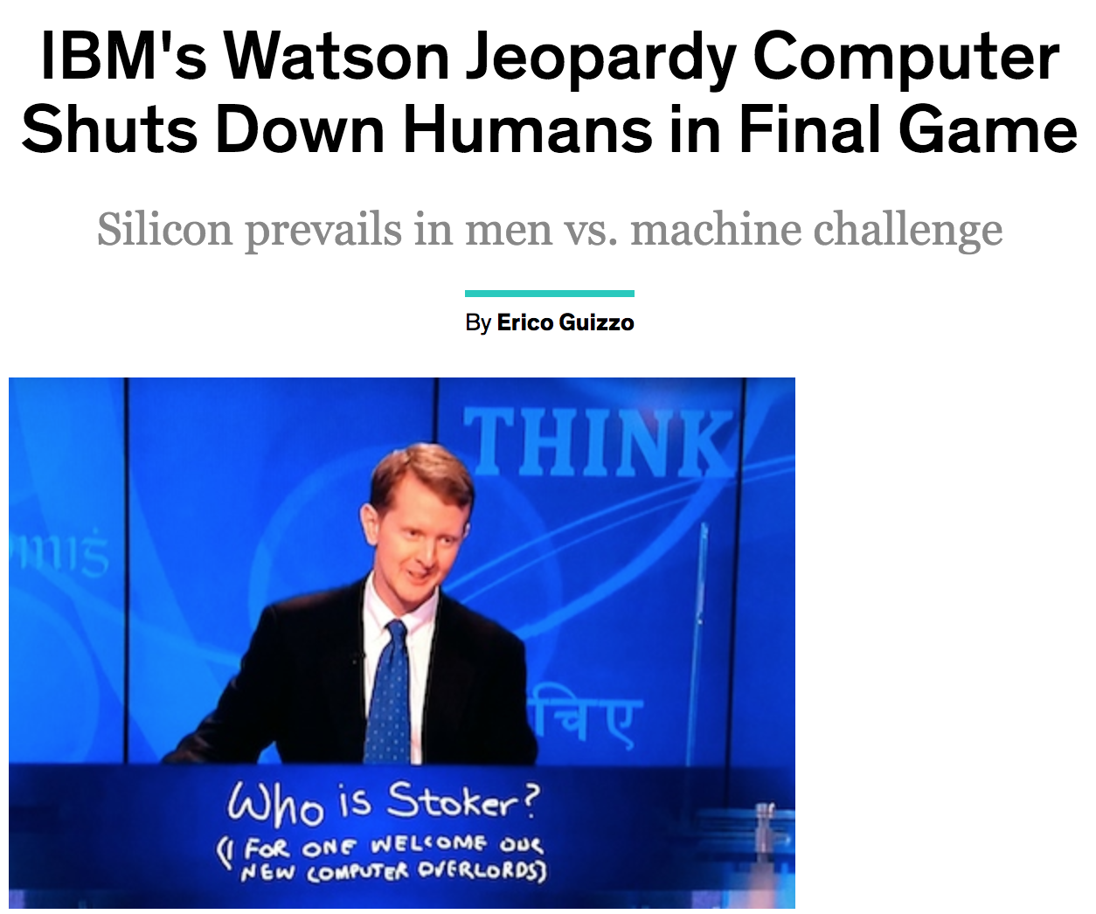
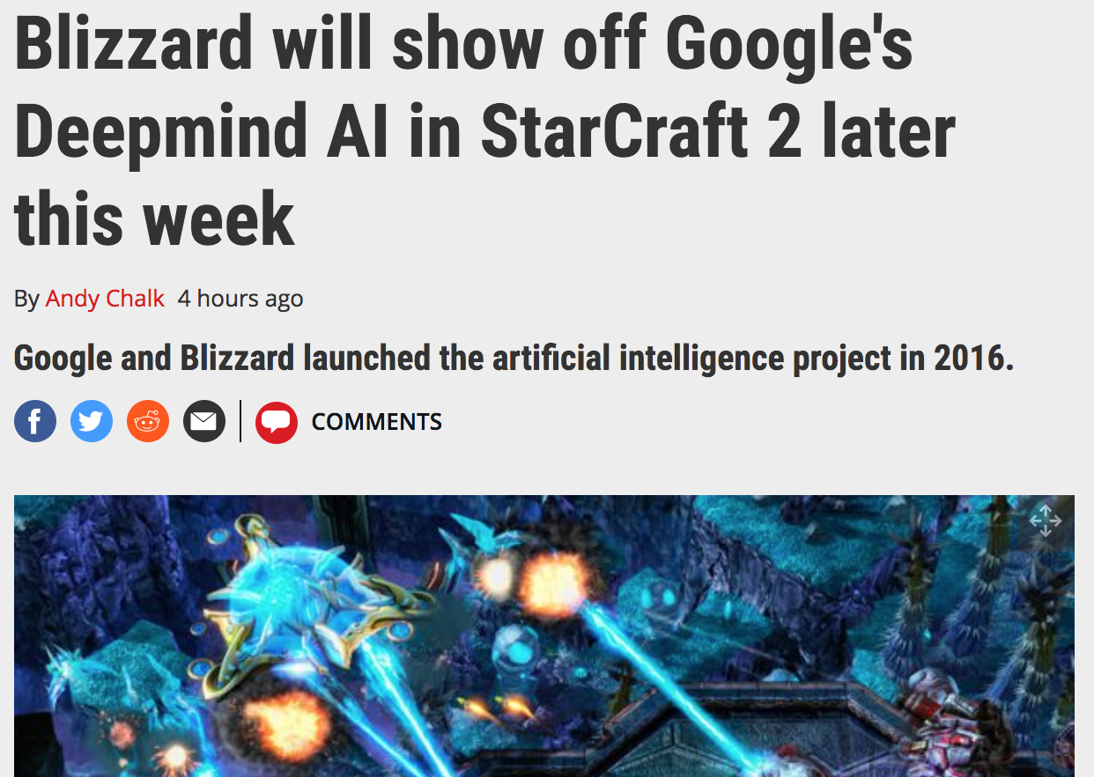
News AI

Slide 4
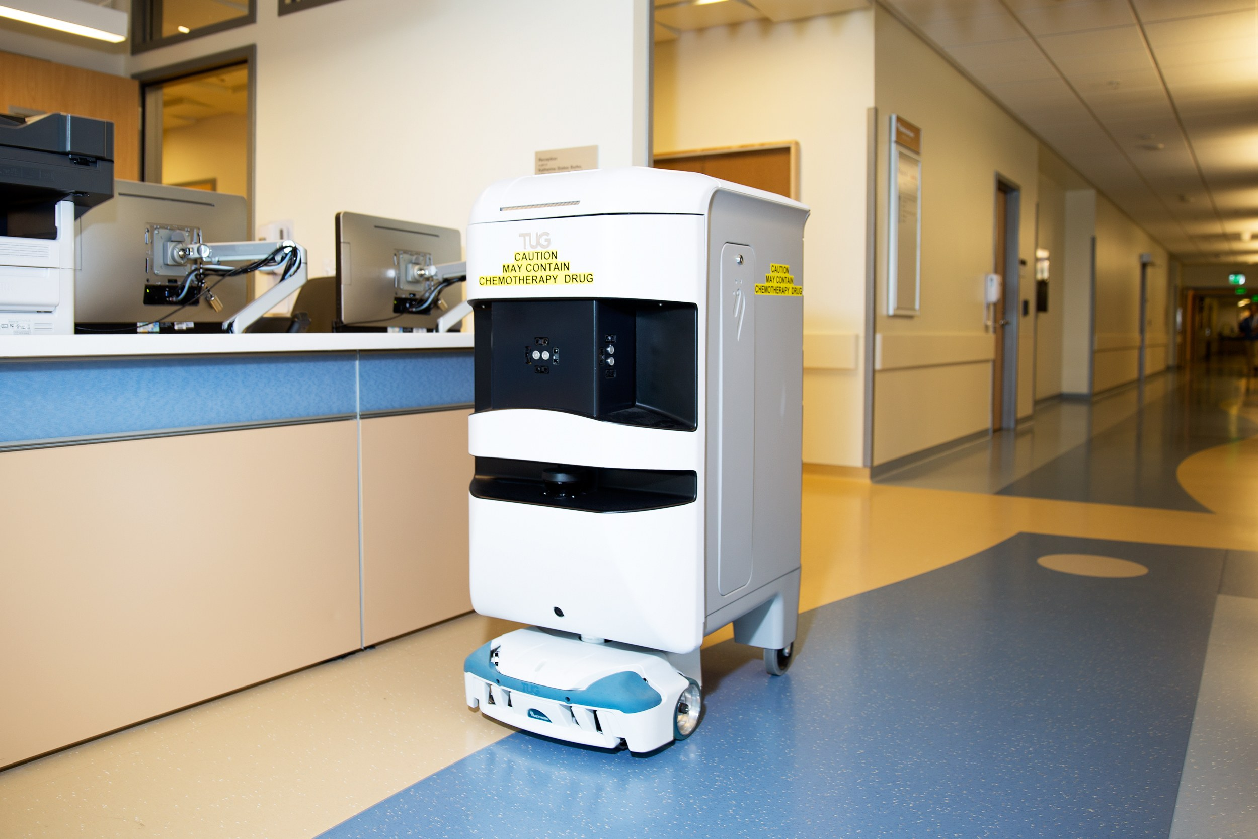
Notes:
Robots help nurses in hospitals deliver stuff to different rooms

Slide 5
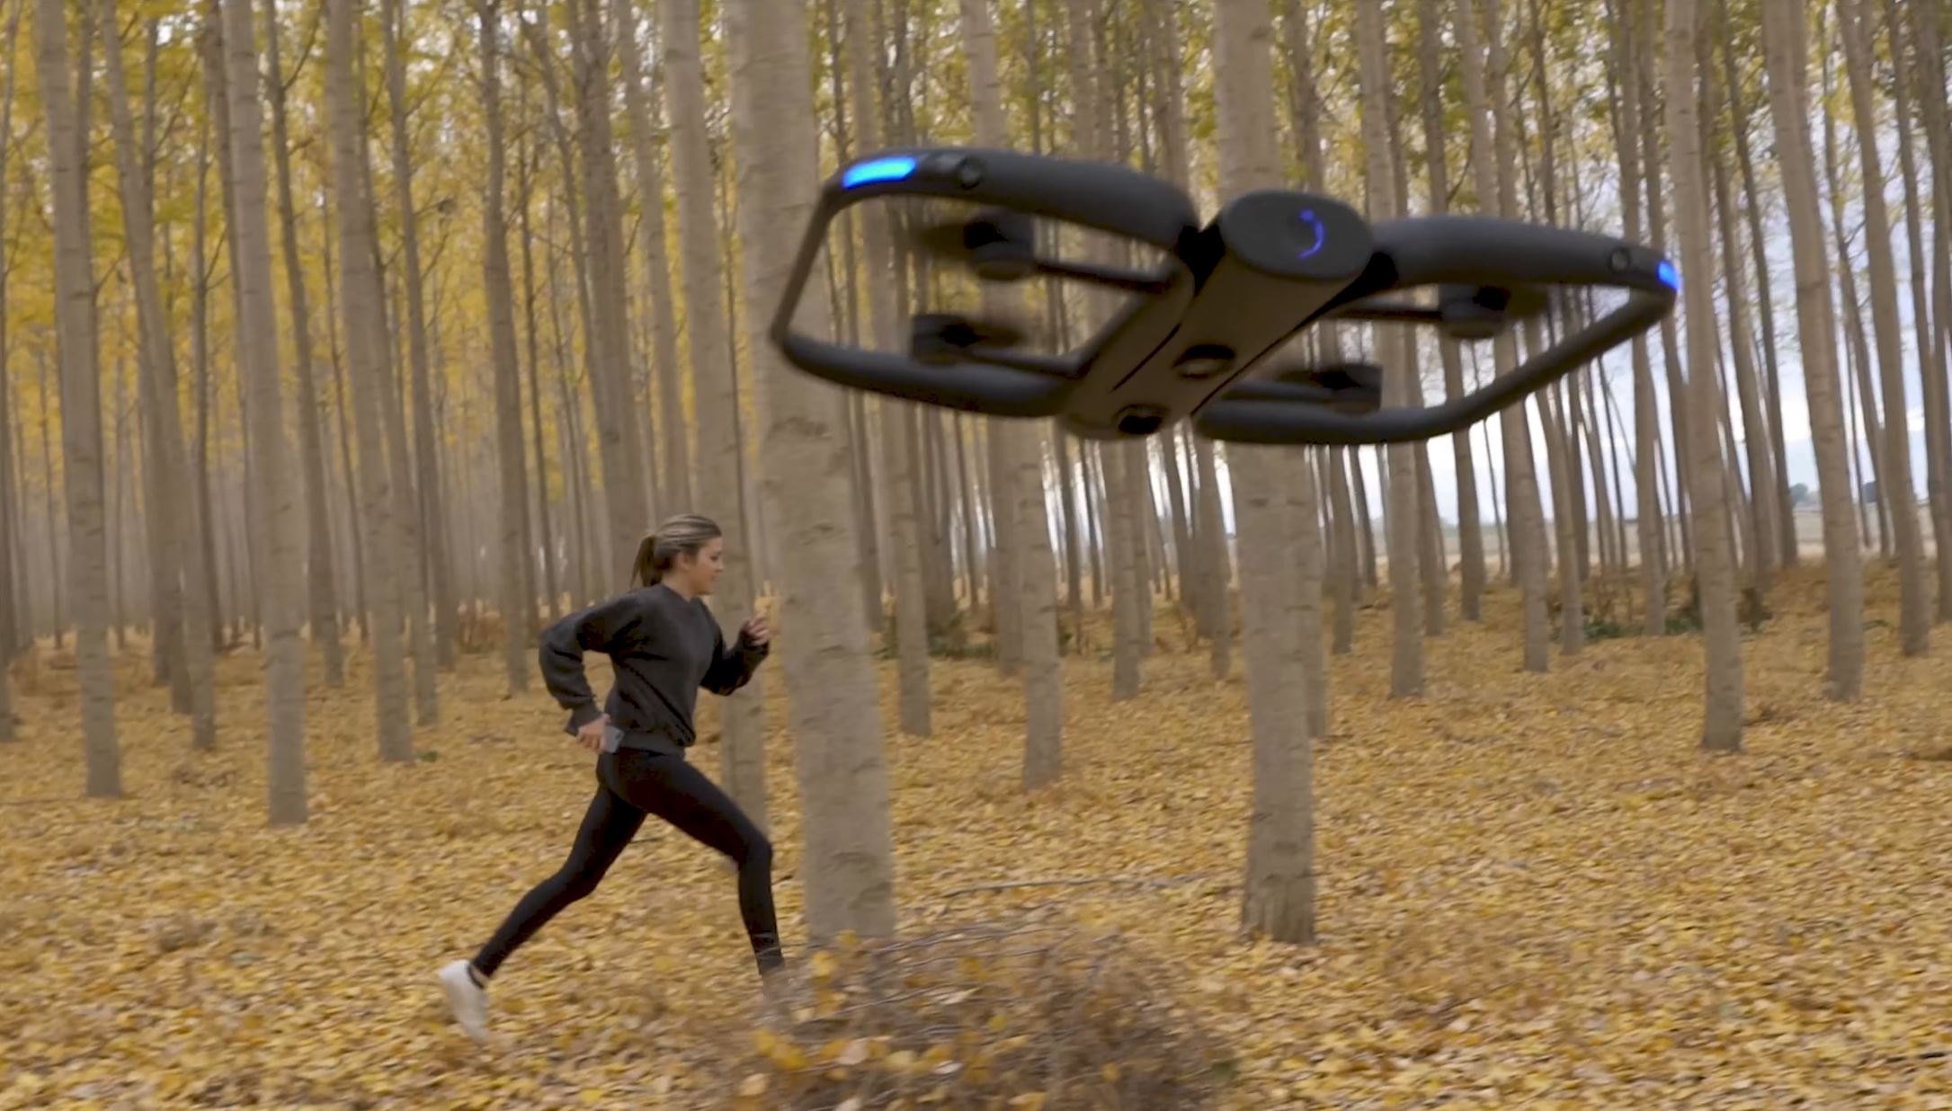
Notes:
Or drones that record cool videos of us as we do outdoor activities, this one can recognize you and follow you around
So what is powering all of this? That’s what this course is for.

Slide 6
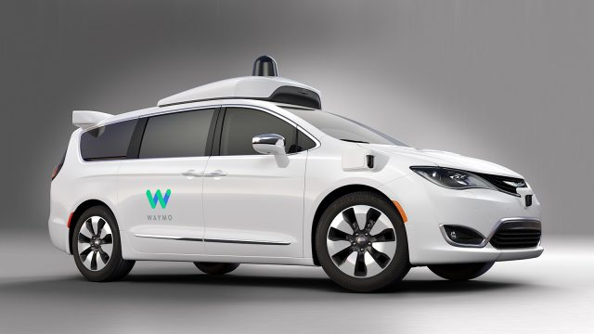
Notes:
Self-driving cars – it’s been 35 yrs and progress is relatively slow but getting there
Problem: must be 99.999% reliable (whereas currently only 99% reliable)

Slide 7
CS 188: Artificial Intelligence
Logistics
Instructors: Angela Liu, Yanlai Yang
University of California, Berkeley
(slides adapted from Dan Klein, Pieter Abbeel, Anca Dragan, et al)

Slide 8
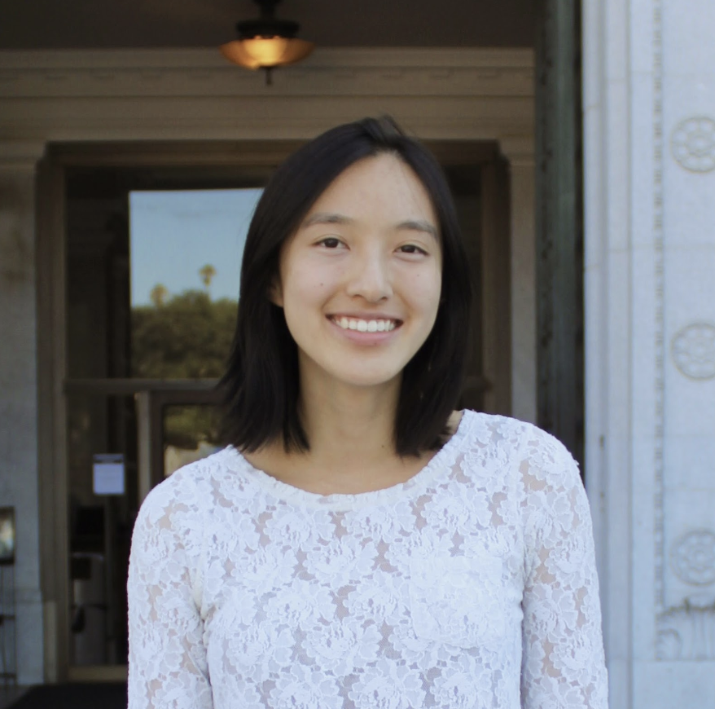
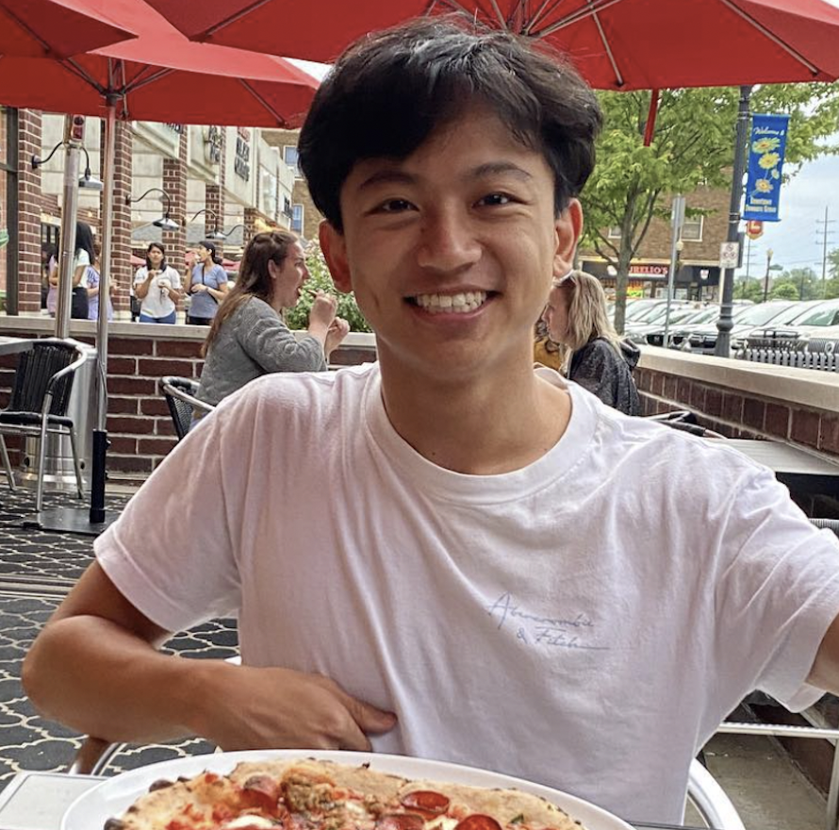
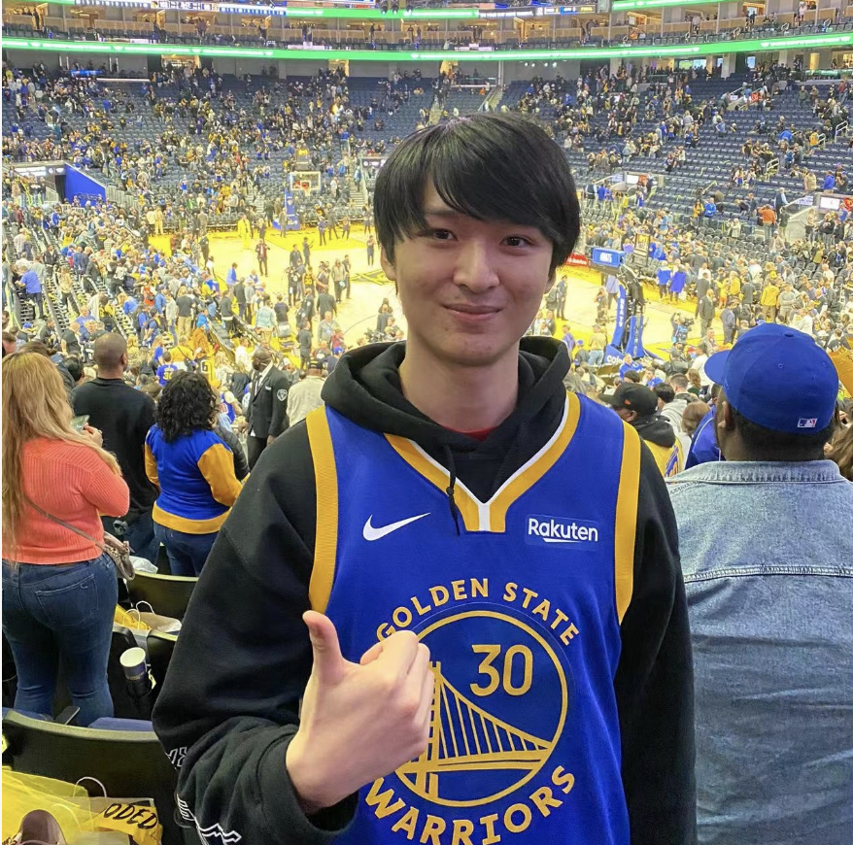
Course Staff
Instructors
GSIs
Arvind Rajaraman | Zhuang Liu | Neil Thomas | Sid Ijju | Joy Liu
Cham Yao | Andrew Wang | Perry Dong | Weijia Zeng | Xiangwei Kong
Angela Liu
Yanlai Yang

Slide 9
Course Information
Website: http://inst.eecs.berkeley.edu/~cs188/su22/
Tentative schedule, lecture slides and notes, course policies, etc.
Piazza: https://piazza.com/berkeley/summer2022/cs188
Announcements, Q&A for any course-related questions
Private posts: personal questions
Gradescope: https://www.gradescope.com/courses/399015, entry code DJ55BE
All assignment submissions and grades
Staff email: cs188@berkeley.edu
Personal questions for the head TAs and Instructors
Individual staff emails can also be found on the website

Slide 10
Prerequisites
Programming experience - CS 61A and CS 61B
Coding/debugging Python, data structures, search strategies (BFS/DFS/A*)
Project 0 – Python setup + short coding diagnostic
Math – CS 70
Discrete probability, counting, derivatives
Homework 0 – probability diagnostic questions
Project 0 and Homework 0 are not graded. Due dates are a recommendation
and you will not be penalized for submitting late (or not at all).
However, we do highly recommend that you complete them!

Slide 11
Course Format – Direct Instructions
Lectures
Live lecture in Lewis 100; lecture recording will be posted afterwards
Discussion Sections
Twice a week: either M+W (regular) or T+Th (exam prep)
Discussion recordings and solutions will be posted after the last section
Office Hours
1-2 TAs helping with course-related conceptual, hw, or proj questions
Hybrid but in-person students will be prioritized on the queue
Homework/Project Parties
Work with other students and TAs on the current hw or proj!

Slide 12
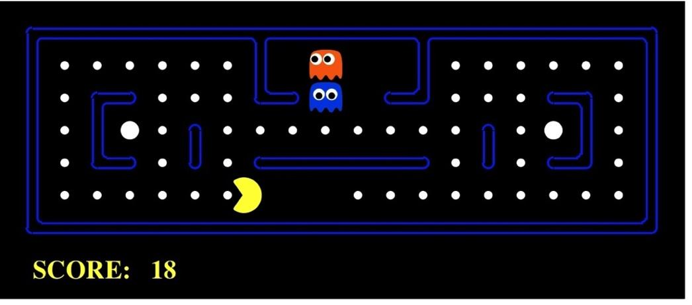
Course Format - Grade Breakdown
Assignments:
Electronic Homework (10%)
Written Homework (10%)
Projects (25%)
Exams:
Midterm (20%)
Final (35%)
This course is not curved, grade bins on the website.

Slide 13
Course Format - Assessments
Midterm: 20%, Final 35%
Times
Midterm: Friday 07/15, 7-9 PM Pacific Time
Final: Friday 08/12, 7-10 PM Pacific Time
No alternative times will be provided.
In-person by default. Remote exam requests will be approved on a case-by-case basis for extraneous situations. (More info provided a week before the exam.)

Slide 14
Some Historical Statistics
Homework and projects: work alone/together, iterate/learn till you nailed it
Exams: assessment

Slide 15
Course Principles
Diversity Statement
A Note on Student Wellness
Academic Integrity

Slide 16
Course Principles
Diversity Statement
We believe in the crucial importance of creating a learning environment that is welcoming and respectful to students of all backgrounds.
We expect all students to understand that not everyone comes from the same background, and no one should make unwarranted assumptions about anyone based on stereotypes. Mutual understanding and respect is extremely important towards building an inclusive atmosphere.

Slide 17
Course Principles – Student Wellness
A Note on Student Wellness
We understand that computer science courses at UC Berkeley are rigorous and mentally demanding, and CS 188 is no exception.
If you ever feel overwhelmed by the course, please email the instructors directly, and we will set up a one-on-one meeting with you to identify your options.
If you would like to seek professional help, you may find a list of resources here: https://sa.berkeley.edu/conduct/resources/wellness
Extensions Policy
All <= 3 day extension requests for any assignment will be automatically granted, no questions asked.
For extensions of > 3 days, please email cs188@berkeley.edu

Slide 18
Course Principles
Academic Integrity Policy
No consultation or collaboration for Exams
You should acknowledge all collaborators and sources on Written HW and projects
Accessing or viewing homework/project solutions online before they are officially released is strictly prohibited.
Posting solutions online (ex. public github project repo) is also considered cheating and a copyright violation
We have a zero-tolerance policy towards academic misconduct
We will forward all suspicious cases to the Center of Student Conduct, and recommend immediate failure (F) if the involved individuals are found guilty.

Slide 19
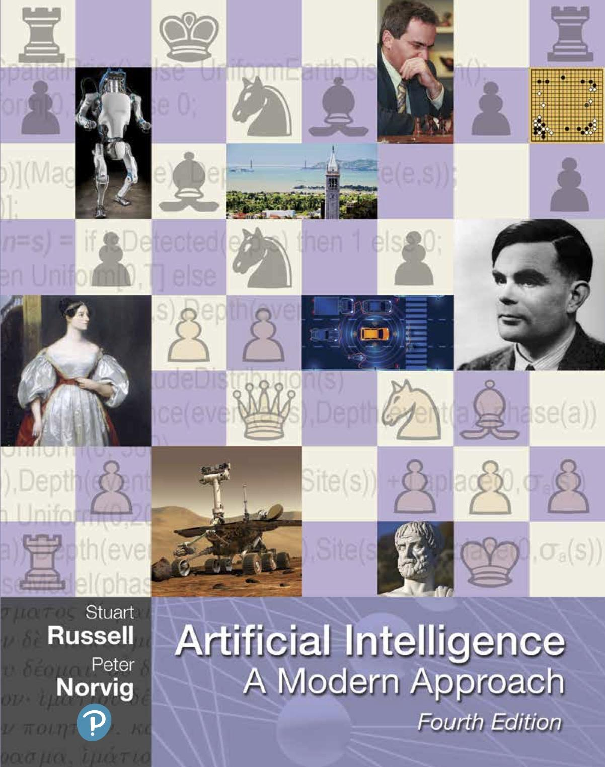
Textbook
Russell & Norvig, AI: A Modern Approach, 4th Ed.

Slide 20
Today
What is artificial intelligence?
Where are we and how did we get here?
How do we think about the design of AI systems?

Slide 21
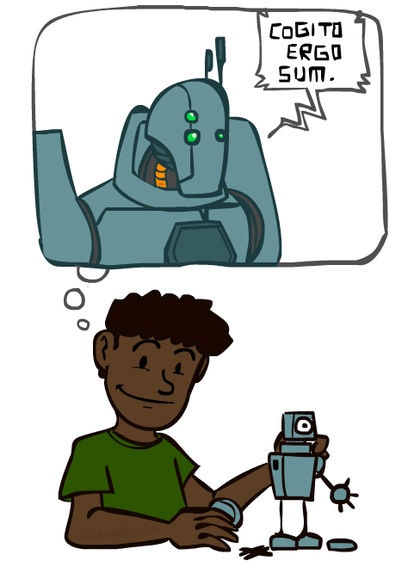
A (Short) History of AI
Demo: HISTORY – MT1950.wmv

Slide 22
A short prehistory of AI
Prehistory:
Philosophy (reasoning, planning, learning, science, automation)
Mathematics (logic, probability, optimization)
Neuroscience (neurons, adaptation)
Economics (rationality, game theory)
Control theory (feedback)
Psychology (learning, cognitive models)
Linguistics (grammars, formal representation of meaning)
Aristotle: For if every instrument could accomplish its own work, obeying or anticipating the will of others . . . if, in like manner, the shuttle would weave and the plectrum touch the lyre without a hand to guide them, chief workmen would not want servants, nor masters slaves
Near miss (1842):
Babbage design for universal machine
Lovelace: “a thinking machine” for “all subjects in the universe.”

Slide 23
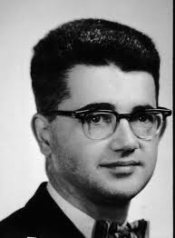
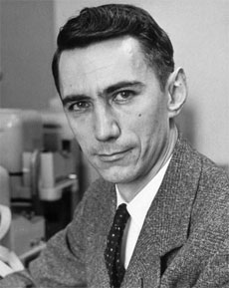
AI’s official birth: Dartmouth, 1956
“An attempt will be made to find how to make machines use language, form abstractions and concepts, solve kinds of problems now reserved for humans, and improve themselves. We think that a significant advance can be made if we work on it together for a summer.”
John McCarthy and Claude Shannon
Dartmouth Workshop Proposal

Slide 25
A (Short) History of AI
1940-1950: Early days
1943: McCulloch & Pitts: Boolean circuit model of brain
1950: Turing's “Computing Machinery and Intelligence”
1950—70: Excitement: Look, Ma, no hands!
1950s: Early AI programs: chess, checkers (RL), theorem proving
1956: Dartmouth meeting: “Artificial Intelligence” adopted
1965: Robinson's complete algorithm for logical reasoning
1970—90: Knowledge-based approaches
1969—79: Early development of knowledge-based systems
1980—88: Expert systems industry booms
1988—93: Expert systems industry busts: “AI Winter”
1990— 2012: Statistical approaches + subfield expertise
Resurgence of probability, focus on uncertainty
General increase in technical depth
Agents and learning systems… “AI Spring”?
2012— ___: Excitement: Look, Ma, no hands again?
Big data, big compute, deep learning
AI used in many industries

Slide 26
AI as Designing Rational Agents
An agent is an entity that perceives and acts.
A rational agent selects actions that maximize its expected utility.
Characteristics of the sensors, actuators, and environment dictate techniques for selecting rational actions
This course is about:
General AI techniques for many problem types
Learning to choose and apply the technique appropriate for each problem
Sensors
Percepts
Agent
Environment
?
Actuators
Actions
Pac-Man is a registered trademark of Namco-Bandai Games, used here for educational purposes

Slide 27
Agents and environments
Agent
Environment
Sensors
Percepts
?
Actuators
Actions
An agent perceives its environment through sensors and acts upon it through actuators (or effectors, depending on whom you ask)
The agent function maps percept sequences to actions
It is generated by an agent program running on a machine

Slide 28
A human agent in Pacman

Slide 29
The task environment - PEAS
Performance measure
-1 per step; + 10 food; +500 win; -500 die; +200 hit scared ghost
Environment
Pacman dynamics (incl ghost behavior)
Actuators
Left Right Up Down or NSEW
Sensors
Entire state is visible (except power pellet duration)

Slide 30
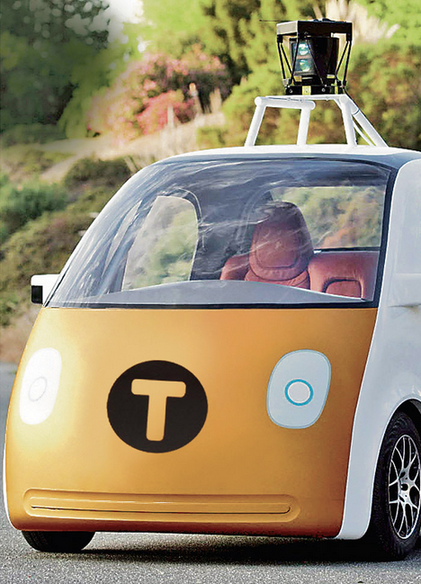
PEAS: Automated taxi
Performance measure
Income, happy customer, vehicle costs, fines, insurance premiums
Environment
US streets, other drivers, customers, weather, police…
Actuators
Steering, brake, gas, display/speaker
Sensors
Camera, radar, accelerometer, engine sensors, microphone, GPS
Image: http://nypost.com/2014/06/21/how-google-might-put-taxi-drivers-out-of-business/

Slide 31
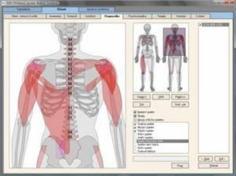
PEAS: Medical diagnosis system
Performance measure
Patient health, cost, reputation
Environment
Patients, medical staff, insurers, courts
Actuators
Screen display, email
Sensors
Keyboard/mouse

Slide 32
Environment types
 | Pacman | Backgammon | Diagnosis | Taxi
Fully or partially observable
Single-agent or multiagent
Deterministic or stochastic
Static or dynamic
Discrete or continuous
Known physics?
Known perf. measure?

Slide 33
Agent design
The environment type largely determines the agent design
Partially observable => agent requires memory (internal state)
Stochastic => agent may have to prepare for contingencies
Multi-agent => agent may need to behave randomly
Static => agent has time to compute a rational decision
Continuous time => continuously operating controller
Unknown physics => need for exploration
Unknown perf. measure => observe/interact with human principal

Slide 34
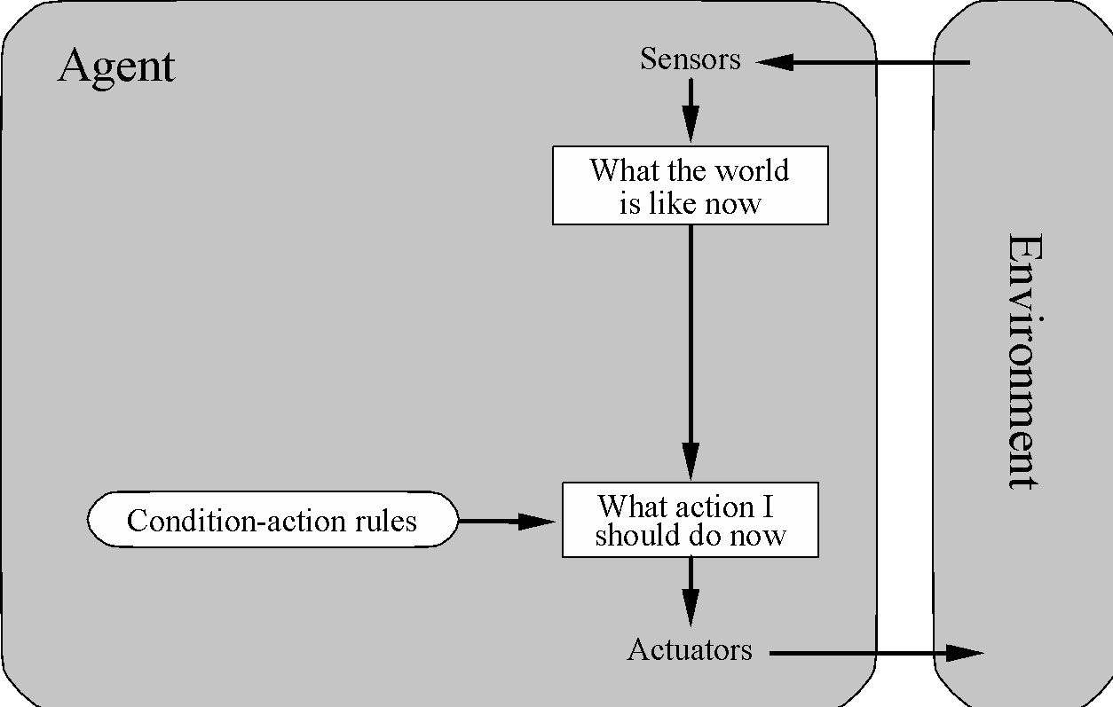
Simple reflex agents

Slide 35
Pacman agent program in Python
class GoWestAgent(Agent):
def getAction(self, percept):
if Directions.WEST in percept.getLegalPacmanActions():
return Directions.WEST
else:
return Directions.STOP

Slide 36
Eat adjacent dot, if any
Notes:
Optimal in some environments!

Slide 37
Eat adjacent dot, if any
Notes:
Not so great in others

Slide 38
Pacman agent contd.
Can we (in principle) extend this reflex agent to behave well in all standard Pacman environments?
No – Pacman is not quite fully observable (power pellet duration)
Otherwise, yes – we can (in principle) make a lookup table…..
How large would it be?
Notes:
106 locations so 106^3 * 2^106 (ignoring power pellet stuff) =~ 10^38 states
Worse if the map is not fixed – all possible physics? No – can simply say 3^150 or whatever

Slide 39
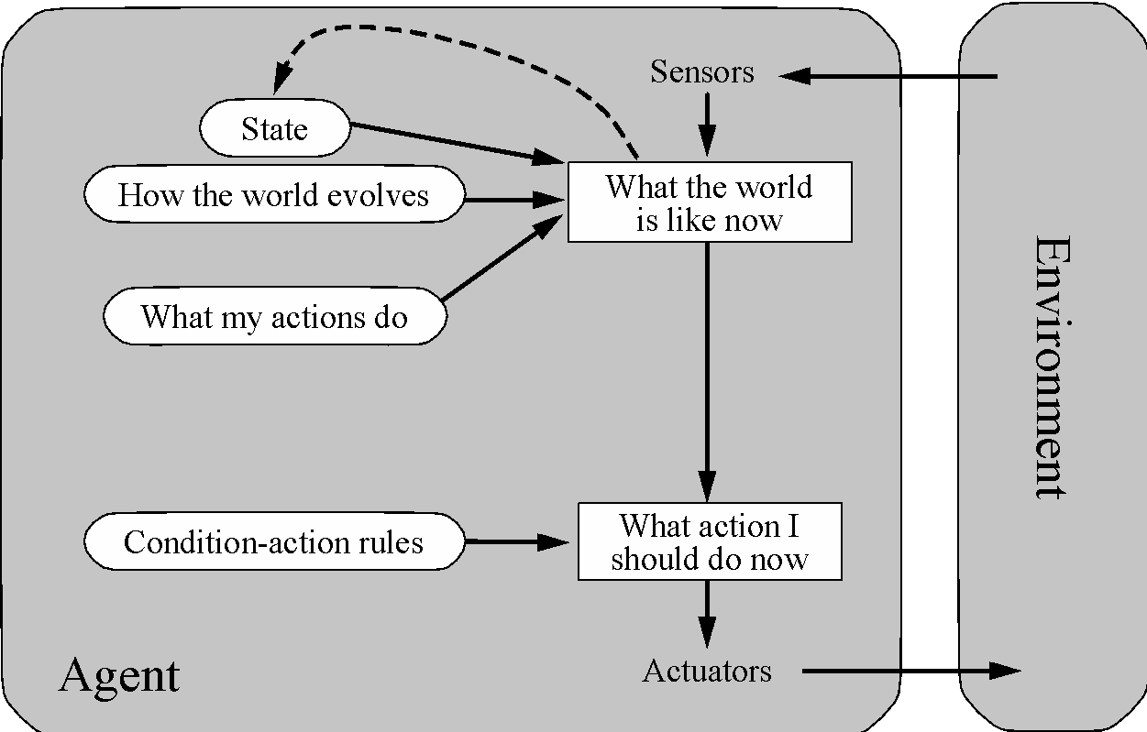
Model-based agents

Slide 40
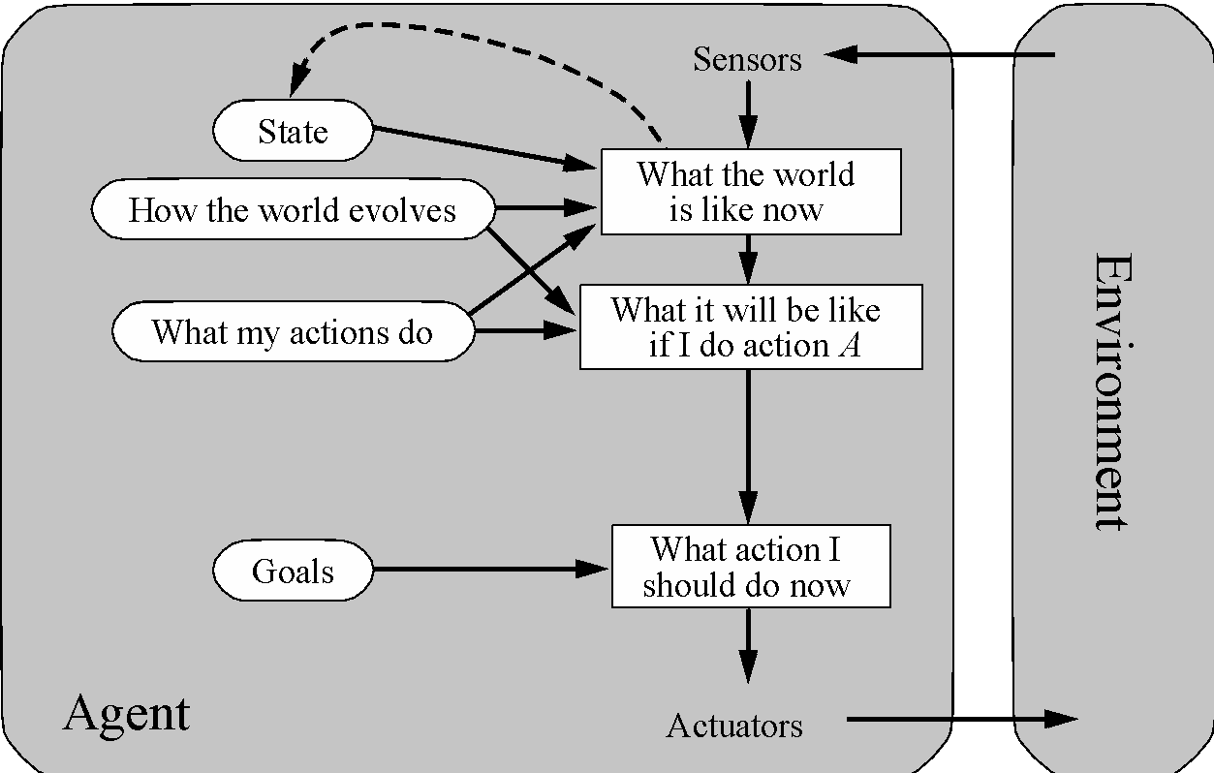
Goal-based agents
Notes:
Act to achieve a goal
Pro: use goal to index into actions that might achieve it, eg “Have milk” -> “buy milk”
Con: cannot handle tradeoffs among goals, failure probability etc.

Slide 41
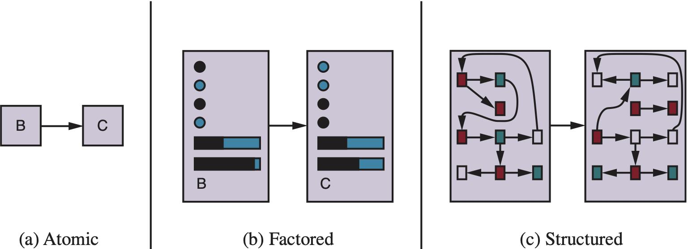
Spectrum of representations

Slide 42
Outline of the course
unknown
RL
known
deterministic
stochastic
atomic
Search
MDPs
factored
CSPs
Bayes nets
structured
First-order logic

