Slide 1

CS 188: Artificial Intelligence
Bayes Nets: Basics and Representation
Instructors: Angela Liu and Yanlai Yang
University of California, Berkeley
(Slides adapted from Stuart Russell and Dawn Song)
Notes:
Please retain proper attribution, including the reference to ai.berkeley.edu. Thanks!

Slide 2
Reminder: elementary probability
Basic laws: 0 ≤ P(ω) ≤ 1, ∑_{ω ∈Ω} P(ω) = 1, P(A) = ∑_{ω ∈ A} P(ω)
Random variable X(ω) has a value in each ω
  Distribution P(X) gives probability for each possible value x
  Joint distribution P(X,Y) gives total probability for each combination x,y
Summing out/marginalization: P(X=x) = ∑_{y} P(X=x,Y=y)
Conditional probability: P(X|Y) = P(X,Y)/P(Y)
Chain rule: P(X₁,..,X_{n}) = ∏_{i} P(X_{i} | X₁,..,X_{i-1})
Bayes Rule: P(X|Y) = P(Y|X)P(X)/P(Y)
Independence: P(X,Y) = P(X) P(Y) or P(X|Y) = P(X) or P(Y|X) = P(Y)
Conditional Independence: P(X|Y,Z) = P(X|Z) or P(X,Y|Z) = P(X|Z) P(Y| Z)

Slide 3
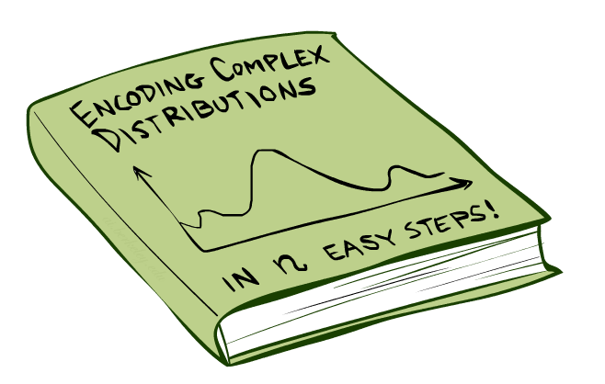
Bayes Nets: Big Picture

Slide 4


Bayes Nets: Big Picture
Bayes nets: a technique for describing complex joint distributions (models) using simple, conditional distributions
  A subset of the general class of graphical models
Use local causality/conditional independence:
  the world is composed of many variables,
  each interacting locally with a few others

Slide 5
Bayes Nets
Part I: Basics, Representation
Part II: Exact inference
Part III: Independence
Part IV: Approximate Inference

Slide 6


Graphical Model Notation
Nodes: variables (with domains)
  Can be assigned (observed) or unassigned (unobserved)
Arcs: interactions
  Indicate “direct influence” between variables
  Formally: absence of arc encodes conditional independence (more later)
Weather
G
0.11
0.11
0.11
C_{1,1}
C_{1,2}
C_{3,3}
0.11
0.11
0.11
0.11
0.11
0.11

Slide 7

Example: Coin Flips
N independent coin flips
No interactions between variables: absolute independence
X₁
X₂
X_{n}

Slide 8
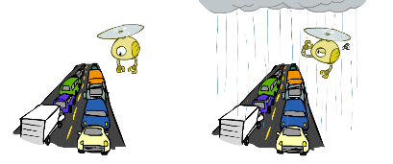
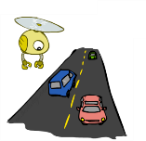
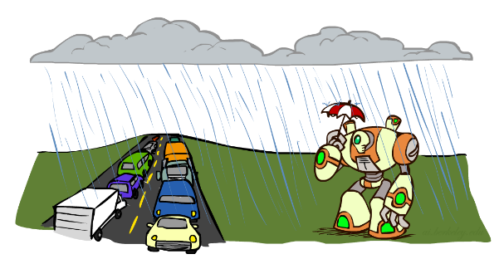
Example: Traffic
Variables:
  T: There is traffic
  U: I’m holding my umbrella
  R: It rains
R
T
U

Slide 9
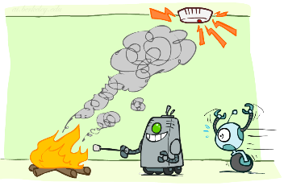
Example: Smoke alarm
Variables:
  F: There is fire
  S: There is smoke
  A: Alarm sounds
F
S
A

Slide 10
Example Bayes’ Net: Car Insurance

Slide 11
Example Bayes’ Net: Car Won’t Start

Slide 12
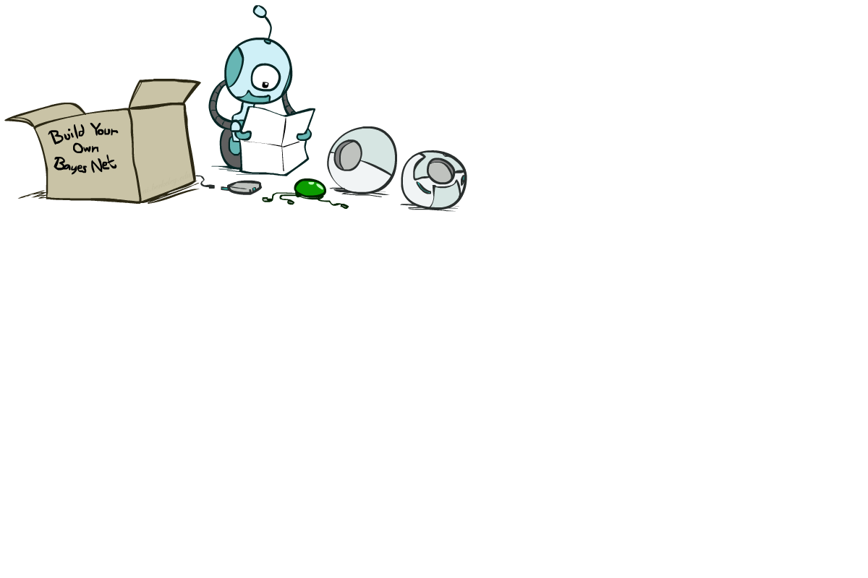
Bayes Net Syntax and Semantics

Slide 13
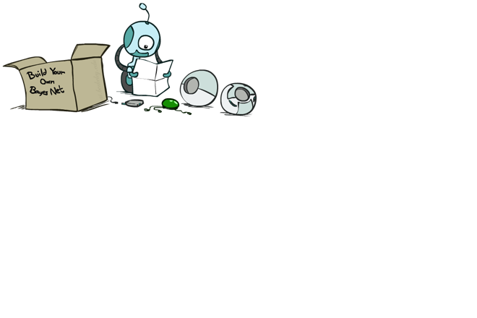
Bayes Net Syntax
A set of nodes, one per variable X
A directed, acyclic graph
A conditional distribution for each node given its parent variables in the graph
  CPT (conditional probability table); each row is a distribution for child given values of its parents
P(G)
(1,1) | (1,2) | (1,3) | …
0.11 | 0.11 | 0.11 | …
G
C_{1,1}
C_{1,2}
C_{3,3}
G | P(C_{1,1} | G)
 | g | y | o | r
(1,1) | 0.01 | 0.1 | 0.3 | 0.59
(1,2) | 0.1 | 0.3 | 0.5 | 0.1
(1,3) | 0.3 | 0.5 | 0.19 | 0.01
…
Bayes net = Topology (graph) + Local Conditional Probabilities

Slide 14
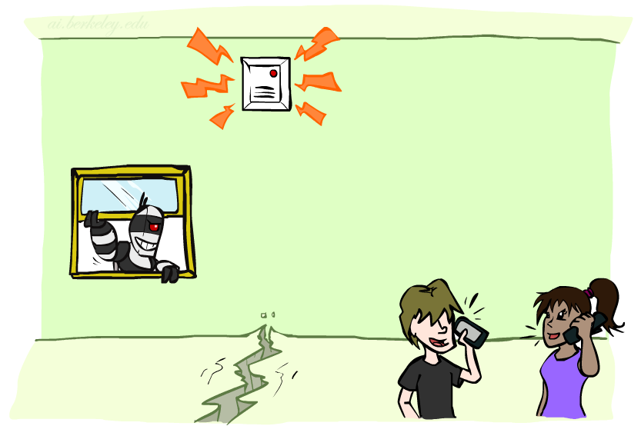
Example: Alarm Network
1
1
P(E)
true | false
0.002 | 0.998
P(B)
true | false
0.001 | 0.999
Burglary
Earthquake
B | E | P(A|B,E)
 |  | true | false
true | true | 0.95 | 0.05
true | false | 0.94 | 0.06
false | true | 0.29 | 0.71
false | false | 0.001 | 0.999
Alarm
4
Number of free parameters in each CPT:
Parent range sizes d₁,…,d_{k}
Child range size d
Each table row must sum to 1
(d-1) Π_{i} d_{i}
John calls
Mary calls
A | P(J|A)
 | true | false
true | 0.9 | 0.1
false | 0.05 | 0.95
A | P(M|A)
 | true | false
true | 0.7 | 0.3
false | 0.01 | 0.99
2
2
Notes:
demo

Slide 15
General formula for sparse BNs
Suppose
  n variables
  Maximum range size is d
  Maximum number of parents is k
Full joint distribution has size O(d^{n})
Bayes net has size O(n .d^{k})
  Linear scaling with n as long as causal structure is local

Slide 16
Bayes net global semantics
Bayes nets encode joint distributions as product of conditional distributions on each variable:
      P(X₁,..,X_{n}) = ∏_{i} P(X_{i} | Parents(X_{i}))

Slide 17
Example
P(E)
true | false
0.002 | 0.998
P(b,¬e, a, ¬j, ¬m) =
P(B)
true | false
0.001 | 0.999
Burglary
Earthquake
P(b)
P(¬e)
P(a|b,¬e)
P(¬j|a)
P(¬m|a)
=.001x.998x.94x.1x.3=.000028
B | E | P(A|B,E)
 |  | true | false
true | true | 0.95 | 0.05
true | false | 0.94 | 0.06
false | true | 0.29 | 0.71
false | false | 0.001 | 0.999
Alarm
John calls
Mary calls
A | P(J|A)
 | true | false
true | 0.9 | 0.1
false | 0.05 | 0.95
A | P(M|A)
 | true | false
true | 0.7 | 0.3
false | 0.01 | 0.99

Slide 18
Conditional independence in BNs
      Compare the Bayes net global semantics
      P(X₁,..,X_{n}) = ∏_{i} P(X_{i} | Parents(X_{i}))
with the chain rule identity
P(X₁,..,X_{n}) = ∏_{i} P(X_{i} | X₁,…,X_{i-1})
      Assume (without loss of generality) that X₁,..,X_{n} sorted in topological order according to the graph (i.e., parents before children), so Parents(X_{i}) ⊆ X₁,…,X_{i-1}
      The Bayes net asserts conditional independences P(X_{i} | X₁,…,X_{i-1}) = P(X_{i} | Parents(X_{i}))
        To ensure these are valid, choose parents for node X_{i} that “shield” it from other predecessors

Slide 19
Conditional independence semantics
Every variable is conditionally independent of its non-descendants given its parents
Conditional independence semantics <=> global semantics

Slide 20
Example: Burglary
P(B)
true | false
0.001 | 0.999
P(E)
true | false
0.002 | 0.998
Burglary
Earthquake
Alarm
Burglary
?
Earthquake
?
?
Alarm
B | E | P(A|B,E)
 |  | true | false
true | true | 0.95 | 0.05
true | false | 0.94 | 0.06
false | true | 0.29 | 0.71
false | false | 0.001 | 0.999

Slide 21
Example: Burglary
P(A)
true | false
Alarm
Burglary
Earthquake
Alarm
?
?
A | B | P(E|A,B)
 |  | true | false
true | true
true | false
false | true
false | false
A | P(B|A)
 | true | false
true
false
Burglary
Earthquake
?
?
?

Slide 22

Inference
Inference: calculating some useful quantity from a probability model (joint probability distribution)
Examples:
  Posterior marginal probability
    P(Q|e₁,..,e_{k})
    E.g., what disease might I have?
  Most likely explanation:
    argmax_{q,r,s} P(Q=q,R=r,S=s|e₁,..,e_{k})
    E.g., what did they say?

Slide 23
Inference by Enumeration in Bayes Net
Reminder of inference by enumeration:
  Any probability of interest can be computed by summing entries from the joint distribution: P(Q | e) = α ∑_{h} P(Q , h, e)
  Entries from the joint distribution can be obtained from a BN by multiplying the corresponding conditional probabilities
P(B | j, m) = α ∑_{e,a} P(B, e, a, j, m)
= α ∑_{e,a} P(B) P(e) P(a|B,e) P(j|a) P(m|a)
So, inference in Bayes nets means computing sums of products of numbers. Sounds easy!!
Problem: sums of exponentially many products!
B
E
A
J
M

Slide 24
Can we do better?
Consider uwy + uwz + uxy + uxz + vwy + vwz + vxy +vxz
  16 multiplies, 7 adds
  Lots of repeated sub-expressions!
Rewrite as (u+v)(w+x)(y+z)
  2 multiplies, 3 adds
∑_{e,a} P(B) P(e) P(a|B,e) P(j|a) P(m|a)
= P(B)P(e)P(a|B,e)P(j|a)P(m|a) + P(B)P(¬e)P(a|B,¬e)P(j|a)P(m|a)
+ P(B)P(e)P(¬a|B,e)P(j|¬a)P(m|¬a) + P(B)P(¬e)P(¬a|B,¬e)P(j|¬a)P(m|¬a)
  Lots of repeated sub-expressions!

Slide 25

To Summarize …
Independence and conditional independence are important forms of probabilistic knowledge
Bayes net encode joint distributions efficiently by taking advantage of conditional independence
  Global joint probability = product of local conditionals
Exact inference = sums of products of conditional probabilities from the network

Slide 26

Next Time
Part I: Basics, Representation
Part II: Exact inference
  Enumeration (always exponential complexity)
  Variable elimination (worst-case exponential complexity, often better)
Part III: Independence
Part IV: Approximate Inference

